Slide 1
Customer Personality Analysis
GROUP 3
TEAM MEMBER:
Mohan Madame
Pratik Zore
Ronit Satone
Rohit Salvi
Shuhul Nehru

Slide 2
PROBLEM STATEMENT
CUSTOMER PERSONALITY ANALYSIS IS A DETAILED ANALYSIS OF A COMPANY’S IDEAL CUSTOMERS. IT HELPS A BUSINESS TO BETTER UNDERSTAND ITS CUSTOMERS AND MAKES IT EASIER FOR THEM TO MODIFY PRODUCTS ACCORDING TO THE SPECIFIC NEEDS, BEHAVIORS, AND CONCERNS OF DIFFERENT TYPES OF CUSTOMERS.
CUSTOMER PERSONALITY ANALYSIS HELPS A BUSINESS TO MODIFY ITS PRODUCT BASED ON ITS TARGET CUSTOMERS FROM DIFFERENT TYPES OF CUSTOMER SEGMENTS. FOR EXAMPLE, INSTEAD OF SPENDING MONEY TO MARKET A NEW PRODUCT TO EVERY CUSTOMER IN THE COMPANY’S DATABASE, A COMPANY CAN ANALYZE WHICH CUSTOMER SEGMENT IS MOST LIKELY TO BUY THE PRODUCT AND THEN MARKET THE PRODUCT ONLY ON THAT PARTICULAR SEGMENT.
TARGET:-
NEED TO PERFORM CLUSTERING TO SUMMARIZE CUSTOMER SEGMENTS.

Slide 3
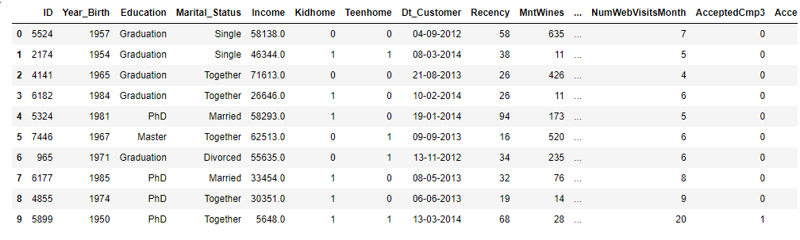
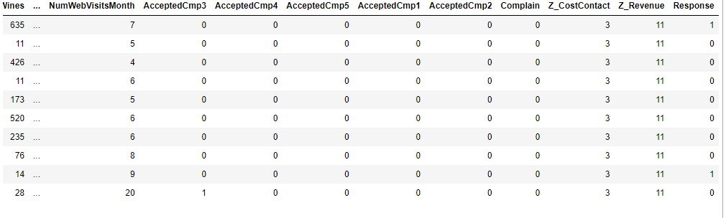
Dataset

Slide 4
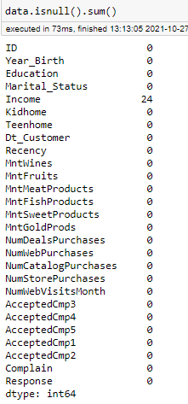
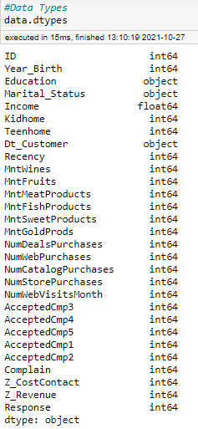
Initial Analysis
#Data Structure
data.shape
(2240,29)
24 NULL Values in Income

Slide 5

Dropping unessential columns
Z_CostContact and Z_Revenue
has only 1 value, so we can drop these columns
2240 rows & 27 columns

Slide 6
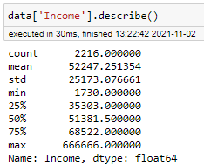
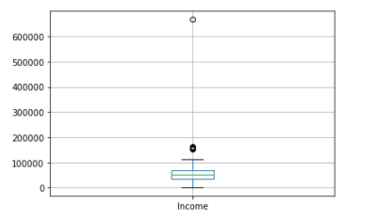
Detecting outliers in Income
Some of the customers have income more than 600000
So, it becomes an outliers for our data

Slide 7
Creating new columns for total accepted offer in all campaigns
Creating new columns for total amount spent on buying products from website in last 2 years

Slide 8
Creating new column for total number of purchase

Slide 9
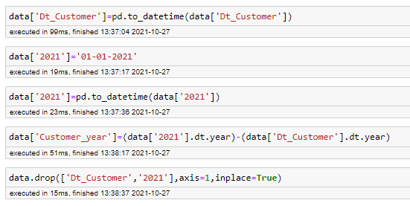

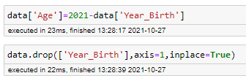

Creating new column to show number of years the customer is using website servive
Creating new feature age (as in 2021) using Year_Birth

Slide 10

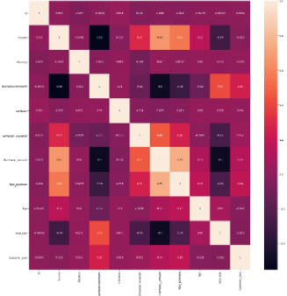
Correlation Plot

Slide 11
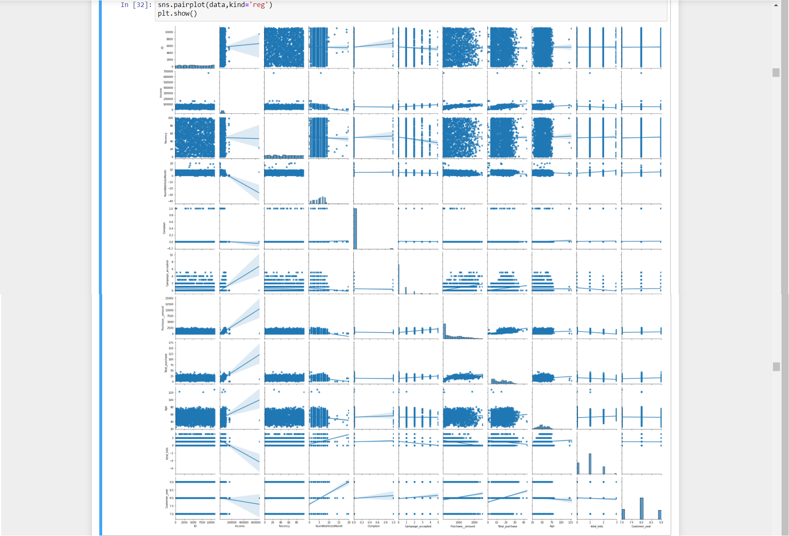
VISUALIZATION
Pair plot

Slide 12
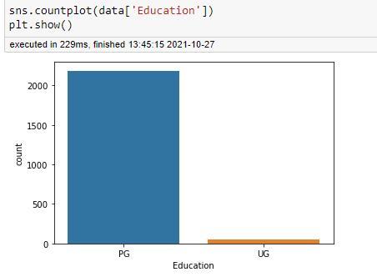
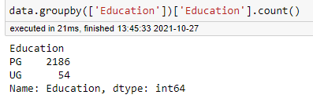
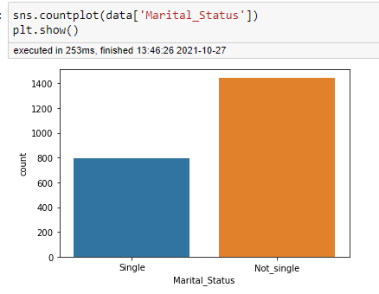
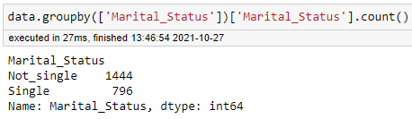
Univariate analysis(Education & Marital Status)
Less number of UG customer
Less number of Single customer

Slide 13
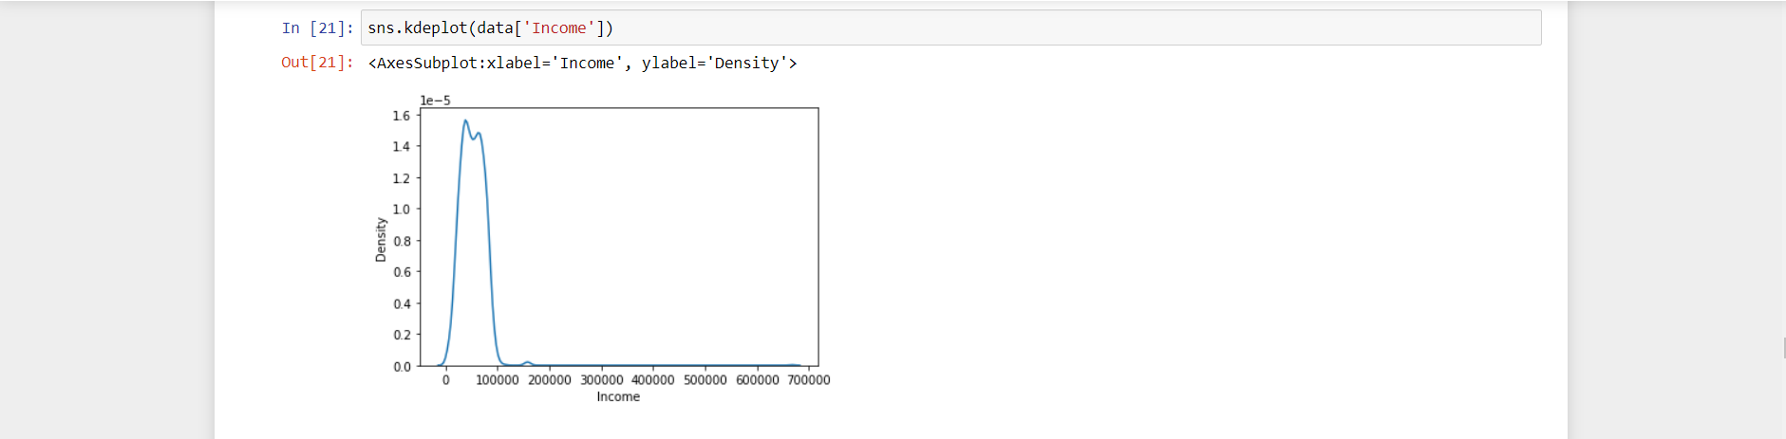
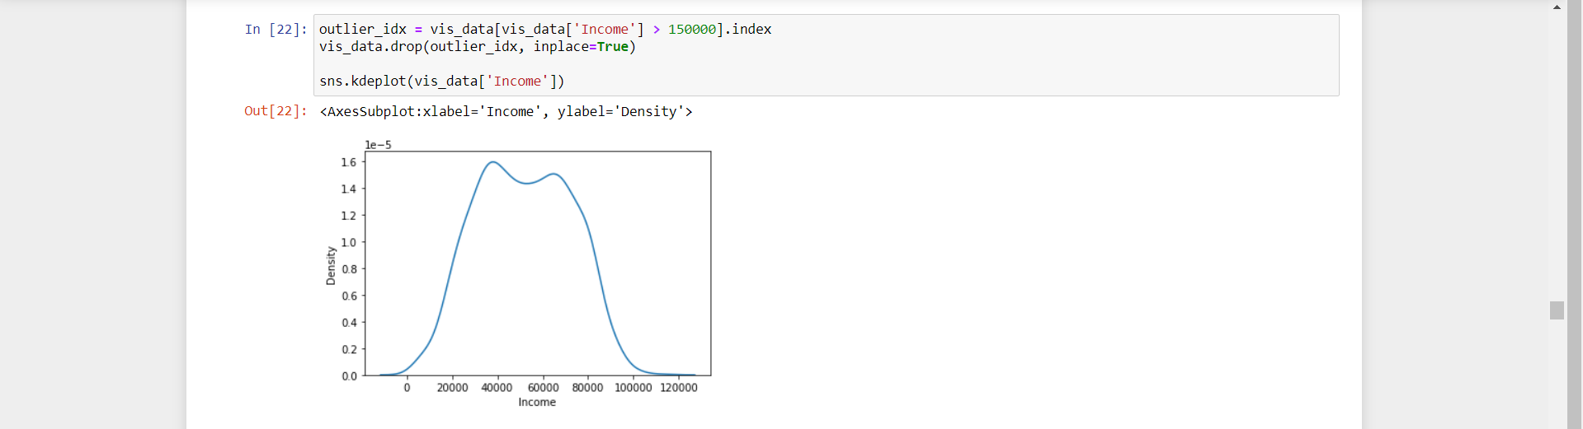
As we can see there are lot of outliers, so wee need to remove these outliers.
As we can see the Income is fairly normal after removing the outliers.

Slide 14
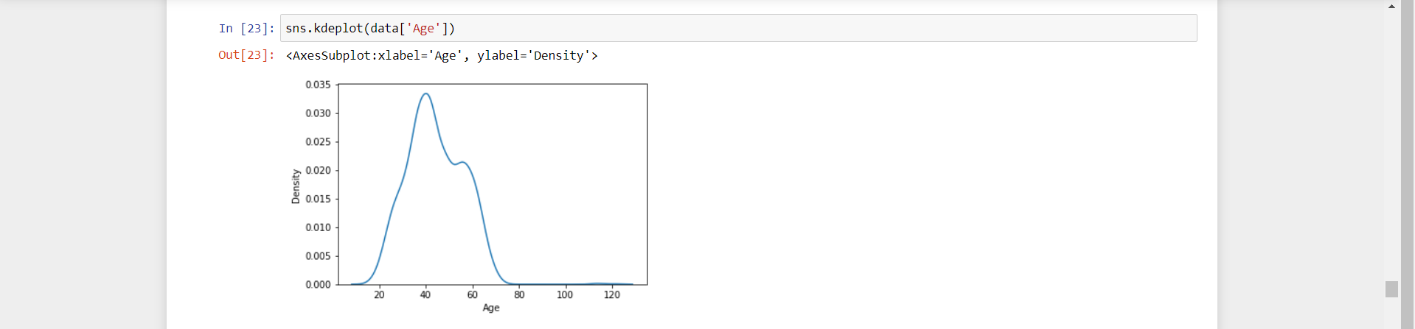
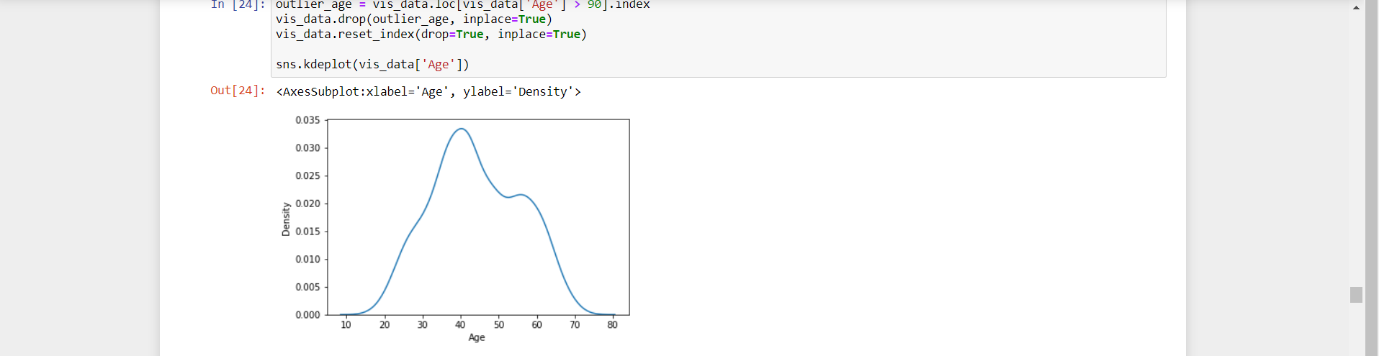
We need to remove the outliers that have age greater than 90
As we have remove the outliers greater than 90 the plot is approximately normal.

Slide 15
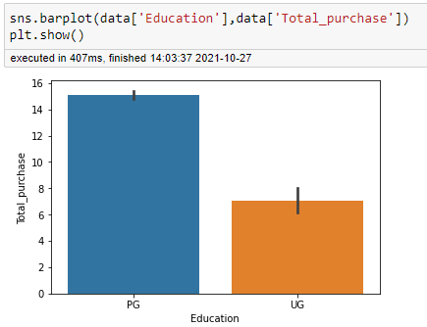
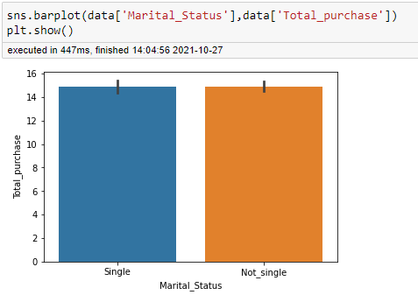
Multivariate analysis(Education & Marital Status)
Total purchase for PG is more as compare to UG
Total purchase for Single and not single are about equal.

Slide 16
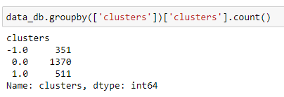
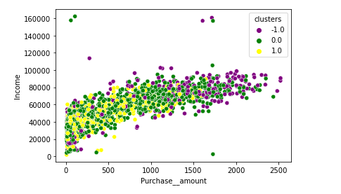
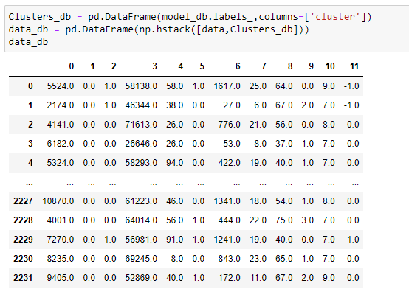
CLUSTERING
DB Scan clustering

Slide 17
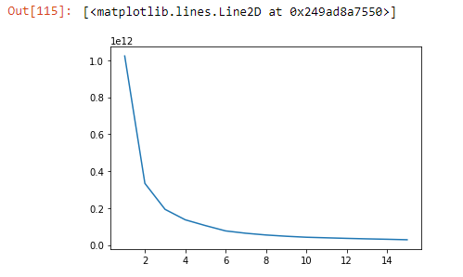
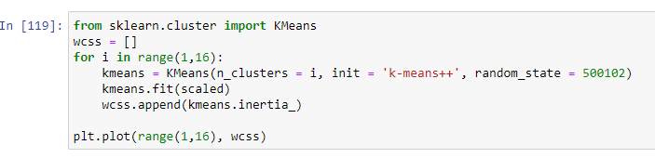
CLUSTERING
Kmeans clustering

Slide 18
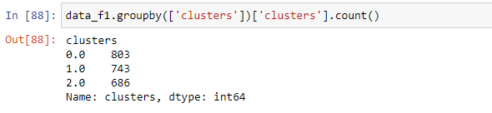
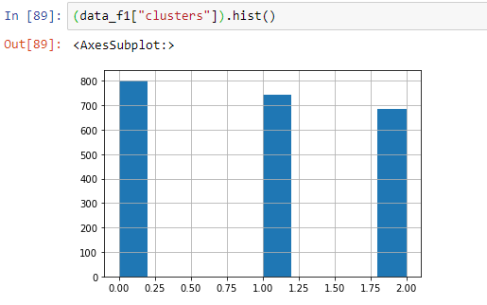
CLUSTERING

Slide 19
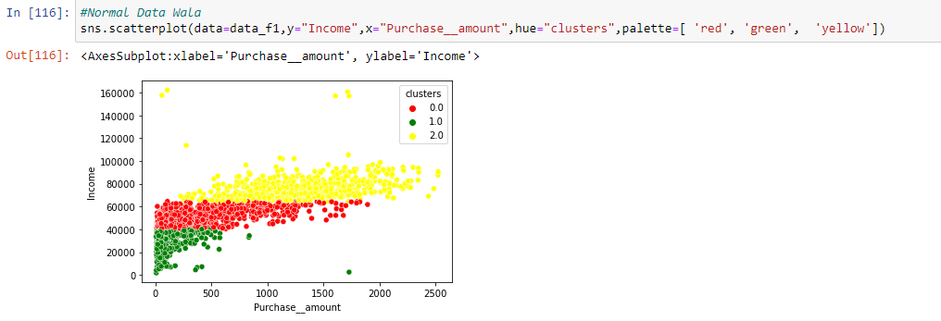
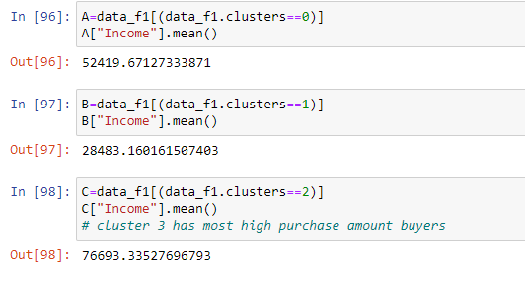
CLUSTERING

Slide 20
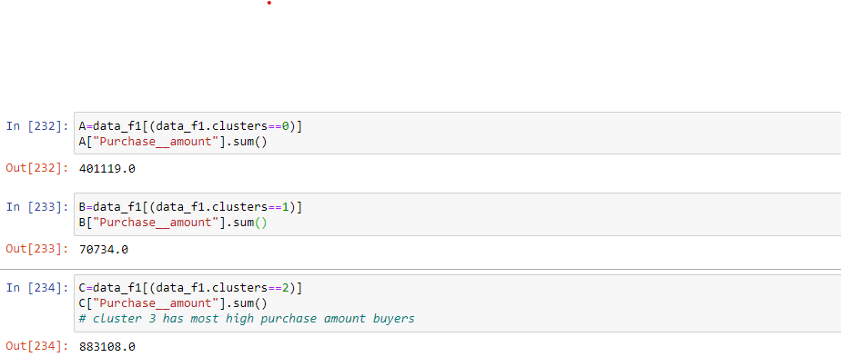
CLUSTERING

Slide 21
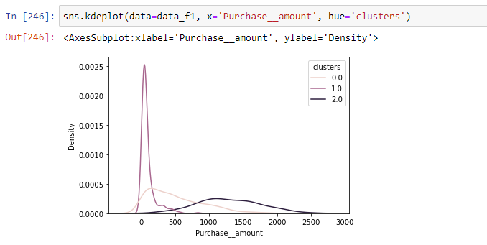
CLUSTERING

Slide 22
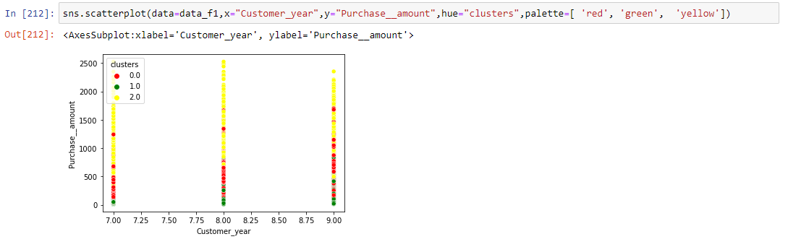
CLUSTERING

Slide 23
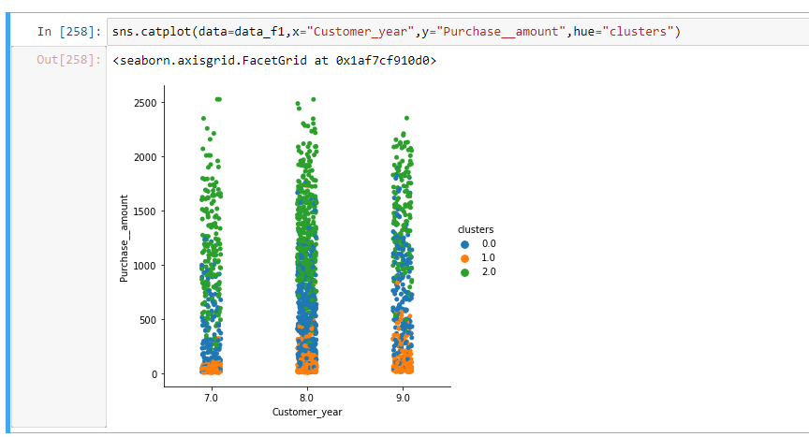
CLUSTERING

Slide 24
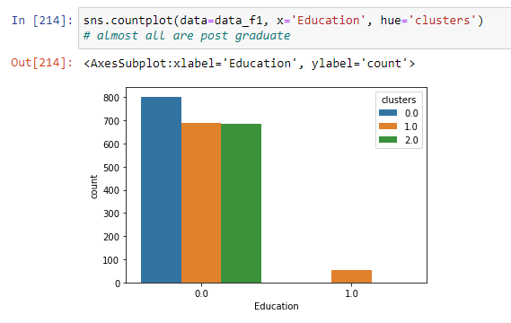
CLUSTERING

Slide 25
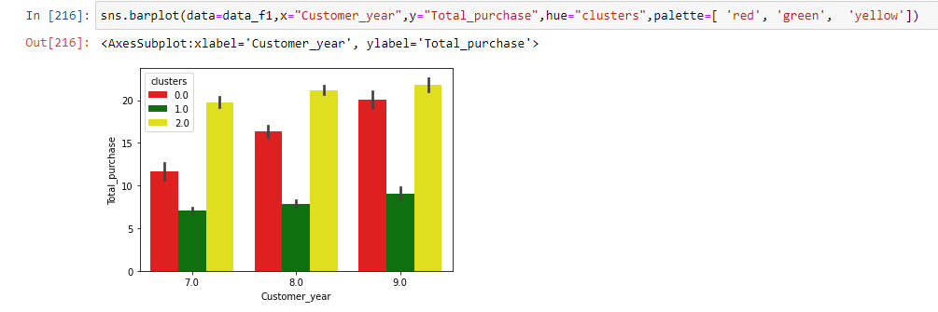
CLUSTERING

Slide 26
Thank You

