Slide 1

ppt

Slide 2


Highcloud airlines
DA_P445
Mrs. Komal Pradeep Deshmukh
Mr . Rohit Pradip Sapkale
Mr. Mangesh Arun Mirge

Slide 3


Introduction
HighCloud Airlines, a leading player in the aviation sector, has been at the forefront of providing seamless air travel experiences.
Established with a commitment to excellence, HighCloud has consistently set industry standards in terms of reliability, safety, and customer satisfaction.
Extensive network of routes spans across regions, connecting people and cultures, making HighCloud a preferred choice for millions of travelers globally.
HighCloud embraces innovation and modern technology to enhance operational efficiency and stay at the forefront of the aviation landscape.
INTRODUCTION

Slide 4
Introduction
To gain a comprehensive understanding of 'High Cloud Airlines' operations through data analysis. This will involve investigating load factor, identifying top carrier names based on passenger preference, analyzing popular routes, and exploring other key metrics. The ultimate goal is to provide actionable recommendations that can enhance operational efficiency and profitability.
OBJECTIVE

Slide 5
Introduction
In today's competitive airline industry, data analysis plays a critical role in optimizing operations and maximizing profitability. By harnessing the power of data, High Cloud Airlines can gain valuable insights into various aspects of its business, allowing them to make data-driven decisions that can lead to .
Improved Load Factor
Enhanced Passenger Experience
Optimized Resource Allocation
Data-Driven Decision Making
BUSINESS OVERVIEW

Slide 6
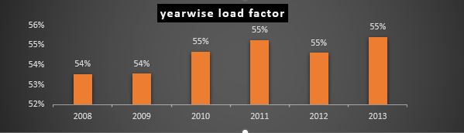
Introduction
1.Load factor percentages range from 53.54% to 55.41% over the six-year period.
2. Highest load factor: 2013 (55.41%)
3.Lowest load factor: 2008 (53.54%)
4.Overall increasing trend in load factor from 2008 to 2013.
5. Yearly load factor shows slight fluctuations but maintains an upward trajectory
YEARLY ANALYSIS

Slide 7
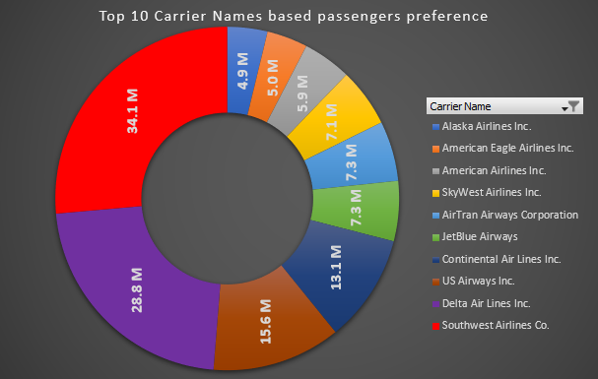
Introduction
Southwest Airlines Co. emerges as the top
carrier based on passengers preference,
with the highest number of passengers transported.
Delta Air Lines Inc. follows closely as the
second most preferred carrier.
16M US Airways Inc. 13M Continental Air Lines Inc.
Other carriers in the top 10 also demonstrate
significant passenger preference,
contributing to a competitive landscape in
the airline industry.
CARRIER BASED ON PASSENGER PREFERENCE

Slide 8
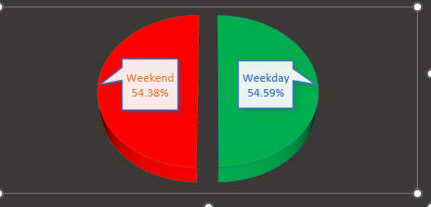

Introduction
LOAD FACTOR CAPACITY BY WEEKDAYS AND WEEKENDS
THIS DATA INDICATES THAT A HIGHER NUMBER OF PASSENGERS PREFER TRAVELING ON WEEKDAYS COMPARED TO WEEKENDS. THIS INSIGHT SUGGESTS THAT INCREASING THE NUMBER OF FLIGHTS ON WEEKDAYS COULD IMPROVE business profitability.
COMPARED TO WEEKDAYS, THE LOAD FACTOR CAPACITY IS LOWER ON WEEKENDS.

Slide 9
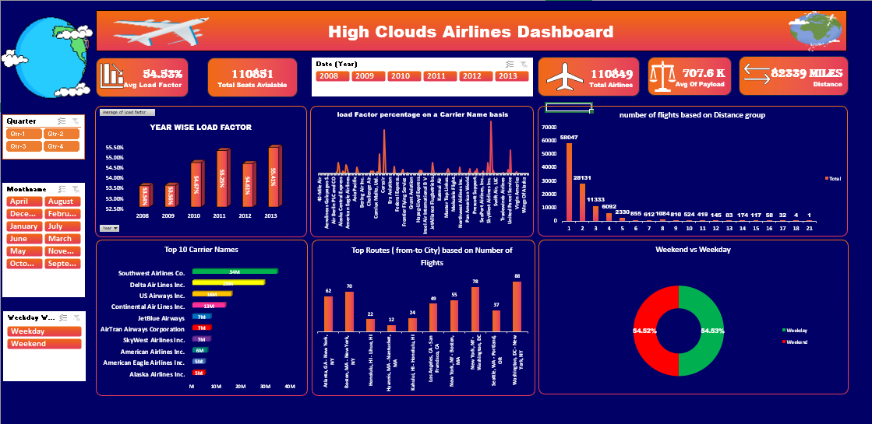
Introduction
DASHBOARD

Slide 10
Introduction
Data Model Challenges Throughout our analysis, we encountered various challenges in handling the data. Overcoming these challenges is crucial for accurate insights.
Data Volume: Managing and processing large datasets efficiently.
• Data Quality: Ensuring accuracy and reliability of the data.
• Complex Relationships: Establishing connections between different data points.
DATA MODEL CHALLENGES

Slide 11
Introduction
Analyzing airline data is pivotal for driving strategic decision-making, enhancing operational efficiency, and ultimately, fostering the overall success and competitiveness of the airline industry.
By harnessing data analytics techniques, airlines can extract valuable insights from diverse sources such as passenger bookings, flight performance metrics, and customer feedback. These insights inform decisions across various domains including route optimization, pricing strategies, fleet management
CONCLUSION

Slide 12

Thank you

