Slide 1
Multiple Regression Analysis

Slide 2
General Linear Models
This framework includes:
Linear Regression
Analysis of Variance (ANOVA)
Analysis of Covariance (ANCOVA)
These models can all be analyzed with the function lm()
Note that much of what I plan to discuss will also extend to Generalized Linear Models (glm)

Slide 3
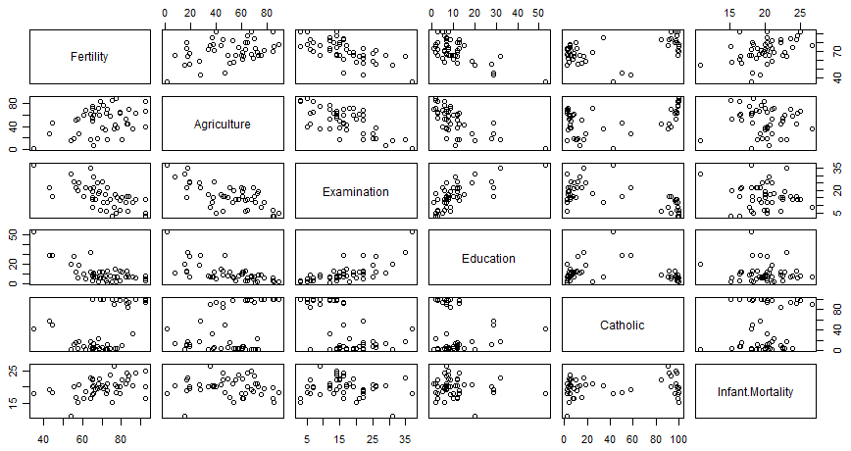
OLS Regression
Model infant mortality (Infant.Mortality) in Switzerland using the dataset swiss

Slide 4
The Data
> summary(swiss)
Fertility Agriculture Examination Education
Min. :35.00 Min. : 1.20 Min. : 3.00 Min. : 1.00
1st Qu.:64.70 1st Qu.:35.90 1st Qu.:12.00 1st Qu.: 6.00
Median :70.40 Median :54.10 Median :16.00 Median : 8.00
Mean :70.14 Mean :50.66 Mean :16.49 Mean :10.98
3rd Qu.:78.45 3rd Qu.:67.65 3rd Qu.:22.00 3rd Qu.:12.00
Max. :92.50 Max. :89.70 Max. :37.00 Max. :53.00
Catholic Infant.Mortality
Min. : 2.150 Min. :10.80
1st Qu.: 5.195 1st Qu.:18.15
Median : 15.140 Median :20.00
Mean : 41.144 Mean :19.94
3rd Qu.: 93.125 3rd Qu.:21.70
Max. :100.000 Max. :26.60

Slide 5
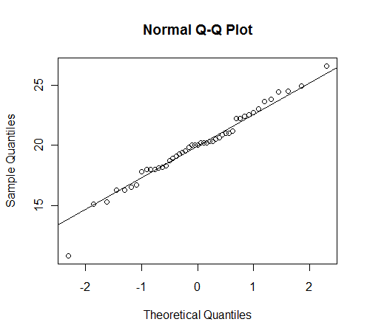
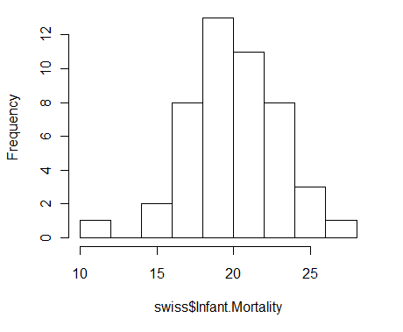
Histogram and QQPlot
> hist(swiss$Infant.Mortality)
> qqnorm(swiss$Infant.Mortality)
> qqline(swiss$Infant.Mortality)

Slide 6
Scatter Plot
> plot(swiss$Infant.Mortality~swiss$Fertility, main="IMR by Fertility in Switzerland", xlab="Fertility Rate",
ylab="Infant Mortality Rate",
ylim=c(10, 30),
xlim=c(30,100))
> abline(lm(swiss$Infant.Mortality~swiss$Fertility))
> lm<-lm(swiss$Infant.Mortality~swiss$Fertility)
> abline(lm)

Slide 7
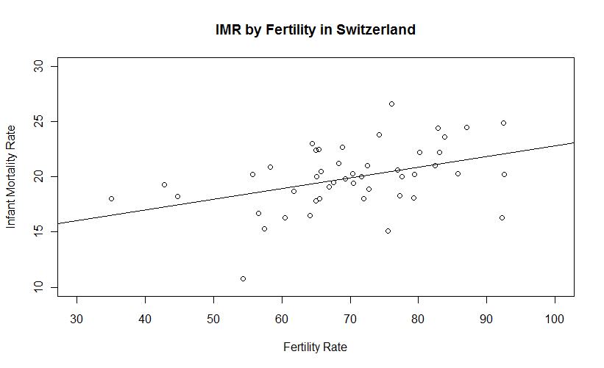
Scatter Plot

Slide 8
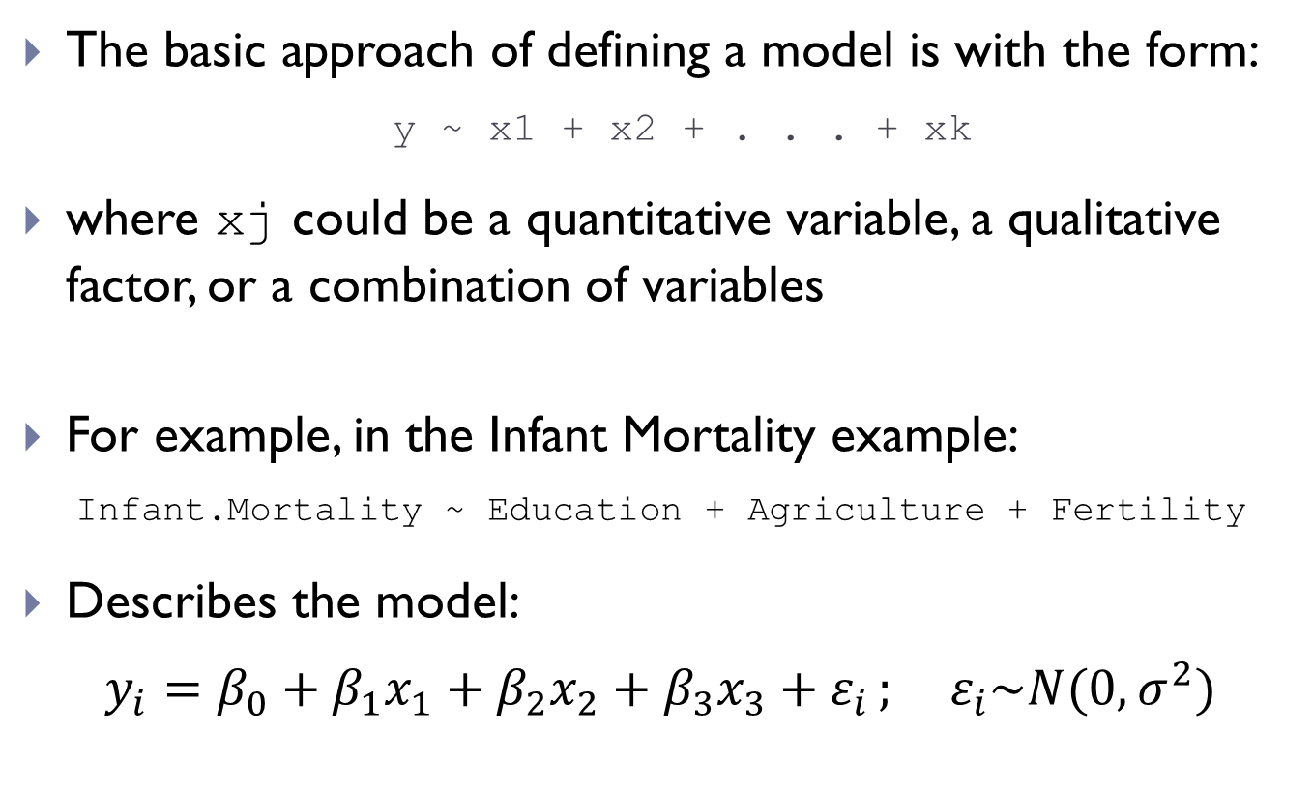
OLS in R
The basic approach of defining a model is with the form:
y ~ x1 + x2 + . . . + xk
where xj could be a quantitative variable, a qualitative factor, or a combination of variables
For example, in the Infant Mortality example:
Infant.Mortality ~ Education + Agriculture + Fertility
Describes the model:
$$y_{i}=β_{0}+β_{1}x_{1}+β_{2}x_{2}+β_{3}x_{3}+ε_{i }\text{; }ε_{i}\sim N(0,σ^{2})$$

Slide 9
The basic call for linear regression
> fert1<-lm(Infant.Mortality ~ Fertility + Education + Agriculture, data=swiss)
> summary(fert1)
Why do we need fert1<-?
Why do we need data=?
Why do we need summary()?

Slide 10
OLS - R output
Call:
lm(formula = Infant.Mortality ~ Fertility + Education + Agriculture, data = swiss)
Residuals:
Min 1Q Median 3Q Max
-8.1086 -1.3820 0.1706 1.7167 5.8039
Coefficients:
Estimate Std. Error t value Pr(>|t|)
(Intercept) 10.14163 3.85882 2.628 0.01185 *
Fertility 0.14208 0.04176 3.403 0.00145 **
Education 0.06593 0.06602 0.999 0.32351
Agriculture -0.01755 0.02234 -0.785 0.43662
---
Signif. codes: 0 ‘***’ 0.001 ‘**’ 0.01 ‘*’ 0.05 ‘.’ 0.1 ‘ ’ 1
Residual standard error: 2.625 on 43 degrees of freedom
Multiple R-squared: 0.2405, Adjusted R-squared: 0.1875
F-statistic: 4.54 on 3 and 43 DF, p-value: 0.007508

Slide 11
ANOVA – R output
Note that this only gives part of the standard regression output. To get the ANOVA table, use:
> anova(fert1)
Analysis of Variance Table
Response: Infant.Mortality
Df Sum Sq Mean Sq F value Pr(>F)
Fertility 1 67.717 67.717 9.8244 0.00310 **
Education 1 21.902 21.902 3.1776 0.08172 .
Agriculture 1 4.250 4.250 0.6166 0.43662
Residuals 43 296.386 6.893
---
Signif. codes: 0 ‘***’ 0.001 ‘**’ 0.01 ‘*’ 0.05 ‘.’ 0.1

Slide 12
What about factors
What is a factor?
It is the internal representation of a categorical variable
Character variables are automatically treated this way
However, numeric variables could either be quantitative or factor levels (or quantitative but you want to treat them factor levels)
> swiss$cathcat <- ifelse(swiss$Catholic > 60, c(1), c(0))
> swiss$cathfact<- ifelse(swiss$Catholic > 60, c("PrimCath"), c("PrimOther"))

Slide 13
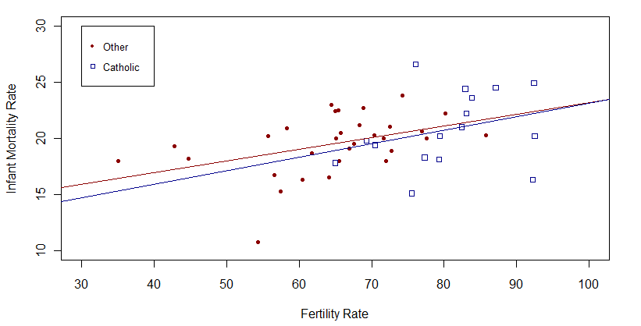
Interactions
Does the effect of one predictor variable on the outcome depend of the level of other predictor variables?

Slide 14
The code
> IMR_other<-swiss$Infant.Mortality[swiss$cathcat==0]
> FR_other<-swiss$Fertility[swiss$cathcat==0]
> IMR_cath<-swiss$Infant.Mortality[swiss$cathcat==1]
> FR_cath<-swiss$Fertility[swiss$cathcat==1]
> plot(IMR_other~FR_other, type="p", pch=20, col="darkred",ylim=c(10,30),xlim=c(30,100),
ylab="Infant Mortality Rate", xlab="Fertility Rate")
> points(FR_cath, IMR_cath, pch=22, col="darkblue")
> abline(lm(IMR_other~FR_other), col="darkred")
> abline(lm(IMR_cath~FR_cath), col="darkblue")
> legend(30, 30, c("Other", "Catholic"), pch=c(20, 22), cex=.8, col=c("darkred", "darkblue"))

Slide 15
Interactions
If their were no interaction, we would want to fit the additive model:
Infant.Mortality~Fertility+Catholic
We can also try the interaction model:
Infant.Mortality~Fertility+Catholic+Fertility:Catholic
In R “:” is one way to indicate interactions
Also some shorthands
For example “*” will give the highest order interaction, plus all main effects and lower level interactions:
Infant.Mortality~Fertility*Catholic

Slide 16
Interactions
Suppose we had three variables A, B, C
The following model statements are equivalent:
y ~ A*B*C
y ~ A + B + C + A:B + A:C + B:C + A:B:C
Suppose that you only want up to the second order interactions
This could be done by:
y ~ (A + B + C)^2
y ~ A + B + C + A:B + A:C + B:C + A:B:C
This will omit terms like A:A (treats is as A)

Slide 17
Interactions in Swiss dataset
> fert4<-lm(Infant.Mortality~Fertility + cathcat + Fertility:cathcat, data=swiss)
> summary(fert4)
Coefficients:
Estimate Std. Error t value Pr(>|t|)
(Intercept) 12.82112 3.01737 4.249 0.000113 ***
Fertility 0.10331 0.04596 2.248 0.029779 *
cathcat -1.70755 7.56707 -0.226 0.822538
Fertility:cathcat 0.01663 0.09728 0.171 0.865071
---
Signif. codes: 0 ‘***’ 0.001 ‘**’ 0.01 ‘*’ 0.05 ‘.’ 0.1 ‘ ’ 1
Residual standard error: 2.733 on 43 degrees of freedom
Multiple R-squared: 0.1772, Adjusted R-squared: 0.1198
F-statistic: 3.087 on 3 and 43 DF, p-value: 0.03704

Slide 18
How to use residuals for diagnostics
Residual analysis is usually done graphically using:
Quantile plots: to assess normality
Histograms and boxplots
Scatterplots: to assess model assumptions, such as constant variance and linearity, and to identify potential outliers
Cook’s D: to check for influential observations

Slide 19
Checking the normality of the error terms
To check if the population mean of residuals=0
> mean(fert5$residuals)
[1] -3.002548e-17
histogram of residuals
> hist(fert5$residuals, xlab="Residuals", main="Histogram of residuals")
normal probability plot, or QQ-plot
> qqnorm(fert5$residuals, main="Normal Probability Plot", pch=19)
> qqline(fert5$residuals)

Slide 20
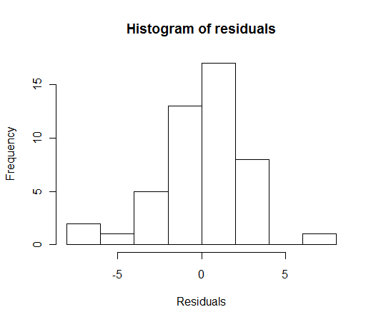
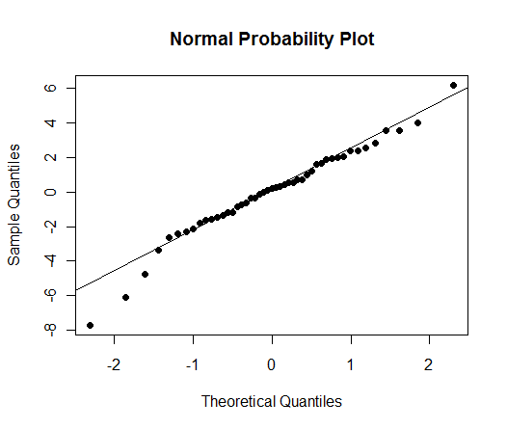
Result

Slide 21
Checking: linear relationship, error has a constant variance, error terms are not independent
plot residuals against each predictor (x=Fertility)
> plot(swiss$Fertility, fert5$residuals, main="Residuals vs. Predictor", xlab="Fertility Rate", ylab="Residuals", pch=19)
> abline(h=0)
plot residuals against fitted values (Y-hat)
> plot(fert5$fitted.values, fert5$residuals, main="Residuals vs. Fitted", xlab="Fitted values", ylab="Residuals", pch=19)
> abline(h=0)

Slide 22
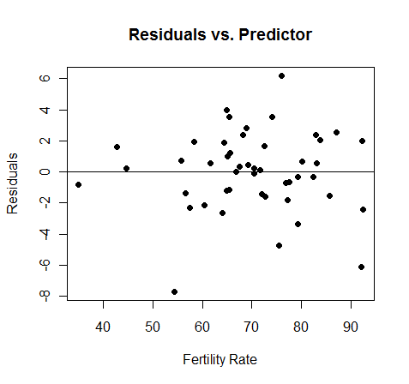
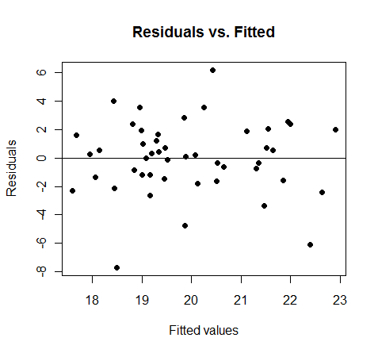
Result

Slide 23
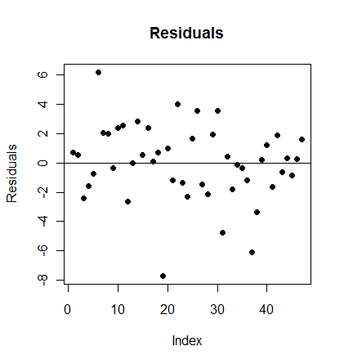
Checking: serial correlation
Plot residuals by obs. Number
> plot(fert5$residuals, main="Residuals", ylab="Residuals", pch=19)
> abline(h=0)

Slide 24
Checking: influential observations
Cook’s D measures the influence of the ith observation on all n fitted values
The magnitude of D_{i} is usually assessed as:
if the percentile value is less than 10 or 20 % than the ith observation has little apparent influence on the fitted values
if the percentile value is greater than 50%, we conclude that the ith observation has significant effect on the fitted values

Slide 25
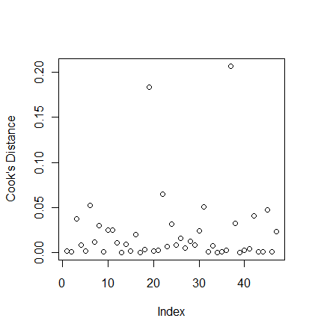
Cook’s D in R
> cd <- cooks.distance(fert5)
> plot(cd, ylab="Cook's Distance")
> abline(h=qf(c(.2,.5), 2, 44))

Slide 26
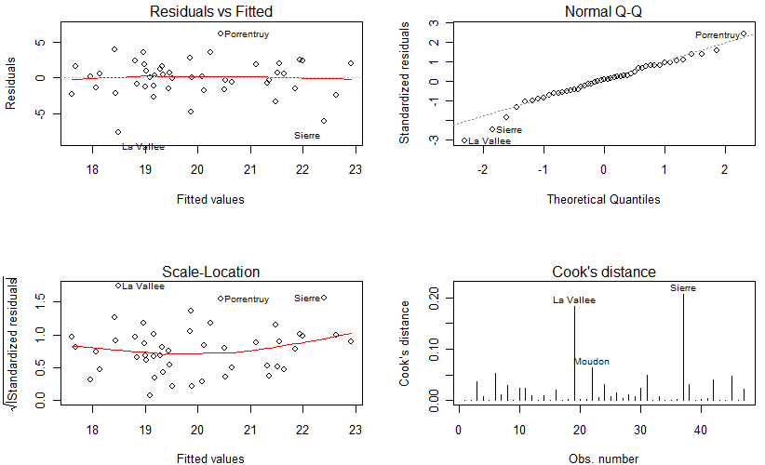
Shortcut
> opar<-par(mfrow=c(2,2))
> plot(fert5, which=1:4)

Slide 27
Comparing models with ANOVA (aka ANCOVA)
> fert1<-lm(Infant.Mortality~Fertility, data=swiss)
> fert5<-lm(Infant.Mortality~Fertility+Education, data=swiss)
> anova(fert1,fert5)
Analysis of Variance Table
Model 1: Infant.Mortality ~ Fertility + Education + Agriculture
Model 2: Infant.Mortality ~ Fertility + Education
Res.Df RSS Df Sum of Sq F Pr(>F)
1 43 296.39
2 44 300.64 -1 -4.25 0.6166 0.4366

