Slide 1
Power BI Banking Domain Dashboard
End-to-End Data Analytics Project
Created by Rohit Shahi

Slide 2
Project Objective
To analyze banking customer data and generate actionable insights
Understand customer demographics and financial behavior
Support data-driven decisions in banking & finance domain

Slide 3
Dataset Overview
Dataset: TechnoEdge Customers Banking Details
Rows: 250 | Columns: 19
Domain: Banking & Finance
Data includes demographics, account types, balances, and loans

Slide 4
Tools & Technologies Used
Power BI Desktop for dashboard development
Power Query for data cleaning and transformation
DAX for calculated measures and KPIs

Slide 5
Data Cleaning & Transformation
Corrected data types for all columns
Merged Name and Surname into a single field
Removed duplicates and blank records
Merged customer and banking tables using Customer ID
Extracted Year, Month, Day from Date Joined
Rounded balance values for better readability

Slide 6
KPIs Used in Dashboard
Total Customers
Total Balance
Total House Loan Count
Total Other Loan Count
Number of Account Types

Slide 7
Customer Demographic Analysis
Gender-wise balance distribution using Donut Chart
Age Group analysis using Clustered Column Chart
Marital Status impact on total balance
Job Classification-wise balance comparison

Slide 8
Geographical Analysis
State-wise total balance analysis
Country-wise customer balance distribution
Identification of high-performing regions

Slide 9
Account & Loan Analysis
Account Type-wise balance distribution (SA, CA, CD)
House Loan vs Other Loan comparison
Loan distribution across states

Slide 10
Time-Based Analysis
Monthly trend of total balance
Customer count variation by month
Seasonal patterns in customer joining and balances

Slide 11
Top Customer Analysis
Top 10 customers by total balance
High-value customer identification
Useful for targeted marketing and relationship management

Slide 12
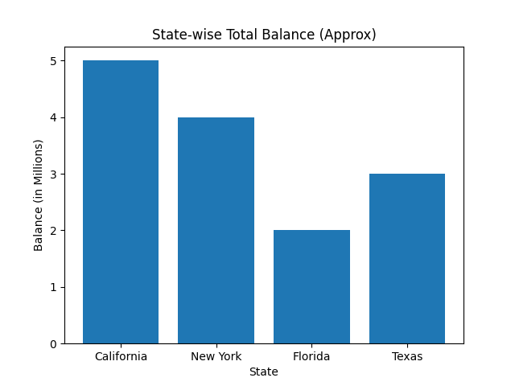
Sample Insight: State-wise Balance Analysis

Slide 13
Business Insights Derived
Savings Accounts contribute the highest balance
Married customers hold higher total balance
California and New York are top-performing states
Male and Female customers show nearly balanced contribution
Specific age groups contribute more to overall balance

Slide 14
Key Learnings
Hands-on experience in banking domain analytics
Improved Power BI dashboard design skills
Stronger understanding of data storytelling
Ability to convert raw data into business insights

Slide 15
Conclusion
Developed a complete Power BI dashboard from scratch
Applied real-world banking analytics concepts
Project demonstrates readiness for Data Analyst roles

