Slide 1

Customer Shopping Behavior Analysis
3,900 purchases • 18 columns • Goal: uncover spending, segments, preferences, subscriptions

Slide 2
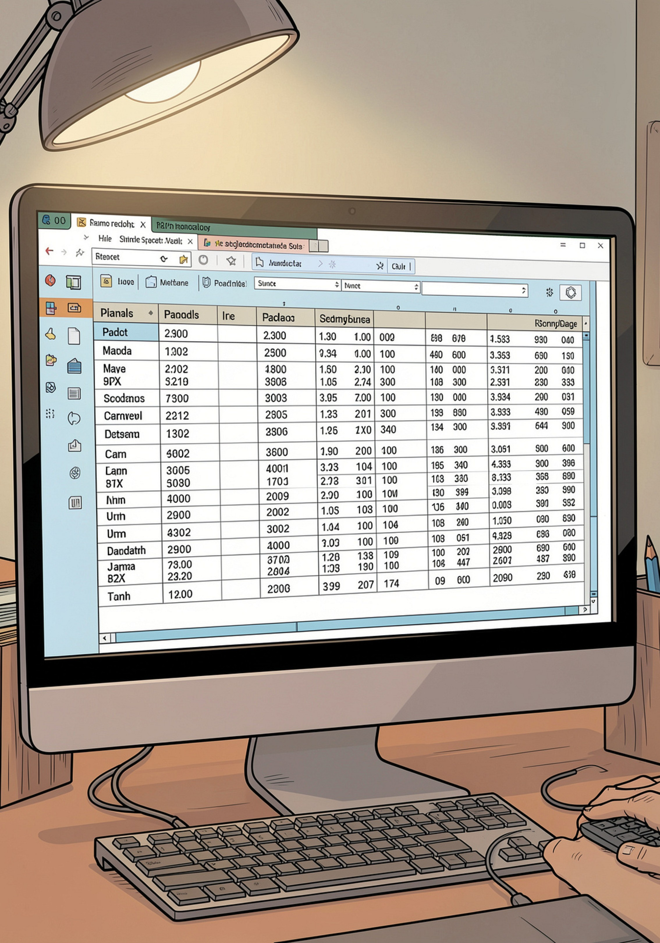
Dataset Summary
Rows / Columns
Key Features
3,900 rows • 18 columns
Demographics, Purchase details, Shopping behavior
Missing Data
37 missing values in Review Rating

Slide 3




EDA — Python
Data Prep
Imported with pandas • df.info() • df.describe()
Cleaning
Imputed Review Rating by category median
Standardize
Renamed columns to snake_case

Slide 4
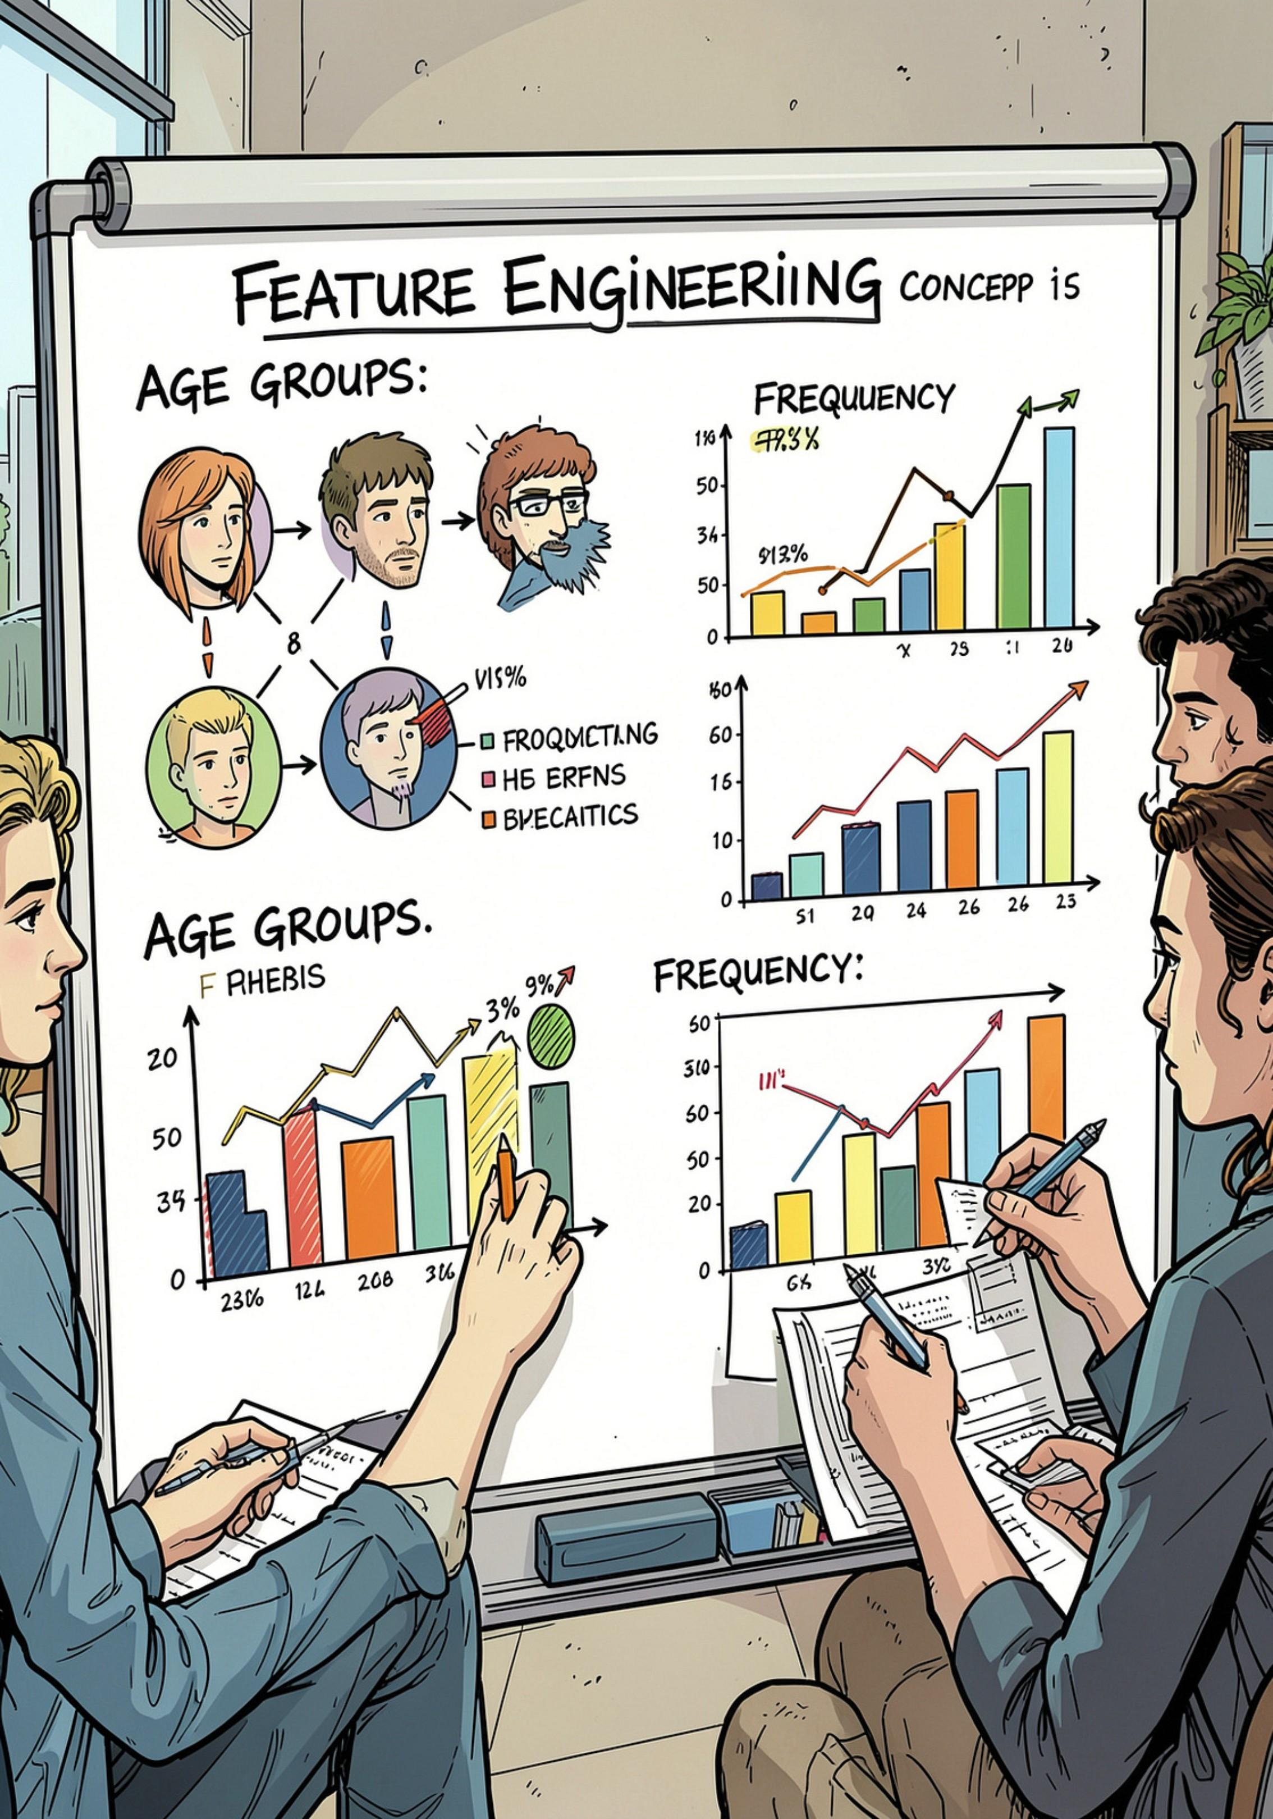
Feature Engineering
Age Groups
Frequency
Created age_group bins
purchase_frequency_days from timestamps
Consistency Checks
Verified discount_applied vs promo_code_used

Slide 5
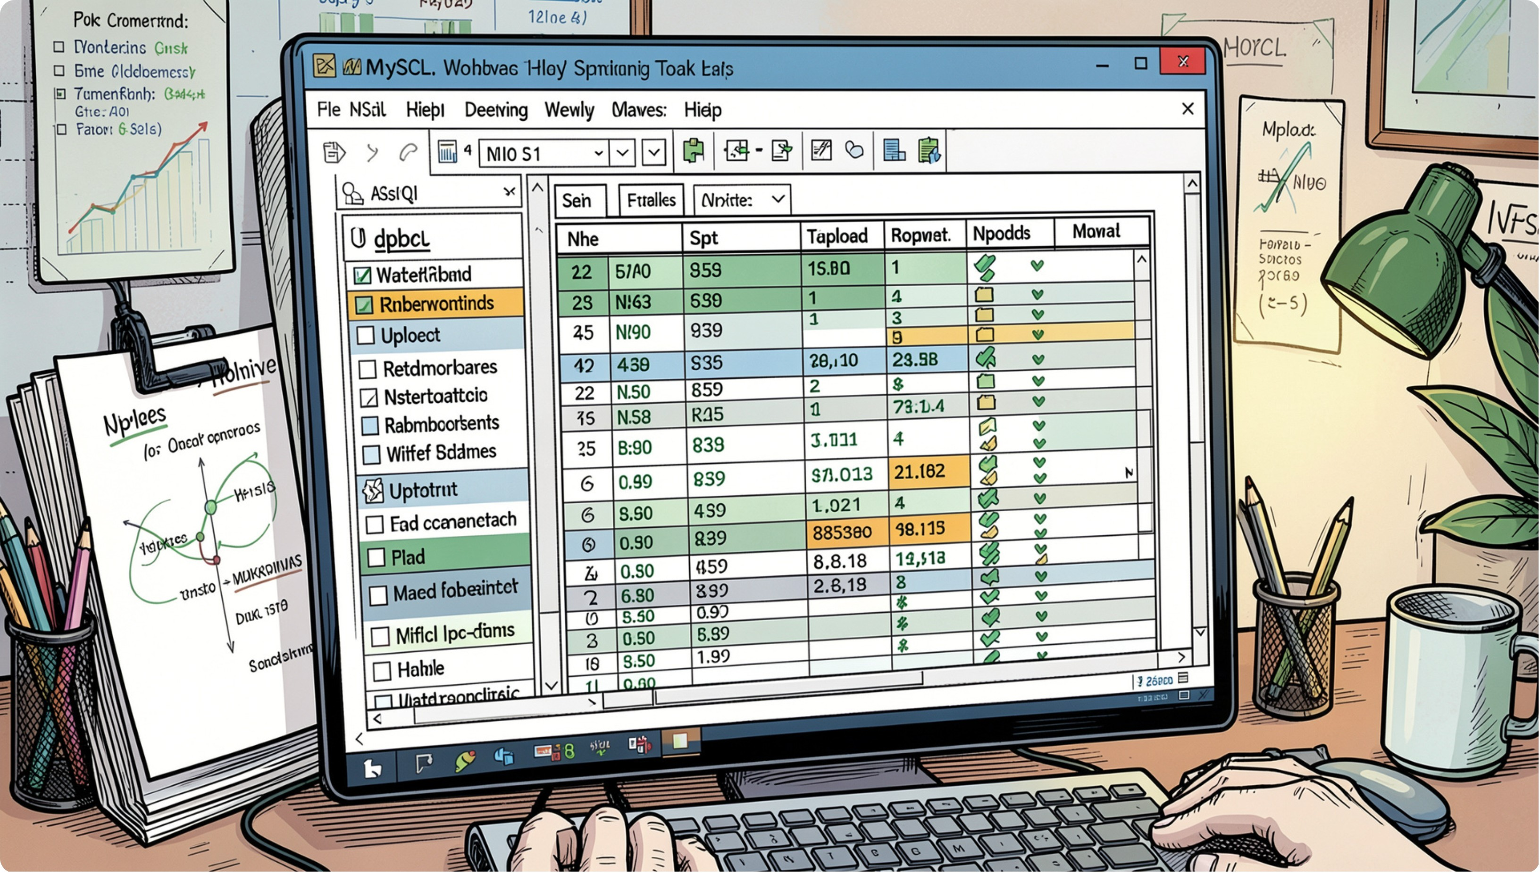
Database Integration
Loaded cleaned DataFrame into MySQL for structured SQL analysis
Enables aggregate queries and reproducible reports

Slide 6
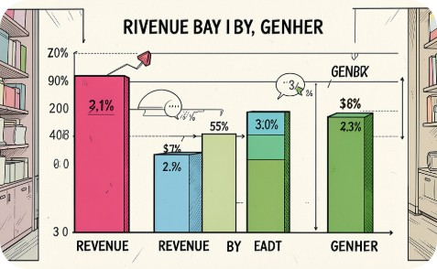
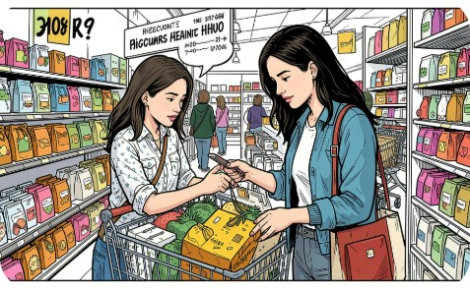
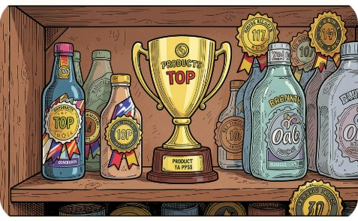
Key SQL Analyses
Revenue by Gender
High-Spending Discount Users
Top-Rated Products
Compare total revenue: male vs female
Discount used but spend > average purchase amount
Top five products by average review rating

Slide 7





More SQL Insights
Further analysis reveals critical patterns in customer behavior and preferences.
Repeat Customer Engagement
Identified 25% of customers making repeat purchases, with an average spend 1.5x higher than first-time buyers.
Category Preferences by Age
Customers aged 18-24 favor Apparel, while 35-44 year olds show higher engagement with Electronics.
Payment Method & AOV
Purchases made via Credit Card have a 15% higher Average Order Value (AOV) compared to other methods.

Slide 8
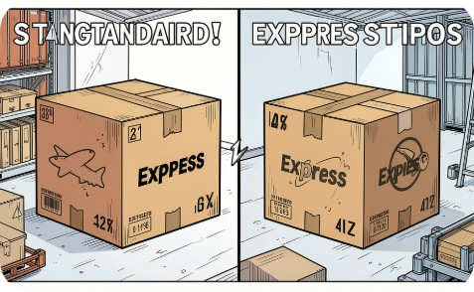

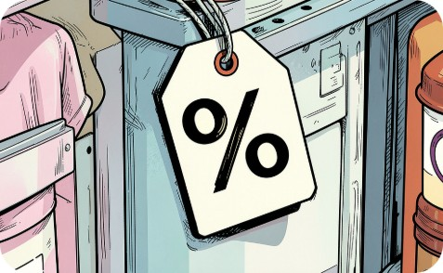
More SQL Insights
Shipping Type
Subscribers vs Non‑Subscribers
Discount-Dependent Products
Avg purchase: standard vs express
Compare avg spend and total revenue by subscription status
Products with highest % of discounts

Slide 9

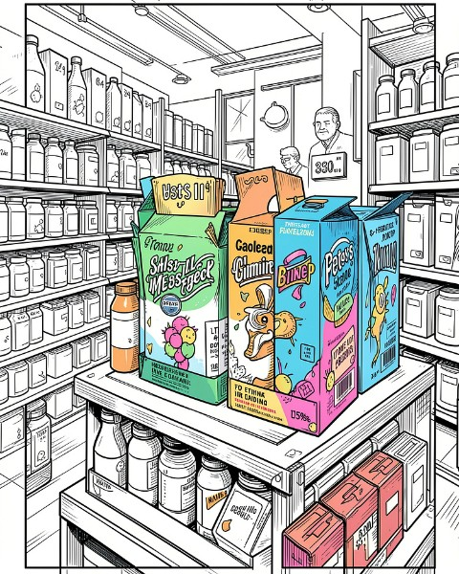
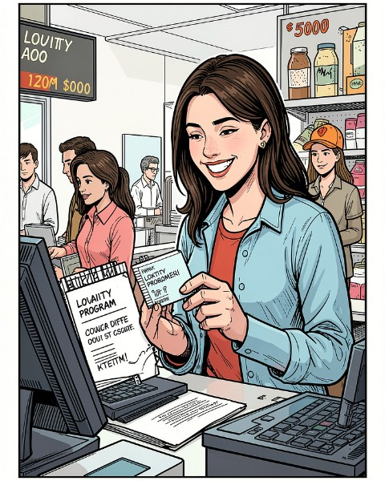
Segmentation & Top Products
Returning
New
Top per Category
List most purchased product within each category
Loyal
Repeat Buyers & Subscriptions
Customers with >5 purchases more likely to subscribe

Slide 10
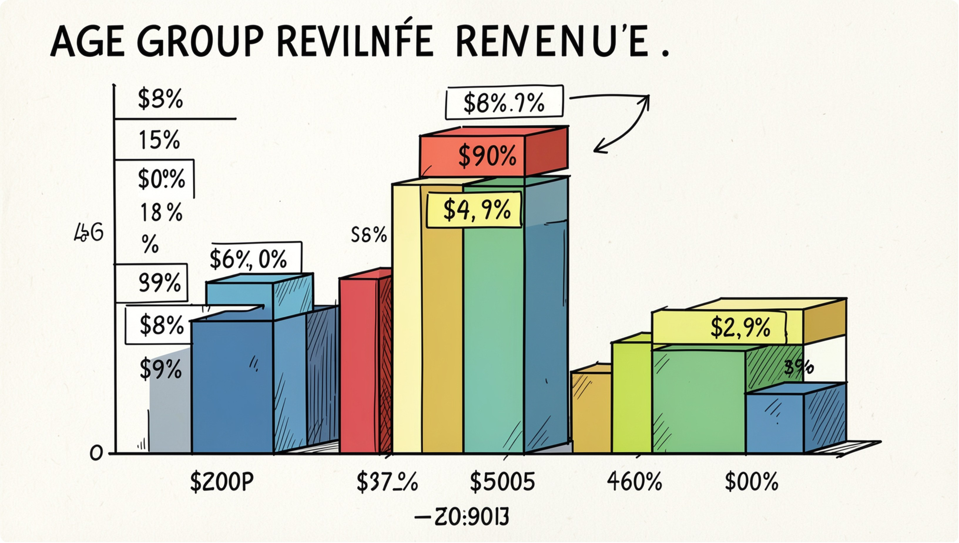
Revenue by Demographics
Calculated total revenue contribution by age_group
Identified high-revenue age segments and express‑shipping users

Slide 11


Business Recommendations
Boost Subscriptions
Loyalty Programs
Review Discounts
Promote exclusive subscriber benefits
Reward repeat buyers to grow 'Loyal' segment
Balance short-term sales with margin control
Product Positioning
Targeted Marketing
Feature top-rated & best-selling items in campaigns
Focus on high-revenue age groups & express‑shipping users

