Slide 1
GDNF Single Loop Alignment with Bicyclic CLIPS
Rohit Shankar

Slide 2
GDNF Alignment Procedure

Slide 3
Python Commands for Alignment
Procedure:
Open bicyclic CLIPS file.
Select left ring of bicyclic (left ring is labeled second in file).
Open GDNF single loop file.
Align GDNF with selected left ring of bicyclic.
Commands:
Cmd.load(“Bicyclic”)
Cmd.Select(“Residue numbers”)
Cmd.load(“GDNF”)
Cmd.align(“GDNF i. residue numbers”, “Bicyclic”)

Slide 4
Selecting GDNF Residues for Alignment

Slide 5
GDNF Alignment Residues
Residue available for mutation had to be upward facing for cysteine. Red portions of next picture.
Alignment started with cysteine and then went around loop via alanine chain lastly ending with middle cysteine of bicyclic.

Slide 6
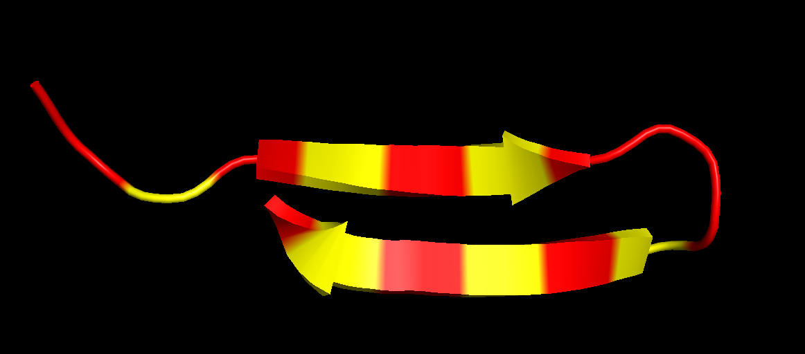
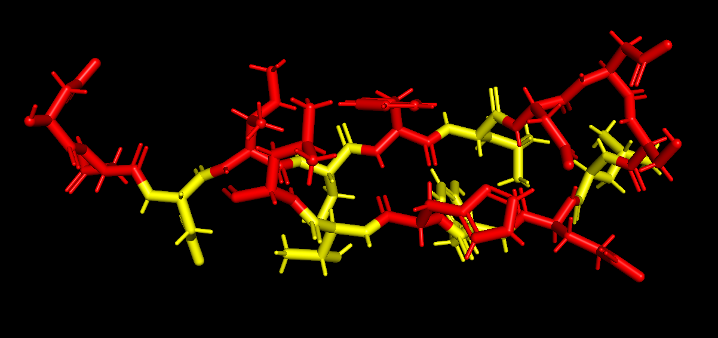
GDNF Loop

Slide 7
GDNF Alignment Results/Pictures

Slide 8
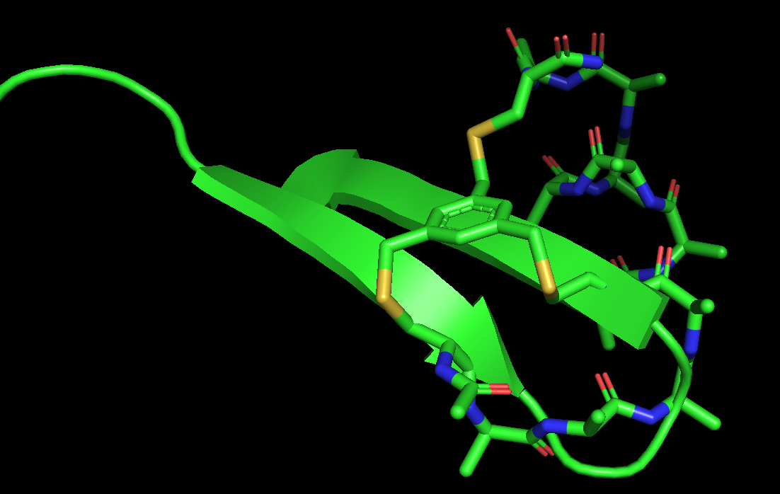
Alignment Length 4 Example

Slide 9
Best Alignment for Length 4
RMSD = 0.011366539
GDNF Residue Selection: 216-221

Slide 10
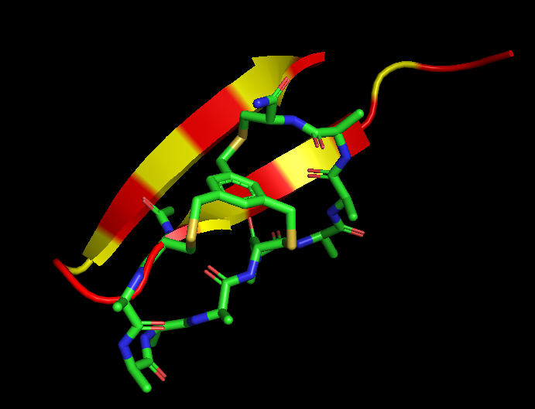
Alignment Length 4

Slide 11
Alignment Example length 5
RMSD = 0.00725465
GDNF Residue Selection: 214 - 220

Slide 12
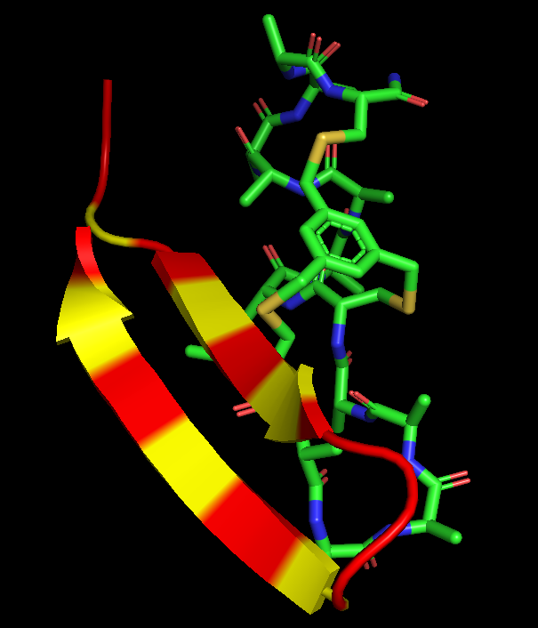
Alignment Length 5

