Slide 1
File modification

Slide 2
1. Create library using IBM with benzylic tribromide + peptide chain + thiol. – Completed
2. Use Monte Carlo Multiple Minimum for conformational sampling. –Completed
3. Modify format of MCMM output to match Protein Data Bank and overlay cyclic peptides with protein backbones. Find low RMSD values.
4. Align with Kirtzer hot loops to find possible mimics

Slide 3
Steps for file modification
Convert maegz to mol2. Completed
Convert mol2 to PDB file format. Almost completed

Slide 4
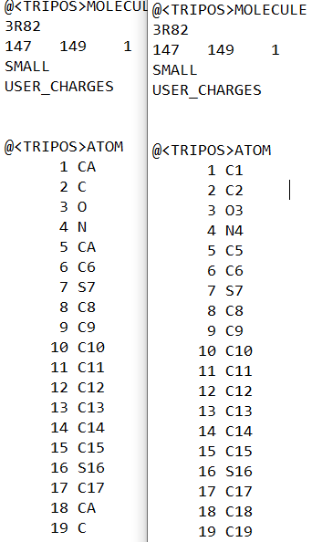
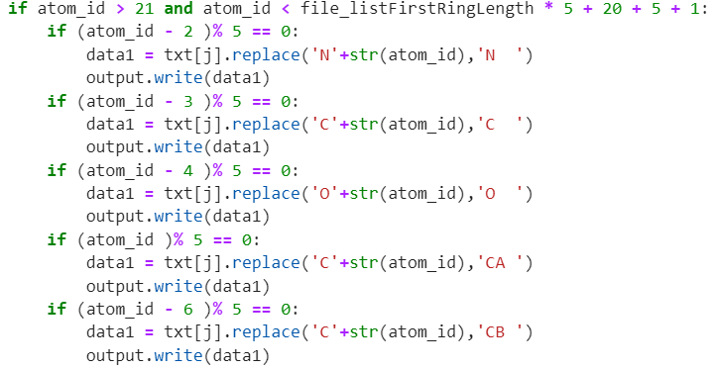
Completed: Changing Atom ID
The script involved changing the carbon atoms to the corresponding bonding information and removing numbers from other elements.

Slide 5
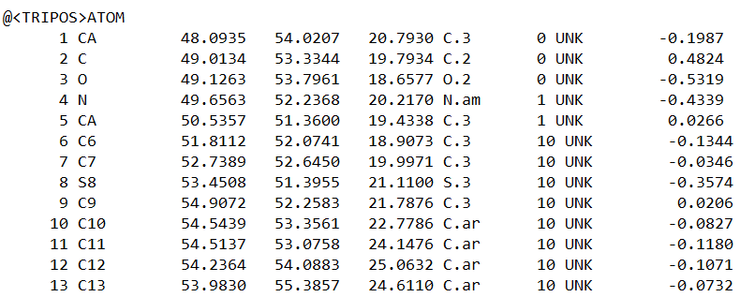
Progress Update
Previously, the script did not function properly due to certain bicyclic peptides having different atom order.
The main difference was that some would have a N at 19 and some would start with a C at 19. After noticing this pattern was due to if the bicyclic started on the larger ring or shorter ring, a new set of parameters were made.

Slide 6
Progress Update
Currently, the script seems to work fine. The residue ID is also updating, and the atom id is changing correctly. Right now, mol2 files from mobxterm are being downloaded and converted to pdb file type.

