Slide 1
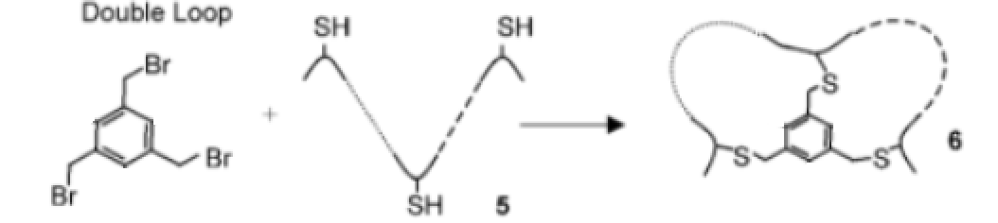
Bicyclic CLIPS
Rohit Shankar

Slide 2
Steps in Project
1. Create library using IBM with benzylic tribromide + peptide chain + thiol. – Completed
2. Use Monte Carlo Multiple Minimum for conformational sampling.
3. Modify format of MCMM output to match Protein Data Bank and overlay cyclic peptides with protein backbones. Find low RMSD values.
4. Align with Kirtzer hot loops to find possible mimics

Slide 3


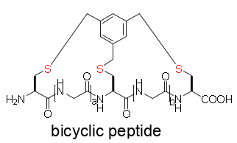

Step 1: Building Library – Completed
Pool 1: Tribromide benzylic
Pool 3: Linear Peptides
N = 1 - 10
N = 3 - 10
Pool 2: Thiols
640 bicyclic peptides in library

Slide 4
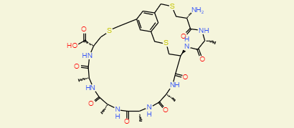
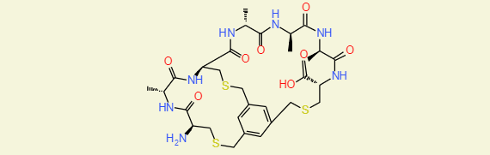
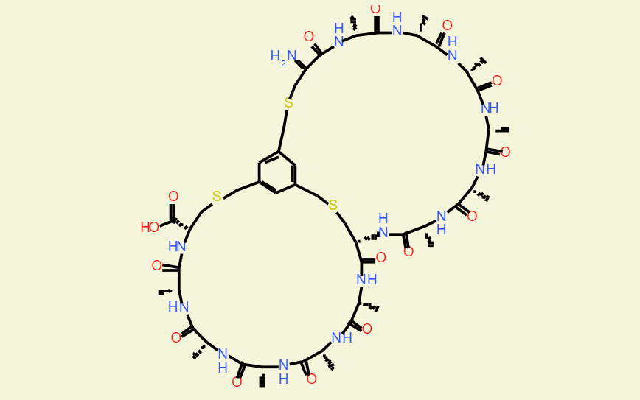
Examples of Completed Bicyclic Peptides in Library

Slide 5
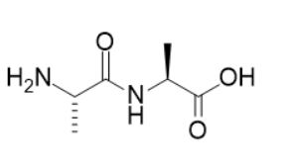
Reaction From SMARTS Used To Build Library
SMARTS is a language used to modify SMILES format
rxnAddAla = AllChem.ReactionFromSmarts('[O:1]([C:2])>>[N:1]([C:2])[C@H:3]([C:4])[C:5](=[O:6])[O:7]')
Used to add thiol group to peptide chain
rxnThiol = AllChem.ReactionFromSmarts('[O:2]([C:3](=[O:4])).[N:1] >> [N:1][C:3]=[O:4] ‘)
Used to add bromide to sulfur
rxnBromo = AllChem.ReactionFromSmarts('[Br:0].[S:2]([C:3]) >> [S:0]([C:3])')

Slide 6
Goals for next week
Use MCMM with exported library for conformational sampling.

