Slide 1
GDNF Alignment with Bicyclic CLIPS
Rohit Shankar

Slide 2
GDNF Alignment Procedure

Slide 3
Python Commands for Alignment
Procedure:
Open bicyclic CLIPS file.
Select residues of both rings in bicyclic
Open GDNF single loop file.
Align GDNF with selection of bicyclic.
Commands:
Cmd.load(“Bicyclic”)
Cmd.Select(“Residue numbers”)
Cmd.load(“GDNF”)
Cmd.align(“GDNF i. residue numbers”, “Bicyclic”)

Slide 4
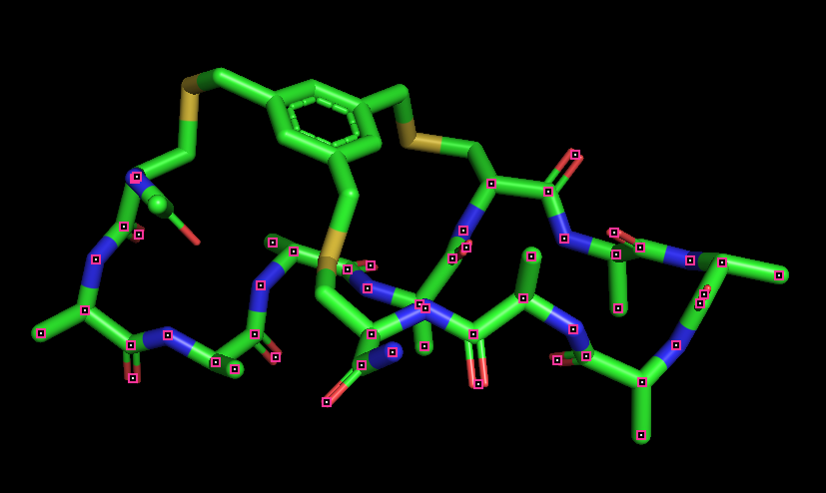
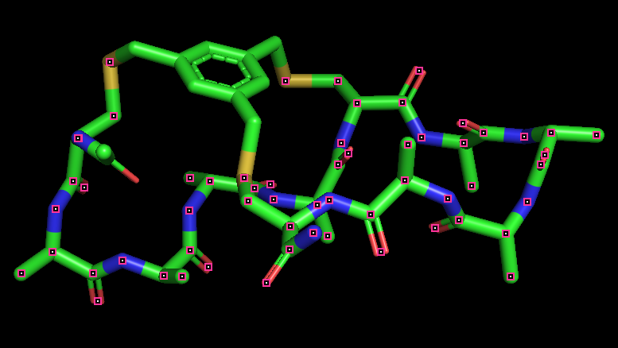
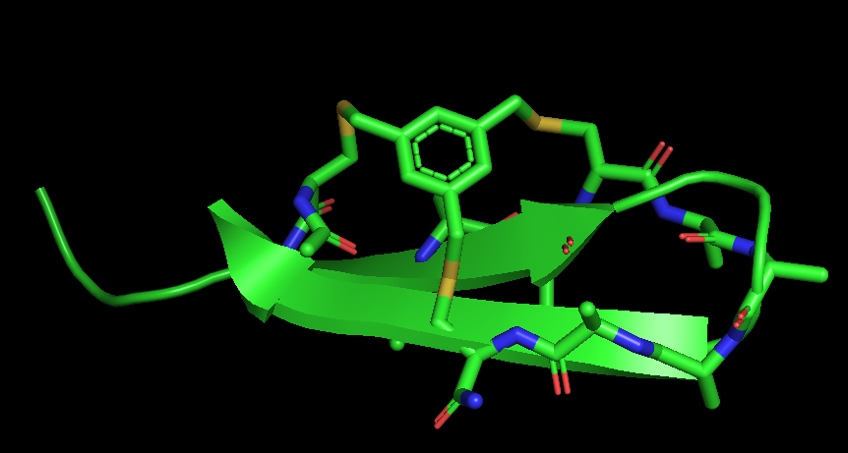
Procedure Visualized

Slide 5
Selecting GDNF Residues for Alignment

Slide 6
GDNF Alignment Residues
Residue available for mutation had to be upward facing for cysteine. Red portions of next picture.
Alignment residues starts with right ring cysteine finding starting mutating point such that middle cysteine and left ring cysteine are also on mutation points. Right ring cysteine tests GDNF residue id 220,222, and 224.

Slide 7
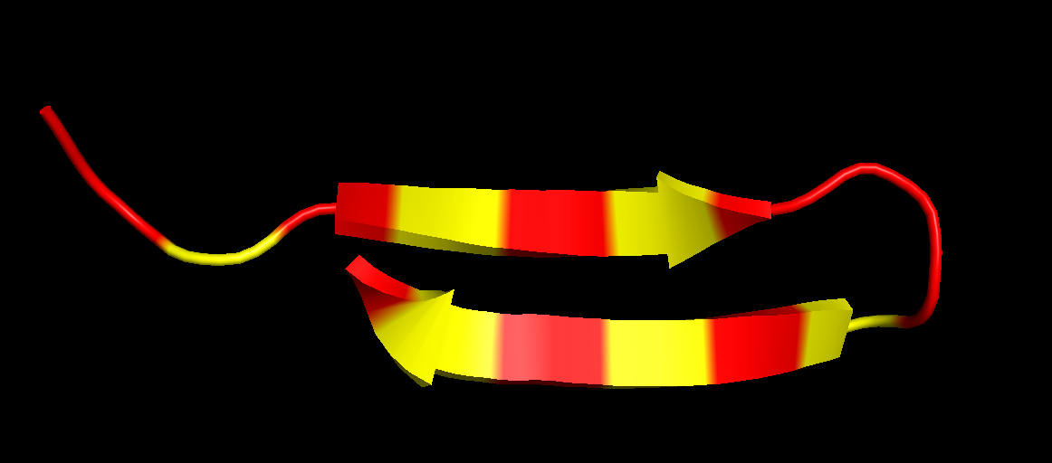
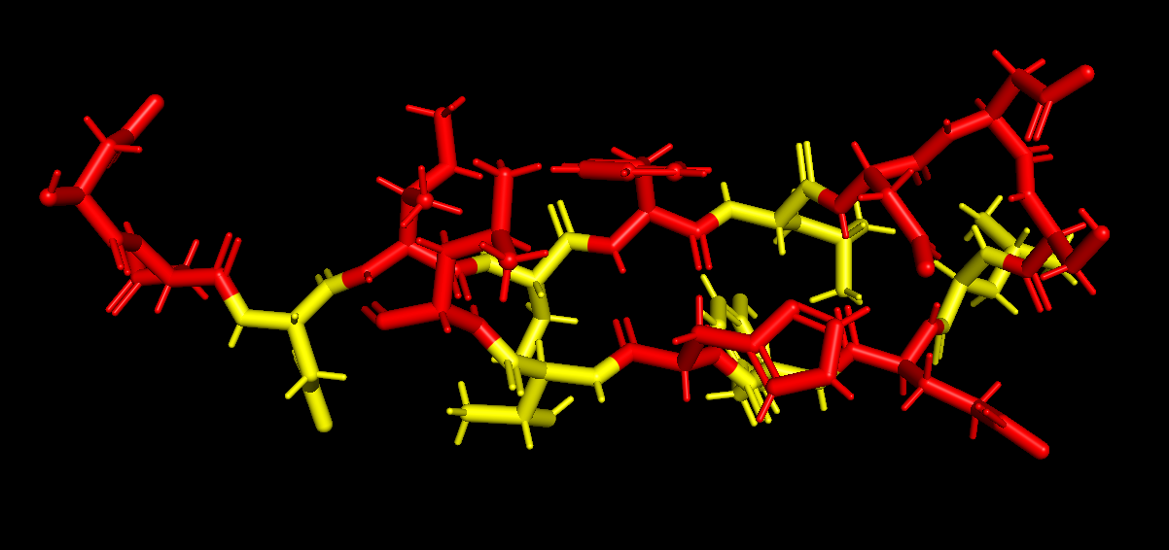
GDNF Loop

Slide 8
GDNF Alignment Results/Pictures

Slide 9
Alignment Length 4 Example
Alignment 4A-4A2_2932
RMSD: 2.025

Slide 10
Alignment Results
RMSD File Name GDNF Selection
2.025034 4A-4A2_2932.mol2 2 1 2 - 2 2 2
2.832149 5A-5A1_3384.mol2 2 1 0 - 2 2 2
2.956409 4A-6A7_3538.mol2 2 1 0 - 2 2 2
3.199573 6A-7A5_4007.mol2 2 0 9 - 2 2 4
3.251551 3A-8A1_5918.mol2 2 0 9 - 2 2 2
3.823663 3A-9A8_2662.mol2 2 1 0 - 2 2 4
4.103341 3A-10A4_1984.mol2 2 0 9 - 2 2 4

