Slide 1
NATHKRUPA
MediConnect
Smart Doctor Appointment System
Name: Tapaswi Kandrikar Roll No :196 Project Guide : Bhagyashree Patil
1

Slide 2
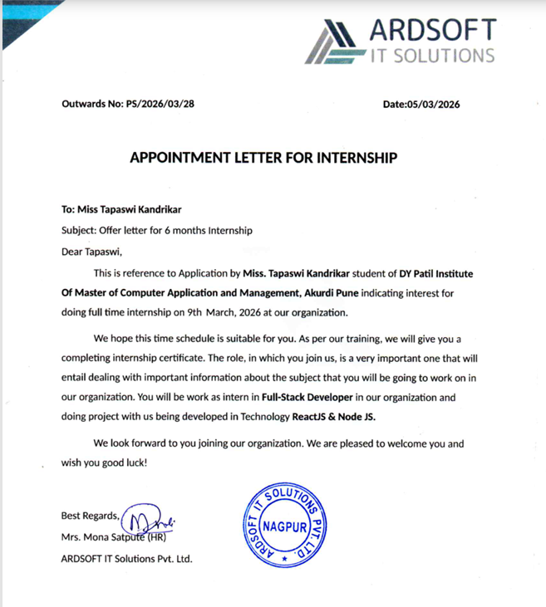
Offer Letter

Slide 3
INTRODUCTION
MediConnect is a web-based healthcare system designed to simplify the process of booking doctor appointments.
It connects patients and doctors through a centralized platform.
Patients can easily find doctors and book appointments online.
Doctors can manage and update appointment status efficiently.
The system reduces manual work and improves accessibility to healthcare services.

Slide 4
OBJECTIVE OF THE PROJECT
To provide an easy and user-friendly platform for booking doctor appointments
To reduce manual effort and waiting time in hospitals
To enable doctors to manage appointments efficiently
To maintain accurate and organized patient and appointment data
To ensure better communication between patients and doctors

Slide 5
SCOPE OF THE PROJECT
Current Scope:
Online appointment booking system
Appointment status tracking (Pending / Approved / Cancelled/Complete)
Doctor dashboard for managing appointments
Admin panel for system control
Future Scope:
Online payment integration
Email/SMS notifications
Video consultation feature

Slide 6
MODULE SPECIFICATION
Patient Module
View doctor specializations
View list of available doctors
Book appointment (date & time selection)
Check appointment status using appointment number
Admin Module
Secure login
Manage doctors, specialization,appointment
Doctor Module
Secure login/Register
Dashboard view
View appointments
Change status of appointments
Update profile

Slide 7
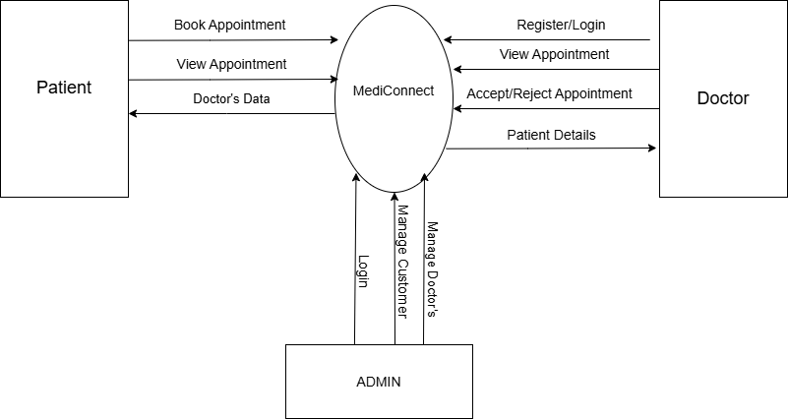
0 LEVEL DATA FLOW DIAGRAM

Slide 8
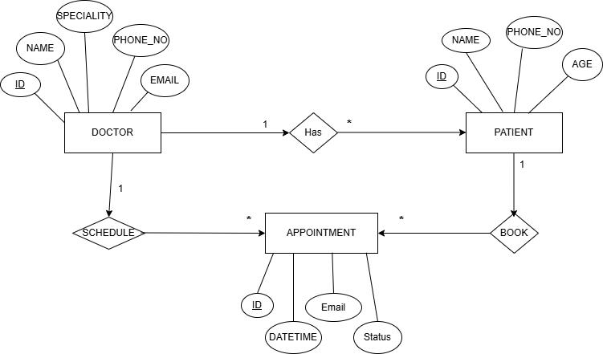
ER DIAGRAM

Slide 9
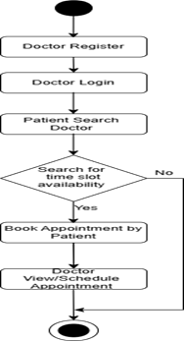
ACTIVITY DIAGRAM

Slide 10
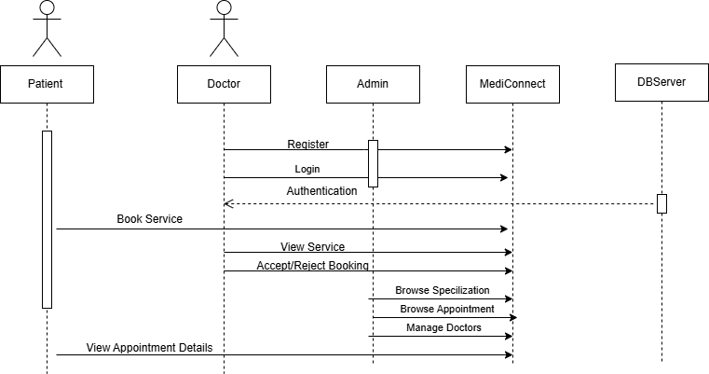
SEQUENCE DIAGRAM

Slide 11
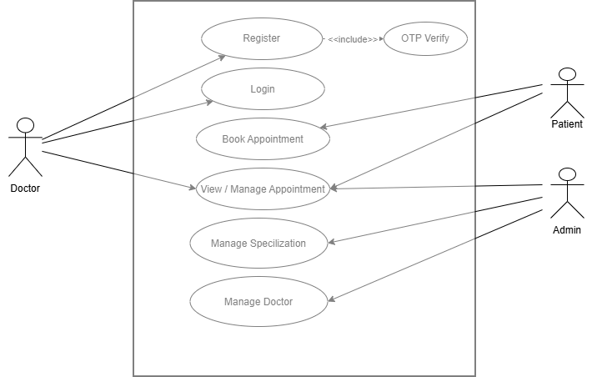
USECASE DIAGRAM

Slide 12
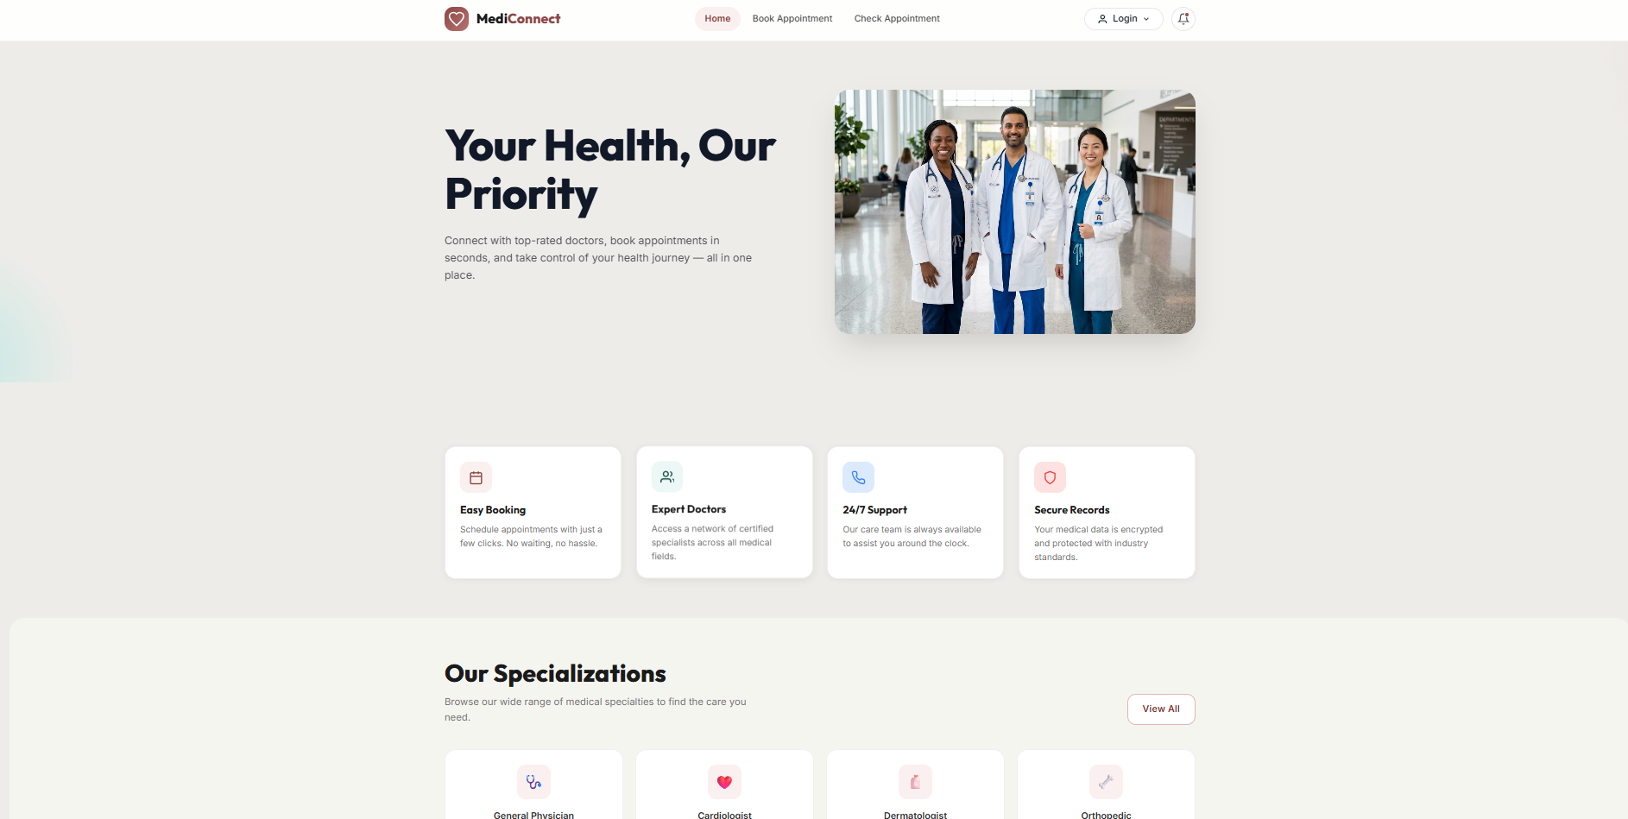
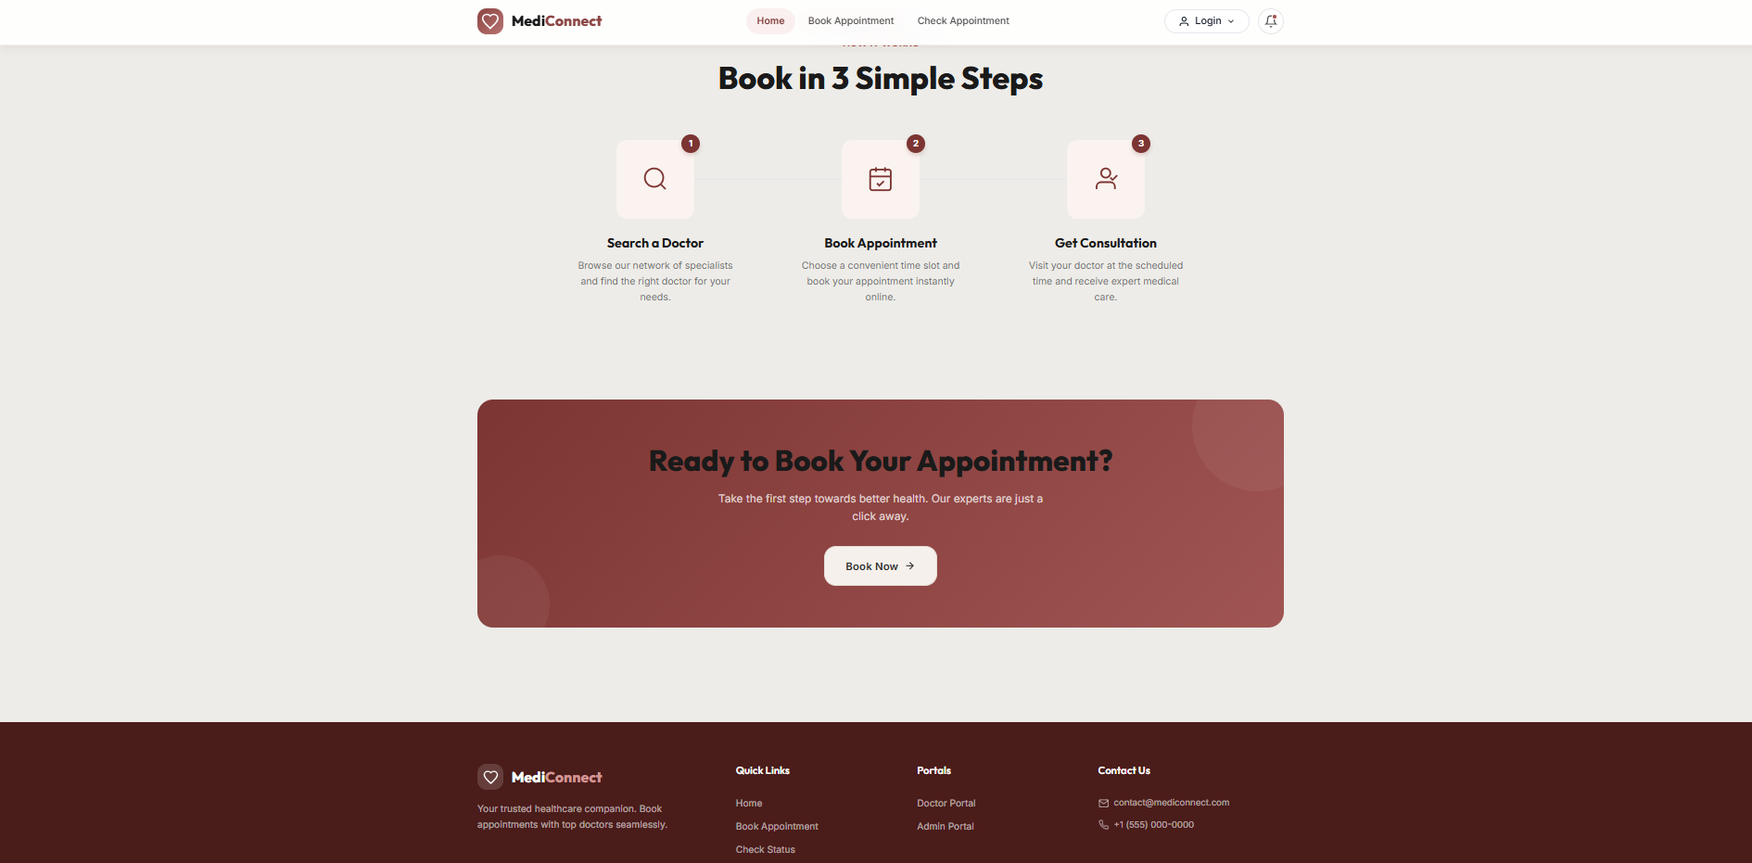
HoME pAGE

Slide 13
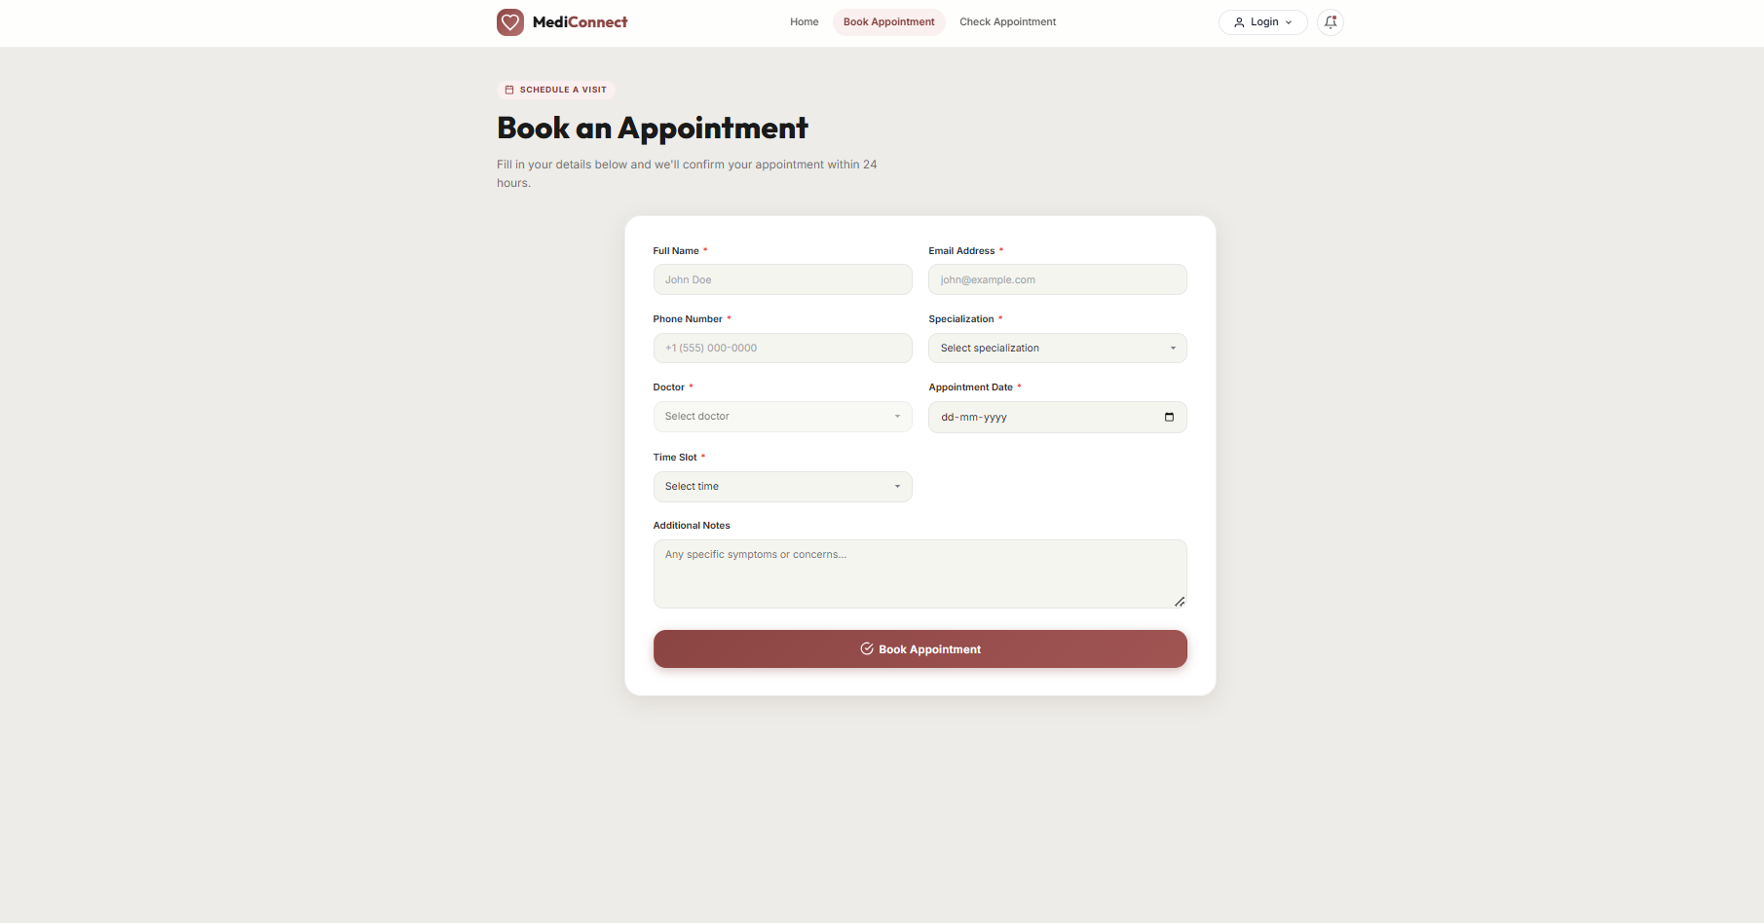
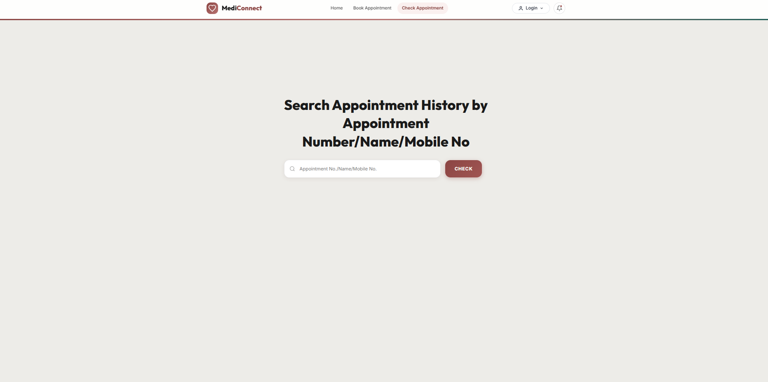
BOOK/CHECK APPOINTMENT PAGE

Slide 14
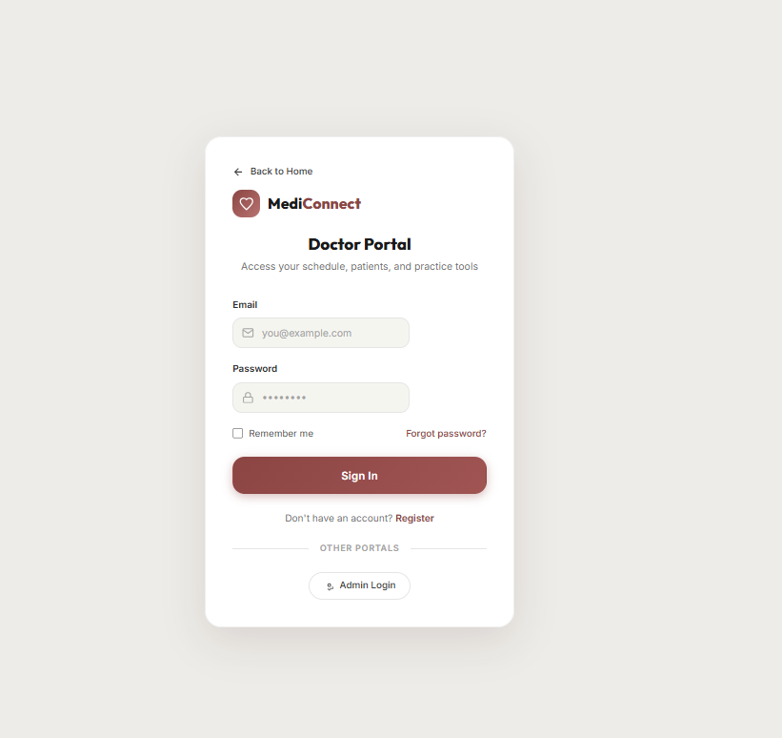
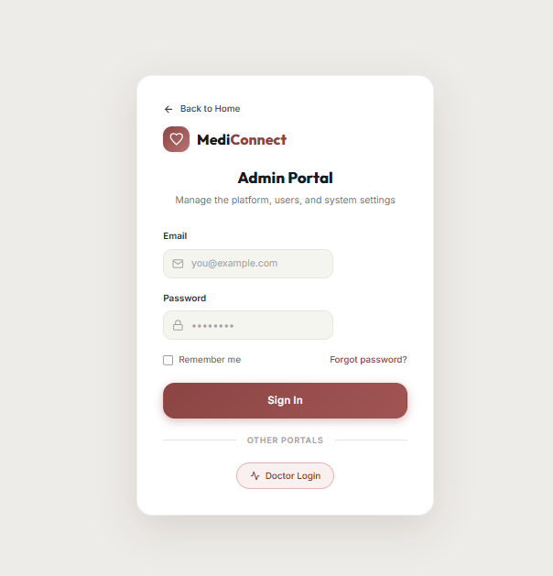
DOCTOR / ADMIN LOGIN PAGE

Slide 15
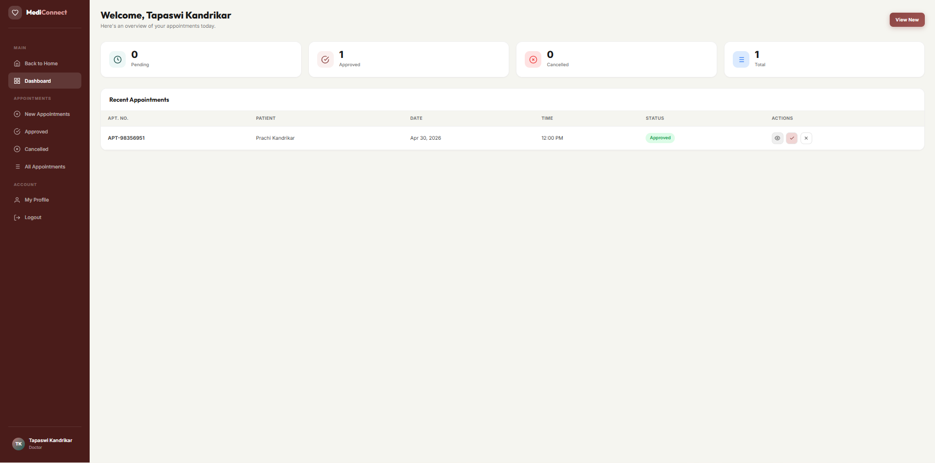
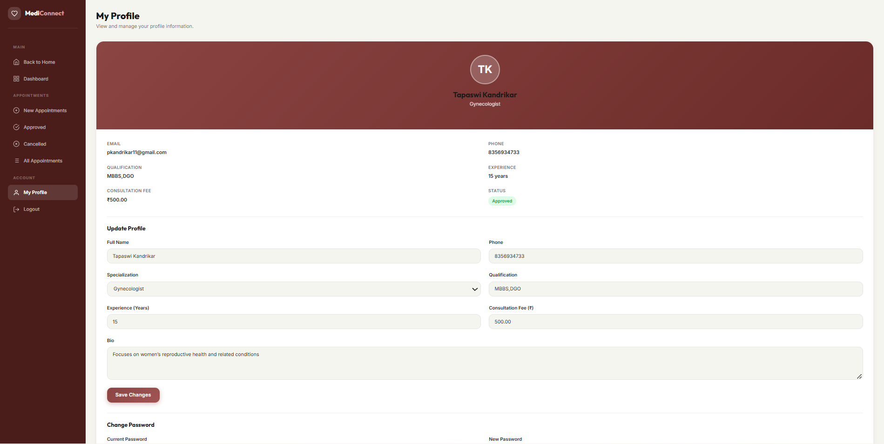
Doctor dashboard

Slide 16
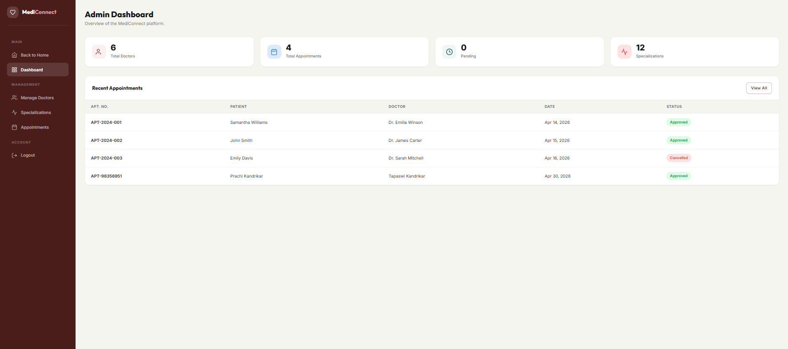
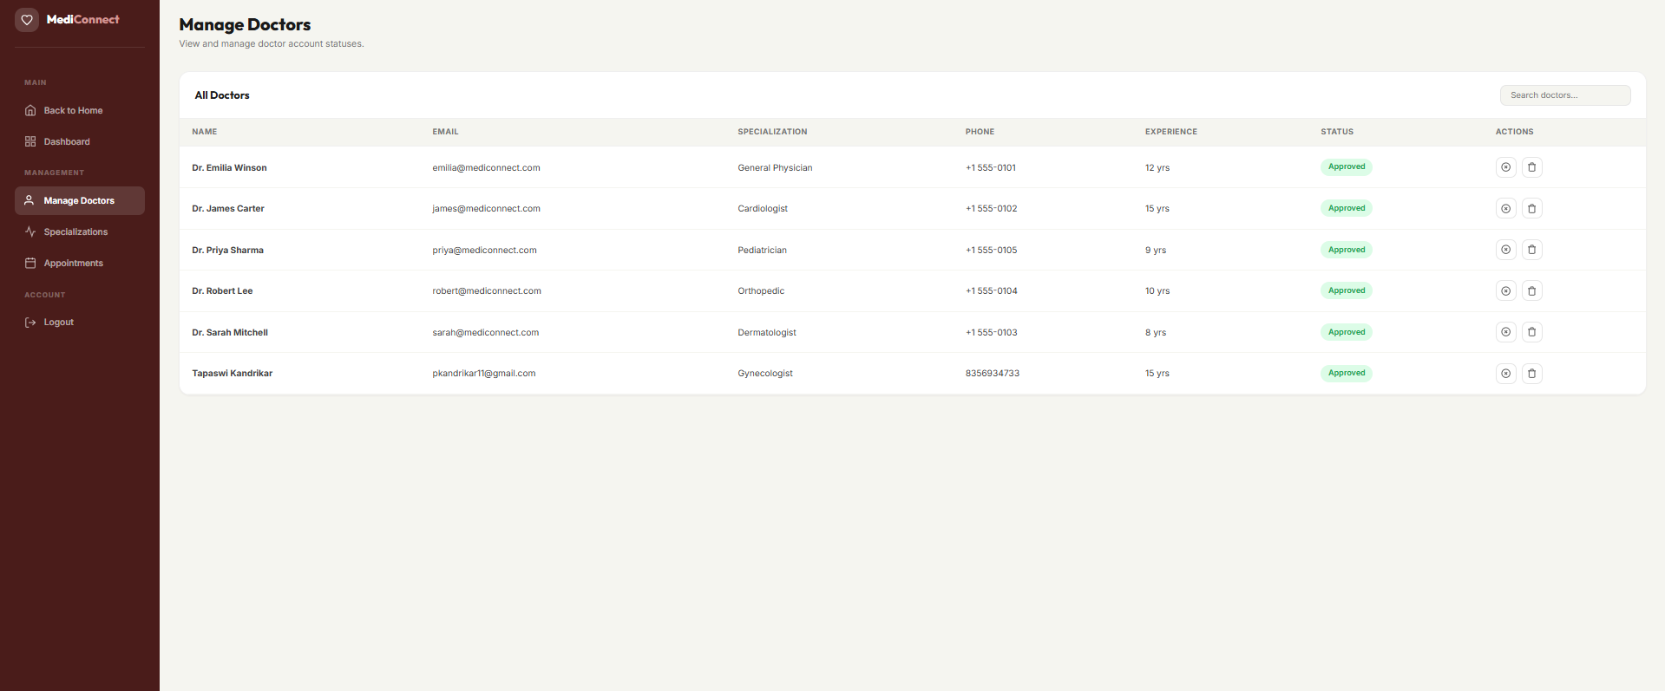
admin dashboard

Slide 17
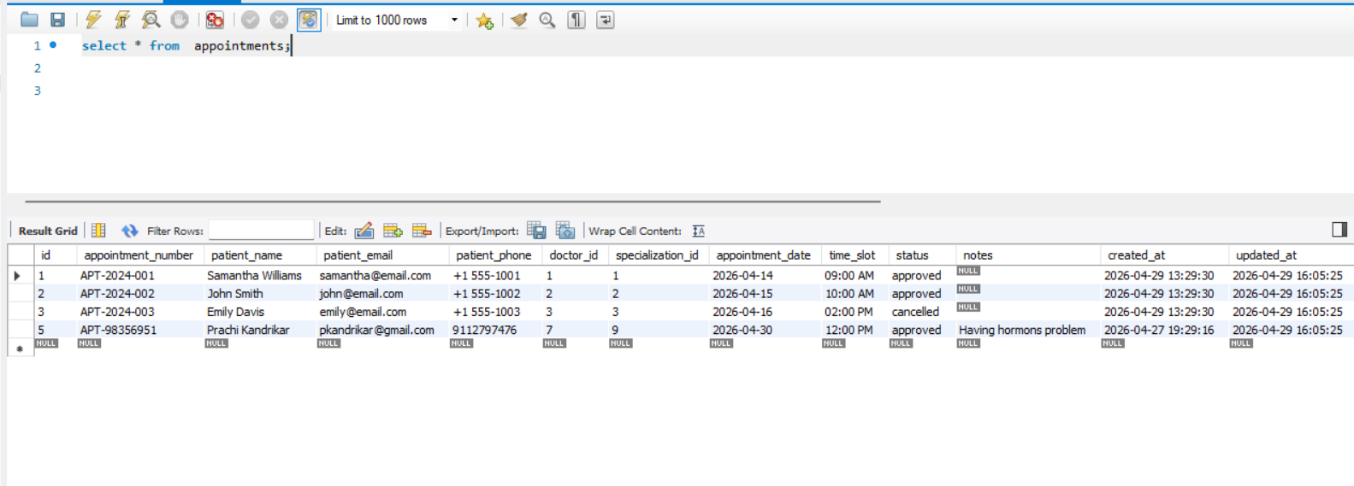
Appointment table

Slide 18
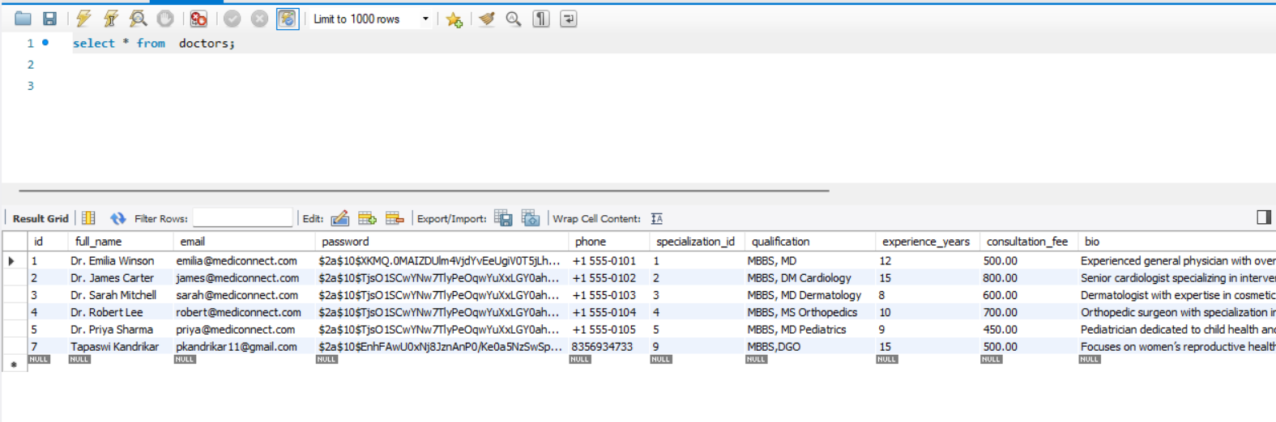
Doctor table

Slide 19
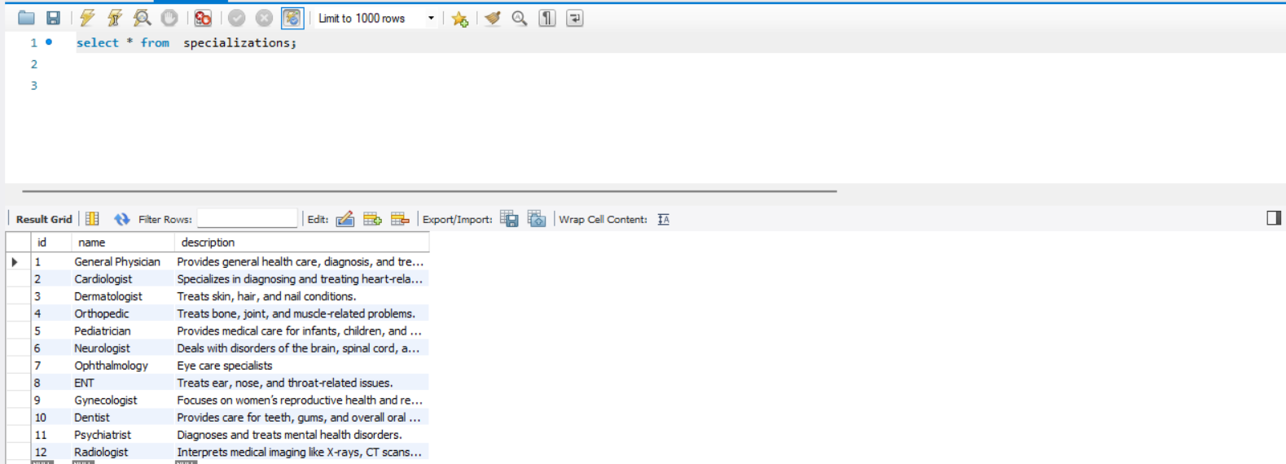
specialization table

Slide 20
THANK YOU
19

