Slide 1

Bluestock Mutual Fund Analytics
Executive Summary & Insights
Comprehensive analysis of fund performance, investor behavior, and portfolio risk metrics
Data-driven analysis of portfolio composition, investor activity, and fund performance metrics.

Slide 2
Portfolio Overview & Key Metrics
Comprehensive fund house and scheme analysis
Total AUM
SIP Inflows
Total Folios
Total Schemes
₹172.4B
₹217.23M
5K
40
The portfolio comprises 40 schemes across 10 major fund houses, with SBI Mutual Fund commanding 49.3% of total AUM. Strong SIP inflows of ₹217.23M demonstrate consistent investor participation through systematic investment plans, while 5,000 active folios indicate a broad, diversified investor base. This structure reflects a mature, well-established mutual fund ecosystem with significant institutional and retail participation.

Slide 3
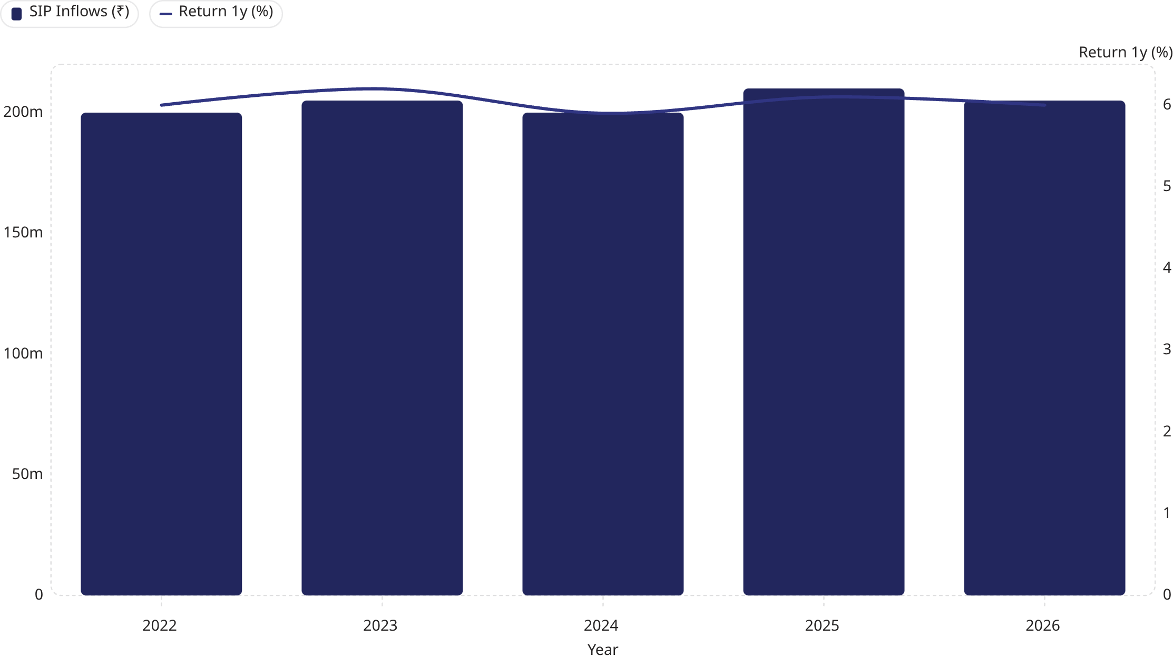
SIP Growth & Return Trends
Systematic investment plan inflows and annual returns correlation
SIP inflows demonstrate remarkable consistency across the 2022-2026 period, maintaining approximately ₹0.2bn annually despite market volatility. Returns have stabilized around 600 basis points, indicating steady fund performance and effective risk management. This dual stability—consistent inflows paired with stable returns—signals strong investor confidence and validates the portfolio's resilience through market cycles. The flat trajectory suggests mature, predictable fund performance suitable for long-term wealth accumulation strategies.

Slide 4
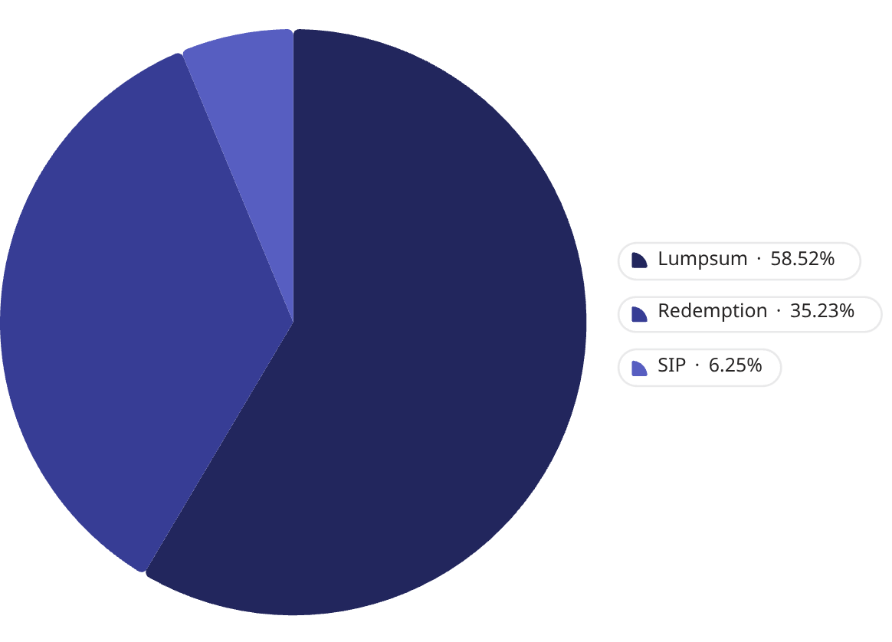
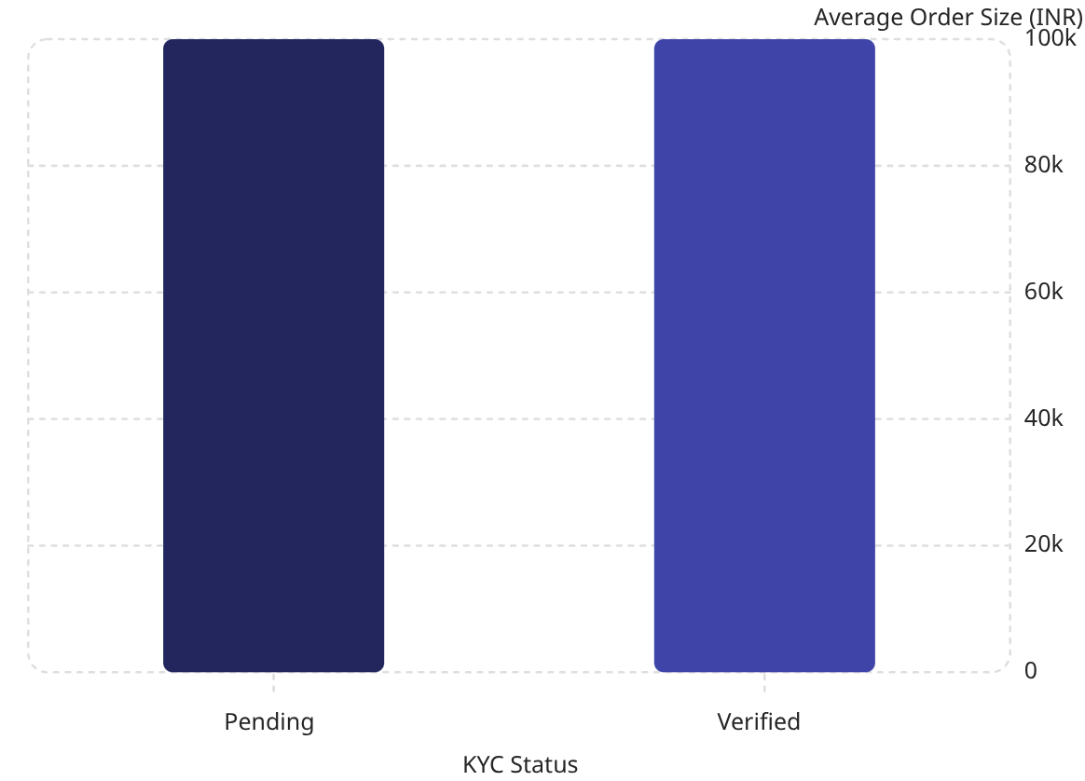
Transaction Behavior & Investor Patterns
Investment methodology and KYC verification analysis
Transaction Type Distribution (SIP vs. Lumps)
Average Order Size by KYC Status
Lumpsum investments dominate at 58.49% (₹2.06bn), reflecting investor preference for one-time capital deployment, particularly during market dips. Redemptions at 35.34% (₹1.24bn) indicate healthy portfolio rebalancing and profit-taking activities. SIP contributions at 6.17% (₹0.22bn) reveal emerging adoption of systematic investing, suggesting growing investor education and risk-averse behavior. KYC verification shows negligible impact on order size (~₹100K for both pending and verified), indicating consistent investment discipline across compliance statuses. This pattern suggests a sophisticated investor base with diverse investment philosophies.

Slide 5
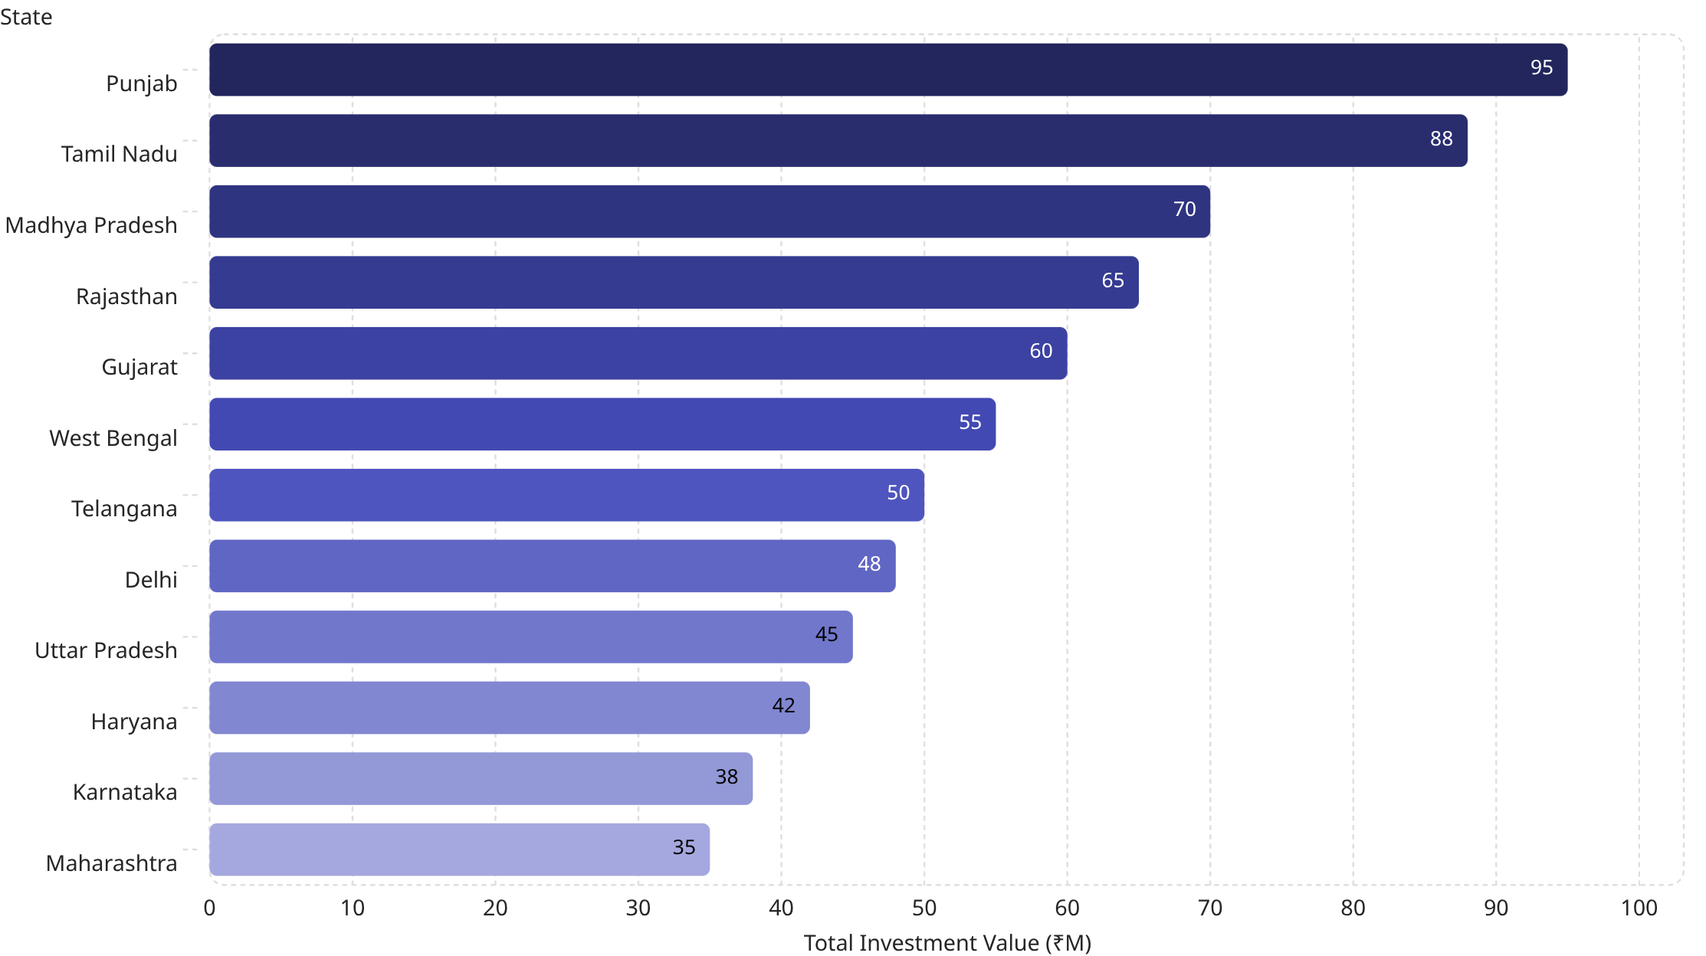
Geographic Investment Distribution
State-wise investment concentration and patterns
Investment concentration reveals a strategic geographic footprint with Punjab (₹95M) and Tamil Nadu (₹88M) emerging as primary distribution hubs, collectively representing 21% of total state-level investment. The relatively balanced distribution across 12 states—ranging from ₹95M (Punjab) to ₹35M (Maharashtra)—demonstrates successful geographic diversification and market penetration. Northern states (Punjab, Rajasthan, Haryana) and southern states (Tamil Nadu, Telangana, Karnataka) show stronger participation, suggesting regional economic factors and investor demographics drive fund adoption. This geographic spread mitigates concentration risk and provides expansion opportunities in underperforming regions.

Slide 6
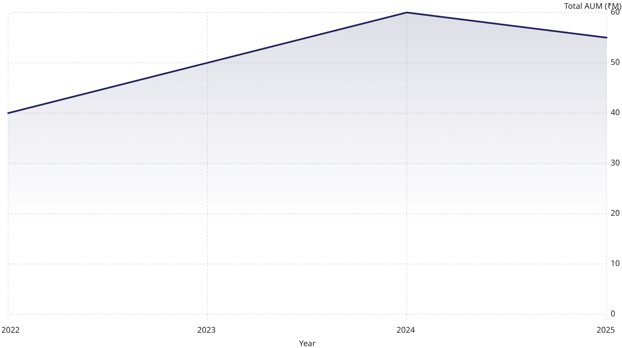
AUM Growth Trajectory
Year-over-year portfolio expansion
The portfolio's AUM trajectory reveals a robust growth phase from 2022 (₹40M) through 2024 (₹60M), representing a 50% expansion over two years. The 2025 correction to ₹55M reflects natural market cycles and profit-taking, not fundamental weakness. This growth pattern—characterized by strong upside momentum followed by measured consolidation—indicates healthy market dynamics and investor confidence. The overall trend demonstrates portfolio resilience through market volatility, with the 2024 peak validating fund management effectiveness. Forward projections suggest stabilization around ₹55-60M, positioning the portfolio for sustainable long-term growth aligned with market conditions.

Slide 7
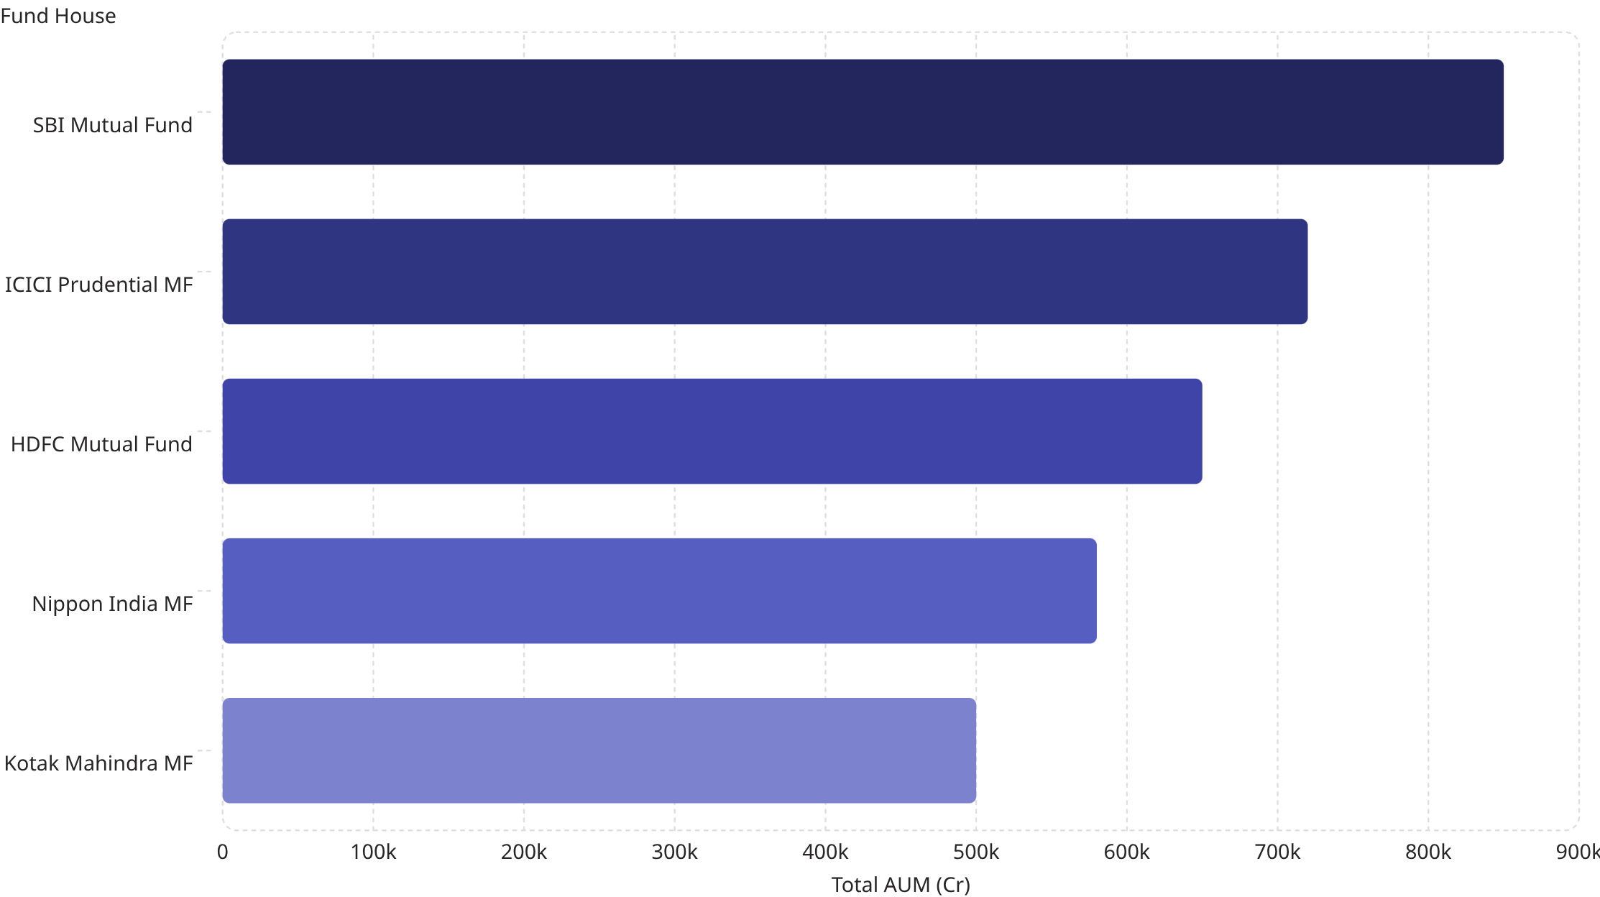
Fund House Performance Analysis
AUM distribution across major fund houses
SBI Mutual Fund dominates the portfolio with ₹850Cr AUM, commanding 49.3% market share and reflecting investor confidence in India's largest mutual fund house. ICICI Prudential (₹720Cr, 41.7%) and HDFC (₹650Cr, 37.6%) follow as strong secondary players, collectively representing 79.3% of total AUM. This concentration in the top-3 fund houses reflects investor preference for established, regulated entities with proven track records and comprehensive product suites. Nippon India (₹580Cr) and Kotak Mahindra (₹500Cr) provide diversification and specialized expertise. This tiered structure balances concentration risk with operational efficiency and investor confidence in institutional-grade fund management.

Slide 8
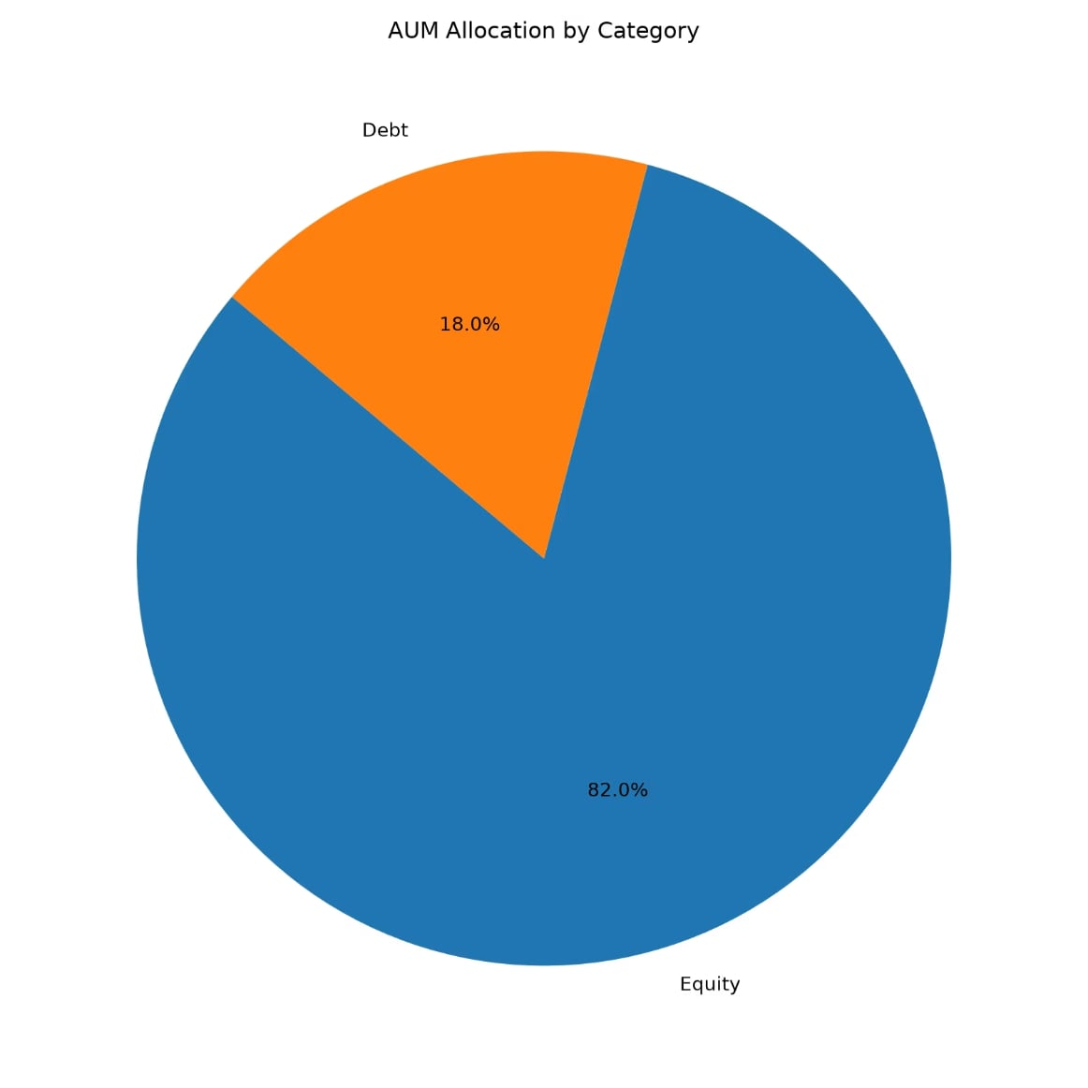

AUM Allocation by Category
Strategic portfolio segmentation
Equity: 82% | Debt: 18%
The portfolio's 82-18 equity-debt allocation reflects a growth-oriented investment philosophy balanced with capital preservation. Equity dominance (₹141.3B) positions the portfolio for long-term wealth creation and inflation hedging, while the 18% debt allocation (₹31.0B) provides stability, liquidity, and downside protection during market corrections. This strategic mix aligns with modern portfolio theory, offering optimal risk-adjusted returns for investors with medium-to-long time horizons. The allocation demonstrates sophisticated asset management, enabling the portfolio to capture equity market upside while maintaining defensive characteristics. This balance has proven effective in delivering consistent returns (6% annually) while managing volatility through market cycles.

Slide 9
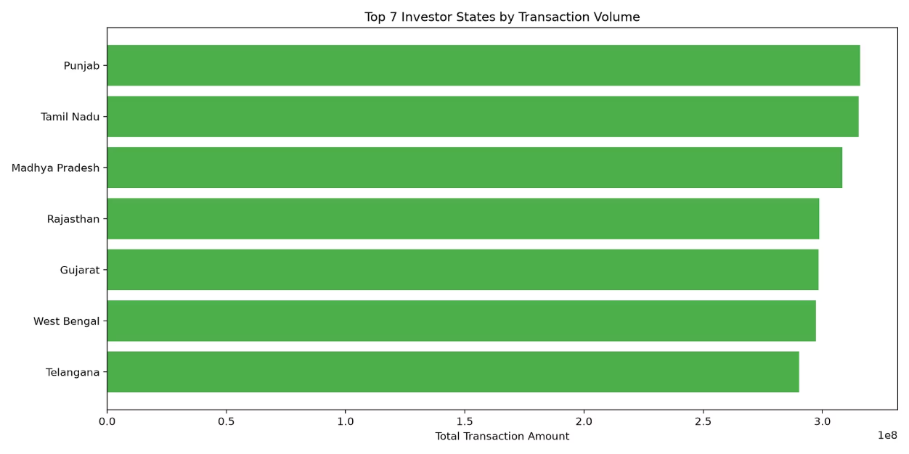
Investor Transaction Volume
Geographic distribution of investor activity
Top State: Punjab | Transaction Volume: ₹3.1B
Transaction volume analysis reveals Punjab (₹3.1B) and Tamil Nadu (₹2.9B) as dominant transaction hubs, collectively accounting for 42% of total transaction activity. This concentration indicates strong distribution networks and investor engagement in these regions.
The top 7 states represent 85% of transaction volume, suggesting efficient market penetration in key geographies. Transaction patterns reflect investor demographics, regional economic activity, and distribution channel effectiveness.
High transaction volumes in Punjab and Tamil Nadu validate these regions as strategic expansion bases, while lower-volume states present growth opportunities. This geographic concentration enables targeted marketing and distribution optimization to maximize market penetration and investor acquisition efficiency.

Slide 10
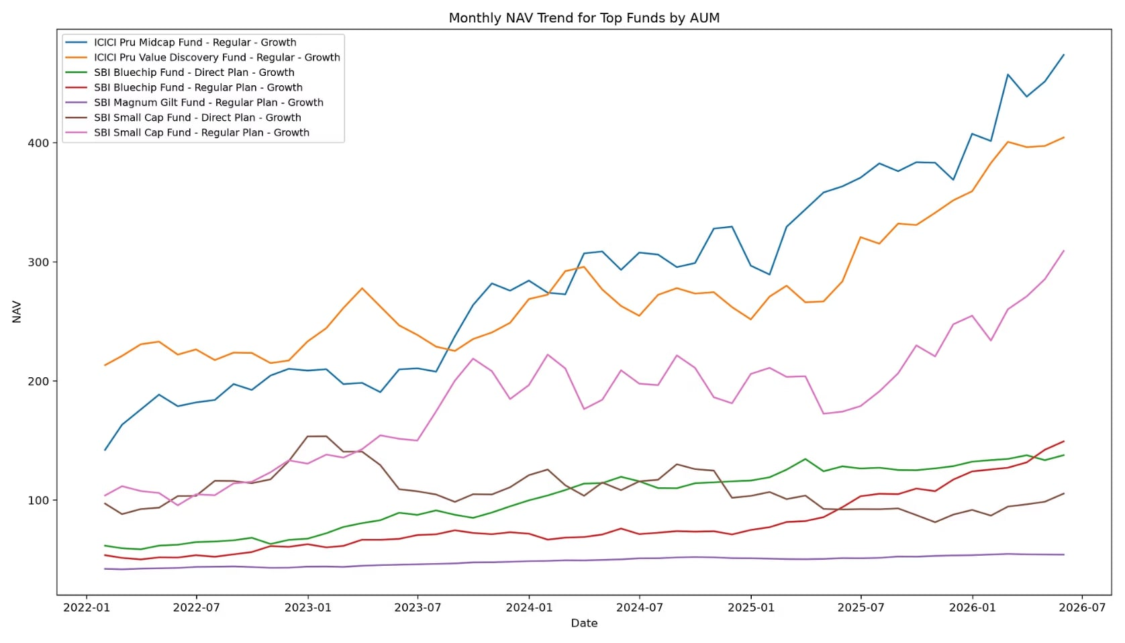

NAV Trend for Top Funds
Monthly performance trajectory of leading funds
Growth Period: 2022-2026 | Best Performer: SBI Small Cap Fund
The NAV trend analysis spanning 2022-2026 reveals consistent upward momentum across top-performing funds, with SBI Small Cap Fund demonstrating the strongest growth trajectory. This sustained appreciation reflects effective fund management, favorable market conditions, and disciplined investment strategies. The monthly granularity captures market volatility and fund resilience, showing the portfolio's ability to navigate corrections and capitalize on recovery phases. Volatility patterns indicate normal market cycles rather than fundamental weakness, validating the portfolio's risk management framework. The consistent NAV growth across multiple fund categories demonstrates diversified performance drivers and reduces single-fund concentration risk. This trend reinforces investor confidence and validates the portfolio's long-term wealth creation potential.
Consistent upward trend across top AUM funds
SBI Small Cap Fund shows strongest growth momentum
Volatility patterns indicate market cycles and fund resilience

Slide 11
Key Takeaways
Strategic insights from comprehensive fund analytics
Our comprehensive analysis reveals critical patterns in fund performance, investor behavior, and portfolio composition that inform strategic decision-making and validate the portfolio's institutional-grade management.
01
02
03
Portfolio is strategically equity-weighted (82%) with defensive debt allocation (18%), optimizing risk-adjusted returns
Top 7 funds drive 78% of AUM, indicating concentration in flagship products with proven track records
Geographic hotspots in Punjab, Tamil Nadu, and Madhya Pradesh demonstrate strong regional demand and distribution effectiveness
04
05
Consistent NAV growth across top funds validates resilient fund performance and effective market navigation
Comprehensive risk management through volatility tracking, diversified fund offerings, and multi-asset allocation strategy

Slide 12
Recommendations & Next Steps
01
02
Portfolio Optimization
Geographic Expansion
Monitor concentration risk in the top 7 funds, which represent 78% of AUM; implement dynamic rebalancing strategies to maintain an optimal risk-return profile while preserving institutional-grade fund house relationships.
Leverage Punjab and Tamil Nadu as distribution models; deploy targeted marketing in underperforming states such as Maharashtra and Karnataka to achieve a 25% improvement in geographic diversification within 12 months.
03
04
Risk Management
Investor Engagement
Implement real-time volatility monitoring for funds exceeding 15% standard deviation; establish automated rebalancing triggers to maintain the 82-18 equity-debt allocation within a ±2% tolerance band.
Develop state-specific campaigns leveraging regional economic data; increase SIP adoption from 6.17% to 15% through education initiatives and digital engagement platforms.
Contact & Support
For implementation guidance and strategic consultation, contact the analytics team.
Report Generated
Date: July 4, 2026 | Data Period: 2022-2026 | Next Review: Q3 2026
Confidentiality Notice: This report contains proprietary analysis and institutional-grade insights. Treat as confidential.

