Slide 1
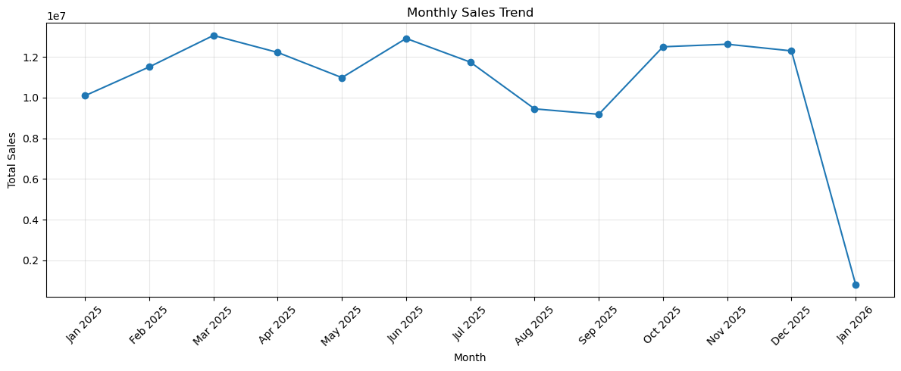
Sales Dashboard Analysis

Slide 2
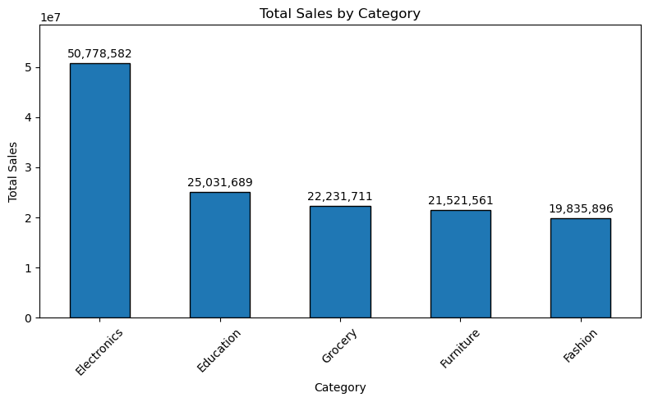
Total Sales By Category using Bar_Chart

Slide 3
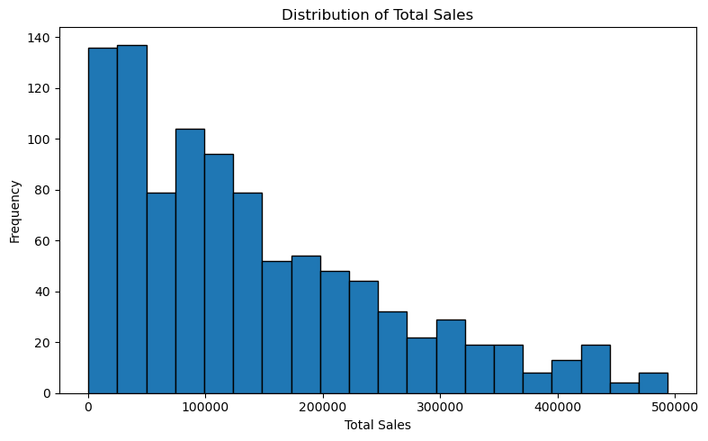
Distribution of Total Sales using Histogram

Slide 4
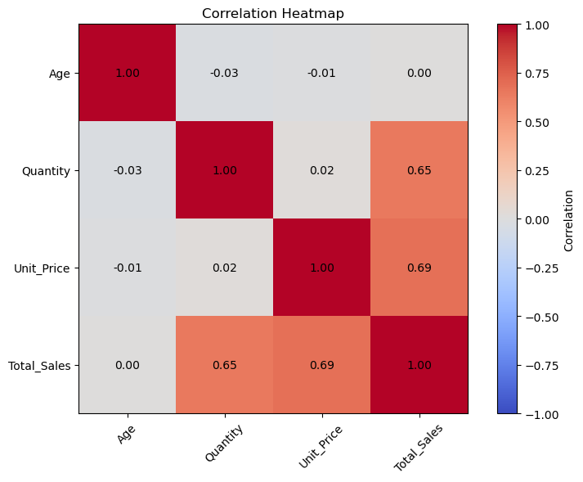
Correlation using Heatmap

