Slide 1
APPIUM MOBILE TESTING
ROHIT JACHAK
SHIVALI SINGHAL

Slide 2
Introduction to APPIUM
Appium is an http server written using node.js and drives ios and android session using webdriver JSON wire protocol.
When Appium is downloaded and installed, then a server is setup on our machine that exposes a REST API.
It receives connection and command request from the client and execute that command on mobile devices (Android / iOS).
It responds back with HTTP responses. Framework such as:
Apple Instruments for iOS , Google UIAutomator for Android API level 16 or higher

Slide 3
Why Appium?
Provides open source, cross-platform solution for native and hybrid mobile automation i.e. Android and iOS.
Allows you to communicate with other Android apps not only app under the test. For example, you can start another app from app under the test (for example, Camera app).
It is build on idea that testing native app don’t require sdk or recompiling app and use test practices, framework and your own tools.

Slide 4
Continued..
It is “black box”. You can test not only app developed by yourself but any *.apk installed on your phone or emulator. Internal implementation of the app is not limitation for testing (except some rules related to UI definition like defining content-description text).
You can write tests with your favorite development tools using any WebDriver compatible language such as Java, Objective-C, JavaScript with node.js, PHP, Ruby, Python, C#… All you need are Selenium WebDriver and language specific libraries.

Slide 5
DIFFERENCE BETWEEN SELENDROID AND APPIUM
features | selendroid | Appium
Supported platforms | Android, IOS | Ios, android, firefox os
Mobile App Support | Native hybrid mobile web & web | Native, hybrid, mobile web & web
Cross platform | x | yes
User agent testing | x | yes
emulator | yes | yes
Real device | yes | yes
Selenium grid support | yes | yes
System requirement | Tested to run on mac,linux windows Java sdk(min 1.6) is installed and JAVA_HOME is configured Latest android sdk is installed and ANDROID_HOME is installed | Android Mac os x 10.7+ or windows 7+ or linux androidsdk >16 sdk<16 in selenium mode IOS MAC OSX 10.7+ XCODE 4.5+ w/command Line tools

Slide 6
SIMULATOR/EMULATOR | REAL DEVICE
specific situations where the deadline to produce text execution results are short and purchasing the required mobile devices may be not possible. | The real device allows the testers to test almost all the real time scenarios which can be tested for the mobile applications.
The wide gamut of mobile devices creates the problems, whereby the testers are not confident about which mobile devices to invest in for testing, considering the budget constraints. Emulator/simulator (s) is tailor made for this type of situation(s). | The real device allows the testers to test even usability issues like the look and feel of the application, color resolution of the screen
Emulator/simulator(s) are in most cases open and free software which can be very easily downloaded from Internet and ready to be tested for. | The real devices allow stringent performance testing issues like working with a real time transport application for 15 hours continuously
The emulator/simulators are not able to simulate the battery issues. | Real world devices can easily perform the same.
It is easier to do web application testing when it comes to opening the web application. | Testing on real devices provides more in terms of reliability.

Slide 7
Step by step demonstration
Install Android SDK in your system.
(guru99.com)
Go to Control panel and set environment variables
Start your Android emulator or attach any Android device to your system

Slide 8
Environment variables (in system variables)
ANDROID_HOME : C:\Program Files\android-sdk-windows\
JAVA_HOME : C:\Program Files\Java\jdk1.8.0_45
PATH : C:\Program Files\android-sdk-windows\tools; C:\Program Files\android-sdk-windows\platform-tools;%SystemRoot%\system32\; C:\Program Files\Java\jdk1.8.0_45\bin

Slide 9
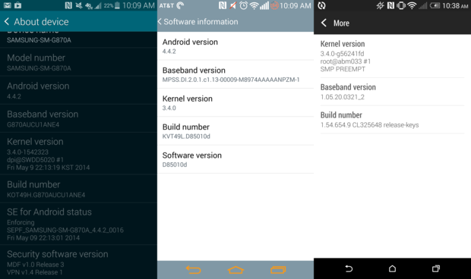
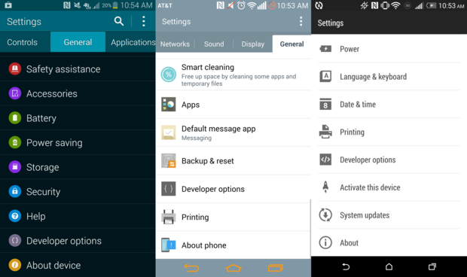
Android mobile device setup

Slide 10
Continued...
Open Command Prompt and navigate to your Android SDK's \platform-tools\ directory .
Run 'adb devices' command. You can see your connected device listed in Command Prompt window
Run 'adb start-server' command. It will start ADB server that will be used by Appium to send commands to your Android device.

Slide 11
Continued..
Now, navigate to Appium directory in your system and start Appium by clicking Appium.exe file.
Do not alter the IP address or port number and click 'Launch' button. Your Appium console start at 127.0.0.1:4723

Slide 12
Libraries to be added
1. Testng : TestNG is a testing framework designed to simplify a broad range of testing needs, from unit testing to integration testing
- http://testng.org/doc/download.html
- For Eclipse 3.4 and above, enter http://beust.com/eclipse.
- Go to eclipse. click on help->install new software->add the above link and click on install.
2. Selenium web driver standalone 2.42.2
3. Java client 2.1.0

Slide 13
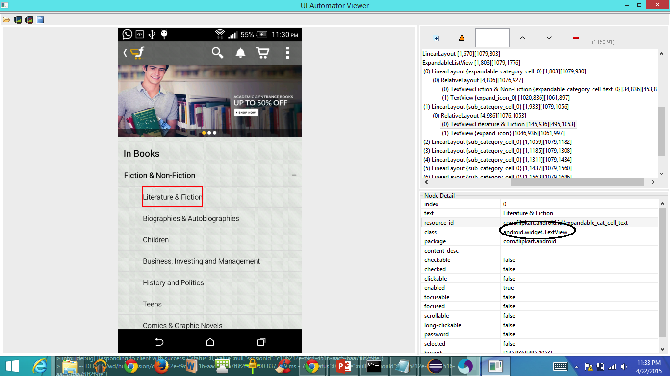
UI Automator to detect element on mobile device

Slide 14
Limitations using APPIUM
Appium does not support testing of Android Version lower than 4.2
Limited support for hybrid app testing. eg: not possible to test the switching action of application from the web app to native and vice-versa.
There is no support to run Appium Inspector on Microsoft Windows

Slide 15
Websites Used
Appium.io
Guru99
Developer.android.com
evideotution
Apk info(from Play Store).

Slide 16
THANK YOU !!

Slide 17
Any questions
???

