Slide 1
B-Trees
B-tree is a perfectly balanced m-way search tree with the following additional properties:
The root is not a leaf : It has 2 . . . m subtrees.
All internal nodes have at least (Ceiling |m/2|) non-null subtrees and at most m non-null subtrees.
All leaf nodes are at the same level; that is the tree is perfectly balanced.
A leaf node has at least (Ceiling |m/2|-1) and at the most m-1 entries.
The following table defines the number of subtrees for non-root nodes:
Order
Number of Subtrees
Minimum
Maximum
3
2
3
4
2
4
5
3
5
6
3
6
...
...
...
m
Ceiling |m/2|
m

Slide 2
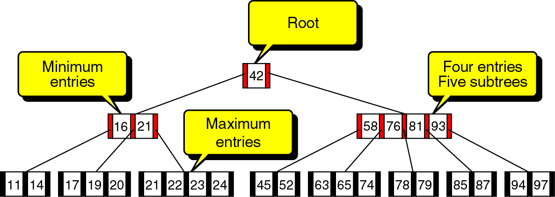
B-Trees
A B-tree of order; m=5.
Min entry : Ceiling|5/2| - 1 = 2 entries.
Max entry: 5 – 1 = 4 entries.
Min subtrees : Ceiling|5/2|=3
Max subtrees: 5
Figure 10-4

Slide 3
B-Tree Operations
There are four basic operations:
Insert
Delete
Traverse
Search

Slide 4
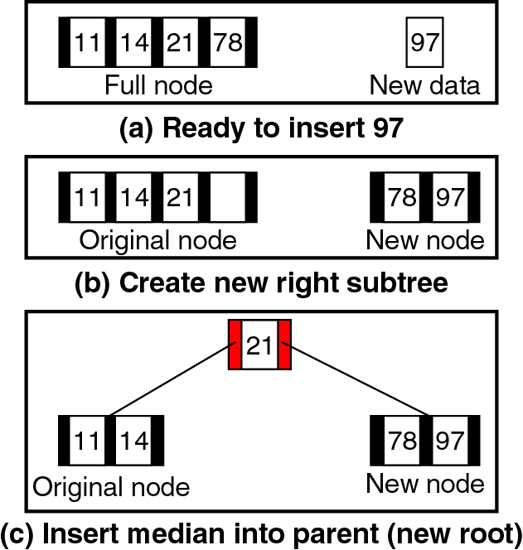
B-Tree Insertion
m=5
B-tree grows from the bottom up.
When the node is full, this condition is called as overflow.
Overflow requires that the node be split into two nodes and median entry is pushed up, the tree grows one level.
Figure 10-5

Slide 5
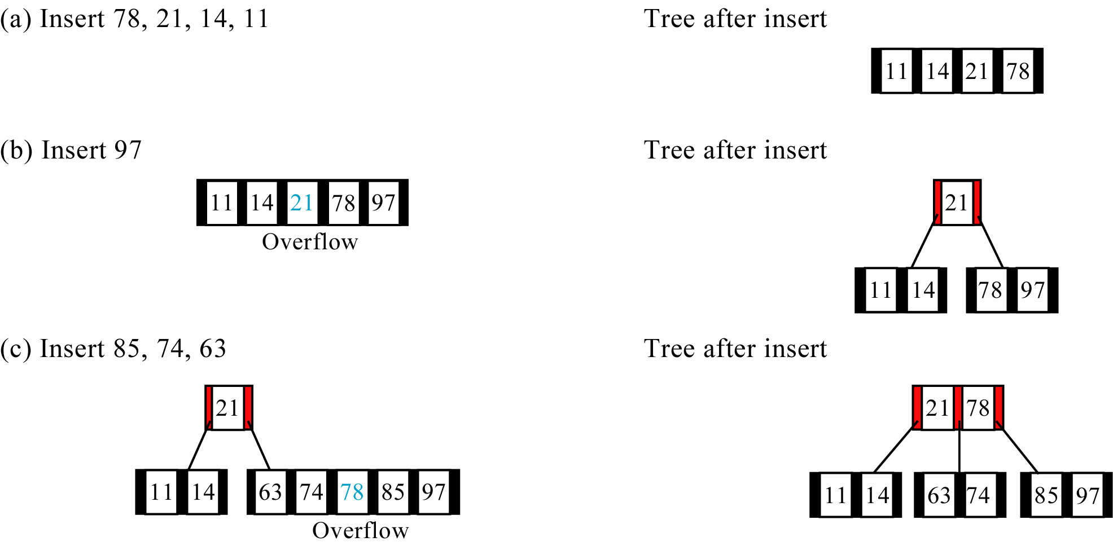
B-Tree Insertion
Figure 10-9 (a, b, and c)‏

Slide 6
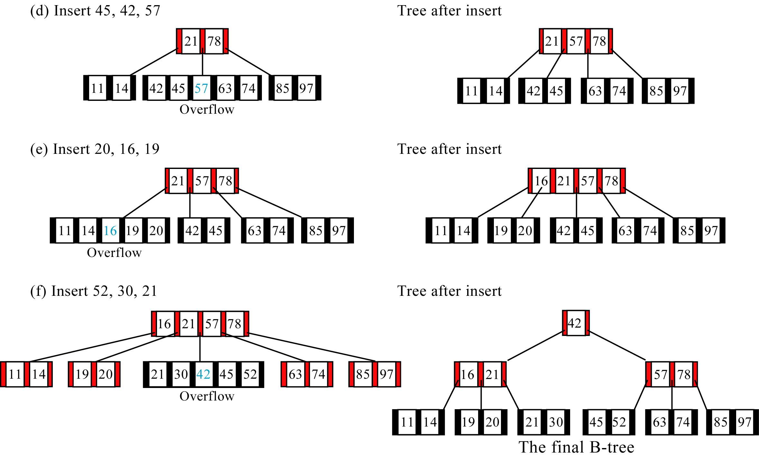
Figure 10-9 (d, e, and f)‏

Slide 7
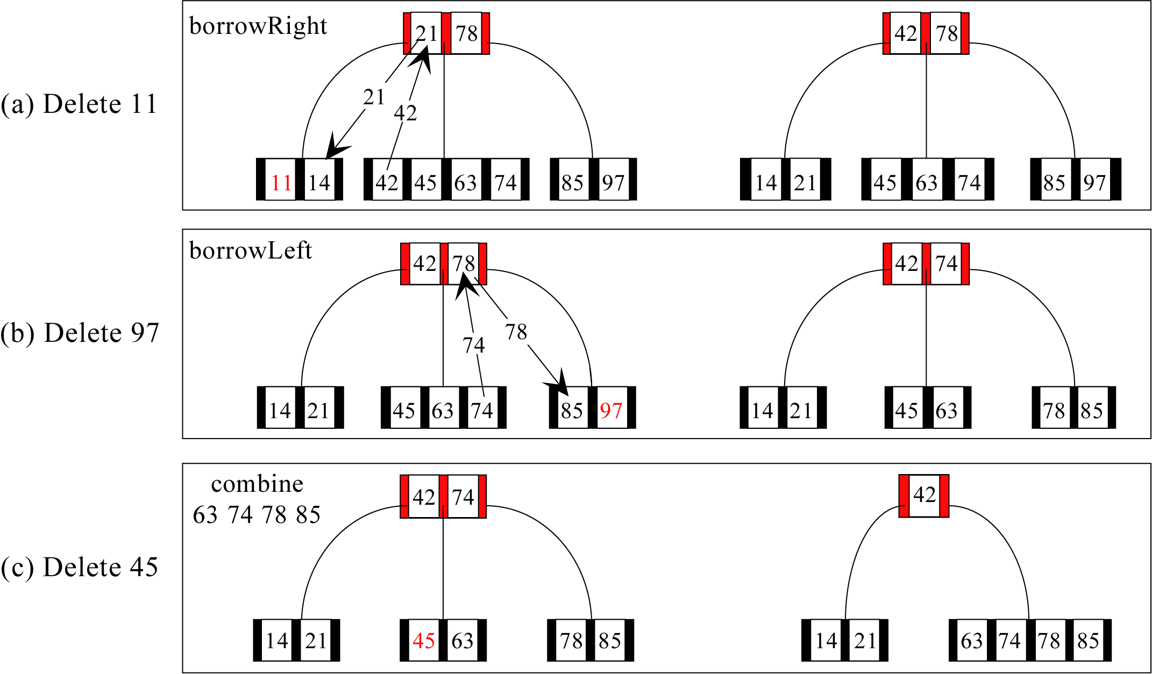
B-Tree Deletion
Figure 10-14 (a, b, and c)‏

Slide 8
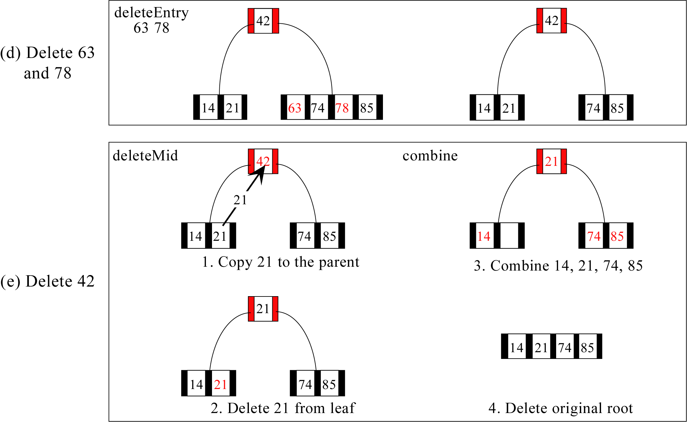
Figure 10-14 (d and e)‏

Slide 9
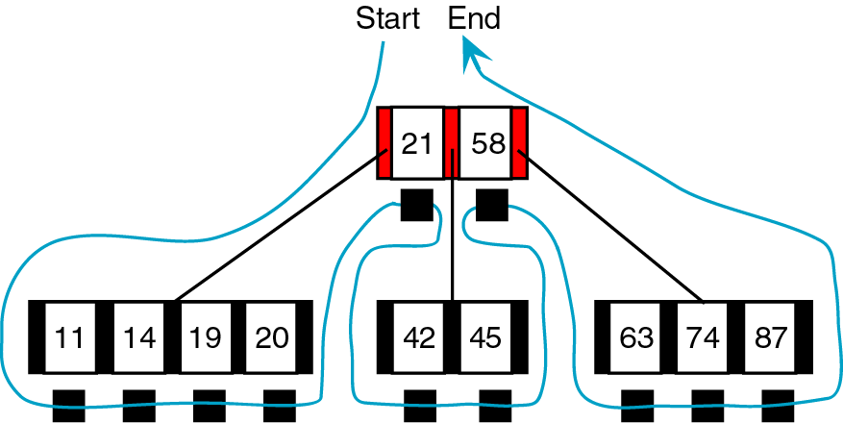
B-Tree Traversal
Figure 10-15

Slide 10
Exercise
Draw the B-tree of order 3 created by inserting the following data arriving sequence:
92 24 6 7 11 8 22 4 5 16 19 20 78

