Slide 1
Motivation for Splay Trees
Problems with AVL Trees
extra storage/complexity for height fields
ugly delete code
Solution: splay trees
blind adjusting version of AVL trees
amortized time for all operations is O(log n)
worst case time is O(n)
insert/find always rotates node to the root!

Slide 2
In a splay tree, splaying an element rearranges all the elements in the tree so that splayed element is placed at the root of the tree.
For example, the insertion operation first inserts the new element using the binary search tree insertion process, then the newly inserted element is splayed so that it is placed at the root of the tree.
The search operation in a splay tree is nothing but searching the element using binary search process and then splaying that searched element so that it is placed at the root of the tree.

Slide 3
Rotations in Splay Tree
1. Zig Rotation
2. Zag Rotation
3. Zig - Zig Rotation
4. Zag - Zag Rotation
5. Zig - Zag Rotation
6. Zag - Zig Rotation

Slide 4
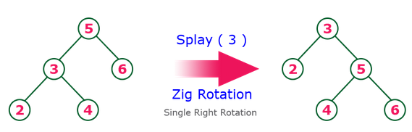
Zig Rotation
The Zig Rotation in splay tree is similar to the single right rotation in AVL Tree rotations. In zig rotation, every node moves one position to the right from its current position. Consider the following example...

Slide 5
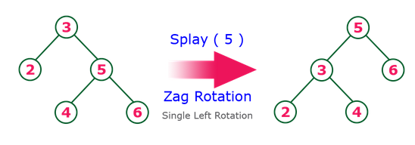
Zag Rotation
The Zag Rotation in splay tree is similar to the single left rotation in AVL Tree rotations. In zag rotation, every node moves one position to the left from its current position. Consider the following example...

Slide 6
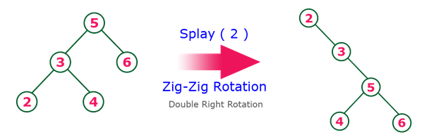
Zig-Zig Rotation
The Zig-Zig Rotation in splay tree is a double zig rotation. In zig-zig rotation, every node moves two positions to the right from its current position. Consider the following example...

Slide 7
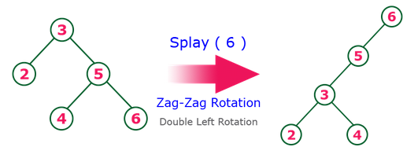
Zag-Zag Rotation
The Zag-Zag Rotation in splay tree is a double zag rotation. In zag-zag rotation, every node moves two positions to the left from its current position. Consider the following example...

Slide 8
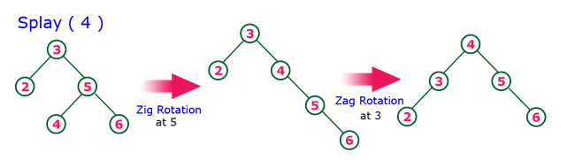
Zig-Zag Rotation
The Zig-Zag Rotation in splay tree is a sequence of zig rotation followed by zag rotation. In zig-zag rotation, every node moves one position to the right followed by one position to the left from its current position. Consider the following example...

Slide 9
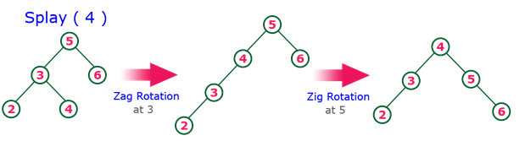
Zag-Zig Rotation
The Zag-Zig Rotation in splay tree is a sequence of zag rotation followed by zig rotation. In zag-zig rotation, every node moves one position to the left followed by one position to the right from its current position. Consider the following example...

Slide 10
Construct the Splay tree for the following data by inserting each of the following data item one at a time : 10, 20, 15, 12, 25, 30, 14, 22.

Slide 11


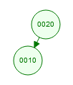
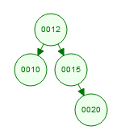
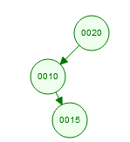
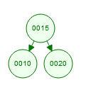
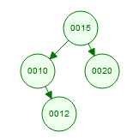
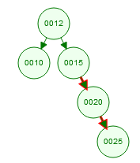
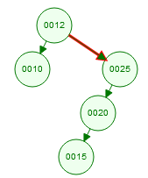
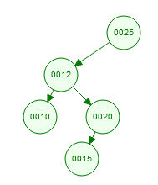
Insert 10 | Insert 20
Insert 15 | Insert 12
insert 25

Slide 12
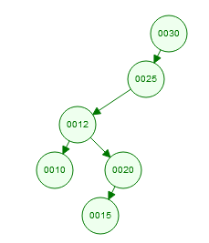
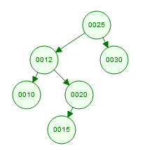
Insert 30

Slide 13
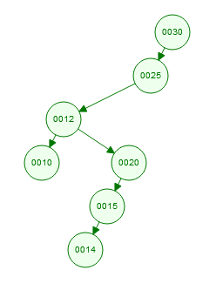
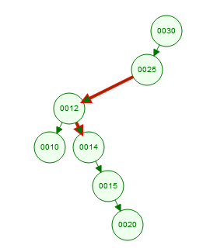
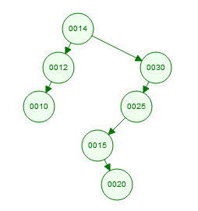
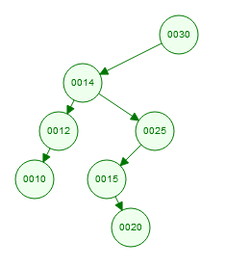

Slide 14
