Slide 1

Book Recommendation System
Presented By :-
Rohit Tiwari (2100520109002)
Shivam Pandey (2000520100061)
Samarth Gautam (2000520100050)

Slide 2
Agenda
Introduction
Related work
Literature Review
Proposed System
Conclusion
Book recommendation System

Slide 3
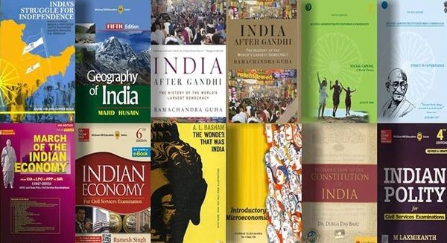
Introduction
In the current era there are many libraries and book selling website present on the internet with many of them having their own recommendation system to recommend books to the buyers. And lots of information and recommendations are pushed to buyers, with most of them not relevant to the user. In this project we are trying to present a new approach of recommending books to the user. We have combined the features of Content filtering and Collaborative filtering produce efficient and effective recommendations

Slide 4
Problem Statement
To develop an algorithm for providing similar type of book by using content and collaborative filtering using Machine Learning Algorithms.
Aim and Objective
Research on how to make an effective recommendation
Research on background study of similar systems that intend to solve the same problem.
To develop a system to recommend books to the user

Slide 5
Related Work
[1] Ashlesha Bachhav, Apeksha Ukirade, Nilesh Patil, Manish Saswadkar, Prof. Nitin Shivale
This paper was published last year in December 2022 by the title “Book Recommendation System using Machine learning and Collaborative Filtering” in IJARSCT journal.
This paper discusses the recommendation outputs on different methods of applying collaborative filtering algorithm.
They used collaborative filtering method based on Cosine Similarity.

Slide 6
Related Work
[2] Ashish Fatarphekar, Tejas Nashikkar, Vivek Patil, Gayatri Naik
This paper was published last year in 2015 by the title “BOOK RECOMMENDATION SYSTEM BASED ON COMBINE FEATURES OF CONTENT BASED FILTERING, COLLABORATIVE FILTERING AND ASSOCIATION RULE MINING”.
In, this paper author designs a books recommendation system based on Hybrid Technology where the intersection of output of content-based filter and collaborative filter is the final recommendation for the buyer.

Slide 7
Literature Review
This chapter gives summary on a detailed background of the field that is being covered on this project. It aims to provide a brief knowledge and understanding of the technical aspects of the project and the outcomes of the research that was conducted.
Collaborative Filtering
Content Based Filtering

Slide 8
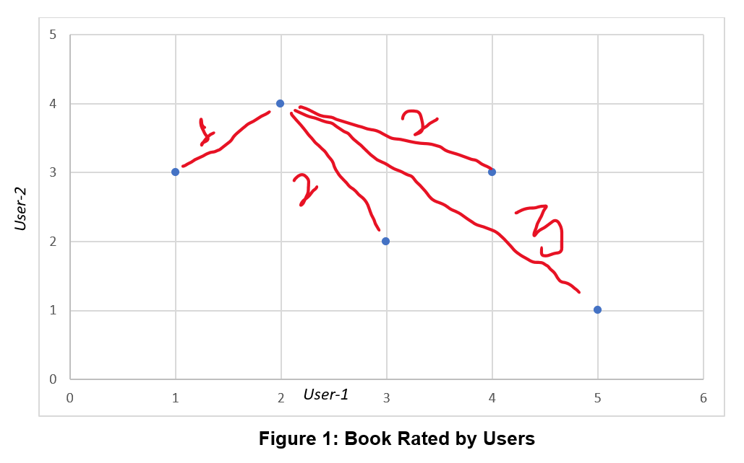
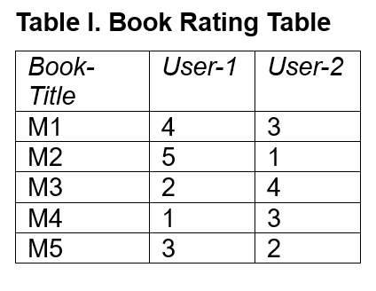
Collaborative Filtering
Collaborative filtering (CF) is a technique used in recommendation systems to develop recommendations based on ratings provided by other users. It's based on the assumption that if a user has rated two books, then to a user who has read one of these books, the other book can be recommended.

Slide 9
Collaborative Filtering
Strengths:
Effective at making recommendations based on user behaviour and prefences.
Works well when you have a large dataset and a significant number of user interactions.
Weaknesses:
Cold Start problem: Struggles to make recommendations for new users or items with no historic data.
Sparsity: In cases where users provide limited feedback or the dataset is sparse, collaborative filtering may not work well.
Limited to finding similar users or items based on past behaviour and doesn’t consider the content of books.

Slide 10
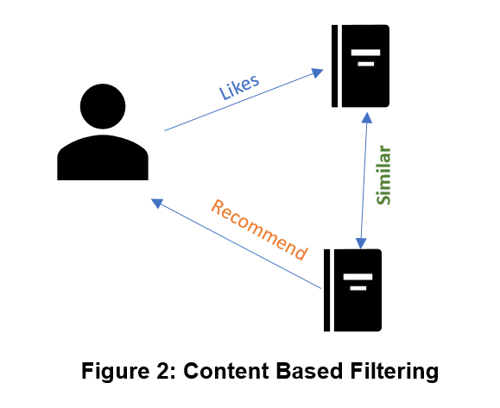
Content-Based Filtering
Content-based filtering recommends items to users based on their prior actions or explicit feedback. For example, if a user likes item1 and item1 is similar to item2, then item2 will be recommended to the user based on their liking of item1.

Slide 11
Content-Based Filtering
Strengths:
Effective for recommending items based on their content and attributes, making it suitable for niche or less-popular items.
Solves the cold start problem by recommending based on item attributes
Weaknesses:
Limited to the information available about items; if metadata is incomplete or inaccurate, recommendations may suffer.
May not capture serendipity or recommend items that are outside a user's existing interests

Slide 12
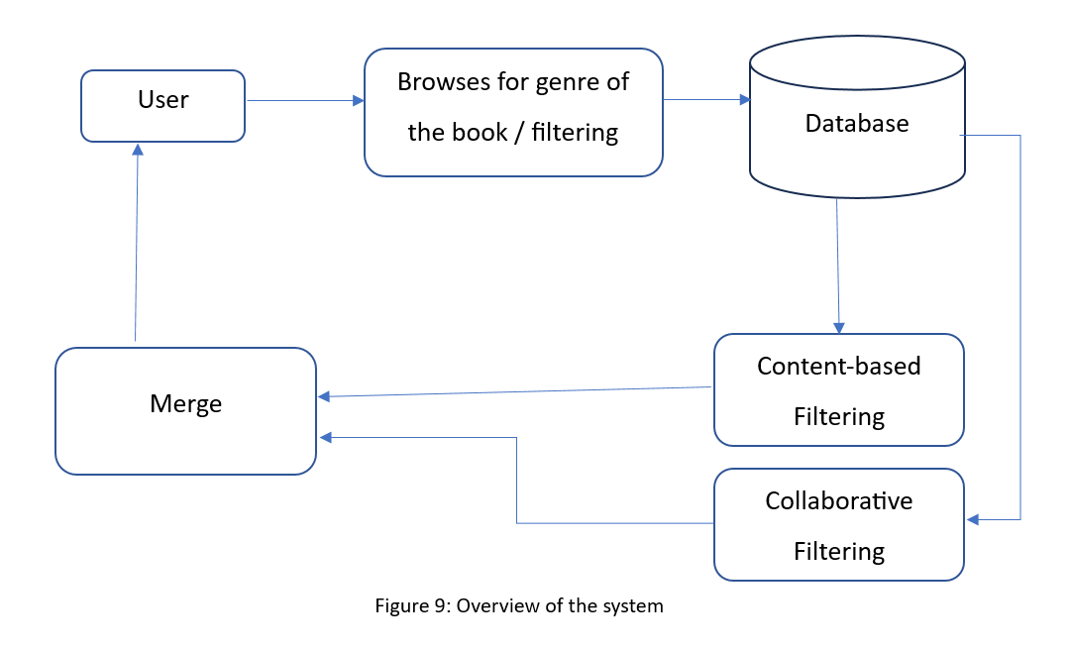
Proposed System
The system consists of following steps –
User chooses a book from the website and submits to the system
System performs content-based filtering on the selected book and finds out a set of books that are either written by the same author or belongs to the same genre.
System performs collaborative filtering on the selected book and finds out a set of books that have highest cosine relation with books.
Display the books to the user in separate columns with the information of on what basis that particular book is recommended to the user.

Slide 13
Merge
Merging can be performed in Three different ways:
Weighted Hybrid: We can assign weights to recommendations from each model and combine them. For instance, we might give a higher weight to collaborative filtering recommendations but include content-based recommendations to add diversity.
Switching Hybrid: We can switch between models based on the user's profile or the item being recommended. For example, for new users, we might rely on content-based recommendations until enough data is collected for collaborative filtering.
Cascade Hybrid: we can use one model to filter and refine the recommendations generated by another model. For instance, content-based filtering can be used as a pre-filter to exclude irrelevant items before applying collaborative filtering.

Slide 14
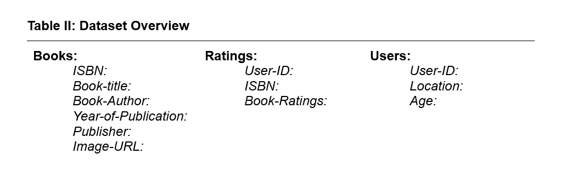
Quick View of Dataset

Slide 15
Expected Result
Primary goals of the Book Recommendation System:
Delivering proficient book recommendations to buyers.
Utilizing the proposed Hybrid filtering approach for improved accuracy.
Additional objectives:
Assessing the quality of a book's content through collaborative filtering.
Incorporating user opinions and ratings as feedback for enhanced recommendations.
Fundamental outcome of the proposed work:
Ability to recommend books tailored to the buyer's interests.
Ultimately boosting productivity and credibility of the Book Recommendation System.

Slide 16
Conclusion
There are millions of books in the entire world wide and people need some instructions to find the appropriate book. Making decision and scrolling for the right book from millions of books can be hard and a complete waste of time. To compete and keep up in the market, some viewers may just rate the book in unbiased form. The use of such overstated descriptions is misleading the viewers to unpromising products or books

Slide 17
Reference Paper: [1] Ashish Fatarphekar, Tejas Nashikkar, Vivek Patil, Gayatri Naik, “BOOK RECOMMENDATION SYSTEM BASED ON COMBINE FEATURES OF CONTENT BASED FILTERING, COLLABORATIVE FILTERING AND ASSOCIATION RULE MINING”, 2015, Advance Research in Social science and Humanties (ISSN: 2208-2387) [2] Ms. Praveena Mathew, Ms. Bincy Kuriakose, Mr.Vinayak Hegde, “Book Recommendation System through Content Based and Collaborative Filtering Method”, 2016, Department of Computer Science Amrita Vishwa Vidyapeetham Mysuru Campus Mysuru, Karnataka, India [3] Madhuri Kommineni, P.Alekhya, T. Mohana Vyshnavi, V.Aparna, K Swetha, V Mounika, “Machine Learning based Efficient Recommendation System for Book Selection using User based Collaborative Filtering Algorithm”, 2020 [4] Ashlesha Bachhav, Apeksha Ukirade, Nilesh Patil, Manish Saswadkar, Prof. Nitin Shivale, “Book Recommendation System using Machine learning and Collaborative Filtering”, 2022, IJARSCT

Slide 18
Thank You

