Slide 1
USL 2 League Wide Analysis
Rohit Thakur

Slide 2
How these stats were found
Purpose:
Analyze player & team performance across the 2025 USL League Two season
Identify top performers, developmental trends, and situational strengths
How this was done:
SQL + Python used to query official league data
Filtered by 300+ minutes for meaningful contribution
Compared mid-season vs full-season data to track changes over time

Slide 3
How I will present the information
Data Overview: Two Key Timeframes
This analysis compares two snapshots from the 2025 season:
Mid-Season: Reflects team rhythm and emerging roles.
Latest Update: Captures late-season trends and shifts.
Why it matters:
Comparing these datasets reveals progression, validates early trends, and highlights late-season developments.

Slide 4
Goals and Assists

Slide 5
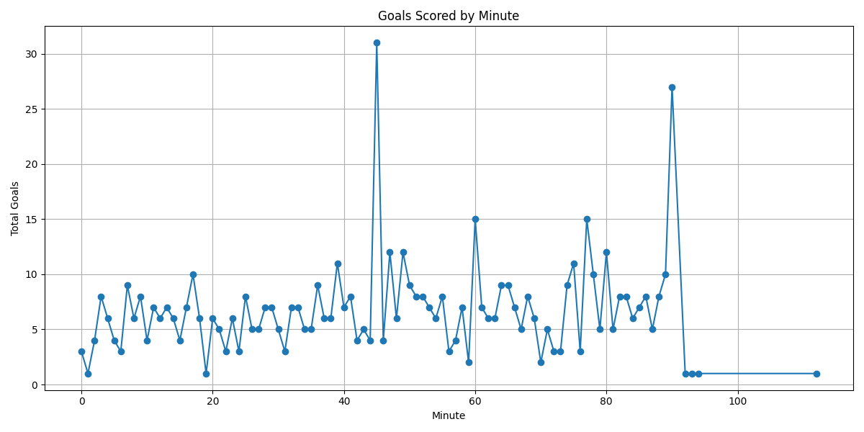
Goals Scored by Minute (½)
When are goals being scored?
Peaks: End of both halves → Defensive lapses & tactical fatigue
Hot spots: 60th & 70th minute → Substitutions and adjustments take effect
Takeaway:
Teams that stay organized late in halves gain a competitive edge.
Players who perform in these windows are valuable in close matches.

Slide 6
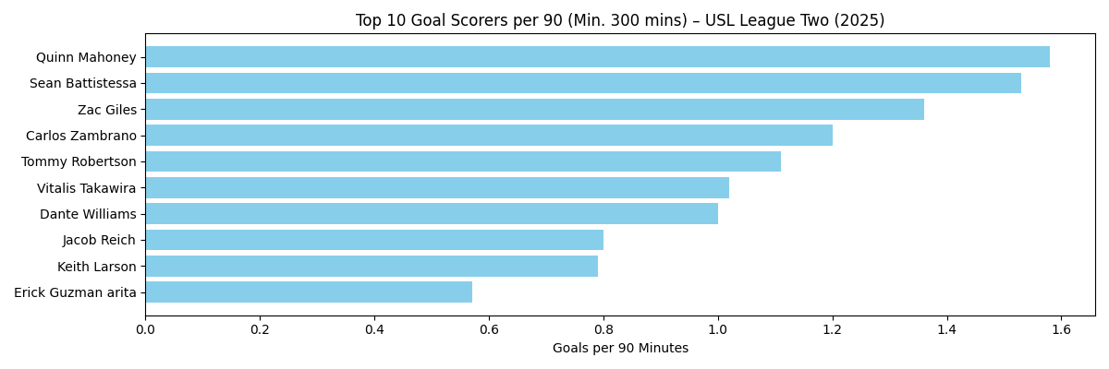
Goals Per 90 Leaders - Midseason
Top 5 Goals per 90 (Mid-Season):
Quinn Mahoney (San Juan SC) – 1.57
Sean Battistessa – 1.35
Zac Giles – 1.31
Carlos Zambrano – 1.20
Tommy Robertson – 1.15
Insight:
Mahoney emerged as early-season leader.
Players on non-top teams (e.g., Zambrano) are prime scouting targets.

Slide 7
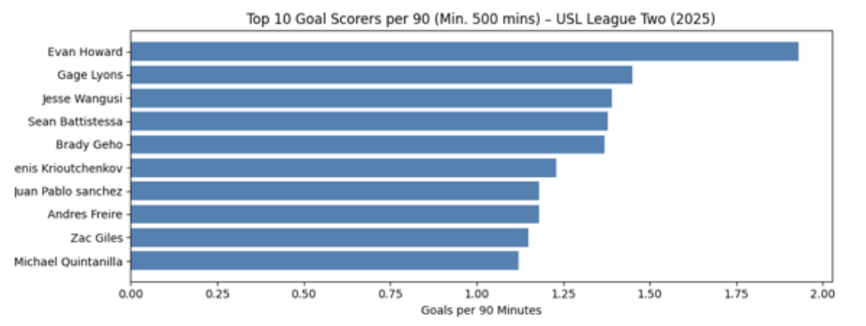
Top Goal Scorers per 90- Full Season
Top 5 Goals per 90 (Full Season):
Evan Howard – 1.94 (late-season breakout)
Sean Battistessa – 1.34
Zac Giles – 1.30
Key Change:
Howard surged to the top late-season.
Mahoney (mid-season leader) fell out of the top 10 →trend shift.
Gage Lyons – 1.45
Jesse Wangusi – 1.39

Slide 8
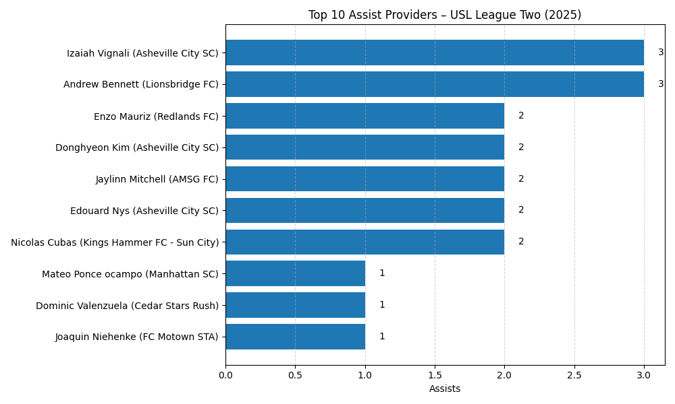
Assist Leaders (Mid-Season)
Andrew Bennett (Lionsbridge) & Izaiah Vignali (Asheville City) lead with 3 assists each.
Asheville City SC features 3 players in the top 10 → strong team-oriented creativity.
Enzo Mauriz & Nicolas Cubas likely serve as deep-lying playmakers or attacking fullbacks, driving buildup play.

Slide 9
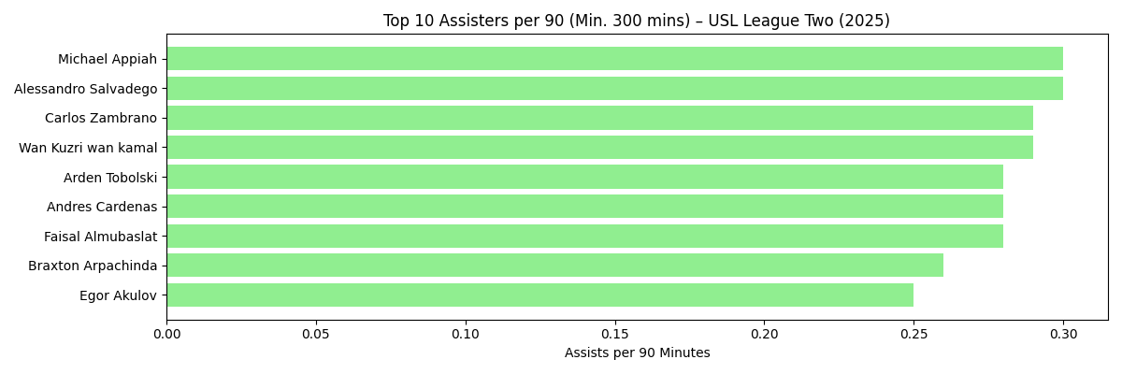
Assist per 90 Leaders Midseason
Top Assisters per 90 – Key Takeaways
Michael Appiah & Alessandro Salvadego lead with 0.30+ assists per 90 → consistent chance creation.
Carlos Zambrano & Wan Kuzri wan Kamal excel in both assists & overall goal involvements → creative dual threats.
All top providers produced over 300+ minutes, proving reliability.
Midfielders & fullbacks dominate the list, showing effective wide and central distribution.

Slide 10
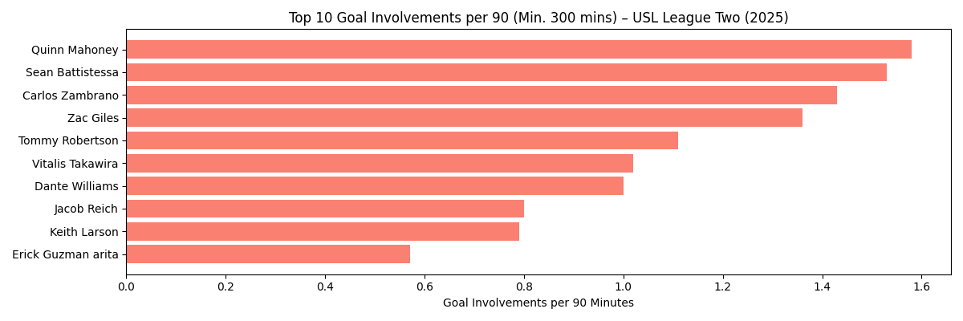
G/A per 90 Leaders Midseason
Top Goal Involvements per 90 – Key Takeaways
Quinn Mahoney leads with 1.58 goal involvements/90, showing strong all-around impact.
Sean Battistessa & Carlos Zambrano follow closely with balanced attacking profiles.
Mahoney, Giles, Zambrano, Robertson appear across both goals & assists charts → versatile offensive threats.
Each contributes to 1+ goal involvement per match, making them vital to team success.

Slide 11
Age-Based Statistics

Slide 12
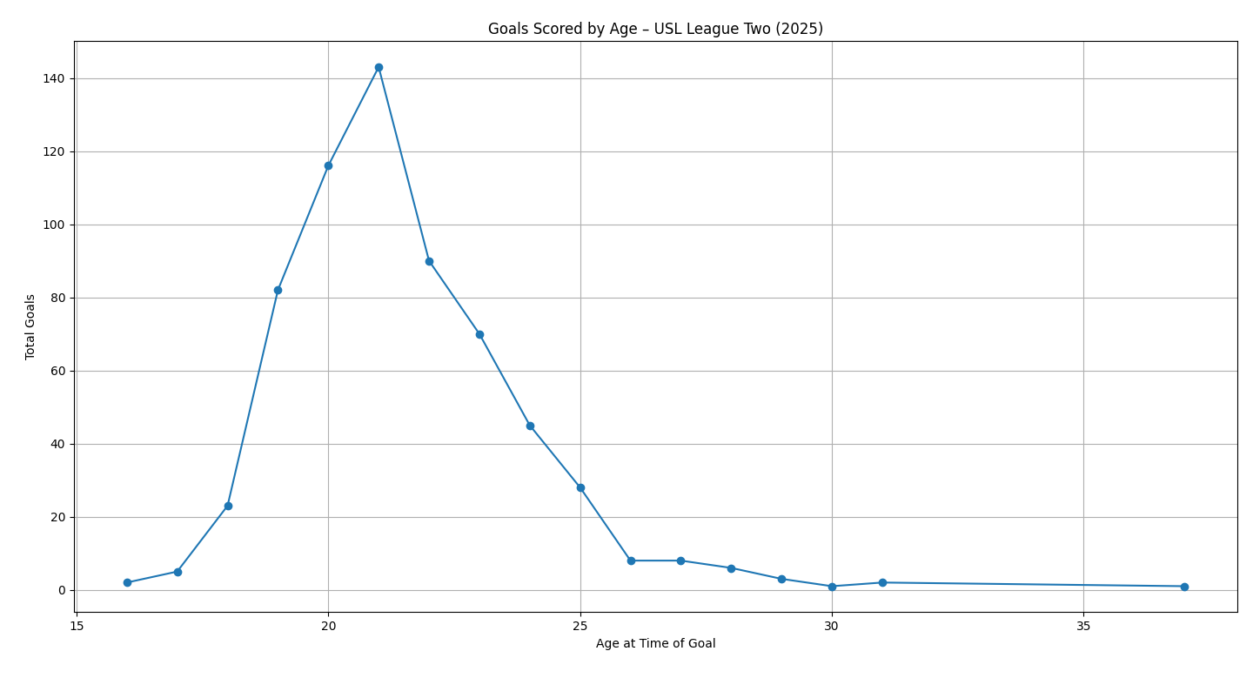
Goals Scored By Age - Midseason
Peak scoring: Ages 20–22, with the highest at 21 → aligns with prime NCAA & pre-pro transition years.
Rapid growth: From 18–21, showing accelerated physical & tactical development → ideal for academy/college scouting.
Decline after 22: Sharp drop by 24 → likely due to fewer older attackers or deeper roles.
Teenagers (16–18): Minimal output but signal early development potential.

Slide 13
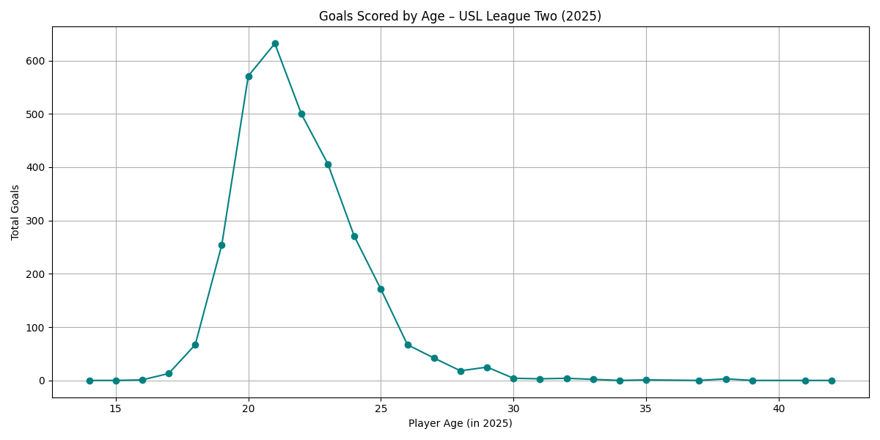
Goals Scored by Age -Full Season
Full Season Insights
Peak remains at 21, followed by 20 & 22 → consistent with mid-season findings.
Steep rise from 18–20 → strong acceleration in attacking impact.
Sharp decline after 22 and minimal contributions from 16–18 & 30+ → confirms the league’s developmental focus.
Reinforced Themes:
Consistency: Mid-season trends held through year-end.
Predictive Value: Early-season data accurately projected final outcomes.
Strategic Use: Supports age-based recruiting & development planning.

Slide 14
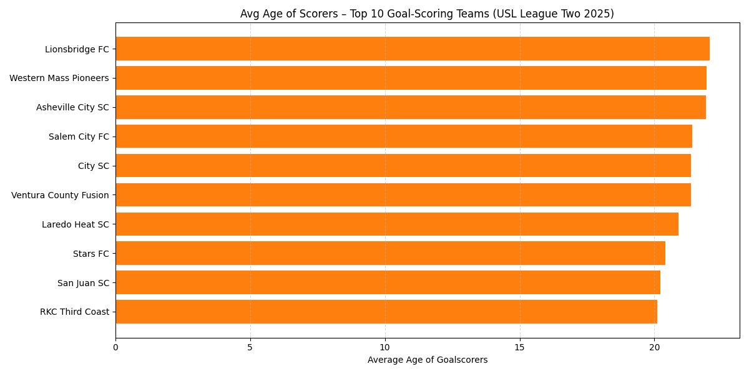
Avg Age of Highest Scoring teams Midseason
San Juan SC & RKC Third Coast (~20 yrs) → Development-focused, likely academy-driven.
Lionsbridge FC, Western Mass, Asheville City (21.5+) → Experienced & tactically mature attacks.
Ventura County Fusion, City SC, Laredo Heat (20.8–21.2) → Balanced mix of youth & experience.

Slide 15
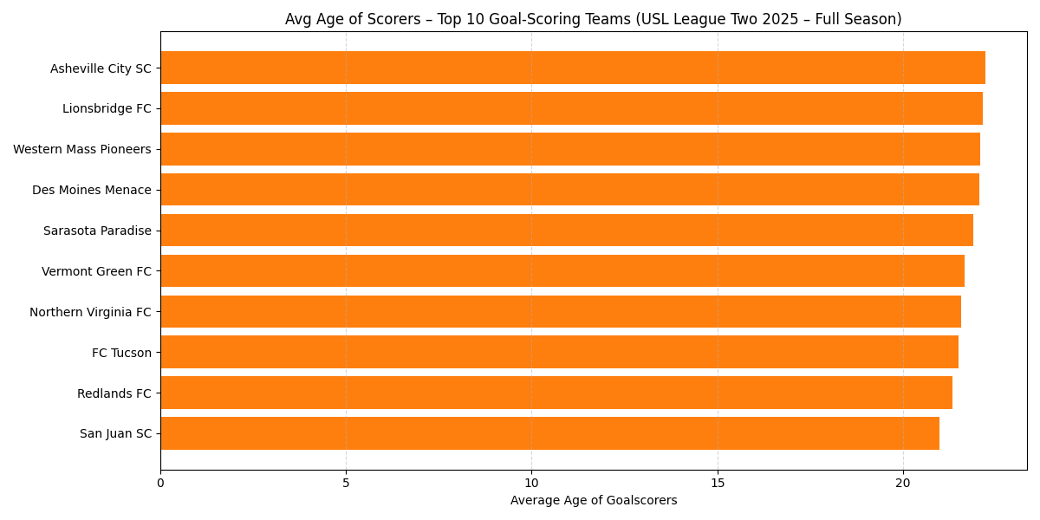
Avg Age of Highest Scoring teams Full Season
Full Season
San Juan SC (~21 yrs) → Sustained youth-driven scoring.
Asheville City SC & Lionsbridge FC → Experienced attacking cores.
Western Mass Pioneers & Des Moines Menace → Older, tactically mature attacks.
Confirmed:
Youth-focused teams (e.g., San Juan) maintained high output.
Experienced teams (e.g., Lionsbridge, Western Mass) stayed consistently strong.

Slide 16
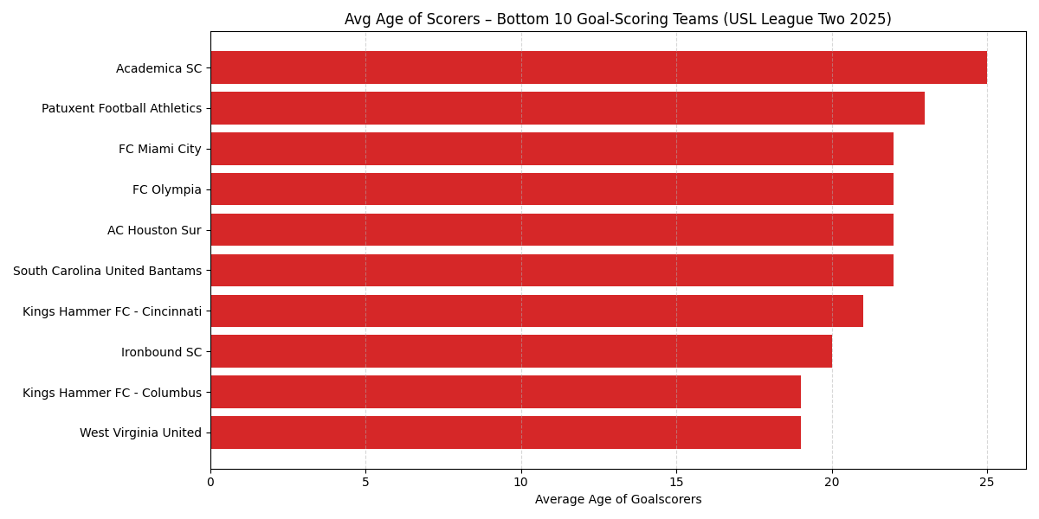
Avg Age of Lowest Scoring Teams Midseason
Academica SC (~25 yrs) → Veteran-led but low attacking return.
Patuxent FA & FC Miami City (22+) → Limited youth integration in attack.
Kings Hammer Columbus & West Virginia United (~19 yrs) → Raw but underdeveloped scoring units.
Scouting Takeaways:
Older, low-scoring teams need an attacking refresh or youth infusion.
Youth-heavy squads (e.g., West Virginia) show long-term development potential.
Greater age diversity here vs. top-scoring teams.

Slide 17
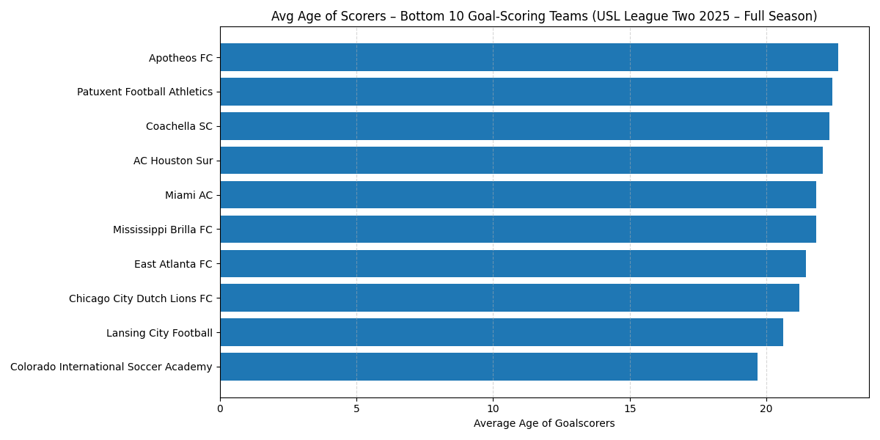
Avg Age of Lowest Scoring Teams Full season
Full Season:
Apotheos FC & Patuxent FA (~22+ yrs) → Older, low-scoring profiles.
Colorado International SA → Young, developmental but underproductive.
Older low-scoring teams consistently underperform.
Very young teams still struggle with finishing efficiency.
Wider age variation vs. top-scoring teams.

Slide 18
Game Situational Statistics

Slide 19
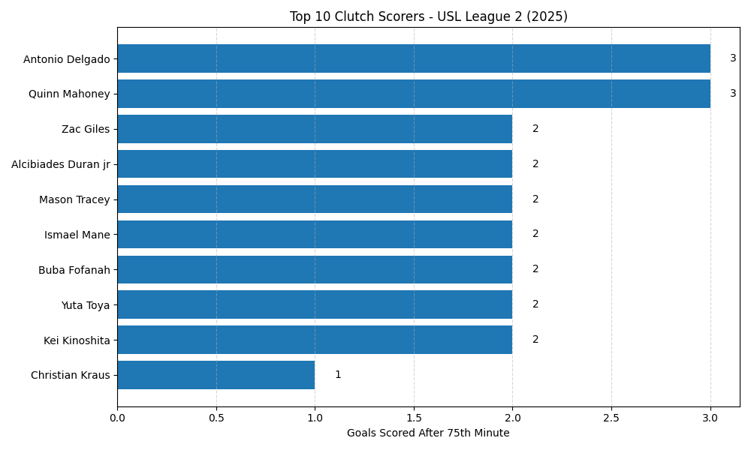
Clutch Scorers (½)
Top Clutch Scorers – 2025 USL League Two
Quinn Mahoney – San Juan SC
Leads league with 3 goals after 75’
Composed and impactful in high-pressure moments
Strong playoff/cup-match value
Antonio Delgado – RKC Third Coast
Also scores 3 late goals
Stamina and sharp positioning make him a constant late-game threat
Zac Giles – San Juan SC
2+ late goals alongside Mahoney
Highlights San Juan SC’s possible emphasis on fitness and finishing strong
Kei Kinoshita – Rochester FC Yuta Toya – Tacoma Stars
Each with 2 goals after 75’
Likely effective impact subs with strong endgame instincts

Slide 20
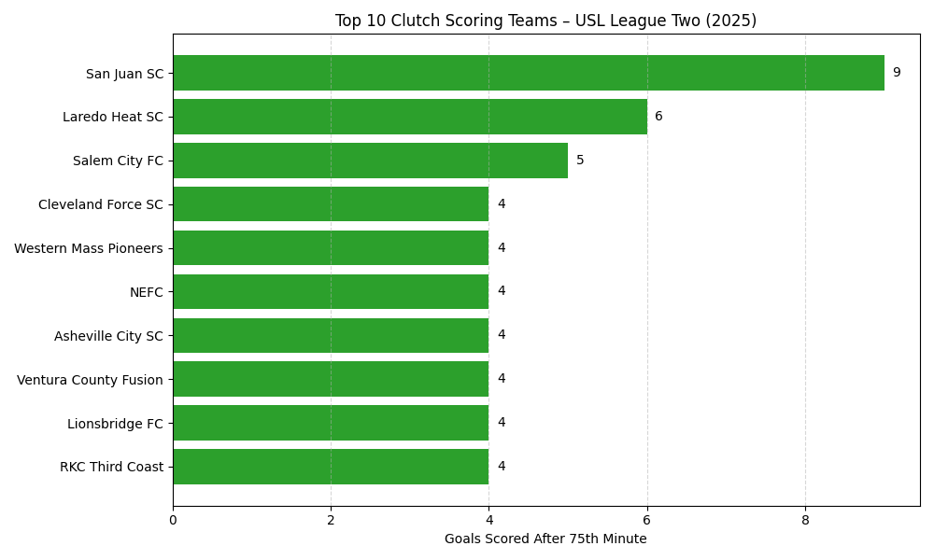
Clutch Teams (½)
Team-Level Clutch Performance – USL League Two (2025)
San Juan SC – 9 late goals
League leader in goals after 75'
Driven by Quinn Mahoney & Zac Giles
Likely fueled by:
Strong substitutions
Superior fitness
Tactical flexibility late in matches
Laredo Heat SC – 6 late goals
Top clutch team in Texas region
Key player: Ismael Mane (top individual scorer after 75’)
Shows both team structure and individual execution
Clustered Midfield (4–5 Goals)
Teams like Salem City FC, NEFC, Asheville City SC, RKC Third Coast
Inconsistent clutch presence
Useful for spotting:
Potential playoff dark horses
Late-game vulnerabilities
Key Insight
Many top-performing teams correlate with strong late-game scoring
Clutch production may predict conference standings and playoff success

Slide 21
Key Takeaways and Insights Midseason
1. Player Scouting:
Evan Howard & Gage Lyons → Late-season breakout scorers.
Carlos Zambrano & Tommy Robertson → High-impact on mid-tier teams → value signings.
2. Development Insights:
Peak production at 20–22 → Prioritize this age band for recruitment.
Youth-heavy teams show long-term potential but need finishing development.
3. Tactical Lessons:
Late-game scoring (75’+) is a strong predictor of team success.
Defensive lapses near half-time & full-time remain exploitable opportunities.
Next Steps:
Use these insights to refine scouting priorities, adjust development models, and target tactical improvements for 2026.

Slide 22
Key Takeaways and Insights Full Season
1. Player Scouting:
◦ Evan Howard & Gage Lyons → Emerged as late-season breakout scorers, prime targets for higher-level recruitment.
◦ Jesse Wangusi & Carlos Zambrano → Sustained consistent high-level contributions, adding value across multiple attacking metrics.
2. Development Insights:
◦ Peak production at ages 20–22 → Confirms this as the primary recruitment and development age bracket.
◦ Youth-driven teams (e.g., San Juan SC) maintained strong output, proving that early developmental investments pay off.
3. Tactical Lessons:
◦ Late-game scoring (75’+) continues to strongly correlate with top team performance and playoff readiness.
◦ Teams with multiple top-10 scorers gained a clear competitive advantage across the season.
4. Next Steps:
◦ Refine scouting to prioritize late-season breakout players and maintain development pipelines for 20–22 age groups.
◦ Use clutch performance metrics as a predictor for postseason success when evaluating players and teams.

