Slide 1

Locating a place to build a gym/yoga studio
Rohit Joshi

Slide 2
Locating a suitable place to build a gym/yoga studio in Chicago
Obesity is a medical condition where excess body fat has accumulated to an extent that may have a negative effect on health.
In the US, about 35% of the population (which is approximately 82 million) are obese. Obesity often adds to various diseases and conditions - often for life.
It is one of the leading preventable causes of death worldwide. It is linked to various cardiovascular diseases, Type 2 Diabetes, few types of cancer, high blood pressure, apnea etc.

Slide 3
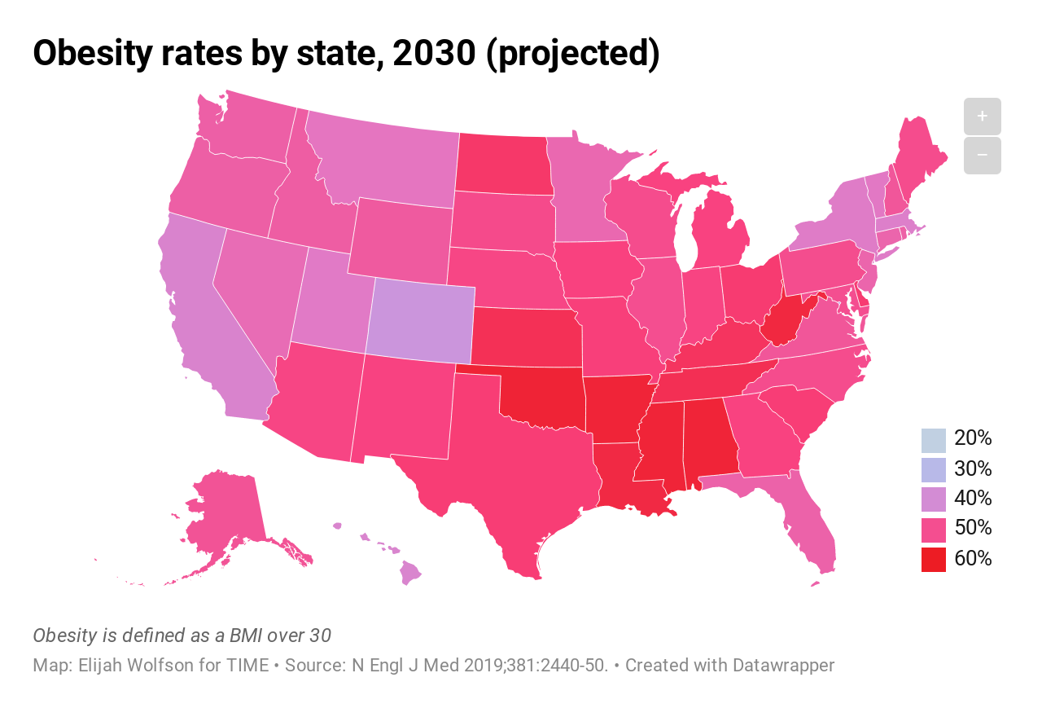
The World Health Organization (WHO) predicts that overweight and obesity may soon replace more traditional public health concerns such as undernutrition and infectious diseases as the most significant cause of poor health.
Obesity also has taken a toll on healthy care costs across the country—estimated between 187 billion dollars and 265 billion dollars in direct and indirect health care costs, as of 2019.

Slide 4
Choosing Chicago
Chicago is home to more than 2.6 million residents.
Obesity is a major problem here, where 36.2% of the city's high school students and 61.2% of adults are overweight or obese.
The aim of this project is to successfully locate suitable locations to construct Gym, fitness centers and/or yoga classes in Chicago.
They should be built in a place having no access to gym/yoga classes.

Slide 5
Data Acquisition and Tuning
Chicago Neighborhood Data - https://en.wikipedia.org/wiki/List_of_neighborhoods_in_Chicago. It contains all the Chicago Neighborhoods by their community areas. I have scraped the neighborhoods table using beautifulsoup library.
Neighborhood Location data - Using Geocoders package to retrieve latitude and longitude data of each neighborhoods.
Neighborhood Venues data - Using Foursquare API, we can gather a list of venues for each neighborhood within radius of 500 meters.
Non – Chicago neighborhoods are dropped and venues within 1000 meters are identified, merged and tuned towards ‘Gym’, ‘Gym/Fitness Center’ and ‘Yoga Studio’ venue categories.

Slide 6
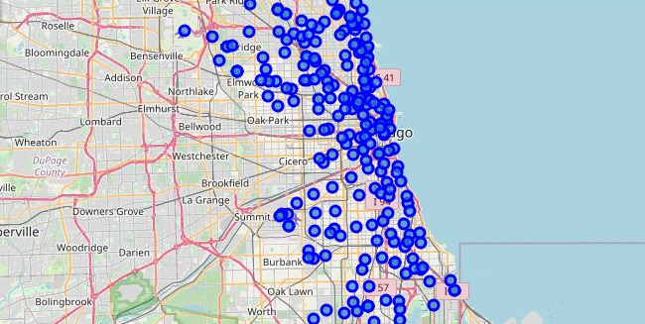
Neighborhoods Map

Slide 7
K-Means Clustering Algorithm
In order to locate a suitable place to construct a gym and/or yoga studio compare the similarities of two cities, we must perform exploratory data analysis on each neighborhoods, segment them, and group them into clusters.
To achieve that we cluster data using the k-means clustering algorithm, which is an unsupervised machine learning algorithm.
We divide our data into 10 clusters and then run the algorithm. These 10 clusters are visualized on a map.
We then analyze each cluster to draw out conclusions which will help us to reach our goal.

Slide 8
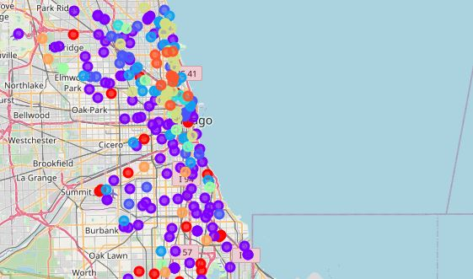
Cluster Map

Slide 9
Results and Discussions
1) Cluster 1 represents the best opportunity to build a gym or yoga studios since this cluster (Red) does not have any gyms, yoga classes or fitness centers. Southern Chicago is the prime location I'd choose given the number of gyms here are scanty.
2) Clusters 0,2,3,8 have gyms/fitness centers but no yoga studios. Gyms are usually more lucrative than yoga studios. Some gyms have in built yoga studios. In such cases, construction of independent yoga studios may be risky.
3) Cluster 6 have yoga studios but no gyms/ fitness centers. As gyms are more popular, I'd choose to construct a gym here.
4) In general, southern and north western Chicago has lesser gyms/ yoga studios when compared to the other parts. This makes sense as suburbs have lesser population compared to the main city. It would be more prudent to build a gym/ yoga studio at the mid point of 3-4 suburban neighborhoods in order to have enough population to sustain the gym/ yoga studio profitably.

Slide 10
Conclusion
This assignment involved scraping the required data, converting it into relevant form and then running K-means clustering algorithm to find a suitable place to construct a gym and/or yoga studio.
I divided the neighborhoods into 10 clusters and ran k-means algorithm on them. My recommendation is to open a gym in cluster 0 and cluster 3 and Yoga studios on cluster 2,6,7 (with caution).

Slide 11
Future Opportunities
In the future, this project can be more refined by collecting population data and refining our analysis a bit more.
Chicago is also known for gun violence, which is amongst the highest in the country. Some neighborhoods will be more crime ridden than the others. If we accommodate crime statistics for each neighborhood, we can refine our analysis even more.
Another idea maybe to open a gym/fitness centers near popular food stalls/restaurants where more people gather.

Slide 12
Thank you!

