Slide 1
Marketing campaign: ads vs PSA
The ad campaign raises conversion by 43.1% vs the PSA (statistically significant)
01 October 2026

Slide 2
The ad campaign raises conversion by 43.1% vs the PSA (statistically significant)
Recommendation: SHIP The primary metric improved significantly and by more than the practical threshold.
• Relative lift in conversion: +43.1% (95% CI [+29.3%, +56.8%])
• Evidence: p < 0.001
• Conversion: the PSA vs the ad campaign: 1.79% vs 2.55%
• Units analysed: psa: 23,524 / ad: 564,577
• Incremental conversions per 1,000 users: 7.7 (95% CI 6.0 to 9.4)
Source: marketing_AB.csv; run 2026-10-01_marketing-ads
2
Notes:
Verdict: Ship. The primary metric improved significantly and by more than the practical threshold. For every 1,000 users, about 7.7 more achieved conversion with the ad campaign than with the PSA. A difference this large is unlikely to be down to chance. PSA ids form a separate block (900,000 to 923,523); assignment unconfirmed. Split confirmed as 96/4 only after a 95/5 check failed. Exposure breakdowns are exploratory, non-causal; 4 of 7 buckets inconclusive. No dates: novelty or wear-off cannot be checked. No guardrail metrics defined; verdict rests on conversion alone. Money impact needs a value per conversion.

Slide 3
How the experiment was set up
Item | Detail
Variants (units) | ad: 564,577, psa: 23,524
Primary metric | converted (binary, goal: increase)
Statistical settings | alpha 0.05, two-sided, power 0.8
Multiple-testing correction | secondary: holm; segments: benjamini-hochberg
Analysis type | post test readout, bayesian readout, heterogeneous effects
Source: marketing_AB.csv; run 2026-10-01_marketing-ads
3
Notes:
Walk through what was tested, on whom, for how long, and how success was defined before looking at results.

Slide 4
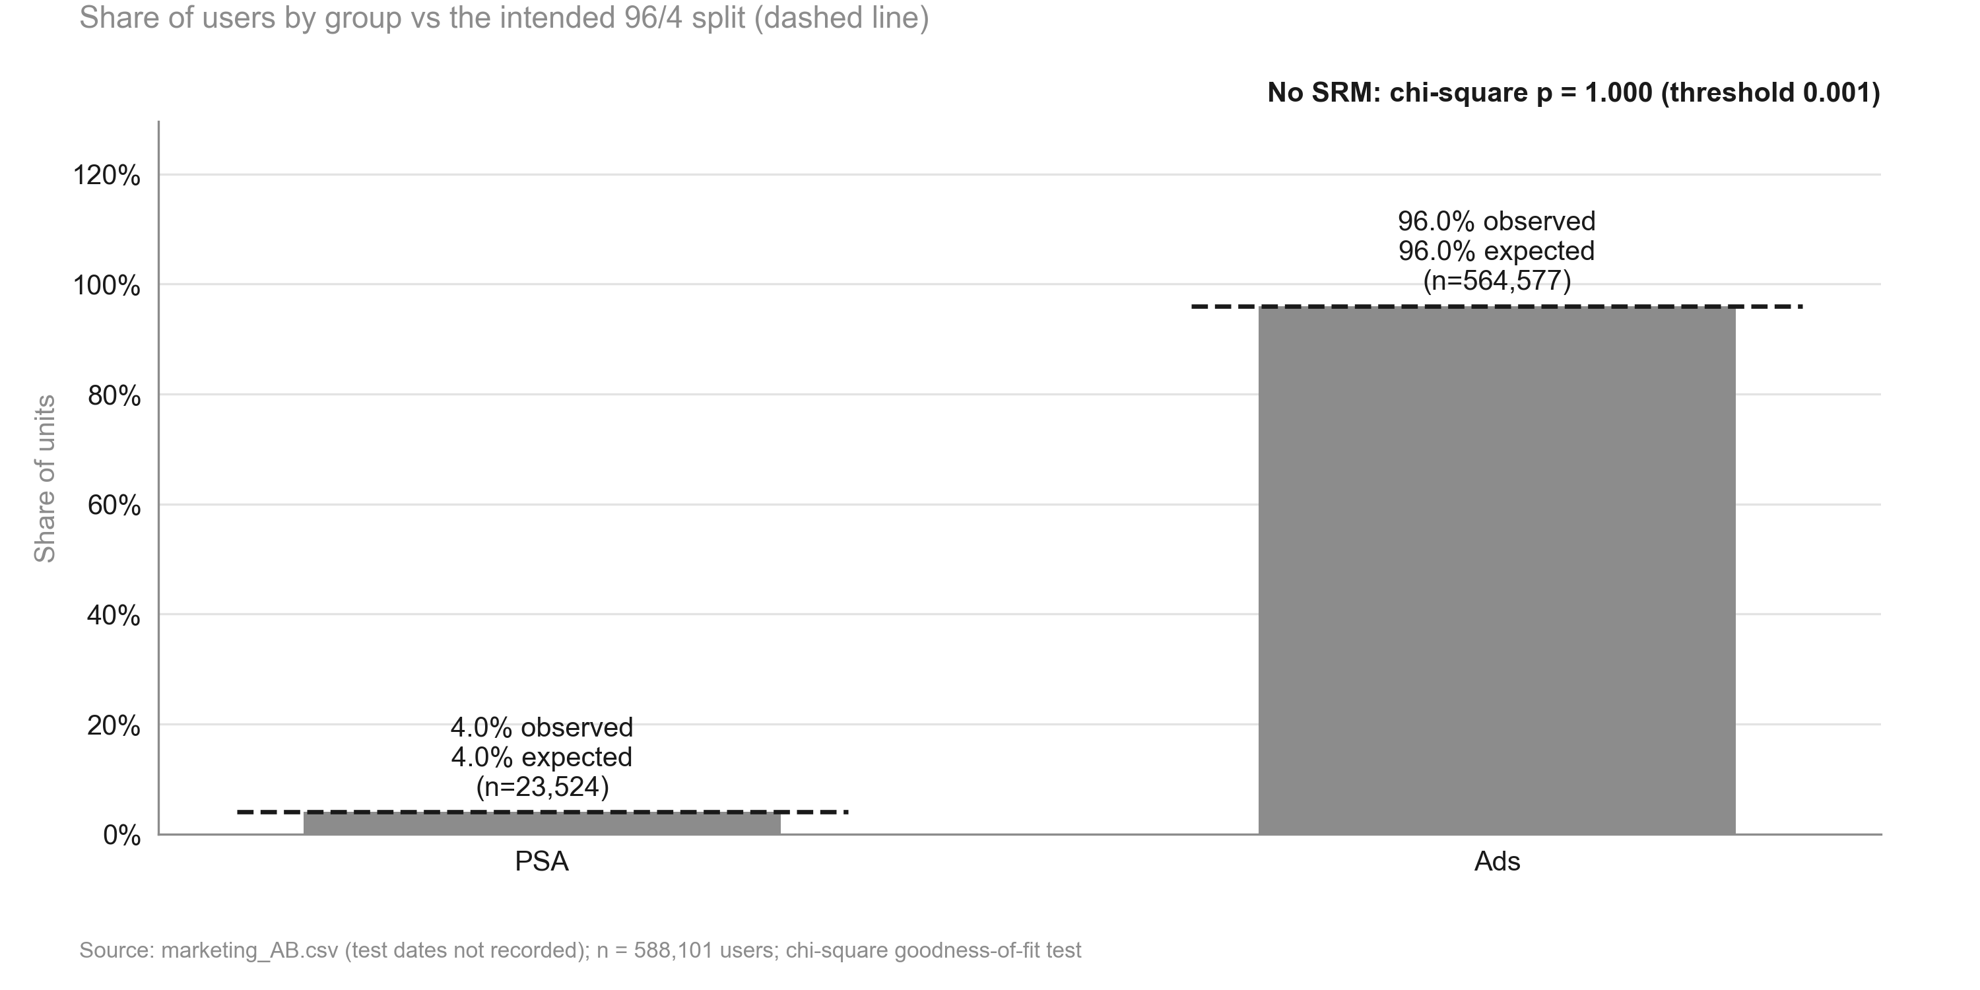
Traffic split matches the intended 96/4 (Ads 96.0%, PSA 4.0%): no sample ratio mismatch
KEY TAKEAWAYS
1. PSA has 23,524 users vs 23,524 expected under 96/4
2. Chi-square p = 1.000 (threshold 0.001): the split is as intended
3. The first-stated 95/5 split failed (p < 0.001); the user confirmed 96/4
Source: marketing_AB.csv (test dates not recorded); n = 588,101 users; chi-square goodness-of-fit test
4
Notes:
speaker note: the groups are the size they were meant to be, so the comparison can be trusted on this check.

Slide 5
Data validation: overall verdict WARN
Check | Verdict | Detail
schema | PASS | 6 columns, 588,101 rows
dtypes | PASS | All metric columns numeric
missing values | PASS | No missing values
duplicates | PASS | 588,101 units, one row each
contamination | PASS | No unit appears in more than one variant
variants | PASS | Counts {'ad': 564577, 'psa': 23524}
SRM | PASS | p = 1.000 (threshold 0.001)
outliers | WARN | Extreme values (reported, not removed): total ads: max is 10x the 99th percentile. Consider winsorised or boot
impossible values | PASS | Metric values within valid ranges
pre-period data | PASS | None described (CUPED not possible)
covariate balance | WARN | Segment mix differs between variants: most ads day (p = 4.8e-48), most ads hour (p = 1.1e-28) (can indicate an
Source: marketing_AB.csv; run 2026-10-01_marketing-ads
5
Notes:
Summarise data quality: anything flagged here limits how far the results can be trusted.

Slide 6
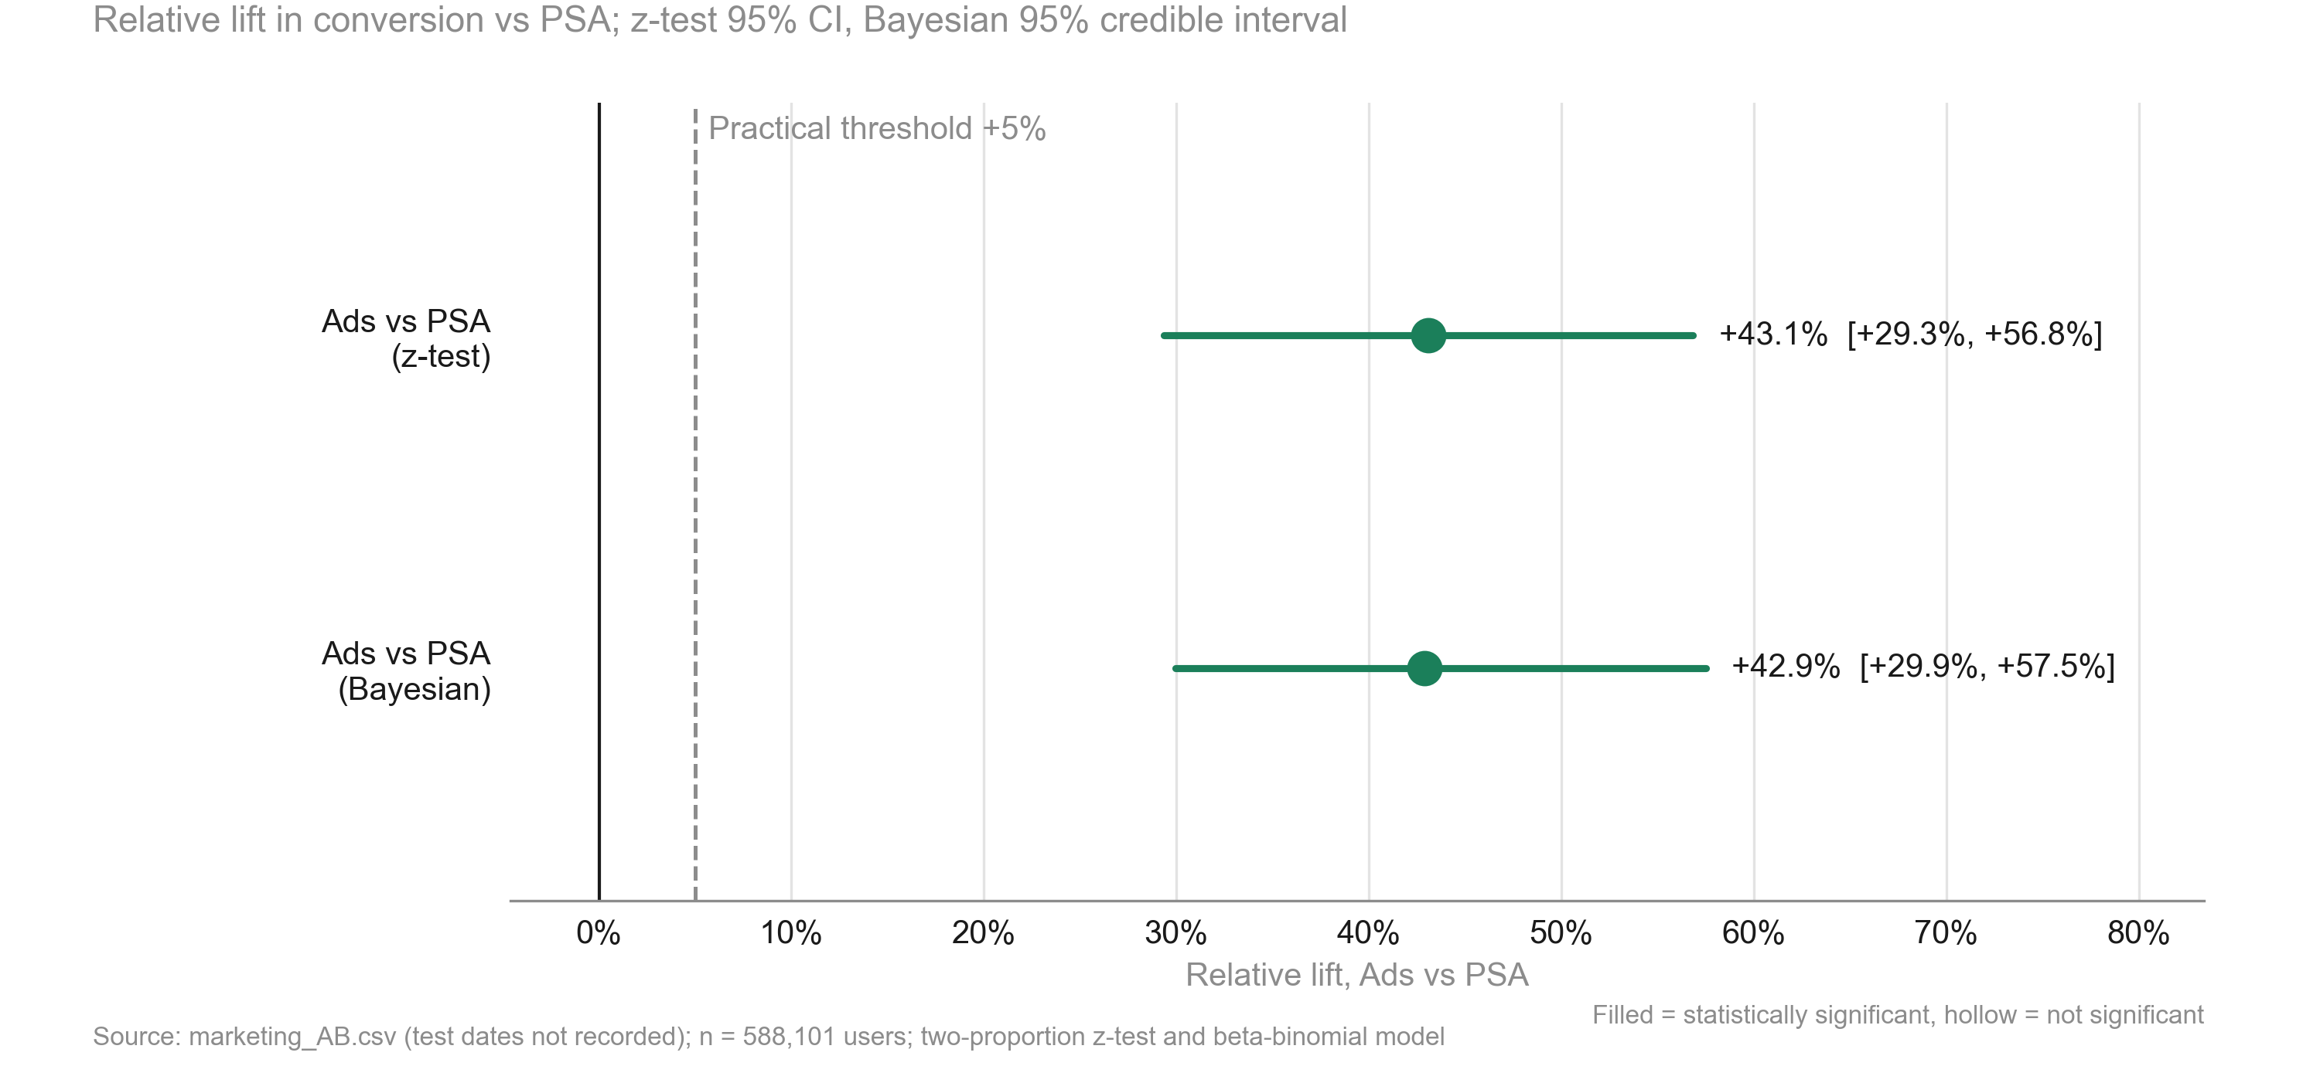
Ads lift conversion by +43.1% vs PSA, statistically significant and above the 5% practical threshold
KEY TAKEAWAYS
1. Relative lift +43.1%, 95% CI [+29.3%, +56.8%]; p < 0.001
2. Even the low end (+29.3%) is above the 5% practical threshold
3. Bayesian view agrees: +42.9%, 95% credible interval [+29.9%, +57.5%]
Source: marketing_AB.csv (test dates not recorded); n = 588,101 users; two-proportion z-test and beta-binomial model
6
Notes:
speaker note: the headline - ads clearly raise conversion, by far more than the bar we set.

Slide 7
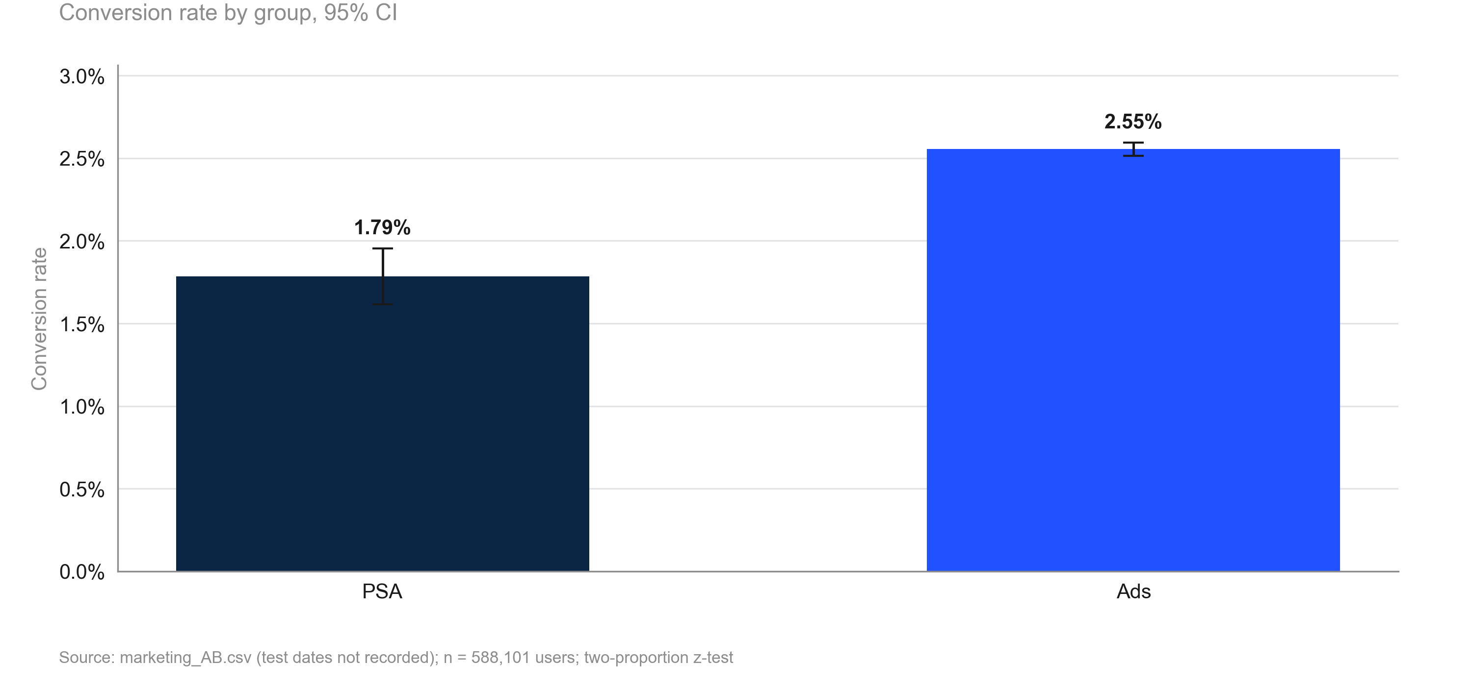
Ads users convert at 2.55% vs 1.79% with PSA: 7.7 extra conversions per 1,000 users, significant
KEY TAKEAWAYS
1. PSA: 1.79% of 23,524 users converted
2. Ads: 2.55% of 564,577 users converted
3. Difference +0.77 pp: 7.7 extra per 1,000 users (95% CI 6.0 to 9.4)
Source: marketing_AB.csv (test dates not recorded); n = 588,101 users; two-proportion z-test
7
Notes:
speaker note: in plain terms, roughly eight more conversions for every thousand people who see the ads.

Slide 8
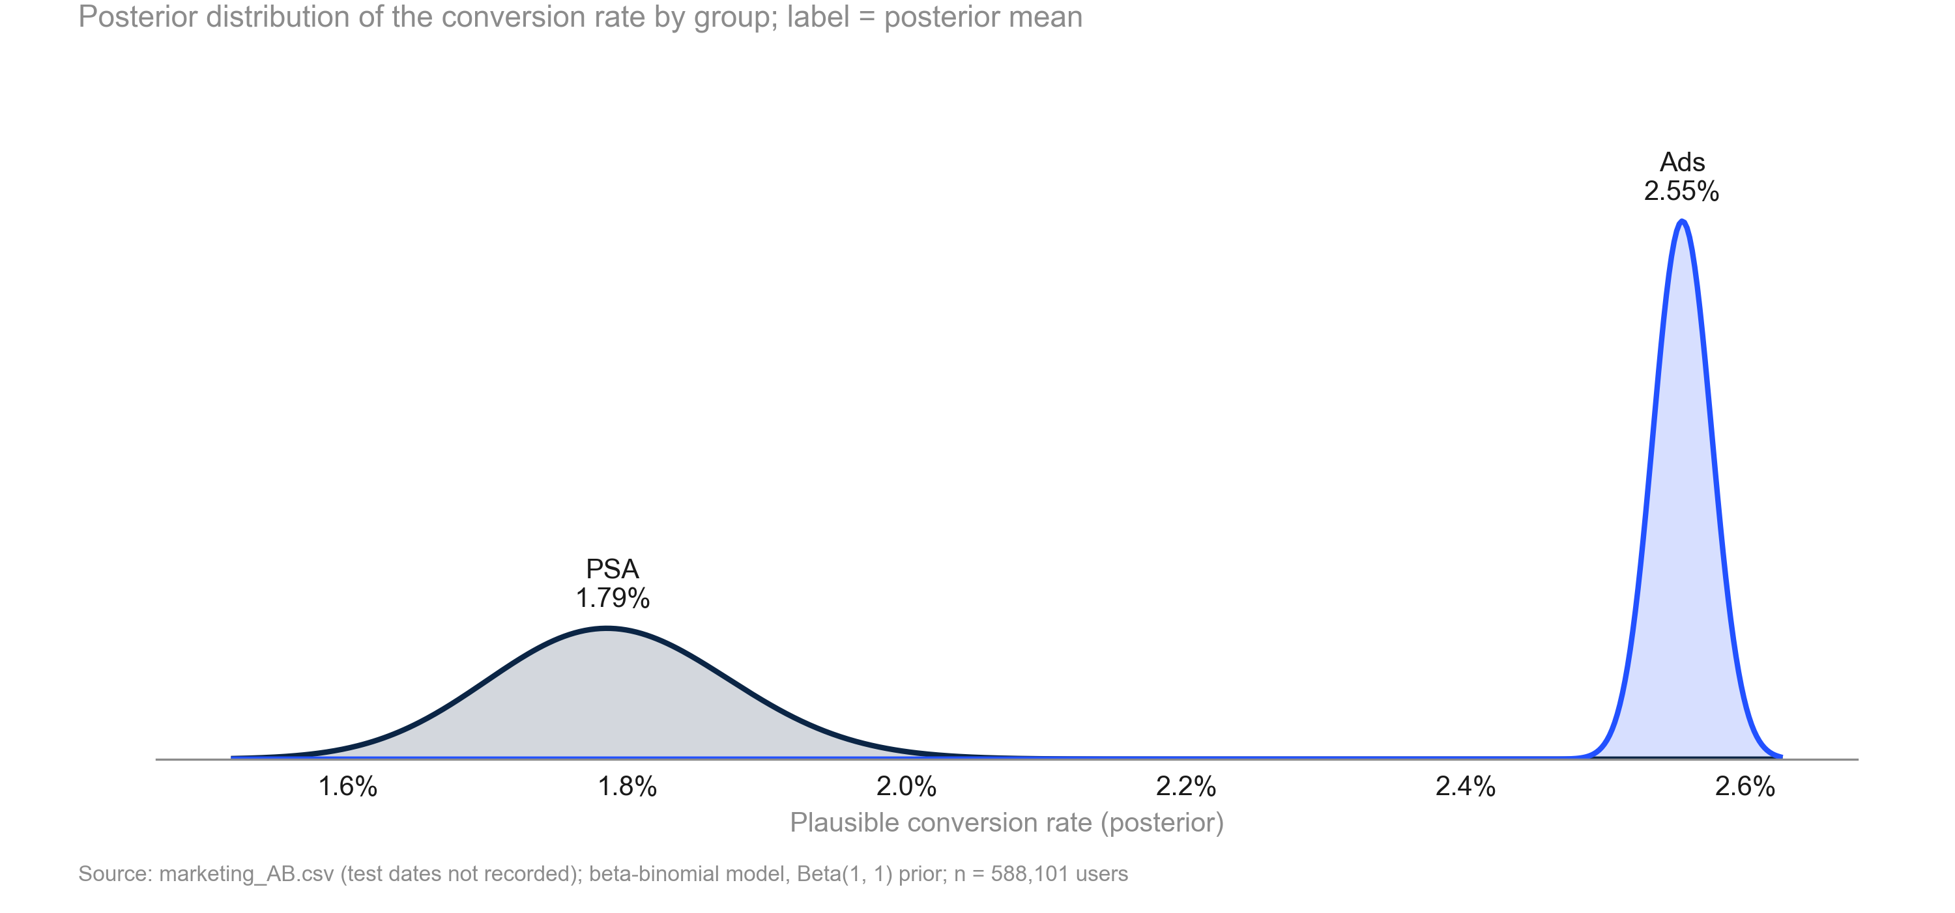
Plausible conversion rates for Ads and PSA do not overlap: Ads beat PSA with > 99.9% probability
KEY TAKEAWAYS
1. PSA: 1.79%, 95% credible interval 1.62% to 1.96%
2. Ads: 2.55%, 95% credible interval 2.51% to 2.60%
3. The ranges are fully separated; the flat prior carries negligible weight at this sample size
Source: marketing_AB.csv (test dates not recorded); beta-binomial model, Beta(1, 1) prior; n = 588,101 users
8
Notes:
speaker note: the Ads curve sits entirely to the right of the PSA curve - no plausible world where PSA wins.

Slide 9
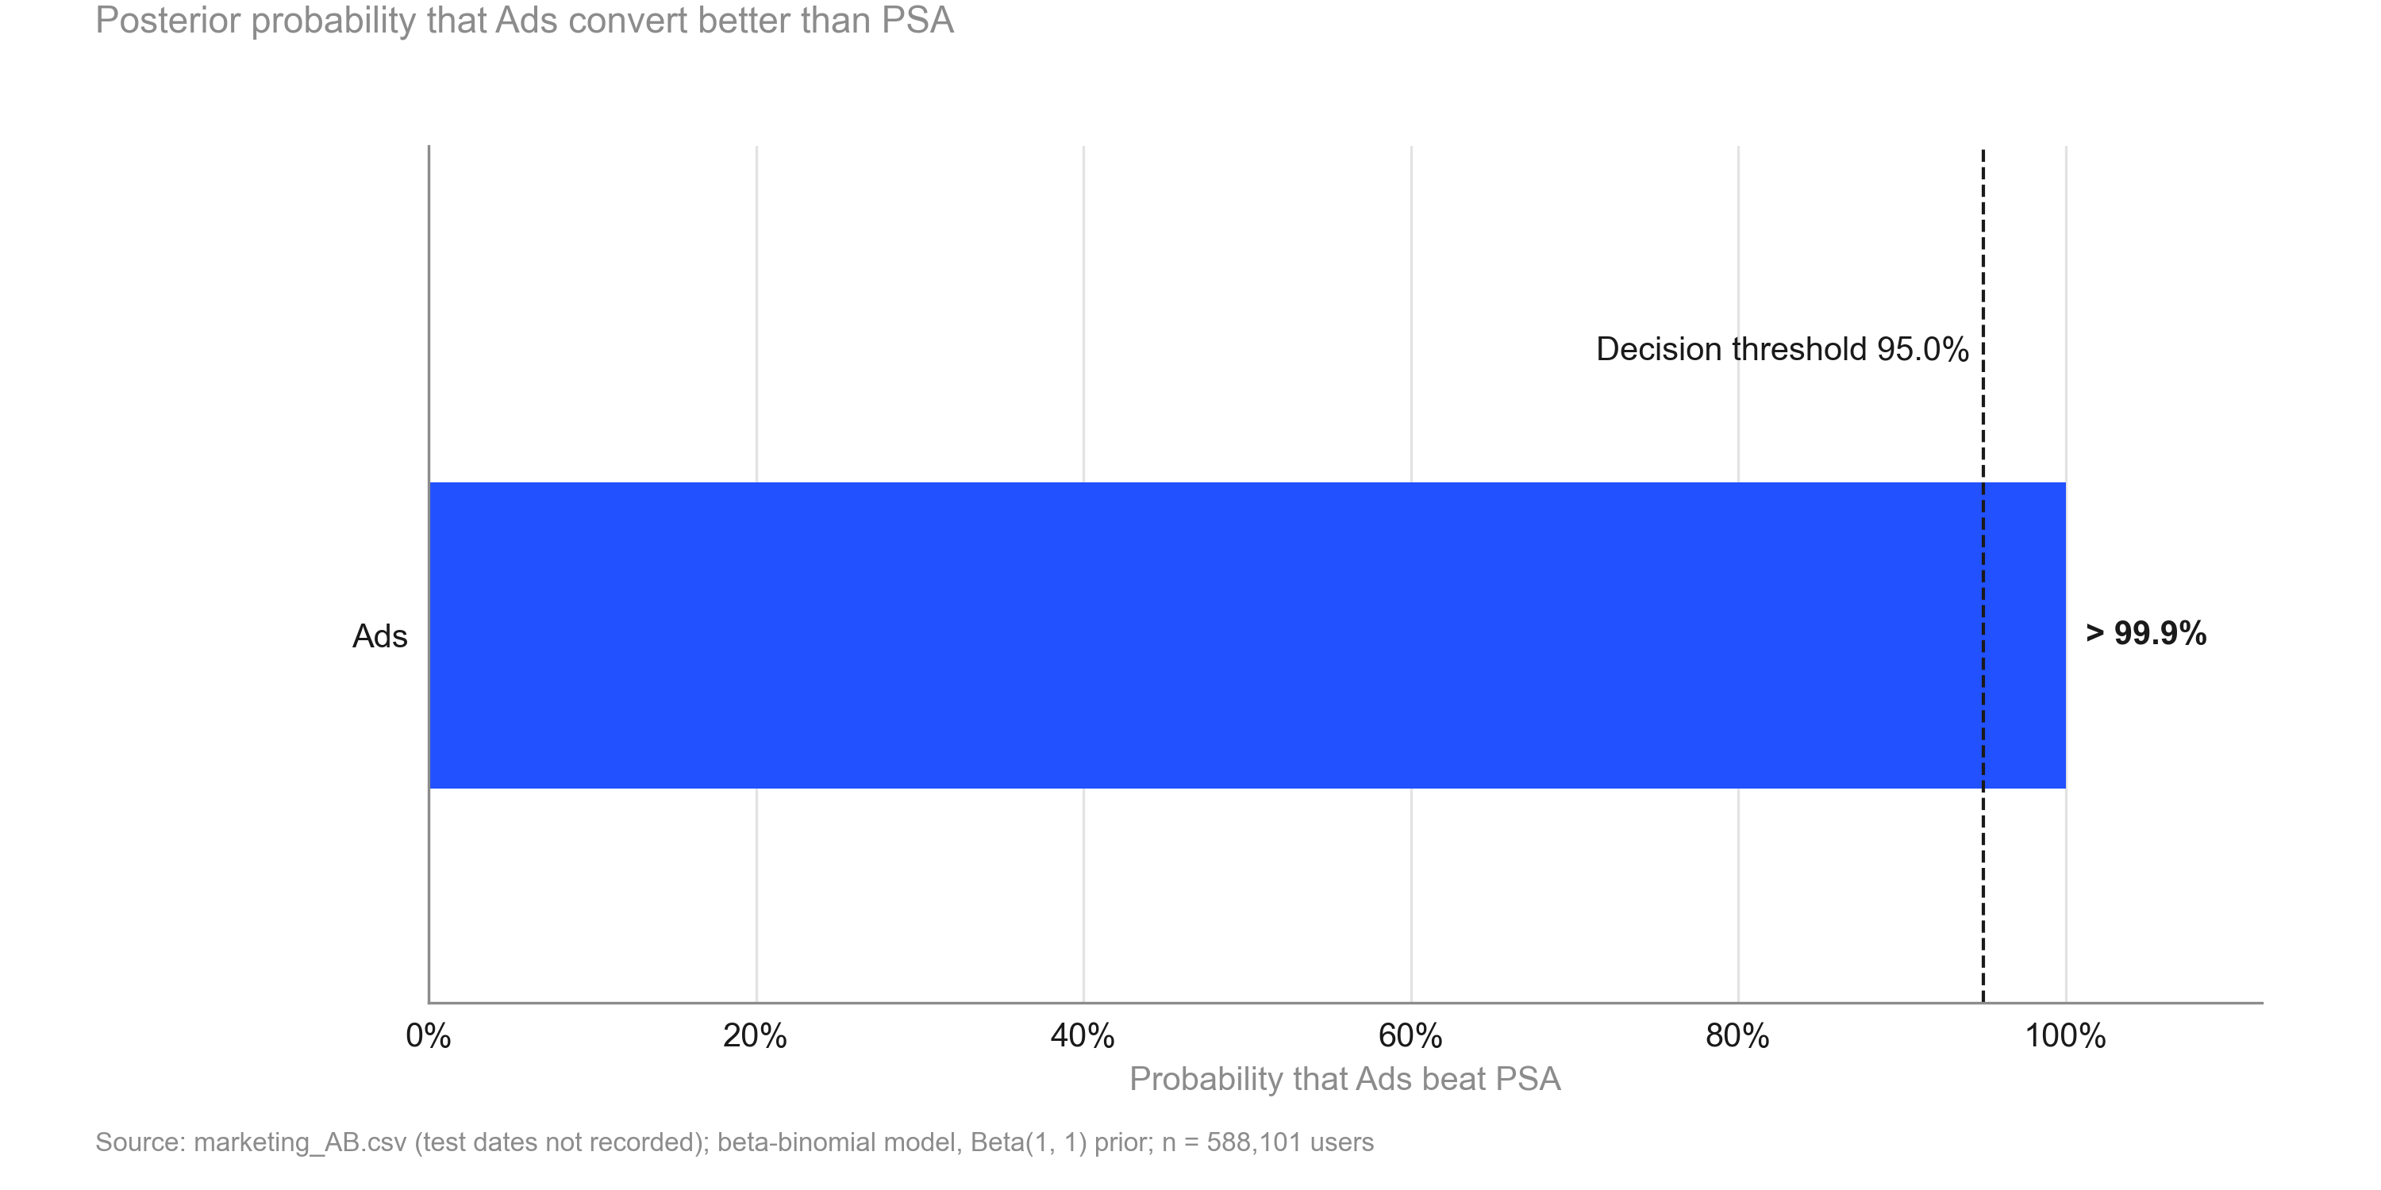
Ads beat PSA on conversion with > 99.9% probability, above the 95% decision threshold
KEY TAKEAWAYS
1. P(Ads beat PSA) > 99.9% vs a 95% decision threshold
2. P(lift above the 5% practical threshold) > 99.9%
3. Staying with PSA would cost an expected 0.77 pp of conversion
Source: marketing_AB.csv (test dates not recorded); beta-binomial model, Beta(1, 1) prior; n = 588,101 users
9
Notes:
speaker note: the Bayesian decision rule says ship - the chance ads are worse than PSA is negligible.

Slide 10
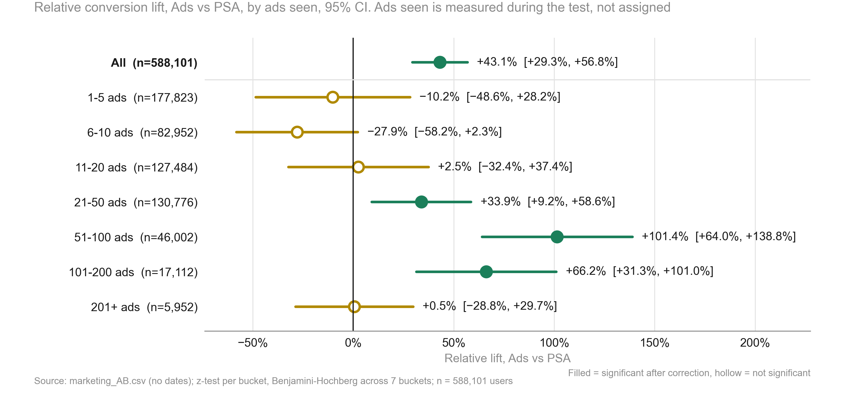
Exploratory, not causal: lift significant only at 21-50, 51-100 and 101-200 ads seen; 4 of 7 buckets inconclusive
KEY TAKEAWAYS
1. Significant: 21-50, 51-100 and 101-200 ads (+33.9%, +101.4%, +66.2%)
2. Inconclusive: 1-5, 6-10, 11-20 and 201+ ads - wide intervals, not no effect
3. Ads seen reflects behaviour; PSA share varies by bucket (p < 0.001): not dose-response
Source: marketing_AB.csv (no dates); z-test per bucket, Benjamini-Hochberg across 7 buckets; n = 588,101 users
10
Notes:
speaker note: descriptive only - heavier-exposure users are different people, so this does not show that more ads cause more lift.

Slide 11
Risks and caveats to keep in mind
• PSA ids form a separate block (900,000 to 923,523); assignment unconfirmed.
• Split confirmed as 96/4 only after a 95/5 check failed.
• Exposure breakdowns are exploratory, non-causal; 4 of 7 buckets inconclusive.
• No dates: novelty or wear-off cannot be checked.
• No guardrail metrics defined; verdict rests on conversion alone.
Source: marketing_AB.csv; run 2026-10-01_marketing-ads
11
Notes:
Be explicit about what could make this conclusion wrong.

Slide 12
Recommendation: Ship
NEXT STEPS
1. Keep ads running: about 7.7 extra conversions per 1,000 users (6.0 to 9.4).
2. Data owner: confirm random assignment to ads vs PSA before scaling spend.
3. Agree a value per conversion to price the 4,343 extra conversions.
4. Test ad frequency in a new randomised test before changing it.
5. Keep a small PSA holdout when scaling to track the lift.
Source: marketing_AB.csv; run 2026-10-01_marketing-ads
12
Notes:
Close with the decision and owners. The primary metric improved significantly and by more than the practical threshold.

Slide 13
Appendix
Methodology, validation and full results

Slide 14
Methodology
• srm: srm check (code/11_validate_srm.py)
• primary test: two proportion ztest (code/20_analysis_primary_test.py)
• bayesian: beta binomial (code/20_analysis_bayesian.py)
• impact: incremental impact (code/20_analysis_impact.py)
• exposure explore: segment effects, two proportion ztest, interaction test, simpsons check (code/20_analysis_exposure_explore.py)
• Settings: alpha 0.05 (two-sided), power 0.8, SRM threshold 0.001
Source: marketing_AB.csv; run 2026-10-01_marketing-ads
14
Notes:
Tests used per analysis step and the scripts that produced each number.

Slide 15
Full results
Metric | Segment | Comparison | Control | Treatment | Rel. lift | CI | p / P(beat) | Method
converted |  | ad vs psa | 1.79% | 2.55% | +43.1% | [+29.3%, +56.8%] | <0.001 (adj.) | two proportion ztest
converted |  | ad vs psa | 1.79% | 2.55% | +42.9% | [+29.9%, +57.5%] | 100.0% | beta binomial
converted | All | ad vs psa | 1.79% | 2.55% | +43.1% | [+29.3%, +56.8%] | <0.001 | two proportion ztest
converted | 1-5 | ad vs psa | 0.28% | 0.25% | −10.2% | [−48.6%, +28.2%] | 0.869 (adj.) | two proportion ztest
converted | 101-200 | ad vs psa | 10.64% | 17.68% | +66.2% | [+31.3%, +101.0%] | <0.001 (adj.) | two proportion ztest
converted | 11-20 | ad vs psa | 0.82% | 0.84% | +2.5% | [−32.4%, +37.4%] | 0.974 (adj.) | two proportion ztest
converted | 201+ | ad vs psa | 15.50% | 15.58% | +0.5% | [−28.8%, +29.7%] | 0.974 (adj.) | two proportion ztest
converted | 21-50 | ad vs psa | 2.18% | 2.92% | +33.9% | [+9.2%, +58.6%] | 0.004 (adj.) | two proportion ztest
converted | 51-100 | ad vs psa | 5.77% | 11.63% | +101.4% | [+64.0%, +138.8%] | <0.001 (adj.) | two proportion ztest
converted | 6-10 | ad vs psa | 0.67% | 0.49% | −27.9% | [−58.2%, +2.3%] | 0.217 (adj.) | two proportion ztest
converted | Friday | ad vs psa | 1.63% | 2.25% | +37.8% | [+3.3%, +72.3%] | 0.016 (adj.) | two proportion ztest
converted | Monday | ad vs psa | 2.26% | 3.32% | +47.4% | [+14.8%, +79.9%] | 0.001 (adj.) | two proportion ztest
Source: marketing_AB.csv; run 2026-10-01_marketing-ads
15
Notes:
Complete table of estimates.

Slide 16
Full results (cont.)
Metric | Segment | Comparison | Control | Treatment | Rel. lift | CI | p / P(beat) | Method
converted | Saturday | ad vs psa | 1.40% | 2.13% | +52.2% | [+4.8%, +99.6%] | 0.013 (adj.) | two proportion ztest
converted | Sunday | ad vs psa | 2.06% | 2.46% | +19.5% | [−10.1%, +49.2%] | 0.183 (adj.) | two proportion ztest
converted | Thursday | ad vs psa | 2.02% | 2.16% | +7.0% | [−16.9%, +30.8%] | 0.555 (adj.) | two proportion ztest
converted | Tuesday | ad vs psa | 1.44% | 3.04% | +110.7% | [+46.9%, +174.5%] | <0.001 (adj.) | two proportion ztest
converted | Wednesday | ad vs psa | 1.58% | 2.54% | +60.9% | [+18.1%, +103.7%] | 0.001 (adj.) | two proportion ztest
Source: marketing_AB.csv; run 2026-10-01_marketing-ads
16
Notes:
Complete table of estimates.

