Slide 1
Single-button checkout test
Treatment raises checkout conversion by 3.2% vs control (statistically significant)
01 October 2026

Slide 2
EXECUTIVE SUMMARY
Treatment raises checkout conversion by 3.2% vs control (statistically significant)
RECOMMENDATION
SHIP
The primary metric improved significantly and no guardrail was breached.
THE ASK
Should we ship the single-button checkout?
WHAT WE FOUND
• Relative lift in checkout conversion: +3.2% (95% CI [+1.2%, +5.2%])
• Evidence: p = 0.001
• Checkout conversion: control vs treatment: 34.25% vs 35.34%
• Units analysed: control: 40,183 / treatment: 39,817
• Guardrail revenue: pass (+2.2%)
WHAT IT MEANS
For every 1,000 users, about 11 more achieved checkout conversion with treatment than with control. A difference this large is unlikely to be down to chance.
WHAT WE RECOMMEND
Roll out the single-button checkout to 100% of users
Source: checkout_ab.csv, 2026-09-01 to 2026-09-14; run 2026-10-01_checkout-sample
2
Notes:
The answer first. Verdict: Ship. The primary metric improved significantly and no guardrail was breached. For every 1,000 users, about 11 more achieved checkout conversion with treatment than with control. A difference this large is unlikely to be down to chance. Caveats:

Slide 3
Agenda
1
The ask: what we were asked to answer
2
Approach: how we answered it
3
Findings: what the data shows
4
Impact: what it means for the business
5
Recommendation: risks, decision and next steps
A
Appendix: methodology, validation and full results
Source: checkout_ab.csv, 2026-09-01 to 2026-09-14; run 2026-10-01_checkout-sample
3
Notes:
The storyline: what we were asked, how we answered it, what we found, what it is worth, and what we recommend.

Slide 4
1 THE ASK 2 APPROACH 3 FINDINGS 4 IMPACT 5 RECOMMENDATION
The ask: Should we ship the single-button checkout?
THE DECISION
WHAT WAS TESTED
Decide whether to roll out the change.
Groups | control: 40,183, treatment: 39,817
Unit | users
Period | 2026-09-01 to 2026-09-14
Primary metric | converted
Guardrails | revenue
Practical threshold | +2% relative
OUR HYPOTHESIS
A single 'Pay now' button raises checkout conversion without lowering revenue per user.
WHAT SUCCESS LOOKS LIKE
Converted must rise by at least 2% (relative) without breaching a guardrail.
Source: checkout_ab.csv, 2026-09-01 to 2026-09-14; run 2026-10-01_checkout-sample
4
Notes:
Restate the question and the decision before any result, so the audience judges the answer against the ask.

Slide 5
1 THE ASK 2 APPROACH 3 FINDINGS 4 IMPACT 5 RECOMMENDATION
We answered it with a randomised comparison of 80,000 users, quality checks and an independent review
1. Data
2. Quality checks
3. Analysis
4. Review
80,000 users in 2 groups (control, treatment). Period: 2026-09-01 to 2026-09-14.
12 data checks: overall PASS. Traffic split as intended (p = 0.196).
Two-proportion z-test, plus non-inferiority test, interaction test, effect over time. Judged against a 2% practical threshold.
Independent reviewer re-checked the numbers from the raw data: 1 round, passed.
Source: checkout_ab.csv, 2026-09-01 to 2026-09-14; run 2026-10-01_checkout-sample
5
Notes:
How the answer was produced and why it can be trusted: data, checks, method, independent review.

Slide 6
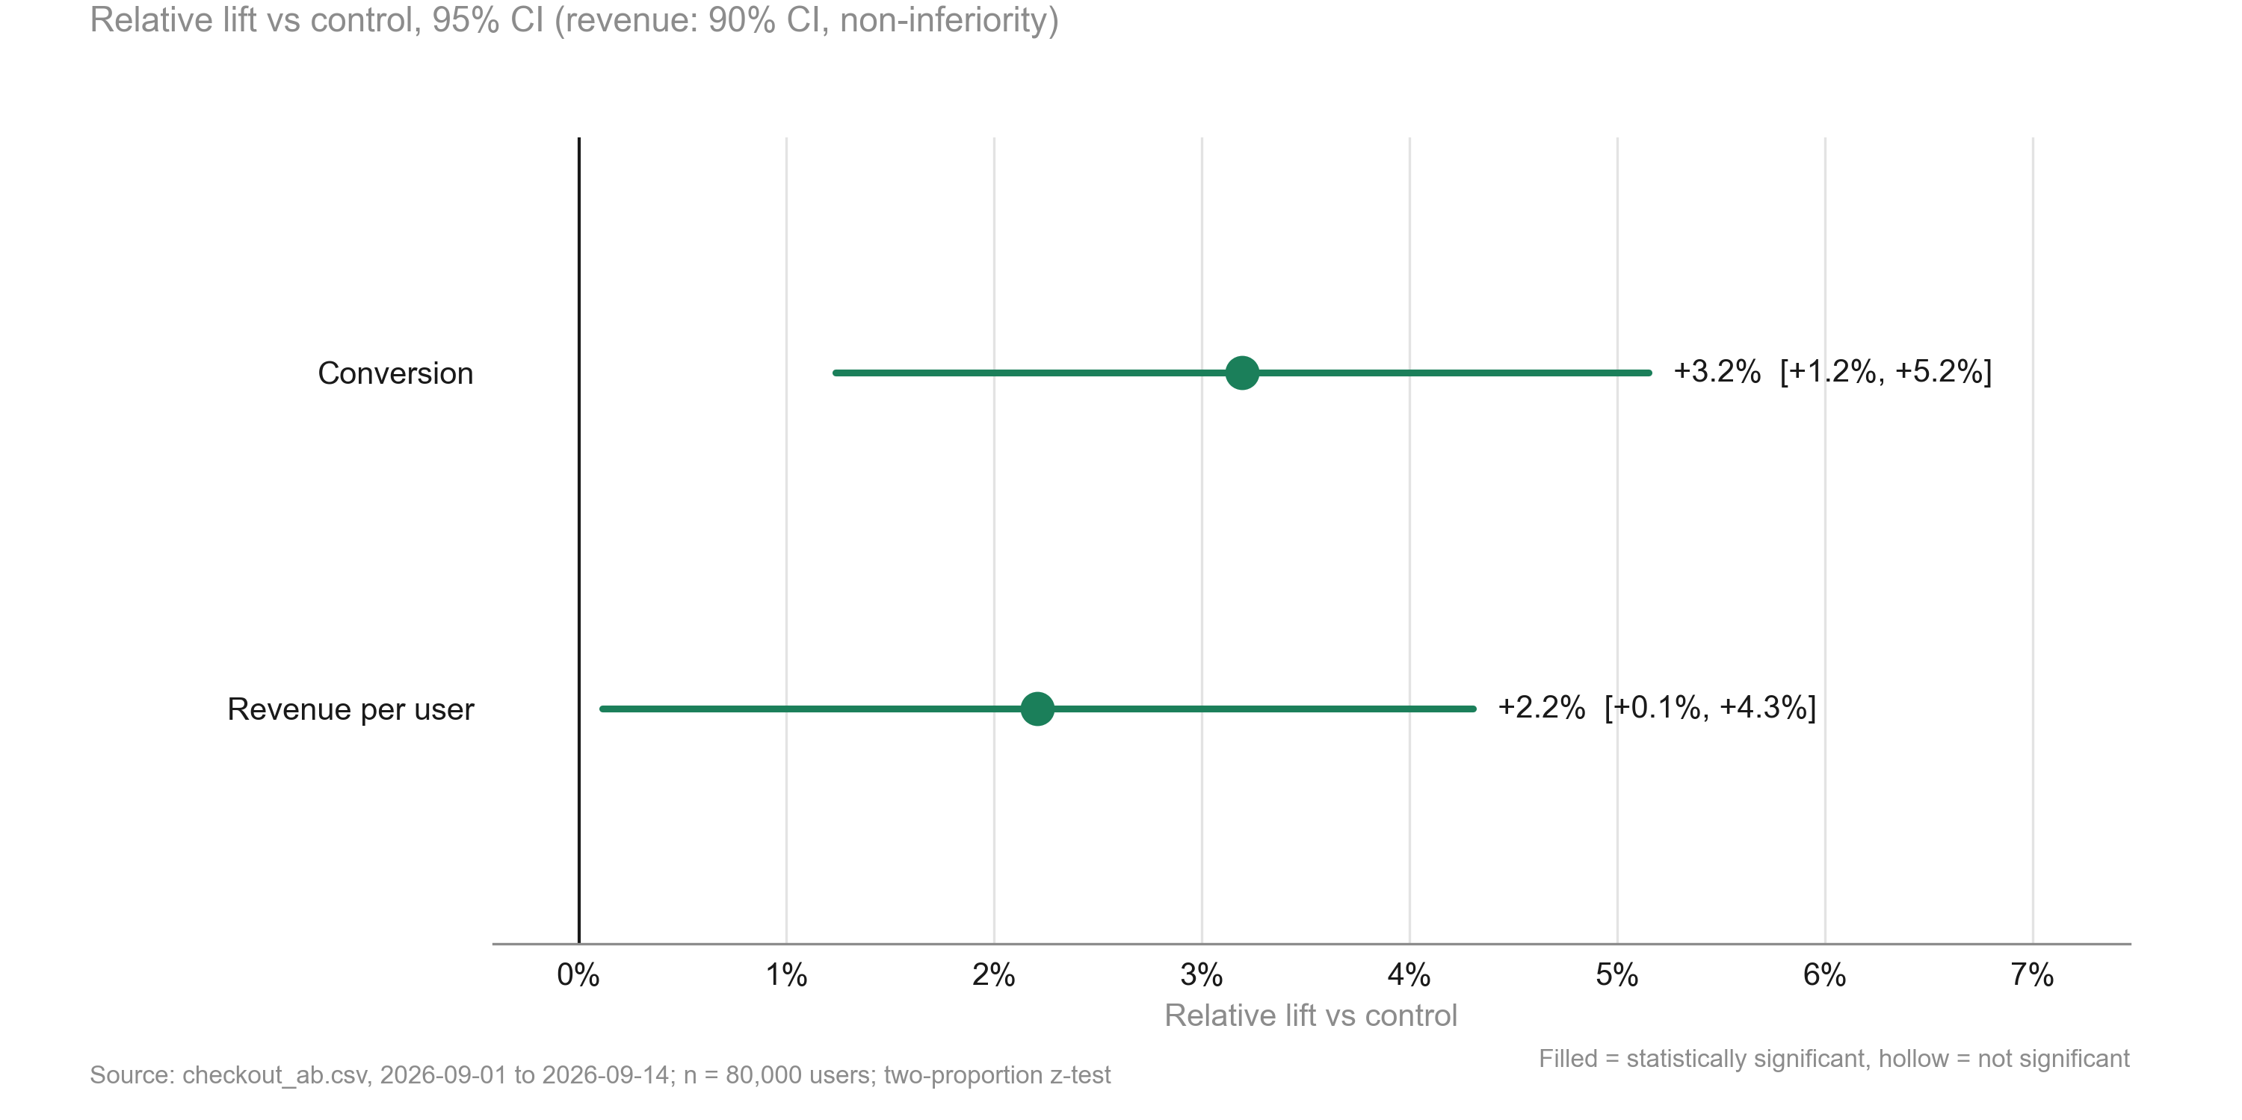
1 THE ASK 2 APPROACH 3 FINDINGS 4 IMPACT 5 RECOMMENDATION
Treatment lifts checkout conversion by +3.2%, statistically significant
KEY TAKEAWAYS
1. Conversion: +3.2% relative, CI [+1.2%, +5.2%]
2. Evidence: p = 0.001, above the 2% practical threshold
3. Revenue per user: +2.2%, non-inferiority pass
Source: checkout_ab.csv, 2026-09-01 to 2026-09-14; run 2026-10-01_checkout-sample
6
Notes:
Key point: Conversion +3.2% (p = 0.001).

Slide 7
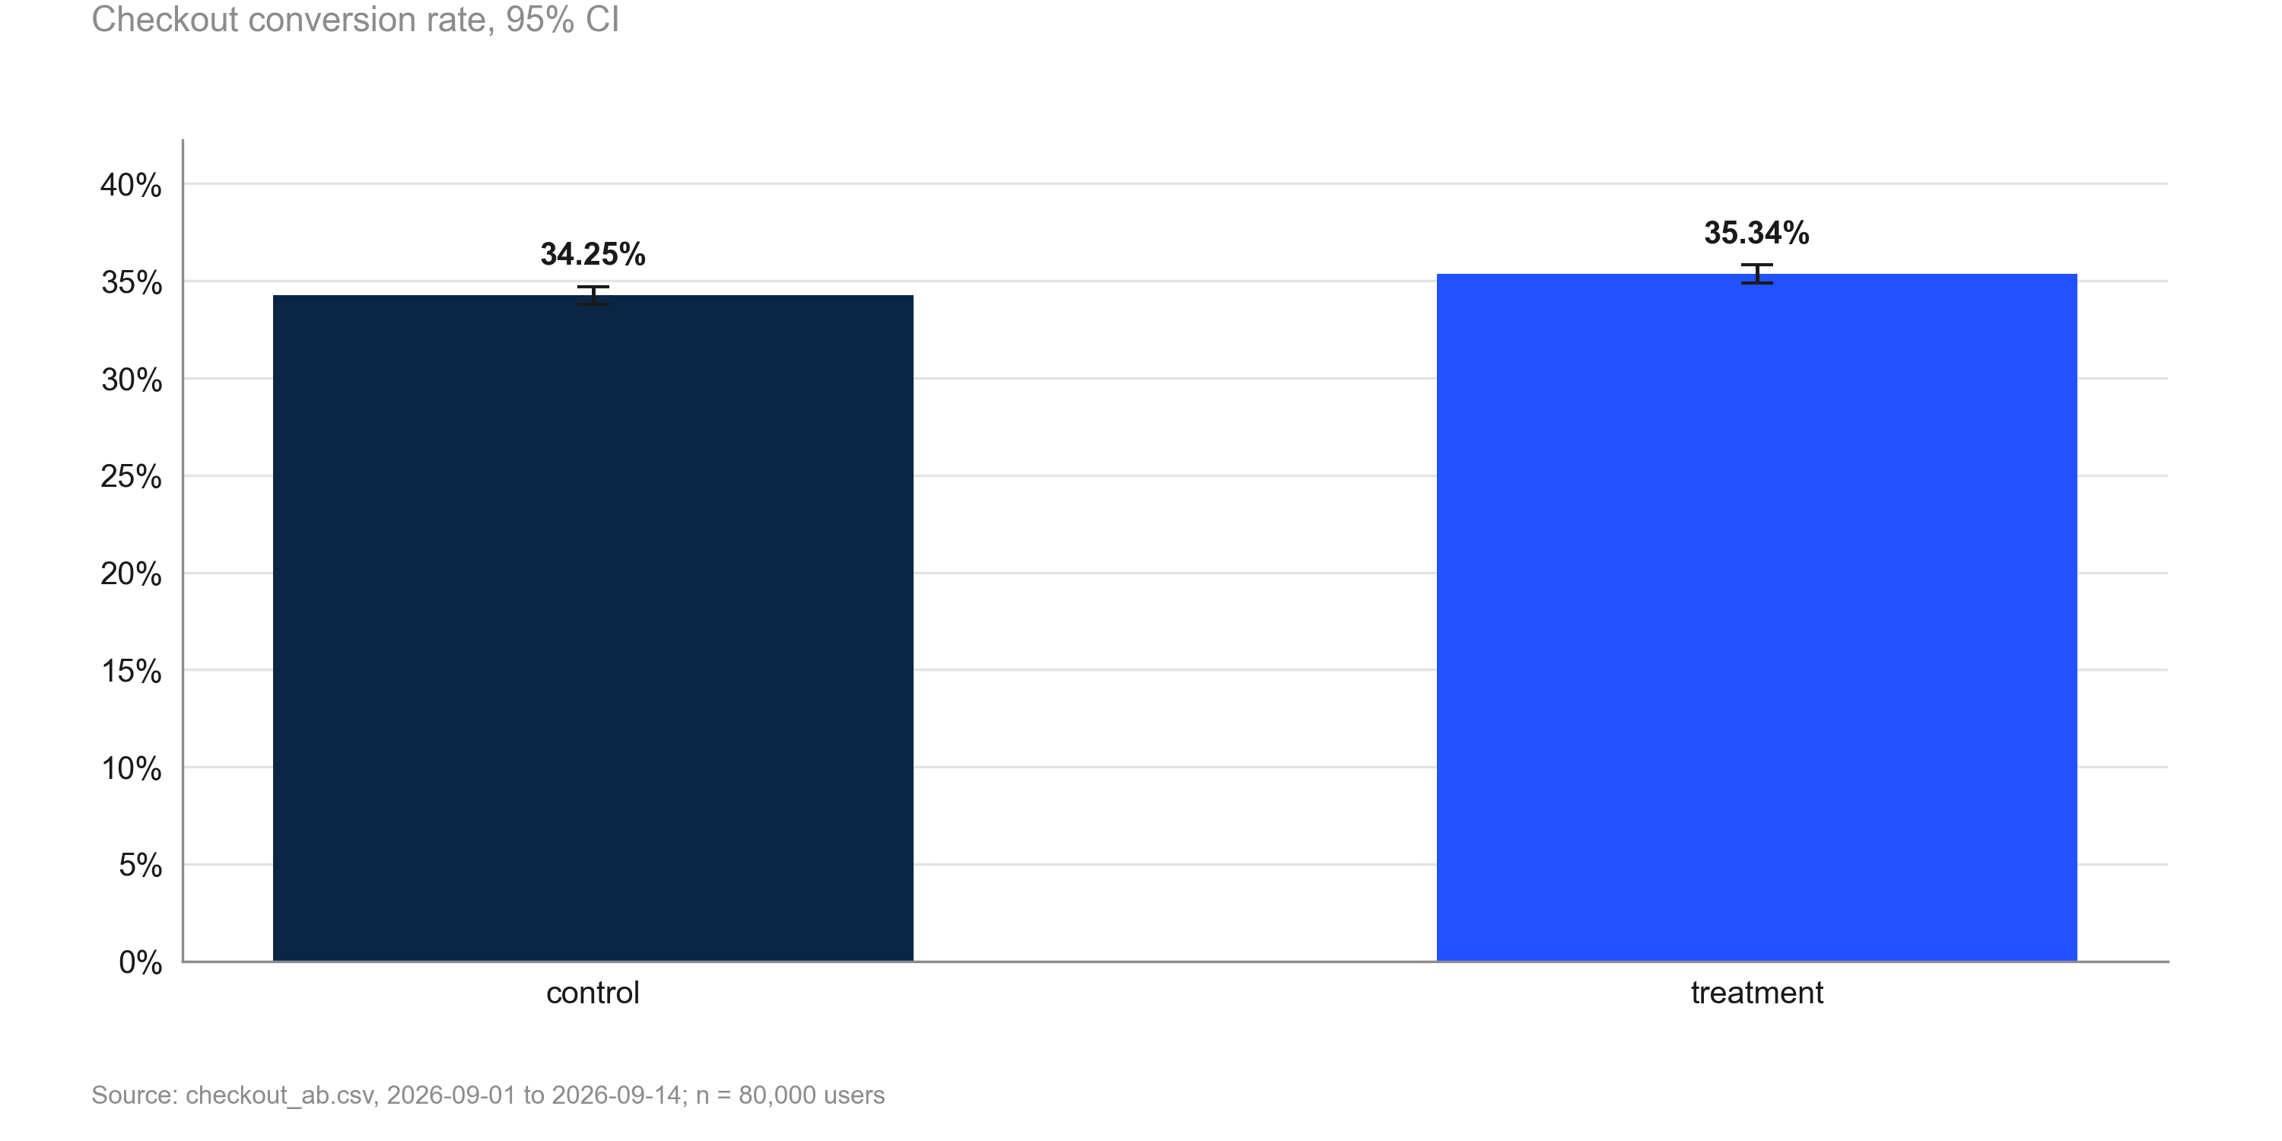
1 THE ASK 2 APPROACH 3 FINDINGS 4 IMPACT 5 RECOMMENDATION
Conversion rises from 34.25% to 35.34%
KEY TAKEAWAYS
1. Control: 34.25%
2. Treatment: 35.34%
3. Absolute change: +1.09 pp
Source: checkout_ab.csv, 2026-09-01 to 2026-09-14; run 2026-10-01_checkout-sample
7
Notes:
Key point: Conversion rises from 34.25% to 35.34%.

Slide 8
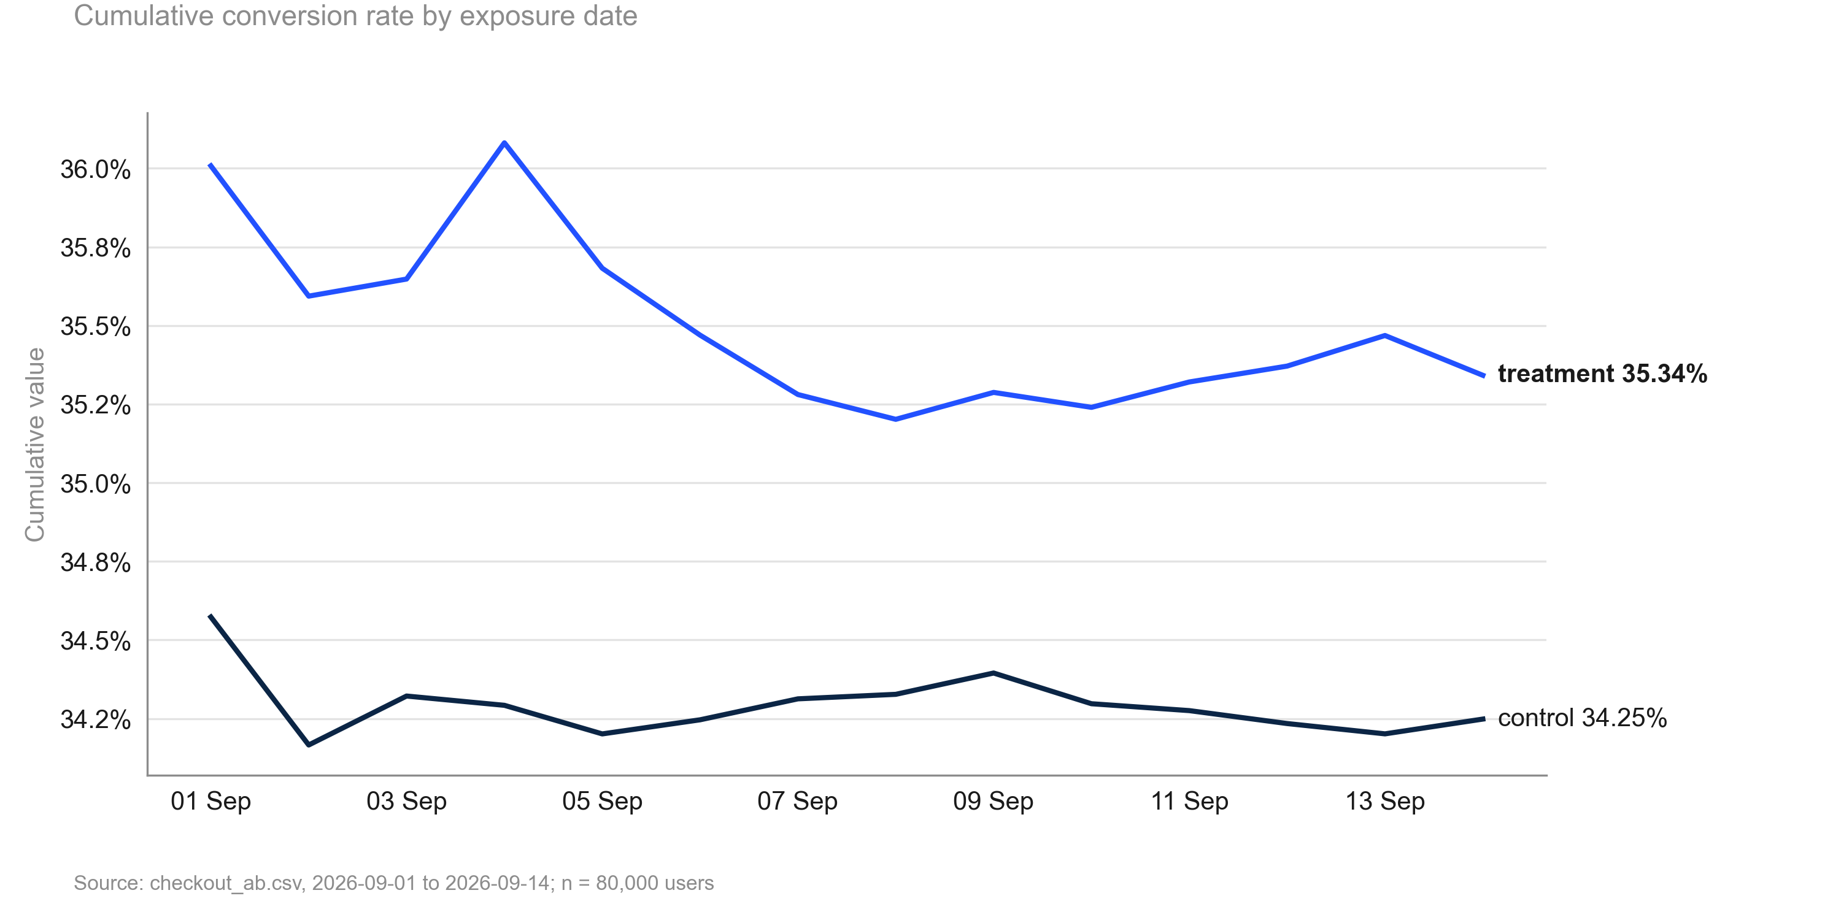
1 THE ASK 2 APPROACH 3 FINDINGS 4 IMPACT 5 RECOMMENDATION
Treatment led on cumulative conversion throughout the test
KEY TAKEAWAYS
1. No reversal over the 14 days
2. Gap stable after the first week
3. No sign of a novelty spike
Source: checkout_ab.csv, 2026-09-01 to 2026-09-14; run 2026-10-01_checkout-sample
8
Notes:
Key point: Treatment led on cumulative conversion throughout the test.

Slide 9
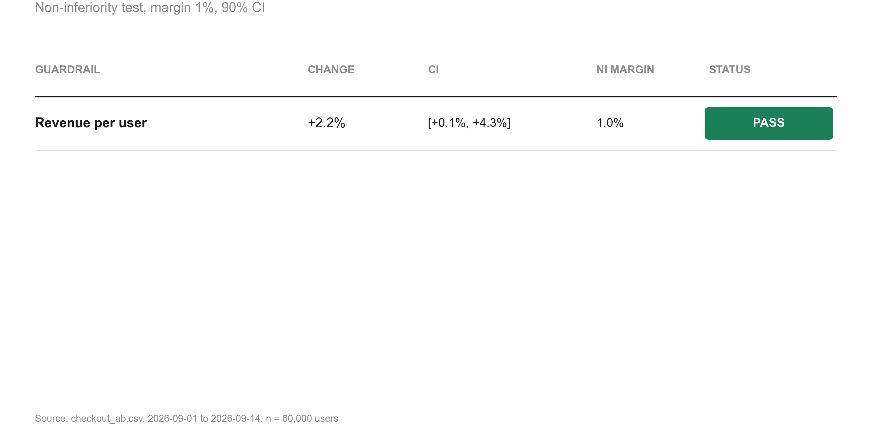
1 THE ASK 2 APPROACH 3 FINDINGS 4 IMPACT 5 RECOMMENDATION
Revenue per user is non-inferior (+2.2%)
KEY TAKEAWAYS
1. Change +2.2%
2. Margin 1%
3. Status: pass
Source: checkout_ab.csv, 2026-09-01 to 2026-09-14; run 2026-10-01_checkout-sample
9
Notes:
Key point: Revenue per user is non-inferior (+2.2%).

Slide 10
1 THE ASK 2 APPROACH 3 FINDINGS 4 IMPACT 5 RECOMMENDATION
Guardrail checks: each tested for non-inferiority against its margin
Metric | Comparison | Control | Treatment | Rel. lift | CI | p / P(beat) | Method | Status
revenue | treatment vs control | 22.73 | 23.23 | +2.2% | [+0.1%, +4.3%] | 0.005 | noninferiority test | PASS
Source: checkout_ab.csv, 2026-09-01 to 2026-09-14; run 2026-10-01_checkout-sample
10
Notes:
Guardrails protect against wins on the primary metric that cost something elsewhere.

Slide 11
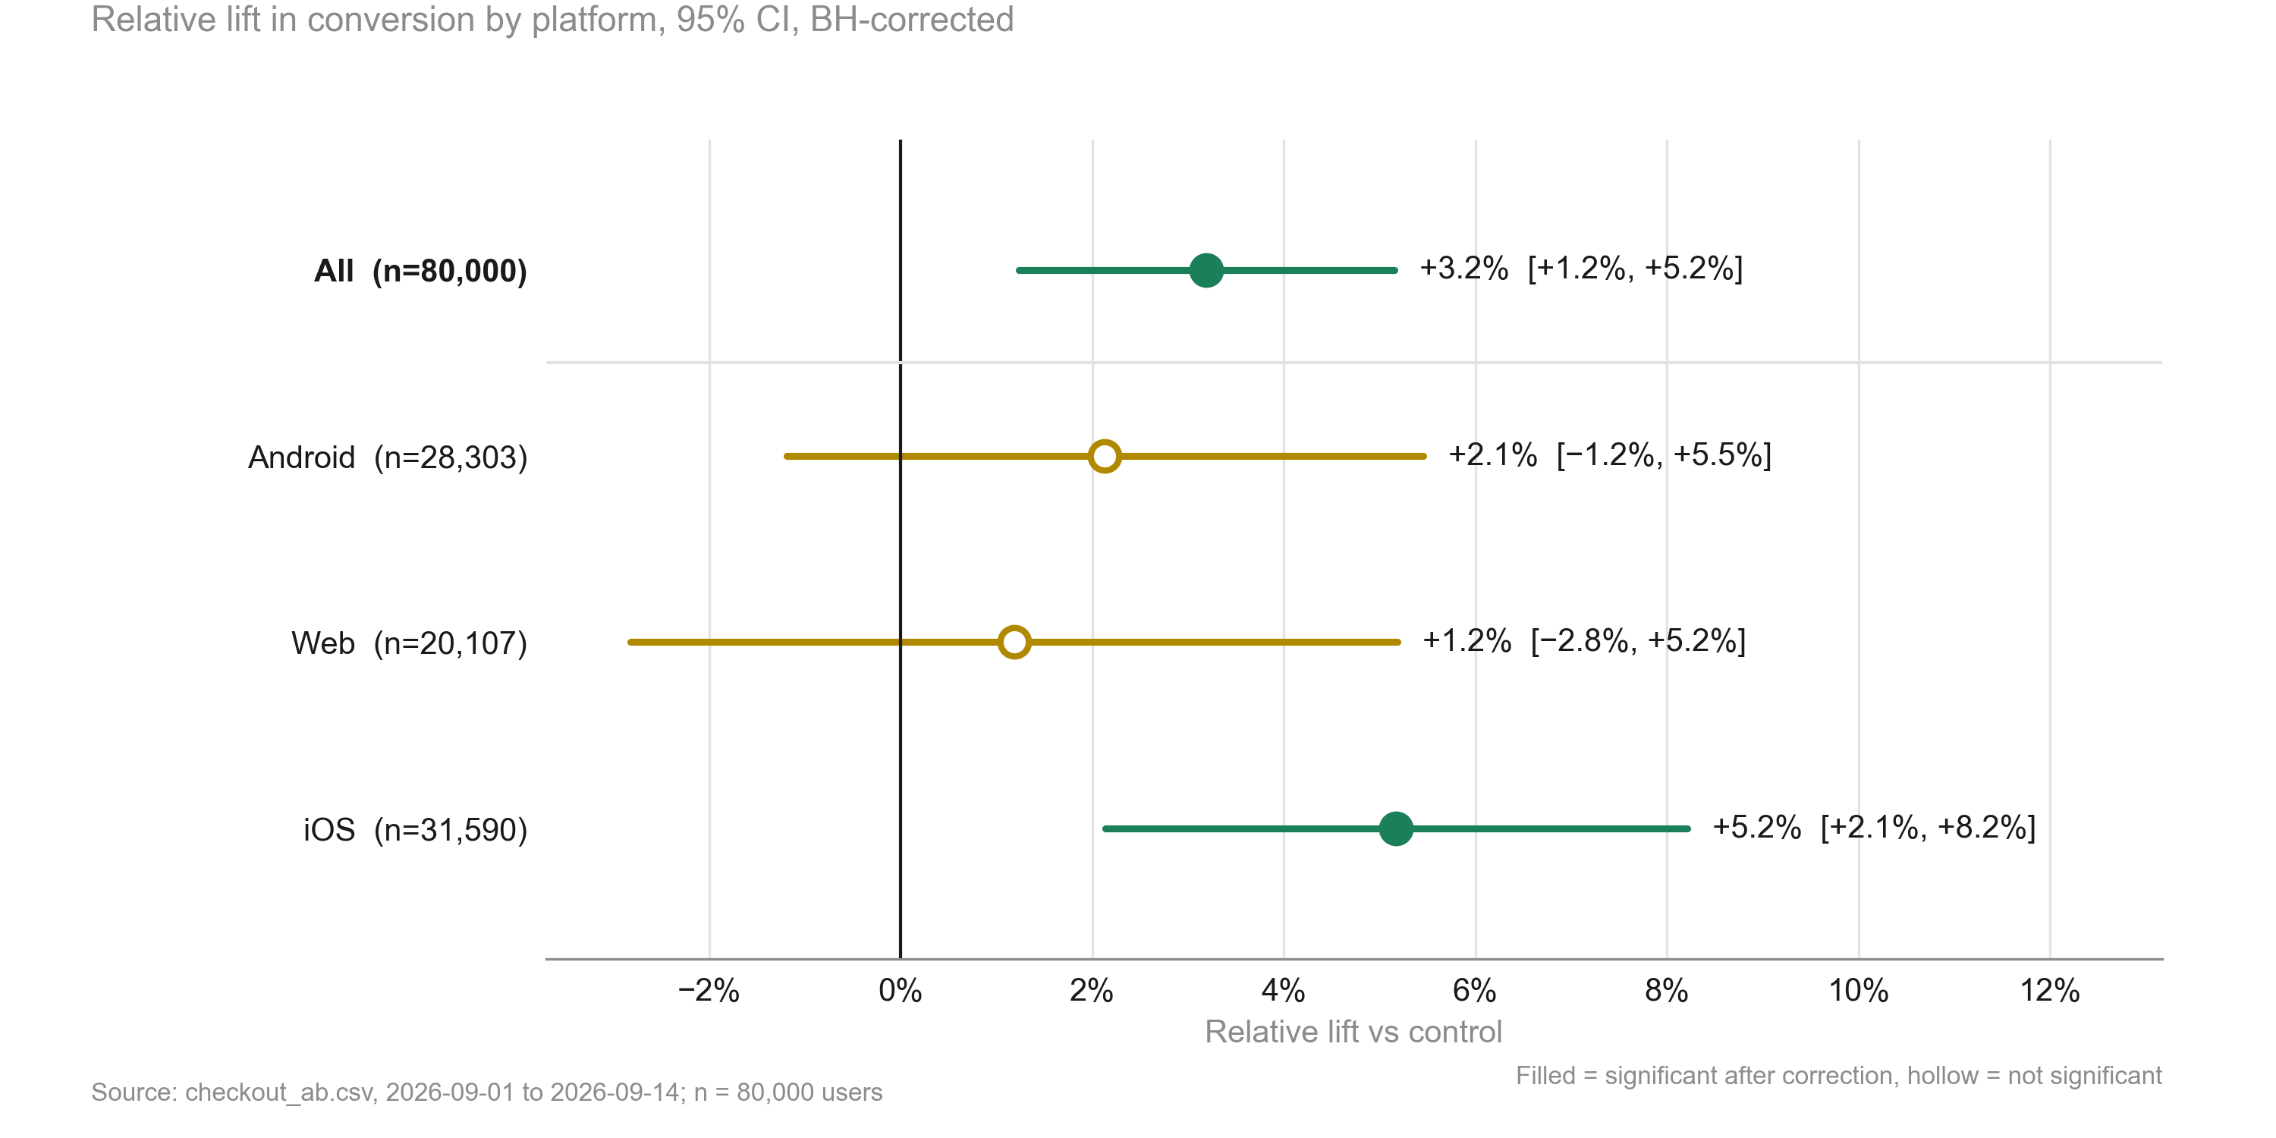
1 THE ASK 2 APPROACH 3 FINDINGS 4 IMPACT 5 RECOMMENDATION
The lift is largest on iOS; differences between platforms are not significant
KEY TAKEAWAYS
1. Interaction test: p = 0.168
2. Treat platform differences as exploratory
3. Direction is positive on every platform
Source: checkout_ab.csv, 2026-09-01 to 2026-09-14; run 2026-10-01_checkout-sample
11
Notes:
Key point: The lift is largest on iOS; differences between platforms are not significant.

Slide 12
1 THE ASK 2 APPROACH 3 FINDINGS 4 IMPACT 5 RECOMMENDATION
For every 1,000 users, about 11 more achieved checkout conversion with treatment than with control.
+3.2%
+10.9
80,000
Relative change in the primary metric
Change per 1,000 users
Units analysed
95% CI [+1.2%, +5.2%]
34.25% → 35.34%
control: 40,183 / treatment: 39,817
SO WHAT
The primary metric improved significantly and no guardrail was breached.
Source: checkout_ab.csv, 2026-09-01 to 2026-09-14; run 2026-10-01_checkout-sample
12
Notes:
Translate the statistics into business terms: what the change is worth.

Slide 13
1 THE ASK 2 APPROACH 3 FINDINGS 4 IMPACT 5 RECOMMENDATION
No material risks identified
• No material risks identified by the analysis or the review.
Source: checkout_ab.csv, 2026-09-01 to 2026-09-14; run 2026-10-01_checkout-sample
13
Notes:
Be explicit about what could make the conclusion wrong.

Slide 14
1 THE ASK 2 APPROACH 3 FINDINGS 4 IMPACT 5 RECOMMENDATION
Recommendation: Ship, with 3 next steps to act on
DECISION: SHIP
The primary metric improved significantly and no guardrail was breached.
NEXT STEPS
# | Action | Owner | Timing
1 | Roll out the single-button checkout to 100% of users | To agree | To agree
2 | Keep monitoring revenue per user for four weeks after rollout | To agree | To agree
3 | Investigate why the Web lift is smaller before the next checkout test | To agree | To agree
Source: checkout_ab.csv, 2026-09-01 to 2026-09-14; run 2026-10-01_checkout-sample
14
Notes:
Close with the decision, then who does what by when.

Slide 15
Appendix
Methodology, validation and full results

Slide 16
Methodology: tests used and the scripts that produced each number
• primary test: two proportion ztest (code/20_analysis_sample.py)
• guardrails: noninferiority test (code/20_analysis_sample.py)
• segments: two proportion ztest, interaction test (code/20_analysis_sample.py)
• time trends: cumulative effects (code/20_analysis_sample.py)
• Settings: alpha 0.05 (two-sided), power 0.8, SRM threshold 0.001
Source: checkout_ab.csv, 2026-09-01 to 2026-09-14; run 2026-10-01_checkout-sample
16
Notes:
Tests used per analysis step and the scripts that produced each number.

Slide 17
Data validation: overall verdict PASS
Check | Verdict | Detail
schema | PASS | 7 columns, 80,000 rows
dtypes | PASS | All metric columns numeric
missing values | PASS | No missing values
duplicates | PASS | 80,000 units, one row each
contamination | PASS | No unit appears in more than one variant
variants | PASS | Counts {'control': 40183, 'treatment': 39817}
SRM | PASS | p = 0.196 (threshold 0.001)
dates | PASS | 2026-09-01 to 2026-09-14 (14 days)
outliers | PASS | No extreme outliers in continuous metrics
impossible values | PASS | Metric values within valid ranges
pre-period data | PASS | None described (CUPED not possible)
covariate balance | PASS | Segment mix similar across variants
Source: checkout_ab.csv, 2026-09-01 to 2026-09-14; run 2026-10-01_checkout-sample
17
Notes:
Full list of validation checks.

Slide 18
Full results
Metric | Segment | Comparison | Control | Treatment | Rel. lift | CI | p / P(beat) | Method
converted |  | treatment vs control | 34.25% | 35.34% | +3.2% | [+1.2%, +5.2%] | 0.001 | two proportion ztest
revenue |  | treatment vs control | 22.73 | 23.23 | +2.2% | [+0.1%, +4.3%] | 0.005 | noninferiority test
converted | Android | treatment vs control | 33.53% | 34.24% | +2.1% | [−1.2%, +5.5%] | 0.306 (adj.) | two proportion ztest
converted | Web | treatment vs control | 32.63% | 33.02% | +1.2% | [−2.8%, +5.2%] | 0.561 (adj.) | two proportion ztest
converted | iOS | treatment vs control | 35.93% | 37.79% | +5.2% | [+2.1%, +8.2%] | 0.002 (adj.) | two proportion ztest
Source: checkout_ab.csv, 2026-09-01 to 2026-09-14; run 2026-10-01_checkout-sample
18
Notes:
Complete table of estimates.

