Slide 1
Single-button checkout test
Treatment raises checkout conversion by 3.2% vs control (statistically significant)
01 October 2026

Slide 2
Treatment raises checkout conversion by 3.2% vs control (statistically significant)
Recommendation: SHIP The primary metric improved significantly and no guardrail was breached.
• Relative lift in checkout conversion: +3.2% (99% CI [+0.6%, +5.8%])
• Evidence: p = 0.001
• Checkout conversion: control vs treatment: 34.25% vs 35.34%
• Units analysed: control: 40,183 / treatment: 39,817
• Guardrail revenue: pass (+2.2%)
Source: checkout_ab.csv, 2026-09-01 to 2026-09-14; run 2026-10-01_checkout-button
2
Notes:
Verdict: Ship. The primary metric improved significantly and no guardrail was breached. For every 1,000 users, about 11 more achieved checkout conversion with treatment than with control. A difference this large is unlikely to be down to chance. CI lower bound +0.6% is below the 2% threshold: the true lift may be smaller than needed (review finding 1). Platforms: iOS +5.2%, Web +1.2%; interaction p = 0.168, no evidence they differ. Revenue is heavy-tailed; bootstrap CI [−1.0%, +5.4%] agrees with the guardrail pass. Daily lift: stable (no significant trend) (p = 0.794).

Slide 3
How the experiment was set up
Item | Detail
Variants (units) | control: 40,183, treatment: 39,817
Test period | 2026-09-01 to 2026-09-14 (14 days)
Primary metric | converted (binary, goal: increase)
Guardrail metric | revenue (continuous, goal: no decrease)
Statistical settings | alpha 0.01, two-sided, power 0.8
Multiple-testing correction | secondary: holm; segments: benjamini-hochberg
Analysis type | post test readout, guardrail check, heterogeneous effects, novelty check
Source: checkout_ab.csv, 2026-09-01 to 2026-09-14; run 2026-10-01_checkout-button
3
Notes:
Walk through what was tested, on whom, for how long, and how success was defined before looking at results.

Slide 4
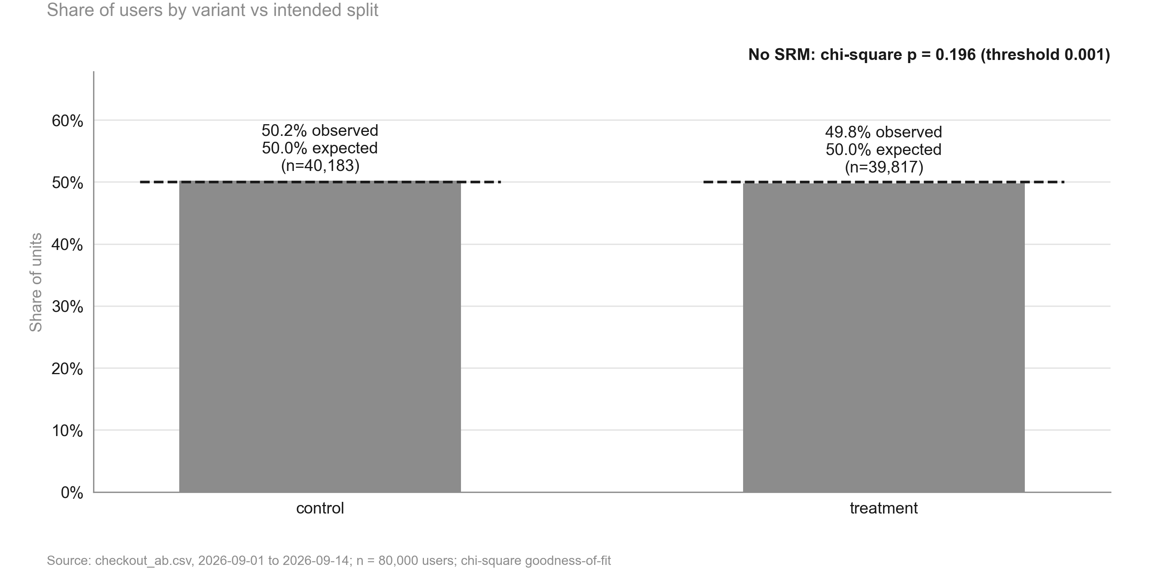
Traffic split matches the intended 50/50 (treatment 49.8%; no sample ratio mismatch)
KEY TAKEAWAYS
1. Control 50.2%, treatment 49.8%
2. Chi-square p = 0.196 vs threshold 0.001
3. Groups are comparable by design
Source: checkout_ab.csv, 2026-09-01 to 2026-09-14; n = 80,000 users
4
Notes:
The split is as intended, so the comparison between groups is trustworthy.

Slide 5
Data validation: overall verdict PASS
Check | Verdict | Detail
schema | PASS | 7 columns, 80,000 rows
dtypes | PASS | All metric columns numeric
missing values | PASS | No missing values
duplicates | PASS | 80,000 units, one row each
contamination | PASS | No unit appears in more than one variant
variants | PASS | Counts {'control': 40183, 'treatment': 39817}
SRM | PASS | p = 0.196 (threshold 0.001)
dates | PASS | 2026-09-01 to 2026-09-14 (14 days)
outliers | PASS | No extreme outliers in continuous metrics
impossible values | PASS | Metric values within valid ranges
pre-period data | PASS | None described (CUPED not possible)
covariate balance | PASS | Segment mix similar across variants
Source: checkout_ab.csv, 2026-09-01 to 2026-09-14; run 2026-10-01_checkout-button
5
Notes:
Summarise data quality: anything flagged here limits how far the results can be trusted.

Slide 6
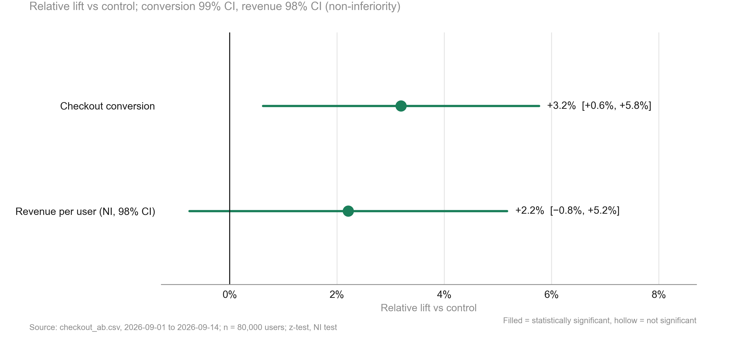
Treatment lifts checkout conversion by +3.2%, statistically significant, with revenue per user holding up
KEY TAKEAWAYS
1. Conversion: +3.2%, CI [+0.6%, +5.8%]
2. Evidence: p = 0.001; point estimate above the 2% threshold
3. Revenue per user: +2.2%, guardrail pass
Source: checkout_ab.csv, 2026-09-01 to 2026-09-14; n = 80,000 users
6
Notes:
Headline chart: the conversion lift is real; the lower end of its CI is below the practical threshold.

Slide 7
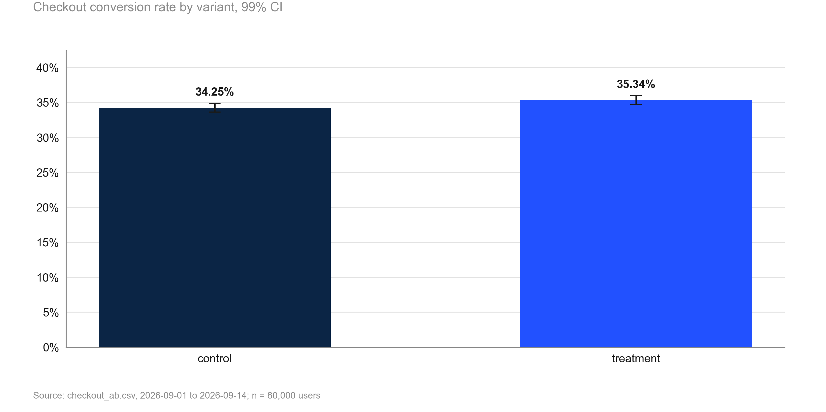
Checkout conversion rises from 34.25% to 35.34%
KEY TAKEAWAYS
1. Control: 34.25%
2. Treatment: 35.34%
3. Absolute change: +1.09 pp
Source: checkout_ab.csv, 2026-09-01 to 2026-09-14; n = 80,000 users
7
Notes:
Absolute levels: about one extra purchase per hundred checkout users.

Slide 8
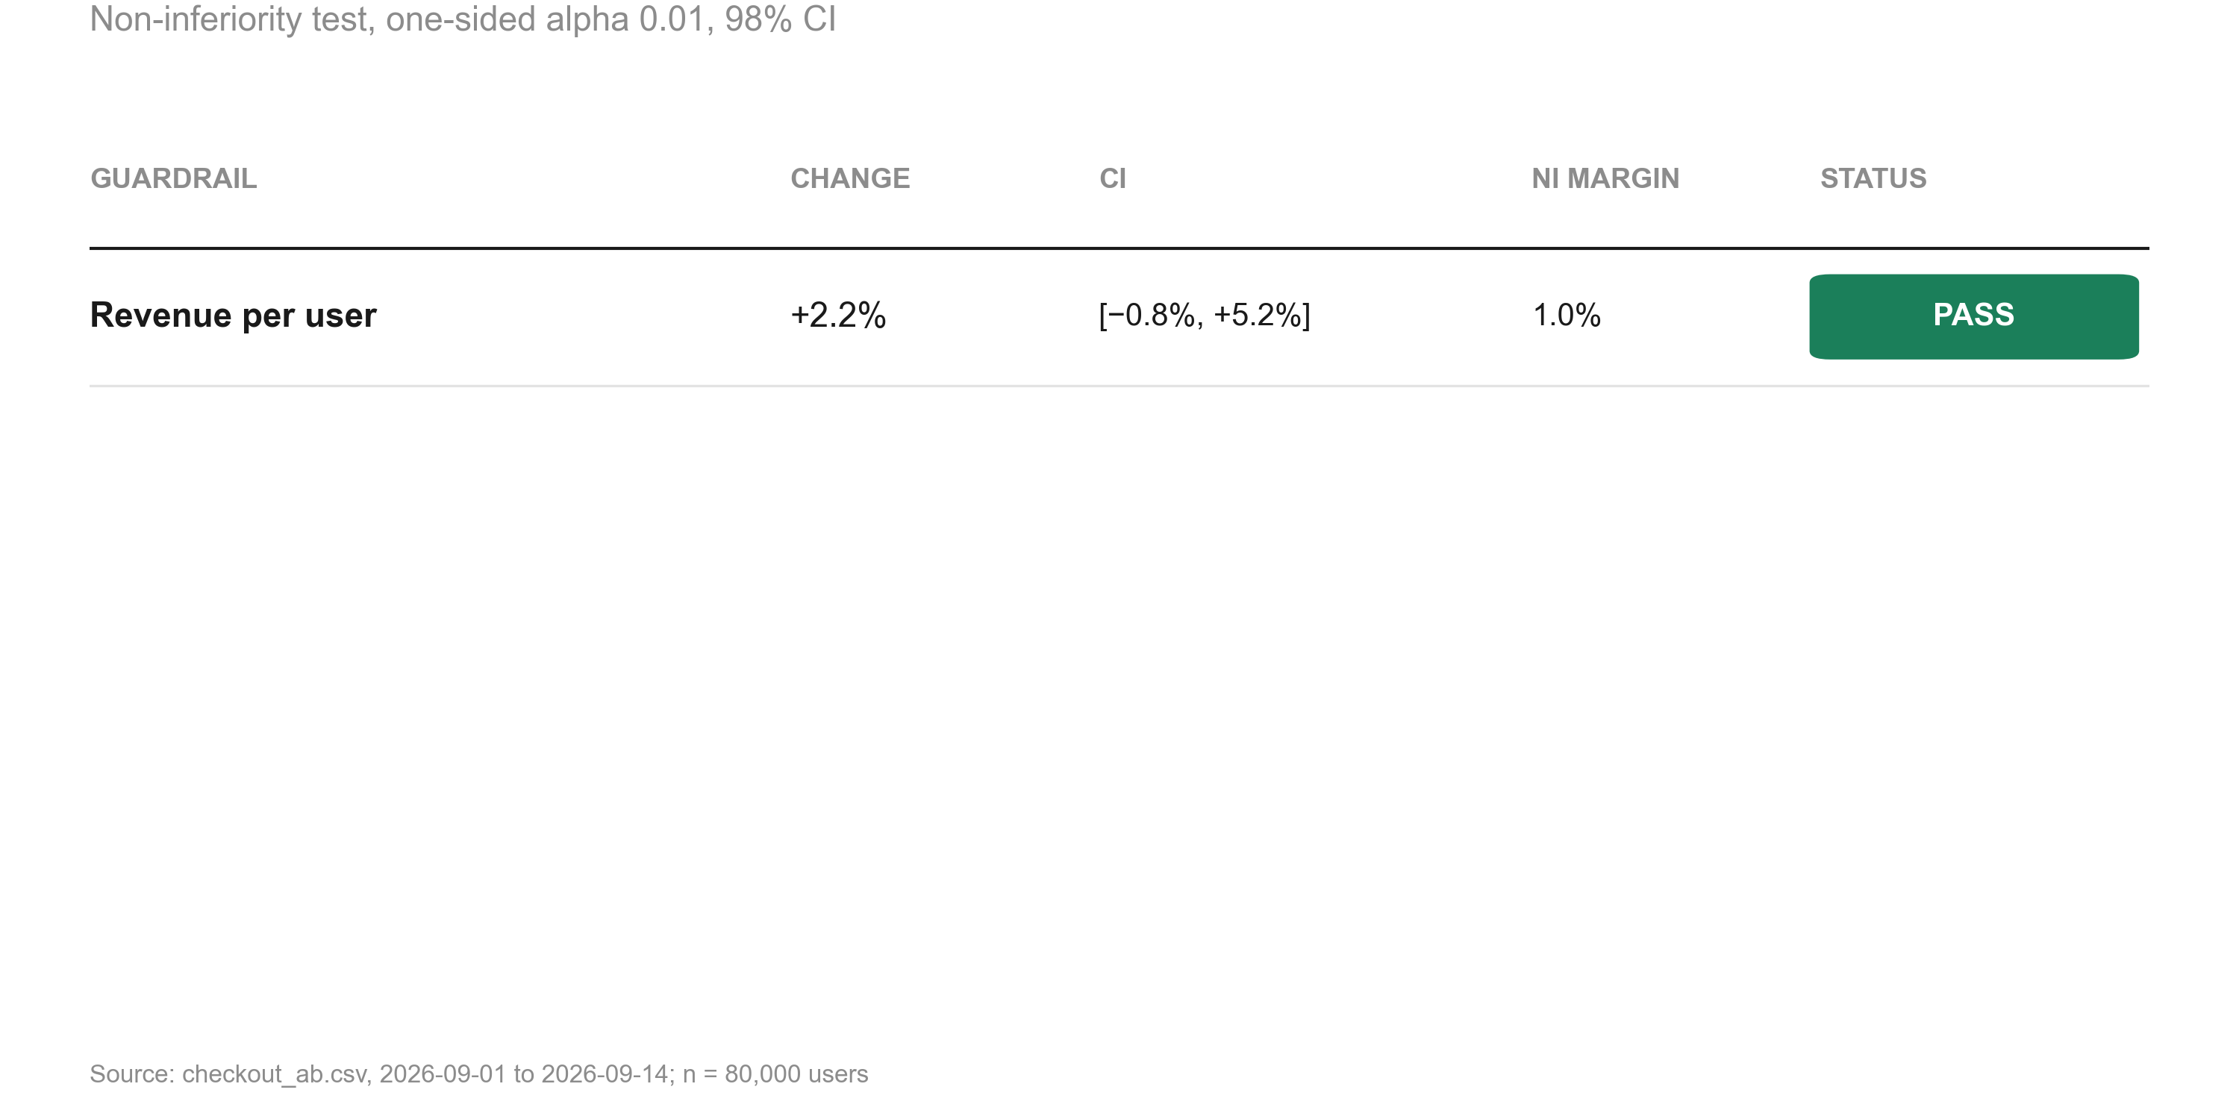
Revenue per user is non-inferior (+2.2%); the 1% margin is ruled out
KEY TAKEAWAYS
1. Change +2.2%, 98% CI [−0.8%, +5.2%]
2. Margin −1.0%: harm beyond it is ruled out
3. Status: PASS
Source: checkout_ab.csv, 2026-09-01 to 2026-09-14; n = 80,000 users
8
Notes:
The guardrail is a positive statement: a revenue drop larger than the margin is ruled out.

Slide 9
Guardrail checks
Metric | Comparison | Control | Treatment | Rel. lift | CI | p / P(beat) | Method | Status
revenue | treatment vs control | 22.73 | 23.23 | +2.2% | [−0.8%, +5.2%] | 0.005 | noninferiority test | PASS
Source: checkout_ab.csv, 2026-09-01 to 2026-09-14; run 2026-10-01_checkout-button
9
Notes:
Each guardrail is tested for non-inferiority against its margin.

Slide 10
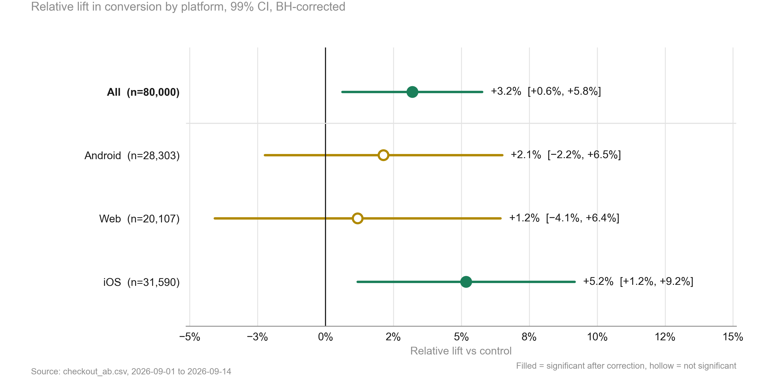
The lift is largest on iOS (+5.2%), but platforms do not differ significantly
KEY TAKEAWAYS
1. Interaction test p = 0.168: one rollout decision
2. iOS: +5.2% (significant after BH)
3. All platforms point in the same direction
Source: checkout_ab.csv, 2026-09-01 to 2026-09-14
10
Notes:
Differences between platforms are exploratory; the interaction test is what counts.

Slide 11
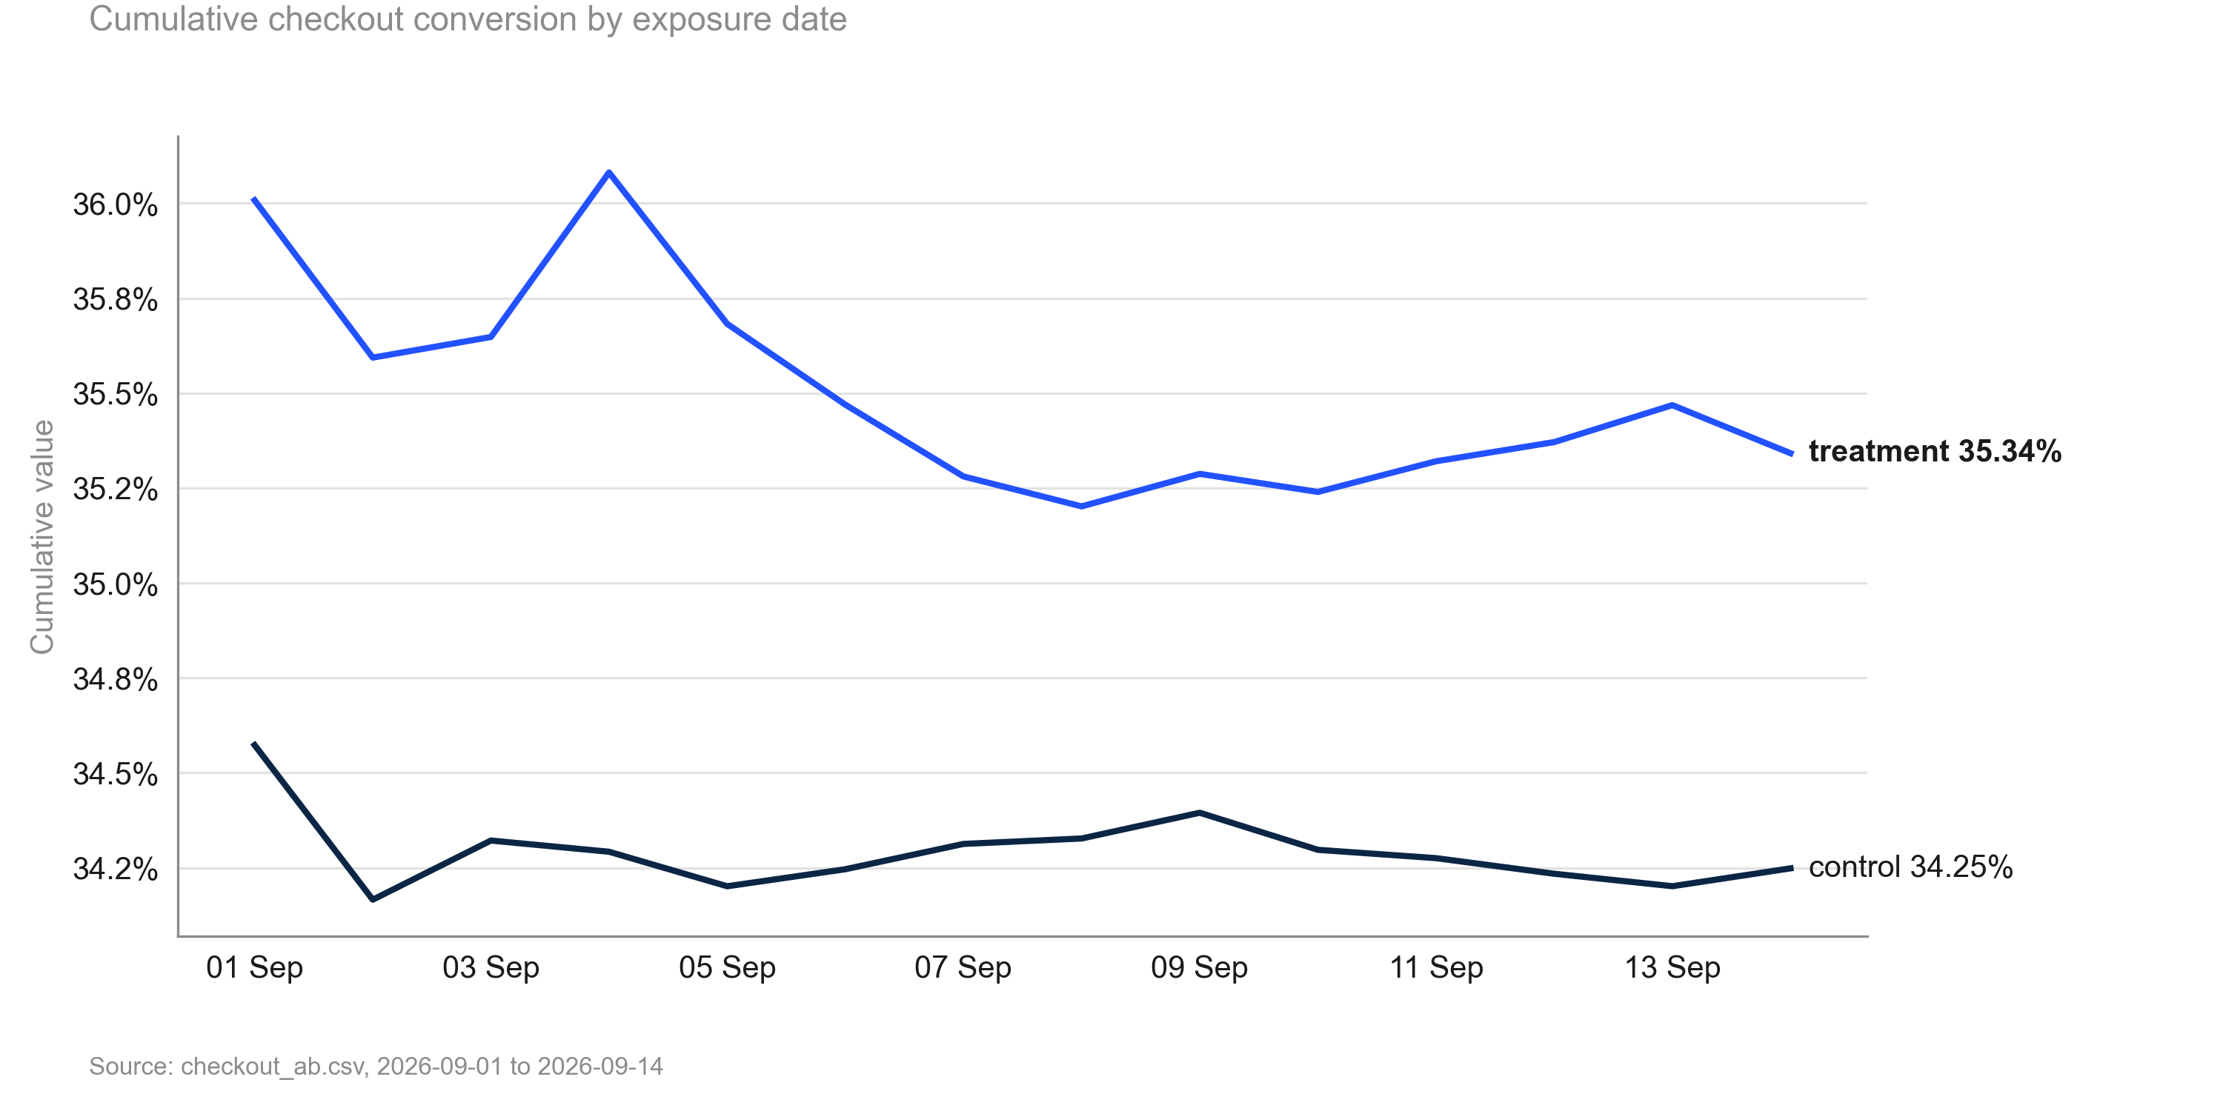
Treatment led on cumulative conversion on all 14 days of the test
KEY TAKEAWAYS
1. Final: 34.25% vs 35.34%
2. Cumulative lift at the end: +3.2%
3. No reversal at any point
Source: checkout_ab.csv, 2026-09-01 to 2026-09-14
11
Notes:
Stability check: the gap opened early and held.

Slide 12
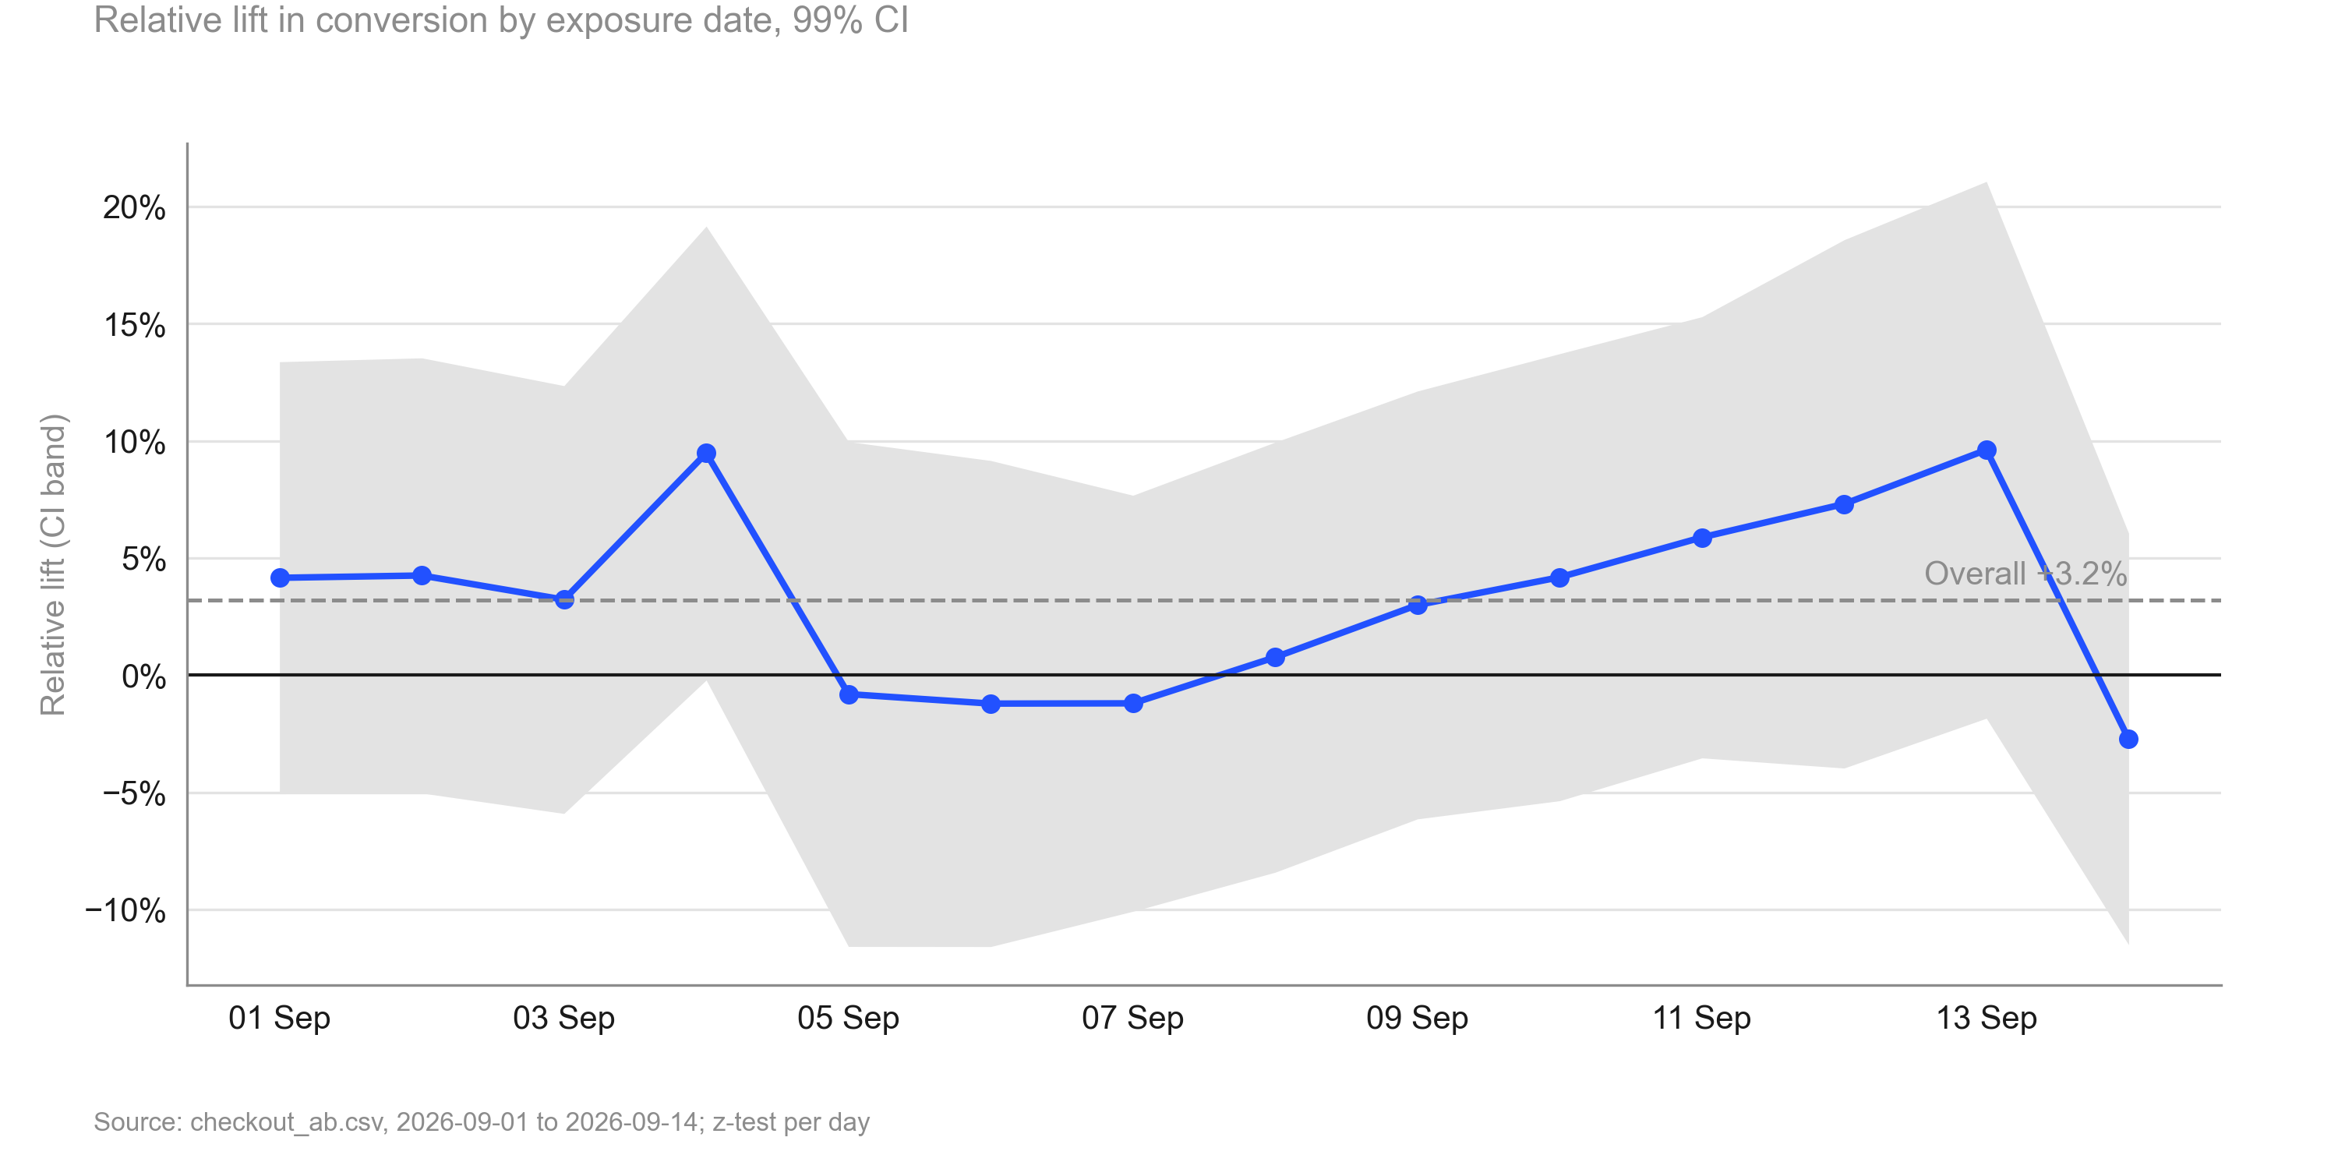
Daily lift is noisy but shows no trend over the test (p = 0.794 for the slope)
KEY TAKEAWAYS
1. Trend slope −0.07% per day, p = 0.794
2. First third +5.3% vs last third +5.0%
3. No novelty decay to adjust for
Source: checkout_ab.csv, 2026-09-01 to 2026-09-14
12
Notes:
Novelty check for a visible UI change: nothing suggests the effect is fading.

Slide 13
Risks and caveats to keep in mind
• CI lower bound +0.6% is below the 2% threshold: the true lift may be smaller than needed (review finding 1).
• Platforms: iOS +5.2%, Web +1.2%; interaction p = 0.168, no evidence they differ.
• Revenue is heavy-tailed; bootstrap CI [−1.0%, +5.4%] agrees with the guardrail pass.
• Daily lift: stable (no significant trend) (p = 0.794).
Source: checkout_ab.csv, 2026-09-01 to 2026-09-14; run 2026-10-01_checkout-button
13
Notes:
Be explicit about what could make this conclusion wrong.

Slide 14
Recommendation: Ship
NEXT STEPS
1. Roll out the single-button checkout to all users on every platform
2. Track conversion and revenue per user for four weeks after rollout against this test's estimates
3. Use a follow-up test if a platform-specific design is wanted (Web shows the smallest lift)
Source: checkout_ab.csv, 2026-09-01 to 2026-09-14; run 2026-10-01_checkout-button
14
Notes:
Close with the decision and owners. The primary metric improved significantly and no guardrail was breached.

Slide 15
Appendix
Methodology, validation and full results

Slide 16
Methodology
• srm: srm check (code/10_validate_profile.py)
• primary test: two proportion ztest (code/20_analysis_primary_test.py)
• guardrail revenue: noninferiority test (code/20_analysis_guardrail_revenue.py)
• revenue sensitivity: welch ttest, bootstrap mean diff (code/20_analysis_revenue_sensitivity.py)
• segments platform: segment effects, two proportion ztest, interaction test, simpsons check (code/20_analysis_segments_platform.py)
• time trends: cumulative effects, trend test (code/20_analysis_time_trends.py)
• Settings: alpha 0.01 (two-sided), power 0.8, SRM threshold 0.001
Source: checkout_ab.csv, 2026-09-01 to 2026-09-14; run 2026-10-01_checkout-button
16
Notes:
Tests used per analysis step and the scripts that produced each number.

Slide 17
Full results
Metric | Segment | Comparison | Control | Treatment | Rel. lift | CI | p / P(beat) | Method
converted |  | treatment vs control | 34.25% | 35.34% | +3.2% | [+0.6%, +5.8%] | 0.001 | two proportion ztest
revenue |  | treatment vs control | 22.73 | 23.23 | +2.2% | [−0.8%, +5.2%] | 0.005 | noninferiority test
revenue |  | treatment vs control | 22.73 | 23.23 | +2.2% | [−1.1%, +5.5%] | 0.079 | welch ttest
revenue |  | treatment vs control | 22.73 | 23.23 | +2.2% | [−1.0%, +5.4%] | 0.082 | bootstrap mean diff
converted | Android | treatment vs control | 33.53% | 34.24% | +2.1% | [−2.2%, +6.5%] | 0.306 (adj.) | two proportion ztest
converted | Web | treatment vs control | 32.63% | 33.02% | +1.2% | [−4.1%, +6.4%] | 0.561 (adj.) | two proportion ztest
converted | iOS | treatment vs control | 35.93% | 37.79% | +5.2% | [+1.2%, +9.2%] | 0.002 (adj.) | two proportion ztest
Source: checkout_ab.csv, 2026-09-01 to 2026-09-14; run 2026-10-01_checkout-button
17
Notes:
Complete table of estimates.

Slide 18
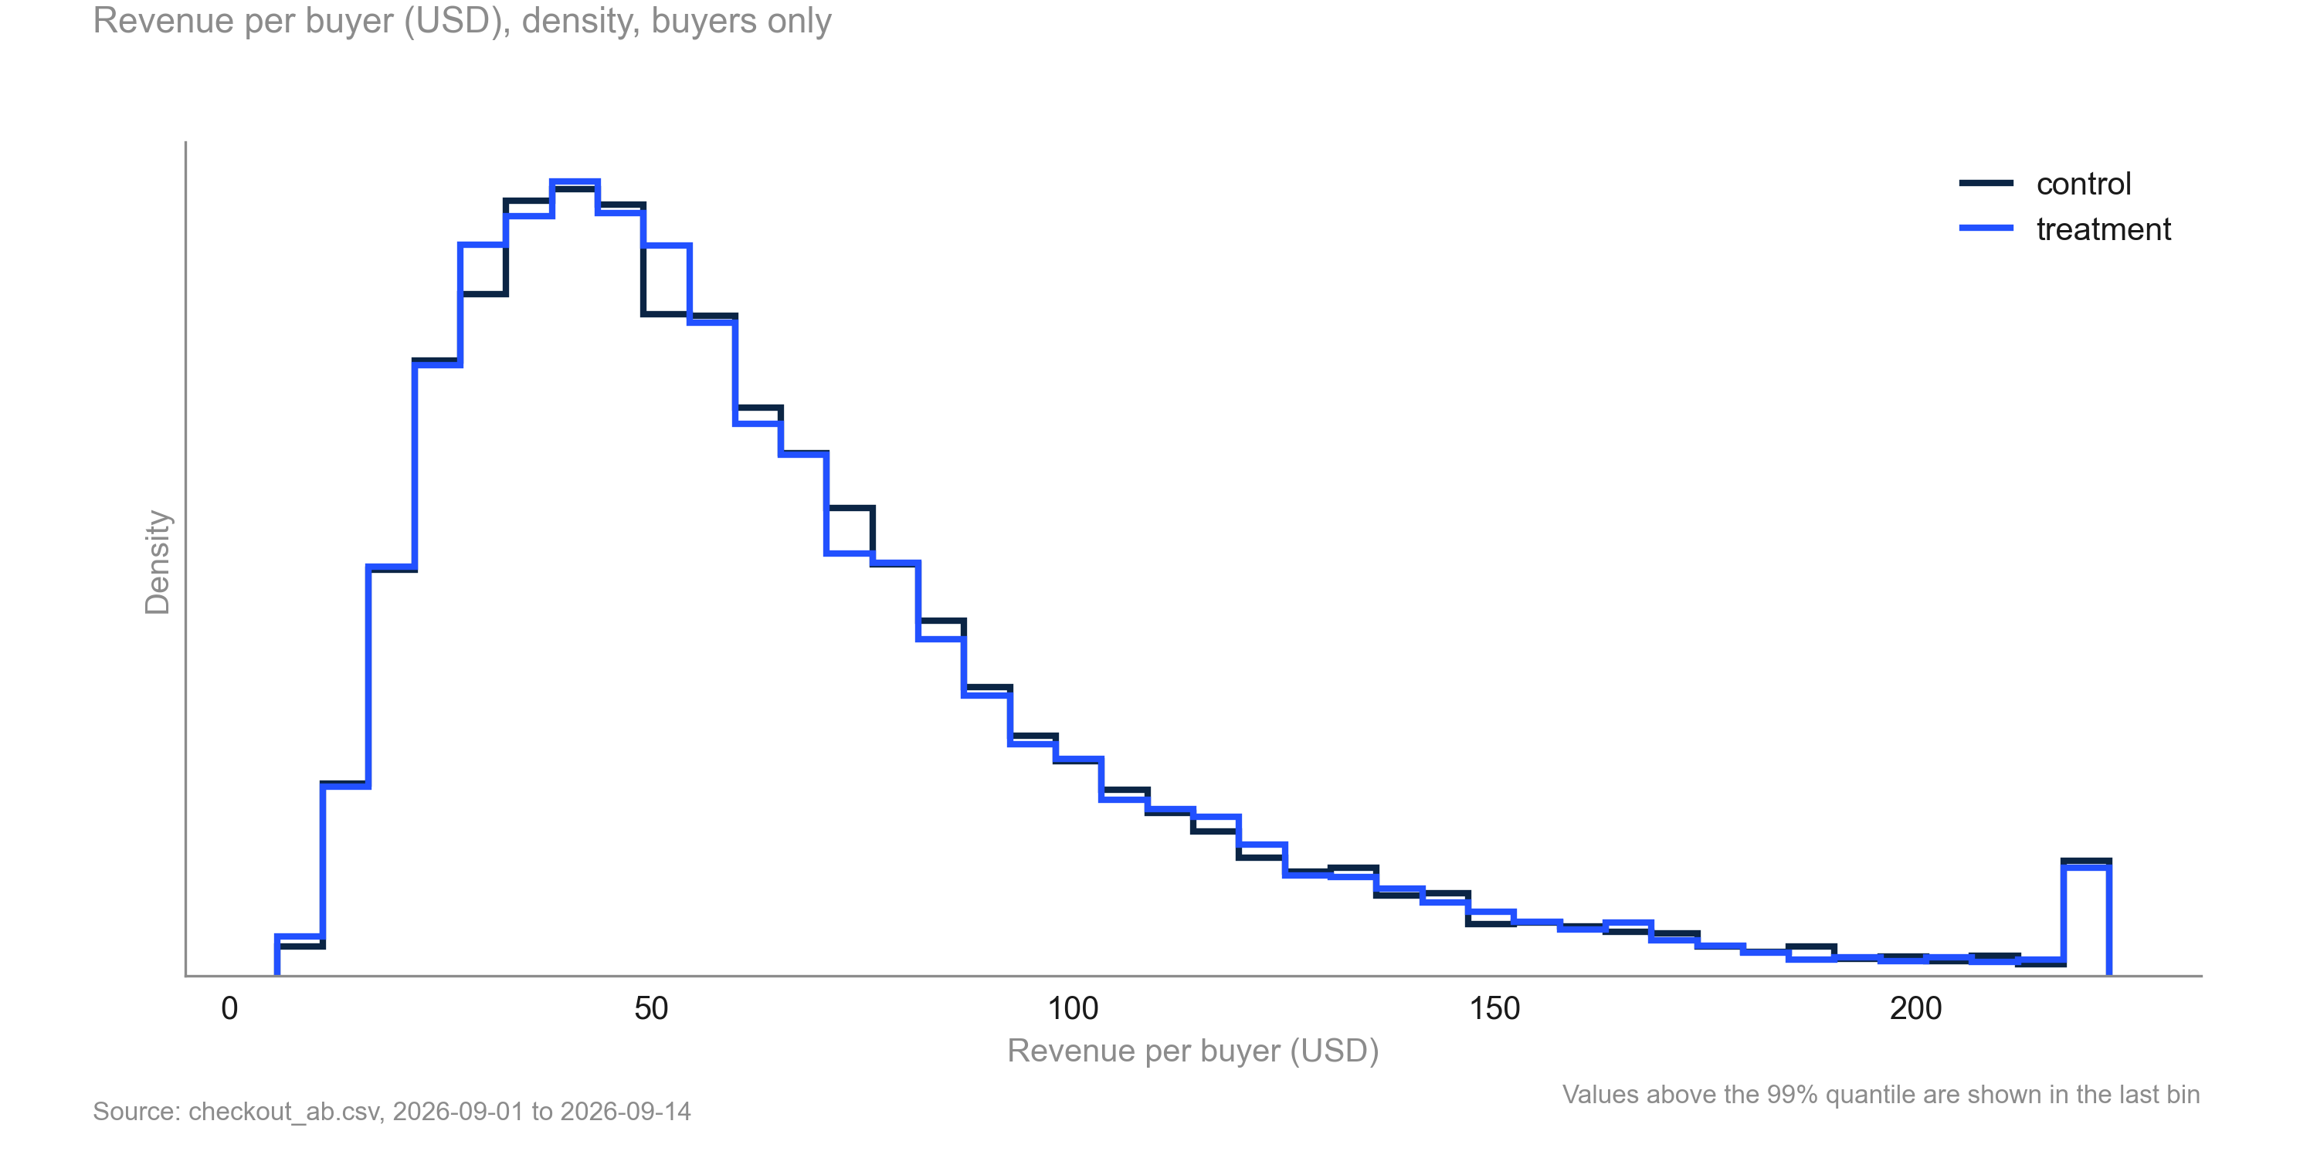
Revenue per buyer has a long right tail in both variants; the shapes are similar
KEY TAKEAWAYS
1. Long right tail in both arms
2. Bootstrap used as a sensitivity check
3. No capping applied
Source: checkout_ab.csv, 2026-09-01 to 2026-09-14
18
Notes:
Why the bootstrap check was run for revenue.

