Slide 1
Home feed redesign
Treatment raises minutes per user by 1.7% vs control (statistically significant)
01 October 2026

Slide 2
Treatment raises minutes per user by 1.7% vs control (statistically significant)
Recommendation: SHIP The primary metric improved significantly and by more than the practical threshold.
• Relative lift in minutes per user: +1.7% (95% CI [+0.0%, +3.3%])
• Evidence: p = 0.042
• Minutes per user: control vs treatment (adjusted): 63.77 vs 64.84
• Units analysed: control: 9,902 / treatment: 10,098
• Unadjusted test (for comparison): +2.1%, p = 0.081
Source: cuped_engagement.csv; run 2026-10-01_home-feed-redesign
2
Notes:
Verdict: Ship. The primary metric improved significantly and by more than the practical threshold. Average minutes per user was 1.07 higher with treatment than with control. A difference this large is unlikely to be down to chance. CUPED chosen after the unadjusted result (p = 0.081) was seen; both reported. CI [+0.0%, +3.3%] includes lifts below the 1% threshold. CUPED lift +1.7% vs unadjusted +2.1%: treatment had a small pre-period head start by chance (review finding 2). Regression adjustment agrees: +1.7% (p = 0.042). No dates in the data: novelty not checked.

Slide 3
How the experiment was set up
Item | Detail
Variants (units) | treatment: 10,098, control: 9,902
Primary metric | minutes (continuous, goal: increase)
Statistical settings | alpha 0.05, two-sided, power 0.8
Multiple-testing correction | secondary: holm; segments: benjamini-hochberg
Analysis type | cuped reanalysis, post test readout
Source: cuped_engagement.csv; run 2026-10-01_home-feed-redesign
3
Notes:
Walk through what was tested, on whom, for how long, and how success was defined before looking at results.

Slide 4
Data validation: overall verdict PASS
Check | Verdict | Detail
schema | PASS | 5 columns, 20,000 rows
dtypes | PASS | All metric columns numeric
missing values | PASS | No missing values
duplicates | PASS | 20,000 units, one row each
contamination | PASS | No unit appears in more than one variant
variants | PASS | Counts {'treatment': 10098, 'control': 9902}
SRM | PASS | p = 0.166 (threshold 0.001)
outliers | PASS | No extreme outliers in continuous metrics
impossible values | PASS | Metric values within valid ranges
pre-period data | PASS | Available; correlations with metrics pre_minutes~minutes=0.73
covariate balance | PASS | Segment mix similar across variants
Source: cuped_engagement.csv; run 2026-10-01_home-feed-redesign
4
Notes:
Summarise data quality: anything flagged here limits how far the results can be trusted.

Slide 5
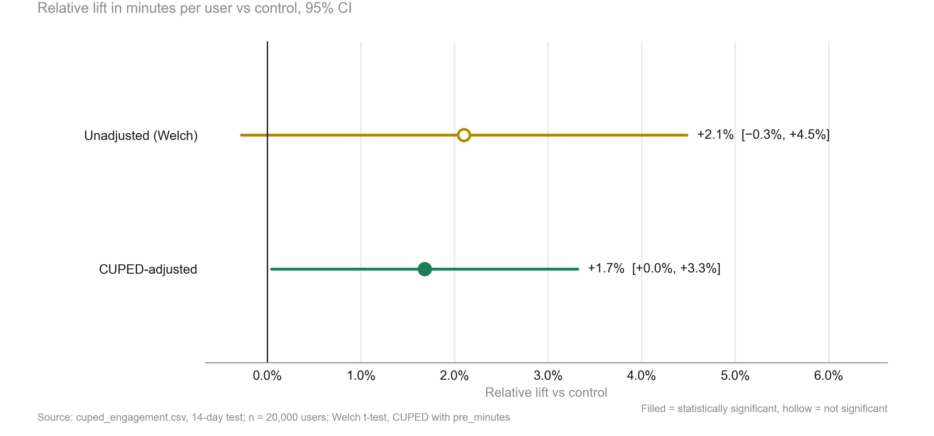
With CUPED, the feed lifts minutes per user by +1.7%, statistically significant (p = 0.042)
KEY TAKEAWAYS
1. Unadjusted: +2.1%, p = 0.081
2. CUPED: +1.7%, CI [+0.0%, +3.3%]
3. CUPED chosen after the first result: stated as a caveat
Source: cuped_engagement.csv, 14-day test; n = 20,000 users; Welch t-test, CUPED with pre_minutes
5
Notes:
Same data, sharper lens: pre-period minutes explain much of the user-to-user noise.

Slide 6
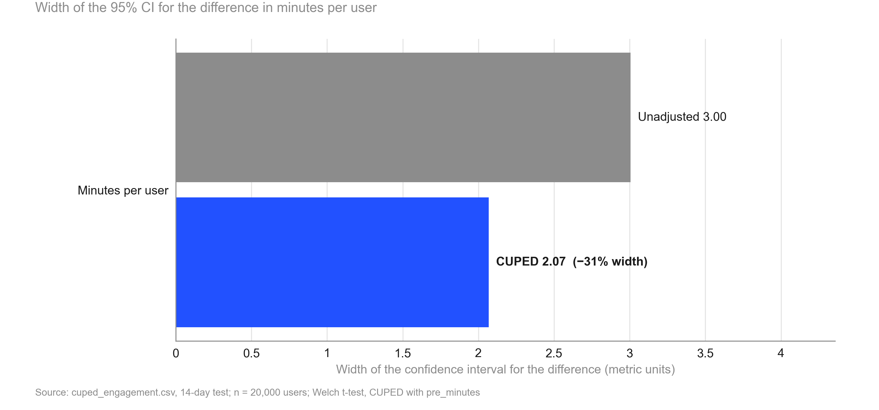
Using pre-period minutes narrows the confidence interval by 31.2%, like having 2.1x the users
KEY TAKEAWAYS
1. Pre/post correlation 0.73
2. Variance removed: 52.6%
3. Equivalent to 2.1x the sample
Source: cuped_engagement.csv, 14-day test; n = 20,000 users; Welch t-test, CUPED with pre_minutes
6
Notes:
Plain-English explanation of CUPED for the product team.

Slide 7
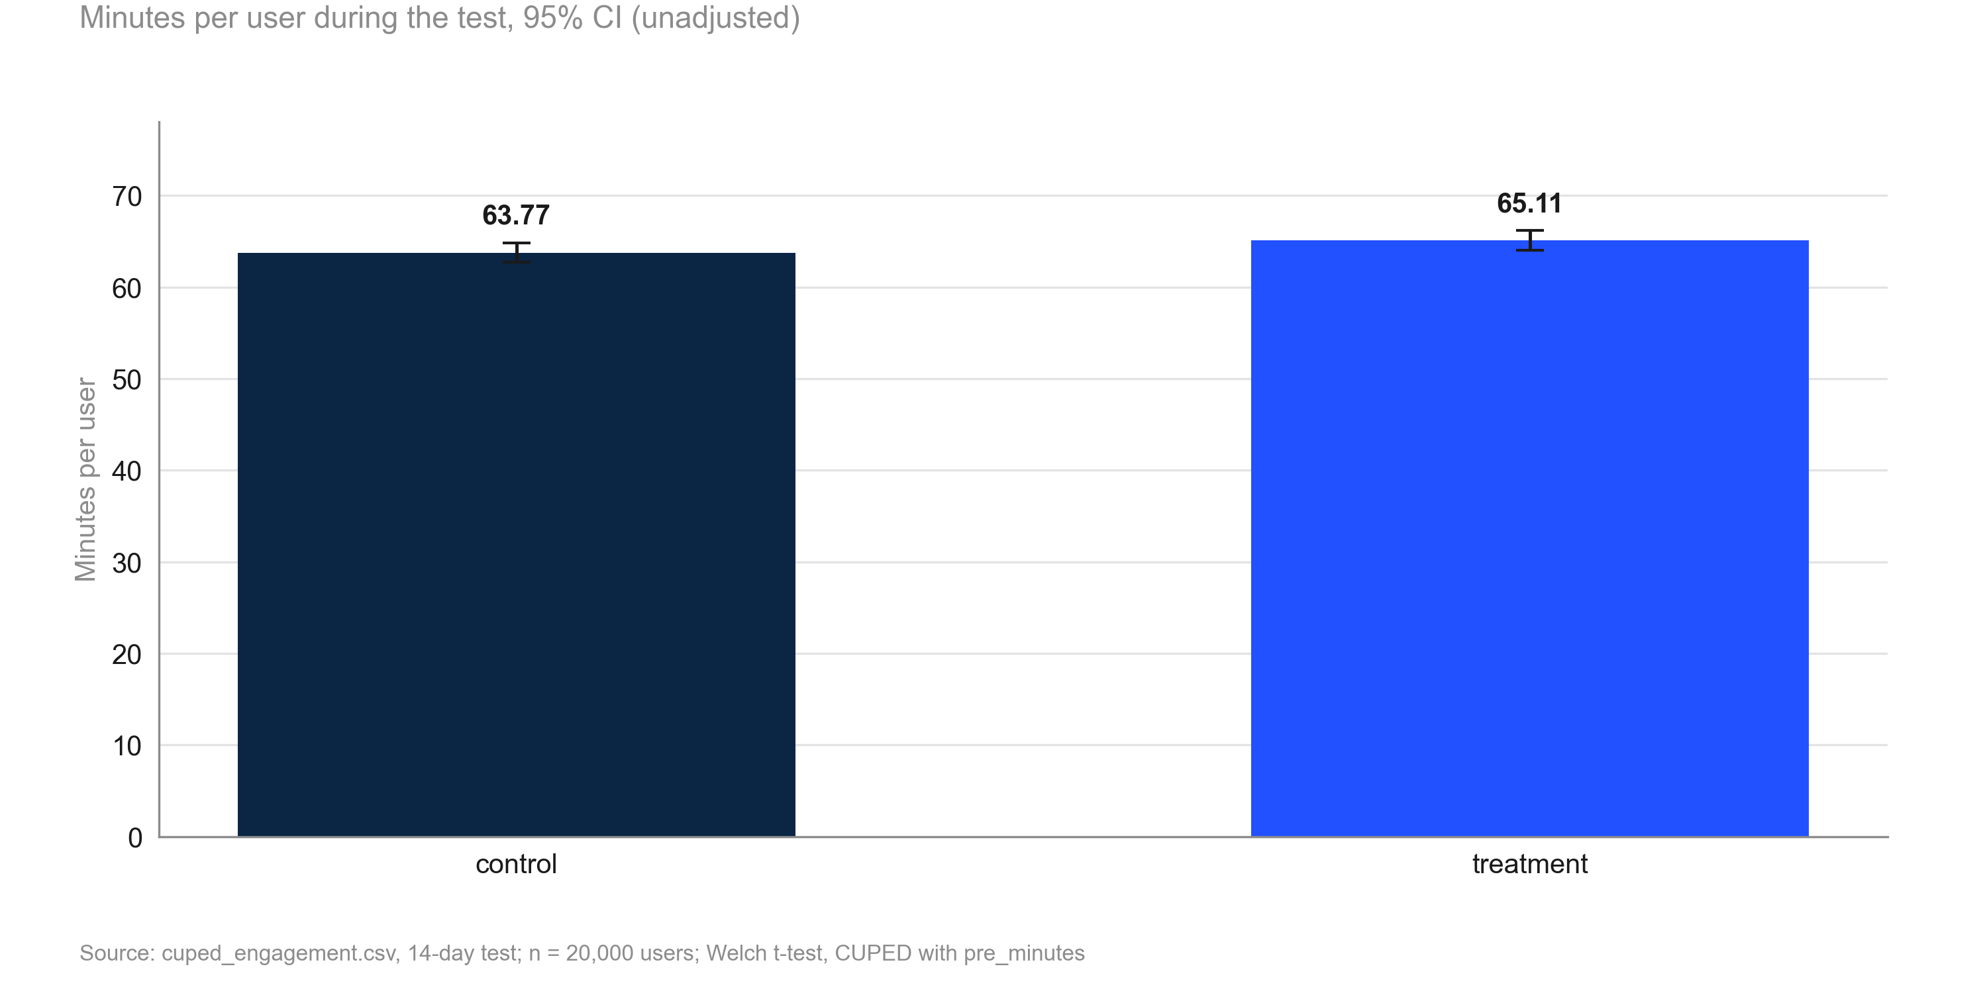
Minutes per user: 63.8 in control vs 65.1 in treatment (unadjusted)
KEY TAKEAWAYS
1. Control 63.8 min
2. Treatment 65.1 min
3. CUPED-adjusted difference 1.07 min
Source: cuped_engagement.csv, 14-day test; n = 20,000 users; Welch t-test, CUPED with pre_minutes
7
Notes:
Raw levels for context; the decision uses the CUPED-adjusted difference.

Slide 8
Risks and caveats to keep in mind
• CUPED chosen after the unadjusted result (p = 0.081) was seen; both reported.
• CI [+0.0%, +3.3%] includes lifts below the 1% threshold.
• CUPED lift +1.7% vs unadjusted +2.1%: treatment had a small pre-period head start by chance (review finding 2).
• Regression adjustment agrees: +1.7% (p = 0.042).
• No dates in the data: novelty not checked.
Source: cuped_engagement.csv; run 2026-10-01_home-feed-redesign
8
Notes:
Be explicit about what could make this conclusion wrong.

Slide 9
Recommendation: Ship
NEXT STEPS
1. Ship the redesigned home feed
2. Pre-register CUPED with pre-period minutes as the default analysis for future engagement tests
3. Check minutes per user again four weeks after launch, as novelty could not be ruled out
Source: cuped_engagement.csv; run 2026-10-01_home-feed-redesign
9
Notes:
Close with the decision and owners. The primary metric improved significantly and by more than the practical threshold.

Slide 10
Appendix
Methodology, validation and full results

Slide 11
Methodology
• srm: srm check (code/10_validate_profile.py)
• naive test: welch ttest, bootstrap mean diff (code/20_analysis_naive_test.py)
• cuped test: cuped (code/20_analysis_cuped_test.py)
• regression check: regression adjustment (code/20_analysis_regression_check.py)
• Settings: alpha 0.05 (two-sided), power 0.8, SRM threshold 0.001
Source: cuped_engagement.csv; run 2026-10-01_home-feed-redesign
11
Notes:
Tests used per analysis step and the scripts that produced each number.

Slide 12
Full results
Metric | Comparison | Control | Treatment | Rel. lift | CI | p / P(beat) | Method
minutes | treatment vs control | 63.77 | 65.11 | +2.1% | [−0.3%, +4.5%] | 0.081 | welch ttest
minutes | treatment vs control | 63.77 | 65.11 | +2.1% | [−0.3%, +4.5%] | 0.081 | bootstrap mean diff
minutes | treatment vs control | 63.77 | 64.84 | +1.7% | [+0.0%, +3.3%] | 0.042 | cuped
minutes | treatment vs control | 63.77 | 64.84 | +1.7% | [+0.1%, +3.3%] | 0.042 | regression adjustment
Source: cuped_engagement.csv; run 2026-10-01_home-feed-redesign
12
Notes:
Complete table of estimates.

Slide 13
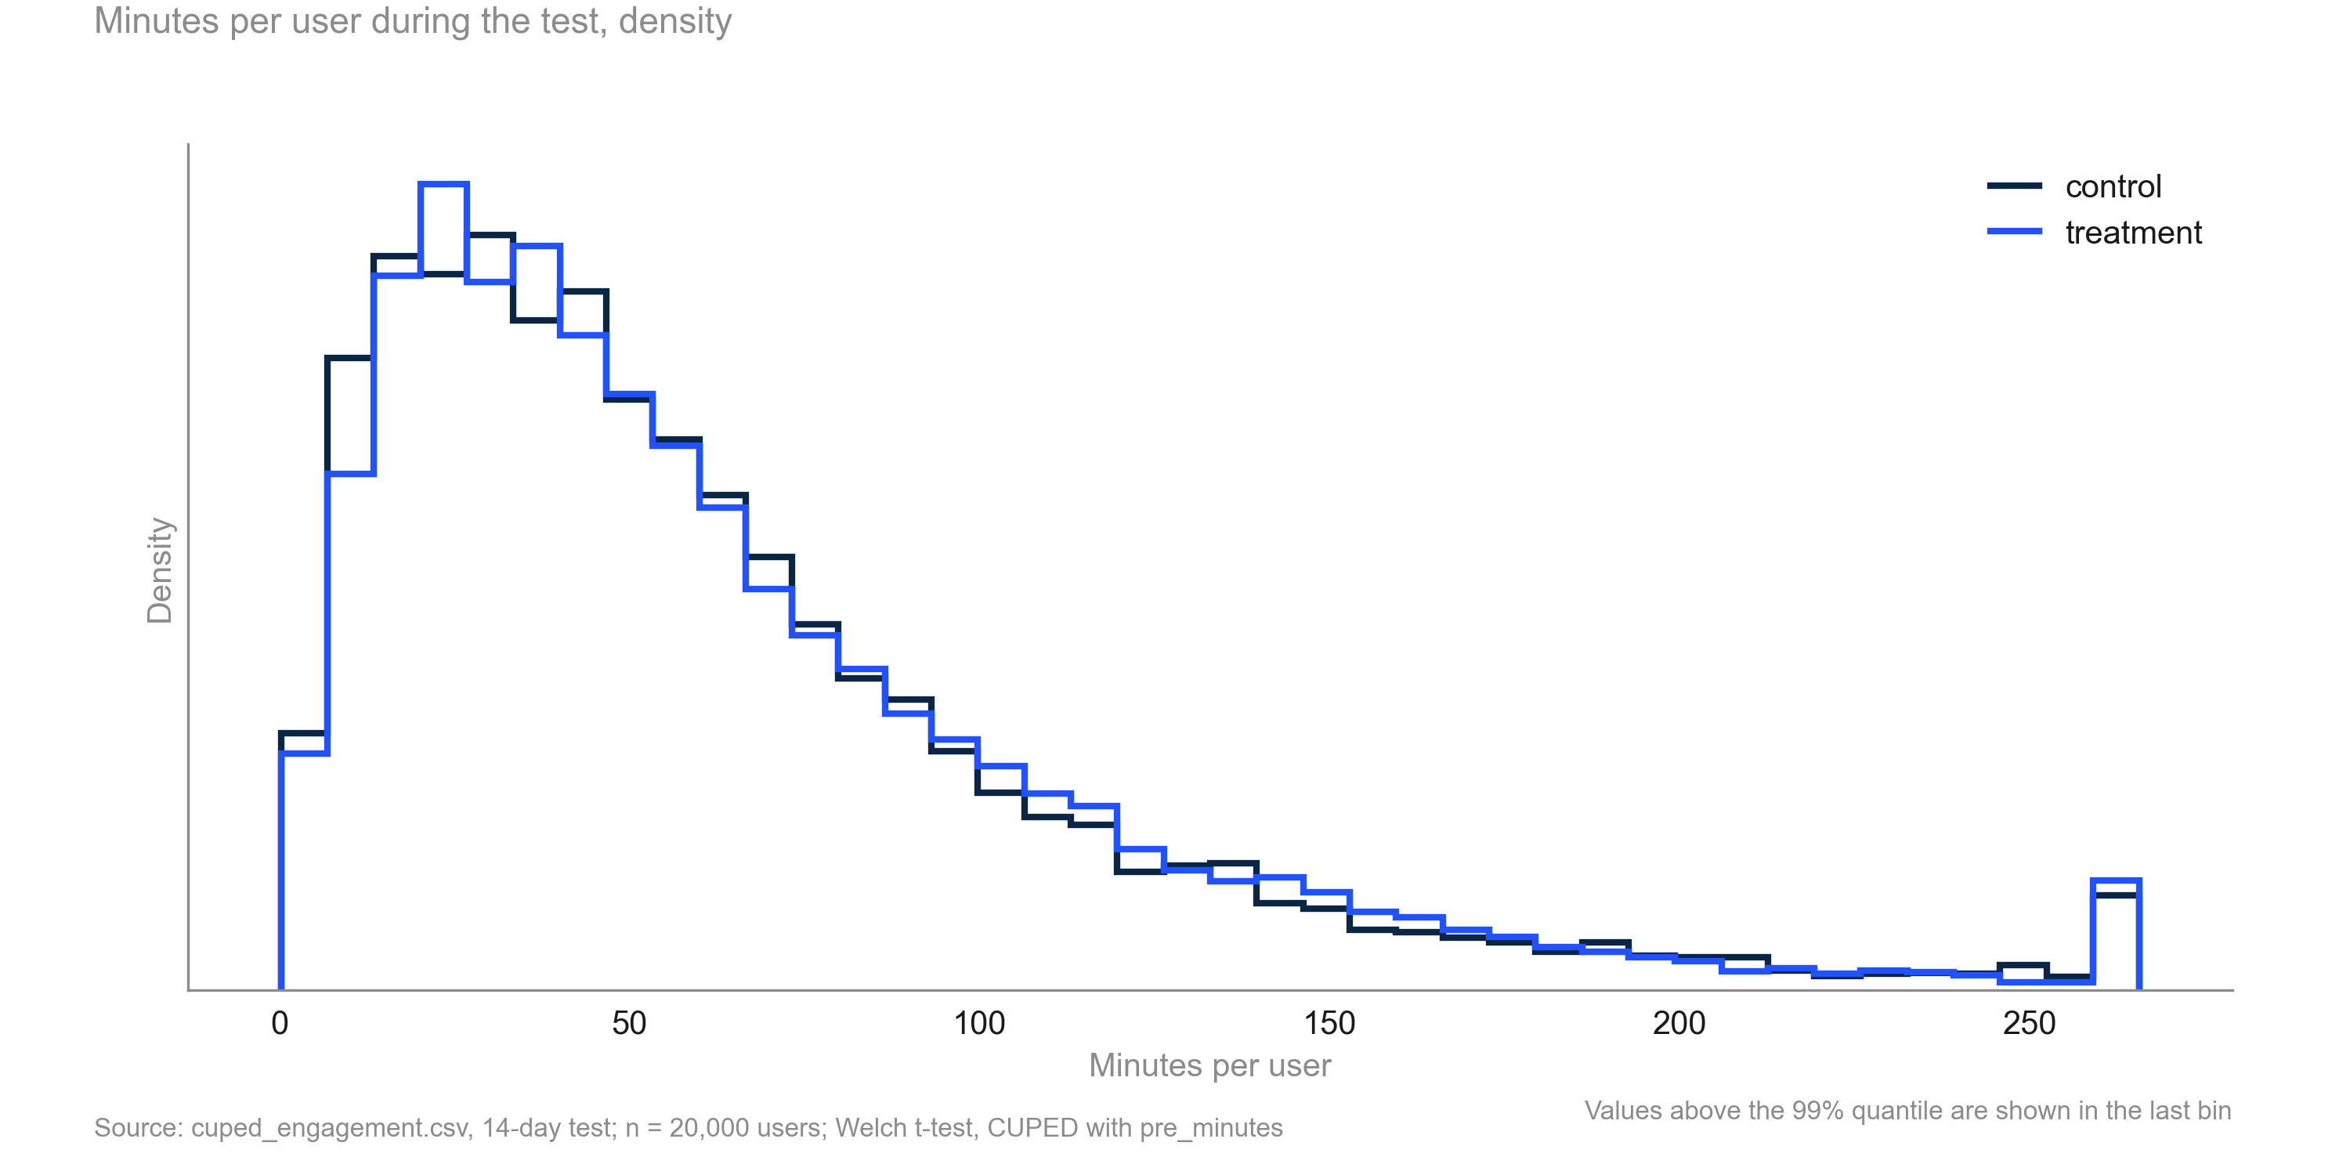
Minutes per user are right-skewed with similar shapes in both variants
KEY TAKEAWAYS
1. Long right tail
2. No change in shape
3. Bootstrap agrees with Welch
Source: cuped_engagement.csv, 14-day test; n = 20,000 users; Welch t-test, CUPED with pre_minutes
13
Notes:
Supports the use of mean-based tests at this sample size.

