Slide 1
Onboarding checklist test
Results withheld: treatment has 7.1% fewer units than the intended split (p < 0.001, sample ratio mismatch)
01 October 2026

Slide 2
Results withheld: treatment has 7.1% fewer units than the intended split (p < 0.001, sample ratio mismatch)
Recommendation: BLOCKED: DATA ISSUE The data failed a blocking validation check, so treatment effects cannot be trusted.
• Observed share control: 53.6% (expected 50.0%)
• Observed share treatment: 46.4% (expected 50.0%)
• SRM test: chi-square p < 0.001 (threshold 0.001)
• Concentrated in: exposure_date 2026-09-05 to 2026-09-14 (10 of 14 levels); platform=Android
Source: srm_broken.csv, 2026-09-01 to 2026-09-14; run 2026-10-01_onboarding-checklist
2
Notes:
Verdict: Blocked: data issue. The data failed a blocking validation check, so treatment effects cannot be trusted. The groups being compared are not the ones the experiment created, so any difference between them could come from the data problem rather than the change. iOS + Web alone show no mismatch (p = 0.323), but an iOS + Web-only readout would answer a different question (it excludes a whole platform); treat it as a sensitivity check only. Activation results were not computed: with units missing non-randomly, any difference could be caused by the loss.

Slide 3
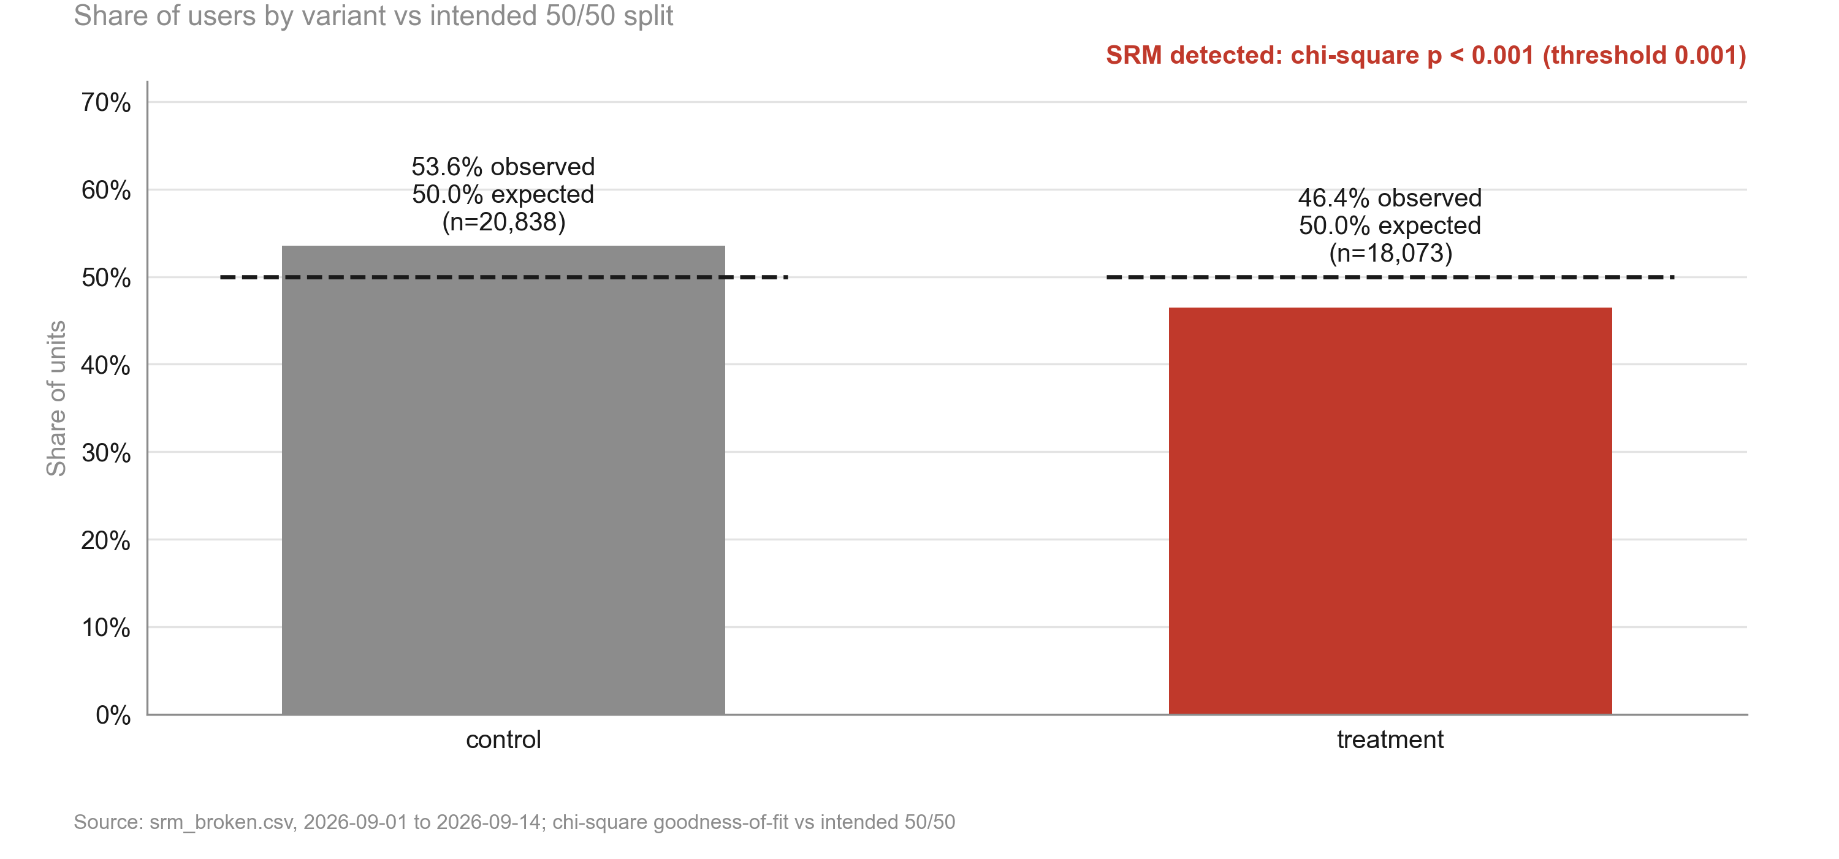
Treatment is missing 7.1% of its expected users: results cannot be trusted until this is fixed
KEY TAKEAWAYS
1. Treatment share 46.4% vs 50.0% intended
2. Chi-square p < 0.001 (threshold 0.001)
3. Effect estimates are withheld
Source: srm_broken.csv, 2026-09-01 to 2026-09-14; chi-square goodness-of-fit vs intended 50/50
3
Notes:
This is the whole story: units went missing unevenly, so the comparison is broken.

Slide 4
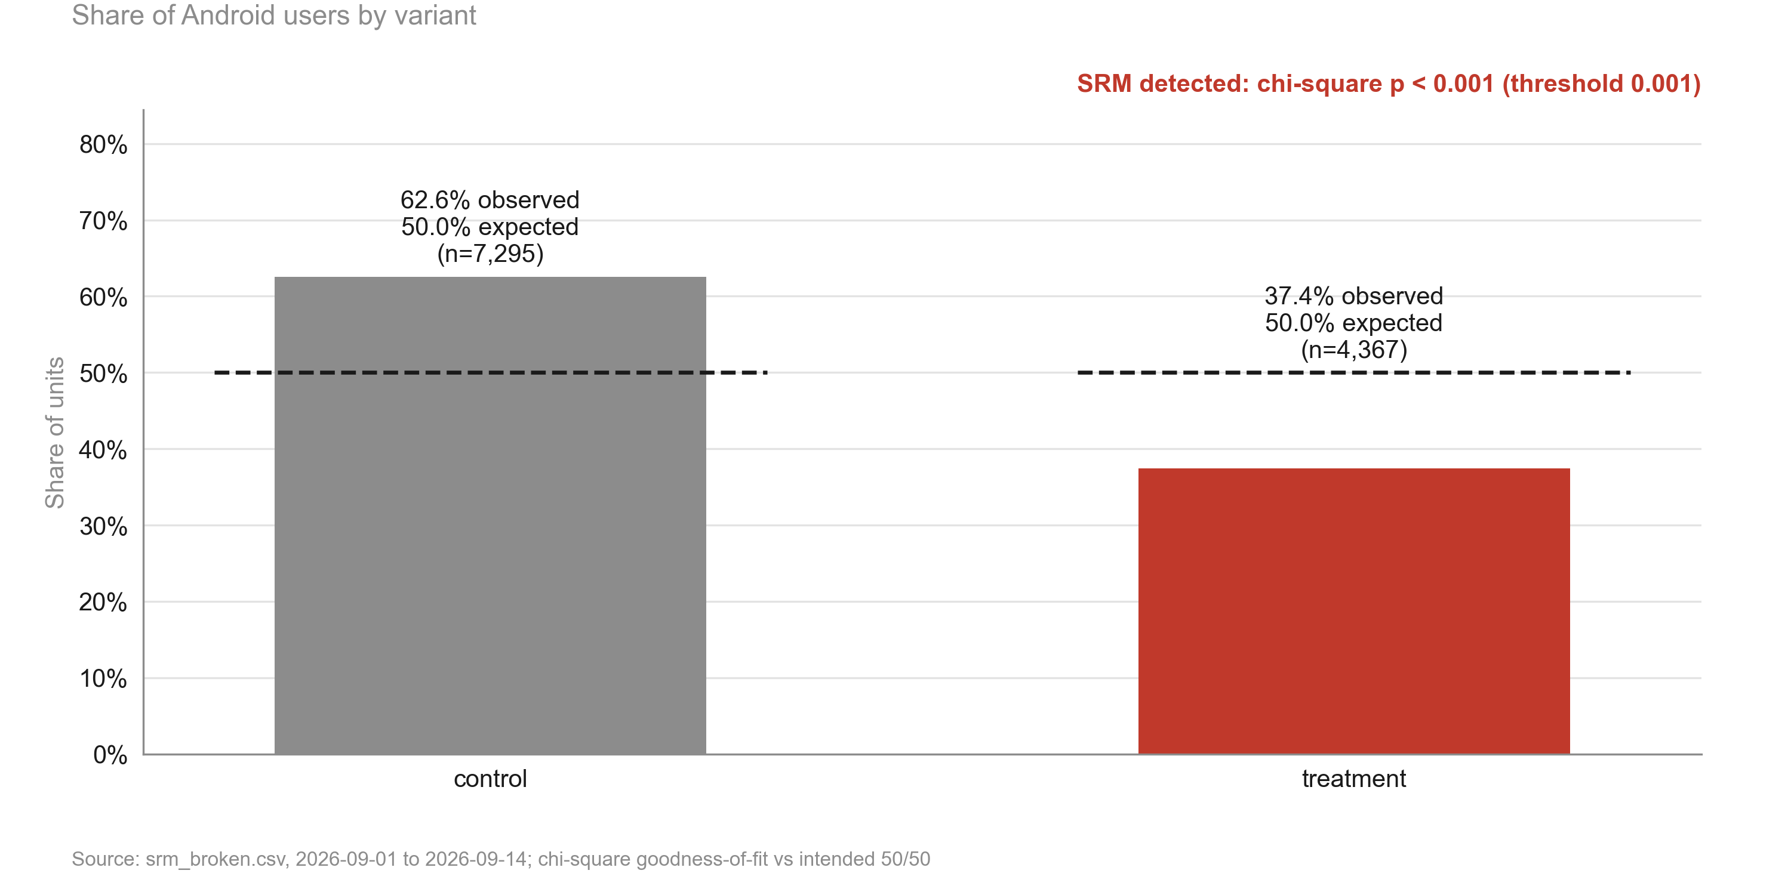
The loss is on Android: treatment has 37.4% of Android users; iOS and Web are balanced
KEY TAKEAWAYS
1. Android: p < 0.001
2. iOS + Web: p = 0.323
3. About 3,085 Android treatment users missing since 5 Sep
Source: srm_broken.csv, 2026-09-01 to 2026-09-14; chi-square goodness-of-fit vs intended 50/50
4
Notes:
Points engineering at the Android exposure event after the 5 September release.

Slide 5
Data validation: overall verdict BLOCK
Check | Verdict | Detail
schema | PASS | 5 columns, 38,911 rows
dtypes | PASS | All metric columns numeric
missing values | PASS | No missing values
duplicates | PASS | 38,911 units, one row each
contamination | PASS | No unit appears in more than one variant
variants | PASS | Counts {'control': 20838, 'treatment': 18073}
SRM | BLOCK | Sample ratio mismatch: p = 1.22e-44 < 0.001; observed shares {'control': 0.5355, 'treatment': 0.4645}. Concent
dates | PASS | 2026-09-01 to 2026-09-14 (14 days)
outliers | PASS | No continuous metrics
impossible values | PASS | Metric values within valid ranges
pre-period data | PASS | None described (CUPED not possible)
covariate balance | WARN | Segment mix differs between variants: platform (p = 5.6e-119) (can indicate an assignment or logging problem,
Source: srm_broken.csv, 2026-09-01 to 2026-09-14; run 2026-10-01_onboarding-checklist
5
Notes:
Summarise data quality: anything flagged here limits how far the results can be trusted.

Slide 6
Recommendation: Blocked: data issue
NEXT STEPS
1. Engineering: fix the Android exposure event lost since the 2026-09-05 release (about 3,085 treatment users missing)
2. Re-extract exposures from server-side assignment logs and rerun this workflow on the corrected data
3. If the logs cannot be repaired, rerun the test for two full weeks after the fix
4. Add an automated daily SRM alert (by platform) to the experiment dashboard
Source: srm_broken.csv, 2026-09-01 to 2026-09-14; run 2026-10-01_onboarding-checklist
6
Notes:
Close with the decision and owners. The data failed a blocking validation check, so treatment effects cannot be trusted.

