Slide 1


SMART INDIA HACKATHON 2025
TITLE PAGE
Problem Statement ID - 25082
Problem Statement Title - Development of a travel related software app that can be installed on mobile phones that could capture trip related information
Theme- Travel and Tourism
PS Category- Software
Team ID -
Team Name – Walk With Us

Slide 2
IDEA TITLE
Walk
With
Us
Proposed Solution
A mobile application that automatically captures trip-related data like origin, destination, time, travel mode, trip duration, and path using GPS & APIs. The app also allows manual entry of trip details (like number of co-travelers). All trip data is stored in a central server/database for later analysis by NATPAC.
Innovation & Uniqueness:
Automatic detection of trip start via GPS.
Integration of MapTiler Maps + OpenRouteService API for route, distance, and path tracking.
Voice-enabled search for destinations.
Dynamic trip mode selection (walk, cycle, bike, car, bus, train).
Secure consent-based data collection for planning.

Slide 3
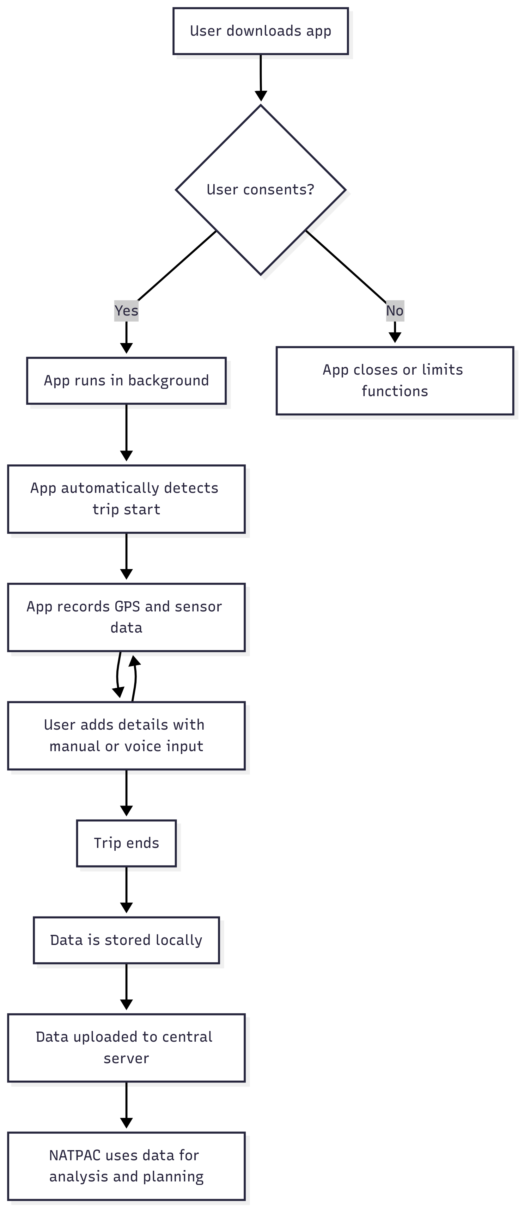
TECHNICAL APPROACH
Walk
With
Us
Tech Stack Used:
Frontend (Mobile/Web): HTML, CSS, JavaScript, MapLibre, MapTiler API, Voice Recognition API
Backend: Node.js + Express.js
Database: SQLite (trip info + user info)
APIs: OpenRouteService (routing & distance), MapTiler (maps & geocoding)
Mobile Deployment: Android (via WebView / APK packaging)
Flow:
  User logs in / creates account
  User selects travel mode
  App captures GPS-based location & start time
  Destination entered (manual/voice) → route fetched via ORS
  App records duration, distance, and path
  Data stored securely in backend SQLite DB
  NATPAC scientists access aggregated trip data

Slide 4
FEASIBILITY AND VIABILITY
Walk
With
Us
  Practicality: Runs on any smartphone, lightweight, no expensive hardware needed.
  Scalability: Can handle millions of trip records on cloud.
  Consent-based: Respects privacy by asking user approval before tracking.
  Challenges: GPS accuracy indoors, user dropout, ensuring battery optimization.
  Mitigation: High-accuracy geolocation, nudges for user input, background optimization.

Slide 5
IMPACT AND BENEFITS
Walk
With
Us
  Provides real-time, large-scale, accurate mobility data to NATPAC.
  Reduces manual surveys → faster planning, lower costs.
  Enables scientists & planners to analyze trip chains, travel patterns, and mode usage.
  Helps in designing better transport policies, road networks, and urban mobility plans.
  Potential extension to traffic congestion analysis & carbon footprint tracking.

Slide 6
RESEARCH AND REFERENCES
Walk
With
Us
References
Berger, M., & Platzer, M. (2015). Field evaluation of the smartphone-based travel behaviour data collection app "SmartMo". Transportation Research Procedia, 11, 263-279.
Geurs, K. T., Thomas, T., Bijlsma, M., & Douhou, S. (2015). Automatic trip and mode detection with MoveSmarter: First results from the Dutch Mobile Mobility Panel. Transportation Research Procedia, 11, 247-262.
Hesjevoll, I. S., Fyhri, A., & Ciccone, A. (2021). App-based automatic collection of travel behaviour: A field study comparison with self-reported behaviour. Transportation Research Interdisciplinary Perspectives, 12, 100501.
Kem, O., Balbo, F., & Zimmermann, A. (2017). Traveler-Oriented Advanced Traveler Information System based on Dynamic Discovery of Resources: Potentials and Challenges. Transportation Research Procedia, 22, 635-644.
Safi, H., Assemi, B., Mesbah, M., & Ferreira, L. (2016). Trip Detection with Smartphone-Assisted Collection of Travel Data. Transportation Research Record, 2594, 18–26.
Tabasi, M., Siripanich, A., Khan, N. A., Auld, J., & Rashidi, T. H. (2024). GPS-supported smartphone app-based integrated travel diary and time-use data collection: challenges and lessons learned. Transportation, 1-27.

