Slide 1
SMS Spam Detection
Rohit Vasudevan

Slide 2
Problem Statement
Using python and a framework of your choice develop an application that does the following:
Using a SMS spam data set http://www.dt.fee.unicamp.br/~tiago/smsspamcollection/
Create a model, that generates a "spam score" of any input text.
Assuming texts with spam probability of 0.7 and above are spammy, develop an application that for any given input string, using the model, outputs "SPAM" or "NOT SPAM".
You’ll be judged on the basis of dataset filtration, input classification, code quality, etc.

Slide 3
Steps to build SMS Spam Detection Model
The objective is to build a binary classification model to detect whether a text message is spam or not.
To do that, we need to prepare and explore the spam data.
Prepare train/test data and pre-process text data.
Train the spam detection model using a few approaches such as Sequential Model and Bidirectional Long Short Term Memory(LSTM).
Compare and select the final model.
Use the final trained classifier to classify the new messages.
Help predict whether the messages are spam or not.

Slide 4
Prepare and explore spam data - Import packages
Import libraries for reading data, exploring and plotting by using packages such as pandas, NumPy, matplotlib.pyplot, seaborn, re and nltk.
Import library for train test split such as sklearn.
For text pre-processing, import libraries such as TensorFlow and Keras.
For data modeling, use libraries such as Keras and TensorFlow.

Slide 5
Prepare and explore the spam data
The dataset provided is present in the Github link called SMSSpamCollection.txt and the code to read the file is present in a Jupyter notebook.
The text file is separated by a tab (“\t”), hence we use pandas to read the text file as a dataframe. Also provide the columns name by passing names, call it label and message.
file_path = "/Users/rohit/Desktop/SMSSpamCollection.txt” df = pd.read_csv(file_path, sep = "\t") msgs = pd.read_csv(file_path, sep = "\t", names = ["label", "message"]) msgs[:4]

Slide 6
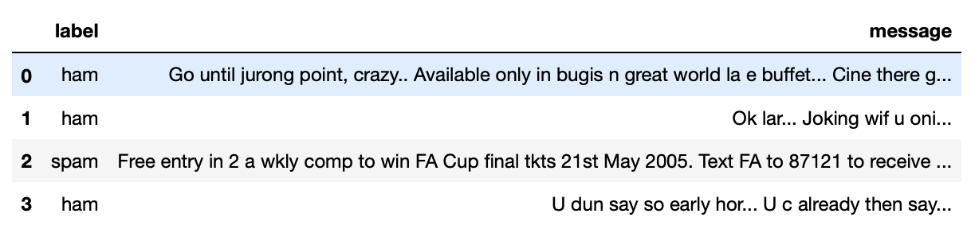
The describe() method in pandas gives us a summary of the data. The summary indicates that there are 5572 labels and messages. There are 2 unique labels indicating “ham” and “spam”.
There are 5169 unique messages compared to the 5572 total messages, which indicates that there are duplicates present. Using msgs.duplicated(), there are 403 duplicated messages.
In all the 5572 messages, there are 4825 ham messages and 747 spam messages. This indicates the imbalanced data.

Slide 7
To further explore the data by label groups, we need to remove the punctuations, stopwords such as ‘a’, ‘is’, ‘the’, etc. as these words do not contribute to the model.
Can also convert the lower cases as similar words with different cases will be treated differently.
Apply lemmatization on the text messages to remove the suffixes and reduce it to its root form, such as solving to solve, which will bring uniformity.
Upon further exploration of the imbalanced data, there are the most frequent ham messages to spam messages (85% to 15%).
There are several ways to handle the imbalanced data, for instance
- Usage of evaluation metrics.
- Resampling the training set: Upsampling or Downsampling
- Ensemble different resample datasets.
I implemented both upsampling and downsampling techniques.
For upsampling, it refers to manually adding data samples to minority classes in order to create a more balanced dataset.

Slide 8
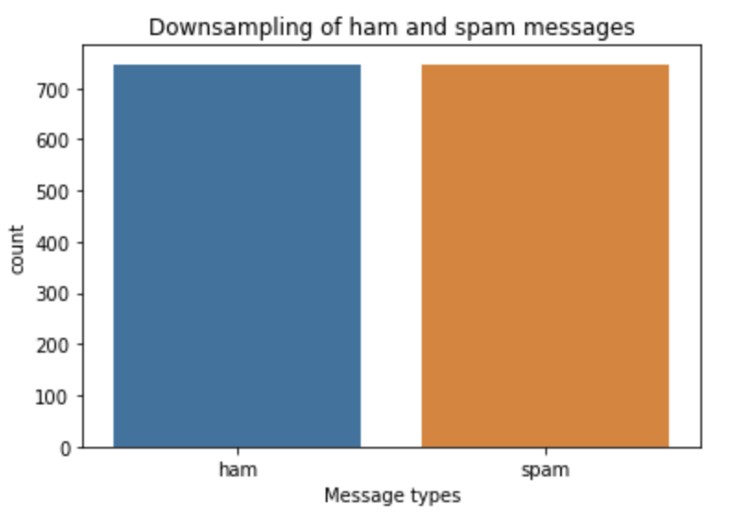
Downsampling refers to removing data from majority classes to create a more balanced dataset. The simplest way is to randomly removing data from the dataset.
Upon downsampling the ham messages, which is the majority message class, there are 747 messages in each class.

Slide 9
Prepare train/test data and pre-process text
Upon exploration of the imbalanced data, it is required to convert the text label into numeric and split the data into training and testing dataset.
It is needed to also map the labels ham and spam 0 and 1 respectively.
Then, convert the label to numpy arrays to fit the deep learning models. The training data comprised of 80% of the data, and 20% comprised of the testing data.
The text pre-processing comprises of converting the text into tokens, the tokens into a word index, word index into a sequence and converting the sequence into a padded sequence.
The pre-processing is done using the TensorFlow API.

Slide 10
Tokenization: Let us convert the text into numerical representation. The Tokenizer API from TensorFlow Keras splits sentences into words and encodes them into integers.
Word Index: We can get the word index using tokenizer.word_index.
Sequencing and Padding: After tokenization, we represent each sentence by sequences of numbers using texts_to_sequences() and pad_sequences() so that each sequence is of the same length. It is done for both training and testing data.

Slide 11
Sequential Keras Model
The Sequential model is a neural network architecture which we implemented to classify the text messages.
The reason I chose this model is because the layers are added in a sequence where there is only one input tensor and one output tensor in each layer.
The first layer, i.e.. Embedding layer maps each layer to a N- dimensional vector of real numbers. It indicates two words with a similar meaning tend to have very close vectors. Since the embedding layer is the first layer, we need to pass the shape of the input layer.
The second layer is the pooling layer, which would reduce the number of parameters of the model to avoid overfitting.
The dense layer along with activation function ‘relu’ as well as a dropping layer to avoid overfitting and a final output layer.

Slide 12
Compile the model using model.compile() with a loss function, optimizer and an accuracy metric.
To fit the classifier, I used model.fit() which uses padded training and testing label for training the model and validation data for validating.
The validation accuracy obtained was – 94.6% on the test data.
As observed by fitting the model, there is a loss of epochs for training and validation datasets. The loss decreases as number of epochs increases.
To check if the model is performing well over the training data, an accuracy plot is generated. If the model performs well over training data and if its performance is worse over testing data, it results in overfitting.
However, there is no issue with overfitting and is handled by the dropout layer of the Sequential model.

Slide 13
Bi-directional Long Short Term Memory(BiLSTM)
BiLSTM is the process of making any neural network have the sequence information in both directions, backward (future to past) and forward (past to future). The input flows in both directions, which increases the computational time.
Due to the increase in computational time, we chose this classifier instead of LSTM. The advantage of BiLSTM over LSTM is better accuracy.
Compile the model using model.compile()
After training and evaluating the model, the validation accuracy is 95%.

Slide 14
Comparison of Models
Both the models referred are comparable in terms of loss and accuracy. The validation accuracy is 94% and 95% respectively.
Based on loss and accuracy of the two models, I decided to use the sequential model for classifying the texts as spam and ham.
It has similar structure and loss and accuracy over epochs is more stable than BiLSTM.

Slide 15
Predict spam/ham message
Using the sequential model, it predicts the spam/ham messages given the text from our data.
I used the same tokenizer to convert them into sequences, which makes sure that in the training set, there are new words with the same token.
Once tokenized, use padding as earlier and provide the same dimension as in the training set.
Wrote a spam_prediction function which helps predict which sentences are spam and not spam. To help categorize as spam, the accuracy was more than 70% as mentioned in the problem statement.

Slide 16
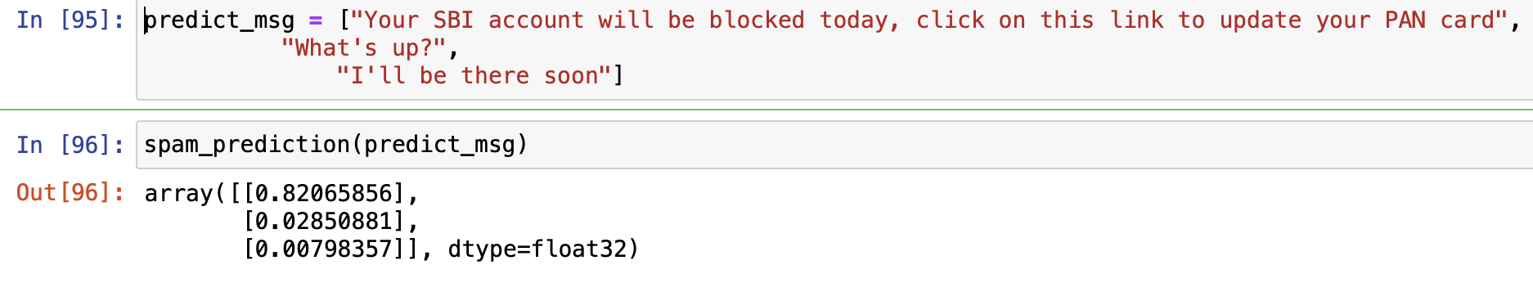
Also, created a new text message and ran it against the classifier to see whether it identifies as spam or ham.
Accurately detects that the first message is spam, and the other two are not spam.

Slide 17
Observations and Improvements
I used the text messages from the text file given and fit deep learning models such as Sequential Model and BiLSTM and compared the accuracy and loss on validation set across these models.
Eventually, I selected the Sequential model to classify the text messages as spam or ham and used it to classify new text messages as well.
Some improvements that can be made are by exploring more sampling approaches for the imbalanced data that we were provided with.
Dealing with more diverse data can help the reduction of duplicate messages that were present in the text file.

Slide 18
There were various messages that had the same semantic meaning, i.e., they convey the same meaning.
Classification of certain messages that were done initially can differ from the model’s prediction of the same message. For example, there is a message in the text file: “I've been searching for the right words to thank you for this breather. I promise i wont take your help for granted and will fulfil my promise. You have been wonderful and a blessing at all times.”
Such a text message is initially classified as ham but can be classified as spam by the models. Dealing with such instances can be done by resampling the datasets, by either undersampling or oversampling or by using advanced techniques such as SMOTE(Synthetic Minority Oversampling Technique).

Slide 19
References
https://keras.io/guides/sequential_model/ - Definitions
https://analyticsindiamag.com/complete-guide-to-bidirectional-lstm-with-python-codes/ - Understanding BiLSTM and LSTM models.
https://towardsdatascience.com/how-i-handled-imbalanced-text-data-ba9b757ab1d8 - How to handled imbalanced data and how to deal with them.

