Slide 1
Topology-Agnostic Anomaly Detection
in O-RAN Systems
Experimental Phase 0 -- Results & Analysis
Somya | Under the guidance of Prof. Bheemarjuna Reddy Tamma
IIT Hyderabad

Slide 2
Agenda
1. Why Topology Variance is a Problem -- Column Explosion & Challenges
2. Data Validation -- Normal vs Anomalous Baselines (Proof)
3. Topology Impact Analysis -- How Faults Propagate Across Topologies
4. Fault Detectability Analysis -- Easy vs Hard Faults & Why
5. Feature Selection & Pairwise Row Formulation
6. Model Selection -- IF vs AE vs BGMM, Distribution Shift, Multi-Topology Training
7. Current Challenges & Proposed Improvements (Residual Features)
8. Temporal Analysis & Data Collection Needs
9. Next Steps -- Challenges & Research Contribution

Slide 3
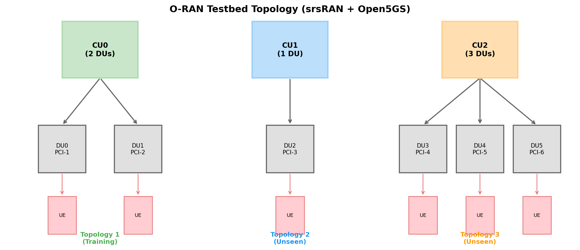
1. The Topology Problem in O-RAN
Why different topologies make anomaly detection hard
Problem: Each CU can have 1, 2, 3, ... N DUs
Raw data has 359 columns per topology
Adding 1 DU adds ~50 new columns (infra + radio)
ML models need FIXED input size!
Naive approach: Pad/truncate columns
-> Wastes capacity, breaks correlations
-> Model trained on 2-DU fails on 1-DU or 3-DU
Our 3 topologies:
CU0: 2 DUs (Training)
CU1: 1 DU (Unseen -- zero siblings!)
CU2: 3 DUs (Unseen -- different scale)
Key: Need a representation that works for ANY number of DUs

Slide 4
1. Column Explosion Problem -- Concrete Numbers
Why fixed-width input is impossible with raw data
Topology | CU Cols | DU Cols | Radio Cols | Total Cols | Input Size
1 CU + 1 DU | 16 | 16 | 31 | 63 | 63
1 CU + 2 DUs | 16 | 32 | 62 | 110 | 110
1 CU + 3 DUs | 16 | 48 | 93 | 157 | 157
1 CU + 6 DUs | 16 | 96 | 186 | 298 | 298
1 CU + N DUs | 16 | 16N | 31N | 16+47N | VARIABLE!
Challenge 1: Variable input dimension -- cannot train one model for all topologies
Challenge 2: Feature misalignment -- DU0's CPU column has no equivalent in 1-DU topology
Challenge 3: Sibling context changes -- 0, 1, or 2+ siblings create fundamentally different feature distributions
Challenge 4: CU metrics scale with N -- CU NET_TX is ~1.3 MB/s PER DU (proven linear)
Challenge 5: Fault localization -- which DU is faulty? All DUs share same CU columns
Solution: CU-DU Pair Representation -- fixed 22-feature vector regardless of topology size

Slide 5
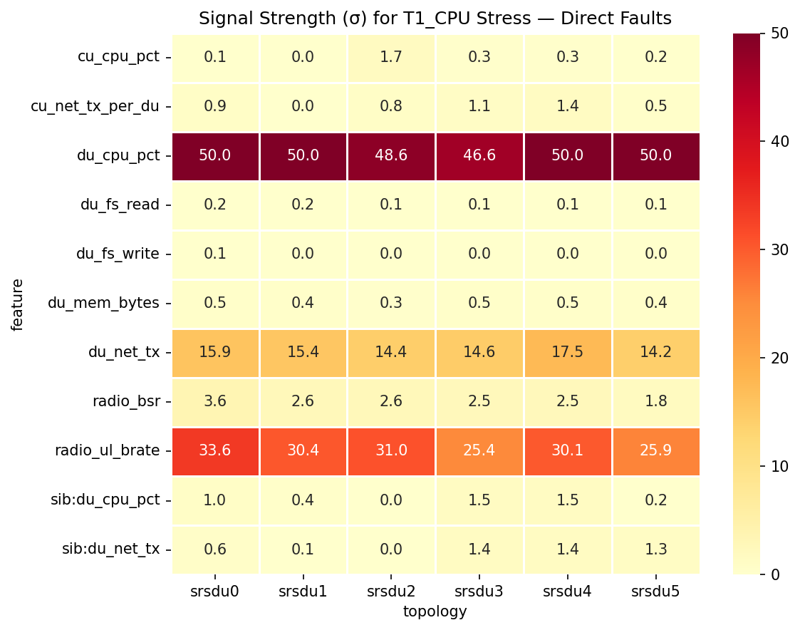
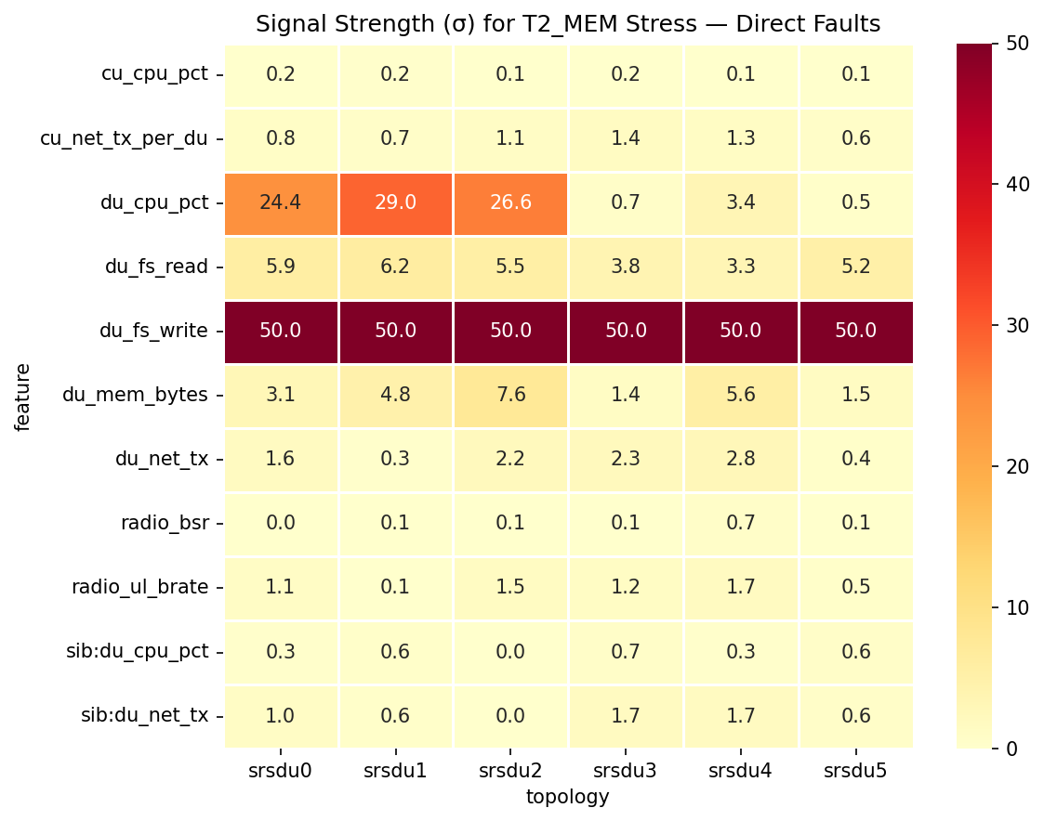
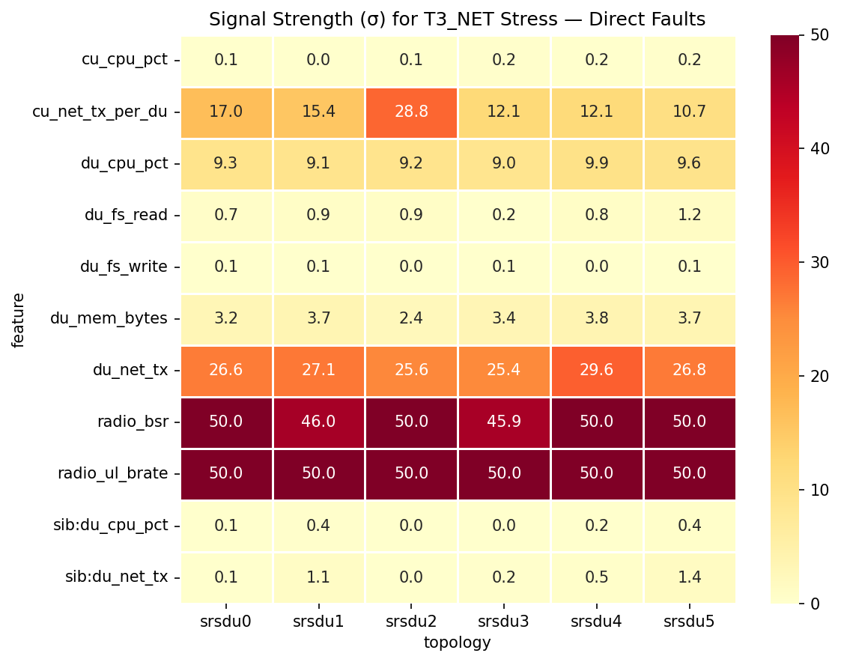
2. Data Validation -- Signal Strength (sigma-distance from normal)
Proof that anomalous data is genuinely different from normal baseline
How to read: Each cell = |mean_anomaly - mean_normal| / std_normal. Higher = stronger signal.
T1_CPU: du_cpu_pct = 50 sigma, radio_ul_brate = +29 sigma (INCREASES -- reporting artifact, see slide 2b)
T2_MEM: du_fs_write = 50 sigma (OOM cycling causes disk thrashing), du_cpu_pct = 24-29 sigma (only in srsdu0-2)
T3_NET: radio_ul_brate = +71 sigma (INCREASES), radio_bsr = +57 sigma, du_net_tx DECREASES 85%
PROOF: Anomalous data is 25-70 standard deviations away from normal -- clearly distinguishable
Conclusion: Normal and anomalous baselines are CLEARLY different. The data is valid for anomaly detection.

Slide 6
2. Data Validation -- Normal vs Anomalous Metric Ranges
Concrete numbers proving the baselines are distinct
Metric | Normal (raw) | T1_CPU (DU direct) | T2_MEM (DU direct) | T3_NET (DU direct)
DU CPU % | 117.6% | 273.7% (+133%) | 193.4% (+64%) | 88.3% (-25%)
DU NET TX | 162.5 MB/s | 79.9 MB/s (-51%) | 153.7 MB/s (-5%) | 25.1 MB/s (-85%)
DU FS Write | ~2.8 KB/s | ~2.2 KB/s | 12.1 MB/s (OOM!) | ~2.1 KB/s
DU Memory | 2.40 GB | 2.51 GB (+5%) | 2.98 GB (+24%) | 1.83 GB (-24%)
Radio ul_brate* | 12.6 Mbps | 30.2 Mbps (+140%) | 13.2 Mbps (+5%) | 50.7 Mbps (+303%)
Radio BSR | 11.3 K | 36.7 K (+225%) | 11.6 K (+3%) | 449.6 K (+3884%)
CU CPU % | 10.9% | 10.9% (same) | 10.9% (same) | 10.9% (same)
CU NET TX/DU | 1.32 MB/s/DU | 1.31 MB/s (-1%) | 1.33 MB/s (+1%) | 1.29 MB/s (-2%)
*ul_brate INCREASES during stress -- likely a reporting artifact (DU stressed -> metric reporting delayed -> accumulated bits in one report).
HARQ retransmissions = 0 always (radio link perfect in lab). ul_nof_ok also increases (+78% T1, +177% T3).
The REAL degradation indicator is DU NET TX drop (-51% T1, -85% T3) and BSR increase (+225% T1, +3884% T3).
CU metrics barely change during DU faults (CU CPU stays at 10.9%) -- explains why CU fault detection is hard.

Slide 7
2b. ul_brate Reporting Artifact -- Data-Verified
Why does radio uplink bitrate INCREASE during DU stress? (UDP traffic, no TCP retransmissions)
Surprising finding: ul_brate INCREASES during stress
We inject UDP traffic (iperf3 -u), so NO TCP retransmissions
HARQ retransmissions = 0 always (ul_nof_nok = 0)
Radio link is perfect in lab environment
Yet ul_brate: Normal 12.6 Mbps
T1_CPU: 30.2 Mbps (+140%)
T3_NET: 50.7 Mbps (+303%)
Root cause: srsRAN metric update staleness
Prometheus scrapes every 1s (timestamps constant
at 1.001s). But srsRAN stops updating values:
ALL radio KPIs go stale together (UL+DL+SNR).
Infra metrics (cadvisor): 34% stale always -> OK.
-> Problem is srsRAN-specific, not Prometheus.
Different mechanism per fault type:
T1_CPU: CPU starvation -> metric thread can't
run. DU CPU: 117% -> 274%. Stale: 15.6%
T3_NET: Data starvation -> DU NET drops 85%,
srsRAN processes fewer packets, metric loop
has nothing new to report. DU CPU DROPS to
88%. Stale: 75.6%, runs up to 9 scrapes.
T2_MEM: OOM kill -> process restarts -> 0% stale
bits_per_HARQ confirms accumulated reporting:
Normal: 88.6K, T1: 119K (+34%), T3: 127K (+44%)
Staleness rate as NEW FEATURE (free to compute):
staleness = count(diff==0) / window_size
Normal=0%, T1=16%, T3=76%. Strong signal!
Metric | Normal | T1_CPU | T3_NET
ul_brate stale rows | 0.0% | 15.6% | 75.6%
Max stale run length | 1 | 2 | 9
Avg stale run length | 1.0 | 1.18 | 4.09
ul_brate + nof_ok stale together | 0.0% | 15.6% | 75.6%
Infra metric (cadvisor) stale | 34.4% | 34.4% | 35.0%
bits per HARQ tx | 88,558 | 118,997 (+34%) | 127,492 (+44%)

Slide 8
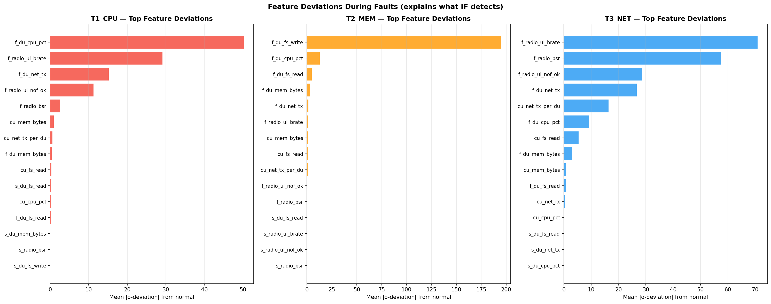
3. Topology Impact -- How Faults Propagate Across Topologies
Do siblings show similar behavior? Does topology size matter?
WITHIN a topology, siblings show SIMILAR behavior:
T1_CPU: srsdu3/4/5 all show ~47-50 sigma on du_cpu_pct
T3_NET: srsdu3/4/5 all show ~25-30 sigma on du_net_tx
Consistent across DUs under same CU
This validates: sibling DUs under same CU
experience same baseline conditions
ACROSS topologies, signal strengths VARY:
T2_MEM: du_cpu_pct = 29 sigma (srsdu1) vs 0.7 sigma (srsdu3)
CU1 (1-DU): Always 100% -- zero-sibling distribution issue
CU2 (3-DU): Higher FPR (~12%) due to different CU load profile
Implication: A model trained on one topology
must generalize to different sibling counts & CU loads

Slide 9
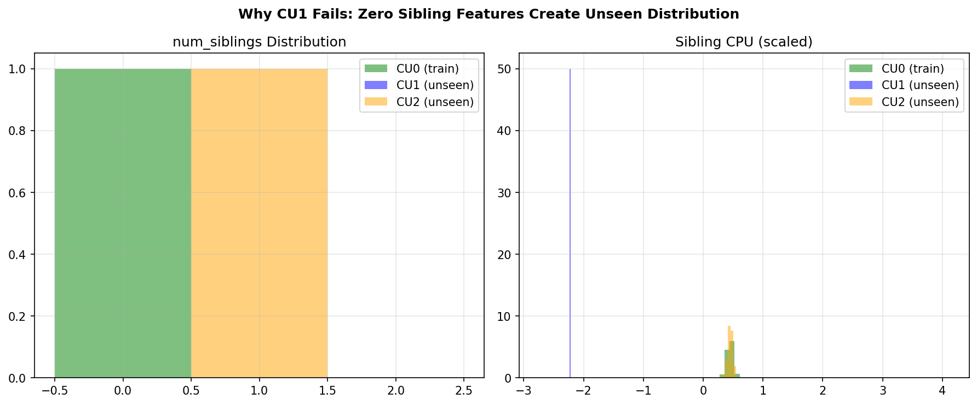
3. The CU1 Generalization Failure -- Zero Siblings Problem
Why 1-DU topology breaks both models
CU0 (training): num_siblings = 1
sibling_cpu = 117%, sibling_net_tx = 162 MB/s
CU1 (unseen): num_siblings = 0
sibling_cpu = 0, sibling_net_tx = 0
8 features are ALL ZEROS!
Both IF and AE: 100% FPR on CU1
Zero-sibling vector is fundamentally
different from training distribution
Root Cause: Sibling features create topology-dependent distribution. Need representation that doesn't depend on siblings.
Indirect False Alarm Problem (when sibling DU is stressed, pair gets flagged):
IF false alarm: 77-90% across topologies | AE false alarm: 100% across all topologies
When DU0 is stressed, CU0-DU1 pair's sibling features show DU0's anomalous values -> false positive
Current representation CANNOT distinguish 'my CU is faulty' (should flag) from 'my sibling is faulty' (should NOT flag)

Slide 10
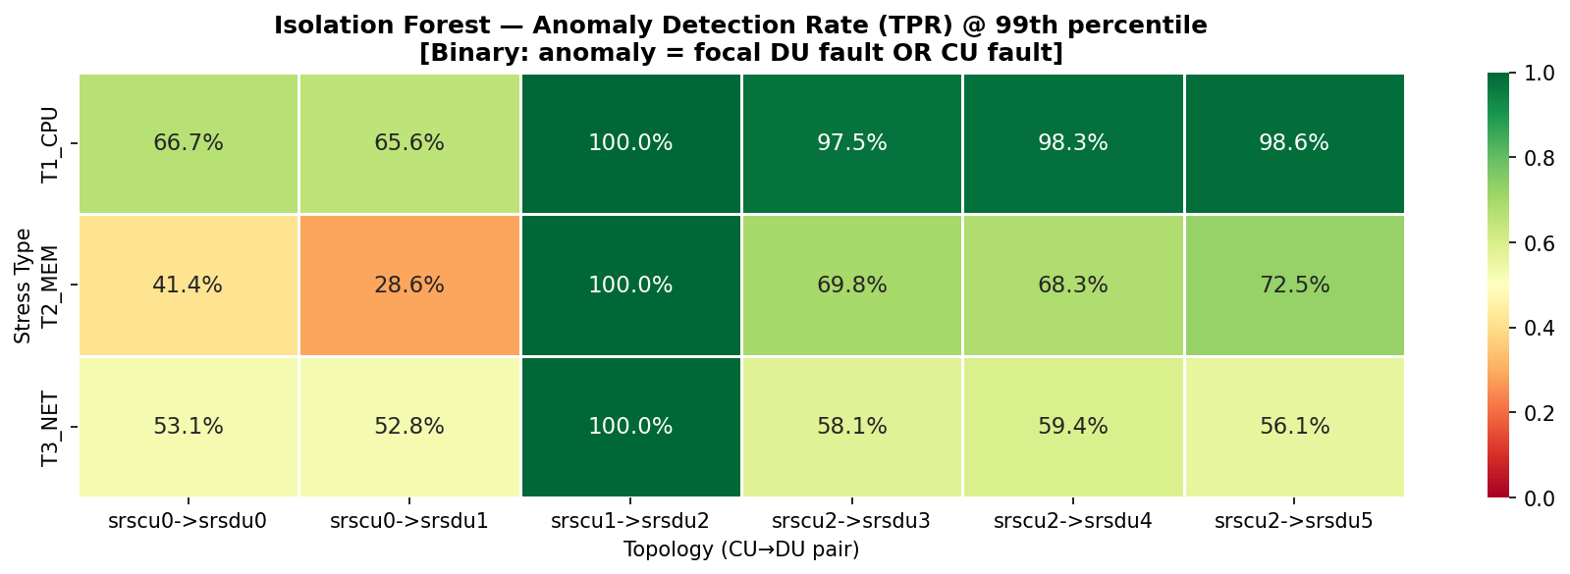
4. Fault Detectability -- Which Faults Are Easy vs Hard?
IF detection rates @ 99th percentile threshold
Fault Type | Detection Rate | Difficulty | Why?
T1 CPU (DU direct) | 99%+ | EASY | du_cpu_pct jumps +100%, massive 50-sigma signal
T3 NET (DU direct) | 99%+ | EASY | radio_ul_brate drops to 0, 50-sigma signal
T2 MEM (DU direct) | 70-99% | MEDIUM | OOM cycling variable; srsdu3-5 only 0.7 sigma on CPU
T1 CPU (CU fault) | 31-32% | HARD | Only 5/22 features change; DU still runs normally
T3 NET (CU fault) | 6-12% | VERY HARD | CU NET_TX drops but DU compensates; subtle signal
T2 MEM (CU fault) | 15-28% | HARD | CU memory barely rises; minimal propagation to DU

Slide 11
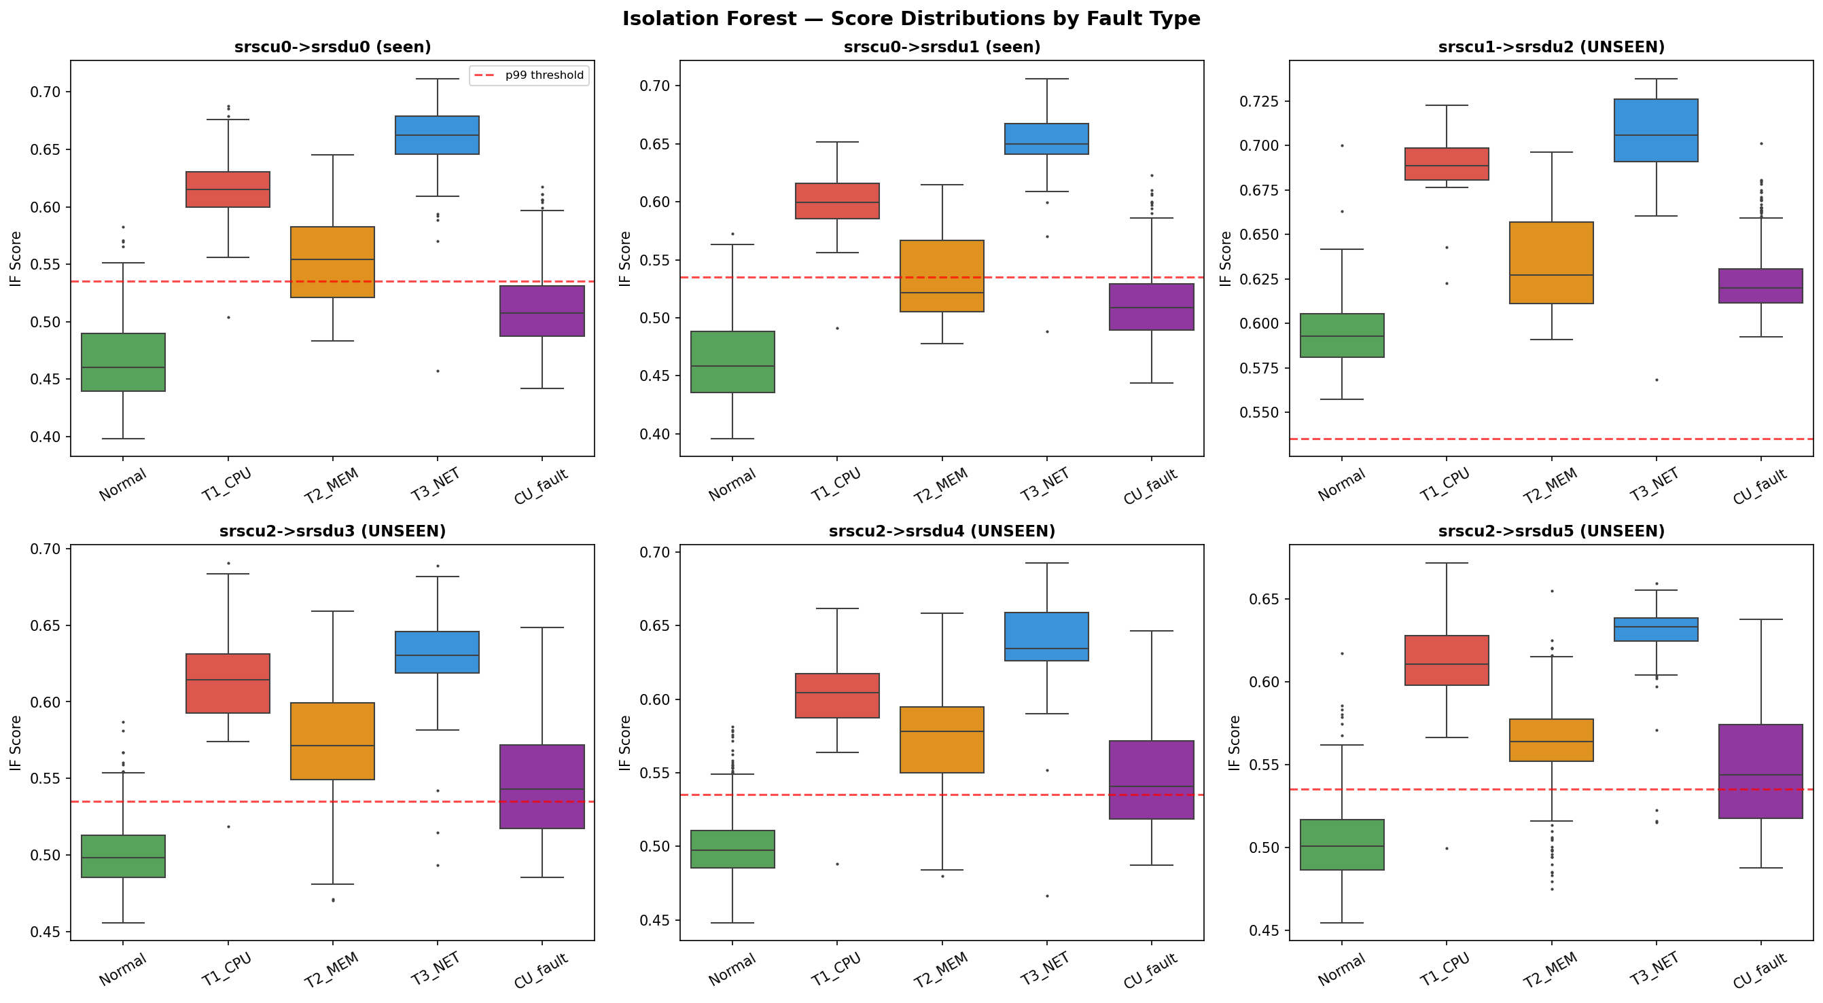
4. Why CU Faults Are Hard -- The 5/22 Feature Problem
Only 23% of the pair vector is anomalous during CU faults
DU fault: 8-13/22 features anomalous
-> IF easily isolates (short path)
CU fault: only 5/22 features anomalous
-> cu_cpu_pct, cu_mem_bytes, cu_net_tx_per_du
-> Focal DU features: NORMAL
-> Sibling features: NORMAL
-> IF: not enough anomalous features
to distinguish from normal
Score overlap visible in box plots:
CU_fault (purple) overlaps with Normal
T1_CPU/T3_NET (red/blue) clearly separated
Combined TPR = (direct_detected + cu_detected) / (direct + cu). CU detection drags down overall TPR from 99% to 53-67%
Example: CU0-DU1 T1_CPU = 65.6% combined TPR
Direct T1: 179/180 = 99.4% | CU T1: 57/180 = 31.7% | Combined: (179+57)/360 = 65.6%

Slide 12
5. CU-DU Pair Representation -- Fixed-Size Feature Vector
Mathematical formulation for topology-agnostic input
Key Idea: Instead of one row per timestamp (variable width), create one row per CU-DU pair per timestamp (fixed width)
Each pair is a fixed 22-dimensional vector regardless of how many DUs exist in the topology:
Group | Features | Count | Justification
CU Infrastructure | cpu_pct, mem_bytes, net_tx_per_du, net_rx, fs_read | 5 | CU health; net_tx divided by N DUs for topology normalization
Focal DU Infra | cpu_pct, mem_bytes, net_tx, fs_write, fs_read | 5 | Direct health of THIS specific DU
Focal DU Radio | ul_brate, bsr, ul_nof_ok | 3 | Radio KPIs from DU's PCI/RNTI; most sensitive to faults
Sibling DU Infra | mean(cpu_pct), mean(mem_bytes), mean(net_tx), mean(fs_write), mean(fs_read) | 5 | Average of all OTHER DUs under same CU (0 if no siblings)
Sibling DU Radio | mean(ul_brate), mean(bsr), mean(ul_nof_ok) | 3 | Average radio KPIs of siblings
Topology Context | num_siblings | 1 | INTEGER (0,1,2,...), NOT binary. Encodes exact topology size
1 timestamp x 6 pairs = 6 rows x 22 features. Train pairs: 52,716. Test pairs: 99,918.

Slide 13
5. Mathematical Justification -- Why These 22 Features?
Feature selection based on discriminative power and redundancy analysis
Starting point: 359 raw columns
Step 1: Remove zero-variance (128 cols)
Constant values = no information
Step 2: Remove near-duplicates (78 cols)
sum(irate(...)) = irate(...) per instance
when only 1 instance exists per container
Step 3: Remove leaking labels (18 cols)
stressType, stepStress columns
Step 4: Remove constant counters (6 cols)
node_boot_time, machine_cpu_cores (same host)
Step 5: Select discriminative metrics
Based on sigma-distance during faults:
Keep features with sigma > 3 for any fault type
Result: 13 infra + 3 radio = 16 per pair side
Why sibling features? (8 features)
Provides context about peer DU health
Enables: 'Is this DU different from its peers?'
Problem: Also leaks sibling fault info (77-90% FPR)
Why CU NET_TX / N? (normalization)
CU0: 2 DUs -> NET_TX = 2.6 MB/s (1.3/DU)
CU2: 3 DUs -> NET_TX = 3.9 MB/s (1.3/DU)
Without normalization: CU2 looks anomalous vs CU0
With normalization: both = 1.3 MB/s/DU (comparable)
Why num_siblings? (1 feature)
Tells model whether sibling_mean = 0 means
'no siblings exist' vs 'siblings are idle'
Without it: 0 is ambiguous
Do we NEED sibling features?
Current evidence: They HURT more than help
77-90% indirect false alarm rate
Next step: Replace with residual features

Slide 14
5. Labeling Scheme -- Binary vs 4-Level
How we define anomaly for each CU-DU pair
Label | Condition | Binary | Rationale
0 (Normal) | No stress anywhere | Normal (0) | Healthy pair
1 (Direct) | Focal DU is stressed | Anomaly (1) | This DU is broken -- flag it!
2 (Indirect) | Sibling DU is stressed | Normal (0) | This DU is fine -- DON'T flag
3 (CU Fault) | Parent CU is stressed | Anomaly (1) | CU broken -> affects all its DUs
Terminology: Positive = Anomaly, Negative = Normal
True Positive (TP): correctly detected anomaly | False Positive (FP) = FALSE ALARM: normal flagged as anomaly
True Negative (TN): correctly identified normal | False Negative (FN) = MISSED DETECTION: anomaly missed
Why NOT flag indirect (sibling) faults?
If DU0 is stressed, only CU0-DU0 pair should be flagged
Flagging CU0-DU1 = FALSE ALARM (FP) -- hurts fault LOCALIZATION
Why flag CU faults for ALL DU pairs under that CU?
CU is shared infrastructure -- if CU is down, ALL DUs are affected

Slide 15
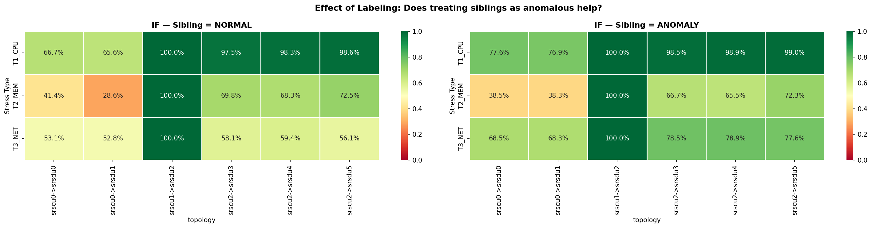
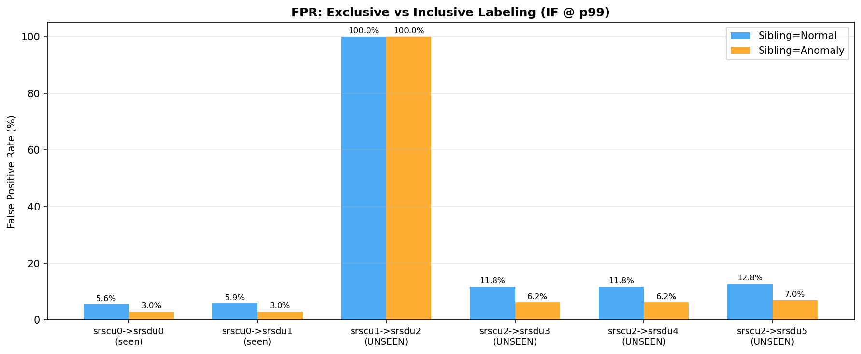
5b. Experiment: What if Sibling = Anomaly?
Does treating sibling-stressed rows as anomalous improve detection?
When sibling = ANOMALY (inclusive):
T1_CPU: 66.7% -> 77.6% (+11% improvement)
T3_NET: 53.1% -> 68.5% (+15% improvement)
FPR: 5.6% -> 3.0% (HALVED!)
FPR unseen: 11.8% -> 6.2% (HALVED!)
WHY does FPR drop?
Previously: sibling stressed = normal (label=0)
But model flags it -> counted as false positive
Now: sibling stressed = anomaly (label=1)
Model flags it -> counted as true positive!
BUT: We lose fault LOCALIZATION
Cannot tell WHICH DU is faulty
Only know 'something in this CU group is wrong'

Slide 16
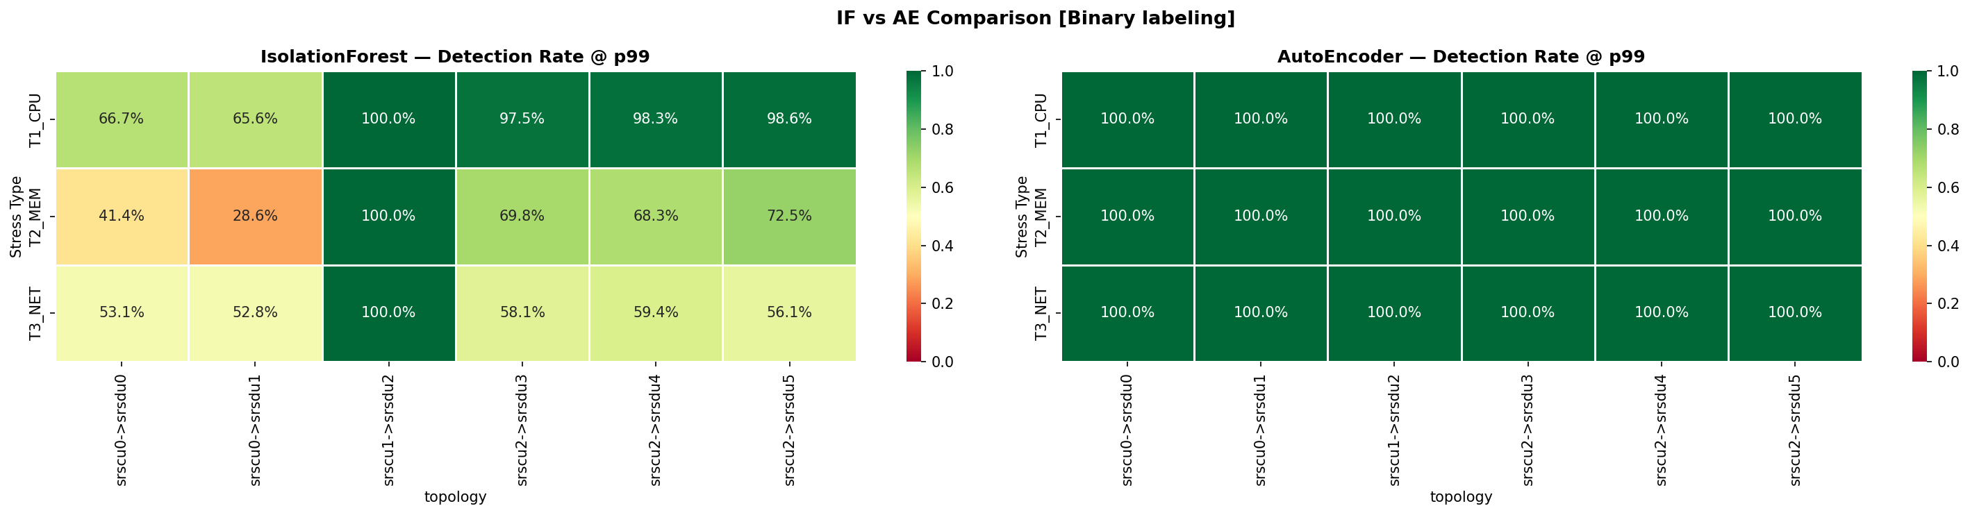
6. Model Comparison -- Isolation Forest vs AutoEncoder
Why we chose IF over AE for Phase 0
Metric | Isolation Forest | AutoEncoder | Winner
FPR (seen topology) | 5.6% | 44% | IF (8x better)
FPR (unseen 3-DU) | 11.8% | 100% | IF
FPR (unseen 1-DU) | 100% | 100% | TIE (both fail)
T1 Direct Detection | 99%+ | 100% | ~TIE
T3 Direct Detection | 99%+ | 100% | ~TIE
Interpretability | High (path length) | Low (MSE) | IF
Robustness to drift | Strong | Fragile | IF
AUROC (mean) | 0.897 | 0.891-0.982 | AE (higher AUROC)

Slide 17
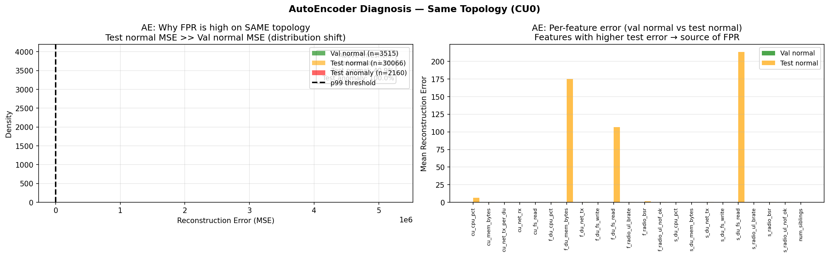
6. Why the AutoEncoder Fails -- Root Cause Analysis
Distribution shift + tight bottleneck = catastrophic FPR
Left: MSE distributions
Val normal << Test normal << Test anomaly
Threshold from val doesn't transfer!
Right: Per-feature error
focal_du_fs_read: 0.000001 -> 106.6
(100 MILLION times increase!)
sib_du_fs_read: similar explosion
Root Cause 1: Too tight bottleneck -- 22->16 = 73% compression forces memorization of specific feature correlations
Root Cause 2: Global scaler amplifies drift -- Features with low training variance get disproportionate reconstruction error
Root Cause 3: No temporal robustness -- Threshold calibrated on same-session validation, doesn't transfer to different sessions
This is a MODEL problem, not a DATA problem. IF handles the SAME data with 5.6% FPR.
AE has higher AUROC (0.98 for CU1) but this is misleading -- ranking is good but the THRESHOLD doesn't transfer

Slide 18
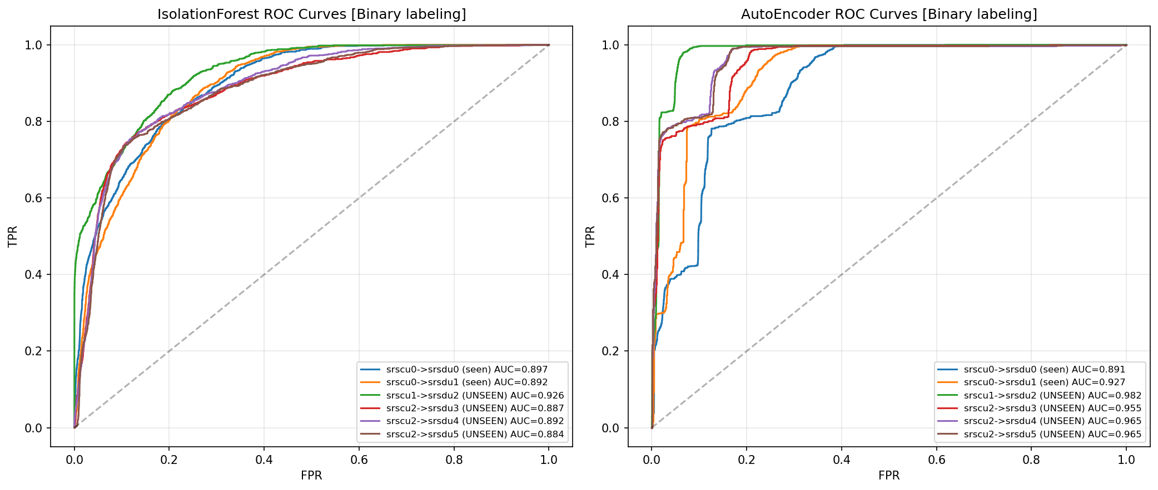
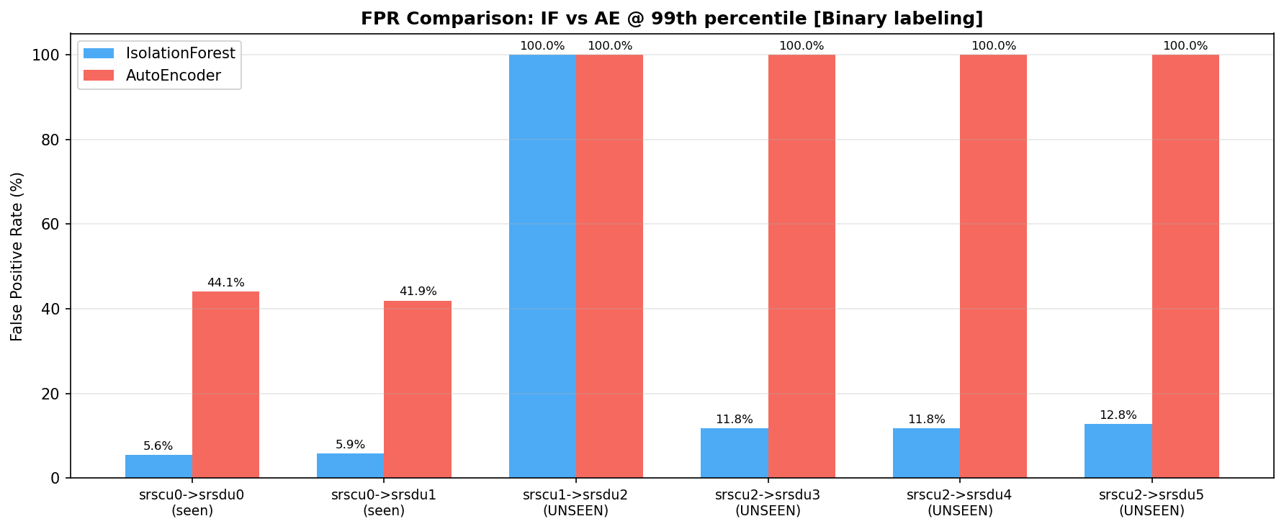
6. ROC Curves & FPR Comparison
AE has good ranking (AUROC) but terrible threshold transfer
ROC Curves (top):
IF: All topologies cluster AUC 0.88-0.93
AE: Higher AUC (0.89-0.98) BUT...
CU1 (purple) AUC=0.93/0.98 yet FPR=100%!
AUROC is MISLEADING here because:
It measures ranking quality (can scores
separate normal from anomaly?)
But we need a THRESHOLD that works
across topologies -- AE can't do this
FPR Comparison (bottom):
IF: 5.6% seen, 11.8% unseen (3-DU)
AE: 44% seen, 100% unseen
IF is 8x better on seen topology
and infinitely better on unseen
Conclusion: IF is the clear winner
for Phase 0 deployment

Slide 19
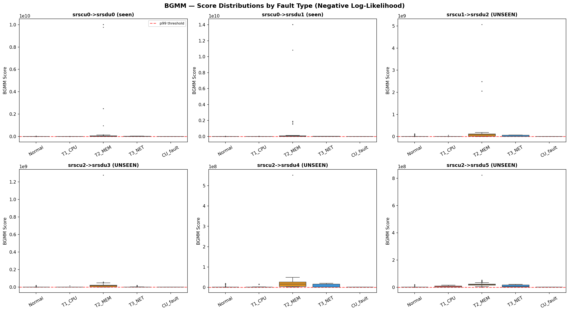

6b. Why Not BGMM? -- Bayesian Gaussian Mixture Model
Tested BGMM as density-based anomaly detector
BGMM: Models normal data as mixture of Gaussians
Score = -log P(x) (negative log-likelihood)
Anomaly = low probability under learned density
Tested n_components: 3, 5, 8, 12, 16
Best: 16 components (11 effective)
Uses Dirichlet Process prior (auto-prunes)
Metric | Isolation Forest | BGMM | AutoEncoder
FPR (seen) | 5.6% | 42.4% | 44.1%
FPR (unseen 3-DU) | 11.8% | 100% | 100%
FPR (unseen 1-DU) | 100% | 100% | 100%
TPR (all) | 53-67% | 100% | 100%
AUROC (seen) | 0.897 | 0.806 | 0.891
BGMM fails for the SAME reason as AE: density estimation is sensitive to distribution shift. BGMM FPR=42% ~ AE FPR=44%. IF's random splits are inherently more robust.

Slide 20
6b. Why Density-Based Models (BGMM, AE) Fail Here
Mathematical intuition: density estimation vs isolation
BGMM models P(x) = sum_k pi_k * N(x | mu_k, Sigma_k)
Problem 1: Covariance estimation in 22D
Full covariance matrix = 22*23/2 = 253 params
per component. With 16 components = 4048 params
Training data (CU0 only): ~14K samples
Overfits to CU0-specific correlations
Problem 2: Curse of dimensionality
In 22D, Gaussian tails decay exponentially
Even small distributional shift between
train/test -> massive NLL increase
e.g., 0.5-sigma shift across 22 features:
NLL increase ~ 22 * 0.5^2 / 2 = 2.75 nats
This exceeds the threshold -> FPR explosion
Why IF is fundamentally different:
IF doesn't estimate P(x)
It measures 'isolation depth':
How many random splits to isolate x?
Random splits are ROBUST because:
- Each tree uses random feature subsets
- Small value shifts don't change split order
- 200-tree ensemble averages out sensitivity
- Non-parametric: no covariance to overfit
Analogy:
BGMM/AE ask: 'Does x look like training data?'
IF asks: 'Is x easy to isolate from the crowd?'
A normal point from unseen topology is
NOT easy to isolate (mixes with crowd)
even though its DENSITY is different

Slide 21
6c. Distribution Shift -- Why AE/BGMM Fail Despite Checking
We verified distributions look similar, yet models fail. Here is why.
What we checked before training:
- Histograms of each feature: train vs test look similar
- Mean/std: within 2-5% of each other
- Same data collection setup, same testbed
So WHY do AE and BGMM fail?
The scaler AMPLIFIES small raw differences:
StandardScaler is fit on ALL training pairs (6 topos)
CU0 features have very low variance in training
Small raw drift becomes massive in scaled space
Example: focal_du_fs_read
Train (raw): mean=1234 bytes, std=15 bytes
Test (raw): mean=1260 bytes (+2% -- looks fine!)
Train (scaled): mean=-0.09, std=0.003
Test (scaled): mean=+1.57, std=10.2
--> +1.7 sigma shift, 3000x variance explosion!
Per-feature scaled distribution shift:
focal_du_mem_bytes: -4.6 sigma shift
sib_du_fs_read: +2.4 sigma, 3600x variance
cu_cpu_pct: +0.85 sigma
cu_net_tx_per_du: +0.51 sigma
Why IF survives but AE/BGMM don't:
AE: Must reconstruct EXACT values. 0.5-sigma
shift across 22 features -> cumulative MSE
explodes. Per-feature error: du_fs_read went
from 0.000001 -> 106.6 (100M x increase!)
BGMM: P(x) drops exponentially with shift.
22-dim Gaussian: 0.5-sigma shift per feature
-> NLL increase ~ 22 * 0.5^2/2 = 2.75 nats
IF: Random feature splits. Small value shifts
don't change isolation path length. 200-tree
ensemble averages out sensitivity.
Lesson: 'Distributions look similar' in raw space does NOT guarantee model robustness. Scaler amplification + reconstruction/density sensitivity = FPR explosion.

Slide 22
6c. Can We Fix Density Models with a Better Scaler?
StandardScaler amplifies drift. What are the alternatives?
Scaler | How it works | Helps? | Why / Why not
StandardScaler (current) | x' = (x - mean) / std | NO | Low-variance features get huge scaled shifts from tiny raw changes
RobustScaler | x' = (x - median) / IQR | Partial | Less sensitive to outliers, but still amplifies low-IQR features
MinMaxScaler | x' = (x - min) / (max - min) | NO | Even worse: unseen values outside [min,max] create huge scaled values
QuantileTransform | Maps to uniform/normal CDF | Partial | Robust to shape, but small quantile shifts still accumulate in 22D
Per-topology scaler | Separate scaler per CU group | YES but... | Fixes drift per topology, but breaks topology-agnostic goal
No scaler + IF | Use raw features with IF | YES | IF is tree-based, scale-invariant. Doesn't need scaling at all!
The fundamental problem is NOT the scaler -- it is that density models (AE, BGMM) require exact value matching.
AE reconstructs x: any shift in feature distribution -> cumulative MSE increase across 22 dimensions
BGMM estimates P(x): any shift -> exponential NLL increase in 22 dimensions (curse of dimensionality)
No scaler can fix this -- the sensitivity is inherent to the model class.
IF is fundamentally different: it measures 'how hard to isolate' (random splits), not exact values.
Small value shifts don't change isolation path length. 200-tree ensemble averages out sensitivity.
Recommendation: Train IF on RAW (unscaled) features. Scaling is unnecessary and can only hurt.
If density model is needed for fault localization: use per-topology scaler + wider bottleneck AE, OR use multi-head AE on raw features with IF for detection.

Slide 23
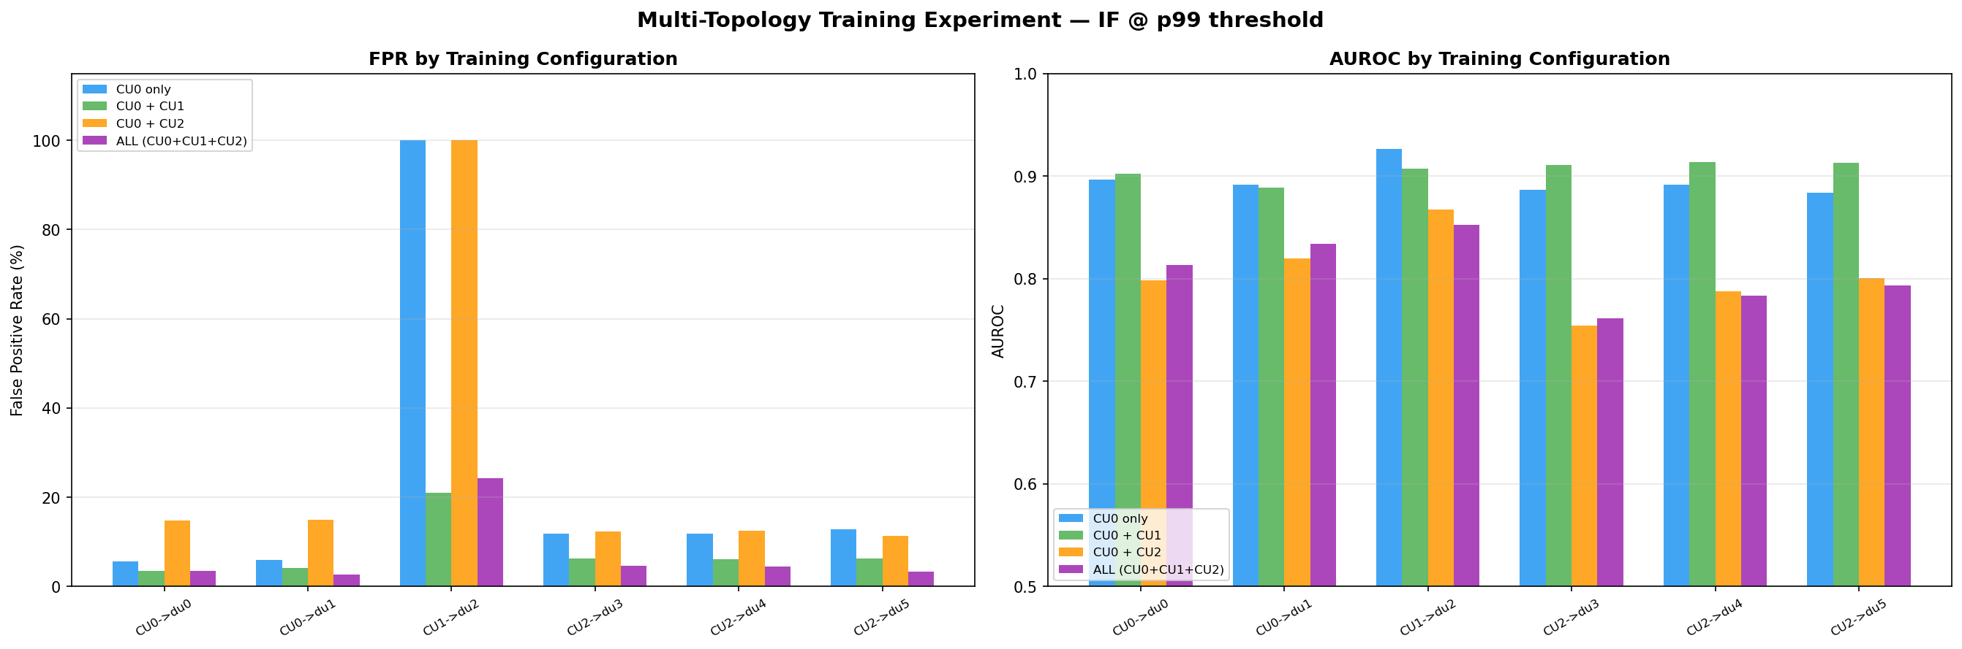
6d. Multi-Topology Training Experiment
Does including more topologies in training help?
Training Config | CU0 FPR | CU1 FPR | CU2 FPR | Avg FPR | Avg AUROC | T1 TPR (CU0)
CU0 only (baseline) | 5.6% | 100% | 12.1% | 24.6% | 0.896 | 66.7%
CU0 + CU1 | 3.4% | 21.0% | 6.2% | 7.9% | 0.906 | 55.6%
CU0 + CU2 | 14.8% | 100% | 12.0% | 27.6% | 0.804 | 45.3%
ALL (CU0+CU1+CU2) | 3.5% | 24.3% | 4.1% | 7.1% | 0.806 | 10.3%
Trade-off: More diverse training data REDUCES false alarms (FPR: 24.6% -> 7.1%) but also REDUCES detection power (T1 TPR: 66.7% -> 10.3%). Best balance: CU0+CU1 (FPR=7.9%, AUROC=0.906).

Slide 24
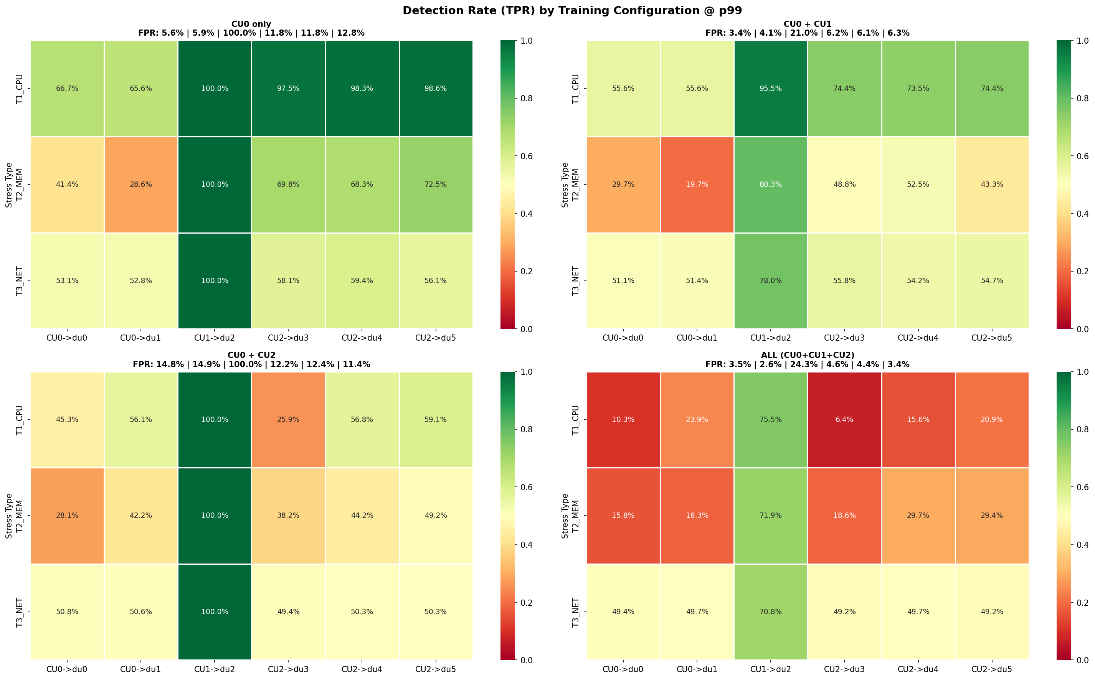
6d. Multi-Topology Detection Heatmaps
Per-stress detection rates for each training configuration
Key findings: (1) Including CU1 (1-DU) fixes CU1 FPR from 100% to 21% -- model learns zero-sibling distribution
(2) Including CU2 (3-DU) alone HURTS -- too much variance confuses IF without fixing CU1
(3) ALL topologies: lowest FPR but IF becomes insensitive -- normal data too diverse, anomalies harder to isolate
(4) CU0+CU1 is the optimal compromise for current testbed

Slide 25
7. Current Challenges -- What Needs to Be Solved
Before proposing architecture, understand the problems deeply
Challenge 1: CU fault detection is weak (6-32% TPR)
Challenge 2: Indirect false alarms = 77-90%
WHY: Only 5/22 features change during CU fault. DU features stay normal.
IF treats all 22 features equally -- 5 anomalous out of 22 isn't enough to isolate.
This is a REPRESENTATION problem, not a model problem.
WHY: When DU0 is stressed, CU0-DU1's sibling features show DU0's anomalous values.
IF sees 8 anomalous sibling features -> flags the pair -> false alarm.
Cannot distinguish 'my CU is faulty' from 'my sibling is faulty'.
Challenge 3: Zero-sibling topology breaks model (100% FPR)
Challenge 4: Distribution shift kills density models
WHY: CU1 has 0 siblings -> 8 sibling features are ALL zeros.
Model trained on CU0 (1 sibling) never saw this pattern.
Even including CU1 in training only reduces FPR to 21%, not 0%.
WHY: AE and BGMM estimate exact density/reconstruction of training data.
Even 2% raw drift -> amplified by scaler -> FPR explosion.
Only IF survives because it doesn't estimate density.
Common root cause: Challenges 1, 2, 3 ALL stem from sibling features. Removing them solves 3 problems at once. Challenge 4 requires a fundamentally different model class (isolation-based, not density-based).
Approach: Replace sibling features with CU-DU residuals that are topology-invariant and don't leak fault info.

Slide 26
7. Residual Features -- Concrete Example
What residual = CU_metric/N - DU_metric means and why it works
Residual Feature: r = (CU_NET_TX / N) - DU_NET_TX
Intuition: If CU is sending data equally to all DUs, each DU's traffic should match CU/N. If not, something is wrong.
NORMAL state: residual is near-zero
ANOMALY: residual spikes (different per fault type)
Metric | CU0 (2 DUs) | CU2 (3 DUs)
CU NET_TX (raw) | 2.6 MB/s | 3.9 MB/s
CU NET_TX / N | 1.3 MB/s | 1.3 MB/s
DU NET_TX | 1.3 MB/s | 1.3 MB/s
Residual | 0.0 MB/s | 0.0 MB/s
Scenario | CU/N | DU TX | Residual | Signal
DU stressed (T1_CPU) | 1.3 MB/s | 0.5 MB/s | +0.8 MB/s | DU slowed down
DU stressed (T3_NET) | 1.3 MB/s | 0.2 MB/s | +1.1 MB/s | DU lost packets
CU stressed (T1_CPU) | 0.5 MB/s | 1.3 MB/s | -0.8 MB/s | CU slowed down
Sibling stressed | 1.0 MB/s | 1.3 MB/s | -0.3 MB/s | Small (sibling effect)
WHY residuals fix Challenge 1 (CU fault detection):
Currently only 5/22 features change. With residuals, CU fault also makes r spike -> 7/15 features now anomalous -> 47% vs 23%
WHY residuals fix Challenge 2 (indirect false alarms):
Sibling features are REMOVED entirely. No way for sibling's fault to leak into this pair's vector.
WHY residuals fix Challenge 3 (zero-sibling):
Residual = CU/N - DU works for ANY N. No sibling features to be zero. CU/1 = CU for 1-DU topology.

Slide 27
7. Proposed Approach -- Why Multi-Head AE?
Addressing each challenge with a specific design choice
New 15-feature pair vector:
[CU_feats(5) | DU_infra(5) | DU_radio(3) | residuals(2)]
Why Multi-Head AE instead of plain IF?
IF works well for detection but cannot LOCALIZE faults
Multi-head AE gives separate reconstruction errors:
e_du -> DU fault confidence
e_cu -> CU fault confidence
e_res -> CU-DU consistency anomaly
This gives operator: WHAT is wrong + WHERE it is
Architecture:
Encoder: 15 -> 32 -> 16 (shared)
Decoder_DU: 16 -> 32 -> 8 (DU infra+radio)
Decoder_CU: 16 -> 32 -> 5 (CU features)
Decoder_RES: 16 -> 32 -> 2 (residual features)
Loss: L = MSE_du + MSE_cu + 5 * MSE_res
5x weight on residuals: forces encoder to learn
CU-DU relationship, not ignore small residuals
But first: We need to validate residual features work with IF before building complex AE. Simple improvements first.
Validation plan (incremental, not jumping to complex architecture):
Step 1: Compute residual features from existing data. Check: do residuals spike during faults?
Step 2: Train IF on 15-feature vector (drop 8 sibling, add 2 residual). Compare FPR and TPR to current 22-feature IF.
Step 3: If residuals help IF, THEN build multi-head AE for fault localization capability.
Step 4: Compare multi-head AE vs IF on 15-feature vector. Does AE's localization justify its complexity?

Slide 28
8. Temporal Analysis -- Deeper Dive
Metric spikes, windows, IF's feature relationships, and traffic variation
Q: Are there spikes in metrics that a point-wise
model would miss?
Stress injection lasts 180 seconds continuously
At 1-second resolution, we get 180 data points
per fault injection -- plenty for point-wise model
Stress is NOT intermittent -- no spikes to miss
BUT: OOM cycling (T2_MEM) creates periodic spikes
~every 0.6 seconds. At 1s resolution, aliasing occurs
-> some samples catch the spike, others don't
-> explains variable T2 detection (28-100%)
Q: Does IF learn metric RELATIONSHIPS or just
individual thresholds?
IF uses random feature subsets per tree
-> implicitly captures multi-feature patterns
e.g., 'CPU high + NET_TX low' (T1_CPU signature)
This is why IF detects CU faults better than
simple z-score thresholding on individual features
BUT: IF doesn't learn explicit correlations
like 'CU_NET_TX should equal sum of DU_NET_TX'
-> Residual features make this relationship
explicit, which should help CU fault detection
Q: What about traffic variation robustness?
Current data: constant UE traffic (iperf3)
Real-world: traffic varies by time of day
A spike in NET_TX could be normal (busy hour)
or anomalous (fault propagation)
Point-wise model CANNOT distinguish these
-> This is where temporal context would help
-> Also motivates longer data collection
with variable traffic patterns
Q: Should we use windowed features?
Options: rolling mean/std over 5s, 10s, 30s windows
Pro: smooths OOM cycling noise, captures trends
Con: adds latency to detection (window-size delay)
Verdict: Worth trying AFTER fixing representation
Priority order:
1. Fix features (residuals, drop siblings)
2. Try windowed features (low-hanging fruit)
3. Full temporal model (LSTM) only if needed
Temporal is NOT the bottleneck. The 50-sigma signals don't need temporal context. Fix the representation first, then explore temporal for edge cases.

Slide 29
8b. Stress Sufficiency -- Verified with Data
Are our fault injections causing visible RAN performance degradation?
Metric | Normal | T1_CPU (DU) | T2_MEM (DU) | T3_NET (DU) | T1_CPU (CU)
DU CPU % | 117.6% | 273.7% (+133%) | 193.4% (+64%) | 88.3% (-25%) | same
DU NET TX | 162.5 MB/s | 79.9 MB/s (-51%) | 153.7 MB/s (-5%) | 25.1 MB/s (-85%) | same
DU FS Write | 2.8 KB/s | 2.2 KB/s | 12.1 MB/s (OOM!) | 2.1 KB/s | same
DU Memory | 2.40 GB | 2.51 GB (+5%) | 2.98 GB (+24%) | 1.83 GB (-24%) | same
BSR | 11.3 K | 36.7 K (+225%) | 11.6 K (+3%) | 449.6 K (+3884%) | same
CU CPU % | 10.9% | same | same | same | 295.5% (+2603%)
Verdict per fault type:
T1_CPU: YES -- DU CPU doubles, NET TX halves,
BSR +225%. Clear degradation. (29-sigma signal)
T2_MEM: PARTIAL -- exceeds cgroup limit ->
OOM cycling. FS_Write spikes to 12 MB/s.
But CPU signal varies across DUs (24-sigma
for srsdu0, only 0.7-sigma for srsdu3-5).
FIX: reduce --vm-bytes from 1425M to 600M
T3_NET: YES -- NET TX drops 85%, BSR +3884%.
Most dramatic impact. (71-sigma signal)
CU faults: CU CPU jumps to 295% but DU metrics
barely change. Only 5/22 features affected.
HARQ in our data:
ul_nof_nok = 0 ALWAYS (all DUs, all faults)
nof_pusch_invalid_harqs = 0 ALWAYS
Radio link is perfect in lab (no real RF)
-> HARQ features are USELESS (zero variance)
-> In real deployments, HARQ would matter
What we CANNOT currently answer:
- Does the UE experience throughput degradation?
(we only have infra metrics, not app-level)
- What is the F1 interface delay during CU fault?
(would help detect CU faults if we had it)
- How many PDCP retransmissions on DU-CU link?
(would directly capture T3_NET without artifact)
T1_CPU and T3_NET: clear degradation. T2_MEM: needs stress-ng fix. CU faults: detectable in CU metrics but don't propagate to DU metrics.

Slide 30
8c. Additional Metrics -- What to Collect & How
Specific gaps in our data and exactly how to fill them
1. OOM Telemetry (fixes T2_MEM detection)
2. End-to-End UDP Throughput (user-perceived impact)
Metrics: container_oom_events_total, container_memory_failcnt,
container_memory_working_set_bytes
How: Already exported by cadvisor. Add to Prometheus scrape_config:
metric_relabel_configs with regex matching these metric names
Why: T2_MEM causes OOM cycling but we can't see it directly.
failcnt would spike every 0.6s, giving a direct signal.
Metric: iperf3 server-side bits_per_second, lost_packets
How: iperf3 -s --json --logfile /path/log.json on server.
Parse JSON output, align timestamps with Prometheus data.
Why: Currently we infer degradation from infra metrics.
Direct throughput lets us validate: 'DU CPU +133%'
means 'user throughput dropped by X%'.
3. F1-AP / DU-CU Latency (fixes CU fault detection)
4. PDCP SDU Retransmissions (explains T3_NET behavior)
Metric: Round-trip time between DU and CU containers
How: Option A: ping between containers every 1 second,
export to Prometheus via textfile collector.
Option B: srsRAN F1-AP timing from debug logs.
Why: CU faults are hard to detect (6-32% TPR) because
DU-side metrics don't change. F1 latency would spike
during CU stress, adding a direct CU fault signal.
Metric: PDCP retransmission count on F1 (DU<->CU) interface
How: srsRAN logs PDCP stats in debug mode. Parse gNB JSON
logs, or check if srsRAN config has PDCP metrics export.
Why: tc netem loss 2% drops packets on DU ethernet.
PDCP retransmits at F1 layer. This metric would directly
capture T3_NET without relying on ul_brate artifact.
Priority: (1) OOM telemetry -- easiest, already in cadvisor, fixes T2 detection. (2) F1 latency -- biggest impact, fixes CU fault detection. (3) iperf3 throughput -- validates user impact. (4) PDCP retx -- explains T3 behavior.
Note: HARQ features (ul_nof_nok, invalid_harqs) are ALL ZERO in our lab. Radio link is perfect. They would only be useful in real RF deployments.

Slide 31
9. Alternative Topology-Agnostic Representations
Other mathematical formulations that could solve the problem
Approach | Representation | Pros | Cons
Pairwise (Current) | x = [CU/N | DU | sib_mean | N] 22-dim fixed vector | Simple, fixed size, works with any ML model | Sibling features leak faults, zero-vector for N=1
Pairwise + Residuals (Proposed) | x = [CU/N | DU | residuals] 15-dim fixed vector | No sibling leakage, works for any N, simple | Loses peer comparison, residuals may be noisy
Graph Neural Network (GNN) | G = (V={CU,DUs}, E={CU-DU}) Node features, edge passing | Natural variable topology, learns CU-DU relationships | Complex, needs graph batching, hard to interpret
DeepSets / Set Functions | x_CU = f(CU, AGG({g(DU_i)})) Permutation invariant | Handles variable N naturally, mathematically principled | Needs custom architecture, AGG choice matters
Per-Node Independent | x_i = [node_i features] No topology context | Simplest possible, no topology dependency | Loses CU-DU relationship, cannot detect CU faults
Attention-Based Aggregation | x = Attention([CU, DU_1,...,DU_N]) Learned weighting | Adaptive, highlights faulty node automatically | Needs all nodes at once, variable sequence length
Recommendation: Start with Pairwise+Residuals (simplest fix). If insufficient, move to DeepSets (principled variable-size handling).
DeepSets formulation: score(CU, {DU_1,...,DU_N}) = rho(f(CU) + SUM_i phi(DU_i)). Provably handles any N. Encoder phi is per-DU, rho is per-CU.

Slide 32
9. Next Steps -- Challenges & How We Will Address Them
Focused on solving the hard problems, not timeline
Challenge: Sibling features cause 3 problems at once
Challenge: CU fault detection is weak (6-32%)
-> Approach: Replace with CU-DU residual features
Validate on existing data first (no new collection needed)
If residuals spike during faults -> proceed to model changes
-> Approach: Residuals make CU-DU relationship explicit
Expected: 7/15 features anomalous (47%) vs current 5/22 (23%)
If still weak -> try separate CU-fault detector
Challenge: Distribution shift breaks AE/BGMM
Challenge: T2_MEM stress exceeds cgroup -> OOM cycling
-> Approach: Use IF as primary (robust to drift)
If AE needed: per-topology normalization, wider bottleneck
Investigate adaptive thresholding (not fixed percentile)
-> Approach: Re-collect with --vm-bytes=600M (fits in headroom)
Add OOM telemetry metrics to Prometheus
Validate that signal is consistent across all DUs
Challenge: Only 3 topologies tested
Challenge: No fault localization capability
-> Approach: Add 4-DU and 5-DU configurations
True test of topology-agnostic claim
Need variable traffic patterns (not just iperf3)
-> Approach: Multi-head AE (DU/CU/residual decoders)
Only AFTER validating residuals work with IF
Gives operator: WHAT is wrong + WHERE it is

Slide 33
9. Research Contribution -- What Is Novel?
Why this work matters beyond just 'detecting faults'
Existing O-RAN anomaly detection:
- Assumes fixed topology (one model per deployment)
- Requires retraining when DUs are added/removed
- Cannot generalize across deployment configurations
Our contribution:
1. CU-DU pair representation that works for ANY N
(22-feature version identifies problems,
15-feature version proposed as fix)
2. CU-DU consistency residuals as topology-invariant
features (CU/N normalization makes N invisible)
3. Multi-head AE for simultaneous detection +
localization (DU vs CU fault diagnosis)
What we need to show for a paper:
1. 15-feature representation + IF beats 22-feature IF
on FPR, CU fault detection, and generalization
2. One model works on N=1,2,3,4,5 DU topologies
without retraining (topology-agnostic claim)
3. Multi-head AE achieves localization that IF cannot
4. Comparison with SOTA: DeepSets, GNN, attention-based
Success metrics:
Direct DU detection: maintain 99%+
CU fault detection: > 70% (currently 6-32%)
FPR (unseen topology): < 10% (currently 12-100%)
Indirect false alarm: < 20% (currently 77-90%)
The topology-agnostic guarantee: Model never sees N. CU/N normalization + per-pair residuals make N invisible. Works for N=1, 2, 3, ..., 100. ONE model for all deployments.
Immediate next experiment: Compute residual features from existing data, train IF on 15 features, compare with current 22-feature IF.
If residuals work -> proceed to multi-head AE. If not -> investigate DeepSets / attention-based aggregation.

Slide 34
Thank You
Questions & Discussion

Slide 35
Additional Slides
Network Architecture, Experiments, & Paper Review

Slide 36
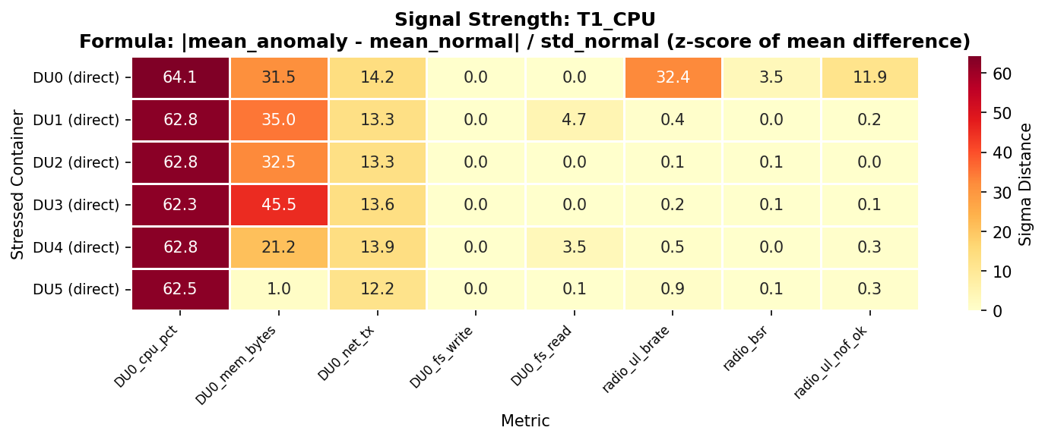
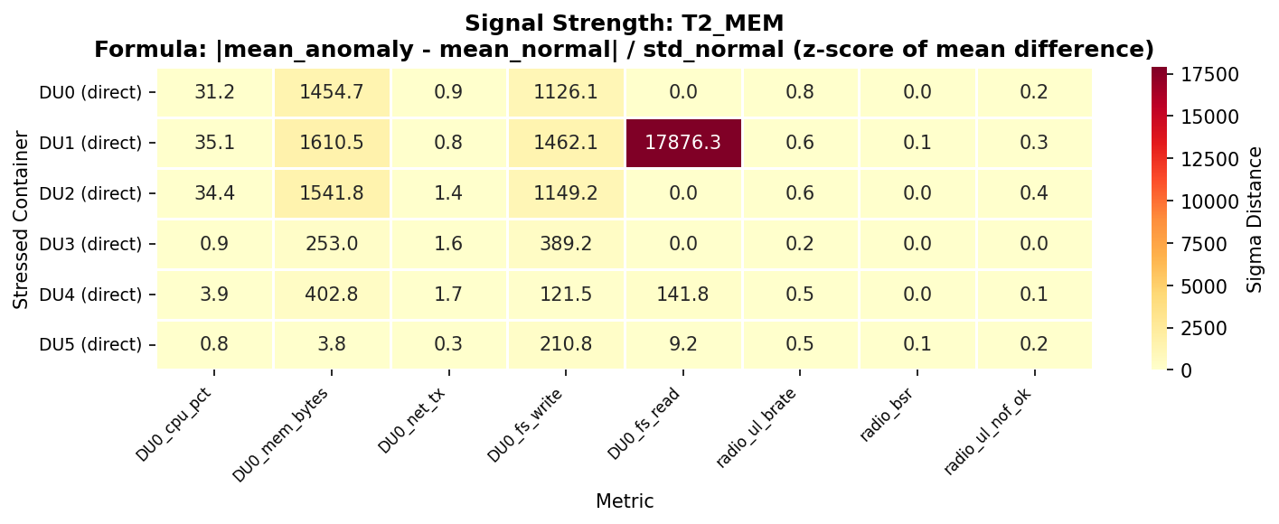
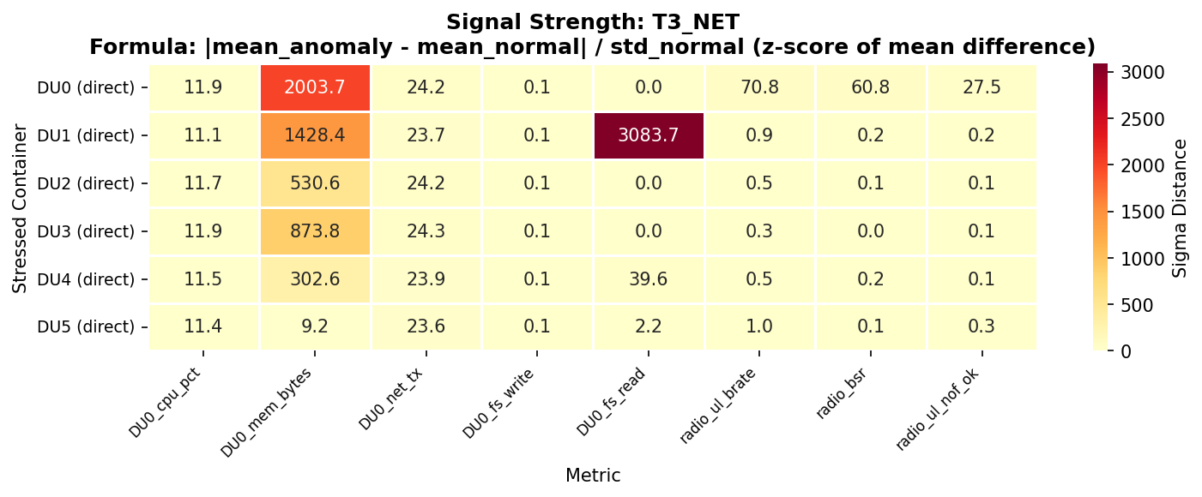
CORRECTED: Signal Strength Validation (z-score of mean difference)
Formula: |mean_anomaly - mean_normal| / std_normal -- using train_normal_final & test_anomaly_final
Formula: sigma = |mean_anomaly - mean_normal| / std_normal
This IS a standard formula: standardized effect size (z-score of the mean difference)
Interpretation: How many standard deviations of normal variation is the anomaly mean displaced by?
sigma > 3: Strong signal (anomaly is clearly distinguishable from normal)
sigma > 10: Extreme signal (trivially detectable)
The formula |mean_a - mean_n| / std_n is a valid z-score measure. It tells us: 'How many SDs of natural normal-variation is the anomaly displaced by?' Values of 25-70 sigma confirm anomalies are trivially distinguishable from normal baseline.

Slide 37
EXPERIMENT: DU eth0 Packet Loss -- Data Collection Setup
Testing: Does adding a second collection interface show the real picture?
Current Setup:
DU containers are dual-homed:
eth0 = oran-intel (175.x) -- data plane
eth1 = telemetry-net (171.x) -- metrics
Metrics collected via eth1 (telemetry-net)
tc netem loss applied on eth0 (oran-intel)
-> Metrics collection UNAFFECTED by tc
Experiment Question:
When we apply tc loss on eth0, is the
uplink bitrate data being updated correctly?
Or is the INCREASE an artifact of batched
metric reporting on the stressed DU?
Proposed Additional Collection Interface:
Add Prometheus scrape on BOTH interfaces:
1. eth1 (171.x) -- current (telemetry-net)
2. eth0 (175.x) -- new (oran-intel direct)
Compare metrics from BOTH interfaces:
If eth0 metrics differ from eth1 metrics
-> proves reporting path matters
If identical -> reporting artifact is real
Also check: CU-side view of the same KPIs
CU sees the actual F1U throughput
If CU sees DROP while DU reports INCREASE
-> confirms DU-side reporting artifact
-> CU metrics are the ground truth
Action: Deploy dual-interface Prometheus scraping + CU-side metrics comparison to validate/invalidate the reporting artifact hypothesis

Slide 38
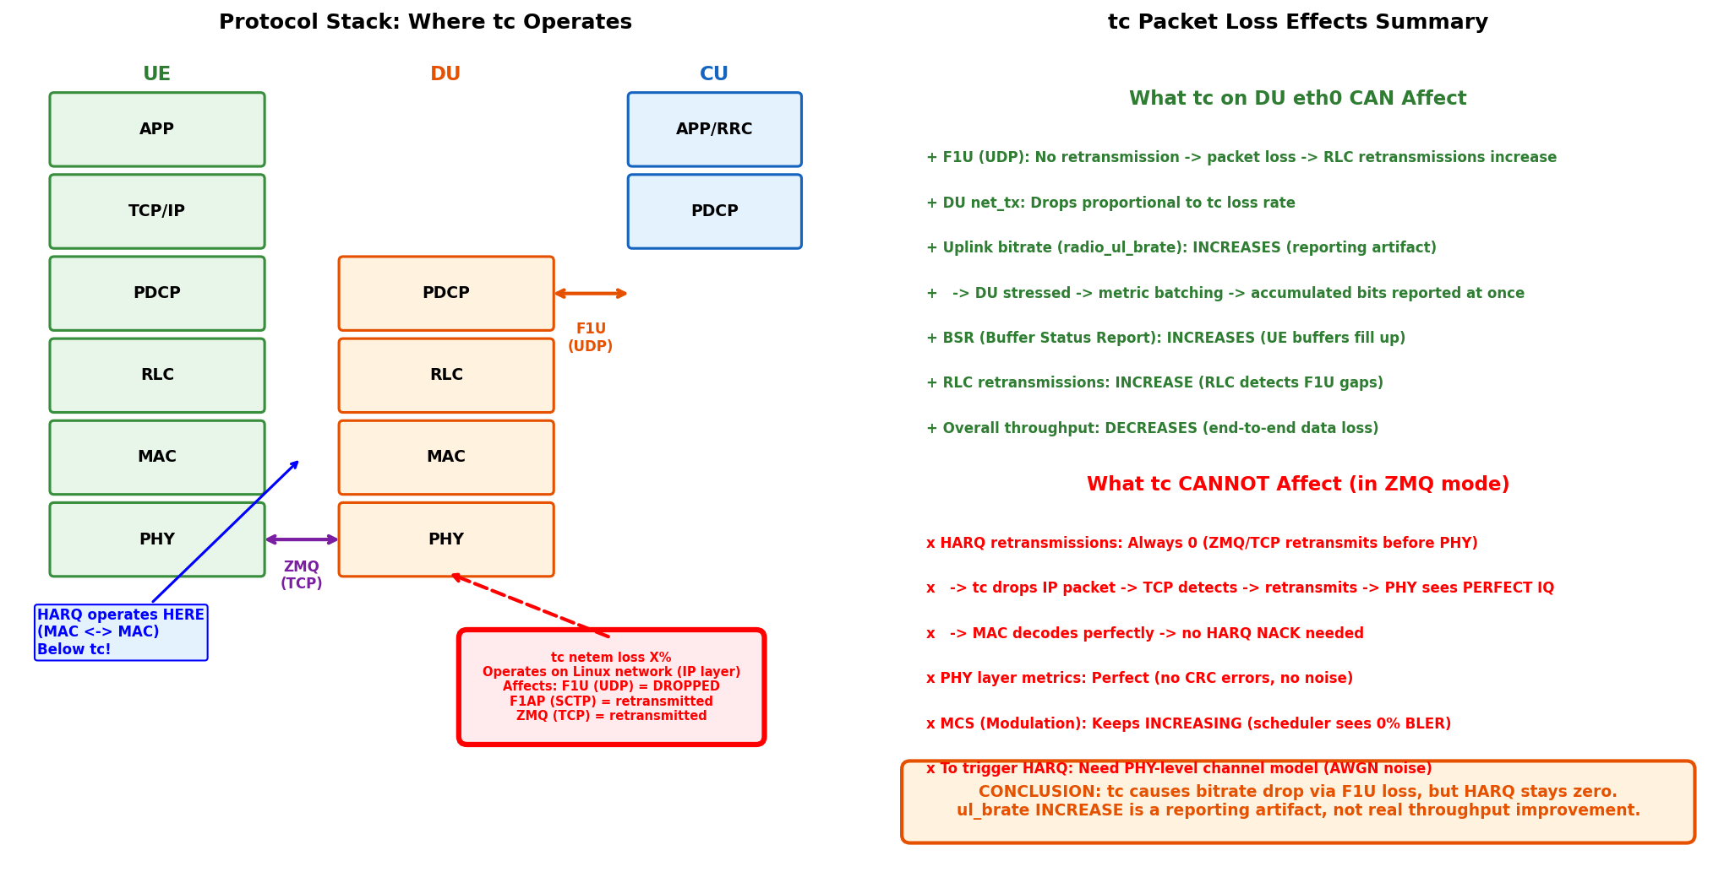
EXPERIMENT: Uplink Bitrate Behavior Under DU eth0 Packet Loss
Why does radio_ul_brate INCREASE during network stress?
Two hypotheses for ul_brate increase: (1) Reporting artifact -- DU batches metric reports when stressed, accumulated bits per report window. (2) Scheduler effect -- 0% BLER in ZMQ makes scheduler increase MCS, raising PHY-level bitrate. Both experiments needed to distinguish.

Slide 39
Lab Architecture: CU-DU-UE Topology (Data + Metrics + Control Planes)
C-Plane (F1AP/N2 SCTP)
U-Plane (F1U UDP / ZMQ TCP)
M-Plane (UDP:55555 telemetry-net)
tc packet loss injection
5GC (AMF/UPF) 175.53.1.2
N2(SCTP)
N3(GTP-U)
CU0 (gnb:511) 175.53.10.1
CU1 (gnb:512) 175.53.10.2
CU2 (gnb:513) 175.53.10.3
F1AP(SCTP:38472)
F1U(UDP)
tc netem loss X%
du0 175.53.1.10
du1 175.53.1.13
du2 175.53.1.14
du3 175.53.1.16
du4 175.53.1.17
du5 175.53.1.18
ZMQ(TCP)
ue0 175.53.2.1
ue1 175.53.3.1
ue2 175.53.4.1
ue3 175.53.5.1
ue4 175.53.6.1
ue5 175.53.7.1
M-PLANE (telemetry-net 171.0.0.0/8) -- All DUs & CUs send metrics via eth1
metrics-server 171.40.1.4:55555
UDP:55555
InfluxDB 171.40.1.5:8086
HTTP
Grafana 171.40.1.6:3000
eth0 = oran-intel (pri:1000) -- Data+Control eth1 = telemetry-net (pri:100) -- Metrics only
tc on eth0 -> F1U(UDP) loss -> bitrate drop, RLC retx ZMQ(TCP) retransmits -> HARQ=0 always in ZMQ mode
Redis: 175.24.0.1 | Metrics flow: DU/CU --[eth1 UDP:55555]--> metrics-server --> InfluxDB --> Grafana

Slide 40
Why HARQ = 0 Always in ZMQ Mode (Despite tc Packet Loss)
Is our HARQ implementation wrong? NO -- it's the ZMQ transport layer
Real 5G (over-the-air):
UE PHY <-> DU PHY via radio channel
Noise/fading -> CRC errors at PHY
-> MAC sends HARQ NACK
-> DU retransmits at MAC layer
HARQ operates BELOW IP layer
ZMQ Simulation (our setup):
UE PHY <-> DU PHY via ZMQ (TCP)
tcp drops IP packet (tc netem)
-> TCP detects loss, retransmits SILENTLY
-> ZMQ receives complete data
-> PHY gets PERFECT IQ samples
-> MAC decodes perfectly
-> NO HARQ NACK ever generated
Is the HARQ implementation wrong? NO!
HARQ is correctly implemented in srsRAN.
It triggers when PHY reports CRC failure.
But in ZMQ mode, PHY NEVER sees CRC failure
because TCP/ZMQ guarantees delivery.
tc operates at Linux network (IP) layer,
which is ABOVE the PHY/MAC layers where
HARQ operates. They're at different layers.
What would trigger HARQ in simulation?
-> PHY channel model (AWGN, fading)
-> Inject noise at IQ sample level
-> srsRAN supports channel models
-> NOT tc (wrong layer entirely)
Protocol | Transport | tc Effect | Retransmission? | HARQ Impact
F1U (DU<->CU) | UDP | Packet dropped | NO (UDP) | N/A (above MAC)
F1AP (DU<->CU) | SCTP | Packet dropped | YES (SCTP retx) | N/A (control)
ZMQ (DU<->UE) | TCP | Packet dropped | YES (TCP retx) | NONE (PHY perfect)
Radio (real) | Air | N/A (no tc) | HARQ at MAC | YES (CRC errors)

Slide 41
Network Topology - Dual Subnet Architecture
175.0.0.0/8 (oran-intel) - DATA PLANE
171.0.0.0/8 (telemetry-net) - METRICS PLANE
5GC 175.53.1.2
metrics-server 171.40.1.4:55555
influxdb 171.40.1.5:8086
grafana 171.40.1.6:3000
cu0 175.53.10.1 2nd: .1.11
cu1 175.53.10.2 2nd: .1.12
cu2 175.53.10.3 2nd: .1.15
cu0 171.53.10.1
cu1 171.53.10.2
cu2 171.53.10.3
du0 .1.10
du1 .1.13
du2 .1.14
du3 .1.16
du4 .1.17
du5 .1.18
du0 171.53.1.10
du1 171.53.1.13
du2 171.53.1.14
du3 171.53.1.16
du4 171.53.1.17
du5 171.53.1.18
ue0 .2.1
ue1 .3.1
ue2 .4.1
ue3 .5.1
ue4 .6.1
ue5 .7.1
Flow: DU/CU -> UDP:55555 -> metrics-server -> influxdb -> grafana All DU/CU containers are dual-homed: eth0 = oran-intel (priority: 1000) eth1 = telemetry-net (priority: 100) metrics-server, influxdb, grafana -> telemetry-net ONLY Prometheus, cAdvisor, node-exporter -> oran-intel (need Docker socket to scrape container/host metrics)
Prometheus 175.x
cAdvisor :8080
node-exp :9100
Redis: 175.24.0.1
Prometheus/cAdvisor/node-exporter on oran-intel (need Docker socket access to scrape container metrics)

Slide 42
Container Interface Assignment & tc Packet Loss
DUAL-HOMED CONTAINER (e.g., srsdu0) +-----------------------------------------------------------+ | | | eth0 (oran-intel) eth1 (telemetry-net) | | IP: 175.53.1.10 IP: 171.53.1.10 | | priority: 1000 (HIGH) priority: 100 (LOW) | | | | | | +----------------+ +------------------+ | | | DATA PLANE | | METRICS | | | | | | | | | | * F1AP -> CU | | * UDP:55555 -> | | | | (SCTP:38472) | | metrics-server | | | | * F1U -> CU | | (171.40.1.4) | | | | (UDP) | | | | | | * ZMQ -> UE | | JSON metrics | | | | (TCP) | | every 500ms | | | +----------------+ +------------------+ | | | | tc qdisc replace dev eth0 <-- CORRECT TARGET | | root netem loss X% (affects data plane) | | | +-----------------------------------------------------------+ WHY priority MATTERS: --------------------- Docker assigns interfaces ALPHABETICALLY by network name: "telemetry-net" (t) > "oran-intel" (o) => eth0 = oran-intel Fix: priority: 1000 on oran-intel forces it to be eth0 priority: 100 on telemetry-net makes it eth1 This ensures: * tc on eth0 = affects srsRAN data plane traffic * Metrics flow on eth1 = unaffected by tc experiments

Slide 43
Why tc Packet Loss Does NOT Trigger HARQ in ZMQ Mode
REAL 5G (over-the-air): ZMQ SIMULATION (this setup): UE DU UE DU +----+ +----+ +----+ +----+ | APP| | | | APP| | | | TCP| | | | TCP| | | | IP | | | | IP | | | |PDCP| |PDCP| |PDCP| |PDCP| |RLC | |RLC | |RLC | |RLC | |MAC |<->|MAC | <- HARQ here |MAC |<------>|MAC | <- HARQ here |PHY |<->|PHY | |PHY | |PHY | +----+ +----+ +--+-+ +--+-+ ^ radio ^ | ZMQ(TCP) | +--------+ +------+------+ noise -> CRC fail | -> HARQ NACK +----+-------+ -> retransmit | Linux net | <- tc operates HERE | (IP/TCP) | +------------+ PROBLEM: tc drops IP packet | TCP detects loss, retransmits SILENTLY | ZMQ receives complete data | PHY gets PERFECT IQ samples | MAC decodes perfectly -> NO HARQ needed RESULT: HARQ = 0 always in ZMQ mode regardless of tc loss Bitrate keeps INCREASING (scheduler sees 0% BLER -> raises MCS) TO TRIGGER HARQ: Need PHY-level channel model (AWGN noise), not tc

Slide 44
Paper Deep Dive (Refined)
Causal Learning for RAN Config Tuning -- Xue et al. HotMobile 2026
What it does -> Why it's needed -> How it works -> Results -> Our leverage

Slide 45
Paper Review
Towards Automated RAN Configuration Tuning
in Cellular Networks with Causal Learning
Xue*, Zhang*, Marina (U. Edinburgh) + Yan, Zhou, Ip, Klosowski (AT&T Labs Research)
HotMobile 2026 | DOI: 10.1145/3789514.3792052
What this paper does: RAN has 275 configuration parameters (power, access control, load balancing, etc.). Changing one affects throughput -- but so does traffic, weather, mobility (hidden confounders). This paper uses CAUSAL LEARNING to separate the TRUE effect of config changes from noise. Result: Predicts 'what would happen if I change CRSGAIN to X?' with 6x better accuracy than existing methods. Evaluated on 1M+ real cells over 6 months.

Slide 46
What Are the Configs & KPIs in This Paper?
Understanding the inputs (knobs) and outputs (measurements)
KPI (Output -- what we measure):
Primary: DL_DRB_TPUT (downlink throughput per cell)
This is the EFFECT we want to predict
Future: latency, reliability (not in this paper)
Static Attributes S (7 total, fixed at deployment):
DL_CH_BW: channel bandwidth (5MHz, 20MHz)
DLMIMOMODE: antenna config (4x4, 4x2)
Morphology: URBAN, SUBURBAN, RURAL
eNodeB Type: MACRO, IDAS
Region, Band, + others
Dynamic Configuration Parameters X (the 'knobs' engineers tune -- 275 total):
Parameter | What It Controls | Example Effect
CRSGAIN | Reference signal power (base station TX power) | Higher -> stronger signal for UEs, but also more inter-cell interference
ACB | Access Class Barring (restricts UE connections) | ACB=1 blocks overload; ACB=0 allows all UEs
QRXLEVMIN | Min signal strength for cell selection | Lower -> UEs connect from farther away
LBUTRANOFFLOAD THRESHOLD | Load balancing trigger point | Controls when UEs are handed off to less-loaded base stations
TTIBUNDLING SWITCHTHRES | TTI bundling threshold | Affects uplink for cell-edge UEs

Slide 47
The Problem: Why Correlation != Causation in RAN
Hidden factors (confounders) make naive data analysis misleading
The Naive Approach:
Look at data: when CRSGAIN=100, throughput is high
Conclusion: CRSGAIN=100 is good!
The Reality:
Engineers SET CRSGAIN=100 specifically BECAUSE
traffic was high in that area (they already knew it
needed more power)
The high throughput might be due to good conditions,
NOT the setting itself
-> This is CONFOUNDING: hidden factor Z (traffic)
affects BOTH the config choice AND the KPI
Confounders Z (hidden/latent factors):
- User mobility patterns
- Traffic surges (concerts, sports events)
- Weather affecting signal propagation
- Interference from neighboring cells
- Measurement noise
These SIMULTANEOUSLY influence:
- Which configs engineers choose (X)
- The network performance (Y)
Result: X and Y are correlated but the
correlation is SPURIOUS (not causal)
[Image: paper_fig2_causal_dags.png]

Slide 48
The Solution: Front-Door Causal Adjustment
Using a MEDIATOR to bypass hidden confounders -- no need to measure Z!
Back-door (ideal but impossible):
Measure ALL confounders Z, condition on them
Problem: Can't measure weather, exact user locations,
interference from non-cellular devices, etc.
Front-door (this paper's solution):
Don't measure Z at all!
Instead, use a MEDIATOR M that transmits
the effect of config X to KPI Y
Causal chain: X -> M -> Y
(Z also affects X and Y, but can't skip over M)
Car Analogy (our interpretation, not in paper):
X = how far you press the gas pedal
M = engine RPM and torque (the physics)
Y = how fast the car goes today
Z = wind, road conditions (hidden noise)
If I tell you the engine is at 4000 RPM (M) on a
flat highway (S), knowing the pedal position (X)
gives you NO extra info about speed (Y).
The RPM already captured the pedal's effect.
What IS the mediator M?
M = distributional summary of KPI outcomes
M = (Q(1), ..., Q(K)) -- K quantiles of KPI dist.
computed over multiple days per unique (X, S) pair
Illustrative example (ours, not from paper):
CRSGAIN=0 in 5MHz Urban cell, over many days:
Q(0.10) = 5 Mbps (worst 10%)
Q(0.50) = 15 Mbps (median)
Q(0.90) = 25 Mbps (best 10%)
Why quantiles, not average?
Quantiles capture the SHAPE of performance:
- Changes in quantile gaps reveal config effects
- Aggregation over days smooths out daily noise
from confounders (traffic, mobility, etc.)
The Math (from paper Sec. 4.2): P(Y|M,X,S) = P(Y|M) * P(M|X,S) * P(X|S) P(M|X,S): How does the config shape the KPI distribution? P(Y|M): Daily KPI Y is a random sample from distribution M. P(X|S): Config prior conditioned on static cell context.
Key: For each KPI there is a different M. This paper focuses on DL_DRB_TPUT only. Future: separate M for latency, reliability.

Slide 49
Three Conditions for Unbiased Causal Estimation
When does the front-door trick actually work?
Condition 1: Mediator Completeness -- X _|_ Y | M, S
Meaning: Config X affects KPI Y ONLY through the physical behavior M. No 'secret path' that bypasses M.
Why it holds: CRSGAIN changes signal power -> changes throughput distribution M -> produces daily Y.
Once you know M (the distribution) and S (the environment), knowing X adds ZERO extra info about today's Y.
Y is just a random sample from M. If Y deviates from M, that's environmental noise (Z), not config effect.
Condition 2: Unconfounded Mediator -- Z does NOT directly influence M
Meaning: Hidden factors Z (traffic, weather) don't corrupt M.
Why it holds: M is computed by AGGREGATING KPIs over 20+ days for each (X, S) pair.
A single day's traffic surge affects that day's Y, but the MEDIAN over 20 days remains stable and representative.
Aggregation across time 'washes away' the daily noise from Z.
Condition 3: Positivity -- P(X=x | S=s) > 0 for all x, s
Meaning: Every config value must appear in every type of environment (no blind spots).
If Urban cells ONLY use CRSGAIN=0 and Rural ONLY use CRSGAIN=100, you can't tell if the performance
difference is from the config or the environment. You need CRSGAIN=0 AND =100 in BOTH Urban AND Rural.
Why it holds: 1M+ cells over 6 months -> enough natural diversity. CRSGAIN=0 appears across all regions.

Slide 50
Stage 1: Feature Selection -- Which Configs Actually Matter?
Pruning 275 parameters down to ~80 causally sufficient ones
The Goal:
Find X-tilde (subset) such that:
P(Y | do(X), S) = P(Y | do(X-tilde), S)
= same causal effect with fewer params
The Filter: I(Xi ; M | S) > epsilon
'Does knowing this param Xi give significant
new info about the distribution M,
AFTER accounting for environment S?'
Example of 3 types of parameters:
1. CRSGAIN (KEEP - causal):
When CRSGAIN changes, M shifts significantly
I(CRSGAIN; M | S) = HIGH
2. Noise params (PRUNE - non-identifiable):
Some params change often but don't shift M
I(Xi; M | S) ~ 0 -> pruned
3. Environmentally induced params (PRUNE):
Correlate with Y but don't CAUSE Y through M
Once you know S and M, they add nothing
How the Model Does It (Architecture):
a) Modulated Encoder P(X|S):
FiLM layers embed configs conditioned on
static attributes (region, bandwidth, morphology)
b) Config Mask Generator:
MLP assigns a WEIGHT to each of 275 params
High weight = likely causal
Low weight = noise or redundant
c) Quantile Decoder P(M|X,S):
Tries to RECONSTRUCT the distribution M
using only the high-weight params
If reconstruction succeeds -> those params
are sufficient to explain M
d) Elbow Cutoff:
Rank by weight, cut the bottom ones
275 -> ~80 causal parameters
[Image: paper_fig3_architecture.png]
At inference: encoder-decoder is DISCARDED. Only the mask generator is used to produce interpretable, sparsity-aware config importance scores.

Slide 51
Stage 2: Value Grouping -- Combinations Matter!
A single parameter rarely determines KPI alone; effects emerge from groups
The Problem:
Looking at params individually is MISLEADING
Example: ACB (Access Class Barring)
Single-param view:
ACB=0: median throughput = 4.0 Mbps
ACB=1: median throughput = 9.9 Mbps
-> Seems like ACB=1 is better!
Grouped view (ACB + CRSGAIN=0 + LoadThresh=1600):
ACB=0: median throughput = 19.5 Mbps
ACB=1: median throughput = 14.1 Mbps
-> With these partners, ACB=0 is BETTER!
Why? When load balancing is optimized (thresh=1600)
and interference is controlled (CRSGAIN=0),
allowing all UEs (ACB=0) lets the network better
utilize physical resource blocks.
The Solution: Neural Combinatorial Solver
1. Config Value Weight Generator:
Outputs contribution of each config VALUE
(not just parameter) to KPI improvement
Trained with contrastive loss
2. Config Group Sampler:
Explores combinations of non-contextual
params (Xn) given contextual ones (Xc)
3. SetTransformer-based Solver:
Permutation-invariant architecture
-> Order of params doesn't matter
Finds groups that maximize KPI improvement
w(Xg | S, Xc)
Distinguishes:
Contextual (Xc): ALL values matter for KPIs
Non-contextual (Xn): effect depends on group
[Image: paper_fig5_acb_grouping.png]
Key Insight: Causal effects can INVERT under different groupings! ACB=0 is worse alone but BETTER when paired with the right load balancing. This is why holistic causal reasoning matters -- not single-param optimization.
For our work: A fault might not be one bad setting, but two settings that CONFLICT. Value grouping catches these interdependent issues.

Slide 52
Key Innovation: Snapshot-Based vs Change-Based Learning
How they get 20x more data from the same network
Change-Based (existing: Chroma, Iridescence, CIPAT):
Wait for a config to CHANGE in a cell
Compare before/after performance
Problems:
- Engineers are CONSERVATIVE (rare changes)
- < 100 joint change events in 6 months
across 20 regions nationwide!
- External factors change simultaneously
(weather, traffic) -> can't attribute cause
- Very few samples for data-driven methods
MAE: 2.86 Mbps (single param)
2.70 Mbps (multi param)
Snapshot-Based (this paper):
Don't wait for changes!
On ANY day, different cells have different
stable configurations
Compare Cell A (CRSGAIN=0, Urban) vs
Cell B (CRSGAIN=100, Urban) on the SAME day
-> Learn the effect without needing a change
Advantages:
- 20x more usable samples
- Aggregation over days smooths confounders
- Works with 1M+ cells of natural diversity
- Enables front-door causal formulation
MAE: 0.43 Mbps (single param) -- 6.6x better
0.41 Mbps (multi param) -- 6.6x better
The data IS dynamic configs, but observed mostly in stable states. The AI uses cross-cell diversity to 'simulate' what would happen if you changed them. No need to actually run experiments in the live network!

Slide 53
Results: 6x Improvement Over Prior Methods
1M+ cells, 6-month dataset, 275 config parameters -> DL_DRB_TPUT
[Image: paper_fig4_causal_weight.png]
[Image: paper_fig6_whatif.png]
Causal Weight Validation (left):
5MHz: CRSGAIN=0 gets highest weight (correct!)
20MHz: monotonic increase to inflection
Model recovers physically consistent trends
What-if Analysis (right):
'If I change CRSGAIN from 0 to 300, what happens?'
Causal model: 0.43 Mbps error (tracks ground truth)
Change-based: 2.86 Mbps error (clusters around 0)
Capability | Result | vs Baseline
Single-param what-if | MAE = 0.43 Mbps | 6.6x better
Multi-param what-if | MAE = 0.41 Mbps | 6.6x better
Unseen config values | 1.5 Mbps median error | Generalizes!
Region transfer | Tracks local KPI median | Transfers!
Feature selection | 275 -> ~80 params | 3.4x reduction
Inference speed | ~10ms per cell | 10K cells/min

Slide 54
Generalizability & Transfer Learning
Works on unseen config values AND transfers across regions
[Image: paper_fig8_generalizability.png]
[Image: paper_fig9_region_transfer.png]
Generalization (left) -- Paper Fig 8:
Training: ONLY values between 50-150
Test: held-out values OUTSIDE this range
Model captures peak at ~110, decline on sides
1.5 Mbps median prediction error
-> Infers patterns for UNSEEN config values!
Region Transfer (right):
Region A: only 5 TTI values, 0 changes (sparse)
Nationwide: 12 values, >393K changes (rich)
Transfer: re-normalize global causal weights
over local config values -> tracks local median
-> Causal structure learned once, applied anywhere!

Slide 55
How We Can Leverage This for Topology-Agnostic AD
Mapping paper concepts to our anomaly detection framework
Paper Concept | Their Application | Our Application
Causal Feature Selection | 275 configs -> 80 causal params (auto, not manual) | 359 raw cols -> 22 features (manual) Causal: auto-select topology-invariant features
Front-door Mediator M | KPI quantile distribution absorbs confounders | CU/N normalization absorbs topology size Causal: learn residual distributions as M
Value Grouping | Config combos that jointly affect KPIs (ACB+CRSGAIN) | Feature combos that jointly signal faults (du_cpu + cu_net_tx/N)
Transfer Learning | Data-rich region -> sparse region (same causal weights) | Seen topology (2-DU) -> unseen (5-DU) (same causal structure, different N)
What-if Analysis | Predict KPI under unseen configs | Predict normal behavior for new topology (what SHOULD N=5 look like?)
Key Connection:
Their causal chain: Config X -> Physics M -> KPI Y
Our causal chain: Fault X -> Metrics M -> Score Y
If we learn which CU-DU metrics CAUSALLY signal
anomalies, that structure is topology-invariant.
CPU stress -> net_tx drop is CAUSAL regardless
of whether N=2 or N=5.
Potential Research Direction: Use causal discovery to AUTOMATICALLY learn which CU-DU features causally affect anomaly scores, replacing manual feature engineering. The causal graph transfers across topologies -- only the distributions change. A new topology with N=5 DUs has the same causal mechanisms as N=2. Train once, deploy everywhere.

