Slide 1

Project: Music Store Database
Our proposed solution towards the project requirements, is a physical store
The technologies used in the project were : XAMP Server, MySql database
The database objects used are : tables, views, PL/SQL stored procedures
Constraints applied : Primary key, Unique key, Not Null
Referential Integrity maintained through foreign key mapping
Features like auto-increment for primary key used
Inter-table relationships : One to One , One To Many, Many To Many

Slide 2
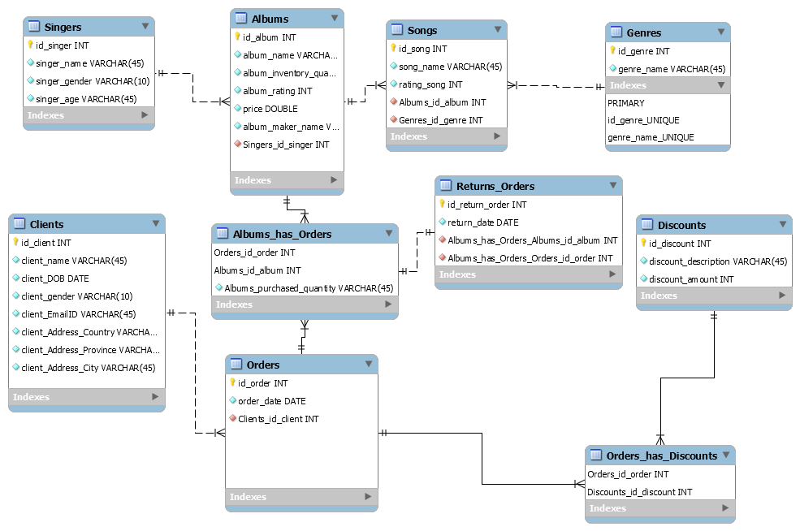
UML Diagram

Slide 3

3 specific scenarios implemented
Our ‘Music Store Database’ implements a discount policy system. The details of various discounts are stored in a separate ‘Discounts’ table. A client order can have either no discount, a specific discount, or a combination of one or more discounts applied. Each discount application, reduces the client’s bill.

Slide 4
Scenario 1
Analysis of availed discounts : which customers are availing which all documents, and the variation/ range of applied savings

Slide 5

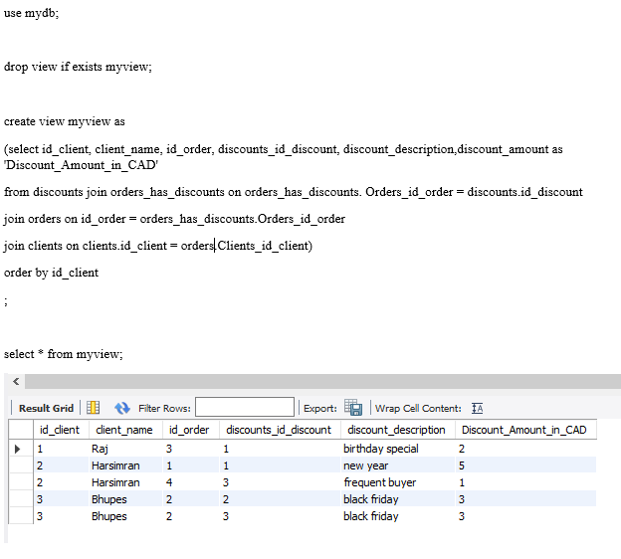

Slide 6
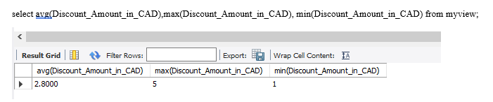

Slide 7
Scenario 2
What factors have allowed the customers to get maximum discount, and thereby maximize his/ her savings; Due to which factors, one or more customers are losing on the available discount?

Slide 8
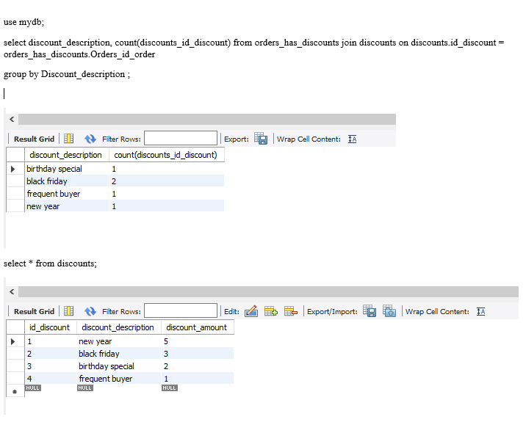

Slide 9
Scenario 3
Analysing information to send feedback to customers to maximize their savings.

Slide 10
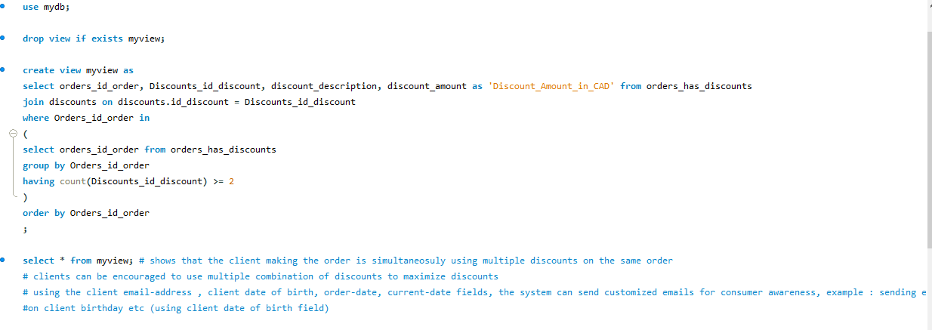

Slide 11
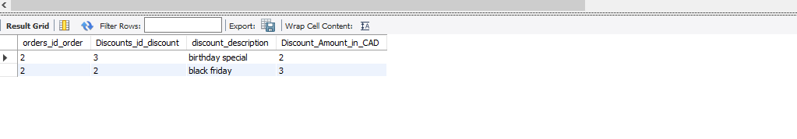

Slide 12
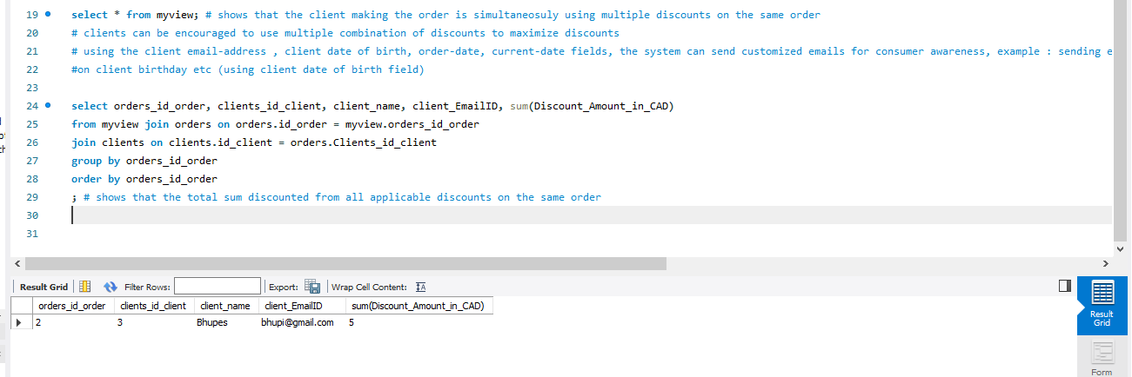

Slide 13
Scope for future enhancements :-
Triggers can be implemented to auto-populate the discounts table whenever a matching discount is found.
Example :- providing new year discount for all orders made on 1January of any year
Atomic blocks of code can be implemented as a transaction, with commit and rollback features.
Example :- Whenever an order qualifies for a discount, an entry in orders_has discount table should not be made, unless a corresponding entry in orders table is made, and vice-versa.
Indexes can be applied to those columns, which are commonly fetched but rarely updated. This will speed up the database querying speed and efficiency.

Slide 14
Concluding Remarks :-
With iterative refinements and continuous database optimization, the database can be made more robust, scalable, efficient and responsive. Our proposed solution aims to meet the project requirements accurately, at the same time leaving scope for future adjustments.
“Data is the new oil.” — Clive Humby
The need to balance data collection and customer privacy.
“No great marketing decisions have ever been made on qualitative data.” – John Sculley
Optimizing database structure and queries to get productive insights and actionable intelligence
“Torture the data, and it will confess to anything.” – Ronald Coase
Ensuring sample size of data is adequate, data-sets meets both ‘reliability’ and ‘validity’ standards

Slide 15
Thankyou

