Slide 1
JULIA : THE CHATBOT
Presented by :-
Rohit Yadav (04120703115)
Monika Bisht (03020703115)
Dhiraj (01320703115)
Neelkamal (03120703115)

Slide 2
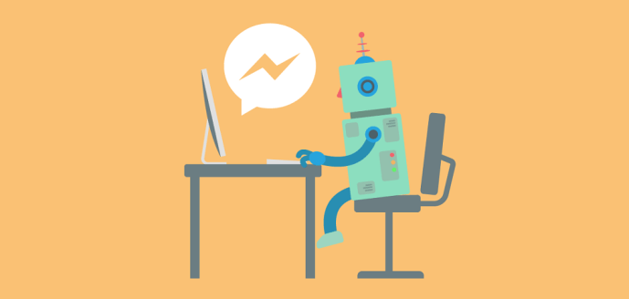
OBJECTIVE
The aim of this project was to propose a cost effective computer program which is trainable and learns from its user.

Slide 3
ABSTRACT
Technology has evolved with time and has made our work easier. Since the invention of computers, developers have been trying to develop a way for the computers to think and learn like human mind.
To compensate the lack of man power in various business fields, the chat bots have been designed to generate responses to the public.

Slide 4
Julia the Chatbot is a computer program which is trainable and learns from its user. It is built using python as its programming language and SQLite 3 & Microsoft workbenche for database methodologies. Julia learns from its user and stores the information in its database automatically. It responds to the queries asked using its database. If the answer required is not in its database, Julia learns from the user.

Slide 5
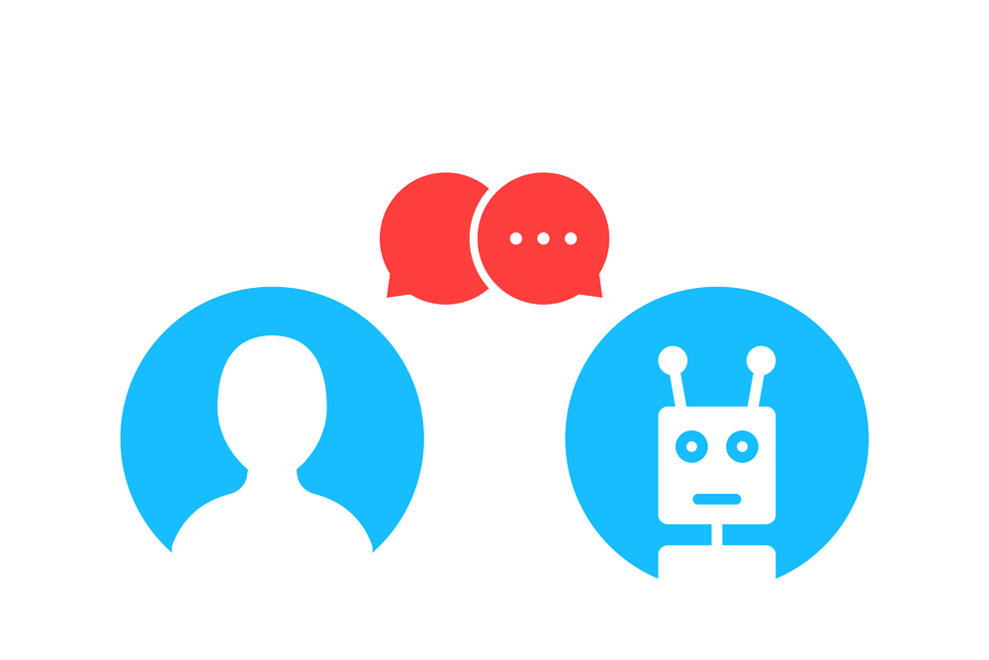
Julia can be used for multiple purposes such as customer care, selling polices or product suggestions, personal assistant etc.

Slide 6
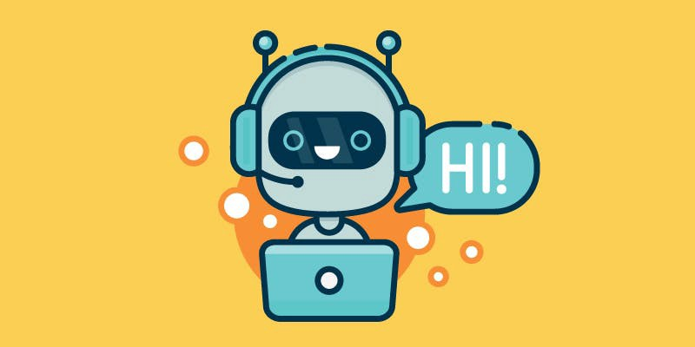
INTRODUCTION
A Chatbot (sometimes referred to as a chatterbot) is a computer program that attempts to simulate the conversation or "chatter" of a human being via text or voice interactions. A user can ask a Chatbot a question or make a command and the Chatbot responds or performs the requested action.

Slide 7
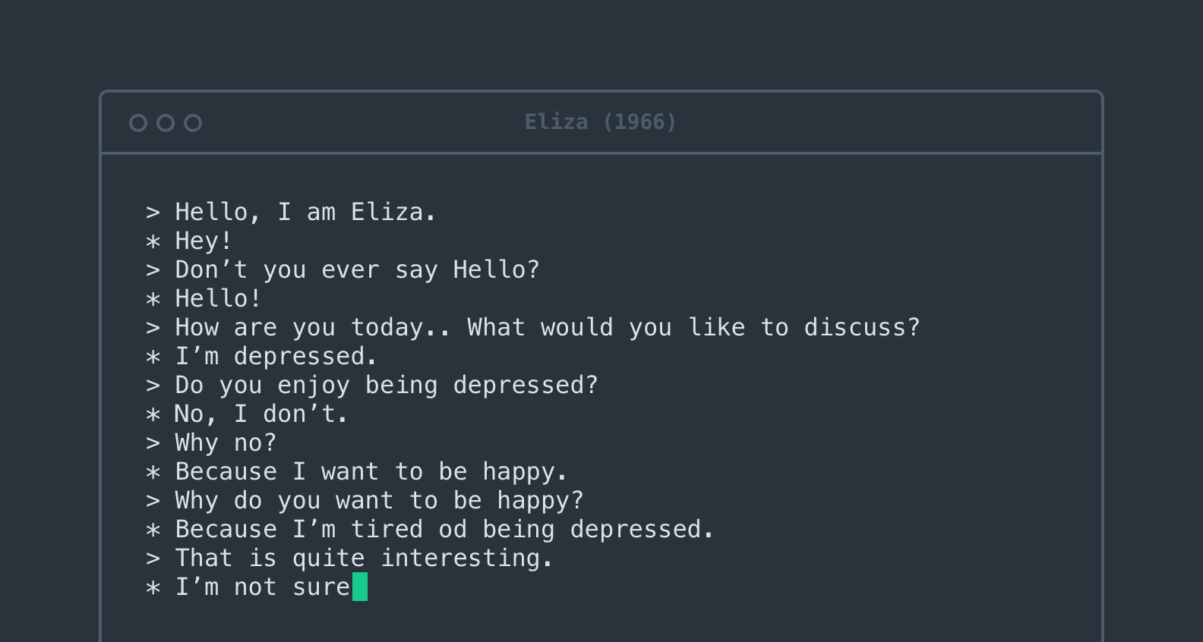
Chat bots such as ELIZA and PARRY were early attempts at creating programs
that could at least temporarily fool a real human being into thinking they were
having a conversation with another person.

Slide 8
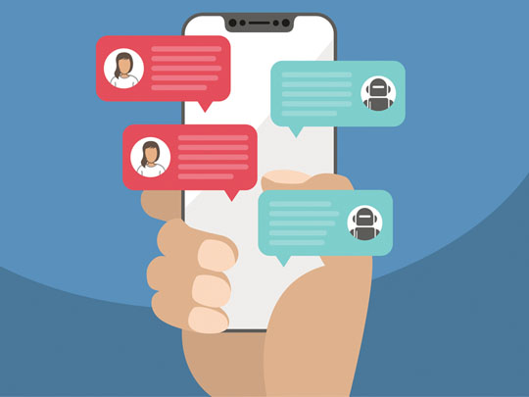
Messaging chat bots may help businesses improve customer service, sell more,
and earn more profit, thanks to a familiar interface and increasing customer
interest.

Slide 9
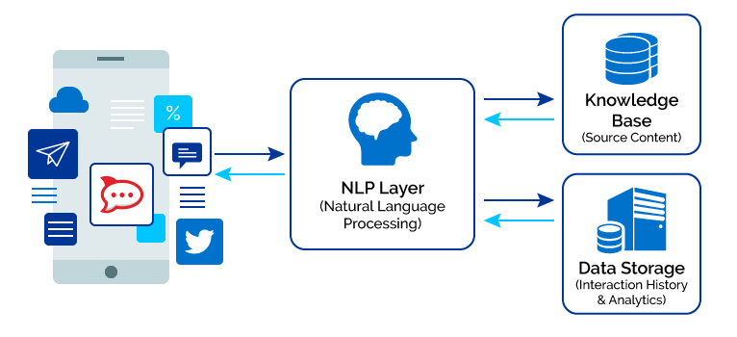
How Chat bots Work ?
A natural-language-processing chat bot takes some combination of steps to convert text or speech into structured data that may be used to select the proper response.

Slide 10
Here are some of the possible NLP steps:
1.
Tokenization
Named entity recognition
2.
Normalization
Part of speech tagging
3.
Dependency parsing
Sentiment analysis

Slide 11
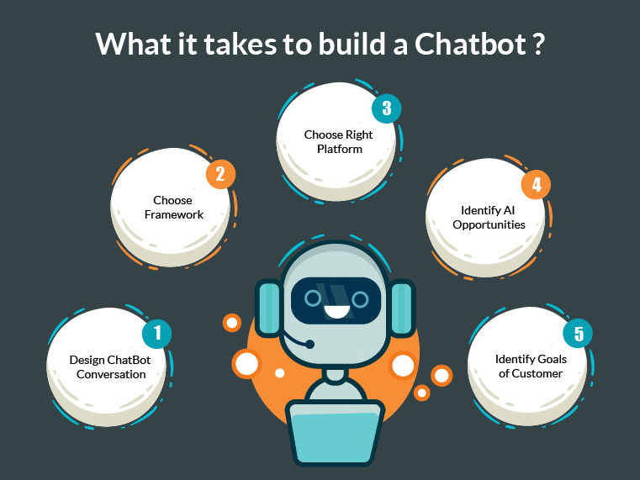

Slide 12
SOFTWARES USED
Python
Python is an interpreted high-level programming language for general-purpose programming. It provides constructs that enable clear programming on both small and large scales. It fully supports Object Oriented and Structured programming.

Slide 13
SQLite 3
SQLite is a relational database management system contained in a C programming library. In contrast to many other database management systems , SQLite is not a client–server database engine. Rather , it is embedded into the end program.

Slide 14
Microsoft Workbench
It is a unified visual tool for database architects, developers, and DBAs.
Workbench provides data modeling , SQL development and comprehensive administration tools for server configuration , user administration , backup and much more.

Slide 15
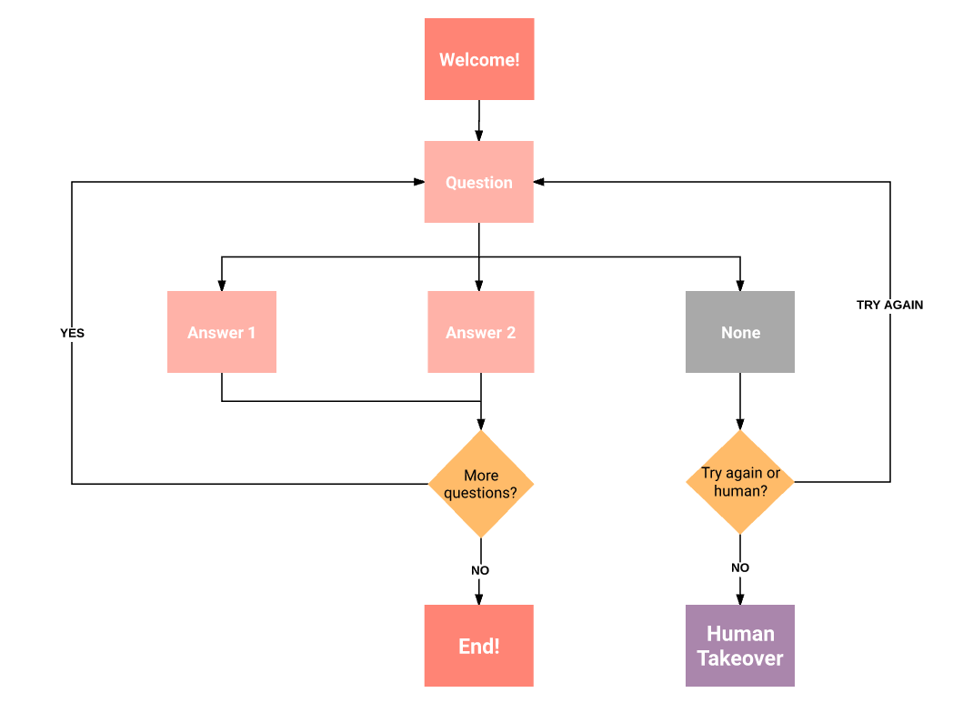
SYSTEM DESIGN AND IMPLEMENTATION

Slide 16
Julia the bot is a chat bot who responds the user when asked any questions.
Julia typically replies and also has the ability to learn from its user. Whenever Julia is asked any questions , it looks into its database for a suitable reply and generates a respond .
Julia is capable of learning from its user , If there is a case where Julia cannot find a suitable answer to the query asked to it, it will learn from the user's replies and would save it in its database.

Slide 17
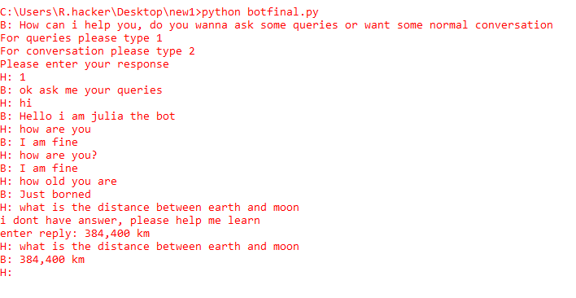

Slide 18
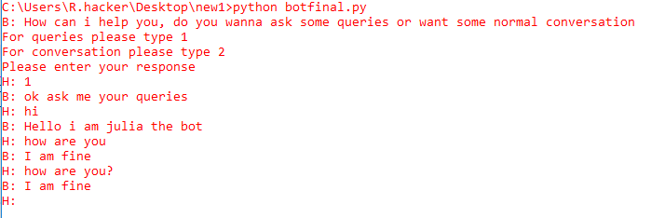

Slide 19
CONCLUSION AND FUTURE WORKS
The aim of this project was to propose a cost effective computer program which is trainable and learns from its user. A man is unable to work 24 * 7 but a machine well trained can be made to work for as long as one wants.
Julia the chatbot can be used at various places due to the growing
market and demands. It saves a lot of time and labour.

Slide 20
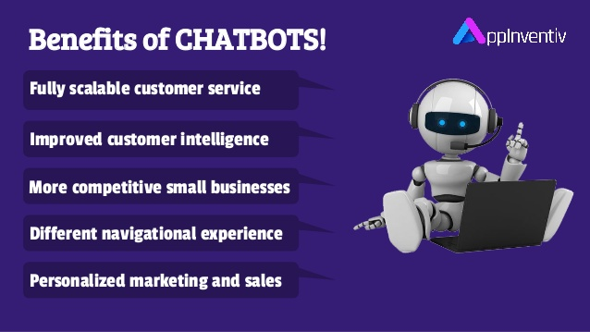
This chatbot can be used for multiple purposes such as customer care, selling
polices or product suggestions, personal assistant etc.

Slide 21
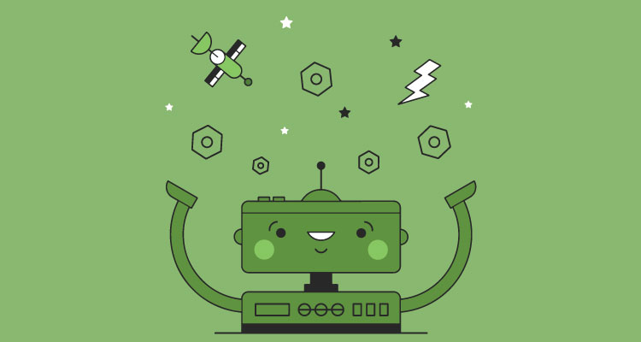
The need for machine learning and such trainable programs will be increased
with time. Such chat bots will reduce wastage of labour and time. It will
provide a better service and will be used in various fields.

Slide 22
FUTURE ENHANCEMENTS
Julia the chat bot can be used as a personal assistant for various systems if provided with sufficient database.
It can work more efficiently like Google assistant when enhanced using IOT.
It can be used by various running websites for their customer handling and business enhancements regardless time constraints.

Slide 23
PROBLEMS FACED
The fundamental problems with which JULIA is concerned are :
Identification of key words
Discovery of minimal context
System Requirements
Generation of responses in the absence of key words
Provisions of an editing for JULIA scripts
Time consuming while learning new words and statements

Slide 24
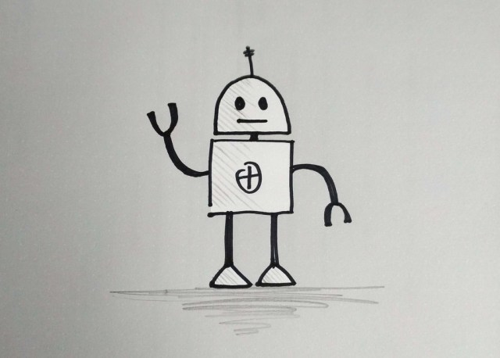
THANK YOU !

