Slide 1

Financial Analytics Project on Proctor & Gamble
By:
Lokesh Bharule
Neha Rani
Jaswinder
Rohit Yadav
Hanish Khattar

Slide 2

Business Analysis

Slide 3

History
William Procter and James Gamble, both from the United Kingdom, migrated to the United States and settled in Cincinnati, Ohio, where they met after marrying sisters Elizabeth and Olivia Norris
William Arnett Procter, William Procter's grandson, implemented a profit-sharing program for the company's employees in 1887, which helped to minimize the likelihood of strikes
Procter & Gamble became a major international corporation, advertising its products in magazines, on radio and lateron television, sponsoring and producing a significant number of soap operas that aired for over six decades

Slide 4

Products and Services
P&G produces and markets a wide range of consumer goods, including personal care products, cleaning agents, pet food, and food and beverage products
P&G's products are sold in over 180 countries, and the company operates through five business segments: Fabric and Home Care, Baby, Feminine and Family Care, Beauty, Grooming, and Health Care
P&G is known for its focus on research and development and has a reputation for being an innovator in the consumer goods industry

Slide 5
Industrial Competitors
Procter & Gamble is a major consumer goods company with various competitors that aim to target its segments individually
The company's top-selling business segment, representing 33% of its net sales in 2019, is Fabric and Home Care
In the beauty segment, Avon is a major competitor to Procter & Gamble, along with other companies such as Colgate-Palmolive, Estee Lauder, Revlon, and Unilever

Slide 6
Valuation Analysis

Slide 7
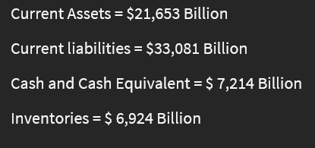
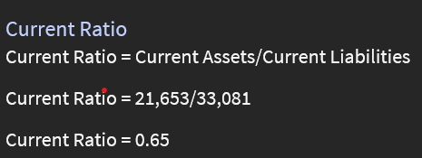
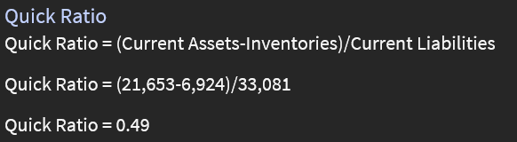
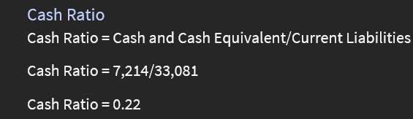
Liquidity Ratio
A liquidity ratio is a type of financial ratio used to determine a company’s ability to pay its short-term debt obligations
The metric helps determine if a company can use its current, or liquid, assets to cover its current liabilities
Cash Ratio = Cash and Cash Equivalent/Current Liabilities

Slide 8
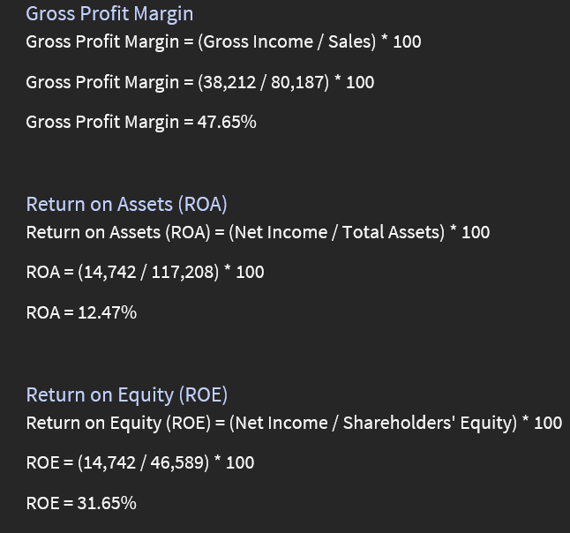
Profitability Ratio
Profitability ratios refer to financial measures that analysts and investors utilize to assess a company's capacity to generate profit or income relative to operating costs, balance sheet assets, revenue, and shareholders' equity within a specific time frame
Essentially, these ratios reflect a company's efficiency in utilizing its resources to produce profit and increase value for shareholders
Companies typically strive for a higher ratio or value as it indicates strong performance, with consistent revenues, profits, and cash flow

Slide 9
CAPM Analysis Formula for CAPM Ra = Rf + βa(Rm - Rf)
The Capital Asset Pricing Model is a theoretical model that outlines how financial markets value securities and predicts the returns on capital investments
It provides a way to estimate the expected return on equity by analyzing risk and converting that risk into projected returns

Slide 10

The cost of equity for stock valuation and determining whether to include a stock in a diversified portfolio can be calculated using the CAPM
Where:
Ra = The Required/expected return for the asset/investment
Rf = The risk-free rate
βa = The beta of the asset/investment
Rm = The expected market return (market risk premium)

Slide 11
Result of CAPM Rf = 2% βa = 0.42 Ra = 8 to 10% (based on historical average return of the S&P 500) Calculating CAPM: r = 2% + 0.42 (8%) = 5.36%
To calculate the CAPM value for our P&G stock we have taken the following into consideration:
Hence, an investor can anticipate a return of 5.36% on investing in P&G stock, as per the CAPM value derived from factors such as the risk-free rate, P&G stock's beta, and the projected market return

Slide 12

Monte Carlo Simulation
Monte Carlo simulations are employed to model the probability of different outcomes in a process that is challenging to forecast due to the intervention of random variables. This approach helps in grasping the impact of risk and uncertainty on forecasting and predictive models. Monte Carlo simulations can address a variety of problems in nearly all fields, such as Engineering, finance, supply chain management, and science. A simulation that incorporates multiple probabilities is another term for Monte Carlo simulation

Slide 13
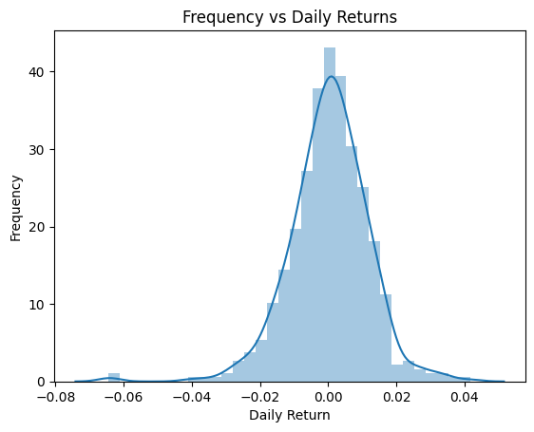
Following graph shows the relation between Frequency and Daily Return
The Monte Carlo Simulation, also referred to as the Monte Carlo Method or a multiple probability simulation, is a mathematical approach utilized for approximating the potential outcomes of an unpredictable event
Since its inception, the Monte Carlo Simulation has been utilized to evaluate the effects of risk in various practical situations, such as stock prices, sales projections, project management, and pricing

Slide 14
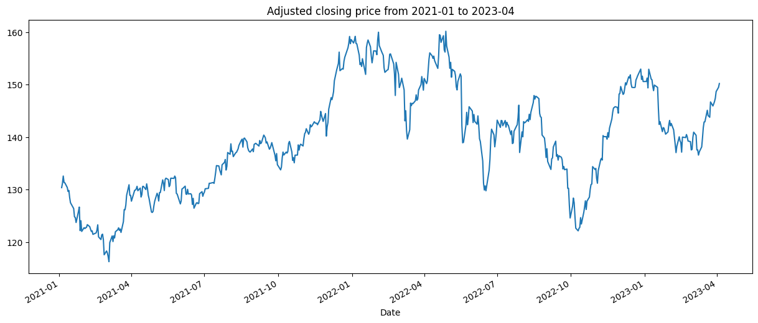
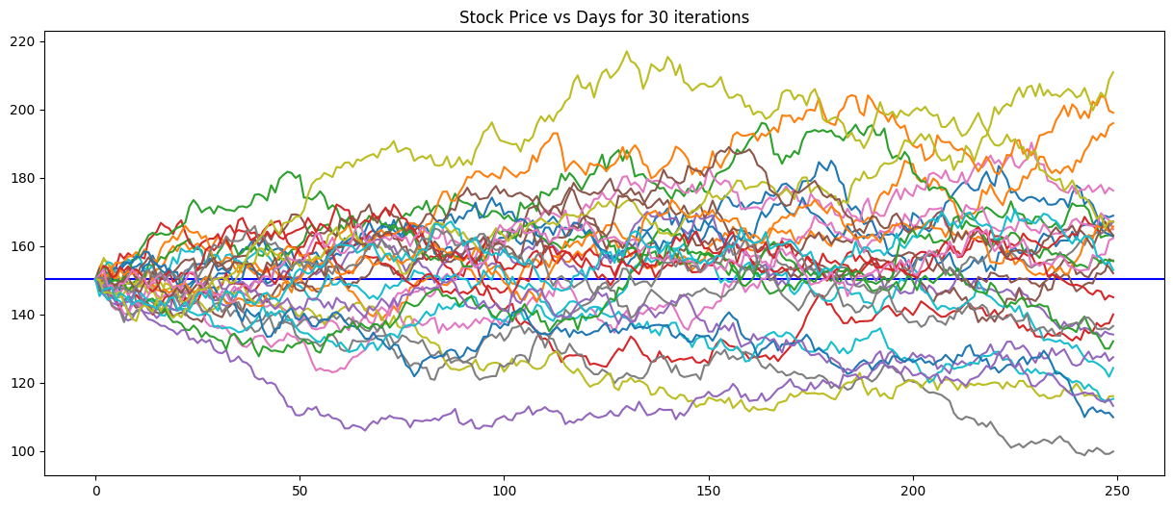
Following graph shows the adjusted closing price from 2021-01 to 2023-04.
This technique was developed by John Von Neumann and Stanislaw Ulam in World War 2 to enhance decision-making in uncertain circumstances
Following graph shows the Stock Price vs Days for 30 iterations

Slide 15
Moving Average
A common technical indicator called the moving average is utilized to eliminate random short-term price changes, also known as "noise", to create a smoother representation of price trends
Moving average can be constructed in several separate ways and employ different numbers of days for the averaging interval

Slide 16
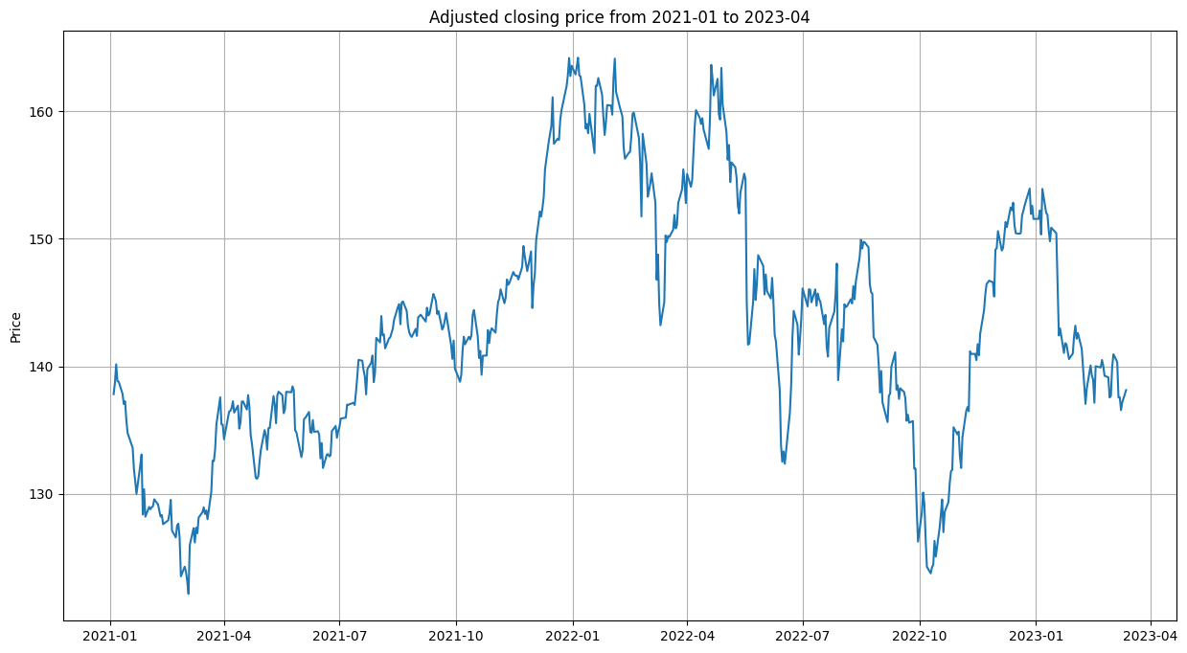
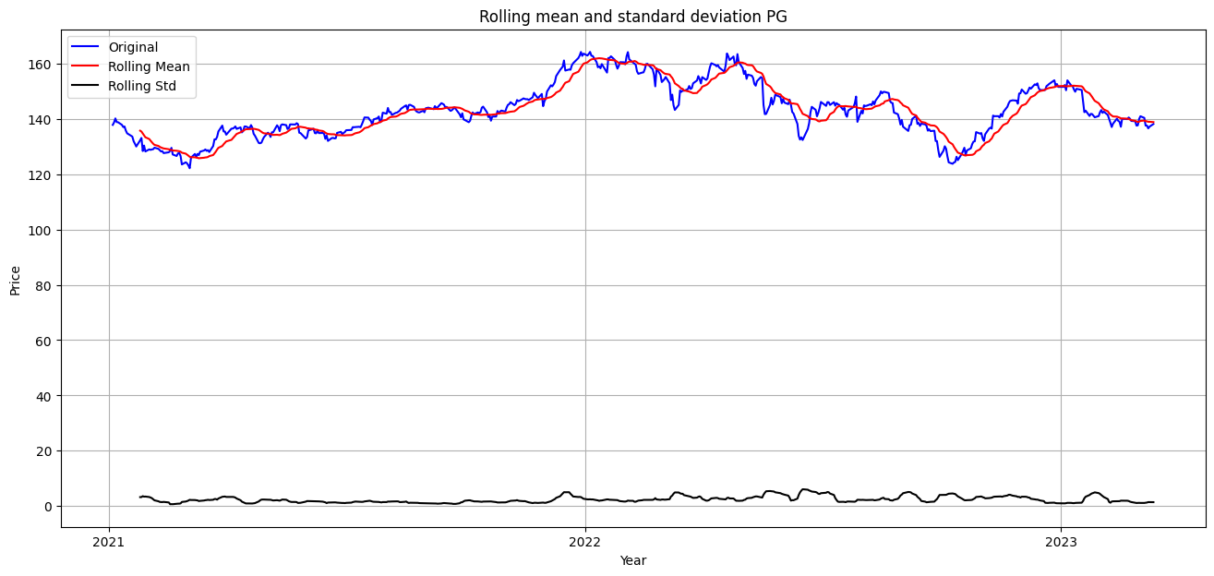
SMA
A moving average is a technique used to analyze data by creating a series of averages of different subsets of the data
A simple moving average is a type of moving average that is calculated by adding recent prices and then dividing that figure by the number of time periods in the calculation
SMAs can be used to identify trends, support, and resistance levels, and overbought and oversold conditions

Slide 17
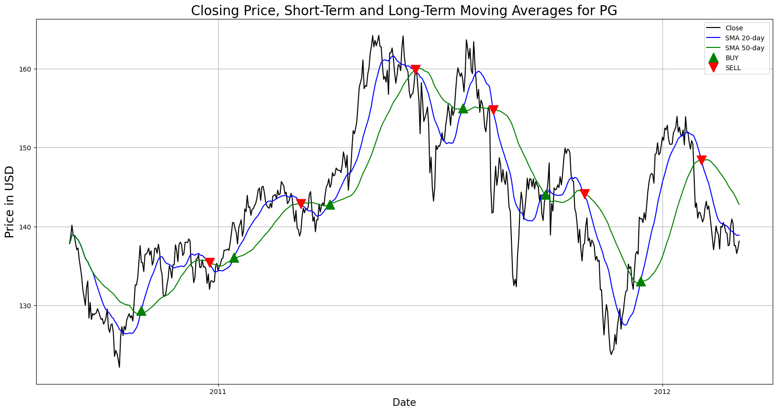
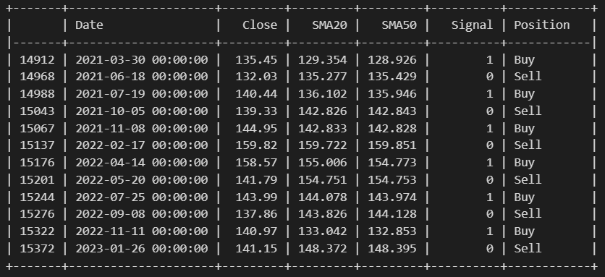

Slide 18
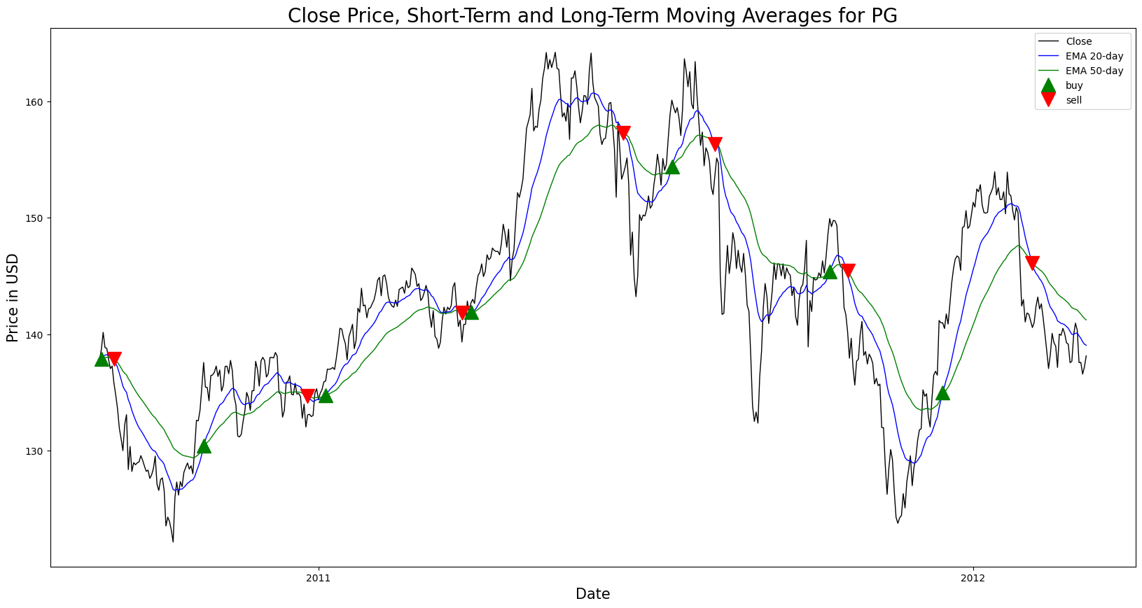
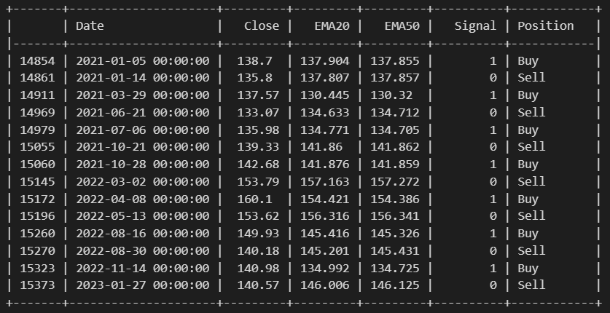
EMA
An exponential moving average is a type of moving average that places more weight on recent data points than older data points
EMAs are often used in technical analysis to identify trends and support and resistance levels
EMAs are a versatile tool that can be used to identify trends, support and resistance levels, and trading signals

Slide 19
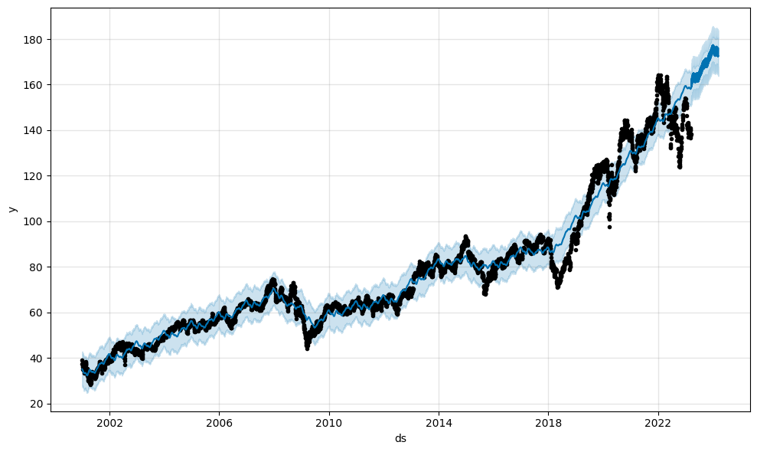
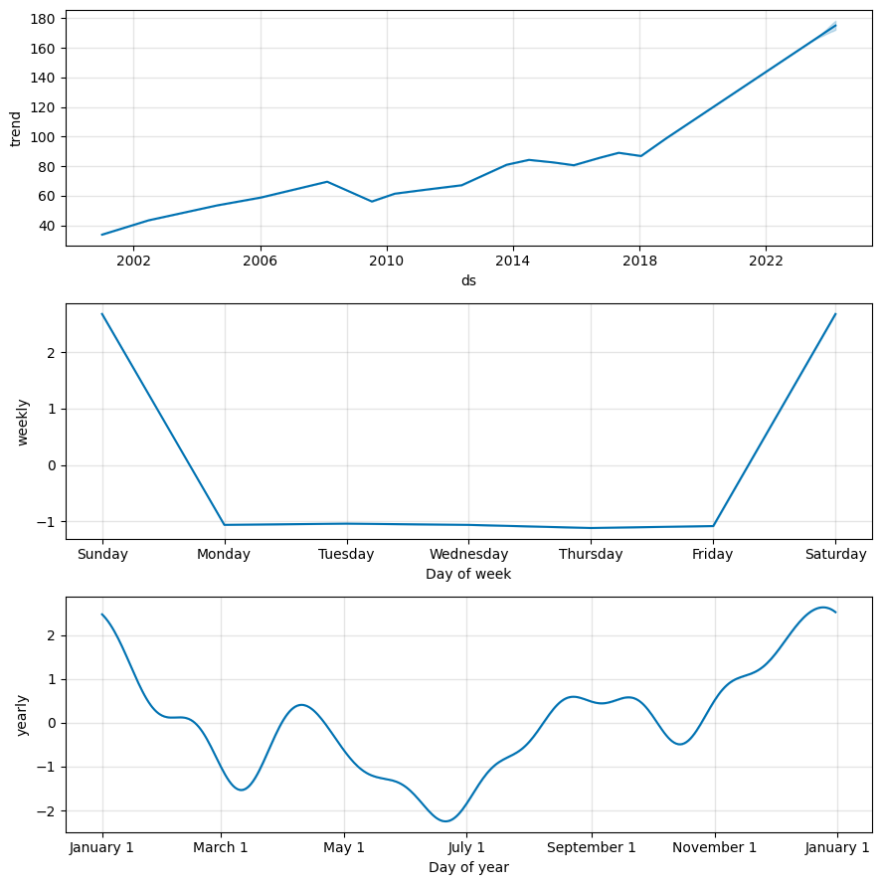
Facebook Prophet : The Facebook Prophet is a forecasting software that can be accessed through R or Python and assists users in analyzing and predicting time-series data. It is frequently utilized by corporations to evaluate performance in relation to a reference point.
They disregard any ARIMA framework that accounts for excluded random variables, which could affect the usefulness of using past Y values to inform the forecast
They do not take into consideration any lead or lag effects of the stochastic and deterministic variables proposed by the users
They identified two turning points in the trend in their primary example, but they only managed to record the more conspicuous one

Slide 20
Recommendation
According to the various ratios and the results of the CAPM and Monte Carlo simulations, it can be concluded that investing in P&G has the potential to yield greater returns, but this also means accepting a higher level of risk
Nevertheless, the company's revenue, gross profit, and valuation have been consistently increasing over the years
Therefore, based on the financial analysis, it can be stated that P&G is an exceptionally strong company with a high revenue

Slide 21

References
https://ca.finance.yahoo.com/quote/PG?p=PG&.tsrc=fin-srch
https://www.investopedia.com/terms/m/montecarlosimulation.asp
https://www.wsj.com/market-data/quotes/PG/financials/annual/balance-sheet
https://www.wsj.com/market-data/quotes/PG/financials/annual/income-statement

