Slide 1

Life Style Store WEBSITE
By:
Rohit Kumar Yadav (191599016)
Km. Soman (191599018)
Khushboo (191599007)

Slide 2
CONTENT
Introduction
Aims of Life Style Store Website
Functionality of Life Style Store Website
DFD of Life Style Store Website
Implementation Details
Snapshots
Conclusion
Future Work

Slide 3
INTRODUCTION
Life Style Store has transformed into one of the most popular channels, both for consumers and suppliers.
It provides a broad range of benefits such as 24/7 opportunity to purchase, online catalogues, comparative pricing, cost efficiency, less time consuming and a lot more.

Slide 4
Aims of Life Style Store Website
To make the shopping easier and comfortable.
To serve the customers without wasting their precious time.
A user can view the specification like price of the product along with image.
The user can easily add a product to or remove a product from the shopping cart.

Slide 5
FUNCTIONALITY OF Life Style Store WEBSITE
Home Page Product Display
Registration Page
Login Page
Add to Cart
Setting Page

Slide 6
Implementation Details
Intellize Idea – As an integrated development environment(IDE).
HTML, CSS, Bootstrap- For front end development
PHP- For back end development
MySQL- For database

Slide 7
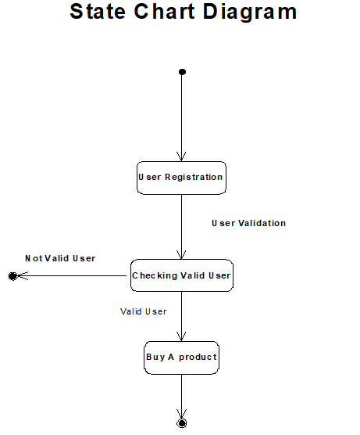

Slide 8
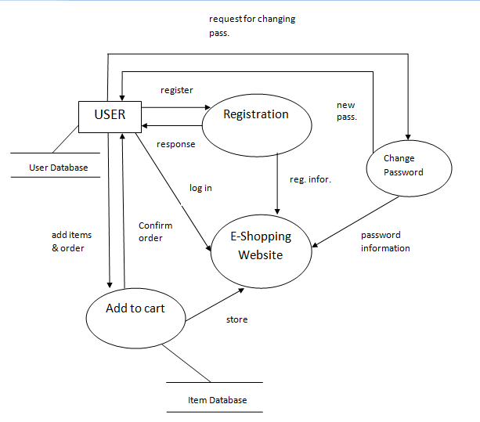
DFD of Life Style Store Website

Slide 9
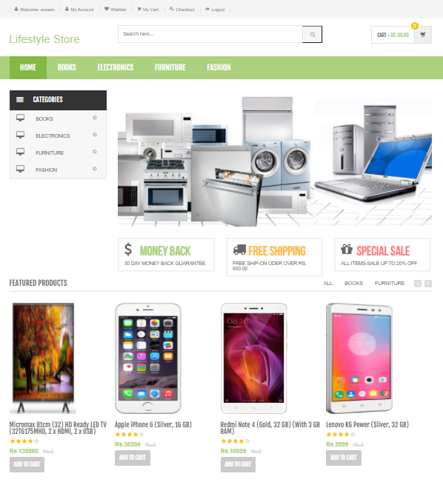
Snapshots: Home Page

Slide 10
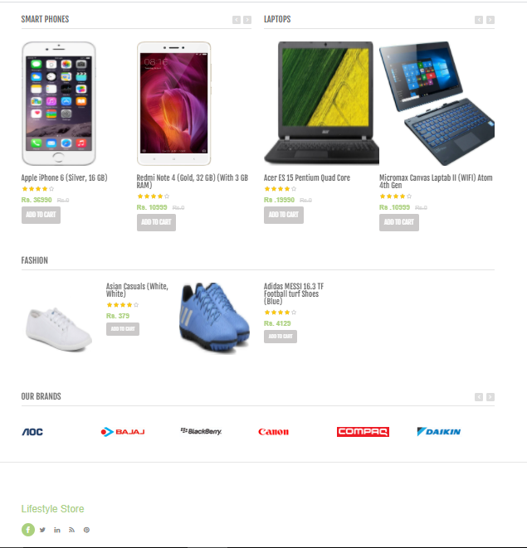
Snapshots: Home Page(Cont…)

Slide 11
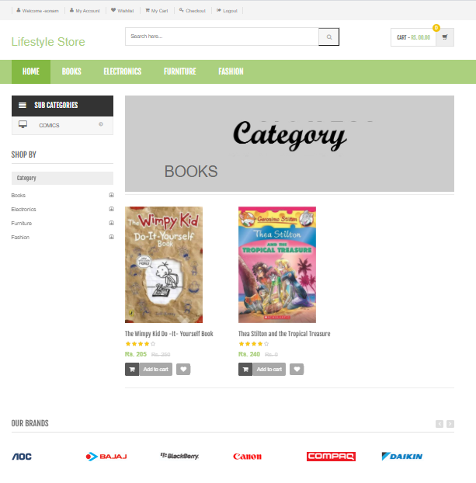
Snapshots: Products Page

Slide 12
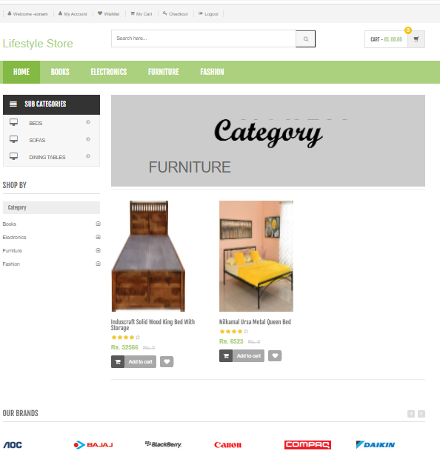
Snapshots: Products Page(Cont…)

Slide 13
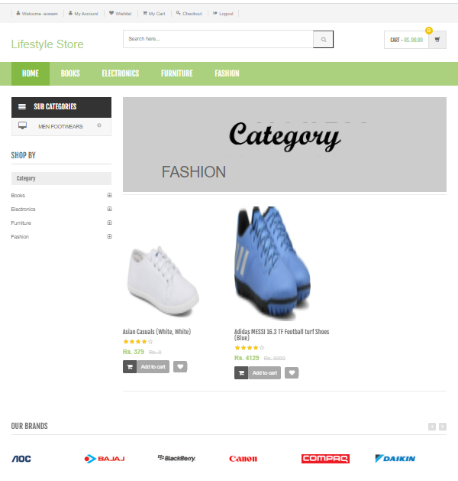
Snapshots: Products Page(Cont…)

Slide 14
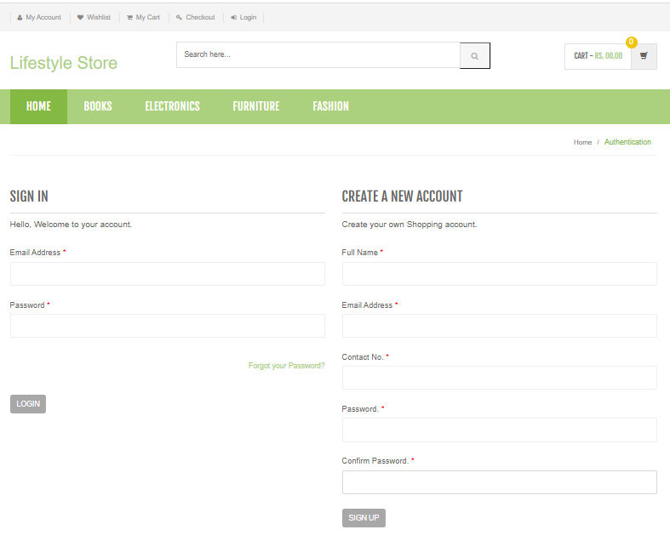
Snapshots: Login Page

Slide 15
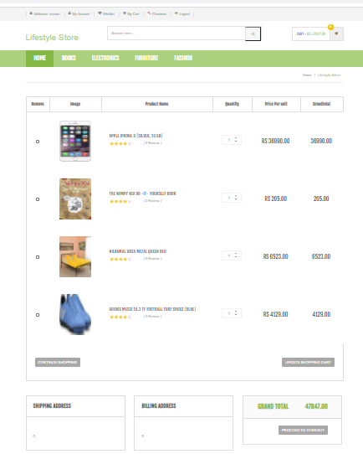
Snapshots: Add to Cart Page

Slide 16
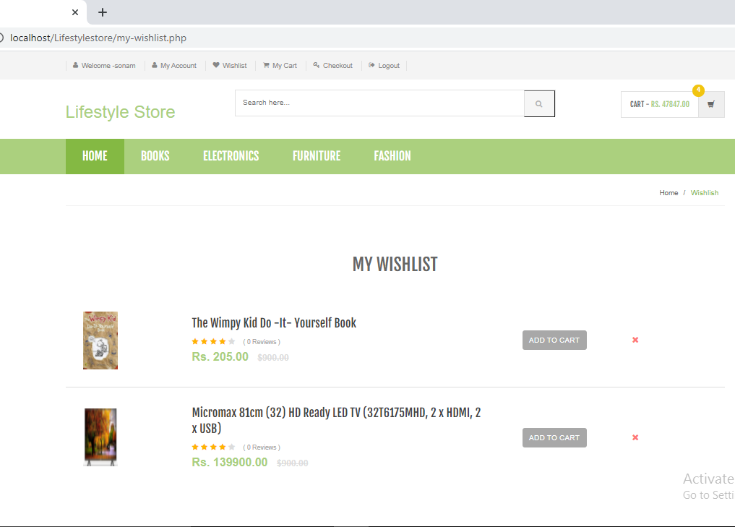
Snapshots: Wishlist Page

Slide 17
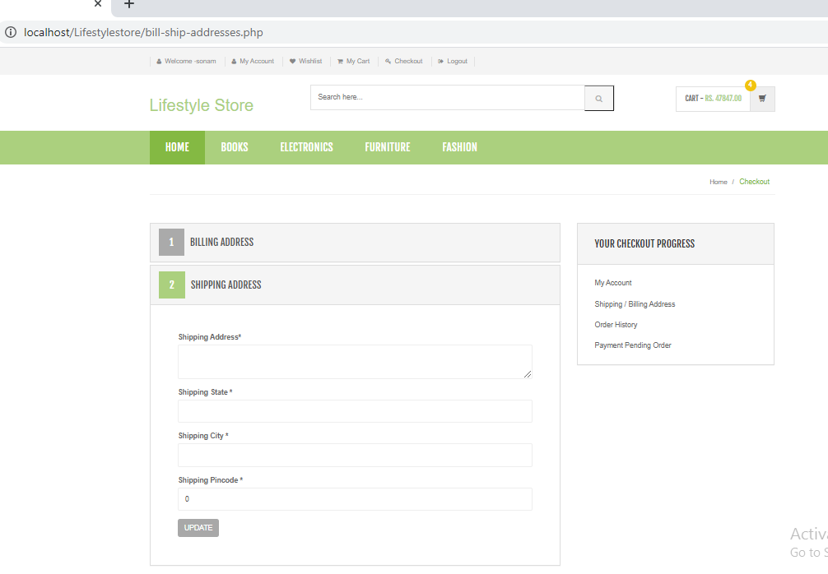
Snapshots: Billing Address Page

Slide 18
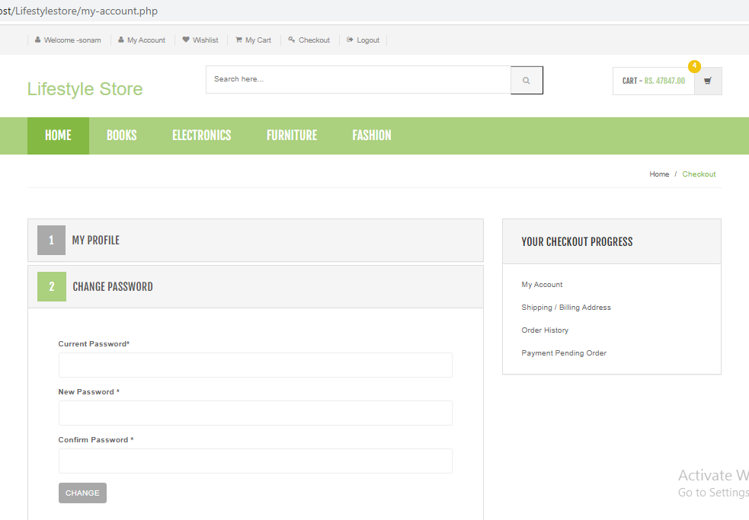
Snapshots: Setting Page

Slide 19
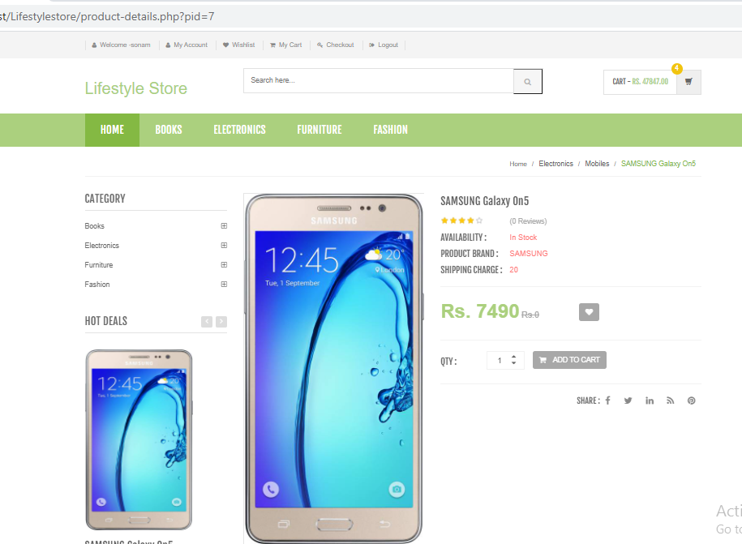
Snapshots: Product Detail Page

Slide 20
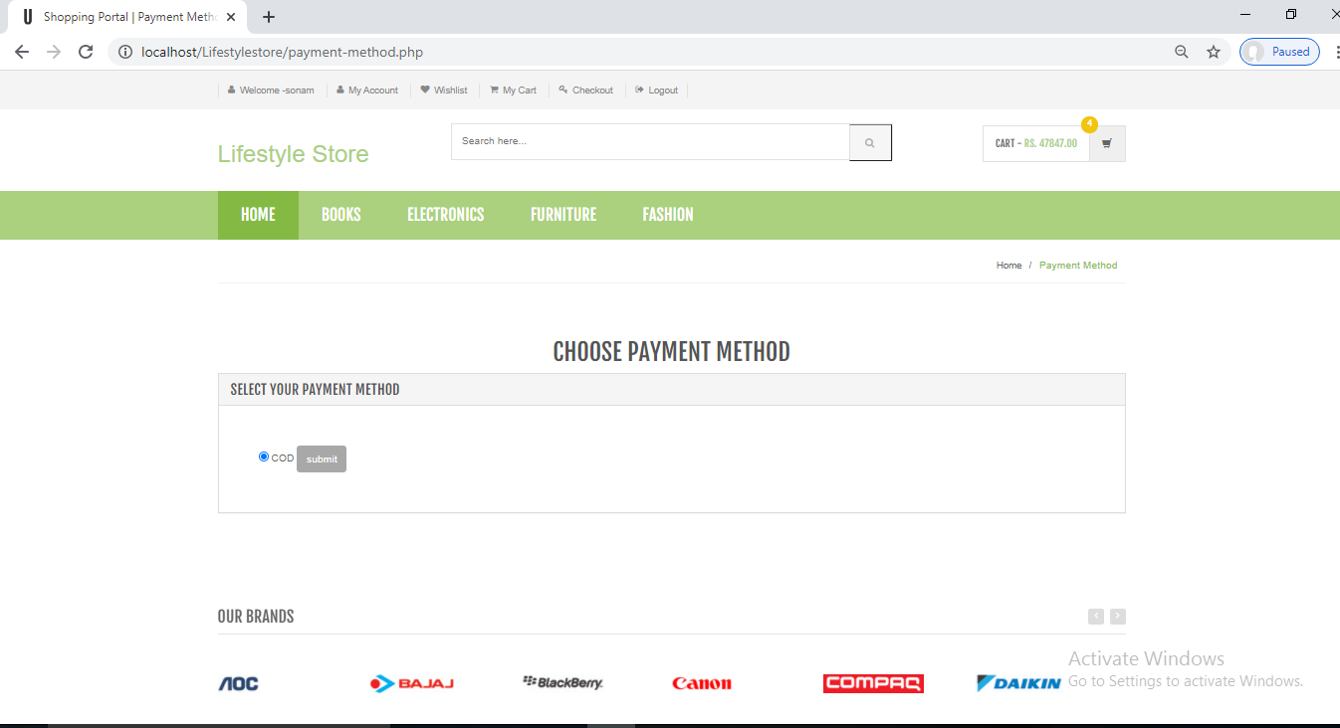
Snapshots: Payment Method Page

Slide 21
Conclusion
The ‘Life Style Store’ is designed to provide a web based application that would make searching, viewing and selection of a product easier.

Slide 22
Refrence
The following books were referred during the analysis and execution phase of the project
PHP and MySQL Web Development
Book by Luke Welling
Head First PHP & MySQL
Book by Lynn Beighley and Michael Morrison
PHP & MySQL for Dummies
Book by Janet Valade

Slide 23
Refrence website
www.w3schools.com
www.tutorialspoint.php
http://stackoverflow.com
Git Hub Link
https://github.com/rohityadavcs19/LifeStyleStore

Slide 24


