Slide 1

Availability Group SQL Cluster
Make your servers Highly Available
Ajay Kumar Dwivedi
http://ajaydwivedi.com

Slide 2




Ajay Dwivedi SQL Server DBA http://ajaydwivedi.com
MCP – SQL Server Administration
MCP – SQL Server Querying
MTA – Python Programming
Production DBA for 8+ years.
ajay.dwivedi2007@gmail.com
@ajaydwivedi2007
Ajay Dwivedi

Slide 3
Agenda
Learn basic of Oracle Virtual Box
Create Domain Controller (DC) using Windows Server 2016
Create SQL Server Boxes SQL-A, SQL-B, SQL-C
Create Multi-Subnet SQL Clustered Instance with Separate network for Heartbeat
Use iSCSI software for SAN & Mounted Volumes for SQL Server
Setup Availability Group & add SQL Clustered Instance as Primary replica

Slide 4
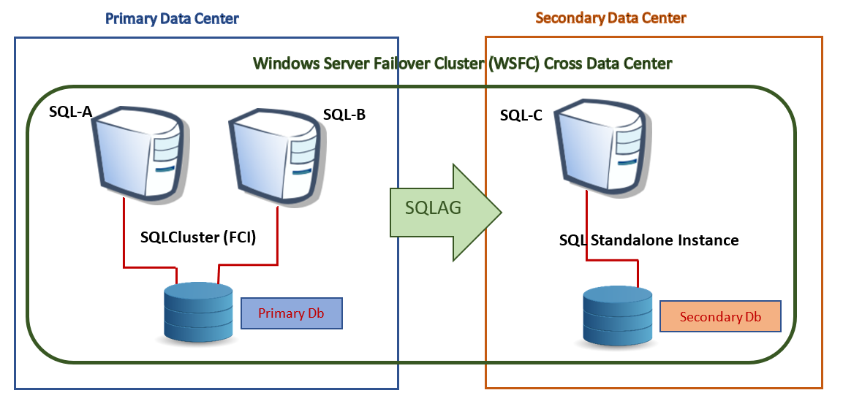
How would it look like?

Slide 5
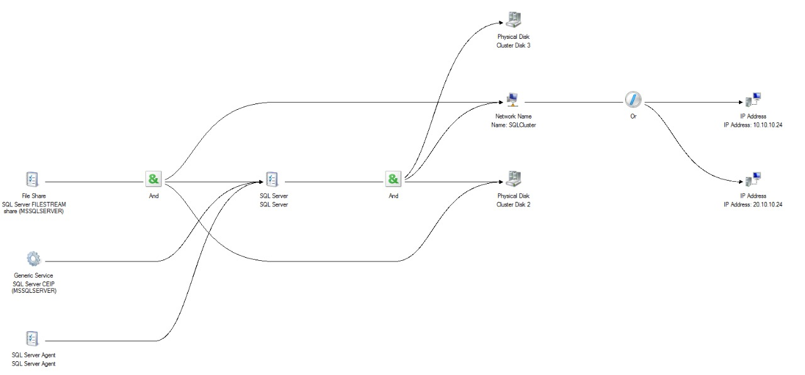
SQLCluster?

Slide 6
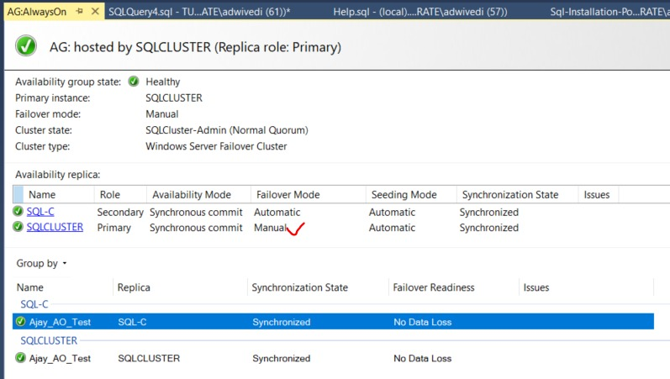
AlwaysOn?

Slide 7
IP Addresses
-- ~~~~ Hosts file ~~~~~~ --
C:\Windows\System32\drivers\etc\hosts
Host-Only Adapters
Ethernet # 1 10.10.10.X
Ethernet # 2 20.10.10.X
10.10.10.10 dc
20.10.10.10 dc
10.10.10.11 host
20.10.10.11 host
10.10.10.21 sql-a
20.10.10.21 sql-a
30.10.10.21 sql-a
10.10.10.22 sql-b
20.10.10.22 sql-b
30.10.10.22 sql-b
10.10.10.23 sqlcluster-admin
20.10.10.23 sqlcluster-admin
10.10.10.24 sqlcluster
20.10.10.24 sqlcluster
10.10.10.25 sql-c
20.10.10.25 sql-c
30.10.10.25 sql-c
10.10.10.26 AlwaysOn
20.10.10.26 AlwaysOn
Internal Network
Ethernet # 3 30.10.10.X

Slide 8
Part 01 # Domain Network Setup
Create another Host-Only Adapter using ‘Host Network Manager’
Create Virtual Machines
DC, SQL-A, SQL-B, SQL-C
Install Windows Server 2016
Install .NET Framework 3.5
Enable firewall exception for rules ‘Virtual Box Monitoring XXX’
Create Domain Controller
Assign IP Addresses. If multiple adapters, then match mac address.
Rename OS
Install Domain Services & Remote Access Feature
Promote DC as Domain Controller
Create domain, Setup Reverse Lookup Zone for both Subnets
Create AD group ‘Contso\SQLDBA’
Create Users ‘Contso\SQLServices’ & ‘Contso\adwivedi’
Configure ‘LAN Routing’ using Routing & Remote Access
Join SQL-A, SQL-B & SQL-C to domain
Assign IP Address & Rename OS
Join machine to Domain (Contso.com)

Slide 9
Part 02 # Create Windows Failover Cluster
Install Failover Clustering feature on SQL-A, SQL-B & SQL-C
Add 200 gb disk (SAN.vhd) on DC
Mounted it as S:\ drive on DC server
Validate/Create Windows Failover Cluster using SQL-A & SQL-B
Do not add Storage for now
Setup iSCSI SAN
Install iSCSI Target feature on DC
Create 3 iSCSI disks & Add SQL-A & SQL-B as iSCSI Initiators (using IP Address)
Quorum – 1 gb
Mounted Drive – 20 gb
MSSQL – 60 gb
Add firewall rules and exceptions
Open iSCSI Initiator on SQL-A & SQL-B, and discover the Disks
Bring iSCSI disk online & mount them on SQL-A Machine
Quorum – 1 gb – Q:\ drive
Mounted Drive – 20 gb – M:\ drive
MSSQL – 60 gb – M:\MSSQL14.MSSQLSERVER\
Add Disks Q:\, M:\, M:\MSSQL14.MSSQLSERVER as Windows Failover Cluster storage

Slide 10
Part 03 # Setup FCI & Standalone Instance
Using SQL 2017 Setup, perform ‘New SQL Server Failover Cluster installation’ on SQL-A Node
Add SQL-B node to SQL Server failover cluster
Open firewall ports for SQL Server on SQL-A & SQL-B
Test SQL Cluster thoroughly from Host Machine
Add 2 Disks on SQL-C
M:\ - 20 GB
M:\MSSQL14.MSSQLSERVER – 50 GB
On SQL-C, perform SQL Server Standalone Installation using M:\ drive
Open firewall ports for SQL Server on SQL-C

Slide 11
Part 04 # Setup AG using FCI as Primary Replica
Enable ‘AlwaysOn High Availability’ feature for FCI
Add SQL-C as node to Windows Failover Cluster (SQL-A & SQL-B already joined) without Storage
Remove SQL-C from Preferred Owner from SQL Cluster resource group, and from Possible Owner of SQL Server services.
Enable ‘AlwaysOn High Availability’ feature for SQL Services on SQL-C
Connect to FCI from SSMS, and Setup AlwaysOn Availability using FCI as primary replica & SQL-C as secondary replica
Test AlwaysOn thoroughly by failing over b/w replicas.
Make note that FCI will always show manual failover mode.

Slide 12


Slide 13
Thank you for your time!
Subscribe to Blog post
http://ajaydwivedi.com
Like on facebook
https://www.facebook.com/tsqlwithajay/
Subscribe to YouTube channel
https://bit.ly/2vUQjK3

