Slide 1
Searching for Prospective Coffee Shop Locations
Los Angeles Edition
R. VELUNTA

Slide 2
Location! Location! Location!
Picking the optimal location for your business will allow you to...
Leverage environment to augment your buyer experience
Reach your target consumers
Motivating Question
Can we predict the location where a particular business can thrive?
Plan
Use location-data of existing venues to develop intuition about how these are achieved.

Slide 3
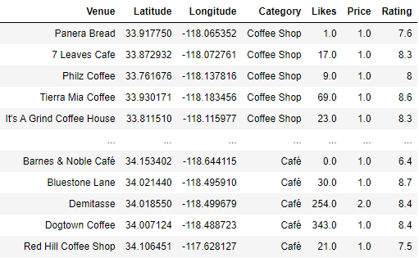
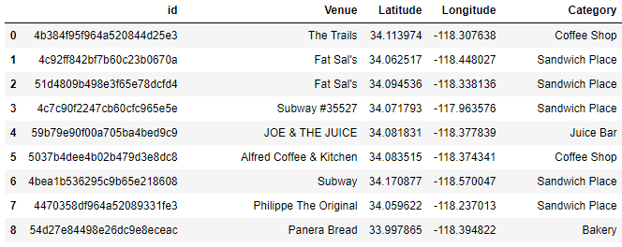
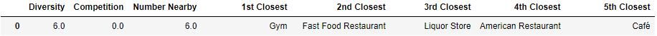
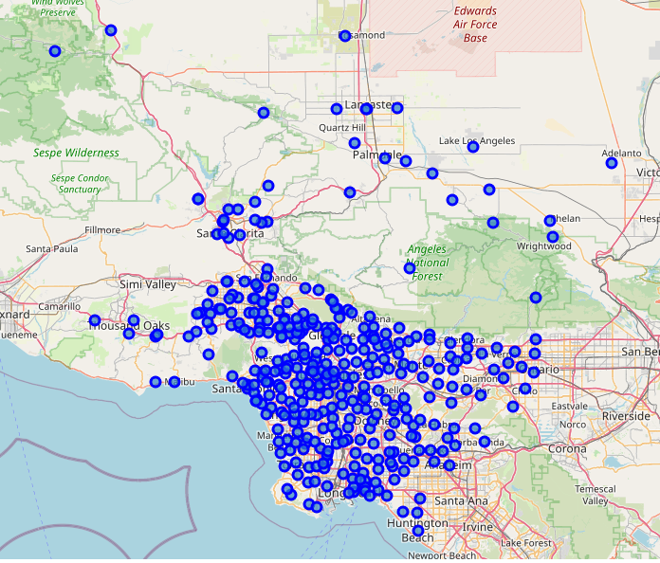
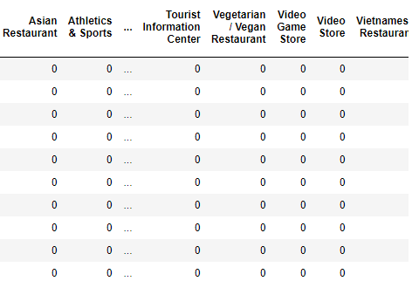

Search for nearby venues in a 200 m radius
Aggregate into single row
LA zip codes used as centers for search areas in order find all coffee shops
Unique neighbor categories
Count of nearby Coffee Shops
Convert top neighbor categories into a one-hot matrix
Data Processing Flow
Powered by
We will focus on Coffee Shops in Los Angeles, CA
Data Acquisition

Slide 4
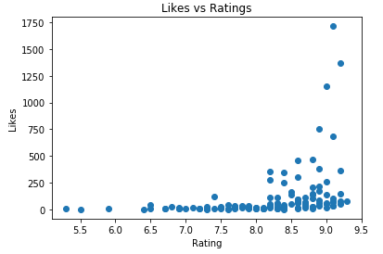
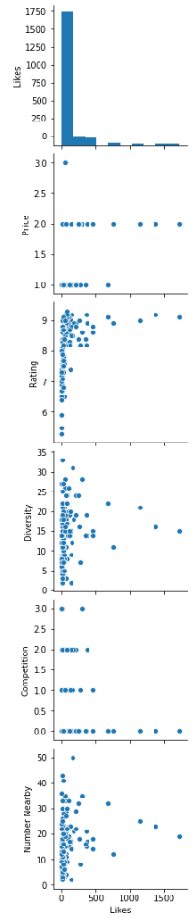
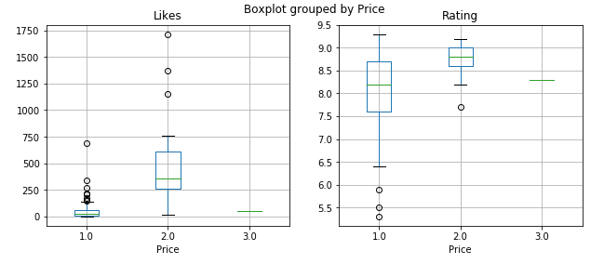
Slight grouping of high ‘Likes’ points at ~15 Diversity
Data Exploration
Likes vs. Diversity/Number Nearby
Slight grouping of high ‘Likes’ points at ~15 Diversity
Slight grouping of high ‘Likes’ points at ~20 Number Nearby
Rates vs. Likes
Likes underneath 100 are distributed over large rating range
Number of likes correlated with price tier => able to price higher
Likes are weighted by number of visitors
Likes are more likely a robust indicator of success
Likes vs. Competition
Extremely high ‘Likes’ only exists in the 0 Competition category
Feature vector
( Diversity, Competition, Num_Nearby, ..., [category], ...)

Slide 5
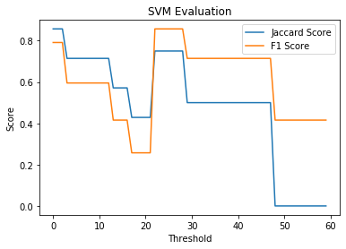
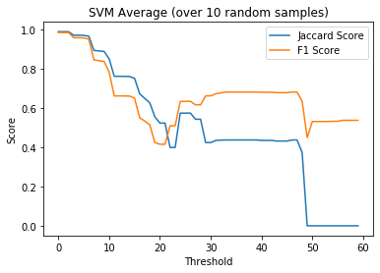
Support
Vector
machine
Trained over various ‘Likes’ thresholds, which affects how much data represents successful cases
Bump in predictive power at 25 - 25 range in both evaluations
Second evaluation averaged over 10 randomly organized sets from the data

Slide 6
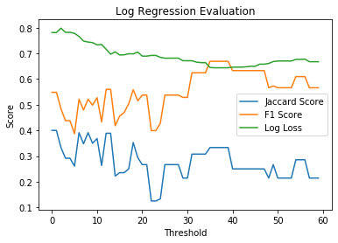
Logistic
Regression
Flat performance over various threshold ranges
Log-loss higher at low threshold due to underfitting when higher amounts of success are included at low threshold
Probability is more useful at this level of performance from both models

Slide 7
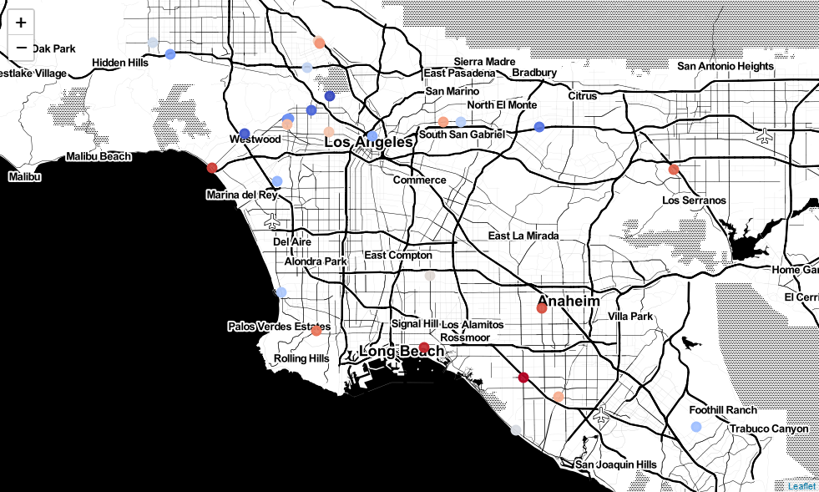

Procedure: Use coordinates of other venues to source possible locations for new shops. The implementation set includes both frequent and infrequent neighbors of the training set
Reasonable correlation with native’s intuition
High probability around west LA and Hollywood
Lower probability in locations farther from dense population
Could potentially implement more continues mapping by performing analysis on all venues
Implementation

Slide 8
Review / Future Directions
Data Size Vulnerability
Potentially low amounts of data depending on business type such as in demonstration
Can increase scope, but may need to account for regional differences
Information Bottleneck
Reliant on the participation of Foursquare users
Unknown distribution of users over geography could cause bias
Successful elementary demonstration
Low amount of data still able to construct general intuition about city neighborhoods
Potential for scope expansion
Need not be limited to Foursquare data

