Slide 1
Creating Dynamic Commands with DatabaseReporter
Rohn Edwards

Slide 2
What is DatabaseReporter?
Engine that helps create advanced PowerShell functions that interact with multiple data stores
Relational Databases
ODBC
OLEDB
Abstracts connection and SQL query details away from users
Turns queries you find yourself repeating into simpler PowerShell style commands that can be grouped together into modules

Slide 3
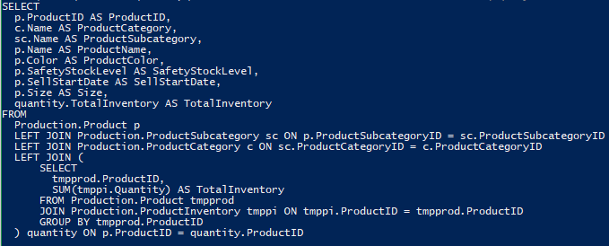
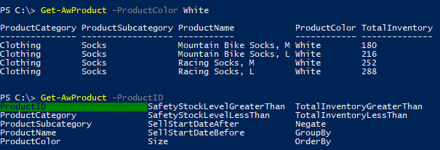
What is DatabaseReporter? (cont)

Slide 4
Where Do I Get It?
Source: https://github.com/rohnedwards/DatabaseReporter
Documentation: https://rohnedwards.github.io/DatabaseReporter/
Steps to use it:
Save DatabaseReporter.ps1 with other module files
Dot source file inside module
Call DbReaderCommand to define a function

Slide 5
Creating a Command with DbReaderCommand
Identify source
RDBMS (SQL Server, SQLite, MS Access, MySQL, PostgreSQL, etc)
Spreadsheet
CSV
Figure out how .NET connects to it via DbConnection object
You’ll need the “connection string”
Lots of built in System.Data.Common.DbConnection types
SqlConnection
OdbcConnection
OleDbConnection
Third party libraries are available via Add-Type that inherit from DbConnection
Identify useful SQL queries
The more complicated, the better ☺
Create advanced function param block with extra attributes

Slide 6
Demo
Code can be found here: github.com/rohnedwards/Presentations/

Slide 7
Contact Info
Blog: rohnspowershellblog.wordpress.com
Twitter: @magicrohn
LinkedIn: linkedin.com/in/rohn-edwards-417290134/
GitHub: github.com/rohnedwards
User Group: www.mspsug.com

Slide 8
Questions?

