Slide 1
Analysis of Indian government schools
SUBMITTED BY:
RHYTHM BALOONI
169105144
ROHAN CHOPRA
169105152
cse-c

Slide 2
The problem
DROPOUTS IN SCHOOLS
There have been a lot of dropouts in government schools as education level increases. Among various reasons is the lack of hygienic sanitation facilities. With age children require proper toilets and if government schools are unable to provide that we can see a significant dropouts, specially in girls. Indian government has taken an initiative to ensure that every school must have at least one toilet.
PROBLEM STATEMENT
To analyse the trends in dropouts from primary classes to high schools and to figue out why these dropouts have occurred.
DATASET
The dataset we used was the official dataset put up by the Indian Government on the site: data.gov.in

Slide 3
PROCESS
Data Cleaning
VISUALIZATION
CORRELATION
All NA values and blank values were removed. The values entered incorrectly in the dataset were corrected.
We performed a trend analysis between the dropouts of boys and girls separately from classes I – X in government schools.
We converted the values given to us into fractions for easy plotting of graphs. This also helped us to find the correlation.
We plotted graphs using the cleaned data.
Now, using the given data of enrollment trends and toilets available in schools in each state we found a positive correlation i.e. 0.49 (approx.)

Slide 4
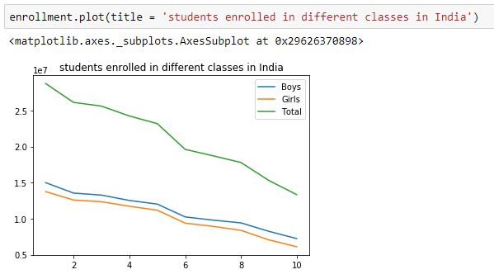
STUDENTS ENROLLED IN DIFFERENT CLASSES IN INDIA

Slide 5
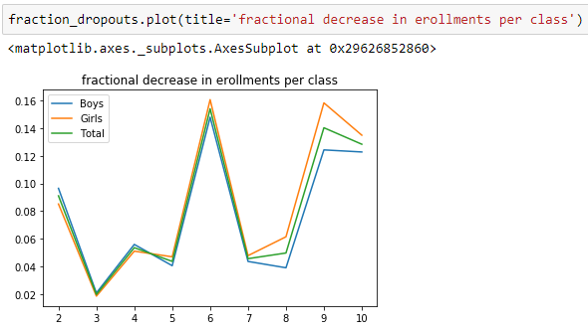
FRACTIONAL DECREASE IN ENROLLMENTS PER CLASS

Slide 6
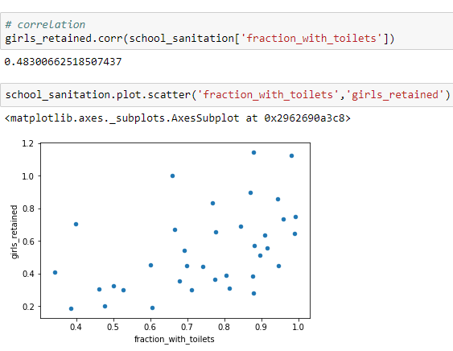
Correlation BETWEEN FRACTION OF SCHOOLS WITH TOILETS AND GIRLS RETAINED IN SCHOOLS FROM CLASS I-X

Slide 7
TIMELINE
AUGUST
SEPTEMBER
OCTOBER
NOVEMBER
Figuring out a challenging Problem
and finding the dataset
Data cleaning , preparation
Trend analysis and plotting of graphs
Finding the correlation

Slide 8
THANK YOU

