Slide 2
Methodology
Database project and Table nyc_job was created in MySQL
Data was loaded in MySQL from the given dataset
Database job_vacancy and table nyc_job was created in hive
Data was imported from MySQL into Hadoop using SQOOP
sqoop import --connect \
jdbc:mysql://127.0.0.1:3306/project \
--username root --password cloudera \
--table nyc_job \
--hive-import --hive-table job_vacancy.nyc_job\
--m 1

Slide 3
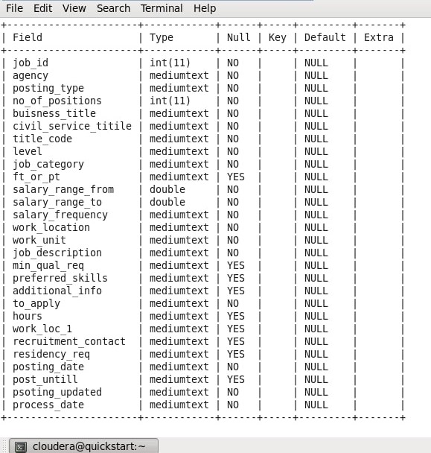
SCHEMA

Slide 4
RESULTS

Slide 5
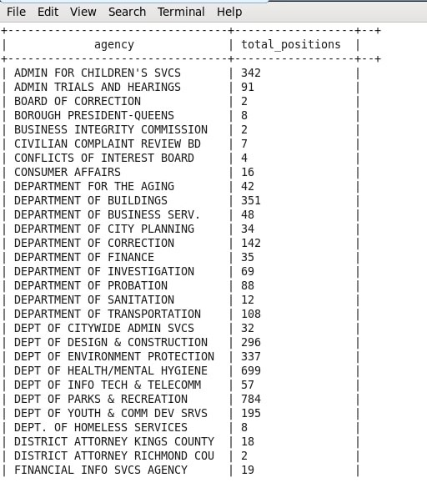
Jobs with highest demand in each agency

Slide 6
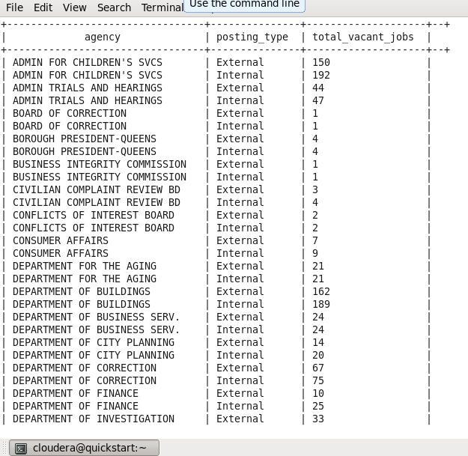
External and internal jobs in each agency
.

Slide 7
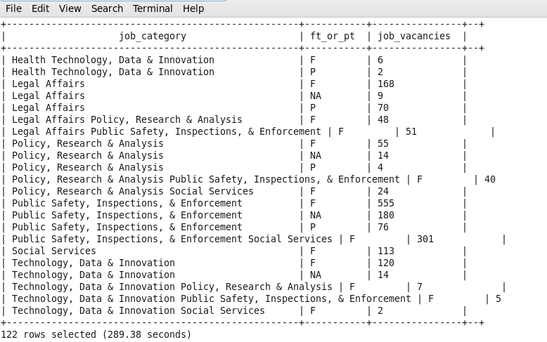
Number of part time and full time jobs vacancies in different job categories.

Slide 8
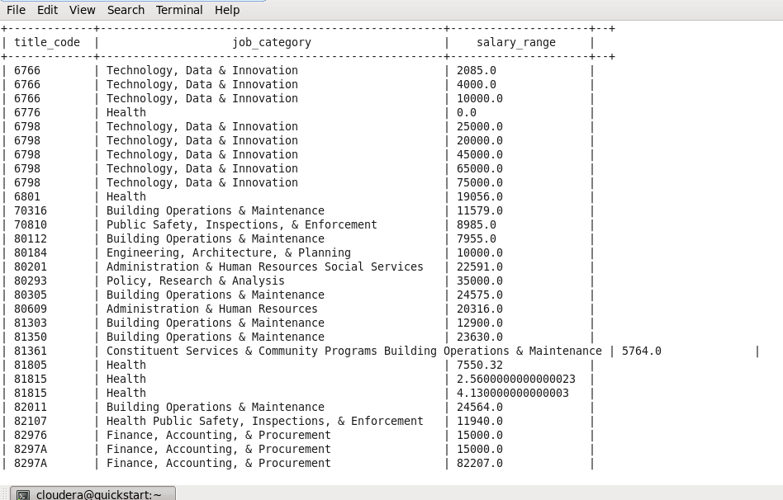
Display different jobs with salary ranges (0 indicates that salary is fixed and there is no increment).

Slide 9
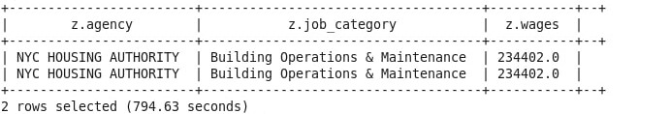
Agency and Job Category having Highest paying jobs.

Slide 10
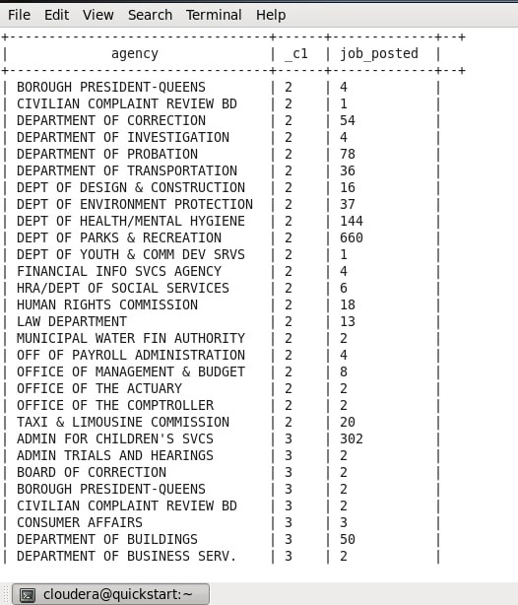
Month wise number of job posted in all agencies

Slide 11

Most popular preferred skills per job category

Slide 12
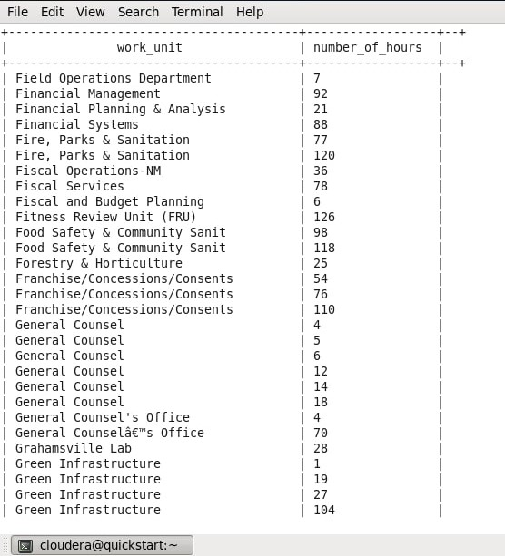
Days taken in job application for each work unit

Slide 13
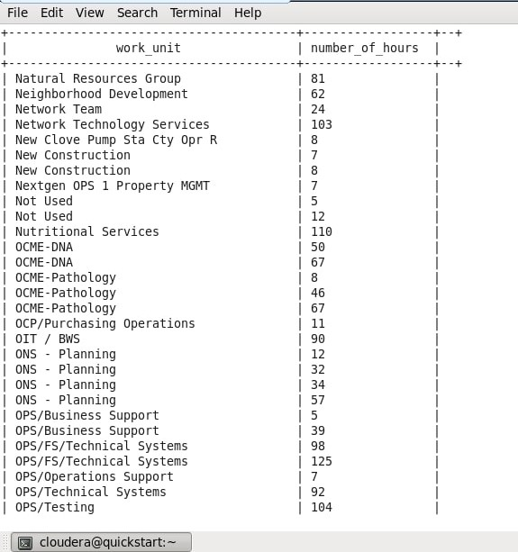
Number of job positions in each work location

