Slide 1
Job Vacancy Analysis
Presented By:
Big BT Data
ROHAN CHOPRA
Emp Id - 46024286

Slide 2
Aim of the project
• To compare different Jobs in different Cities from the given data by performing ETL and generating reports.
• Help the candidates with different choices of jobs in different cities based on their various criteria.
• Help students to identify industries in which there is higher chances to get a job.

Slide 3






Technologies Used

Slide 4
Microsoft EXCEL (Database)
Excel is capable of creating and editing spreadsheets that are saved with a .xls or .xlsx file extension. General uses of Excel include cell-based calculation, pivot tables, and various graphing tools.
Dataset has 28 fields and 1660 records
In our project we have set different line separator delimiter and saved it in form of csv i.e. comma separated values and then we used our dataset. We used different delimiter because in many fields “,” appeared in string and that string was being tokenized and not occurred as a complete string.

Slide 5
MySQL
MySQL is a fast, easy-to-use RDBMS being used for many small and big businesses. MySQL is developed, marketed and supported by MySQL AB
MySQL works very quickly and works well even with large data sets.
MySQL is customizable. The open-source GPL license allows programmers to modify the MySQL software to fit their own specific environments
We created a table nyc_job in which the data was loaded.
The use of MySQL could be avoided in this project by directly creating table in Hive and dataframe in Spark.

Slide 6
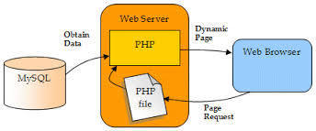
Working of MySQL

Slide 7
SQOOP
Sqoop (SQL-to-Hadoop) is a big data tool that offers the capability to extract data from non-Hadoop data stores.
It transform the data into a form usable by Hadoop and then loads the data into HDFS. This process is called ETL i.e Extract, Transform, and Load.
Extract - data is extracted from the source system into the staging area.
Transform - you apply a set of functions on extracted data to load it into the target system.
Load - During Load phase, data is loaded into the end-target system and it can be a flat file or a Data Warehouse system.

Slide 8
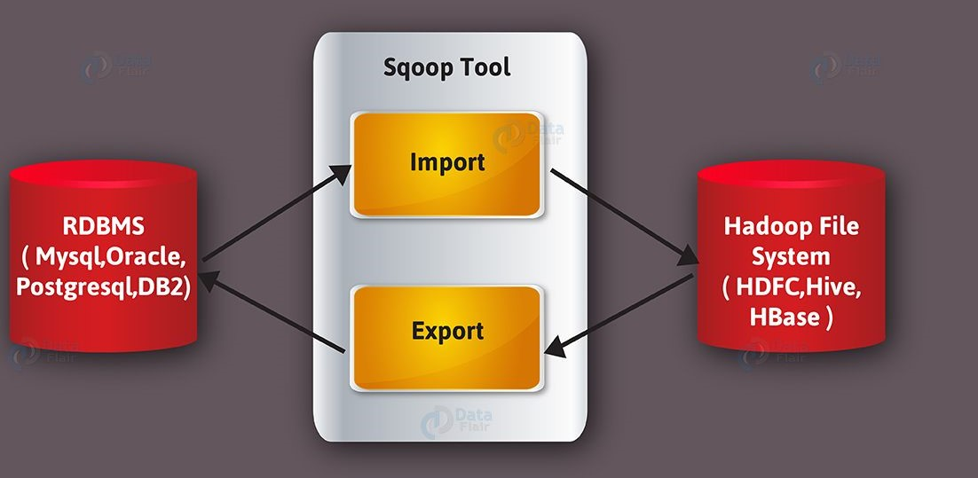
Working of SQOOP

Slide 9
Hive/Beeline
The Apache Hive data warehouse software facilitates reading, writing, and managing large datasets residing in distributed storage using SQL.
Structure can be projected onto data already in storage. A command line tool and JDBC driver are provided to connect users to Hive

Slide 10
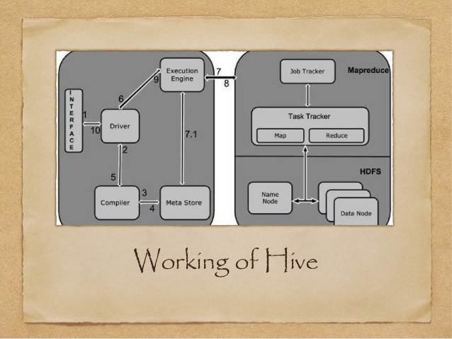
Working of Hive

Slide 11
Approach Followed
Load data into MySql using excel (csv format)
Creating tables in SQL and loading data in it
Importing the data into hive using sqoop and transforming it
Running queries in hive and finding the outputs

Slide 12
Pre-Processing of Data
Different line separator i.e “|” is used to separate fields
For Spark, we used “@” delimiter because “|” separated each character and raised problem in creation of dataframe.
After loading the data into hive, we have replaced blank columns/fields with NA and follow the approach of not deleting the entire column as we do not tamper the dataset provided by the client

Slide 13
Methodology
Database project and table nyc_job was created in MySQL
Data was loaded in MySQL from the given dataset
Database job_vacancy and table nyc_job was created in hive
Data was imported from MySQL into Hadoop using SQOOP
Hive was connected using Beeline CLI for better GUI
To reduce effort, we directly created a table in hive using SerDe properties and load data into that table.
To save time, we used Spark as an alternative for MapReduce job.
Link hive data warehouse to spark
Load file into RDD and create DataFrame.
Perform queries in spark using sqlContext.sql() which would reflect in hive table.

Slide 14
RESULTS

Slide 15
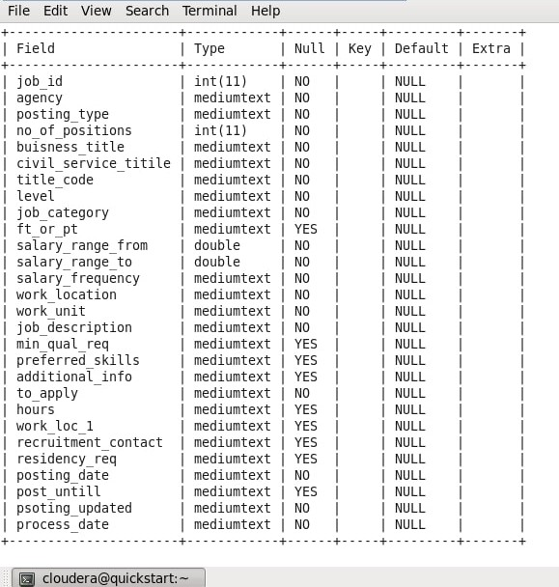
SCHEMA of nyc_job Table

Slide 16
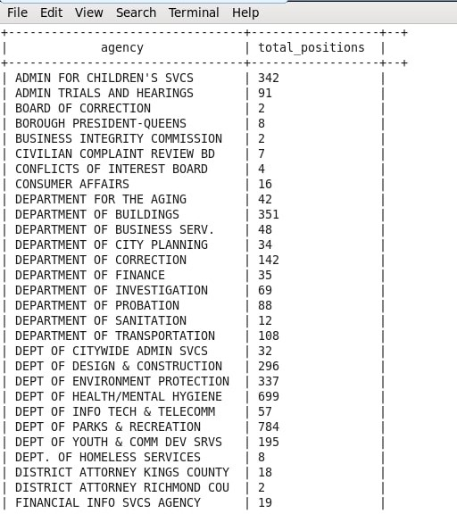
Jobs with highest demand in each agency

Slide 17
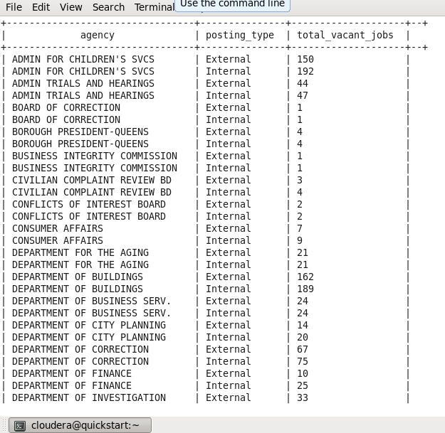
External and internal jobs in each agency
.

Slide 18
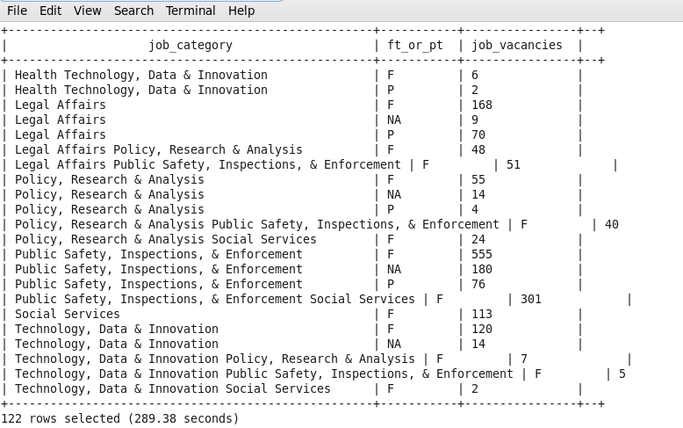
Number of part time and full time jobs vacancies in different job categories.

Slide 19
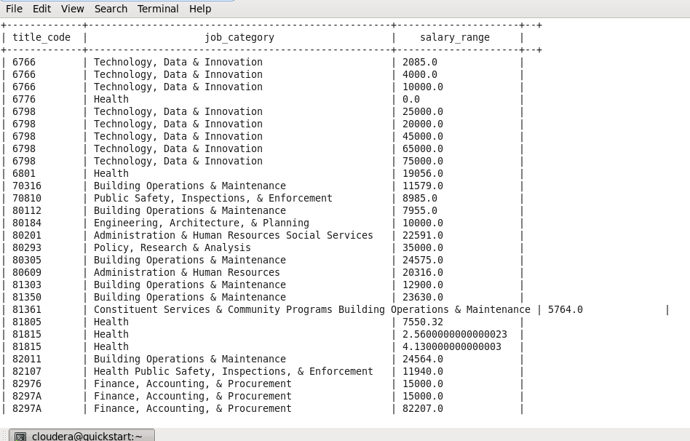
Display different jobs with salary ranges (0 indicates that salary is fixed and there is no increment).

Slide 20
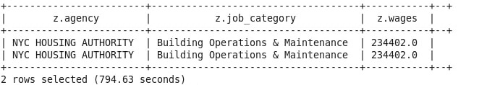
Agency and Job Category having Highest paying jobs.

Slide 21
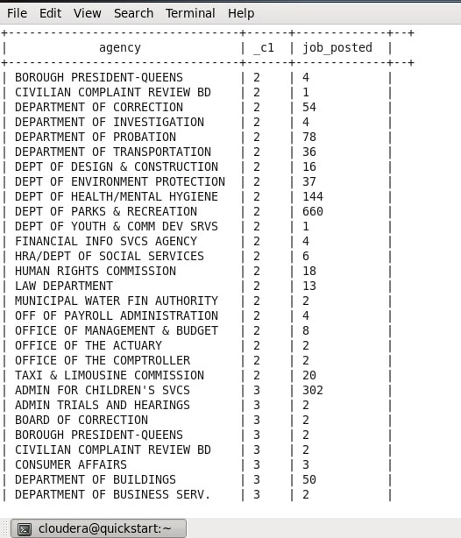
Month wise number of job posted in all agencies

Slide 22
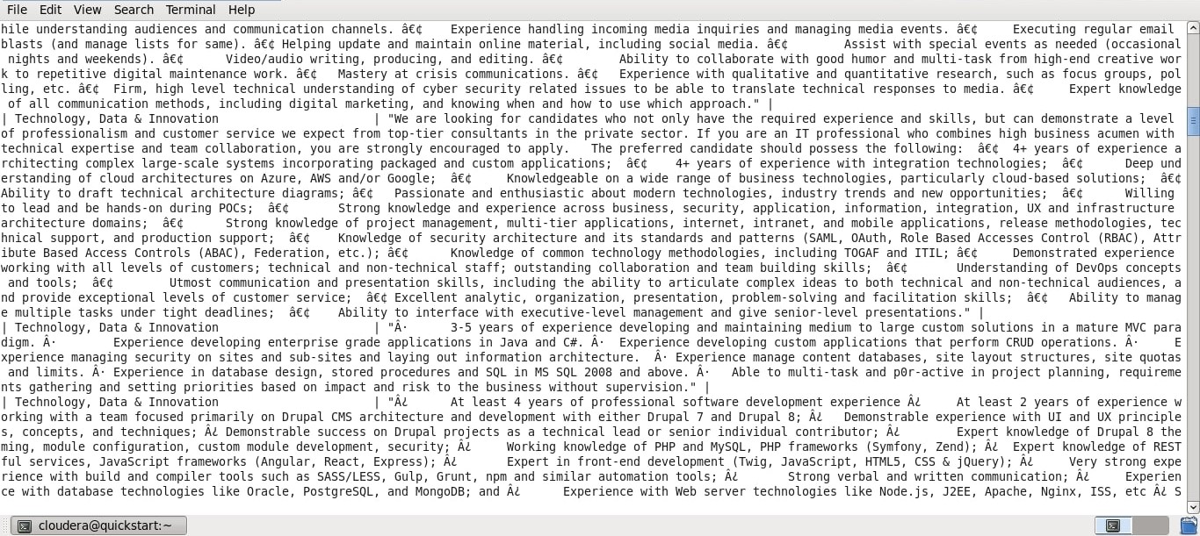
Most popular preferred skills per job category

Slide 23
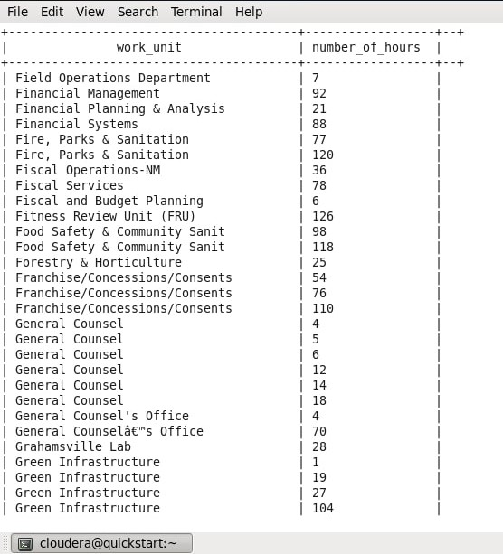
Days taken in job application for each work unit

Slide 24
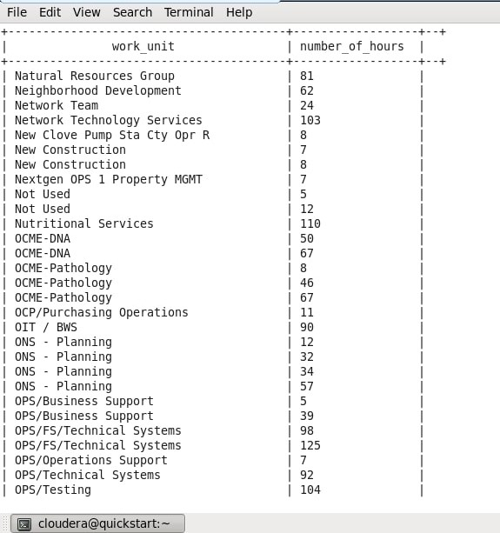
Number of job positions in each work location

Slide 25
References
To access dataset file
https://drive.google.com/file/d/1RKh28jT0EnhHQxII4nM5Ff2RMiyonFT4/view?usp=sharing
To access @ delimited file
https://drive.google.com/open?id=1pQ7QLw-L9wiPn0eaHjX0t9uqVDge8b8R
To access | delimited file
https://drive.google.com/open?id=1P088Tdw48WafjQ_dkBGUO8PD4nilHK2t
To access script in which all the commands are written
https://drive.google.com/open?id=1QR-UEkdGo3OX4LN_5GwB88LCcpeEnq8A
To access report of the Project
https://drive.google.com/open?id=1Z0aQnqs5-4fRI0OUthVBMWfje5CTzo4a

Slide 26
Remaining Work
Learning Cloud Fundamentals and implementing it and how we can work
with big data on cloud.

Slide 27
Plan of Action for Remaining Work
To complete the remaining work I have to learn cloud fundamentals. Therefore,
I am doing a certification course in AWS Cloud Practitioner Certification which
has been set mandatory by the Capgemini Company before joining.

Slide 28
THANK YOU

