Slide 1


Data models choice
Exploring the world of data storage

Slide 2
Agenda
Which data models do you know?
Do you have any experience with them?
If starting a new project, how would you choose the data model to use?
SQL
Relational model
NoSQL
Document model
In-Memory store
Search engine
Graph-Like data model
Column-oriented storage
Indexes, storage and retrieval
Data warehousing
Conclusions

Slide 3
Which data solutions do you know?
Relational DBs
MySQL
PostgreSQL
OracleDB
others
NoSQL dbs
MongoDB
Redis/Memcached
Elasticsearch??
other??

Slide 4
Experience with these models
Relational DBs
MySQL
PostgreSQL
OracleDB
others
Almost everyone has created and configured a relational db in some occasion
NoSQL dbs
MongoDB
Redis/Memcached
Elasticsearch??
other??
Personal usage
I know we use it for caching purposes
Just hitting it (creating some queries, maybe)
In general, short experience, not too close and with everything pre-configured.

Slide 5
If starting a new project, I would choose...
Besides SQL, NoSQL and NewSQL classification, what else do we know/care about?
How is each of these in selected db?
Performance
Query language
Indexing
Supported data types
Replication
Partitioning
Fault-tolerance
Scalability
Usually, people choose familiar dbs (similar to choosing the proper Java collection), but not the most appropriate ones.

Slide 6
Relational model
SQL
Many-to-one
Many-to-many Good support for joins
No ambiguity
Storing id → information meaningful to humans in one place
Relations (tables), rows and columns
Seeking normalization
Ease of updating
PostgreSQL
MySQL
OracleDB
Schema on write

Slide 7
NoSQL
Greater scalability
Very large datasets/W throughput
SQL
Not only SQL
Specialized query operations
Many-to-one
Many-to-many Good support for joins
One-to-one
One-to-many
No relations (logs)
Dynamic and more expressive data model, flexible schema
Locality
Relations (tables), rows and columns
No ambiguity
Storing id → information meaningful to humans in one place
Data duplication
Seeking normalization
Denormalization
Weak join support
Ease of updating
Schema on write
PostgreSQL
MySQL
OracleDB
Schema on read
Usually free and open source

Slide 8
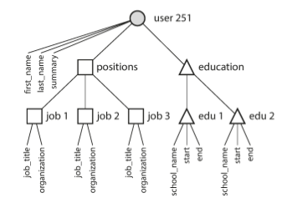

Document model
Locality, self-contained documents (JSON, XML, BSON) → better performance
H
E
T
E
R
O
G
E
N
E
U
S
Used by the app
Keep them
small!
Logs
Many to many may not be needed
MapReduce
Schemaless
Schema on Read
Update?
Consistency?

Slide 9




In-memory store
Many datasets are simply not that big → feasible to keep them in memory.
Anti-
caching
Periodic Snapshots
Key-value
RAM
Cloud
Durability (weak, async)
Data loss
Durability
Relational model
Data structures

Slide 10
Indexes, storage and retrieval
Different types of storage engines:
Some optimized for transactional workloads
Some optimized for analytics
Index
additional structure derived from primary data
Writes
Hash index
Reads
SSTables
Range queries
B-Trees
Typos
Fuzzy and inverted indexes
Full-text search (VS LIKE, REGEXP)
Levenshtein
Document classification / ML

Slide 11

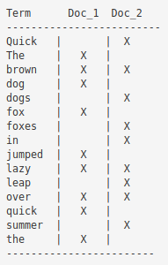

Search Engine
Fuzzy indexes: allow to find misspelled/transposed terms (typos)
Lucene: full-text search. Levenshtein distance
Doc 1: The quick brown fox jumped over the lazy dog
Doc 2: Quick brown foxes leap over lazy dogs in summer
Refresh

Slide 12
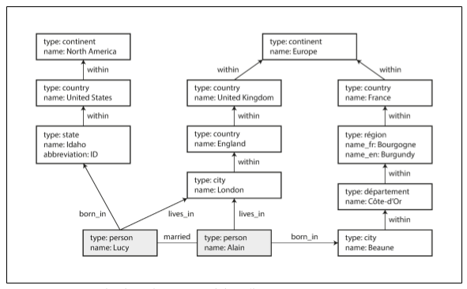






Graph-Like data model
Many-to-many complex relationships (relational model is not enough)
Social Graph
Vertices and edges (unordered)
Any V can have an E to any other V (flex)
Web Graph
Anything potentially related to everything
Car Navigation (TSP)
people/location/event/checkin/comment
Page
Rank
how many joins??

Slide 13



Data warehousing
OLTP
Materialized views
Data analytics
AGV
SUM
COUNT
Million records
R few columns
Aggregations
Periodic dump
OLAP
$$
BI
Data warehouse
Read only
TB to PB
Often relational
ETL
Total revenue
Most purchased brand

Slide 14


Column-oriented storage
OLTP
row oriented
Trillion rows
documents
load, parse, filter
+100 columns
OLAP
column oriented
Compression
Can’t update-in-place

Slide 15
Conclusions
Data has a tendency of becoming more interconnected as features are added to applications.
Usage of unappropriate db might have a big impact in performance:
Elastisearch as main db
Redis pub/sub when needing high retention periods
Mongodb when having mainly many-to-many relationships
etc.
Proper choice at a proper time is fundamental.
We will usually need a combination of these (polyglot persistence):
Main db might be MongoDB
ElasticSearch for searching purposes
Redis available for caching/session purposes
Snapshots to Cassandra
etc.

Slide 16
Data models choice: Exploring the world of databases
Any questions?

Slide 17
Possible future talks (from whoever dares…)
Document-store within MySQL ??
Distributed DB
Redundancy - Partitioning - CAP
GraphQL - Prisma
Search engines - ElasticSearch
Encoding types - JSON, XML, Protobuf, Thrift, Avro. Interaction with REST

