Slide 1
MapReduce in detail

Slide 2
AGENDA
Definition
Components
  Tasks
  Phases
WordCount
MR Design patterns
  Summarization patterns
  Filtering patterns

Slide 3
1. Definition
What exactly is MapReduce?

Slide 4
MapReduce
Computing paradigm for processing data residing on hundreds of computers.
It is powerful but it doesn’t provide a general solution.

Slide 5
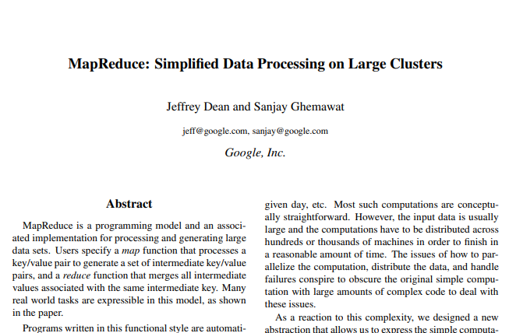
MR Origin
“MR: simplified data processing on large clusters”. Jeffrey Dean, 2004.
Paper of how Google split, processed and aggregated their data set of mind boggling size.
Doug Cutting started working on MR after this paper was published in his Nutch project.

Slide 6
Features
Framework
It is more a framework than a tool. You need to fit your solution into the framework
Constraints
Clear boundaries of what you can and cannot do! It demands cleverness
Advantages
Ability to process data with distributed computing without needing to deal with concurrency, robustness, scalability.

Slide 7
2. Components
Which are the different tasks and phases in a MapReduce job?

Slide 8
MR tasks
MR jobs are divided into a set of:
Map tasks: generally load, parse, transform and filter data
Reduce tasks: handle subset of map tasks output
These tasks:
run in a distributed fashion on cluster of computers
work on small subset of assigned data (spread load)

Slide 9
MR input
Set of files spread out over HDFS
InputFormat defines how to separate a file into InputSplits
InputSplit: byte oriented view of a chunk of the file to be loaded by map tasks

Slide 10
MR phases
MR phases
Map phases
Reduce phases

Slide 11
MR phases - Record Reader
MR phases
Map phases
Reduce phases
Record Reader
Translates input split into records. Passes data to mapper in KV pairs. Can be customized

Slide 12
MR phases - Mapper
MR phases
Map phases
Reduce phases
Record Reader
Mapper
User-provided code on each KV to produce zero to N new KV intermediate pairs

Slide 13
MR phases - Combiner
MR phases
Map phases
Reduce phases
Record Reader
Mapper
Combiner
Optional localized reducer. Can group data in map phase. Reduces amount of data to move over network. Not guaranteed to execute

Slide 14
MR phases - Partitioner
MR phases
Map phases
Reduce phases
Record Reader
Mapper
Combiner
Partitioner
Splits KV pairs into shards, one per reducer. Can be customized. Data written to local FS for each map tasks, later pulled by reducer.

Slide 15
MR phases - Shuffle and Sort
MR phases
Map phases
Reduce phases
Record Reader
Mapper
Combiner
Partitioner
Shuffle and Sort
Downloads partitioners data to reducer machine, sorts and groups by key into one larger data list. Not customizable.

Slide 16
MR phases - Reducer
MR phases
Map phases
Reduce phases
Record Reader
Mapper
Combiner
Partitioner
Shuffle and Sort
Reducer
Runs reduce function once per key grouping to aggregate, filter or combine. It sends zero to N KV pairs to final step

Slide 17
MR phases - Output format
MR phases
Map phases
Reduce phases
Record Reader
Mapper
Combiner
Partitioner
Shuffle and Sort
Reducer
Output format
Translates final KV pair and writes it out to a file by a record writer. Can be customized

Slide 18
3. WordCount
Let’s review the most typical MR example

Slide 19
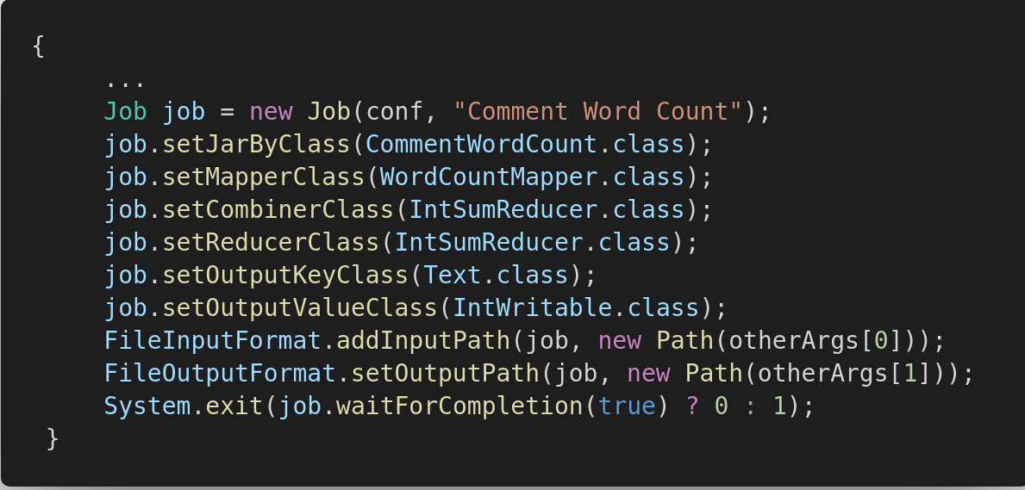
WordCount - Driver

Slide 20
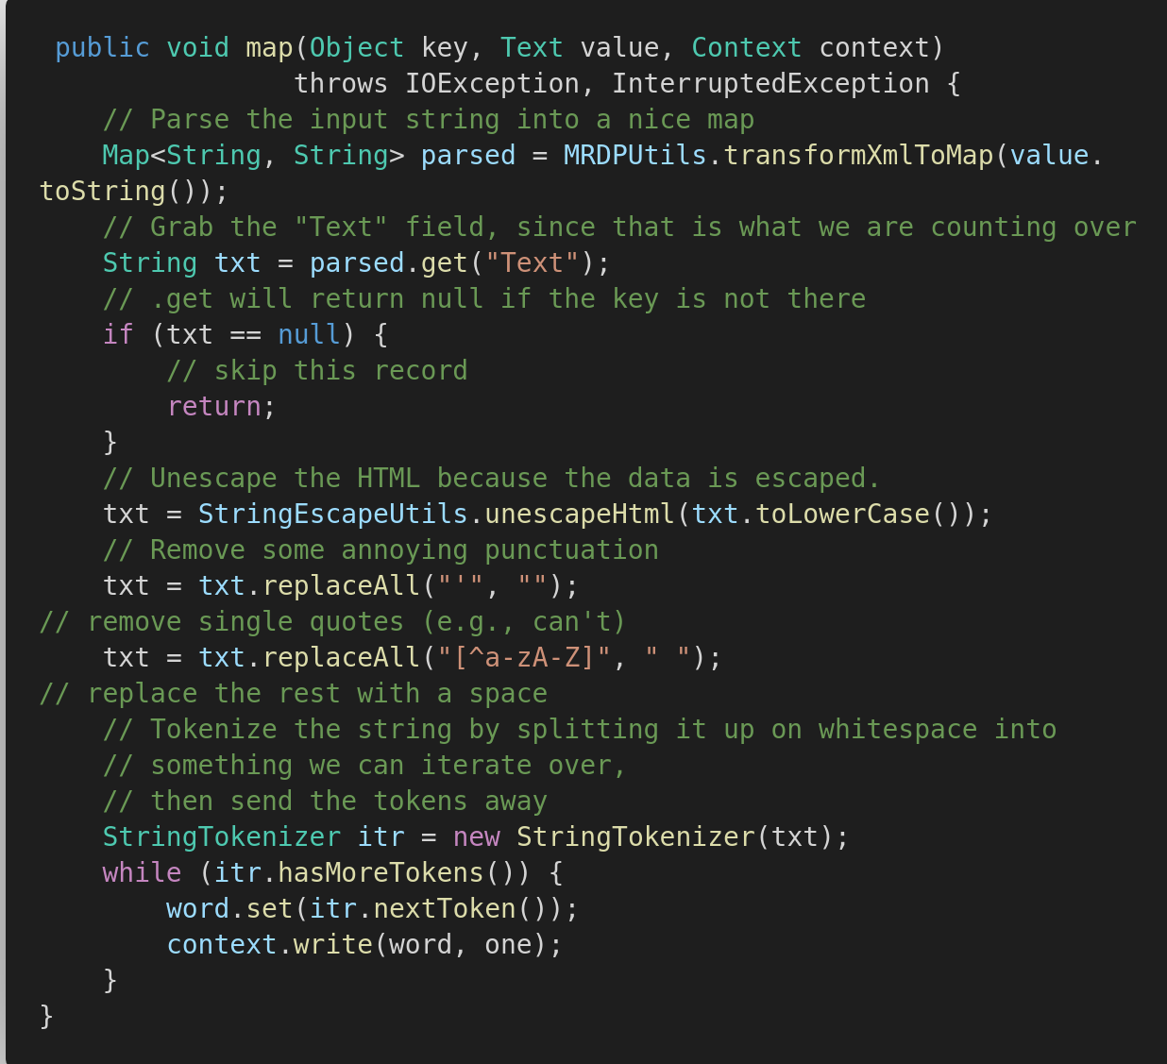
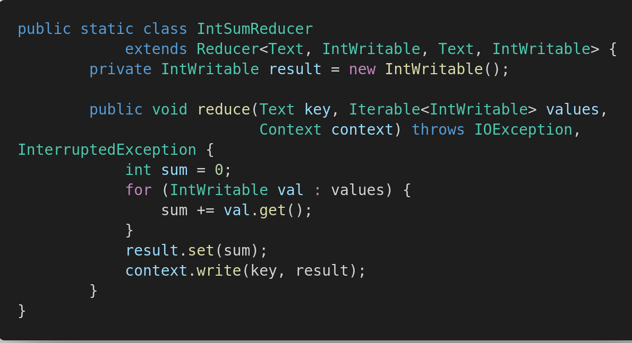
WordCount - Map and reduce methods

Slide 21
4. MR design patterns
Templates for solving common data manipulation problems with MR

Slide 22
Summarization patterns
Numerical summarizations
Inverted index
Counting with Counters

Slide 23
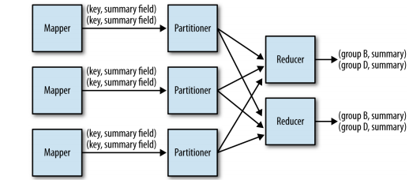
Summarization patterns - Numerical

Slide 24
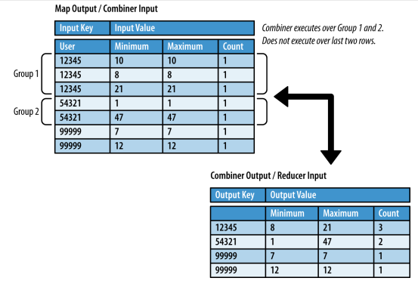
Summarization patterns - Numerical
Min, Max and Count

Slide 25
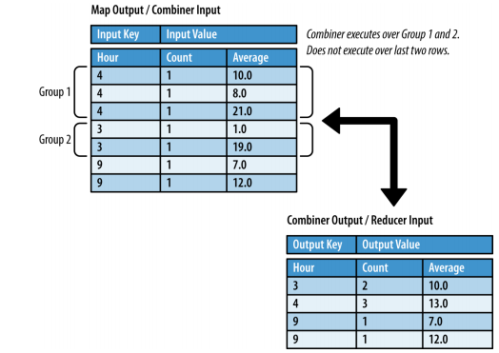
Summarization patterns - Numerical
Average
Can we use a combiner in here?
We can, but only if the count is output with the average

Slide 26
Summarization patterns - Numerical
Median and Standard Deviation
Not associative
Cannot benefit from combiner as counterparts
  Median: requires all values, shuffled and sorted
  Std deviation: requires total average to be discovered prior to reduction

Slide 27
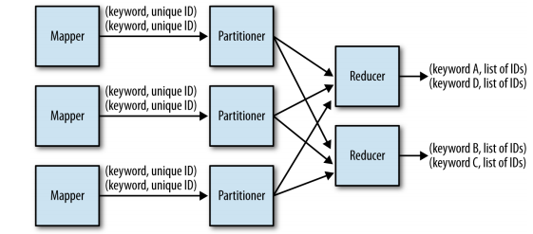
Summarization patterns - Inverted Index

Slide 28
Summarization patterns - Counting with Counters
Global sum entirely on map side
No output produced
Uses counters
No reduce phase (nor combiner, nor partitioner)

Slide 29
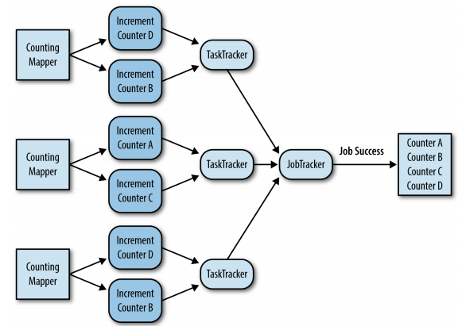
Summarization patterns - Counting with Counters

Slide 30
Filtering patterns
Actual records are not changed
Find subset of data
Can be considered a form of search
Sampling (e.g., highest value for a field)

Slide 31
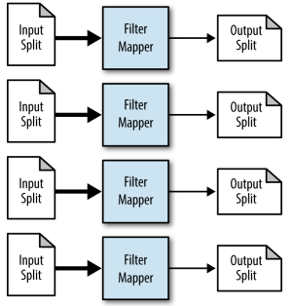
Filtering patterns - Filtering
No reduce phase

Slide 32
Filtering patterns - Bloom Filtering
Eval function applied to each record
Hot Values: predefined set
  Filter records that belong to hot values
Distributed cache usage
  Bloom filter data object, compact
Can sometimes return false positives
  Will never return false negatives

Slide 33
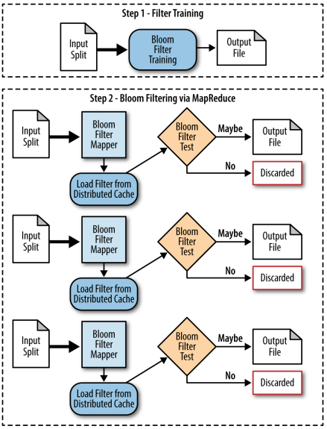
Filtering patterns - Bloom Filtering
No reduce phase

Slide 34
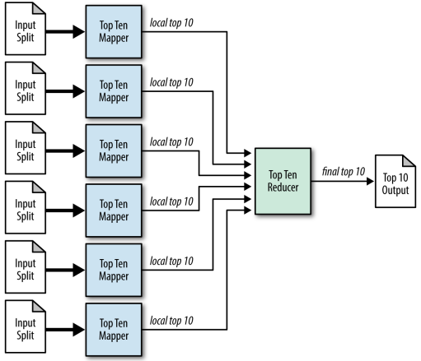
Filtering patterns - Top Ten

Slide 35



References
MapReduce Design Patterns. Donald Miner and Adam Shook, 2012.
MapReduce Design Patterns Tutorial YouTube video
DA Academy Github repository MapReduce content

Slide 36

Thanks!

