Slide 1
Unique Entity Head Extraction from Structured data
Presented by:
Amruta Diwakar Argade | PRN: 210940125005
Jori Omkar Nathu | PRN: 210940125020
Patil Aditi Hemant | PRN: 210940125032
Rohit Gupta | PRN: 210940125039
Varun Kumar Jha | PRN: 210940125052

Slide 2
What is Entity ?
In data records often contain observation about real-life people, places, organization as well as things like servers
or vessels
Entities can be any noun your care about, that have information in one or more records in your data sources.
What is Resolution?
The act or process of resolving such as
Analyzing a complex notion to simpler ones
The act of answering: SOLVING
The act of determining

Slide 3
Goal of Entity Resolution
Goal of ER is to identify all profiles that describe the same real-world object
Resolving when two observation relate to the same entity, despite having been described differently.
Example:
Conversely, it also means recognizing when observations do not relate to the same despite having been described similarly.
Robert Smith | Robert J.Smith
123 Main Street | 123 E Main Street
703.554.1214 | RJSasmith.com

Slide 4
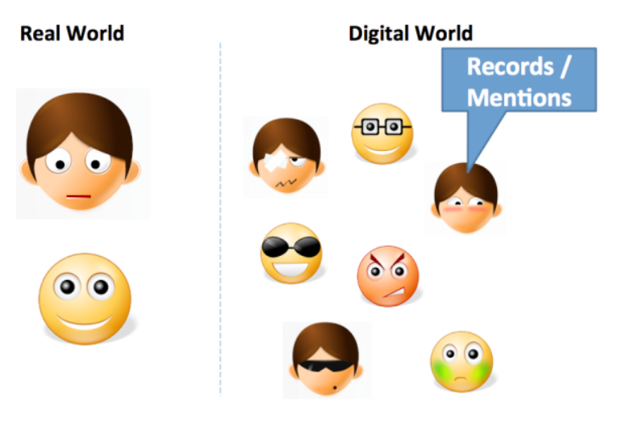
Entity Resolution
The ER is the task that identifies the same real-world object across different entity profiles. It constitutes a quadratic task, since it requires every entity to be compared with all others.
Applications:
🡪 Online Shopping
🡪 National Census
🡪 Crime and Fraud Detection

Slide 5
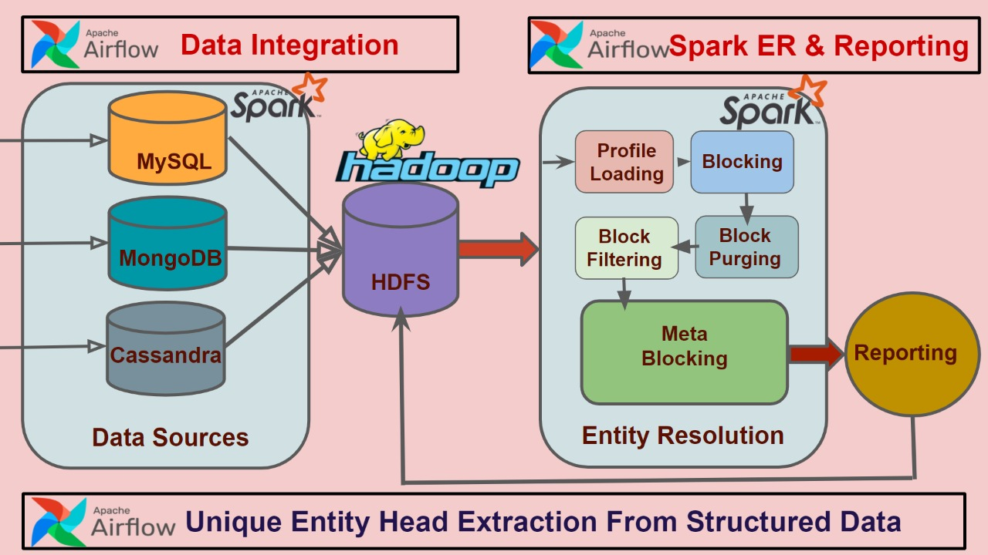
Flow Chart

Slide 6
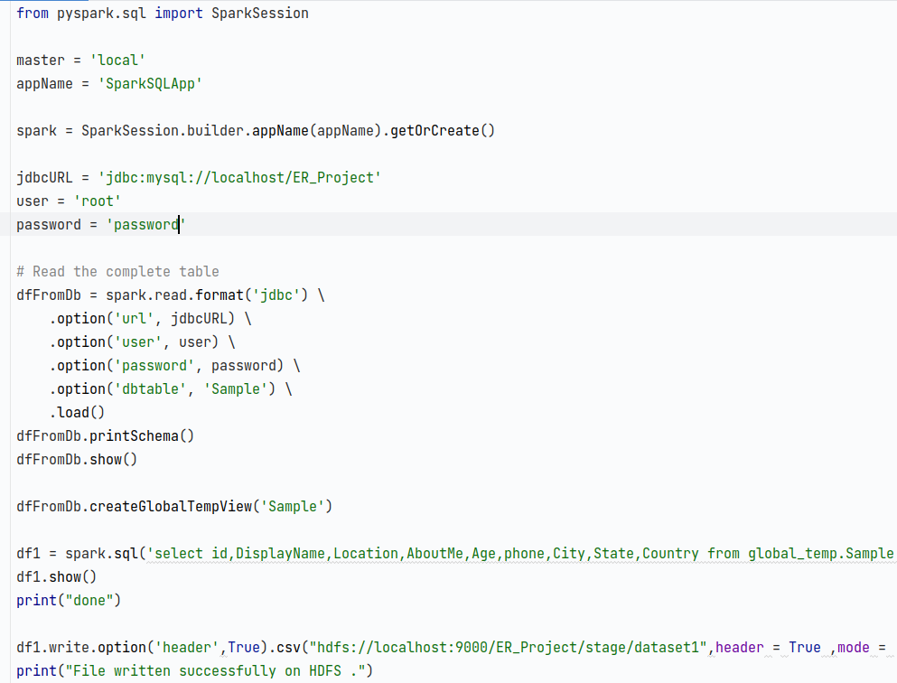
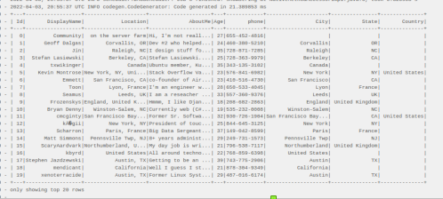
Methodology
Data Integration:
MySQL
Airflow Output:

Slide 7
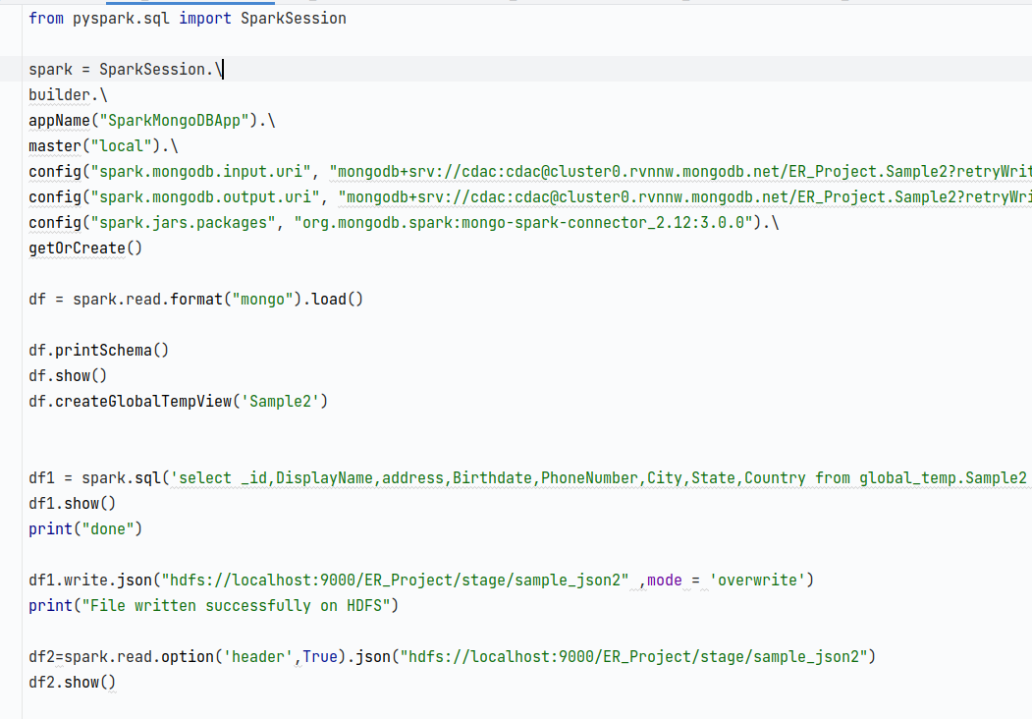
Methodology
MongoDB
Airflow Output:

Slide 8
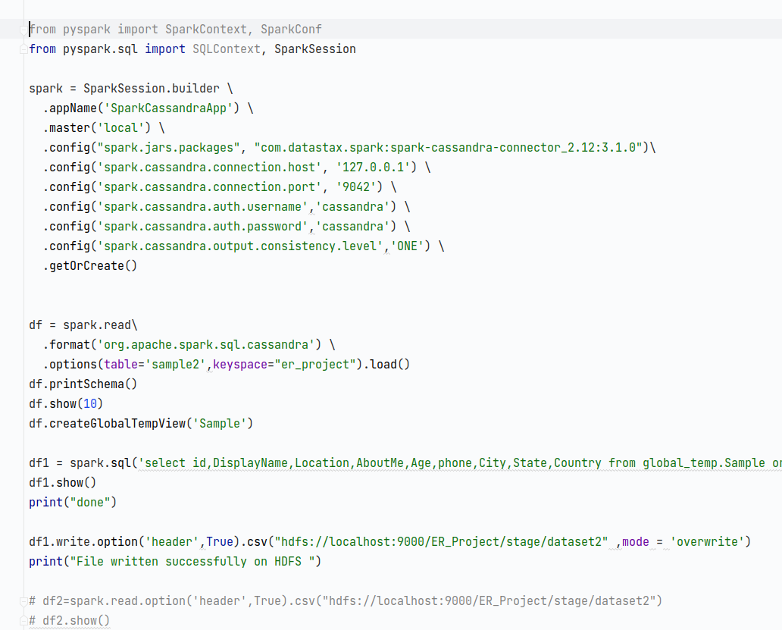

Methodology
Cassandra
Airflow Output

Slide 9
Methodology
2. Transformation:
SparkER
SparkER Architecture

Slide 10
Stages
Profile Loading:
Dataset A (Example)
P_id | id | Name | Job | Location
P1 | 1 | Jack Lloyd Miller | auto seller | USA
P2 | 2 | Erick Green | car trader | UK
P3 | 3 | Jack Miller | Car vendor seller | United States
P_id | id | Name | Profession | Location
P4 | 1 | Erick Lloyd Green | Vehicle vendor | UK
P5 | 2 | James Jordan | car seller | Europe
P6 | 3 | Nick Papas | car dealer | Europe

Slide 11
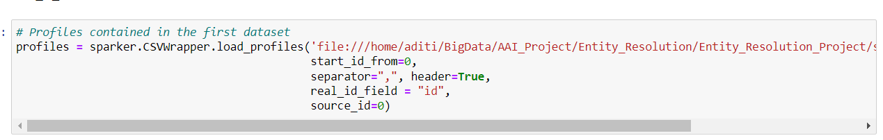
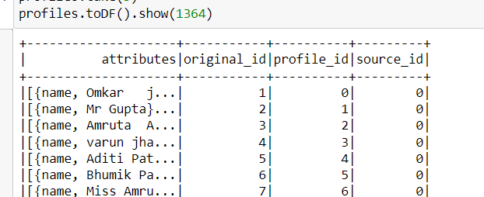
Stages
Profile Loading:

Slide 12
Stages
2. Blocking:
Blocking / Indexing is used to reduce comparisons
improves the run-time of ER tasks
Example:
b1(Jack)
b2(Miller)
b3(Lloyd)
b4(seller)
b5(Erick)
{P1, P3}
{P1, P3}
{P1, P4}
{P1, P3, P5}
{P2, P4}
b6(Green)
b7(car)
b8(vendor)
b9(UK)
b10(Europe)
{P2, P4}
{P2, P3, P5, P6}
{},{P4,P5}
{P2},{P5}
{P3},{P6}

Slide 13
Token Blocking
In essence, it splits the attribute values of every entity profile into tokens based on whitespace; then, it creates a separate block for every token that appears in at least two profiles.
Token ti creates a distinct block bi that contains all entities having ti in the values of their profile regardless of the associated attribute names.
In this way, blocks are built in an attribute-agnostic manner, and every entity is placed in multiple blocks, ensuring a redundancy-positive functionality.

Slide 14
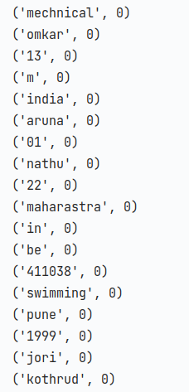
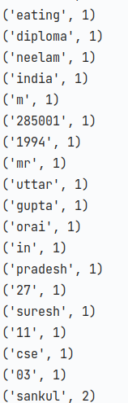
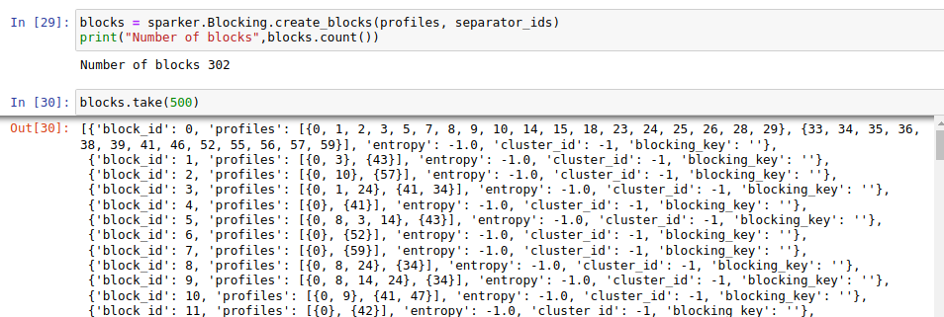
Token Blocking

Slide 15
N-gram Blocking
N-gram based indexing takes each blocking (or sorting) key value and converts it into a list of n-grams. A n-gram (also known as n-gram) is a substring of length q characters or n= 3 (called trigrams ).
The list of n-grams of a string s is generated using a sliding window approach that extracts n characters from s at any position from 1 to k of the string.
For example, the bigram list that is generated from the string ‘christen’ is [‘ch’, ‘hr’, ‘ri’, ‘is’, ‘st’, ‘te’, ‘en’].
Advantage of N-gram blocking
overcome errors and variations in the BKVs
records that refer to true matches are more likely inserted into the same index list.
Improved matching quality.

Slide 16
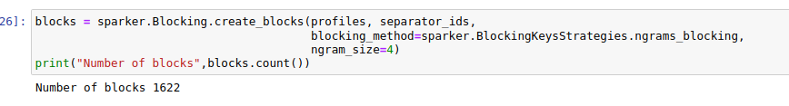
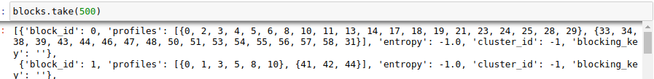








N Gram blocking

Slide 17
Stages
3. Block Purging:
Aims for discarding oversized blocks that are dominated by redundant and superfluous comparisons.
Example:
b1(Jack)
b2(Miller)
b3(Lloyd)
b4(seller)
b5(Erick)
{P1},{P4}
{P1},{P3}
{P1},{P5}
{P1,P3},
{P4}
{P2},{P5}
b6(Green)
b8(vendor)
b9(UK)
b10(Europe)
{P2},{P5}
{},{P4,P5}
{P2},{P5}
{P3},{P6}

Slide 18
Stages
4. Block Filtering:
Block Filtering which intelligently removes profiles from blocks, in which their presence is unnecessary
Filtering ratio must be between [0,1]

Slide 19
Stages
5. Meta-Blocking:
Meta-blocking restructures a block collection B into a new one B’ that contains a significantly lower number of unnecessary comparisons, while detecting almost the same number of duplicates.
Meta-blocking discards most superfluous comparisons by pruning the edges with low weights.
The similarity of two entities is proportional to the number of blocks they have in common.

Slide 20
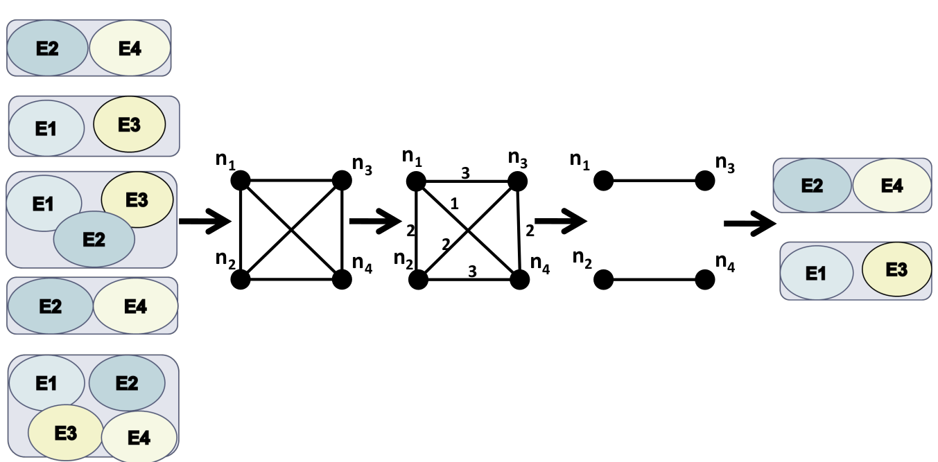

Slide 21
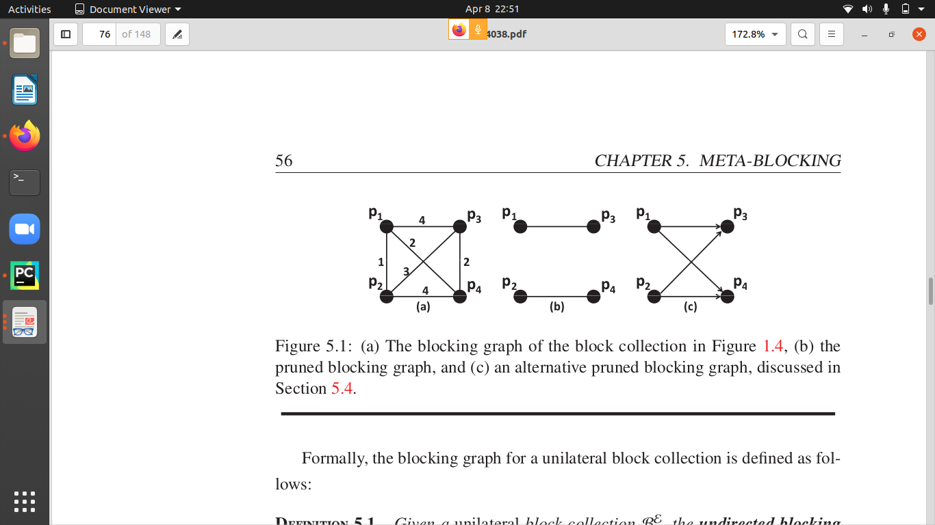
we present the simplest scheme, which sets the weight of each edge equal to the number of blocks the adjacent entities have in Common.
The blocking graph of Figure (b) can be derived from that of Figure (a) by discarding edges with a weight lower than 2, or by retaining the two edges with the highest weight.
For example, the pruned blocking graph of Figure 5.1(b) is transformed in the blocks b 1 = {{p 1 }, {p 3 }} and
b 2 = {{p 2 }, {p 4 }}.
The last step of our meta-blocking approach transforms the pruned blocking graph into the new block collection that is returned as output.

Slide 22
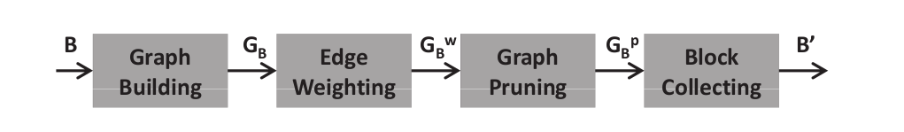
Basic Principle
The techniques aim at identifying the most similar pairs of entities so as to place them in the restructured blocks of the output.
The internal functionality of meta-blocking.
Graph Building receives a block collection B and derives the blocking graph Gb from its block assignments.
Edge Weighting takes as input a blocking graph Gb and turns it into the weighted blocking graph (GwB ) by determining the weights of its edges. We introduce several weighting schemes for this procedure
Graph Pruning receives as input the weighted blocking graph and derives the pruned blocking graph (Gb ) from it, by removing some of its edges.
Block Collecting is given as input the pruned blocking graph G B and extracts from it a new block collection B ′ , which actually constitutes the final output of the entire meta-blocking process

Slide 23
Edge Weighting
Common Block Scheme
Common blocks Scheme (CBS ). A strong indication for the similarity of two entities is provided by the number of blocks they have in common; the more blocks they share, the more likely they are to match. Hence, the weight of an edge connecting entities p i and p j is set equal to:
e i, j .weight = |B i, j |

Slide 24
Pruning Algorithm
In general, the pruning algorithms can be categorized in two classes:
• The edge-centric algorithms iterate over the edges of a blocking graph in order to select the globally best comparisons, by filtering out those that do not satisfy the pruning criterion.
• The node-centric algorithms iterate over the nodes of a blocking graph with the aim of selecting the locally best comparisons for each entity (i.e., the adjacent entities with the largest edge weights).
Pruning criteria
The functionality of pruning criteria distinguishes them into:
• weight thresholds, which specify the minimum weight for the edges to be retained, and
• cardinality thresholds, which determine the maximum number of retained edges.

Slide 25
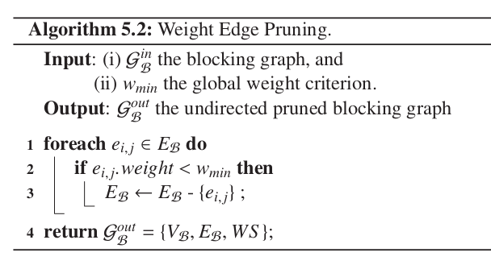
WEP:
(Line 1) Iterates over all edges
(Line 2) those having a weight lower than the input threshold
(Line 3) discards the edges which does satisfy the criteria of edges containing less weight than the threshold.

Slide 26
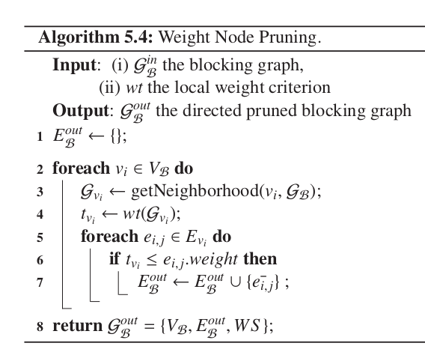
WNP:
(Line 2) It iterates over all nodes of the input blocking graph
(Line 3) Then, it specifies the minimum edge weight for G v i according to the given threshold criterion
(Line 4) Gvi according to the given threshold criterion t iterates over all edges of E v i
(Line 5) for each undirected edge exceeding the specified local threshold, it adds edge to the pruned graph.

Slide 27
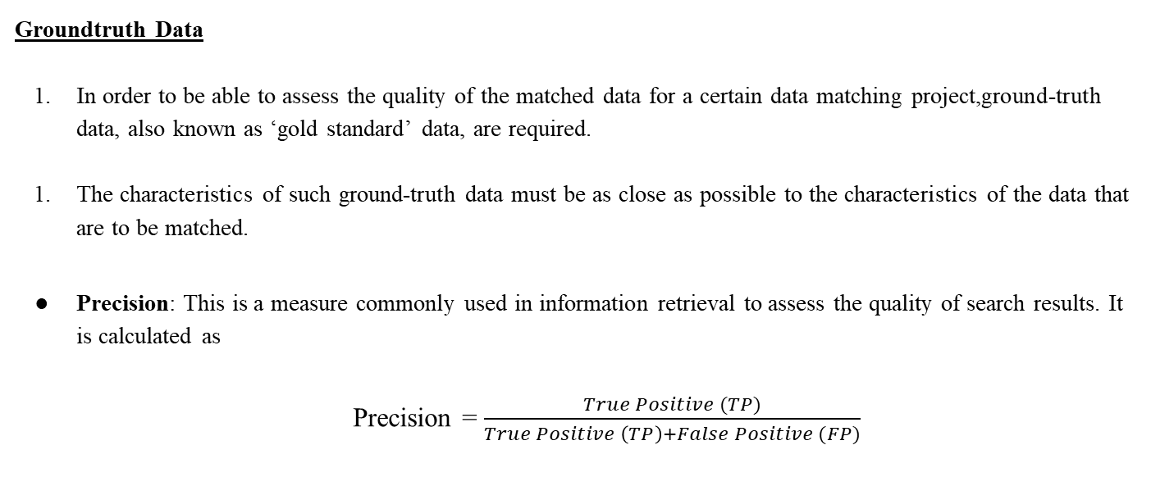
Evaluation Metrics

Slide 28
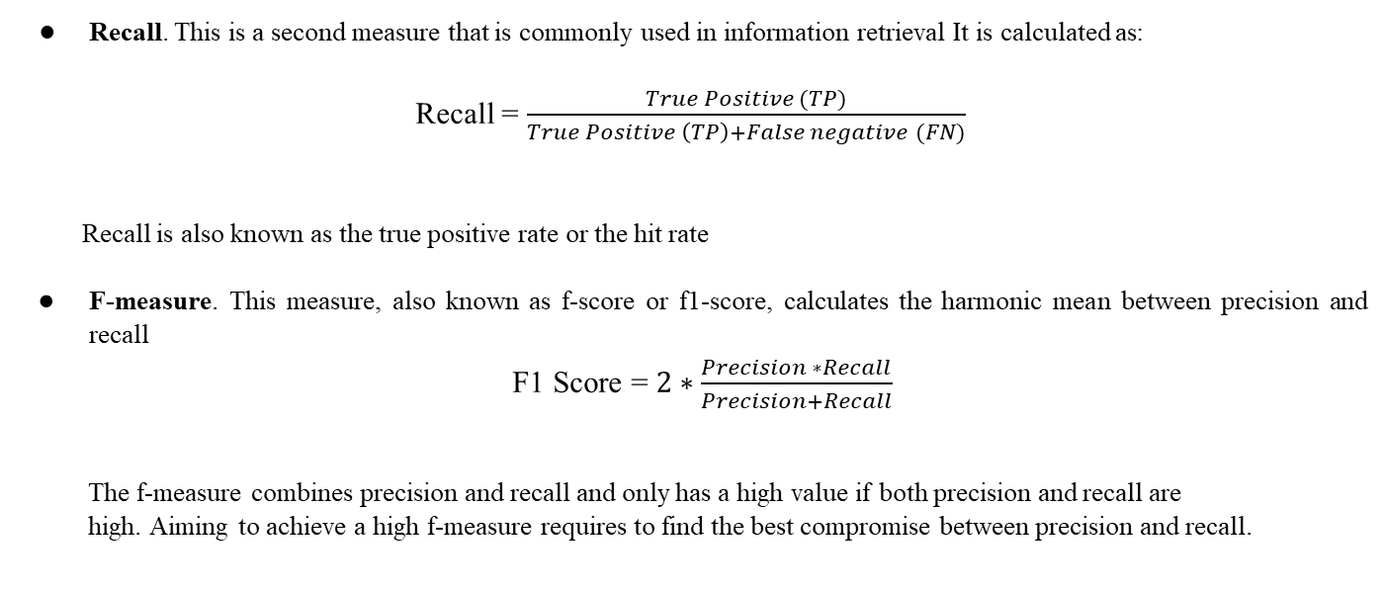
Evaluation Metrics

Slide 29
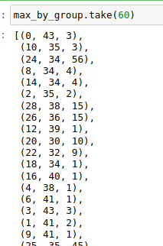
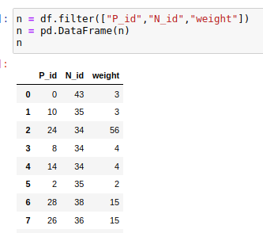
Maximum weight by applying group method
max_by_group = (edges
.map(lambda x: (x[0], x))
.reduceByKey(lambda x1, x2: max(x1, x2, key=lambda x: x[-1]))
.values())

Slide 30
Max weight: The profiles which has maximum weight are retained and they have probability of being similar.
n = dataframe
By applying max 2. By applying average
max = n["weight"].max()
print(max)
new_df = n[(n['weight']>max)]
new_df
max_avg = n["weight"].avg()
print(max_avg)
new_df = n[(n['weight']>max_avg)]
new_df

Slide 31
3. By applying some percentage of max weight
max1 = n["weight"].max()
print(max1)
max_percentage = (max1*70)/100
mmax_percentageax1
n["N_id"] = n["N_id"]-(separator_id+1)
new_df = n[(n['weight']>=(max_percentage))]
new_df

Slide 32
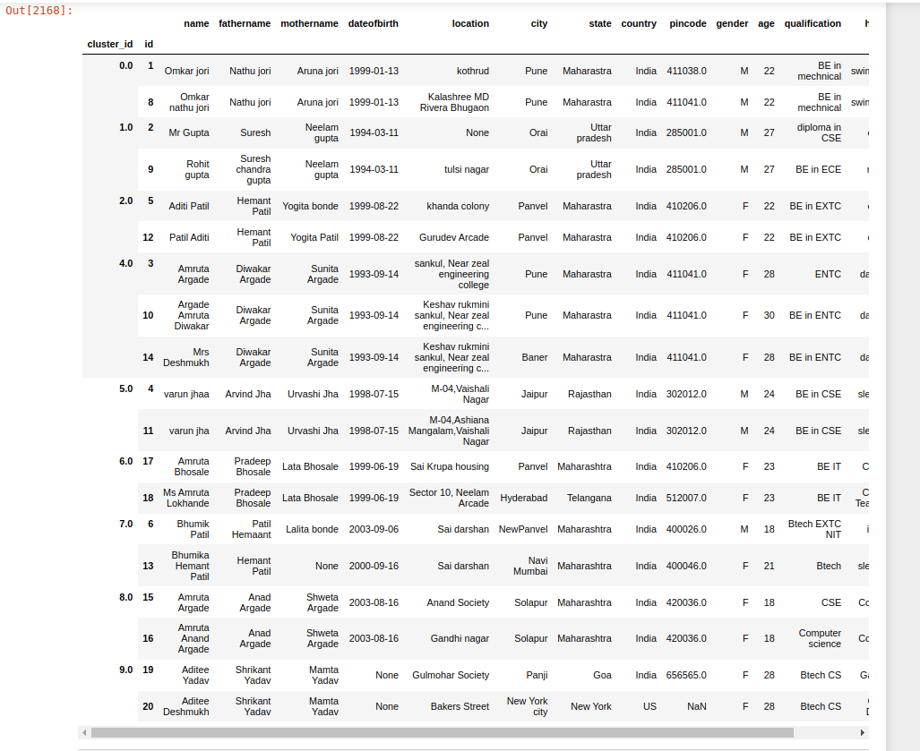
Dirty ER Output
Final Output

Slide 33
Limitations of SparkER
SparkER takes maximum 2 files as input.
Groundtruth has to be given for evaluating the performance of meta-blocking algorithms.
Maximum no of attributes should be similar of two entities to determine their match
If there are more no of attributes the accuracy of determining the similarity is high.
We are determining the similarity of profiles on the basis of maximum weighting criteria between two profiles.
Threshold criteria has to be defined for determining similarity.

Slide 34
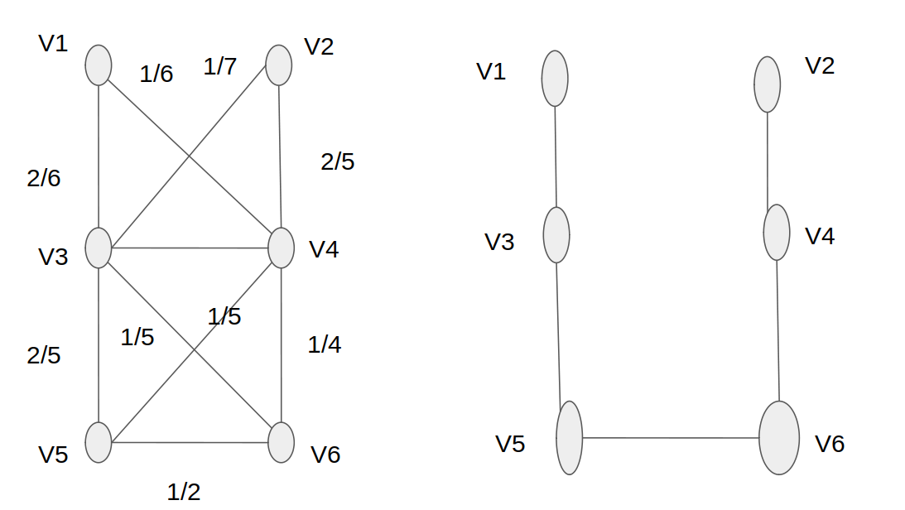
Stages

