Slide 1

School of Computer Science and Engineering
Internship Review - Presentation
BCSE399J (Summer Industrial Internship)/
CBS1902/CSE1902/ CSI3903 (Industrial Internship)
FALL SEMESTER 2025-26
Type of Intern: CDC Course
Title of Intern: Learner
Internship completed at :
Oracle Cloud Infrastructure and Generative AI Professional
Duration : 30 days : 15th May 2025 to 15th June 2025
Date of Presentation: 30th October 2025
by
Rohit N
23BAI1463

Slide 2
Contents (Industry/TBI/VAC)
Outline slide
Introduction
Aim, objective(s) and motivation.
About the industry/TBI / VAC
Certificate (Period of study)
Skills acquired during industrial internship / VAC period
New technologies/Frameworks/real-time problems/Analysis based knowledge acquired during industrial internship
8. Conclusion (Brief Summary)

Slide 3
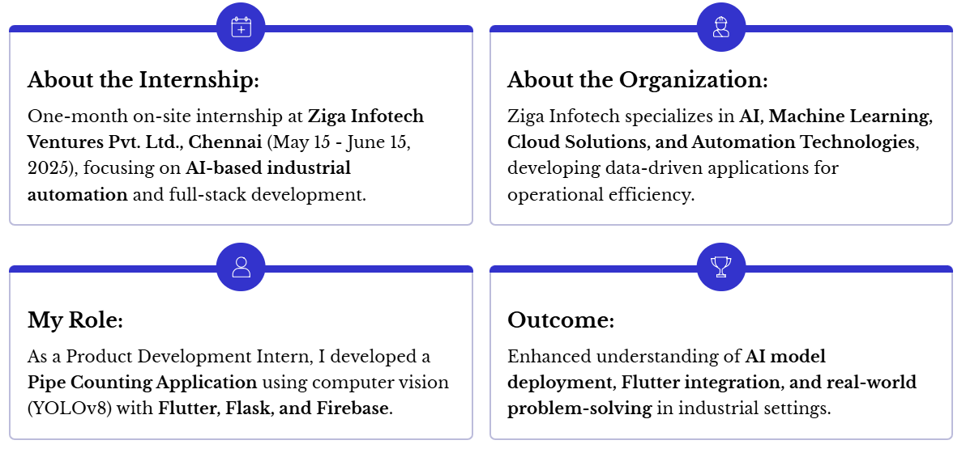
Introduction

Slide 4
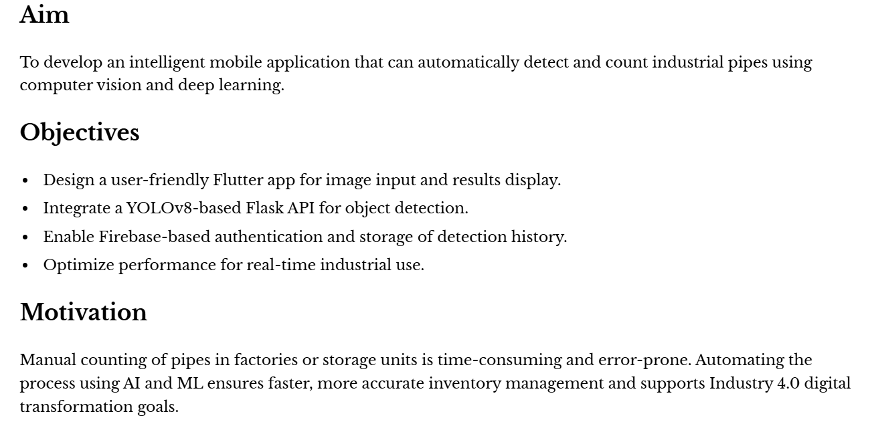
Aim, objective(s) and motivation.
Rohit N 23BAI1463

Slide 5

About the Industry
Rohit N 23BAI1463

Slide 6
Certificate

Slide 7
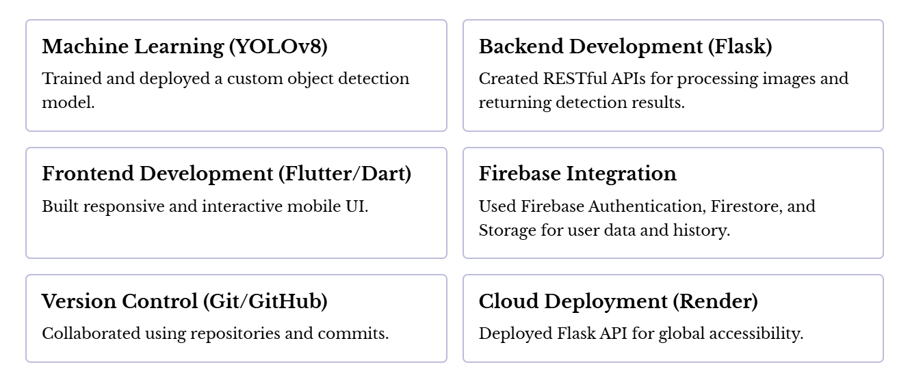
Skills acquired during industrial internship

Slide 8
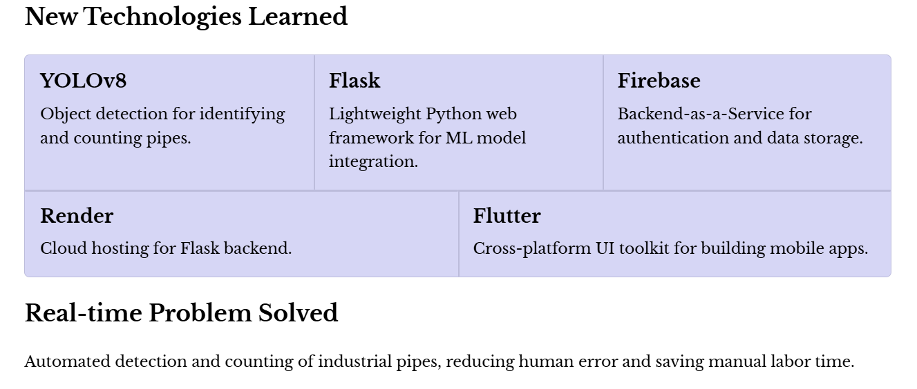
New Technologies and Real-time Problem Analysis

Slide 9
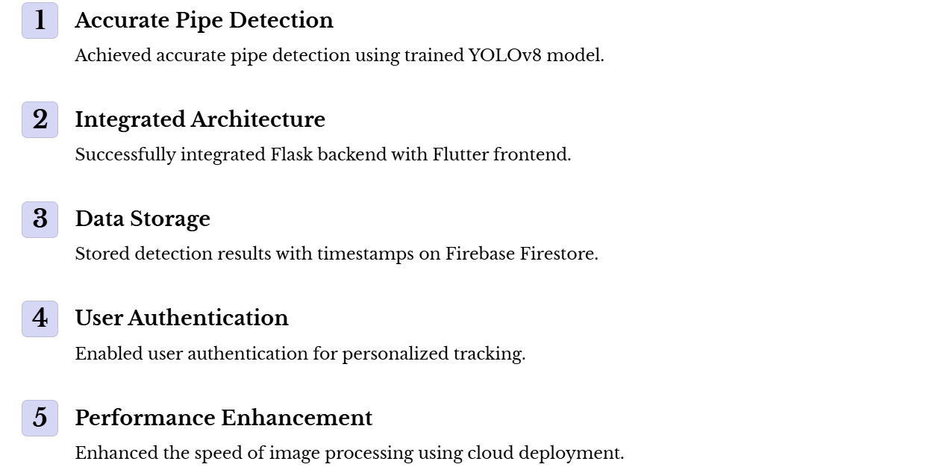
Analysis and Outcomes

Slide 10
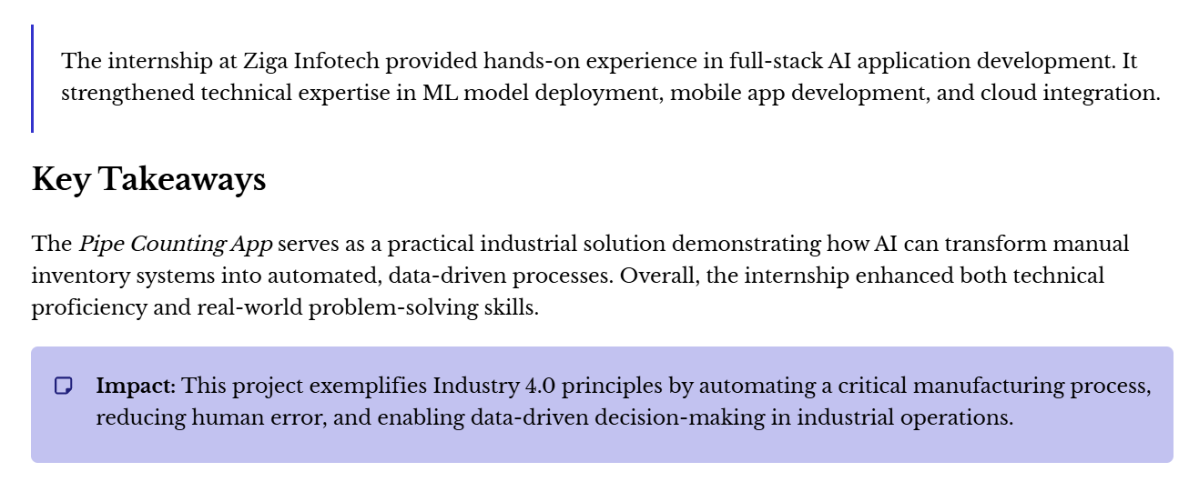
Conclusion

