Slide 1
Report Analytics of F&B Sales Dataset (FMCG)
Team 4
07/01/23

Slide 2
Team Info
Mentor Name: Mr. Mahendra
Coordinator: Mrs. Gowrishankar P.
Team Members:
Jyoti Patil
Siddartha Reddy
Rohan Patil
Subha Panigrahi
Shraddha Gurmale
Ajay Alat

Slide 3
Project Flow
Kick off and Business Objective discussion
Understanding the Dataset and KPI’s
Implementation of KPI’s using Excel
Implementation of KPI’s using Tableau
Implementation of KPI’s using PowerBI
Final Presentation of the Project

Slide 4
Data set details
The dataset which was provided to us was regarding FMCG.
It contains the food and beverages sales data.
The dataset was regarding Zapto.
The KPI's were Total Sales, Store Wise Sales, Sales Growth, Daily, Sales Trend, Brand Wise Sales, AM wise Sales, Sales Vs Budget, Model Wise Sales, Sales Comparison and Product Wise Sales.
Created a dashboard.

Slide 5
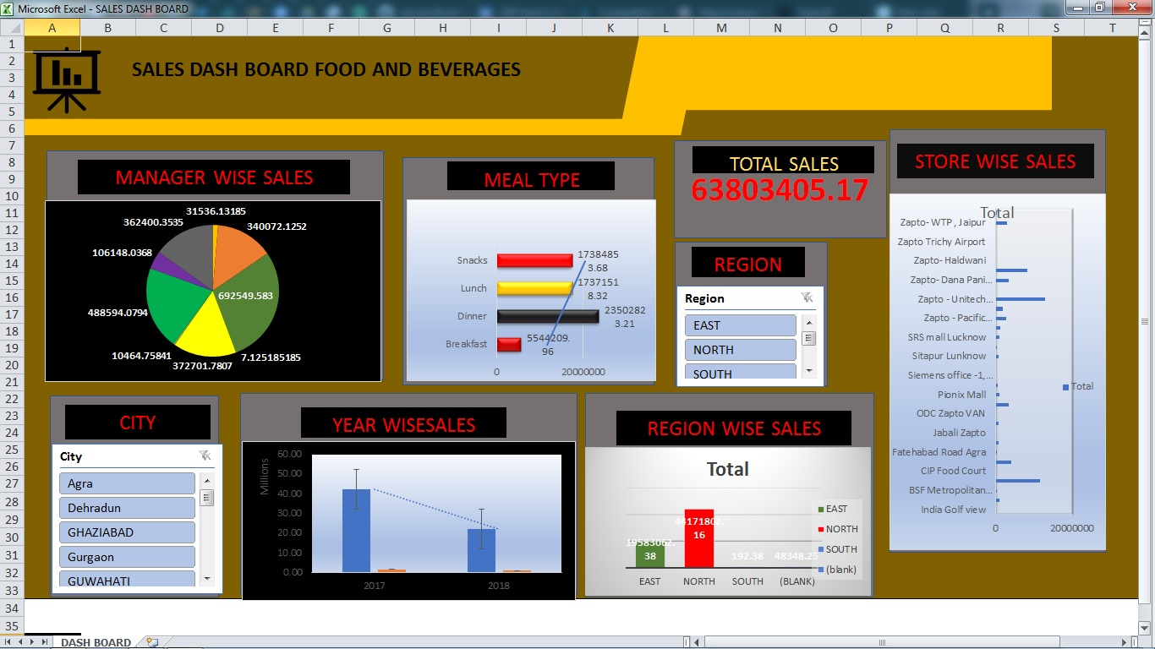
Excel Dashboard

Slide 6
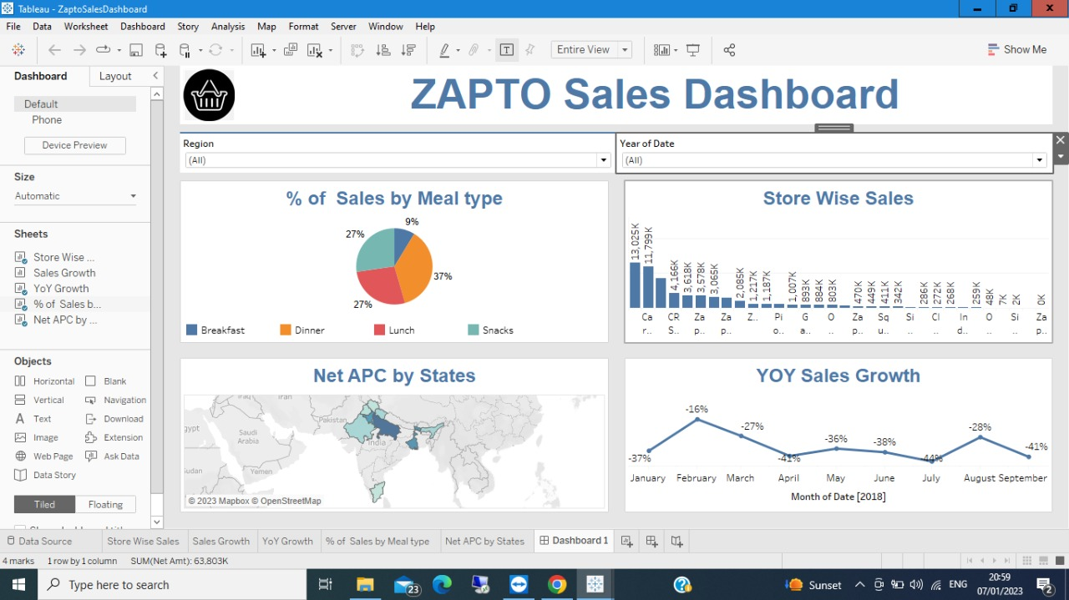
Tableau Dashboard

Slide 7
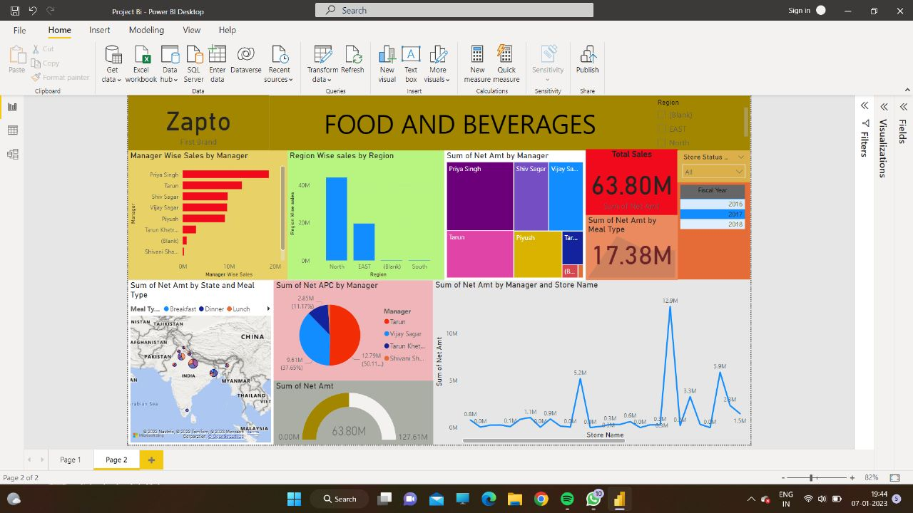
Power BI Dashboard

Slide 8
Thank You !

