Slide 1

“Daily” Data Analysis for a Product listed on Amazon
Classification project

Slide 2
Business Problem:
Need to get daily Analysis of a product such as emotions, Sentiment etc. Using Amazon data.
They have provided data and sentimental analysis provided in that.
Need to get daily product sentiments analysis and emotion mining with some charts like
histogram, Density plot, Bar plot, pie-plot etc.

Slide 3
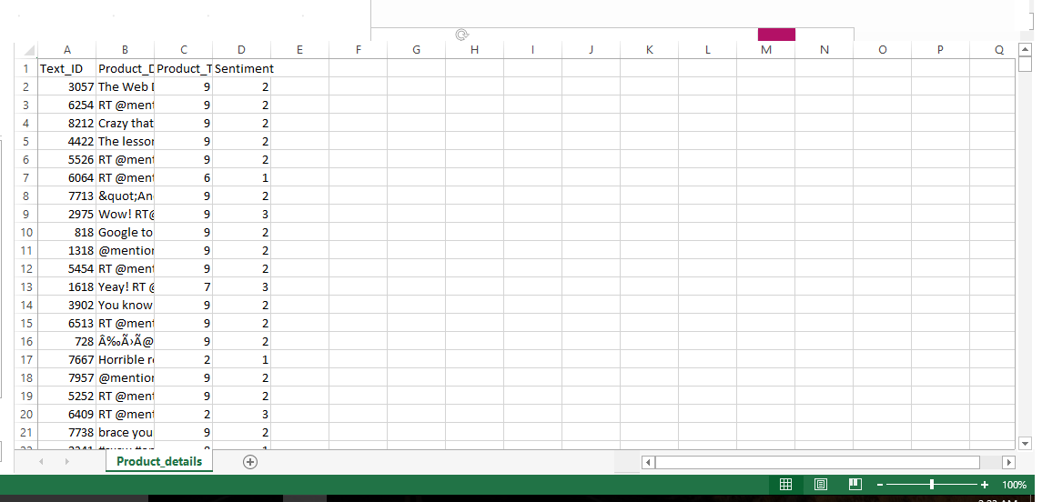
The Data set is given to us
- Our goal is to eventually train a sentiment analysis classifier

Slide 4
Project Flow
Kick off and Business Objective discussion
Data set Details
EDA
Model Building
Model Evaluation
Deployment

Slide 5
What is NLP & Sentimental Analysis:
Natural Language Processing (NLP) is a form of Artificial Intelligence that comprehends and interprets the written or spoken word in a human-like way.
NLP sentiment analysis is the practice of using computers to recognize sentiment or emotion expressed in a text. Through NLP, sentiment analysis categorizes words as positive, negative or neutral.

Slide 6
In this project we were clean the given data set using the following cleaning process
The next steps about data cleaning will be:
Remove URLs
Tokenize text
Remove emails
Remove new lines characters
Remove distracting single quotes
Remove all punctuation signs
Lowercase all text
De-tokenize text
Convert list of texts to Numpy array

Slide 7
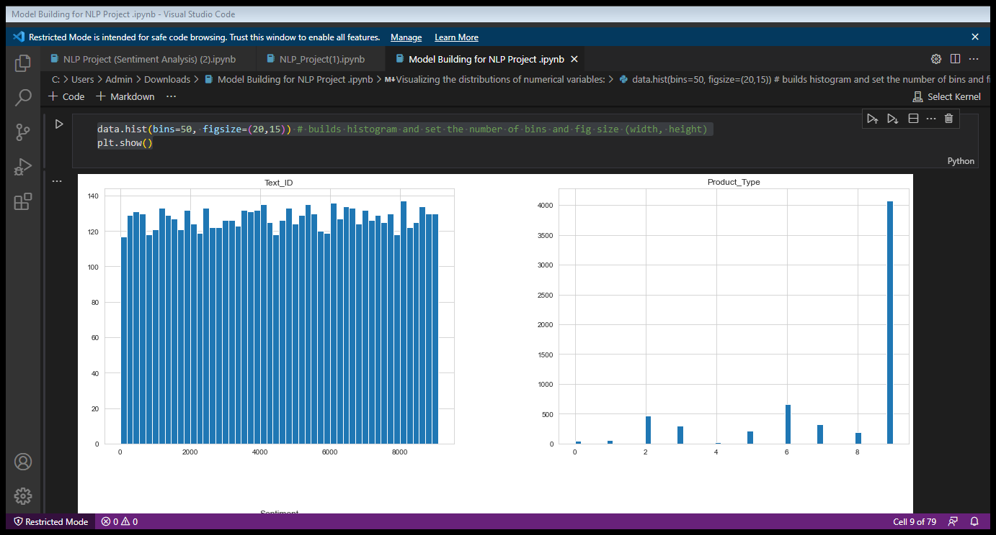
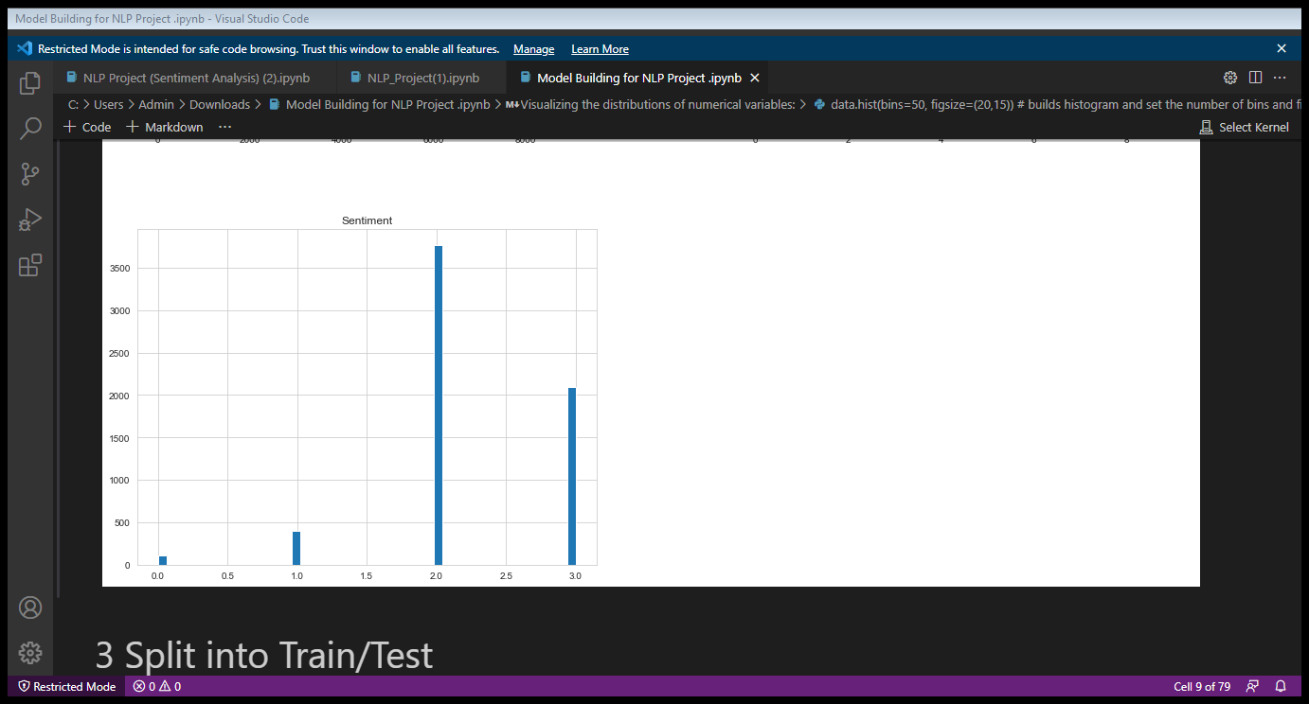
Visualizing the distributions of numerical variables:
data.hist(bins=50, figsize=(20,15))
# builds histogram and set the number of bins and fig size (width, height)
plt.show()

Slide 8
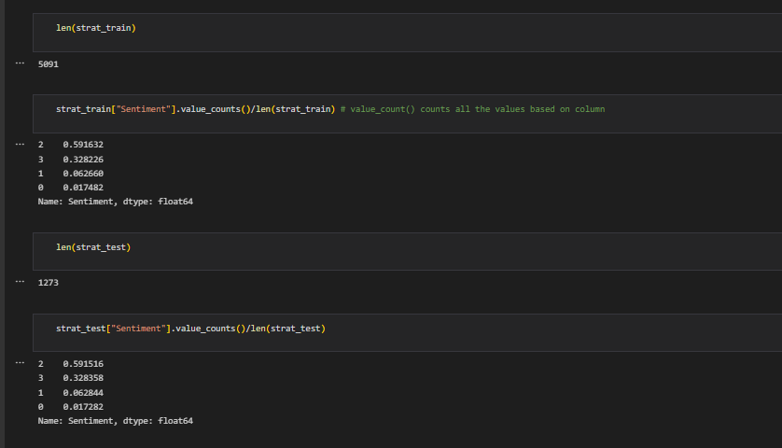
Split into Train/Test
- Since the majority of reviews for sentiment 2 and 3, we will need to do a stratified split on the reviews score to ensure that we don't train the classifier on imbalanced data
- To use sklearn's `Stratified ShuffleSplit` class, we're going to remove all samples that have NAN in review score, then covert all review scores to `integer` datatype
Check to see if train/test sets were stratified proportionately in comparison to raw data.

Slide 9
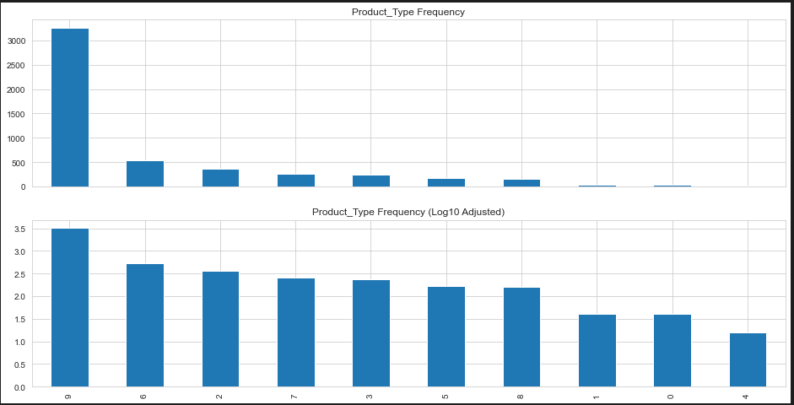
Confirmed our hypothesis that each product_id can have multiple Text_ID.Therefore we should only really concern ourselves with which product_id's do well, not the Text_ID's.

Slide 10
INSIGHTS:
-Based on the bar graph for Product_type, we see that certain products have significantly more reviews than other products.
- We also took the log of the Product_type to normalize the data, in order display an in-depth picture of each Product_type, and we see that the distribution still follows a "right tailed" distribution

Slide 11
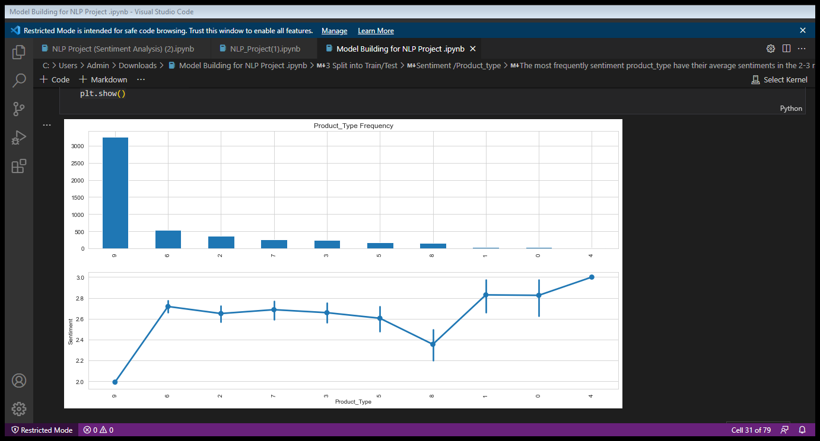
Sentiment /Product type

Slide 12
The most frequently sentiment product_type have their average sentiments in the 2-3 range, with little variance.
Although there is a slight inverse relationship between the product_type frequency level and average sentiment for the 8th product_type.
Note that point-plot graph automatically takes the average of the sentiment data.

Slide 13
Building a Pipeline from the Extracted Features
We will use Multinominal Naive Bayes as our Classifier
- Multinominal Niave Bayes is most suitable for word counts where data are typically represented as word vector counts(number of times outcome number X[i,j] is observed over the n trials), while also ignoring non-occurrences of a feature i
- Naive Bayes is a simplified version of Bayes Theorem, where all features are assumed conditioned independent to each other (the classifiers), P(x|y) where x is the feature and y is the classifier.
Test Model
import numpy as np
predictedMultiNB = clf_multiNB_pipe.predict(X_test)
np.mean(predictedMultiNB == X_test_targetSentiment)
O/P = 0.9198743126472899
Here we see that our Multinominal Naive Bayes Classifier has a 91.98% accuracy level based on the features.

Slide 14
Testing Other Models
Logistic Regression Classifier:-
Accuracy:- 91.98%
Decision Tree Classifier:-
Accuracy:- 89.94%
Support Vector Machine Classifier:-
Accuracy:- 92.30%
Random Forest Classifier:-
Accuracy:- 92.69%

Slide 15
CONCLUSION:-
From Fine tuning the Support Vector Machine Classifier
above Looks like all the models performed very well (>85%), and we use the Support Vector Machine Classifier since it has the highest F1 score level at 92.30%
Note that Support Vector Machines is very suitable for classification by measuring extreme values between classes, to differentiate the worst case scenarios so that it can classify between Positive, Neutral and Negative correctly.

Slide 16
For detailed analysis:
- Analyze the best mean score of the grid search (classifier, parameters, CPU core)
- Analyze the best estimator
- Analyze the best parameter
for performance_analysis in (gs_clf_LinearSVC_pipe.best_score_,
gs_clf_LinearSVC_pipe.best_estimator_,
gs_clf_LinearSVC_pipe.best_params_):
print(performance_analysis)
Accuracy:= 0.9241814175074372

Slide 17
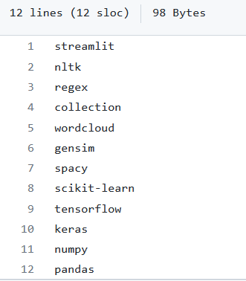
Deployment using Streamlit
requirements.txt

Slide 18
Deployment and Output
The deployment is shown in web page. We deployed it over public web server and make our website accessible for everyone.
Here, we have used the streamlit to deploy our model.
Link- https://hz004-project-nlp-based-classification.streamlit.app/

Slide 19
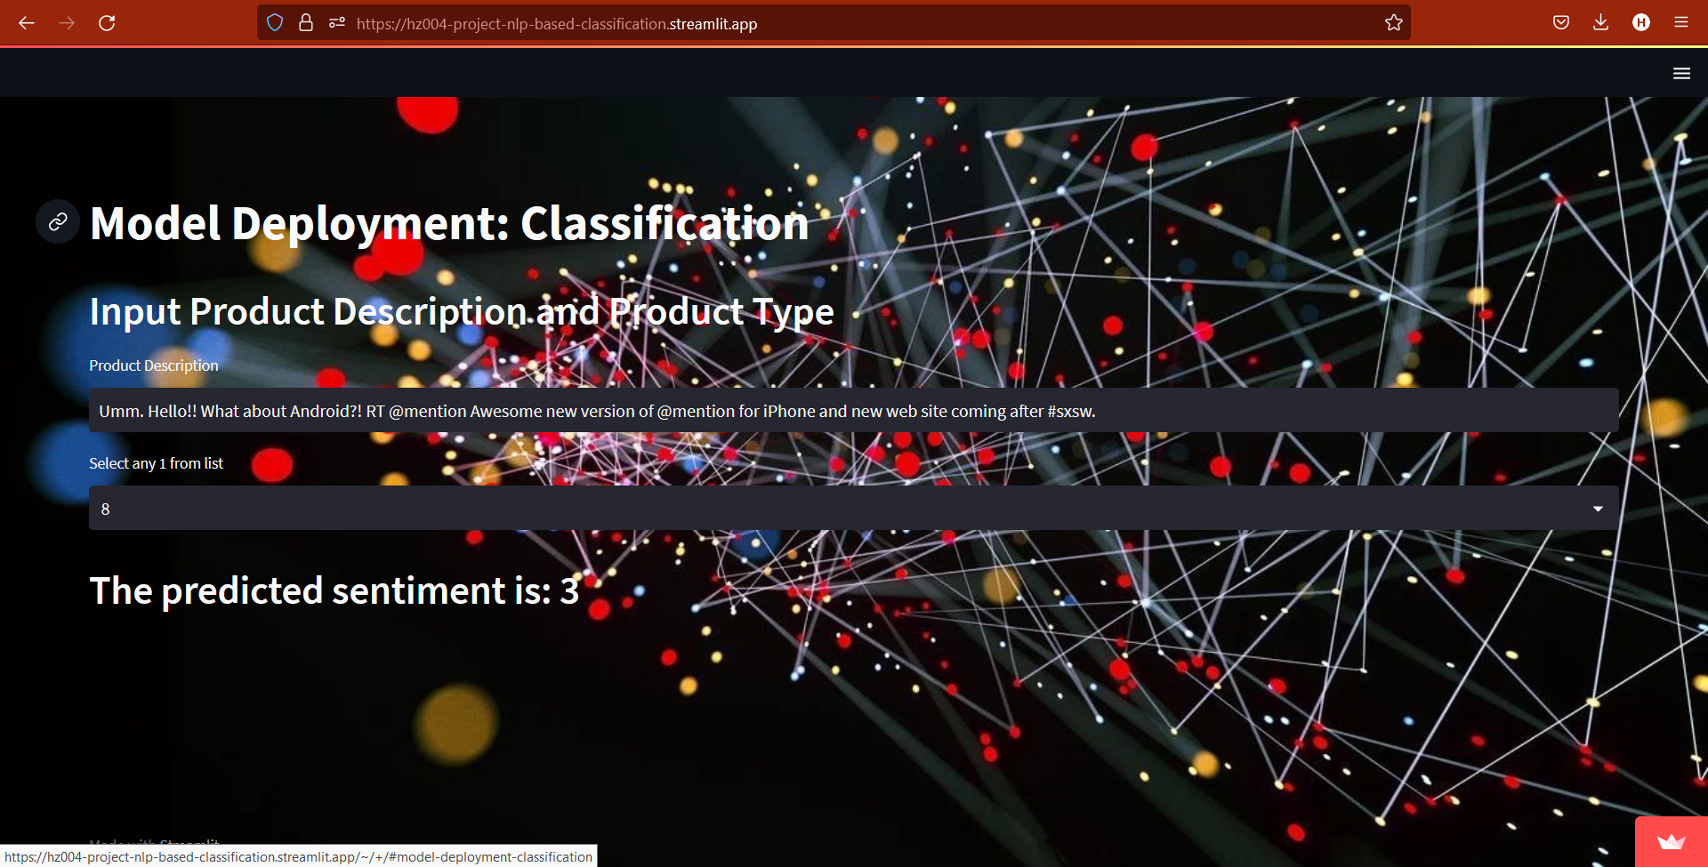

Slide 20
Challenges Faced?
1) Skewed Dataset.
2) Lot of noise in the given data.
3) Selection of right model.
How did we overcome?
Possible solutions include use of SMOTE or Upsampling by finetuning the hyperparameters.
Cleaning data by looking at some sample entries.
Model Selection was not solely based on the accuracy and consideration for precision, recall and f1-score had to be kept in mind.

Slide 21
Thank You!

