Slide 1

FINAL YEAR PROJECT
Text-Based Emotion Recognition
Comparing Machine Learning and Deep Learning (LSTM) Approaches for
Classifying Emotions in Text
Submitted By: Anila Batool (BC210411041)
Supervisor: Umair Ali
Department of Computer Sciences, Virtual University of Pakistan

Slide 2
AGENDA
What We'll Cover
1
Introduction & Problem Statement
6
Machine Learning Models
2
Objectives, Scope & Requirements
7
Deep Learning Model (LSTM)
3
Methodology & System Architecture
8
Results & Comparison
4
Dataset Overview
9
Application Walkthrough
5
Data Preprocessing Pipeline
10
Conclusion & Future Work
2

Slide 3

01 · INTRODUCTION
Understanding Emotion in Text
Emotion recognition from text is a subfield of Natural Language Processing (NLP) that identifies and extracts subjective, emotional information from written language.
In an increasingly digital world, automatically understanding emotion in text has real applications — customer service, social media monitoring, market research, and interactive AI systems.
“I am feeling so happy today!”
This project classifies text into six core emotions:
Predicted Emotion: Joy
Confidence: 97.2%
Joy
Sadness
Anger
Fear
Love
Surprise
3

Slide 4


02 · PROBLEM & OBJECTIVES
Problem Statement & Objectives
Problem Statement
Project Objectives
Manually understanding emotion behind large volumes of text (reviews, messages, posts) is slow, inconsistent, and impossible to scale. There is a need for an automated system that can reliably classify the emotion expressed in a piece of text.
Compare traditional Machine Learning algorithms against a Deep Learning (LSTM) model
Implement a complete NLP pipeline: preprocessing, feature engineering, training & evaluation
Develop a functional, user-friendly app that predicts emotion from user-entered text
4

Slide 5
03 · SCOPE
Project Scope & Requirements
Scope
Key Requirements
16,000 labelled text comments (pre-existing dataset)
4 ML models + 1 DL model implemented and compared
Predictive system with a saved, reusable model for inference
Limited to 6 emotion classes and the English language
Functional
Accept text → preprocess → vectorize → classify → show emotion + confidence
Performance
Prediction returned within a few seconds
Usability
Simple, intuitive interface
Accuracy target
At least 80% on the test set
5

Slide 6
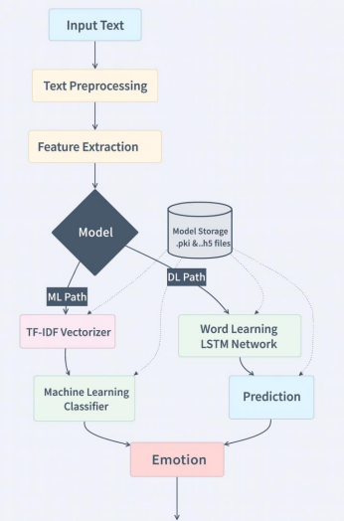
04 · METHODOLOGY
Development Methodology & Architecture
An Agile methodology was adopted, allowing iterative development and continuous experimentation with different models and hyperparameters — each cycle producing an improved version of the system.
Two pipelines were built and compared side-by-side:
Traditional ML Pipeline TF-IDF features + classical classifiers (Naive Bayes, Logistic Regression, Random Forest, SVM)
Deep Learning Pipeline Word embeddings + LSTM network to capture sequential context in text
6

Slide 7
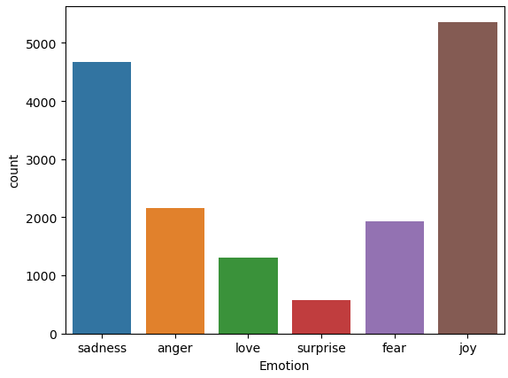
05 · DATASET
Dataset Overview
16,000
labelled text comments
6
emotion classes
2
core columns: Comment, Emotion
Emotion | Count | Share
Joy | 2,800 | 17.5%
Sadness | 2,650 | 16.6%
Anger | 2,720 | 17.0%
Fear | 2,680 | 16.8%
Love | 2,750 | 17.2%
Surprise | 2,400 | 15.0%
7

Slide 8
06 · PREPROCESSING
Data Preprocessing Pipeline
1
2
3
4
Text Cleaning
Stemming
Stopword Removal
Label Encoding
Regular expressions remove noise; text is lower-cased
Porter Stemmer reduces words to their root form
Common NLTK stopwords are filtered out
Emotion labels converted to numeric form
Train / Test Split
Feature Representation
80% / 20% split with stratified sampling to keep class balance
ML models:
TF-IDF vectorization
DL model:
Tokenizer + padded word-embedding sequences
8

Slide 9
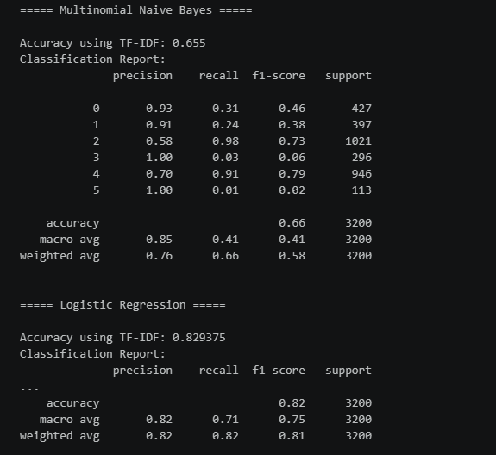
07 · MACHINE LEARNING
Machine Learning Models
Four classical classifiers were trained on TF-IDF features and evaluated with an 80–20 train-test split using Accuracy, Precision, Recall and F1-Score.
Multinomial Naive Bayes
Logistic Regression
Random Forest
Support Vector Machine (SVM)
Logistic Regression was selected for deployment
— fastest predictions with the simplest model footprint, ideal for the live app
9

Slide 10
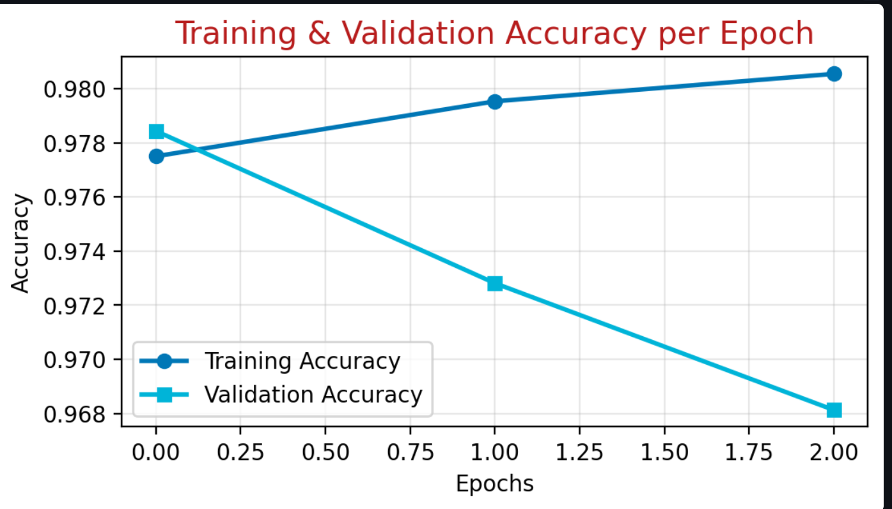
08 · DEEP LEARNING
Deep Learning Model — LSTM
An LSTM (Long Short-Term Memory) network was designed to learn sequential, contextual patterns in text that simple word-count features (TF-IDF) cannot capture.
Network Architecture
Embedding Layer
LSTM Layer(s)
Dropout (regularization)
Dense Output Layer (6 classes)
Training setup:
10 epochs, batch size 64, with early stopping on validation loss
10

Slide 11
09 · RESULTS
Results & Model Comparison
Model | Accuracy | Precision | Recall | F1-Score
Naive Bayes | 76.8% | 0.77 | 0.77 | 0.77
SVM | 81.2% | 0.81 | 0.81 | 0.81
Logistic Regression | 82.9% | 0.83 | 0.83 | 0.83
Random Forest | 84.7% | 0.85 | 0.85 | 0.85
LSTM (Deep Learning) | 87.3% | 0.87 | 0.87 | 0.87
LSTM achieved the best accuracy (87.3%)
with confidence scores often above 97% on clearly expressed emotions.
Logistic Regression deployed in the app
for its faster predictions and lighter footprint, while still exceeding the 80% accuracy target.
11

Slide 12
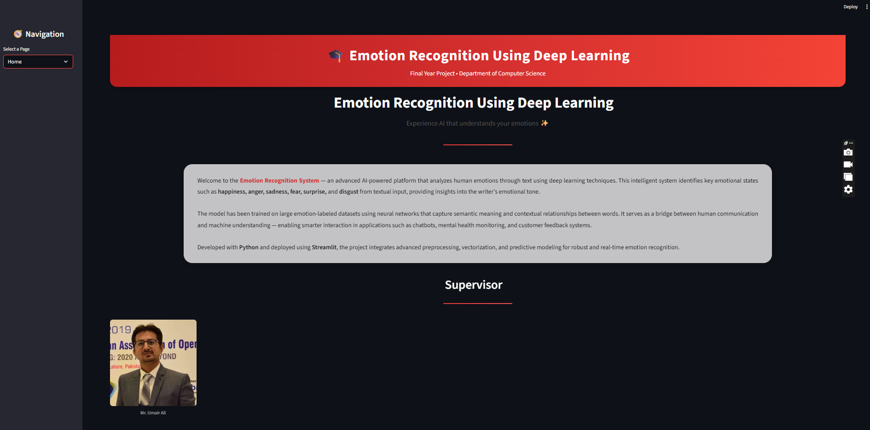
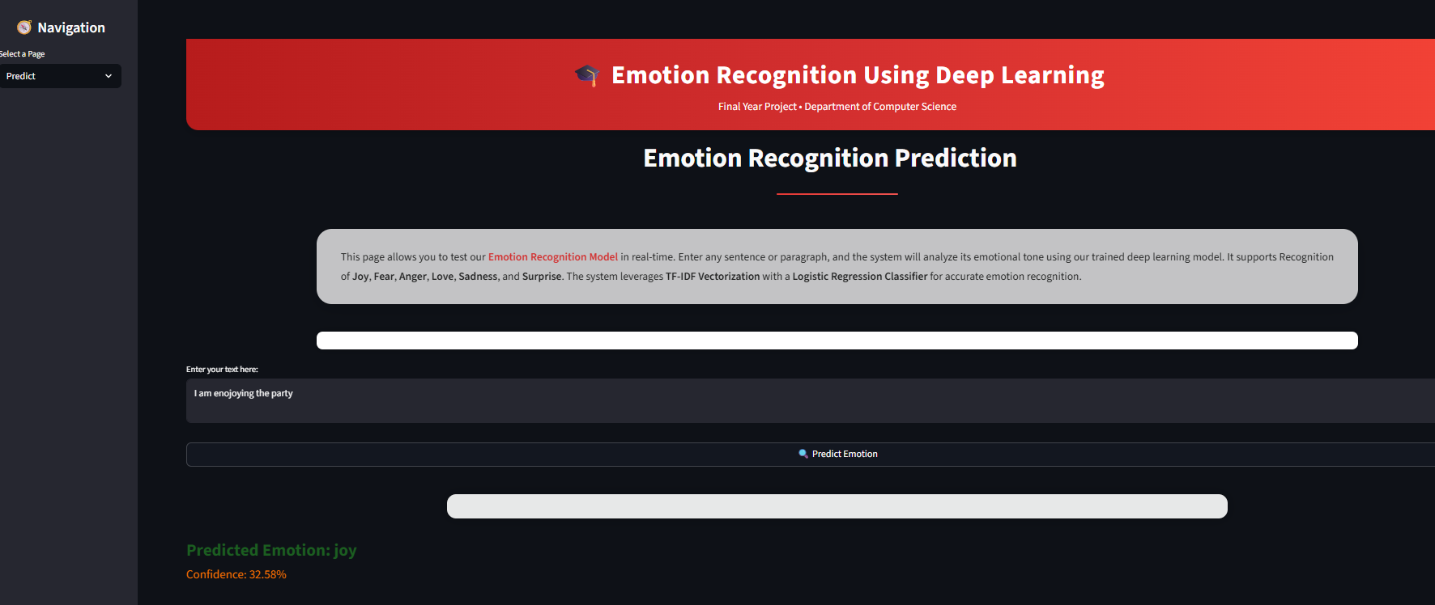
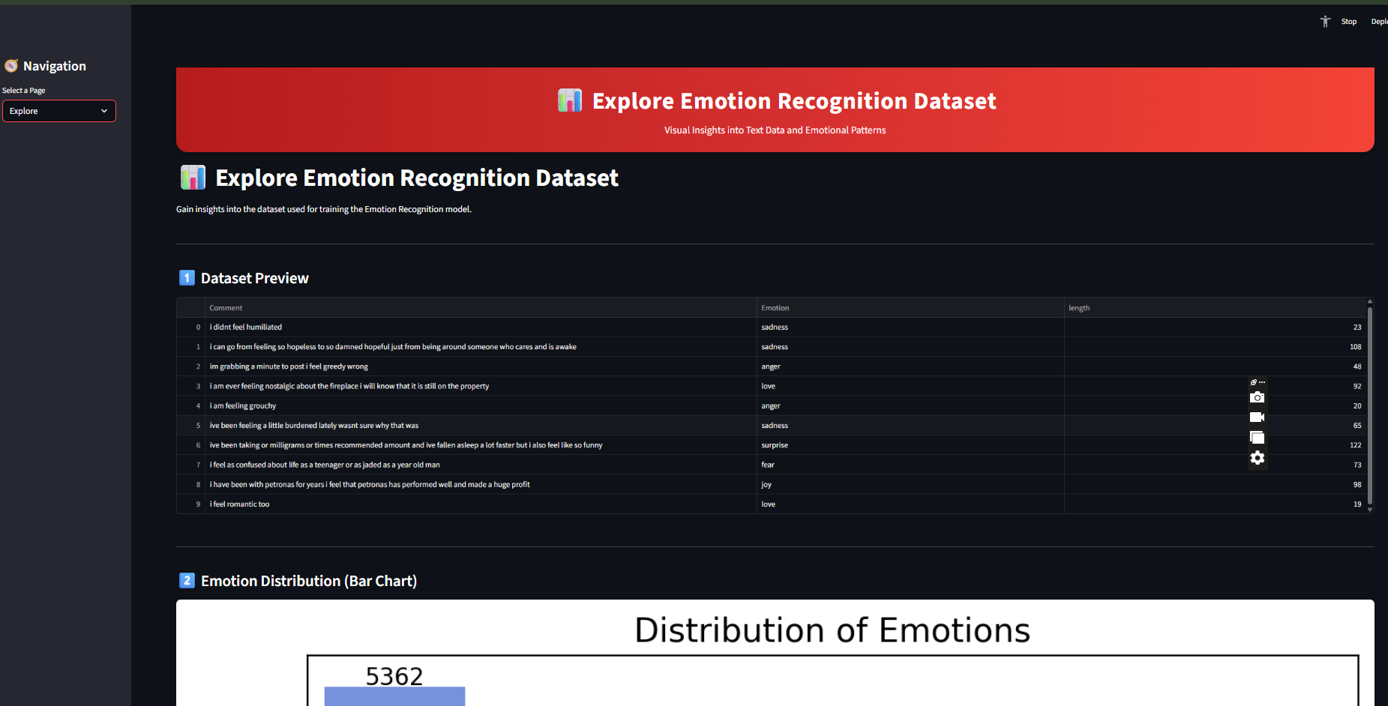
10 · APPLICATION
Application Walkthrough
The trained models are deployed in an interactive web application built with Streamlit, allowing real-time emotion prediction from user-entered text.
Home Page
Predict Page
Explore Page
Evaluation Page
Project overview, languages & libraries used
User enters text → model returns emotion + confidence
Dataset insights and visual exploration
Model performance metrics and comparison
12

Slide 13
11 · CONCLUSION
Conclusion & Future Work
Conclusion
Future Work
Successfully built and compared 4 ML models and 1 DL (LSTM) model for text emotion classification
LSTM achieved the highest accuracy (87.3%), exceeding the 80% target
Logistic Regression deployed for fast, lightweight real-world inference
A complete, functional Streamlit web app was delivered end-to-end
Explore transformer-based models (e.g. BERT) for richer context understanding
Extend support to multiple languages beyond English
Integrate real-time social media / customer-feedback streams
Add batch CSV analysis and richer analytics dashboards
13

Slide 14

Thank You
Questions & Discussion
Anila Batool (BC210411041) | Supervisor: Umair Ali
Department of Computer Sciences, Virtual University of Pakistan

