Slide 1

DSA-3 · ADVANCED ALGORITHMS
TradeOptima – An Optimal Trading platform
An Algorithmic Trading Platform Spanning the Advanced-Algorithm Canon
String Search · Dynamic Programming · Network Flow · NP-Hard Approximation · Randomized Algorithms
V. Rohan | 2520030558
J. Satyan | 2520030088
K. Shankar | 2520030063
Team: 2 | Course: [25CS2103E/ Section - 3]

Slide 2

PROJECT OVERVIEW
Abstract
A real trading platform is never a single-algorithm system. It needs fast search over tickers and news, optimal decisions under trading constraints, efficient order routing across venues, smart selection under a budget, and realistic risk simulation.
TradeOptima is a single trading platform, built across five subsystems: a string-algorithm ticker/news search engine, a dynamic-programming core that optimizes constrained multi-trade profit under trade limits, fees, and cooldowns, a network-flow order router for cross-venue liquidity matching, an NP-hard portfolio selector solved via approximation under a budget constraint, and a randomized risk engine using Monte Carlo simulation.
One Platform,
Five Algorithm Families
5 subsystems
DP core + 4 supporting engines
< 2 s
core DP optimizer runtime at max scale

Slide 3



Problem Statement
Design and implement optimal trading platform, a modular algorithmic-trading platform spanning five advanced-algorithm families: fuzzy ticker/news search (string algorithms), constrained multi-trade profit optimization (dynamic programming), cross-venue order routing (network flow), budget-constrained portfolio selection (NP-hard approximation), and Monte Carlo risk simulation (randomized algorithms) — each hand-built, since the linear and tree/graph algorithms from DSA-1/DSA-2 cannot solve sub-quadratic search, optimal constrained sequencing, or capacity-constrained routing.
Input
Output
Constraints
Price history, trade limits, fee & cooldown
Ticker/news corpus, venue order books
Candidate assets + budget
Buy/Sell/Hold trade ledger
Routed order plan + matched venues
Selected portfolio + risk estimate
Core DP: N ≤ 10⁵, k ≤ 1000, < 2 s
No java.util across all subsystems
Each subsystem independently tested

Slide 4




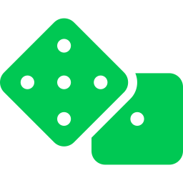
Proposed Implementations
Module 2 — Ticker & News Search
KMP, Z-function & Aho-Corasick for exact and multi-pattern search across tickers and news feeds.
Module 3 — Constrained Trade Optimizer (Core)
State-machine DP over Idle / Holding / Cooldown computes max profit under k trades, fees & cooldown, then backtracks to a full trade ledger.
Module 4 — Cross-Venue Order Router
Min-cost max-flow and bipartite matching route orders across exchanges for best execution price.
Module 5 — Budget-Constrained Portfolio Selector
Knapsack-style NP-hard asset selection solved via an approximation algorithm with a provable ratio guarantee.
Module 6 — Monte Carlo Risk Engine
Randomized Value-at-Risk simulation and reservoir sampling over streaming price data.

Slide 5

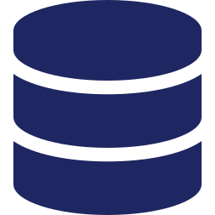




IMPLEMENTATION STACK
Tools & Technologies
Java
Market Data
JUnit 5
Hand-built algorithms & data structures — no java.util
Historical price series, order-book & news data feeds
Unit tests per subsystem, incl. randomized-algorithm checks
Git
GitHub
Javadoc
Version control for five parallel subsystem modules
Repository hosting and team collaboration
API documentation and per-subsystem design notes

Slide 6

EXPECTED OUTCOME
Five Algorithms, One Trading Platform
< 2 s
100%
Core DP optimizer runtime at
N = 10⁵ prices, k = 1000 trades
Core-optimizer ledger matches
brute-force reference on small inputs
TradeOptima delivers a single, working Java platform spanning ticker/news search, constrained trade optimization, cross-venue order routing, budget-constrained portfolio selection, and Monte Carlo risk simulation — demonstrating command of every advanced-algorithm family in the DSA-3 canon, hand-built end to end.

