Slide 1
KLH UNIVERSITY • BOWRAMPET CAMPUS, HYDERABAD
Department of Computer Science & Engineering
Used Car Price Estimator
Predicting fair market value of pre-owned vehicles using regression-based machine learning
PRESENTED BY
UNDER THE GUIDANCE OF
2520030314 B Rishik
2520030558 Rohan V
2520030618 M Nityay
Dr. G. S. Raghavendra Sir
Department of CSE
KLH University, Bowrampet Campus
B.Tech II Year | Minor Project - Review 1 | Academic Year 2026-27 | Date: 13-10-2026
Notes:
About 30 seconds: greet the panel, state the title, introduce the three team members and the guide, Dr. G. S. Raghavendra. Do not read the slide word for word.

Slide 2
AGENDA
Contents
1
Introduction & Domain Background
7
Methodology & Modules
2
Problem Statement & Motivation
8
Tools and Technologies
3
Literature Survey
9
Work Completed / Demo
4
Research Gap Identified
10
Timeline & Review Plan
5
Objectives of the Project
11
Expected Outcome & Conclusion
6
Proposed System Architecture
12
References
Dept. of CSE | KLH University, Bowrampet Campus
2
Notes:
Keep the agenda brief. Spend the most time on the literature survey, objectives and work completed.

Slide 3
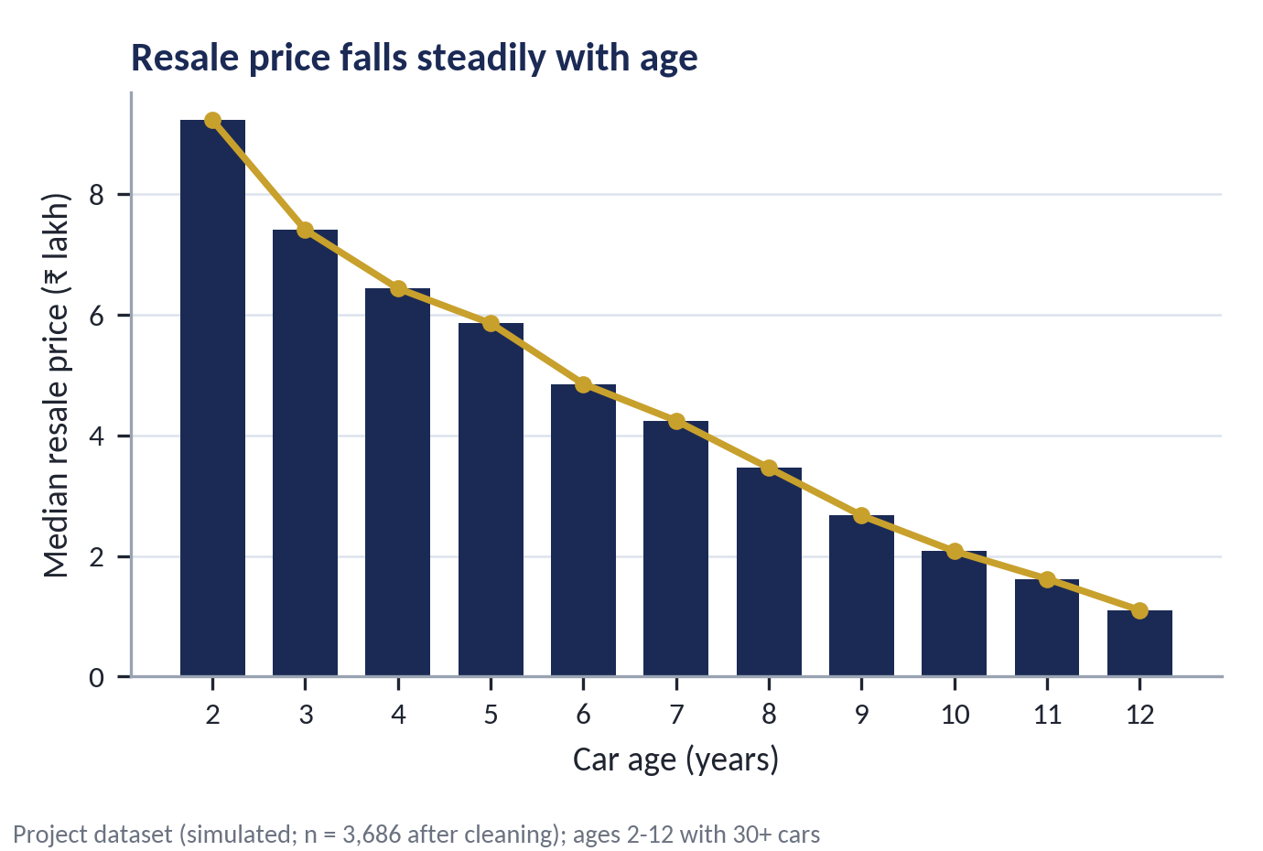
SECTION 1
Introduction & Domain Background
What is the domain?
Used-car valuation is a supervised regression task: predict a resale price from age, mileage, brand, engine specification, fuel, transmission and ownership.
Why is it relevant today?
India's used-car market was valued at USD 24.24 billion in 2019, with a forecast growth of about 15% a year [1].
Where does your project sit?
We train and compare three regressors to estimate a fair resale price for Indian cars and serve it as a web app and REST API.
Our approach
Three regressors on a multi-brand dataset; the best one (Gradient Boosting, R² 98.02%) is served through a web app and REST API.
Dept. of CSE | KLH University, Bowrampet Campus
3
Notes:
Start broad (used-car valuation), end narrow (our regression task). The market figure comes from reference [1]. The chart is drawn from our own dataset, which is simulated, so it illustrates depreciation and is not real market data.

Slide 4
SECTION 2
Problem Statement & Motivation
PROBLEM STATEMENT
“Existing used-car pricing fails to give a fair, data-driven valuation because it depends on subjective dealer markups and rule-of-thumb appraisal, which results in overpriced listings, low-ball offers and unfair deals.”
1
2
3
Who is affected?
What is the cost of the problem?
Why solve it now?
Used-car buyers, sellers, dealers and online marketplaces in India - anyone who needs a trustworthy resale price before negotiating.
A car loses about 20% of its value every year [1], so a mispriced listing can swing a deal by a full year of depreciation; manual appraisal is slow and does not scale online.
Online platforms price cars with differing algorithms and can give inconsistent results [1], and recent studies rely on small or single-city data [1]-[4].
Dept. of CSE | KLH University, Bowrampet Campus
4
Notes:
One-sentence problem statement. Beneficiaries: buyers, sellers, dealers, platforms. Cost: about 20% depreciation per year [1]. Why now: inconsistent platform pricing and small-data studies.

Slide 5
SECTION 3
Literature Survey
Four of the most relevant papers on used-car price prediction (2021 onward); full citations on slide 14.
S.No | Author & Year | Title / Technique Used | Dataset / Tools | Key Findings | Limitation / Gap
1 | Longani et al. (2021) [1] | Used-car price prediction with Random Forest vs XGBoost | Mumbai listings (2,454 records); Python, scikit-learn, Flask | XGBoost RMSE 0.53 vs Random Forest 3.44 | Single city; only two models compared; no linear baseline
2 | Bhatnagar et al. (2024) [2] | Voting, Gradient Boosting, RF, Decision Tree, SVR and Linear Regression; GridSearchCV | 200+ cars, 26 parameters | Test accuracy: RF 89.75%, GB 88.67% | Tiny dataset; GB falls from 97.84% (train) to 88.67% (test)
3 | Lin (2024) [3] | Linear, Ridge and Random Forest regression with RandomizedSearchCV | CarDekho listings (India); pandas, scikit-learn | RF best of three models (80/20 split) | Small sample, possible overfitting; no boosting model tested
4 | Wang (2024) [4] | Linear, Decision Tree, RF and XGBoost with cross-validation | Kaggle Ford data: 17,966 entries, 9 features | XGBoost best, R² = 0.9347 | Covers one brand (Ford) only
Common gap: small or single-source data, limited validation and no ready-to-use estimator - see Research Gap.
Dept. of CSE | KLH University, Bowrampet Campus
5
Notes:
Do not read the table. Trend: Random Forest and boosting models win, but the studies use small or single-city data, show overfitting, and mostly stop at metrics. Be ready to name other papers surveyed.

Slide 6
SECTION 4
Research Gap Identified
GAP 1
OUR PROJECT ADDRESSES
Data-level gap: existing work uses small or single-source data - one city, one brand or about 200 cars [1], [2], [4] - so it does not generalise to a multi-brand Indian market.
Closes all three: 10-brand data (3,686 records), three models with feature importance, and a live web app + REST API.
GAP 2
Method-level gap: existing models are validated on limited data and show overfitting (train 97.84% vs test 88.67% in [2]; small sample in [3]).
GAP 3
Note: our dataset is simulated on Indian-market patterns (generate_dataset.py); validation on real listings is the next step.
Deployment gap: most surveyed work ends at model comparison ([2]-[4] report metrics only); [1] offers a Mumbai-only web UI.
Each gap above is traced to the Limitation / Gap column of the literature survey on slide 5.
Dept. of CSE | KLH University, Bowrampet Campus
6
Notes:
Each gap maps to the last column of the survey table. Be ready for the question about the simulated dataset: say it was generated on Indian-market patterns and that validation on real listings is the next step.

Slide 7
SECTION 5
Objectives of the Project
Four demonstrable objectives - each one is matched to a module (slide 9) and a result (slide 11).
To prepare a multi-brand Indian used-car dataset (3,825 simulated listings, 12 attributes), cleaned to 3,686 records with an 80/20 train-test split.
1
To design & implement a scikit-learn pipeline (car_age, km_per_year, power_per_liter features) with Linear, Random Forest and Gradient Boosting regressors.
2
To evaluate the models using R², MAE and RMSE against a target of R² above 85% and response under 1 s, and to report feature importance.
3
To deploy a Flask web app and REST API (/api/predict) that return an instant price estimate with a fair negotiation band.
4
Result check: R² 98.02%, MAE ₹0.37 L and < 15 ms latency in the current build.
Dept. of CSE | KLH University, Bowrampet Campus
7
Notes:
Objectives and results match one-to-one: dataset of 3,686 cleaned records; pipeline with three regressors; R² 98.02% and MAE 0.37 lakh; Flask web app and REST API.

Slide 8
SECTION 6
Proposed System Architecture
INPUT
PRE-PROCESSING
CORE MODULE
OUTPUT
Web form or JSON request: brand, model, year, km driven, fuel, transmission, owner, engine, power, mileage, seats
Impute gaps; derive car_age, km_per_year, power_per_liter; scale numerics and one-hot encode categories
Gradient Boosting Regressor (best of Linear, Random Forest and Gradient Boosting)
Fair price in ₹ lakhs with a ±5% band, insights and latency shown in the UI
DATA FLOW - what travels along each arrow
Arrow 1 (Input to Pre-processing): vehicle record - 11 fields as form values or a JSON request.
Arrow 2 (Pre-processing to Core): 13 engineered features - scaled numerics plus one-hot encoded categories.
Arrow 3 (Core to Output): predicted price in ₹ lakhs, returned as JSON with a ±5% fair band.
Training vs. inference
Offline: used_cars.csv, train_model.py, then best_model.joblib (Gradient Boosting pipeline). Online: Flask /api/predict loads the pipeline and answers in < 15 ms.
Dept. of CSE | KLH University, Bowrampet Campus
8
Notes:
Walk left to right: input form or JSON, pre-processing, Gradient Boosting, price band in the UI. The box below names what flows on each arrow. Keep this slide open during questions.

Slide 9
SECTION 7
Methodology & Modules
1
Module 1 - Data
2
Module 2 - Processing
used_cars.csv: 3,825 raw listings (10 brands, 47 models, 12 attributes) simulated on Indian marketplace patterns. 3,686 records after cleaning; 80/20 split = 2,948 train / 738 test.
Remove duplicates, median-impute gaps, trim outliers (1st-99th percentile). Derive car_age, km_per_year, power_per_liter; scale and one-hot encode inside a scikit-learn Pipeline [5].
3
Module 3 - Core Logic
4
Module 4 - Interface
Linear Regression [6], Random Forest [7] and Gradient Boosting [8] compared. Gradient Boosting was chosen for the lowest error (R² 98.02%, MAE ₹0.37 L).
Flask back end serves the saved joblib pipeline at /api/predict; HTML/CSS/JS front end with Chart.js, 1-click presets and a live API tester. Run: python app.py.
Dept. of CSE | KLH University, Bowrampet Campus
9
Notes:
Four modules let each team member explain their own part: data, processing, core model, interface.

Slide 10
SECTION 8
Tools and Technologies
SOFTWARE
HARDWARE / PLATFORM
Language: Python 3.10+
Libraries: scikit-learn, pandas, NumPy, joblib
Front end: HTML, CSS, JavaScript, Chart.js
Back end: Flask (REST API at /api/predict)
Data store: CSV file (used_cars.csv)
Model store: joblib pipeline + JSON metadata
Processor: Intel i5 or above (CPU only)
RAM: 8 GB recommended
GPU / Cloud: not required (about 1 s to train a model)
Devices: none - runs in any web browser
Deployment: localhost (Flask, port 5001)
Version control: Git / GitHub
Dept. of CSE | KLH University, Bowrampet Campus
10
Notes:
Versions from requirements.txt: Flask 3.0+, scikit-learn 1.4+, pandas 2.2+, NumPy 1.26+, joblib 1.3+.

Slide 11
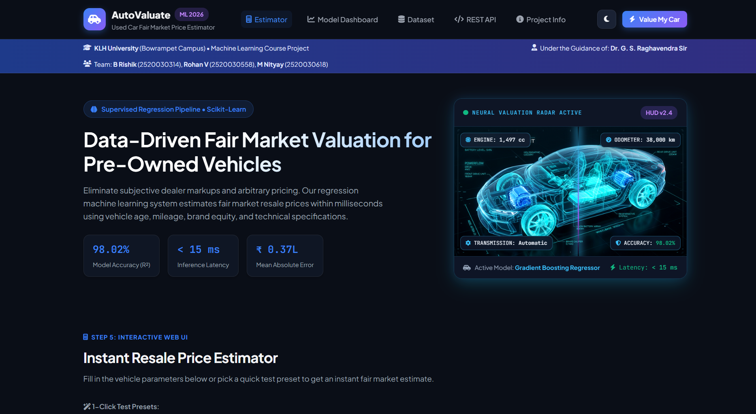
SECTION 9
Work Completed / Demo
Literature survey
Completed
Dataset collection
Completed
Pre-processing pipeline
Completed
Model training
Completed
User interface (Flask web app + API)
Completed
AutoValuate web UI running locally: Gradient Boosting, R² 98.02%, MAE ₹0.37 L, < 15 ms per prediction.
Testing & evaluation (real-data check)
In progress
Dept. of CSE | KLH University, Bowrampet Campus
11
Notes:
Live demo: run python app.py, open 127.0.0.1:5001, click the Hyundai Creta preset and show the price, the fair band and the latency. Be honest: the 98.02% R² is on a held-out 20% split (738 records) of a simulated dataset; real-data validation is still pending.

Slide 12
SECTION 10
Timeline & Review Plan
Review 0
Review 1
Review 2
Final
Week 2
Week 5
Week 9
Week 14
Title, abstract, team roles finalised
Literature survey, gap, objectives
Architecture frozen; tuning and real-data validation
Full demo, results, report, paper draft
Filled circles = completed reviews; hollow circles = upcoming reviews.
Plan for the remaining weeks: validate on real marketplace listings, add k-fold cross-validation and hyper-parameter tuning, deploy the app on a cloud host, then finalise the report and paper draft.
Dept. of CSE | KLH University, Bowrampet Campus
12
Notes:
Reviews 0 and 1 are complete. For the remaining weeks: real-data validation, cross-validation and tuning, cloud deployment, report and paper draft.

Slide 13
SECTION 11
Expected Outcome & Conclusion
DELIVERABLE
MEASURABLE TARGET
BEYOND THE LAB
A working web app and REST API that estimate a fair resale price, with a ±5% band, for Indian used cars
R² above 85% and response under 1 s. Achieved: R² 98.02%, MAE ₹0.37 L, latency < 15 ms
Buyers, sellers, dealers and online marketplaces; deployable on any Python-capable cloud host
CONCLUSION
Used-car prices in India are set by subjective markups because no standard, data-driven reference exists. The surveyed studies rely on small or single-city data and stop at model comparison, which leaves a gap for a multi-brand, deployable estimator. Our Gradient Boosting pipeline reaches R² 98.02% and serves a fair price band in under 15 ms through a Flask web app and REST API. Future scope: retrain on real marketplace listings and add accident-history and location features.
Dept. of CSE | KLH University, Bowrampet Campus
13
Notes:
Do not introduce anything new here. Restate the problem, the gap and what the system delivers.

Slide 14
SECTION 12
References
IEEE style, numbered in the order they are cited in the slides.
[1] C. Longani, S. P. Potharaju and S. Deore, "Price prediction for pre-owned cars using ensemble machine learning techniques," in Recent Trends in Intensive Computing, M. Rajesh et al., Eds. Amsterdam, The Netherlands: IOS Press, 2021, pp. 178-187, doi: 10.3233/APC210194.
[2] P. Bhatnagar, G. H. Lokesh, J. Shreyas, F. Flammini and S. Gautam, "An analysis of car price prediction using machine learning," in Proc. 9th Int. Conf. Machine Learning Technologies (ICMLT), Oslo, Norway, 2024, pp. 11-15, doi: 10.1145/3674029.3674032.
[3] J. Lin, "Predicting used car price based on machine learning," in Proc. 1st Int. Conf. E-commerce and Artificial Intelligence (ECAI), SciTePress, 2024, pp. 553-560, doi: 10.5220/0013270500004568.
[4] Y. Wang, "Price prediction of Ford cars applying multiple machine learning methods," in Proc. 1st Int. Conf. E-commerce and Artificial Intelligence (ECAI), SciTePress, 2024, pp. 280-285, doi: 10.5220/0013214800004568.
[5] F. Pedregosa et al., "Scikit-learn: Machine learning in Python," J. Mach. Learn. Res., vol. 12, pp. 2825-2830, 2011.
[6] T. Hastie, R. Tibshirani and J. Friedman, The Elements of Statistical Learning, 2nd ed. New York, NY, USA: Springer, 2009.
[7] L. Breiman, "Random forests," Machine Learning, vol. 45, no. 1, pp. 5-32, 2001.
[8] J. H. Friedman, "Greedy function approximation: A gradient boosting machine," Ann. Statist., vol. 29, no. 5, pp. 1189-1232, 2001.
References [1]-[4] are the surveyed papers (slide 5); [5]-[8] support the methodology (slide 9).
Dept. of CSE | KLH University, Bowrampet Campus
14
Notes:
References [1]-[4] are the surveyed papers; [5]-[8] support the methodology. All appear in the slides.

Slide 15
Thank You
Questions & Suggestions
Team: B Rishik | Rohan V | M Nityay Guide: Dr. G. S. Raghavendra Sir Dept. of CSE, KLH Bowrampet
Notes:
Keep the architecture slide open during questions - most panel questions point back to it.

