Slide 1

Basic Regression
By: Nur Rohman Widiyanto

Slide 2













Simple Explaination
$$500$$
Supervised Learning
Given the “Right answer” for example in the data
Regression Problem
Predict real-valued output
$$400$$
$$Price (y)$$
$$300$$
$$200$$
$$100$$
$$0$$
$$500$$
$$1000$$
$$1500$$
$$2000$$
$$2500$$
$$Size(x)$$

Slide 3
Problem
Build a Simple Linear Regression Model to predict sales based on the money spent on TV advertising.
Decide whether TV advertising is effective or not and if it is effective
How much money the company should spend on TV advertising to get a particular increase in sales.
Let’s inspect the datasets @Notebook #1 2_1_data_processing.ipynb →

Slide 4
From Scratch

Slide 5
Dataset understanding using Exploratory Data Analysis (EDA)
The goal is to understand our dataset.
EDA techniques can be divided into two types:
Numerical techniques
Graphical techniques
Let’s inspect the datasets @Notebook #2 2_1_data_processing.ipynb →

Slide 6
Take the Conclusion
Since there seems to be a linear relationship between TV advertising and sales.
We can build a linear regression model as our problem statement defines.
What do you do if you see a non-linear relationship between the two variables?
You cannot build a linear regression model.

Slide 7
Analyze the distribution of variables
Let’s inspect the datasets @Notebook #2 →
Histogram of TV Ad spending:
The distribution of TV Ad spending is symmetric.
The mean and median are approximately the same.
TV Ad spending follows a uniform distribution with a mean of 147.
The center is close to 150. The typical deviation in TV Ad spending from the mean is about 85.9 units.

Slide 8
Analyze the distribution of variables
Let’s inspect the datasets @Notebook #2 →
Histogram of sales:
The distribution of sales is single-peaked (unimodal) and symmetric.
The mean and median are approximately the same.
Sales approximately follow a normal distribution with a mean of 15.13.
The center is close to 16.
The typical deviation in sales from the mean is about 5.2 units.

Slide 9

Regression Model
Simple Linear Regression
$$hθ\left(x\right)= θ0+ θ1x1$$
$θ$₀ and $θ$₁: Model parameters
$hθ\left(x\right)$: Response variable
$x1$: Predictor

Slide 10
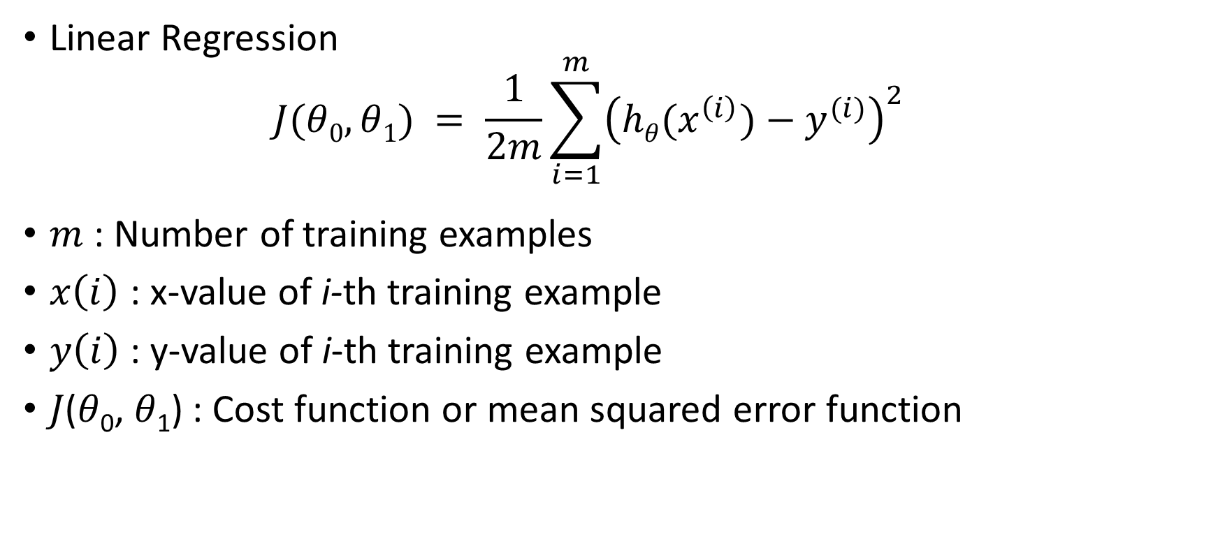
Cost Function
Linear Regression
$$J(θ0, θ1) = \frac{1}{2m}\sum_{i=1}^{m}{{\left(hθ(x^{\left(i\right)})−y^{(i)}\right)}^{2}}$$
$m$ : Number of training examples
$x\left(i\right)$ : x-value of i-th training example
$y\left(i\right)$ : y-value of i-th training example
𝐽(𝜃₀, 𝜃₁) : Cost function or mean squared error function

Slide 11

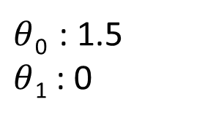

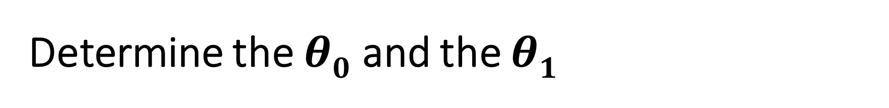

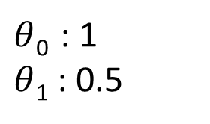
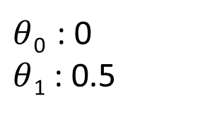
Determine the $θ0$ and the $θ1$
$$1$$
$$1$$
$$1$$
$θ$₀ : 1.5 $θ$₁ : 0
$θ$₀ : 0 $θ$₁ : 0.5
$θ$₀ : 1 $θ$₁ : 0.5
Code now @Notebook #1 2_2_linear_regression_gradient_descent.ipynb →

Slide 12
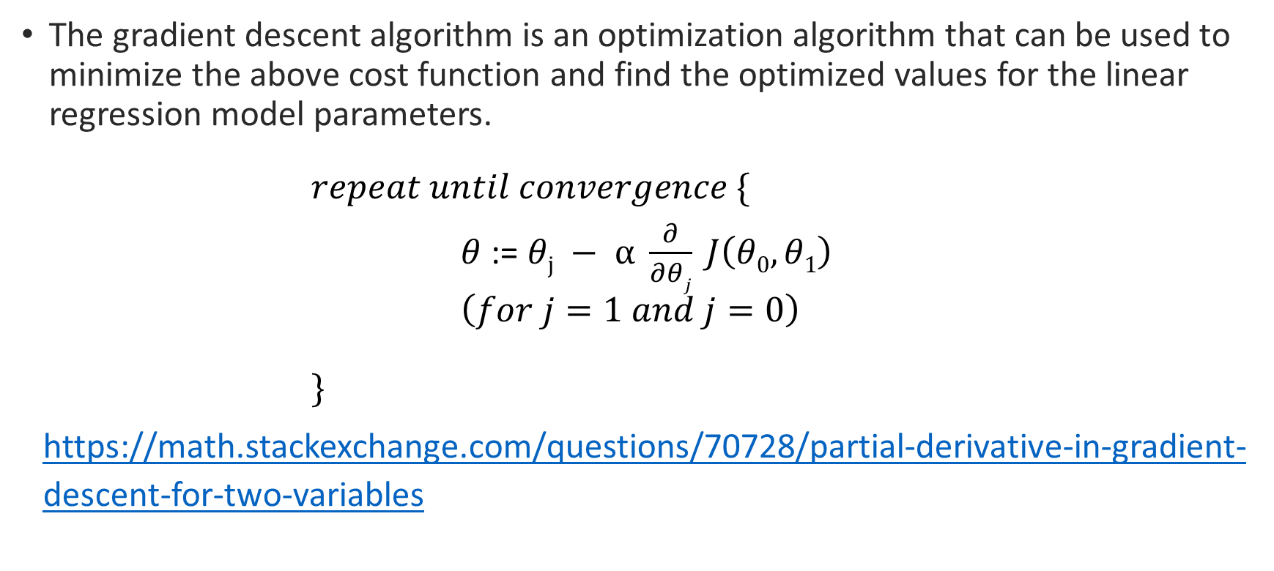
Gradient Descent
The gradient descent algorithm is an optimization algorithm that can be used to minimize the above cost function and find the optimized values for the linear regression model parameters.
$$repeat until convergence \{$$ $θ$ := $θj − α \frac{∂}{∂θj} J\left(θ0, θ1\right)$ $\left(for j=1 and j=0\right)$
$$\}$$
https://math.stackexchange.com/questions/70728/partial-derivative-in-gradient-descent-for-two-variables

Slide 13
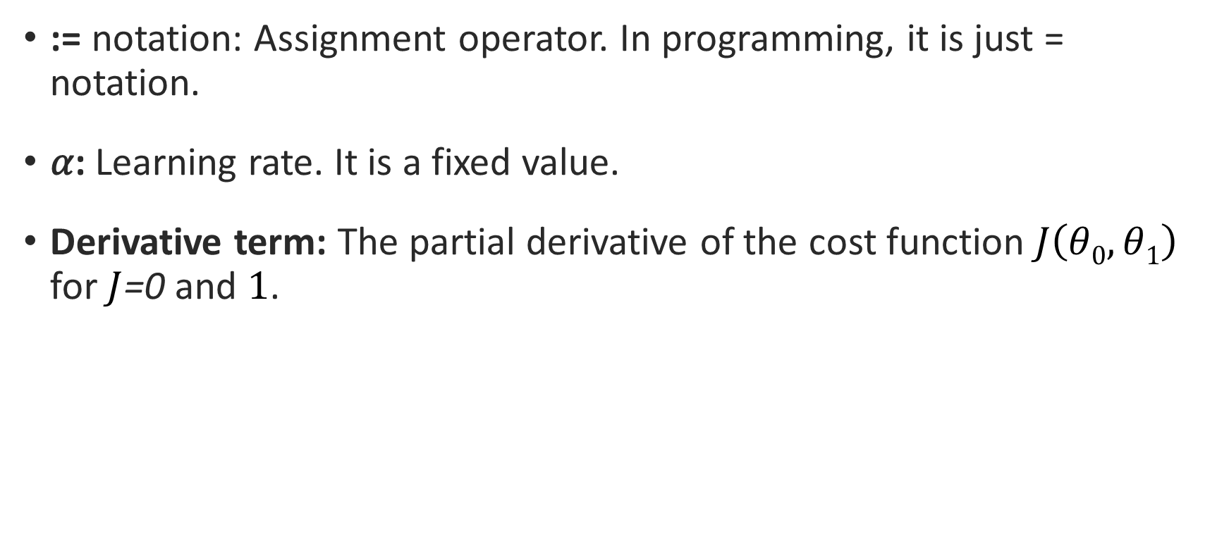
Gradient Descent
:= notation: Assignment operator. In programming, it is just = notation.
𝛼: Learning rate. It is a fixed value.
Derivative term: The partial derivative of the cost function $J\left(θ0, θ1\right)$ for $J$=0 and $1$.

Slide 14
Choosing 𝛼 (Learning rate)
α is too small, the gradient descent can be slow. It will require more iterations (hence time) to reach the minimum.
α is too large, the gradient descent can overshoot the minimum. In that case, it may fail to converge or even diverge.

Slide 15
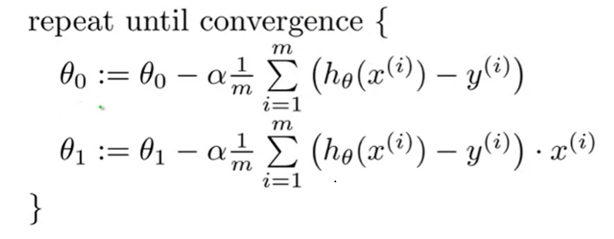
Gradient Descent
Code now @Notebook #2 2_2_linear_regression_gradient_descent.ipynb →

Slide 16
Plot the Convergence
Plot the result of Gradient Descent Process to search 𝜃₀ and 𝜃₁ as cost function or 𝐽(𝜃₀, 𝜃₁).
Let’s inspect the datasets @Notebook #3 2_2_linear_regression_gradient_descent.ipynb →

Slide 17
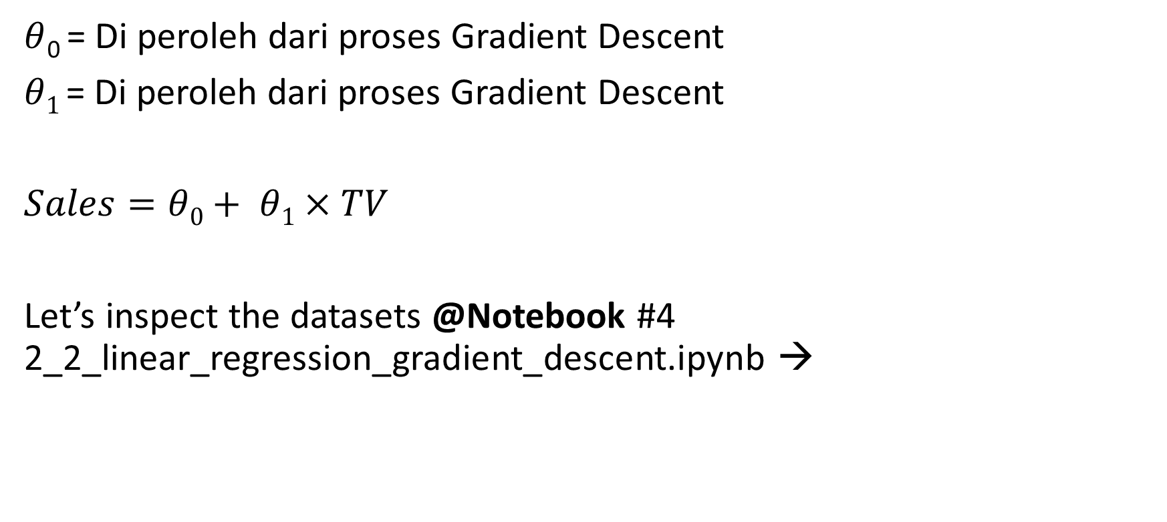
Train the Model
$θ$₀ = Di peroleh dari proses Gradient Descent
$θ1$ = Di peroleh dari proses Gradient Descent
$Sales=θ0+ θ1$ $×TV$
Let’s inspect the datasets @Notebook #4 2_2_linear_regression_gradient_descent.ipynb →

Slide 18
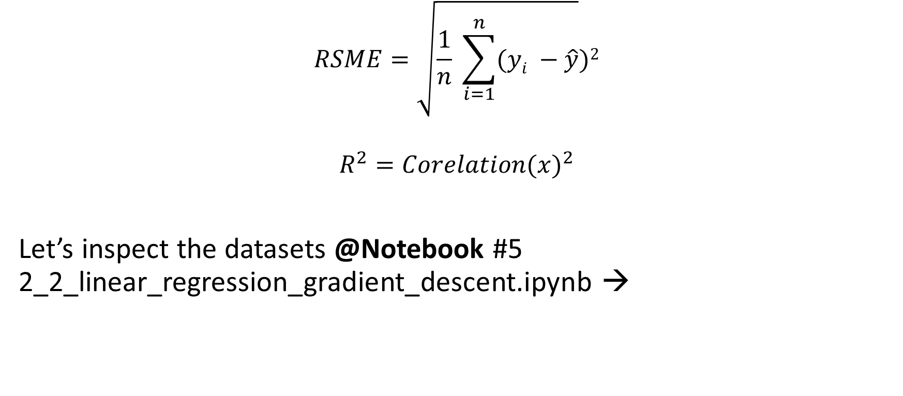
Evaluate the Model Performance
$$RSME=\sqrt{\frac{1}{n} \sum_{i=1}^{n}{(yi −\hat{y}}})2$$
$${R^{2}=Corelation(x)}^{2}$$
Let’s inspect the datasets @Notebook #5 2_2_linear_regression_gradient_descent.ipynb →

Slide 19
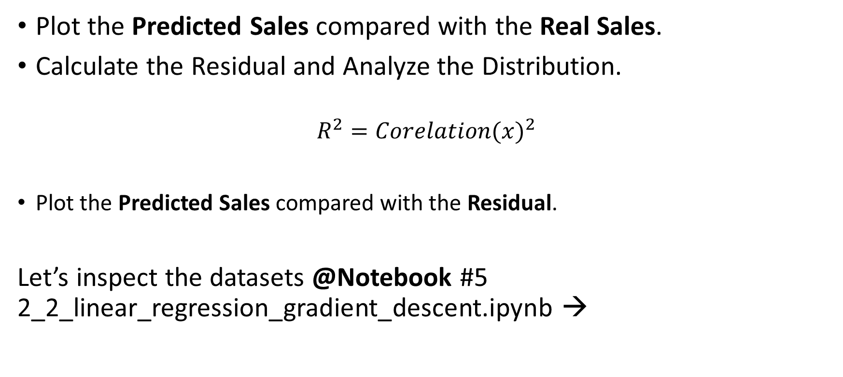
Evaluate the Model Performance
Plot the Predicted Sales compared with the Real Sales.
Calculate the Residual and Analyze the Distribution.
$${R^{2}=Corelation(x)}^{2}$$
Plot the Predicted Sales compared with the Residual.
Let’s inspect the datasets @Notebook #5 2_2_linear_regression_gradient_descent.ipynb →

Slide 20
With Scikit

Slide 21
Steps
Define x and y #1
Split the dataset into a Training Set and a Testing Set #2
Create and fit (train) the Model #3
Get the Gradient and Intercept of the Linear Regression Line #4
Make Predictions #5
Evaluate the Model Performance #6
Let’s inspect the datasets @Notebook 2_3_linear_regression_with_gradient_descent_with_scikit →

Slide 22
With Normal Equation

Slide 23
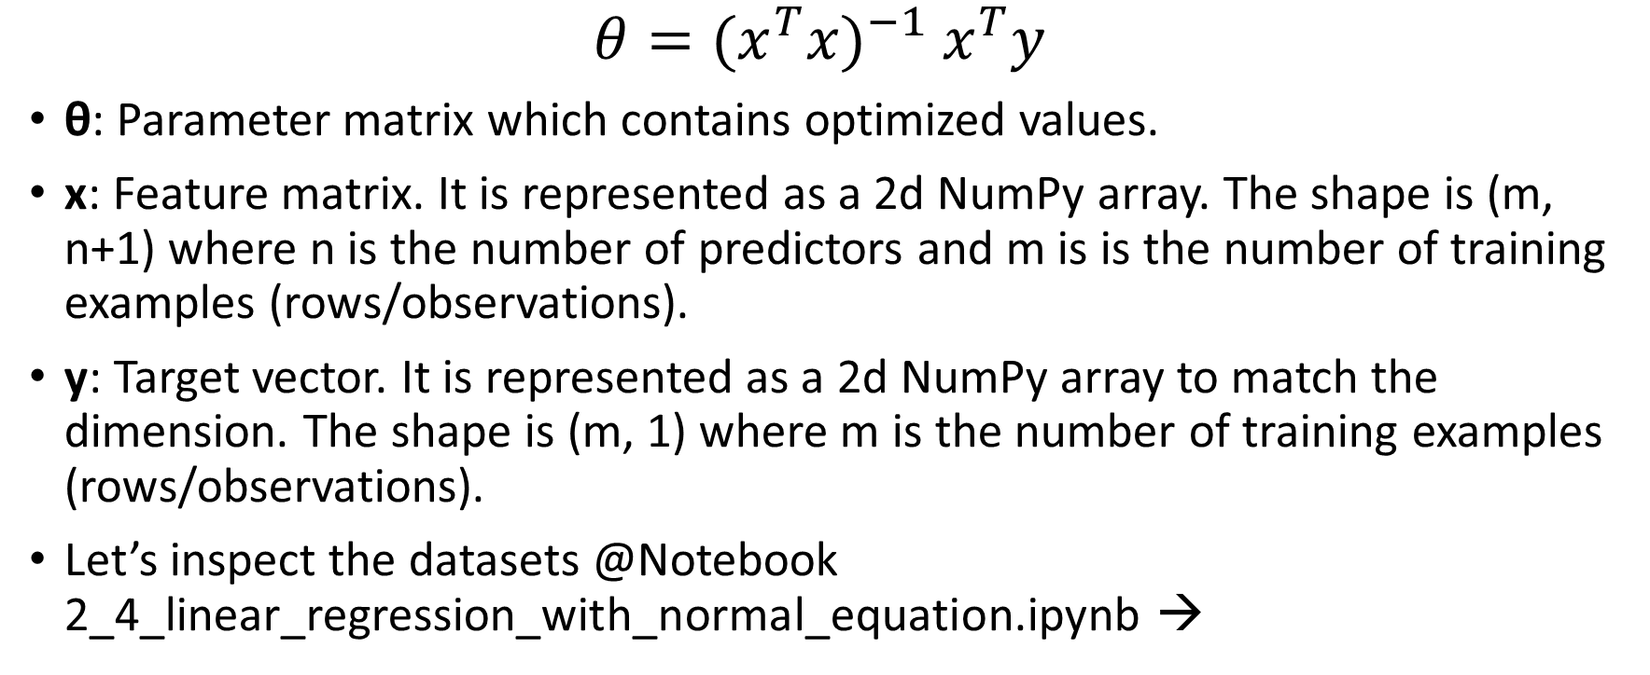
Steps
$$θ=({x^{T}x)}^{−1} x^{T}y$$
θ: Parameter matrix which contains optimized values.
x: Feature matrix. It is represented as a 2d NumPy array. The shape is (m, n+1) where n is the number of predictors and m is is the number of training examples (rows/observations).
y: Target vector. It is represented as a 2d NumPy array to match the dimension. The shape is (m, 1) where m is the number of training examples (rows/observations).
Let’s inspect the datasets @Notebook 2_4_linear_regression_with_normal_equation.ipynb →

Slide 24
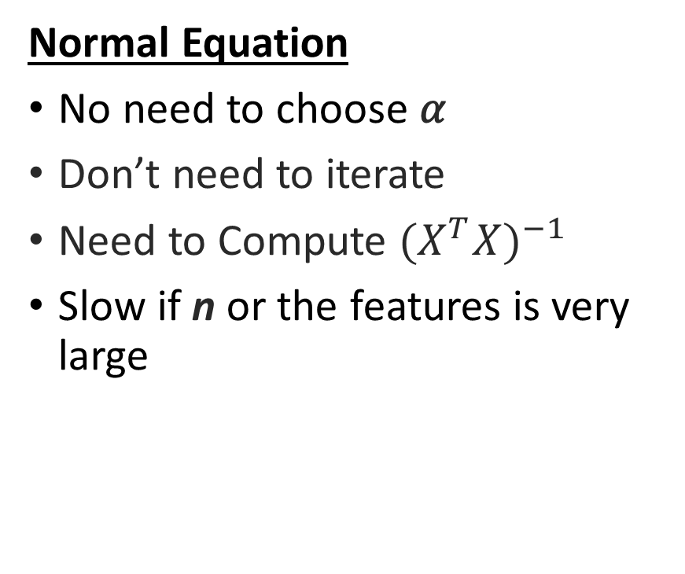
Gradient Descent vs Normal Equation
Gradient Descent
Need to choose 𝛼
Need many iterations
Works well even when n or the features is large
Normal Equation
No need to choose 𝛼
Don’t need to iterate
Need to Compute ${(X^{T}X)}^{−1}$
Slow if n or the features is very large

Slide 25
Advancing Regression
https://youtube.com/playlist?list=PLLssT5z_DsK-h9vYZkQkYNWcItqhlRJLN

Slide 26

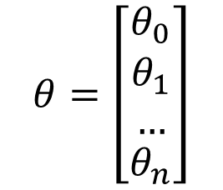
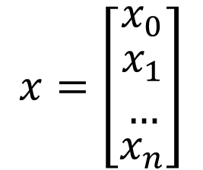
Gradient Descent with Multiple Features
$hθ\left(x\right)= θ0+ θ1x1+ θ2x2$ $+ …$ $+ θnxn$
$$x=\left[\begin{matrix}x_{0} \\ \begin{aligned}x_{1} \\ …\end{aligned} \\ x_{n}\end{matrix}\right]$$
$$θ=\left[\begin{matrix}θ_{0} \\ \begin{aligned}θ_{1} \\ …\end{aligned} \\ θ_{n}\end{matrix}\right]$$
$$hθ\left(x\right)= θ^{T}x$$

Slide 27


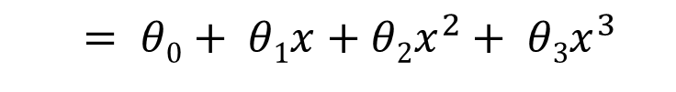
Polynominal Linear Regression
$$= θ0+ θ1x+θ2x^{2}$$
$$500$$
$$400$$
$$= θ0+ θ1x+θ2x^{2}+ θ3x^{3}$$
$$Price (y)$$
$$300$$
$$200$$
$$100$$
$$0$$
$$500$$
$$1000$$
$$1500$$
$$2000$$
$$2500$$
$$Size(x)$$
$hθ\left(x\right)= θ0+ θ1x1+ θ2x2$ $+ …$ $+ θnxn$
$$= θ0+ θ1x+θ2x^{2}+ θ3x^{3}$$

Slide 28

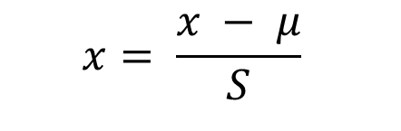
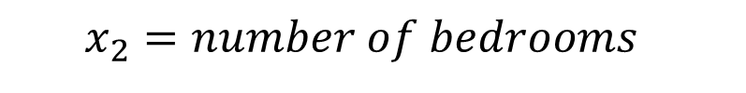
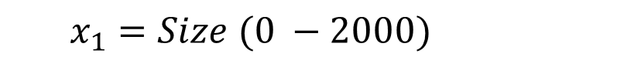
Feature Scaling
$$x_{1}=Size (0 −2000)$$
$$x_{2}=number of bedrooms$$
$$0 ≤x ≤1$$
Mean Normalization
$$x= \frac{x − μ}{S}$$

Slide 29
LATIHAN
@Notebook 2_1_data_processing_life_expectancy.ipynb →

