Slide 1
Toyota Branding Project
Trae Toelle
Digme137
12/12/2022

Slide 2
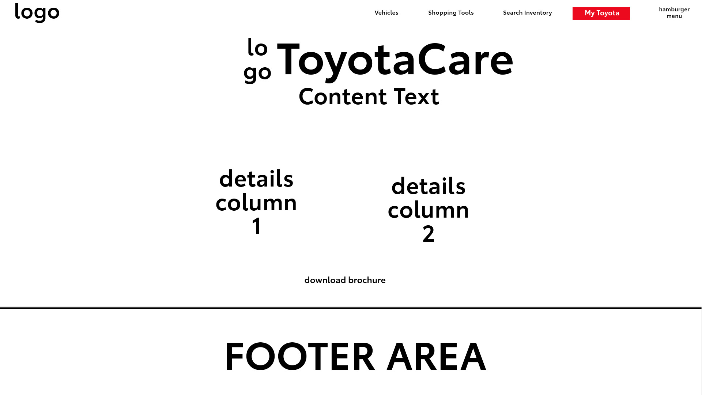
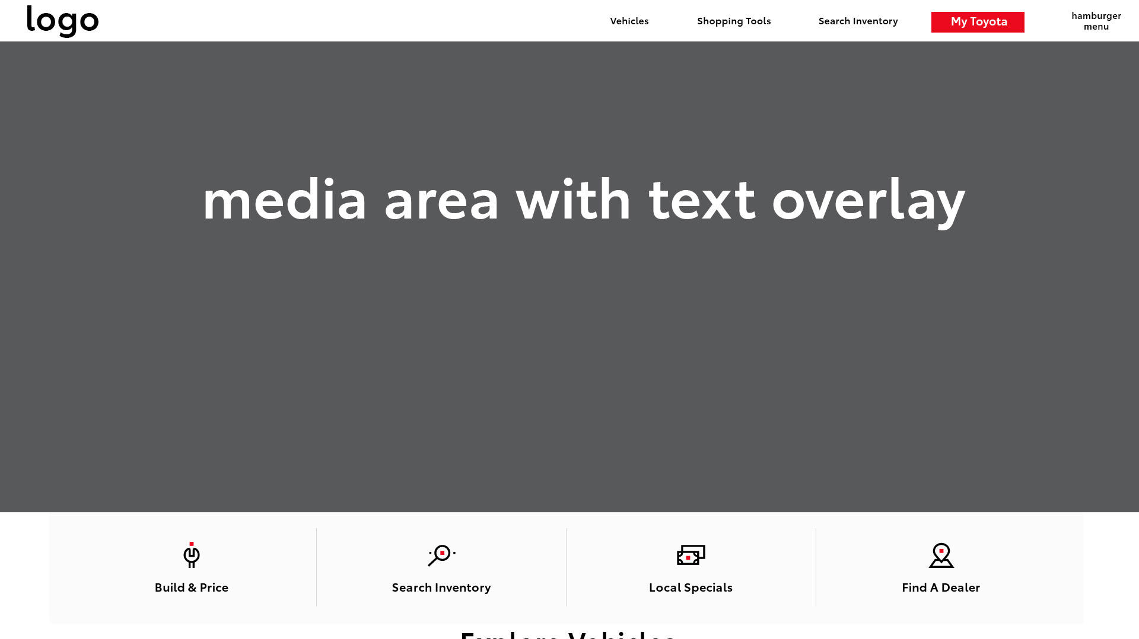
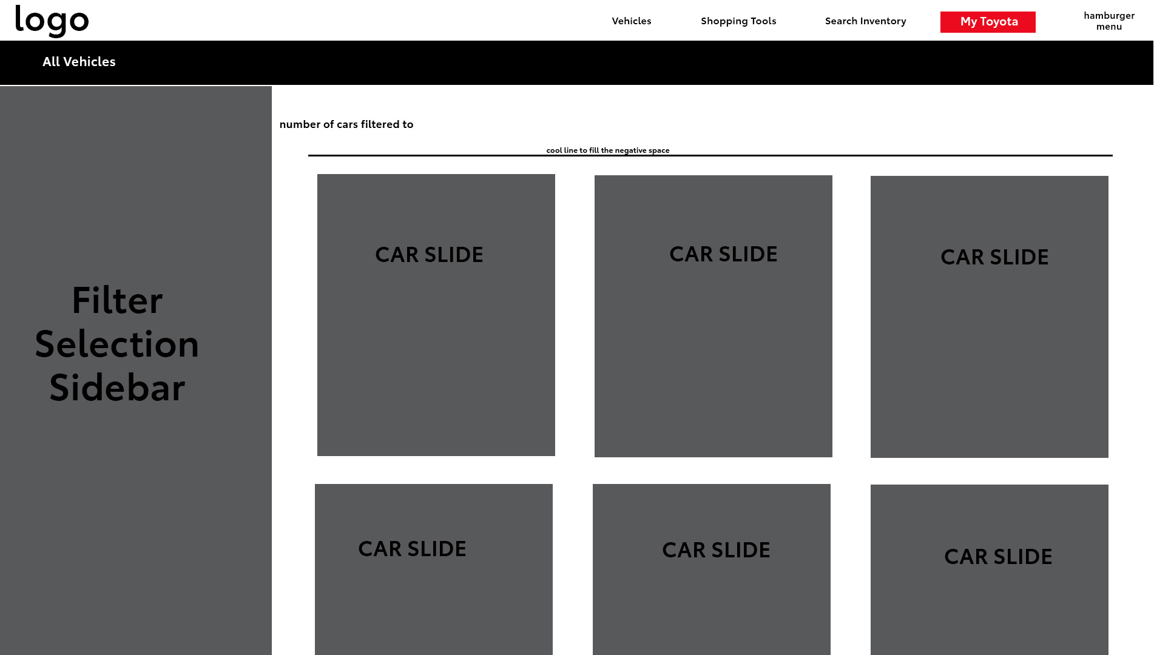
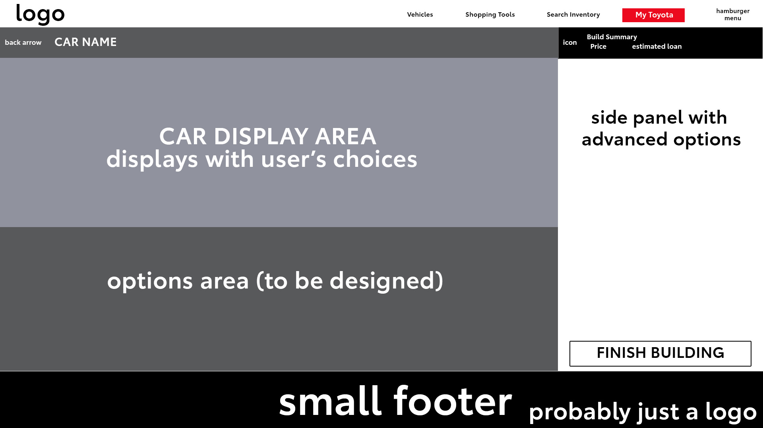
Planning
Planning wise, I looked a lot of other car manufacturers’ websites and tried to see what worked and what didn’t. I combined all of that with Toyota’s branding guidelines and what you’re about to see is that idea put forward.

Slide 3
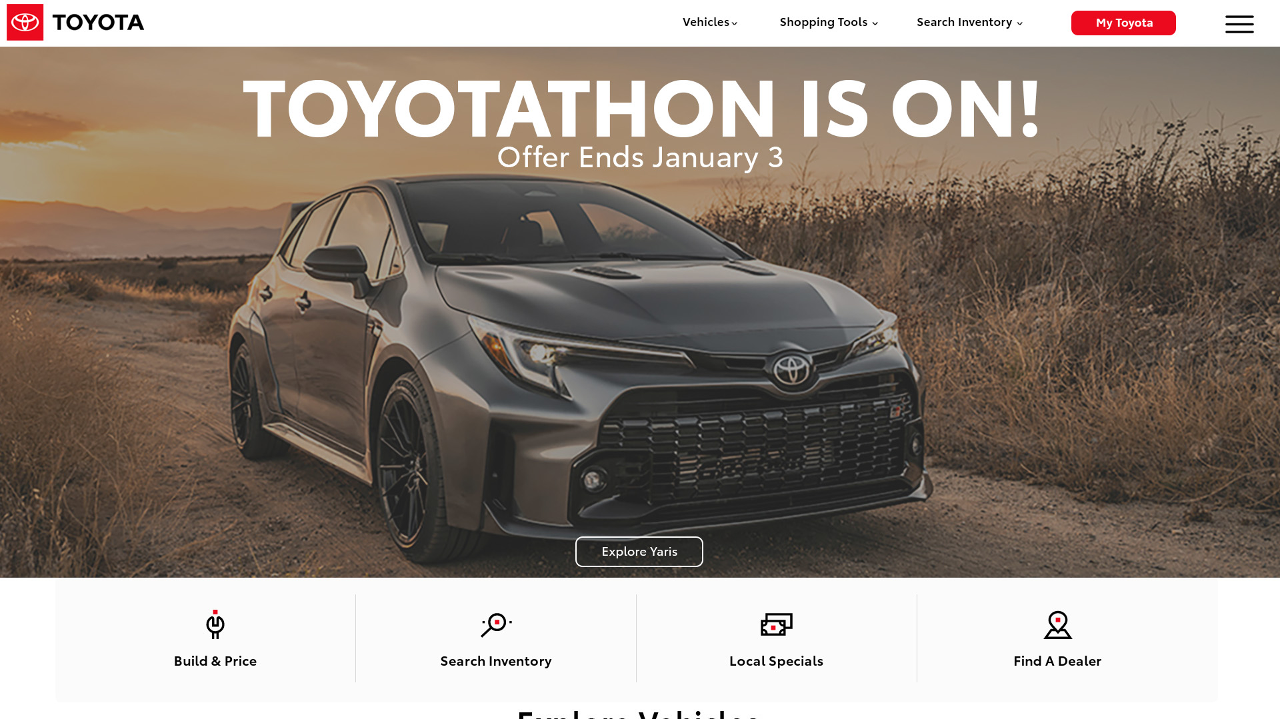
Website - Homepage
Notes:
This is the homepage of the website. I wanted to keep everything similar to the original website as that design is nice. I changed the media space here to remove the video. I also moved these icons here up and the vehicles below, that’s cut off down there. I also made the logo in the header a bit bigger and added a “My Toyota” button to the menu instead of having that hidden in the “hamburger menu”

Slide 4
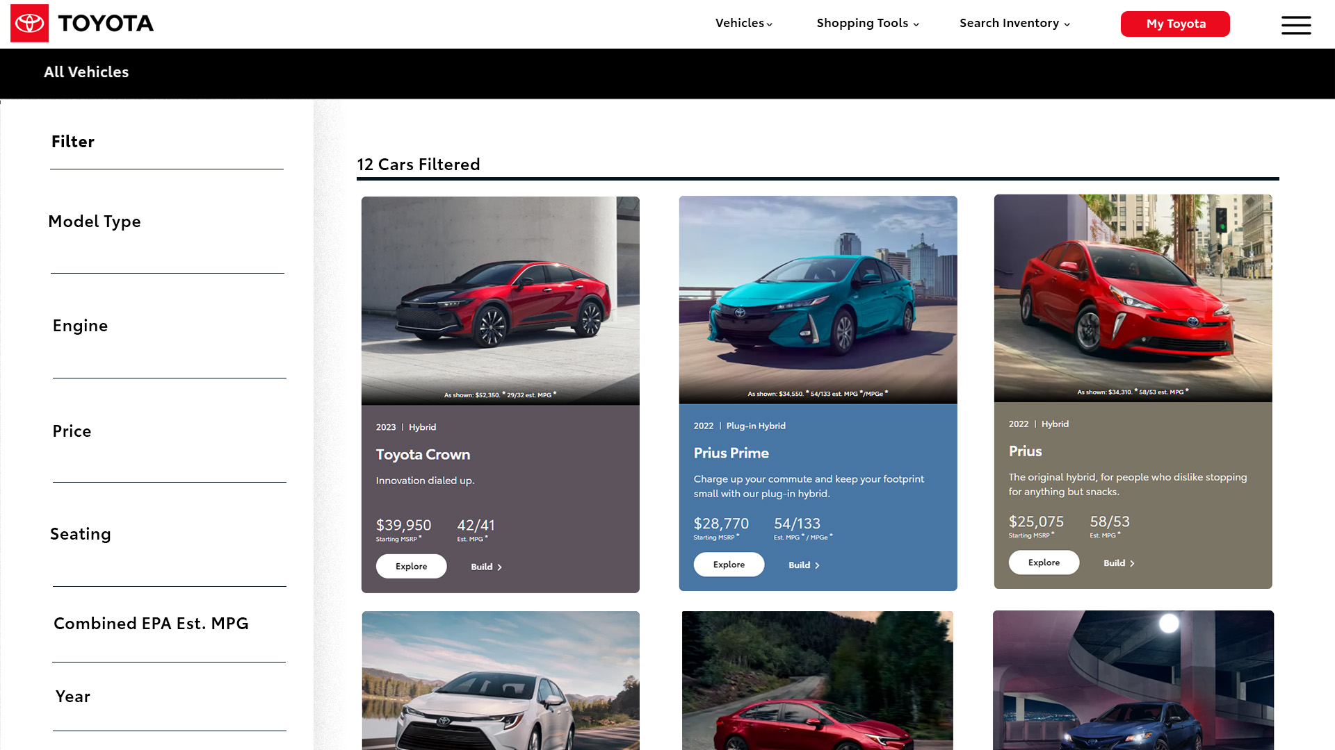
Website - Vehicles
Notes:
I completely changed this. I kept the header the same and changed this to look more like a marketplace that most customers are familiar with. I took the car slides from the homepage and built out the filtering on the side.

Slide 5
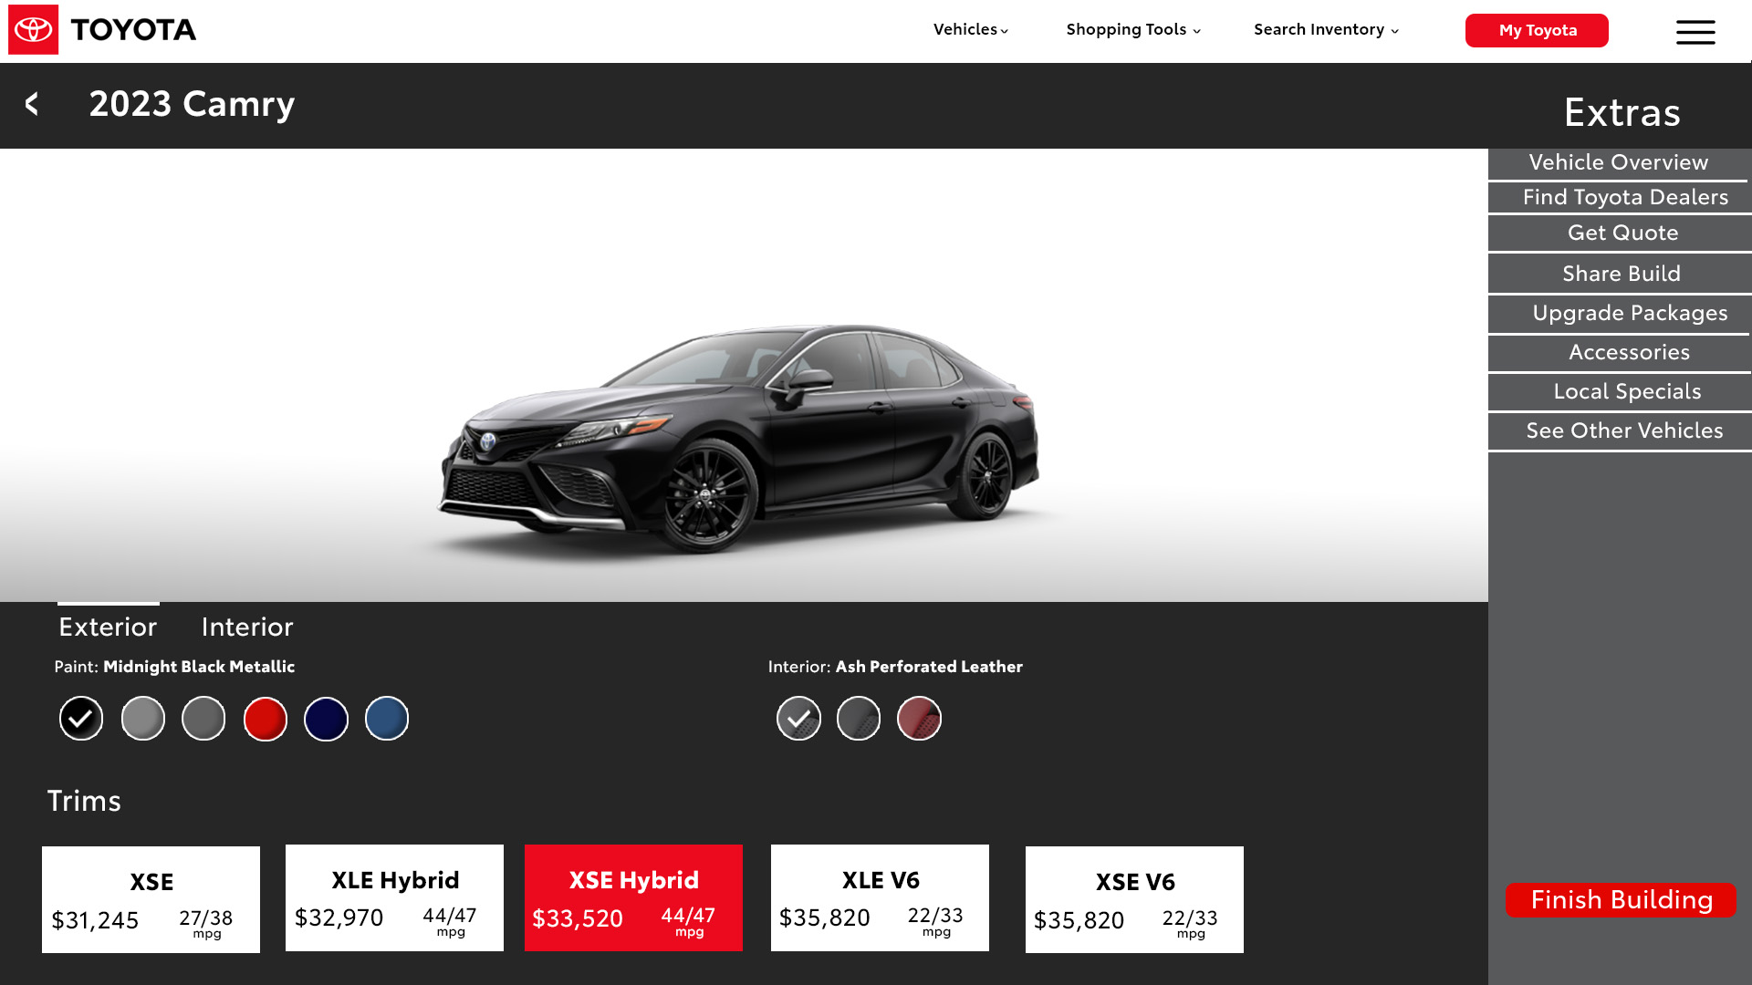
Website - Build
Notes:
In short, I didn’t like their current build page and so I fixed it. The only thing I could have done differently here is pad out that right side with more content.

Slide 6
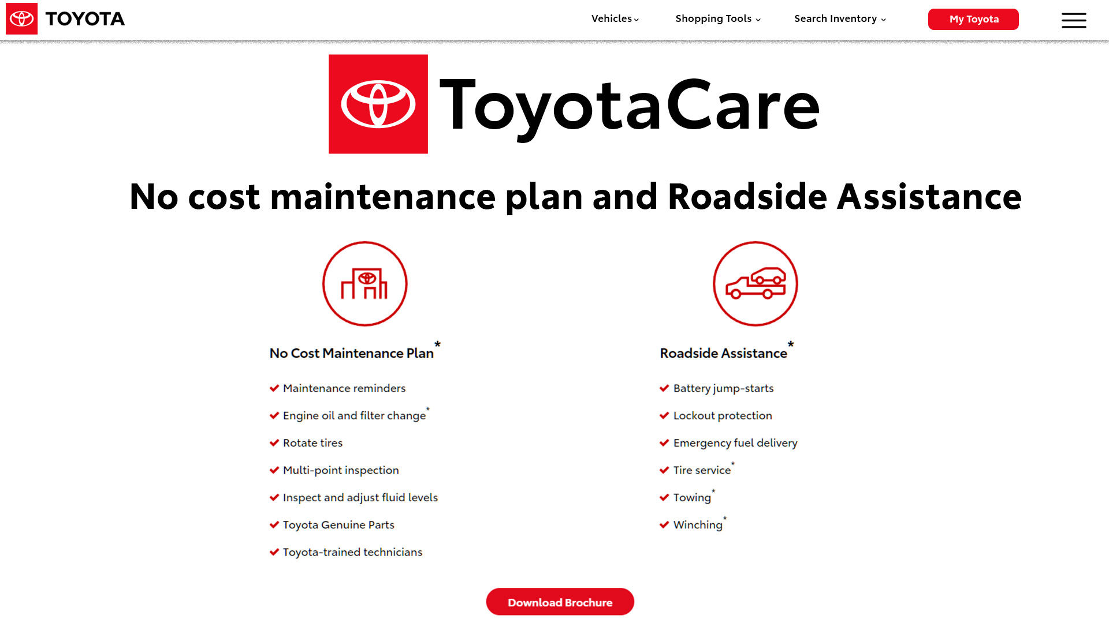
Website - ToyotaCare
Notes:
With this page, I scaled everything to fill some of the negative space that made the website feel a bit empty. It’s mostly the same as it was, just removing some filler text that can be found in the brochure.

Slide 7
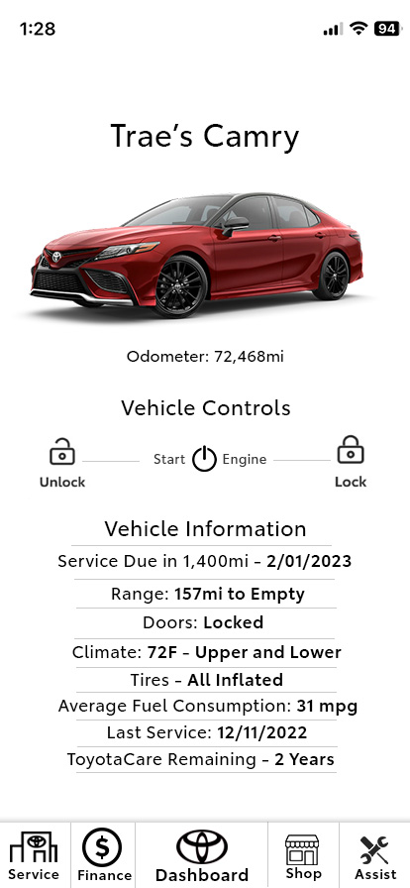
App - Home
Notes:
Their app right now is not too dissimilar to this look. Having the start, lock and unlock on their vehicle page. I decided I would just put that all into a dashboard with pertinent information displayed with [read list]. The app has a uniform design, white backgrounds and not too much going on.

Slide 8
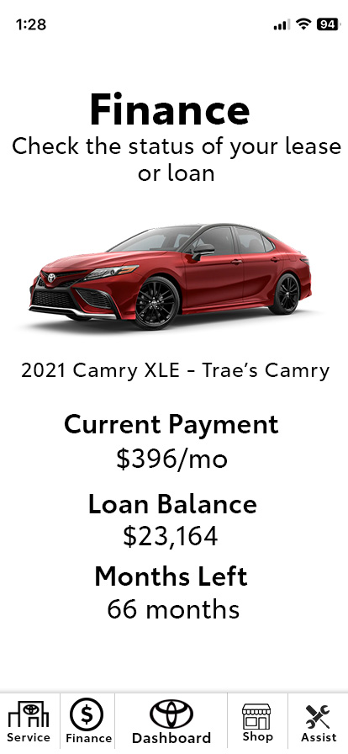
App - Finance
Notes:
A big part of buying a car is paying for it. So, here’s a page to view that progress. I should have made a “make payment” button on there now that I think about it. It still looks decent though.

Slide 9
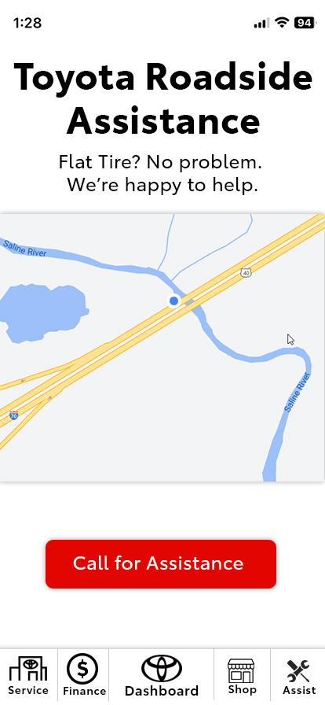
App - Roadside
Notes:
Not really much happening here. Just a map to show where you are and it would work when you press the button it sends a message to Toyota that you need help with your location, and it starts a phone call.

Slide 10
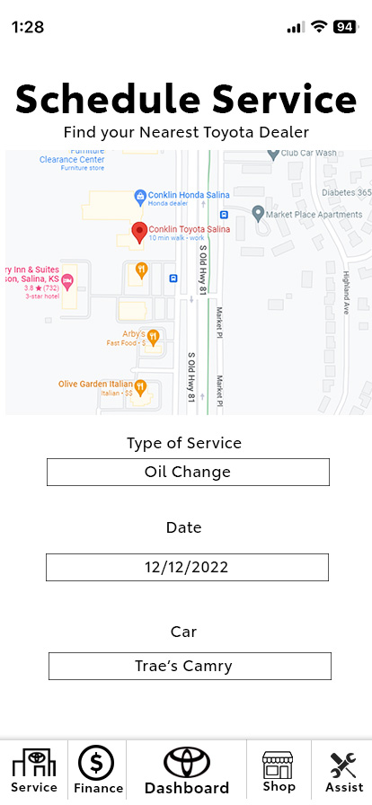
App - Service
Notes:
The idea here was to provide a place for owners to schedule service when needed. In this case, my fictional Camry needs it’s oil changed and I selected the dealer, the type of service and the car I want to pick from my garage, this implying I have more than 1 car.

Slide 11



Web Ads
Notes:
With the one here on the left I thought, keep it simple. So, I overlayed the logo onto this picture I found. No real information it but it makes for a little ad.
The top one on the right is a typical banner ad, advertising for the Toyotathon and showing the fleet of Toyotas
The bottom one is for a singular car. There most popular one, the Camry. Just a price and the link would lead to the build page where the customer might be more inclined to buy the car.

Slide 12
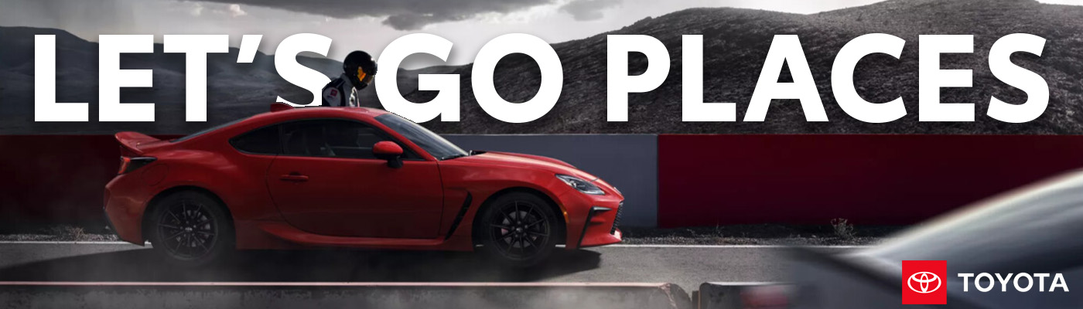
Digital Billboard
Notes:
If you go to Toyota’s website and scroll down a little you’ll see an image that’s similar to this. Same mood and everything. I thought, huh, that would work on a billboard, the big text and the logo in the corner. So, I took that concept and applied it to this photo. Ducking the text behind the car and the driver and a little bit of drop shadow to make it readable against the light gray sky.

