Slide 1
Green Wave
April 09, 2025

Slide 2
Motivation
Hunter Gatheres hunted large herbivores
Large Herbivores like fresh green in the spring
Spring is later in northern latitudes
Herbivores move with the „green wave“

Slide 3
Goals
Parameterize annual greening curve
Predict spring green up for paleoclimate conditions
Identify predictors:
Annual time series of:
Insolation
Precipitation
Temperature
Vegetation

Slide 4
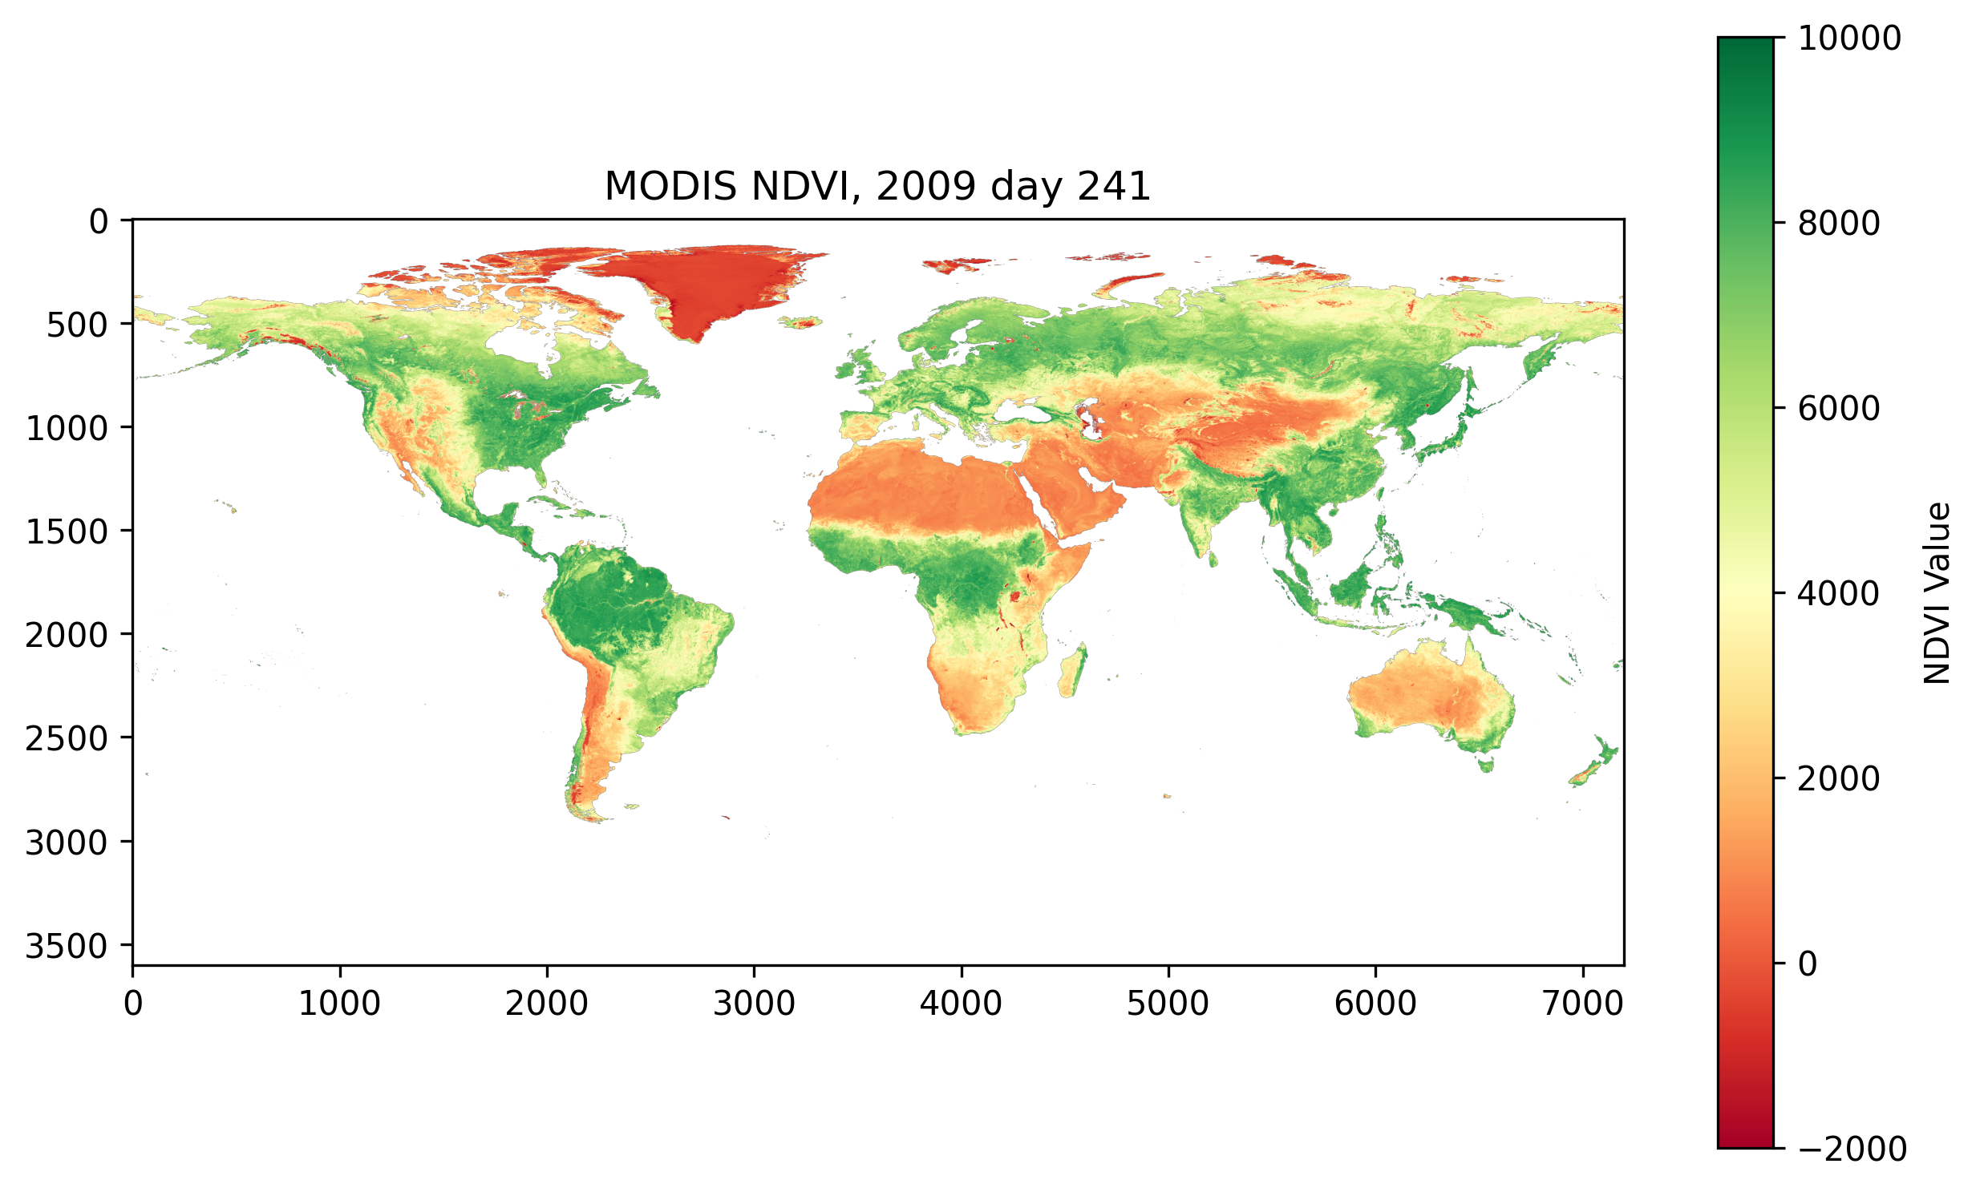
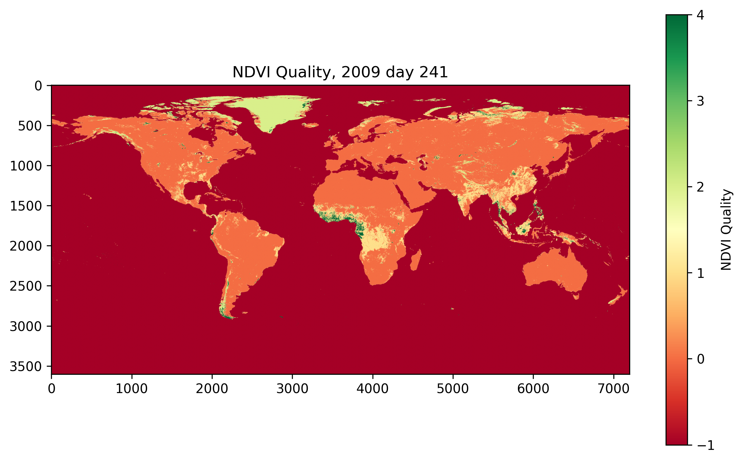
Vegetation Data
MODIS NDVI Data (2000-2024)
Satellite spectrography data
Temporal Resolution 16 days
Global coverage
Spatial resolution 0.5 degree
(higher resolution available)

Slide 7
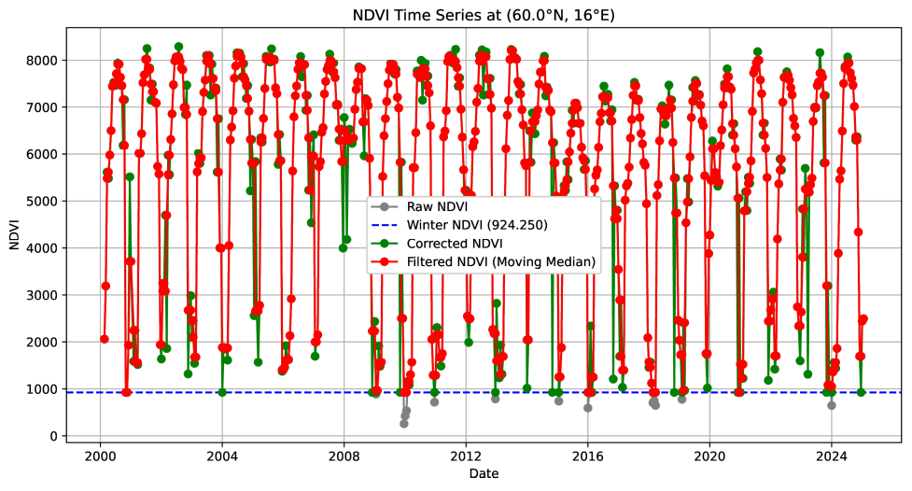
Clip low outliers to 2.5% quantile
Moving Median Filter,
Window size 3

Slide 8
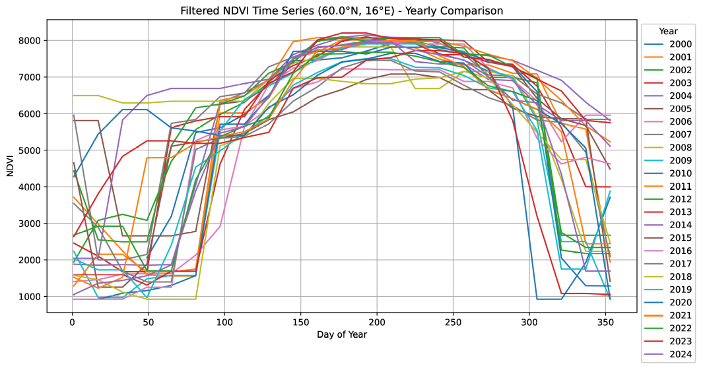

Slide 9
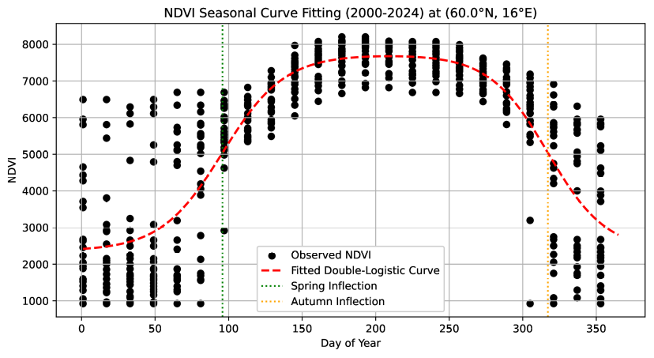
Shows good fit for
temperate regions with distinct spring + autumn
Extract day of max.
derivative (IRG) from the model

Slide 10
Drawbacks & Next steps
Issues:
Precipitation-limited regions (e.g. Mediterranean)
Southern Hemisphere “inversion”
Next steps:
Explore alternate cyclical models
Incorporate precipitation data to detect moisture-driven
Seasonality
Eventually integrate paleoclimate and orbital forcing for mid-Holocene

