Slide 1
Chapter 5: Plotting and Visualization
Python for Data Scientists

Slide 2
Chapter Objectives
In this chapter, we will introduce:
Matplotlib
Plotting functions in pandas
Python visualization tool ecosystem

Slide 3
Chapter Concepts
Introducing Matplotlib
Plotting Functions in Pandas
Python Visualization Tool Ecosystem
Chapter Summary

Slide 4
Introducing Matplotlib
matplotlib is a plotting package designed for creating publication quality plots
Has a number of add-on toolkits
3D plots
Mapping and projections
pyplot is a module built on matplotlib usually imported as plt
Run in pylab mode in IPython
In this chapter, we provide enough detail to begin working with matplotlib
Full documentation including extensive examples can be found at:
http://matplotlib.org/2.0.0/index.html

Slide 5
Figures and Subplots
Plots reside within a Figure object
Subplots are added to a Figure object
Using add_subplot(rows, columns, plot number)
Returns AxesSubplot objects
import matplotlib
from matplotlib import pyplot as plt
from numpy.random import randn
figure = plt.figure()
sp1 = figure.add_subplot(2,2,1)
sp2 = figure.add_subplot(2,2,2)
sp3 = figure.add_subplot(2,2,3)
sp4 = figure.add_subplot(2,2,4)
sp1.plot(randn(100).cumsum(), 'k--')
sp2.hist(randn(100), bins=20)
sp3.scatter(randn(100), randn(100)-5*randn(100))
sp4.hist(randn(100), bins=20, color='r')
plt.show()
2x2 subplots, subplot 1
2x2 subplots, subplot 2

Slide 6
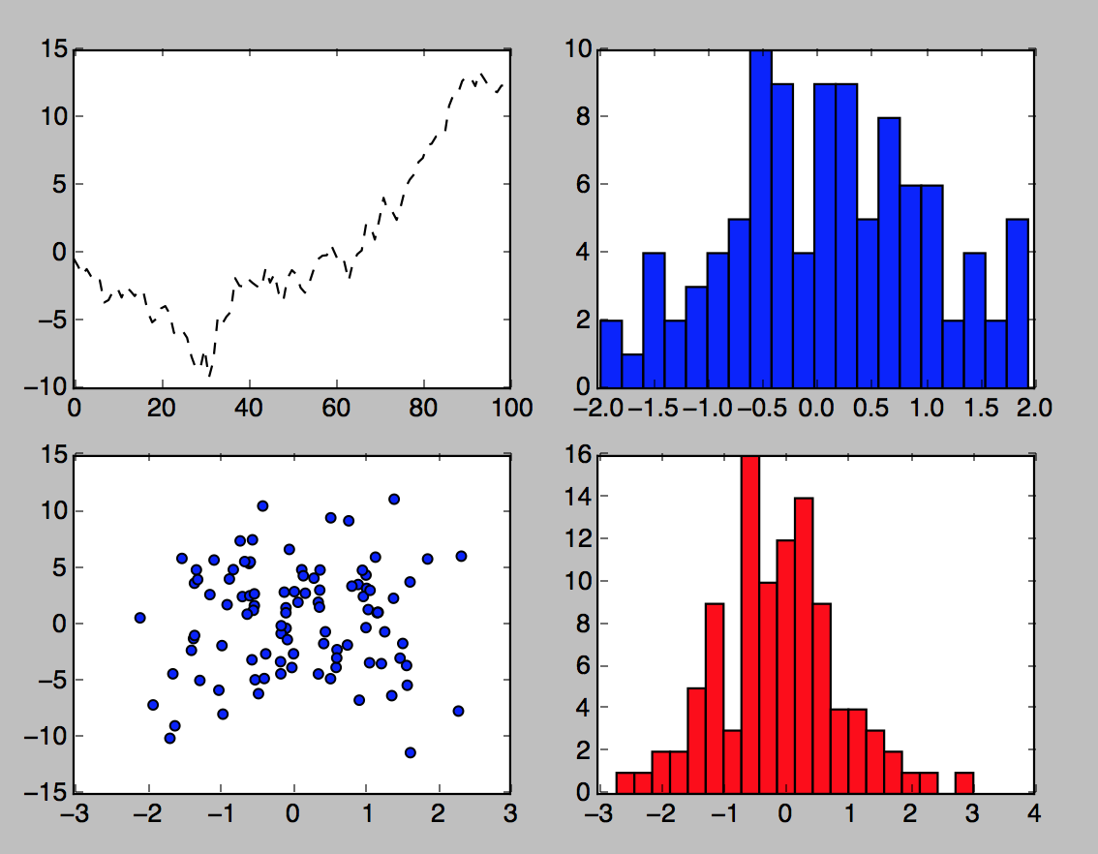
Figures and Subplots Example

Slide 7
Saving Plot
Plots can be saved using the savefig method
Various file formats are supported and can be listed with the following command:
Using the extension indicates which format to save as
plt.gcf().canvas.get_supported_filetypes_grouped()
{'Postscript': ['ps'],
'Encapsulated Postscript': ['eps'],
'Portable Document Format': ['pdf'],
'PGF code for LaTeX': ['pgf'],
'Portable Network Graphics': ['png'],
'Raw RGBA bitmap': ['raw', 'rgba'],
'Scalable Vector Graphics': ['svg', 'svgz'],
'Joint Photographic Experts Group': ['jpeg', 'jpg'],
'Tagged Image File Format': ['tif', 'tiff']}
plt.savefig('chart1.jpg')
plt.savefig('chart1.pdf')

Slide 8
Colors and Styles
The plot function accepts arrays of x and y coordinates and also an optional string
Optional string is for color and style
E.g., sp1.plot(x, y, 'r--')
r indicates red color and -- is the dashed style
More explicit requests for color and style can be made
E.g., sp1.plot(x, y, linestyle='--', color='r')
Plots will have continuous line plots and, therefore, will have data interpolated
Can request data points to be shown
E.g., sp1.plot(x, y, 'ro--')
Or sp1.plot(x, y, linestyle='--', color='r', marker='o')

Slide 9
Labels and Legends
Following example shows how to change axis ticks, labels, and add a title
figure = plt.figure()
p1 = figure.add_subplot(1,1,1)
p1.plot(randn(1000).cumsum())
p1.set_title('Random Walk')
p1.set_xticks([0,500,1000])
p1.set_xlabel('Count')
p1.set_ylabel('Random Number')
set_yticks for Y axis

Slide 10
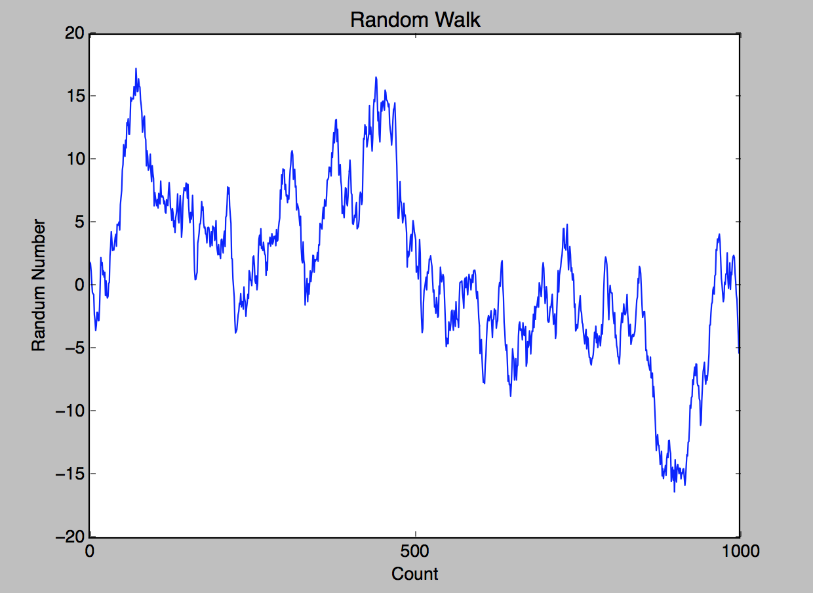
Labels and Legends Example
Random Number

Slide 11
Chapter Concepts
Introducing Matplotlib
Plotting Functions in Pandas
Python Visualization Tool Ecosystem
Chapter Summary

Slide 12
Plotting Functions in Pandas
Pandas objects have built-in plotting functions
Simplify working with Matplotlib
In particular, for DataFrame objects
Provide support for a number of different chart types such as:
Line plots
Bar plots
Histograms
Density plots
Scatter plots
Etc.

Slide 13
A Simple Example
Consider plotting a series of data
import numpy as np
import pandas as pd
from pandas import Series, DataFrame
ts = Series(np.random.randn(1000), \ index=pd.date_range('1/1/2000', periods=1000))
ts = ts.cumsum()
ts.plot()
Built-in function

Slide 14
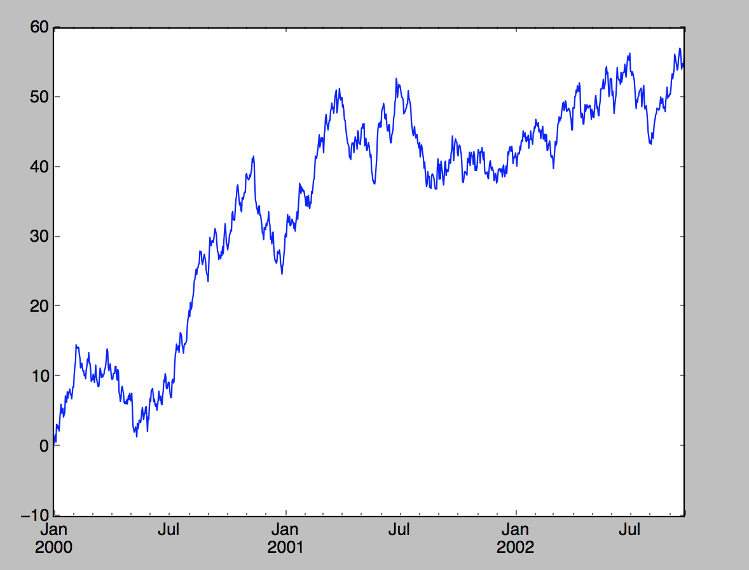
A Simple Example (continued)

Slide 15
Line Plot with DataFrame
DataFrame’s plot method plots each of its columns as a different line
On the same plot
A legend is created automatically
ts = Series(np.random.randn(1000), \ index=pd.date_range('1/1/2000', periods=1000))
df = DataFrame(np.random.randn(1000,4), \
index= ts.index, columns=list('ABCD'))
df = df.cumsum()
df.plot()
Used in legend

Slide 16
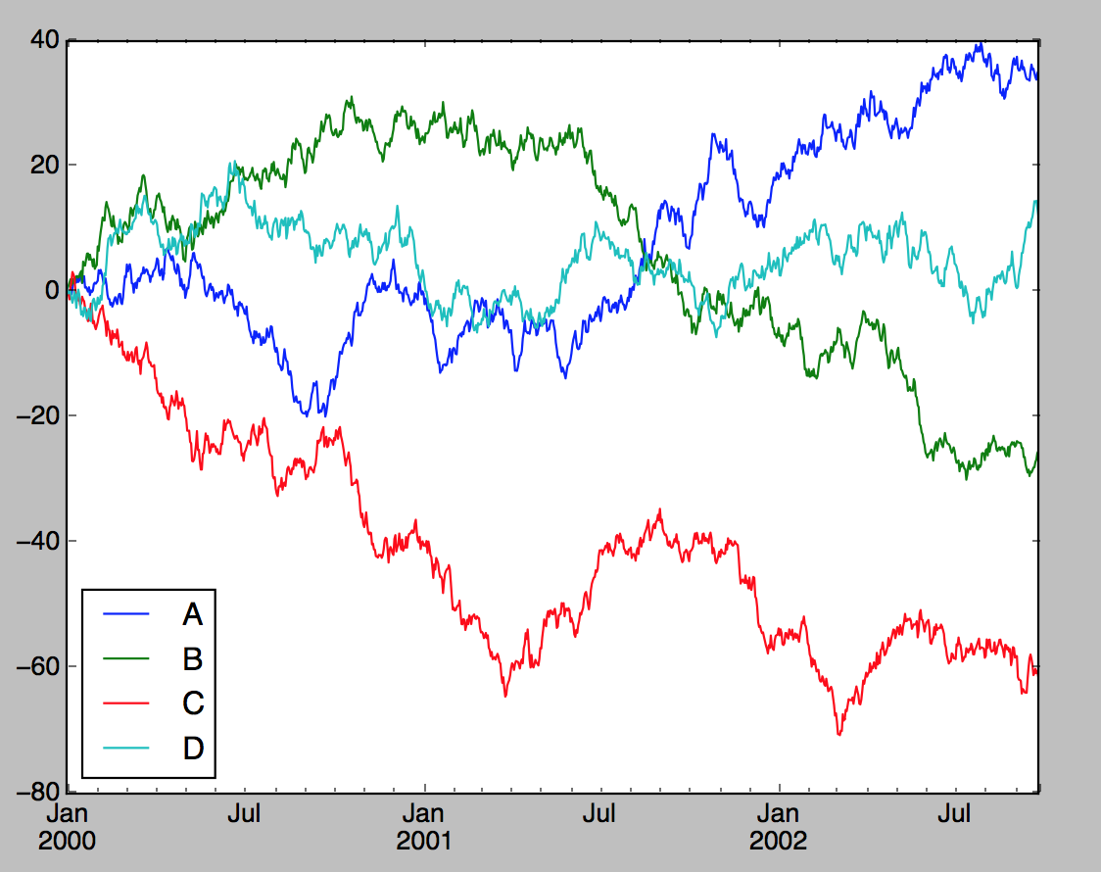
Line Plot with DataFrame (continued)

Slide 17
Series plot() Arguments
Series plots can be customized using arguments to plot()
label
Label for plot legend
style
String such as 'g--' for Matplotlib
alpha
Fill opacity from 0 to 1
kind
Line, bar, barh, kde
grid
Display axis grid
logy
Use logarithmic scaling on the Y axis
For full list, see:
http://pandas.pydata.org/pandas-docs/stable/generated/pandas.Series.plot.html

Slide 18
DataFrame plot() Arguments
Series plots can be customized using arguments to plot()
subplots
Plot each DataFrame in separate subplot
sharex
Share same x axis for subplots
sharey
Share same y axis for subplots
figsize
Size of figure to create
title
Plot title as a string
legend
Add a subplot legend
sort_columns
Plot columns in alphabetical order using existing column order
For full list, see:
http://pandas.pydata.org/pandas-docs/stable/generated/pandas.DataFrame.plot.html

Slide 19
Histogram Example
df = pd.DataFrame({'A': np.random.randn(1000) + 1, \
'B': np.random.randn(1000), \
'C': np.random.randn(1000)-1})
print (df.head())
A B C
0 0.627152 1.984009 0.785683
1 1.316856 0.318605 0.143795
2 -0.763011 -0.261403 -1.346760
3 1.174517 1.044114 0.556043
4 1.052025 -0.021766 -1.868798
df.plot(kind='hist')
Select histogram

Slide 20
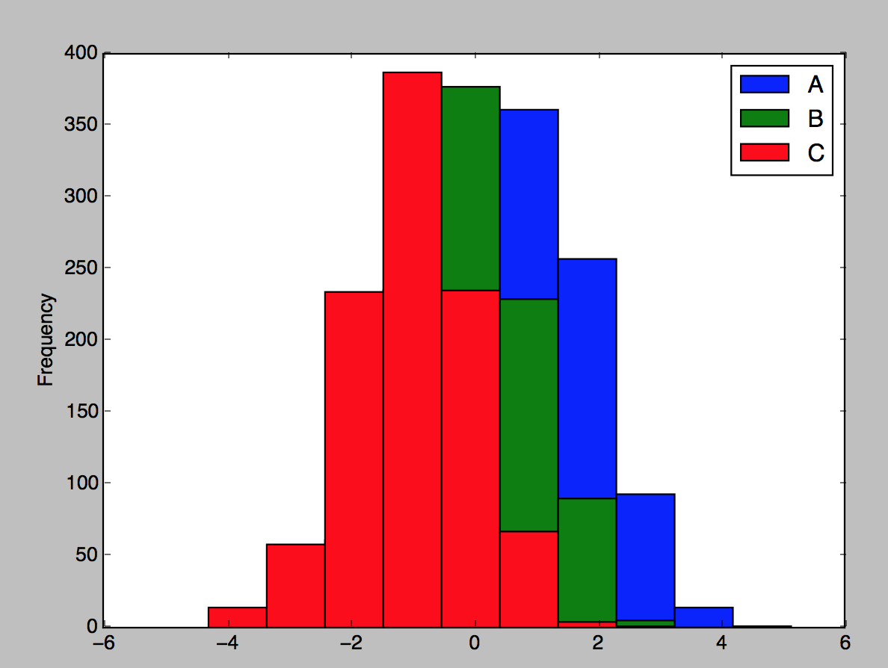
Histogram Example (continued)

Slide 21
Scatter Plots
Useful way of visualizing relationship between two one-dimensional data series
matplotlib and pyplot have a scatter method for plotting charts
df.head()
A B C
0 0.627152 1.984009 0.785683
1 1.316856 0.318605 0.143795
2 -0.763011 -0.261403 -1.346760
3 1.174517 1.044114 0.556043
4 1.052025 -0.021766 -1.868798
plt.scatter(df['A'], df['B'])
plt.title('Changes in A v changes in B')
Scatter plot

Slide 22
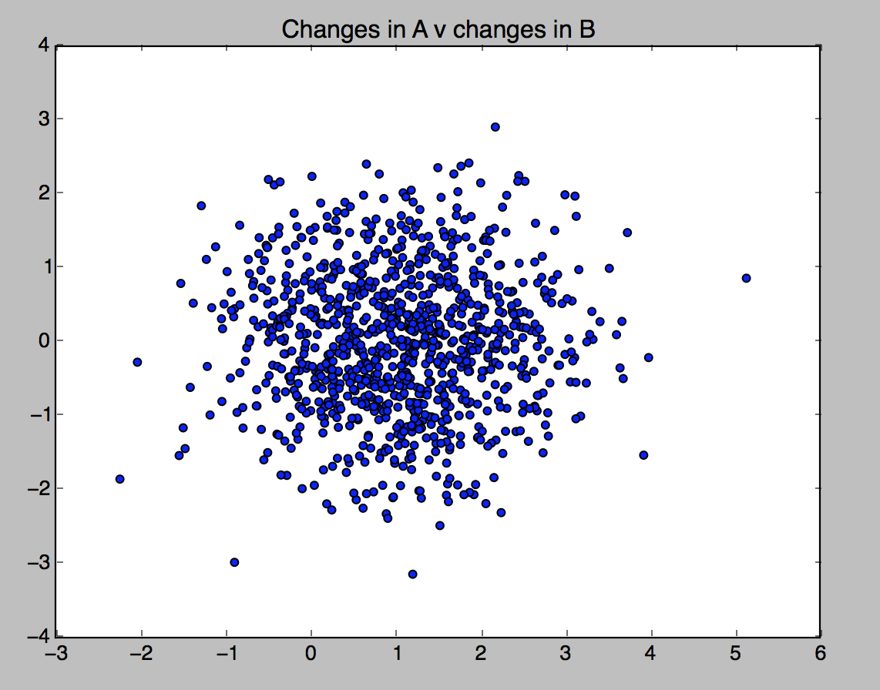
Scatter Plots (continued)

Slide 23
Scatter Plot Matrix
For exploratory data analysis, it may be helpful to look at all scatter plots amongst a group of variables
Known as a pair plot or scatter plot matrix
Pandas has scatter_matrix function
Works with a DataFrame
Also supports placing histograms or density plots of each variable along the diagonal
df.head()
A B C
0 0.627152 1.984009 0.785683
1 1.316856 0.318605 0.143795
2 -0.763011 -0.261403 -1.346760
3 1.174517 1.044114 0.556043
4 1.052025 -0.021766 -1.868798
pd.plotting.scatter_matrix(df, diagonal='kde', alpha=0.3)
Density plot on diagonal

Slide 24
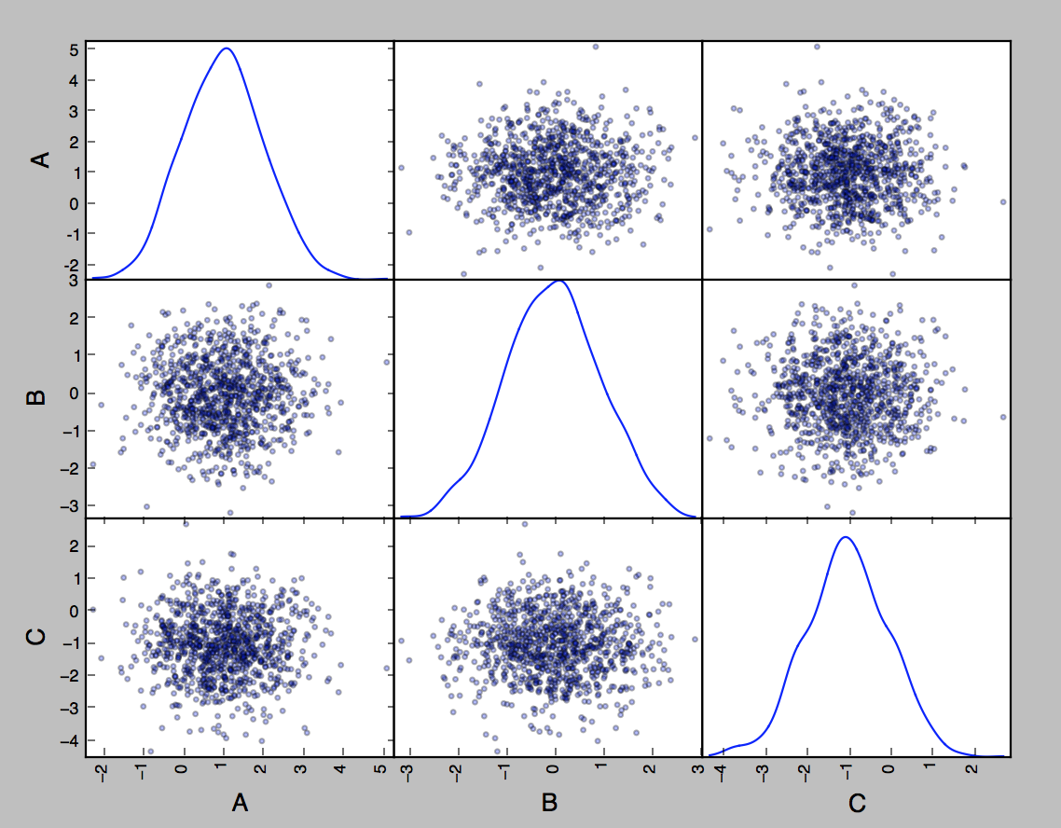
Scatter Plot Matrix Example

Slide 25
Chapter Concepts
Introducing Matplotlib
Plotting Functions in Pandas
Python Visualization Tool Ecosystem
Chapter Summary

Slide 26
Seaborn
A library to simplify making presentation quality graphs from matplotlib
Short-cut methods to create advanced graphics
Especially combining more than one graph
Themes and palettes to simplify applying consistent styles
Applies themes immediately to all matplotlib graphs
Even those created without seaborn
To use
Usually imported as sns
Many seaborn methods accept additional parameters
Passed to the underlying implementation (e.g., matplotlib, pandas)
Sometimes makes it hard to understand all the options
Seaborn has many options
Too many for this course to cover all of them
The following slides pick out some key areas of interest
import seaborn as sns
sns.set()
Apply basic pre-set style

Slide 27
Seaborn Style Control
Most seaborn style commands follow a common format
Accept a parameter choosing from a set of pre-defined names
Allow an extra parameter rc to override settings
Accepts a dictionary of detailed style settings
Will only override styles that are part of the pre-defined name
Context defines basic settings (labels, lines, etc.) suitable for certain uses
notebook (default), paper, talk, poster
Pre-defined style sheets:
darkgrid, whitegrid, dark, white, and ticks
set_style affects overall graphic
set_axes can be used to affect individual subplots
sns.set_context('talk', rc = {'lines.linewidth': 3})
Apply settings suitable for a talk
Override the line width, if line width were not part of the talk settings, would not be affected

Slide 28
Seaborn Style Control (continued)
Colors
set_color_codes() changes how the color codes are interpreted
Single parameter, palette, set to one of
deep, muted, pastel, dark, bright, and colorblind
set_palette() change color palette
Named palette (from the list above) or any form that matplotlib accepts, such as a color map (Blues, GnBu, rainbow, etc.)
Shortcut
set()
Set style parameters in one step
Context, Style, Palette, Font, Font Scale, Color codes

Slide 29
Tidy DataFrames
Many data analysis libraries require data in Tidy DataFrames
Including most seaborn tools
Based on Tidy Data defined in a paper by Hadley Wickham (http://vita.had.co.nz/papers/tidy-data.html)
Lays out rules for the structure of data
Each variable (height, weight) forms a column and contains values
Each observation (person, car) forms a row
Each type of observational unit forms a table
Do not mix, do not split
Identifies five common problems
Column headers are values, not variable names
Multiple variables are stored in one column
Variables are stored in both rows and columns
Multiple types of observational units are stored in the same table
A single observational unit is stored in multiple tables

Slide 30
Column Headers Are Values
Column headers are values, not variable names
Such a common issue that pandas has a function, melt, to address it
row | col | value
A | x | 1
B | x | 4
C | x | 7
A | y | 2
B | y | 5
C | y | 8
A | z | 3
B | z | 6
C | z | 9
row | x | y | z
A | 1 | 2 | 3
B | 4 | 5 | 6
C | 7 | 8 | 9
melt
Company | Quarter | Value
Ace Chemical | Q1 | 123,456.78
Ace Chemical | Q2 | 99,100.01
Ace Chemical | Q3 | 42,424.42
Ace Chemical | Q4 | 79,234.56
Acme Corp | Q1 | 29,306.67
Company | Q1 | Q2 | Q3 | Q4
Ace Chemical | 123,456.78 | 99,100.01 | 42,424.42 | 79,234.56
Acme Corp | 29,306.67 | … | … | …
… | … | … | … | …

Slide 31
Multiple Variables in One Column
Multiple variables are stored in one column
Company | 1Q2018 | 2Q2018 | 3Q2018 | 4Q2018 | 1Q2019 | 2Q2019 | 3Q2019 | 4Q2019
Ace Chemical | 123,456.78 | 99,100.01 | 42,424.42 | 79,234.56 | 101,501.29 | 89,900.42 | 56,789.00 | 90,909.09
Acme Corp | 29,306.67 | … | … | … | … | … | … | …
… | … | … | … | … | … | … | … | …
Company | Quarter | Year | Value
Ace Chemical | Q1 | 2018 | 123,456.78
Ace Chemical | Q2 | 2018 | 99,100.01
Ace Chemical | Q3 | 2018 | 42,424.42
Ace Chemical | Q4 | 2018 | 79,234.56
Ace Chemical | Q1 | 2019 | 101,501.29
Ace Chemical | Q2 | 2019 | 89,900.42
Ace Chemical | Q3 | 2019 | 56,789.00
Ace Chemical | Q4 | 2019 | 90,909.09
Acme Corp | Q1 | 2018 | 29,306.67

Slide 32
Variables in Rows and Columns
Variables are stored in both rows and columns
Company |  | 1Q2018 | 2Q2018 | 3Q2018 | 4Q2018 | 1Q2019 | 2Q2019 | 3Q2019 | 4Q2019
Ace Chemical | Income | 123,456.78 | 99,100.01 | 42,424.42 | 79,234.56 | 101,501.29 | 89,900.42 | 56,789.00 | 90,909.09
 | Profit | 23,456.77 | 80,000.11 | -21,222.22 | … | … | … | … | …
Acme Corp | Income | 29,306.67 | … | … | … | … | … | … | …
 | Profit | … | … | … | … | … | … | … | …
… | … | … | … | … | … | … | … | … | …
Company | Quarter | Year | Income | Profit
Ace Chemical | Q1 | 2018 | 123,456.78 | 23,456.78
Ace Chemical | Q2 | 2018 | 99,100.01 | 80,000.11
Ace Chemical | Q3 | 2018 | 42,424.42 | -21,222.22
Ace Chemical | Q4 | 2018 | 79,234.56 | …
Ace Chemical | Q1 | 2019 | 101,501.29 | …
Ace Chemical | Q2 | 2019 | 89,900.42 | …
Ace Chemical | Q3 | 2019 | 56,789.00 | …
Ace Chemical | Q4 | 2019 | 90,909.09 | …
Acme Corp | Q1 | 2018 | 29,306.67 | …

Slide 33
Split and Combined Tables
Multiple types of observational units are stored in the same table
The idea is analogous to data normalization in a relational database
Tables frequently combine data about an observational unit with data about the values
Should be split into two tables
However, while this aspect of Tidy Data is useful in cleaning data, it is usually undone when creating a reporting data set
Separate tables are combined
A single observational unit is stored in multiple tables
Common to split data across multiple files
E.g., file per year, file per variable

Slide 34
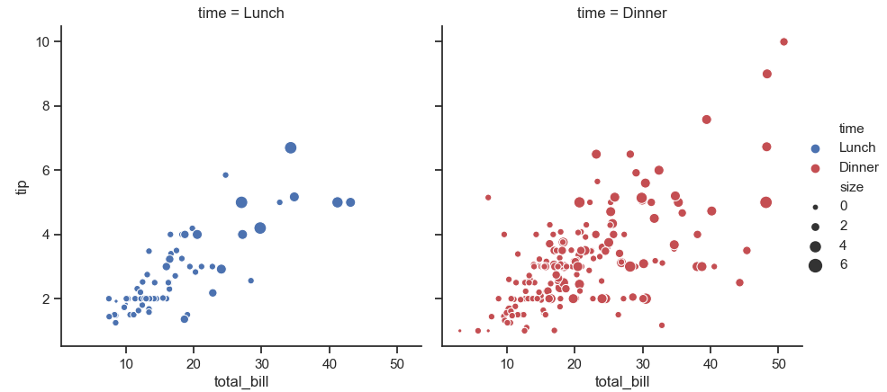
Relational Plots
Compare two principal variables
Using a scatter or line graph superimposed on a FacetGrid
Line graph automatically includes confidence interval by default
Represent subsidiary variables
Not normal to use all of these to show different variables
Using size, color, or style (data point marker, line type)
By separating facets (subplots arranged in a grid)
import seaborn as sns
sns.set(style = 'ticks')
tips = sns.load_dataset('tips')
g = sns.relplot(
x = 'total_bill',
y = 'tip',
hue = 'time',
size = 'size',
palette = ['b', 'r'],
sizes = (10, 100),
col = 'time',
data = tips)
Facet
Facet
Facet (may be row or col)

Slide 35
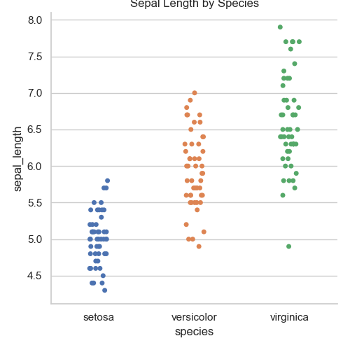
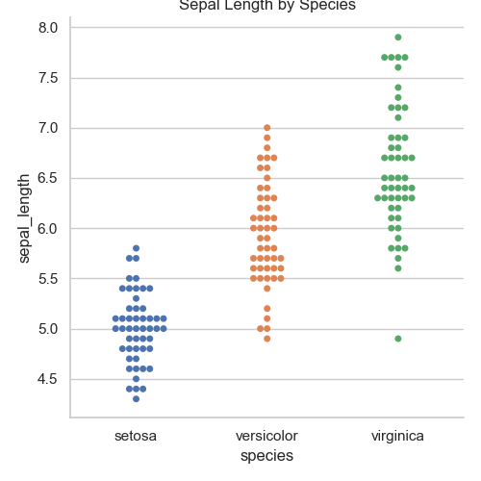
Categorical Plots
Compare a numerical value with one, or more, categories
Using scatter, boxes, violins, error bars, histograms
iris = sns.load_dataset('iris');
ax = sns.catplot(
x = 'species',
y = 'sepal_length',
data = iris,
kind = 'strip'
);
iris = sns.load_dataset('iris');
ax = sns.catplot(
x = 'species',
y = 'sepal_length',
data = iris,
kind = 'swarm'
);

Slide 36
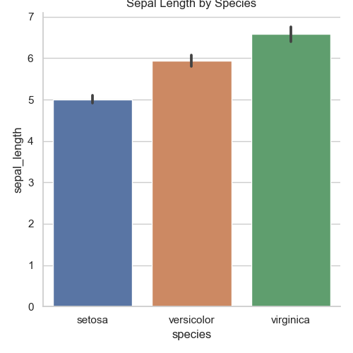
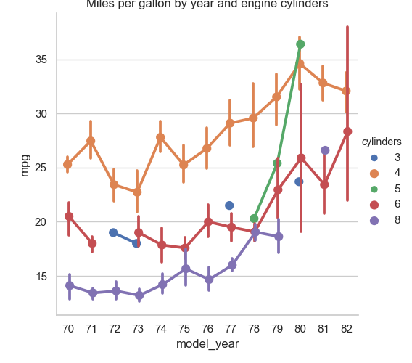
Categorical Plots (continued)
iris = sns.load_dataset('iris');
ax = sns.catplot(
x = 'species’,
y = 'sepal_length’,
data = iris,
kind = 'strip’
);
mpg = sns.load_dataset('mpg')
ax = sns.catplot(
x = 'model_year',
y = 'mpg',
data = mpg,
kind = 'point',
hue = 'cylinders',
dodge = True
);
Automatically calculates mean and shows error bars

Slide 37
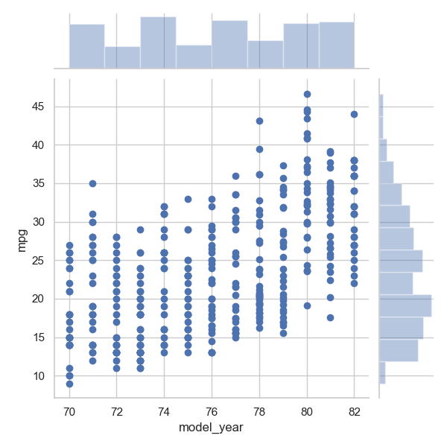
Joint Plots
Add plots along each axis of the central plot
ax = sns.jointplot(
x = 'model_year’,
y = 'mpg’,
data = mpg
);

Slide 38
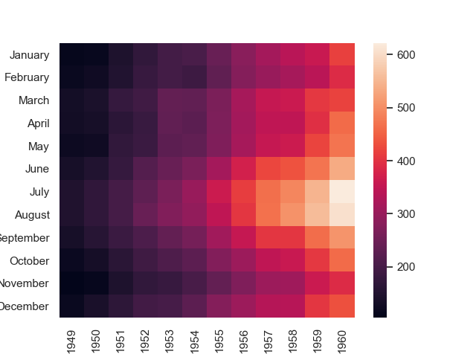
Heatmaps
Use color to show the scale of data at the intersection of two categories
A colored matrix
Good for highlighting correlation
flights = sns.load_dataset('flights')
flights = flights.pivot('month', 'year', 'passengers')
ax = sns.heatmap(flights)

Slide 39
Other Data Visualization Tools
Plotly
Based on the popular plotly.js library
Creates interactive plots
Folium
Visualize geospatial data on maps
Ggplot
Graphing package based on ggplot2 from R
Uses The Grammar of Graphics to create plots at a high level without thinking about implementation details
Bokeh
Also based on The Grammar of Graphics
Create interactive plots
Altair
A declarative library based on the Vega-lite visualization grammar

Slide 40
Chapter Concepts
Introducing Matplotlib
Plotting Functions in Pandas
Python Visualization Tool Ecosystem
Chapter Summary

Slide 41
Chapter Summary
In this chapter, we have introduced:
Matplotlib
Plotting functions in pandas
Python visualization tool ecosystem

