Slide 1
Chapter 7: Classification Models
Python for Data Scientists

Slide 2
Chapter Objectives
In this chapter, we will:
Understand the use cases for Classification models
Discuss and compare various algorithms
Naive Bayes
Decision Tree
Logistic Regression
Neural Network

Slide 3
Chapter Concepts
Classification Model
Algorithms
Chapter Summary
Notes:
Highlight the topic that follows this page, and place the delta arrow next to it by moving vertically, but maintain the horizontal placement.
If there are too many topics to fit on the page, reduce the line spacing to fit.

Slide 4
Classification
There are many business use cases for wanting to predict whether a record will fall into one category or another
Is a credit card swipe fraudulent or not?
Does a patient have a disease?
Will an applicant be a profitable customer?
Classification can make such predictions by using historical data to train the model to look for patterns
To see how good a job the model does, you test it with another set of data that was not used to train the model
By comparing the known values to the predicted ones, you can judge how well the model performs
If the model guesses better than a coin flip or random guess, it may not be perfect, but it’s better than nothing and could be used to create actionable business decisions with a best guess
There are many different algorithms that can do classification, so it’s best to run the same data through many different models to see which works best for your data

Slide 5
Steps to Classification
There are some consistent steps you need to do regardless of which algorithm you use, although some models have different requirements
Usually categorical data needs to be re-encoded as either a series of numbers or as dummy encoded data
There’s really no consistency among different algorithms
Learn from experience and examples which algorithms require which style of data
All models should take the data set and split it into a training and testing set
First, you fit the model with the training set
Can take some time for large datasets
Once the model is trained, you can see how good it is at making predictions by using a predict function and comparing those values to known values for the variable you are trying to predict
After you’ve picked the model that does the best job, you can use it to predict values either individually or in a batch for new data as it comes in

Slide 6
Notes on Classification
Often you are trying to predict an either/or value
Is a card swipe fraudulent or legitimate?
Does a patient have cancer or not?
Not limited to just two choices, you could predict whether a record falls into a category with many different values
It just gets trickier sometimes to interpret the results
The math and techniques behind the scenes can get complicated, but you don’t really need to know any of it to use the algorithms
Just knowing how to identify that you need a classification model and how to prep the data and interpret the results is often good enough to get started
As you get more sophisticated, you can learn the math behind the scenes to tweak the results and try to get better results

Slide 7
Applying Classification
Let’s look at some data first, and use this with several different algorithms
import pandas as pd
df = pd.read_csv('CreditCardFraud.csv')
print (df.shape, df.columns)
print (df.isFraud.value_counts())
print (df.type.value_counts())
(6362620, 11) Index(['step', 'type', 'amount', 'nameOrig', 'oldbalanceOrg', 'newbalanceOrig', 'nameDest', 'oldbalanceDest', 'newbalanceDest', 'isFraud', 'isFlaggedFraud'], dtype='object')
0 63544071 8213
Name: isFraud, dtype: int64
CASH_OUT 2237500
PAYMENT 2151495
CASH_IN 1399284
TRANSFER 532909
DEBIT 41432
Name: type, dtype: int64

Slide 8
Change Categorical Column
Change the type categorical column to codes and keep certain columns
Split the data into training and testing sets
Check the ratios of the two sets are about the same
columns = ['type', 'amount', 'oldbalanceOrg', 'newbalanceOrig',
'oldbalanceDest', 'newbalanceDest', 'isFlaggedFraud',
'isFraud']
df = df[columns]
df.type = pd.Categorical(df.type).codes
from sklearn.model_selection import train_test_split
from sklearn import preprocessing as pp
trainX, testX, trainY, testY = train_test_split \
(df[df.columns[:-1]], df.isFraud, \
train_size = train_size, test_size = test_size)
print (testY.value_counts())
print (trainY.value_counts()/trainY.count())
print (testY.value_counts()/testY.count())
print (trainX[:10])

Slide 9
Chapter Concepts
Classification Model
Algorithms
Chapter Summary
Notes:
Highlight the topic that follows this page, and place the delta arrow next to it by moving vertically, but maintain the horizontal placement.
If there are too many topics to fit on the page, reduce the line spacing to fit.

Slide 10
Naive Bayes
Based on Bayes theorem and involves calculating lots of probabilities of events occurring based on prior observations of conditions related to that event
Pros
It’s easy and fast to train often outperforming more complex algorithms
Performs well with categorical data
Works well for multi-class predictions
Cons
Doesn’t do well if a category is found in the test set that is missing from the training set
Not useful for tweaking the false negatives (FN)/false positives (FP)

Slide 11
Apply Naive Bayes
Load the module, create a model and train it
Run a prediction on the reserved testing set and compare the predicted values to the known values
from sklearn.naive_bayes import GaussianNB
modelNB = GaussianNB()
modelNB.fit(trainX, trainY)
predY = modelNB.predict(testX)
from sklearn.metrics import confusion_matrix
cm = confusion_matrix(testY, predY)
print (cm)
def cm_percent(cm, length):
import numpy as np
return np.ndarray(shape = (2,2), buffer = \
np.array([100 *(cm[0][0] + cm[1][1])/length, \
100 * cm[0][1]/length, 100 * cm[1][0]/length, \
100 * (cm[1][0] + cm[0][1])/length]))
print (cm_percent(cm, len(testY)))
print (testY.value_counts())
print (len(testY))

Slide 12
Interpret the Results
The confusion matrix shows/compares the predictions to the known values
1,263,180 predicted to be 0 for fraud and were right (True Negatives)
285 were predicted to be 1 for fraud and were right (True Positives)
7667 were predicted to be 1 for fraud but were wrong (false positive or Type I error)
1,263,180 + 7667 = 1,270,847 total predicted 0
1392 were predicted to be 0 for fraud wrong (false negative or Type II error)
1392 + 285 = 1677 total predicted 1
[[1263180 7667]
[ 1392 285]]
[[99.28810773 0.60250337]
[ 0.1093889 0.71189227]]
0 1270847
1677
1272524
Results as percentages
99.28% correct
.71% incorrect
.60% false positive
.10% false negative
Overall pretty good at predicting

Slide 13
Save and Load Model
To save the results of a lengthy training process
pip install joblib
To reload a saved model
from joblib import dump, load
dump(modelNB, 'modelNB.joblib')
modelNB2 = load('modelNB.joblib')
predY = modelNB2.predict(testX)
cm = confusion_matrix(testY, predY)
print (cm)
cmp = cm_percent(cm, len(testY))
print (cmp)

Slide 14
Decision Trees
Data is split up based on some factor among the independent variables, then evaluated for how good a job it did
Recursively keeps applying this algorithm over and over until it comes up with a good set of rules
Pros
It’s easy
Performs well with categorical data and continuous data
Transparency lets you see how it made its choices
Cons
Calculations take a lot longer as you add more and more columns
Becomes difficult to understand the decision tree as it gets larger

Slide 15
Apply Decision Tree
Load the module, create a model and train it
Run a prediction on the reserved testing set and compare the predicted values to the known values
from sklearn.tree import DecisionTreeClassifier modelDT = DecisionTreeClassifier()
modelDT.fit(trainX, trainY)
def important_features(model, columns):
return pd.DataFrame(model.feature_importances_, \
columns=['Importance'], \
index = columns).sort_values(['Importance'], \
ascending = False)
predY = modelDT.predict(testX)
from sklearn.metrics import confusion_matrix
cm = confusion_matrix(testY, predY)
print (cm)
print (cm_percent(cm, len(testY)))
print (testY.value_counts(), len(testY))
print (important_features(modelDT, trainX.columns))

Slide 16
Interpret the Results
Results of the confusion matrix are interpreted exactly as before
The numbers different so see which did a better job
Decision Trees have additional information about what factors contributed to its decisions
Calculated by number of samples that reach the node divided by the total number of samples
The higher the number, the more important the feature
Based on these results, we can see the most important factors as to how it decided a transaction was legitimate or fraudulent where oldbalanceOrg and newbalanceDest is followed by the amount
The remaining columns were of less importance
Importance
oldbalanceOrg 0.432194
newbalanceDest 0.228966
amount 0.161474
oldbalanceDest 0.087661
newbalanceOrig 0.069822
type 0.019578
isFlaggedFraud 0.000305

Slide 17
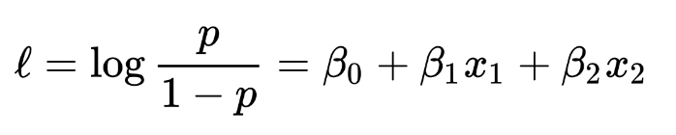
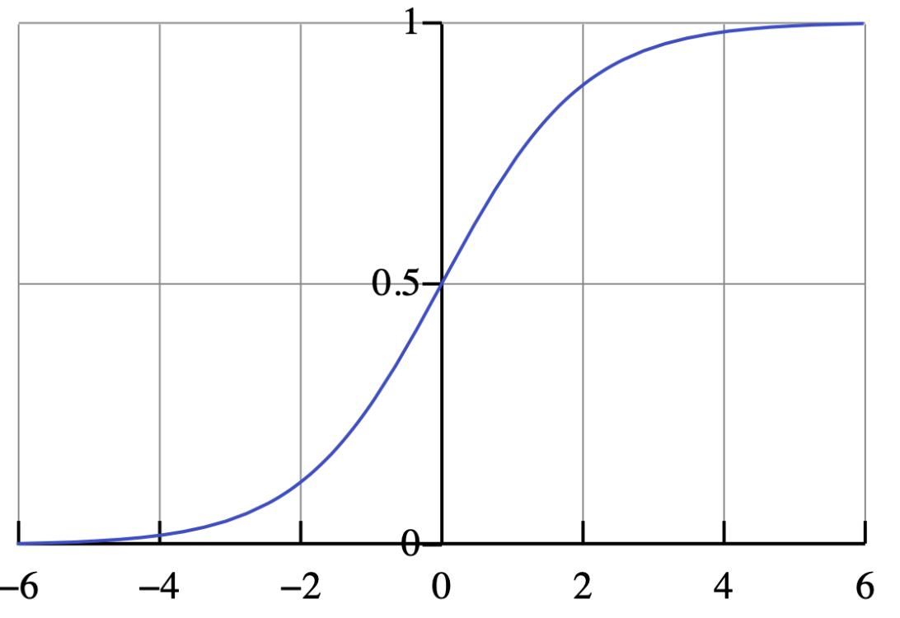
Logistic Regression
Yet another alternative to categorizing, but with a twist
Not only predicts a value but predicts the probability of its occurrence
Allows you to change a probability threshold to favor false positives or false negatives
The math behind it involves logarithms and finding coefficients of the independent variables

Slide 18
Logistic Regression (continued)
Data needs to be dummy encoded skipping one value as a reference value
Pros
Works better in cases with low signal to noise ratio
Allows for tweaking of false positives and false negatives
Transparency lets you see how it made its choices
Cons
Does not perform well with too many features (independent variables)
Not good with large number of categorical values within a feature because of dummy encoding

Slide 19
Apply Logistic Regression
Need to dummy encode categorical features
Use this helper function to make that easier
from sklearn.model_selection
import train_test_splitfrom sklearn
import preprocessing as pp
def dummy_code(data, columns, drop_first = True):
for c in columns:
dummies = pd.get_dummies(data[c], prefix = c, \
drop_first = drop_first)
i = list(data.columns).index(c)
data = pd.concat([data.iloc[:,:i], dummies, \
data.iloc[:,i+1:]], axis = 1)
return data
df2 = dummy_code(df, ['type'], drop_first = True)
trainX, testX, trainY, testY = train_test_split(df2.iloc[:, df2.columns != 'isFraud'], df2.isFraud, train_size = train_size, test_size = test_size)
print (testX.columns)
print (testX.head())

Slide 20
Apply Logistic Regression (continued)
Create and train the logistic model
from sklearn.linear_model import LogisticRegression
modelLR = LogisticRegression(multi_class='auto', solver='lbfgs')
modelLR.fit(trainX, trainY)
print (modelLR.coef_)
[[-2.34708708e-08 -2.08083063e-09 -3.31118886e-07
-8.31500683e-10 -8.26614837e-04 8.30307380e-04
-9.09162361e-04 7.04021006e-07 -2.41542762e-06
1.05305835e-11]]

Slide 21
Interpret the Results
The coefficients show how the math formula is trained
Multiply each feature by its coefficient and sum them up to get the probability
ln(p/(1-p)) = β + β1X1 + β2X2 + β3X3 + … + βnXn
Confusion matrix is interpreted just like all the other models
0.9980016093999013 0.0019983906000987013
[[1268705 2162]
[ 381 1276]]
PC FP
FN PW
[[9.98001609e+01 1.69898564e-01]
[2.99404962e-02 1.99839060e-01]]

Slide 22
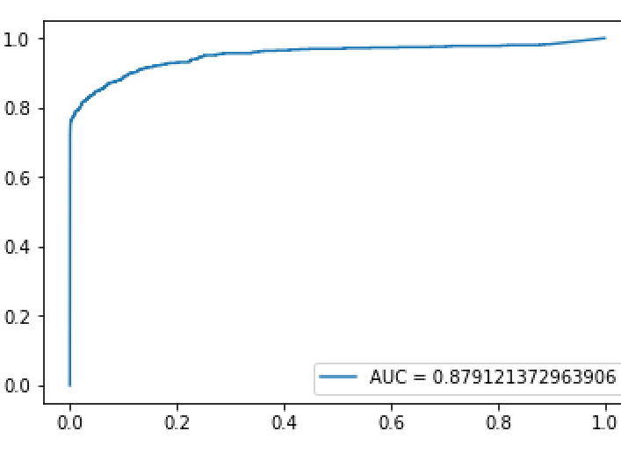
ROC Curve
Shows the tradeoff between accuracy and sensitivity in adjusting the False Positives
The closer the curve is to the left or top border the more accurate it is
The closer to the 45 degree line, the less accurate it is
predY1 = modelLR.predict_proba(testX)
from sklearn.metrics import roc_auc_score, roc_curve
roc = roc_auc_score(testY, predY)
fpr, tpr, x = roc_curve(testY, predY1[:,1])
import matplotlib.pyplot as plt
plt.plot(fpr, tpr, label = 'AUC = ' + str(roc))
plt.legend(loc=4)
plt.show()

Slide 23
Different Thresholds
Additionally, you can do the prediction probabilities
Set a threshold probability to determine whether the prediction is positive or negative
Allows you to tweak the accuracy, false positives and false negatives
Use the predict_proba function instead
predY = modelLR.predict_proba(testX)
print (predY[:10])
[9.99999999e-001 1.72171774e-113] # 99% likely positive
[8.26513185e-001 1.73486815e-001] # 82% likely positive
[6.28732003e-178 1.00000000e+000] # 100% likely negative
[5.20000000e-001 4.80000000e-001] # 52% likely positive

Slide 24
Tweak the Results
Run the prediction on the same trained model several times with different probability thresholds and compare the accuracy and FP/FN
Highest accuracy turned out to be about 70 in this case
Lower threshold yielded more false positives, fewer false negatives
Tune the threshold to fit the business case of whether you favor FP or FN
predY = modelLR.predict_proba(testX)
print (predY[:10])
print (modelLR.score(testX, testY))
for threshold in range(30, 91, 10):
predY1 = np.where(predY[:,1] >= threshold/100, 1, 0)
mse = np.mean((predY1 - testY)**2)
cm = confusion_matrix(testY, predY1)
print ('\nTHRESHOLD', threshold, 'MSE', mse)
print (cm)
print (cm_percent(cm, len(testY), legend = False))

Slide 25
Neural Networks
Simulates the way the human brain solves
Uses a perceptron, algorithm, or function run in multiple layers
Not only predicts a value but predicts the probability of its occurrence
Allows you to change a probability threshold to favor false positives or false negatives
Pros
Often perform better than others which can be important where accuracy is desired (predicting cancer)
Good for unusual data like image, video, audio
Cons
Black box, you don’t know how it made its decision
Not appropriate in cases where transparency is important
Require a lot more data to train than other models
Computationally expensive
Cool visualization of Neural Network from Google
https://playground.tensorflow.org/

Slide 26
Neural Network Visualized
Input Layer
Hidden Layer
Output Layer
Data

Slide 27
Apply Neural Network
Need to dummy encode categorical features
This time keep the first element
Also works best if you rescale the numeric values
Rescale the whole dataset before splitting it or else the results differ
Look at the results just like all the other classification models
from sklearn.model_selection import train_test_split
from sklearn import preprocessing as pp
# rescale the data
df2 = dummy_code(df, ['type'], drop_first = False)
print (df2.columns)
df2[['amount', 'oldbalanceOrg', 'newbalanceOrig', 'oldbalanceDest', 'newbalanceDest']] /= df2[['amount', 'oldbalanceOrg', 'newbalanceOrig', 'oldbalanceDest', 'newbalanceDest']].max()
trainX, testX, trainY, testY = train_test_split(df2.iloc[:,df2.columns != 'isFraud'], df2.isFraud, train_size = train_size, test_size = test_size)

Slide 28
Support Vector Machine
Support Vector Machine attempts to find the hyperplane that separates the two classes better—in this case, B clearly does that
Next, it tries to find the right hyperplane that maximizes the distances from that plane to the nearest data points in either group—again, it is B in this case
This is called a margin
B
A
C
B
A
C

Slide 29
Support Vector Machine (continued)
In this case, B has a bigger margin but A is the plane it determined did a better job of classifying them so it would choose A
Here we have a blue outlier, and SVM has a feature that allows such outliers to be ignored
B
A

Slide 30
Support Vector Machine (continued)
Here it would be impossible to draw a straight line that separates the groups, but we could translate this into a new feature z = x2 + y2
The new feature ‘z’ could then be used to find the hyperplane using a built-in feature called kernel trick
Effectively it can solve for a non-linear feature
Y
X
Y
A
X

Slide 31
Apply SVM
SVM looks like most other models and has lots of parameters to play with
Run it through several combinations to compare the results
from sklearn import svm
train_size = .03; test_size = .01
trainX, testX, trainY, testY = train_test_split( \ df2.iloc[:,df2.columns != 'isFraud'], df2.isFraud, \ train_size = train_size, test_size = test_size)
def do_SVM(kernel, gamma):
print ("\nKernel:", kernel, "Gamma:", gamma)
modelSVM = svm.SVC(gamma = gamma, kernel = kernel)
modelSVM.fit(trainX, trainY)
print (modelSVM.score(testX, testY))
predY = modelSVM.predict(testX)
print (confusion_matrix(testY, predY))
do_SVM('linear', gamma='auto')
for kernel in ['rbf', 'poly', 'sigmoid']:
for gamma in ['auto', 10, 100]:
if not (kernel == 'poly' and gamma == 100):
do_SVM(kernel, gamma)

Slide 32
Ensemble Learning
Different models have different strengths and weaknesses
Ensemble learning provides techniques to run multiple different models and blend them together to often return a more reliable result
There are different techniques that are often used:
Max voting
The result of each model are considered a vote and the majority of predictions indicates the prediction for the group
Works well for classification models
from sklearn.ensemble import VotingClassifier
modelVC = VotingClassifier(estimators=[('lr', modelLR), ('nb', modelNB), ('rf', modelRF)], voting='hard')
modelVC.fit(trainX, trainY)
print(modelVC.score(testX,testY))
predY = modelVC.predict(testX)
cm = confusion_matrix(testY, predY)
print (cm)

Slide 33
Ensemble Learning
Averaging method works better when trying to predict a value such as with regression or a prediction probability with classification
could do a normal or a weighted average
predLR = modelLR.predict_proba(testX)
predNN = modelNN.predict_proba(testX)
predSVN = modelSVN.predict_proba(testX)
predAVG = (predLR + predNN + predSVN)/3
print (confusion_matrix(testX, predAVG)
predAVG = (predLR * .4 + predNN * .35 + predSVN * .25)/3
print (confusion_matrix(testX, predAVG)

Slide 34
Random Forest
Creates Decision Trees on randomly selected samples of the training set
Performs multiple iterations and gets prediction results
Votes on the best random sample
Pros
Often highly accurate due to the strength of multiple predictions
Usually does not suffer from overfitting
Can see the relative feature importance which is useful in revising the model
Cons
Slow to generate because of multiple iterations
Compared to a Decision Tree you cannot really see the path of the tree

Slide 35
Apply Random Forest
Load the module, create a model and train it
Run a prediction on the reserved testing set and compare the predicted values to the known values
from sklearn.ensemble import RandomForestClassifier
modelRF = RandomForestClassifier(n_estimators=10)
modelRF.fit(trainX, trainY)
predY = modelRF.predict(testX)
from sklearn import metrics
print ("Accuracy:",metrics.accuracy_score(testY, predY))
cm = confusion_matrix(testY, predY)
print (cm)
import pandas as pd
feature_imp = pd.Series(modelRF.feature_importances_,\ index=trainX.columns).sort_values(ascending=False)
print (feature_imp)

Slide 36
Other Options
Overfitting is when the model predictions too closely fit the data and gives a good score but fails to produce good results on new data
Underfitting occurs when the model does not make good predictions and is usually because the model is too simple or does not have enough data
Bagging is a technique to decrease the variance of the predictions by generating more data from the original dataset by duplicating rows and helps improve accuracy & reduce overfitting
Boosting combines many average models and uses voting to come up with a blended model that often is more accurate helps reduce underfitting
Stacking uses the results of many models to create another model
Blending is a variation on stacking that uses a training, validation and then testing set, building up the results of the previous steps

Slide 37
Chapter Concepts
Classification Model
Algorithms
Chapter Summary
Notes:
Highlight the topic that follows this page, and place the delta arrow next to it by moving vertically, but maintain the horizontal placement.
If there are too many topics to fit on the page, reduce the line spacing to fit.

Slide 38
Classification Review
Classification is one of the most widely used models
It is supervised
Good at predicting either/or or multiple-choice categories
Lots of algorithms
No one algorithm is best for all situations so often it involves running many of them, documenting the results, and choosing the best for your data and business case
Can save the results of a lengthy training to a file and reload it for use with the predict function when needed

Slide 39
Next Steps
Classification is one of the most useful models
We have explored several different algorithms here and there are tons more, each with its own strengths and weaknesses
Some other algorithms to explore:
Boosted Trees
K-Nearest Neighbor
Stochastic Gradient Descent
Ensemble techniques
AdaBoost

Slide 40
Chapter Summary
In this chapter, we have:
Understood the use cases for Classification models
Discussed and compared various algorithms
Naive Bayes
Decision Tree
Logistic Regression
Neural Network

